Slide 1
Chronos: Learning the Language of Time Series (Nov 2024) cited 682 times ﻿Chronos-2: From Univariate to Universal Forecasting (Oct 2025) cited 5 times
﻿Abdul Fatir Ansari, Amazon AWS Lab

Slide 2
Chronos
Zero-shot univariate forecaster (univariate input, univariate output)
Proposes two synthetic data generation algorithms: TSMixup and Kernel Synth: Synthetic Data Generation using Gaussian Processes
Performs tokenization via quantization
Performs regression via classification
Dequantizes the predicted results

Slide 3
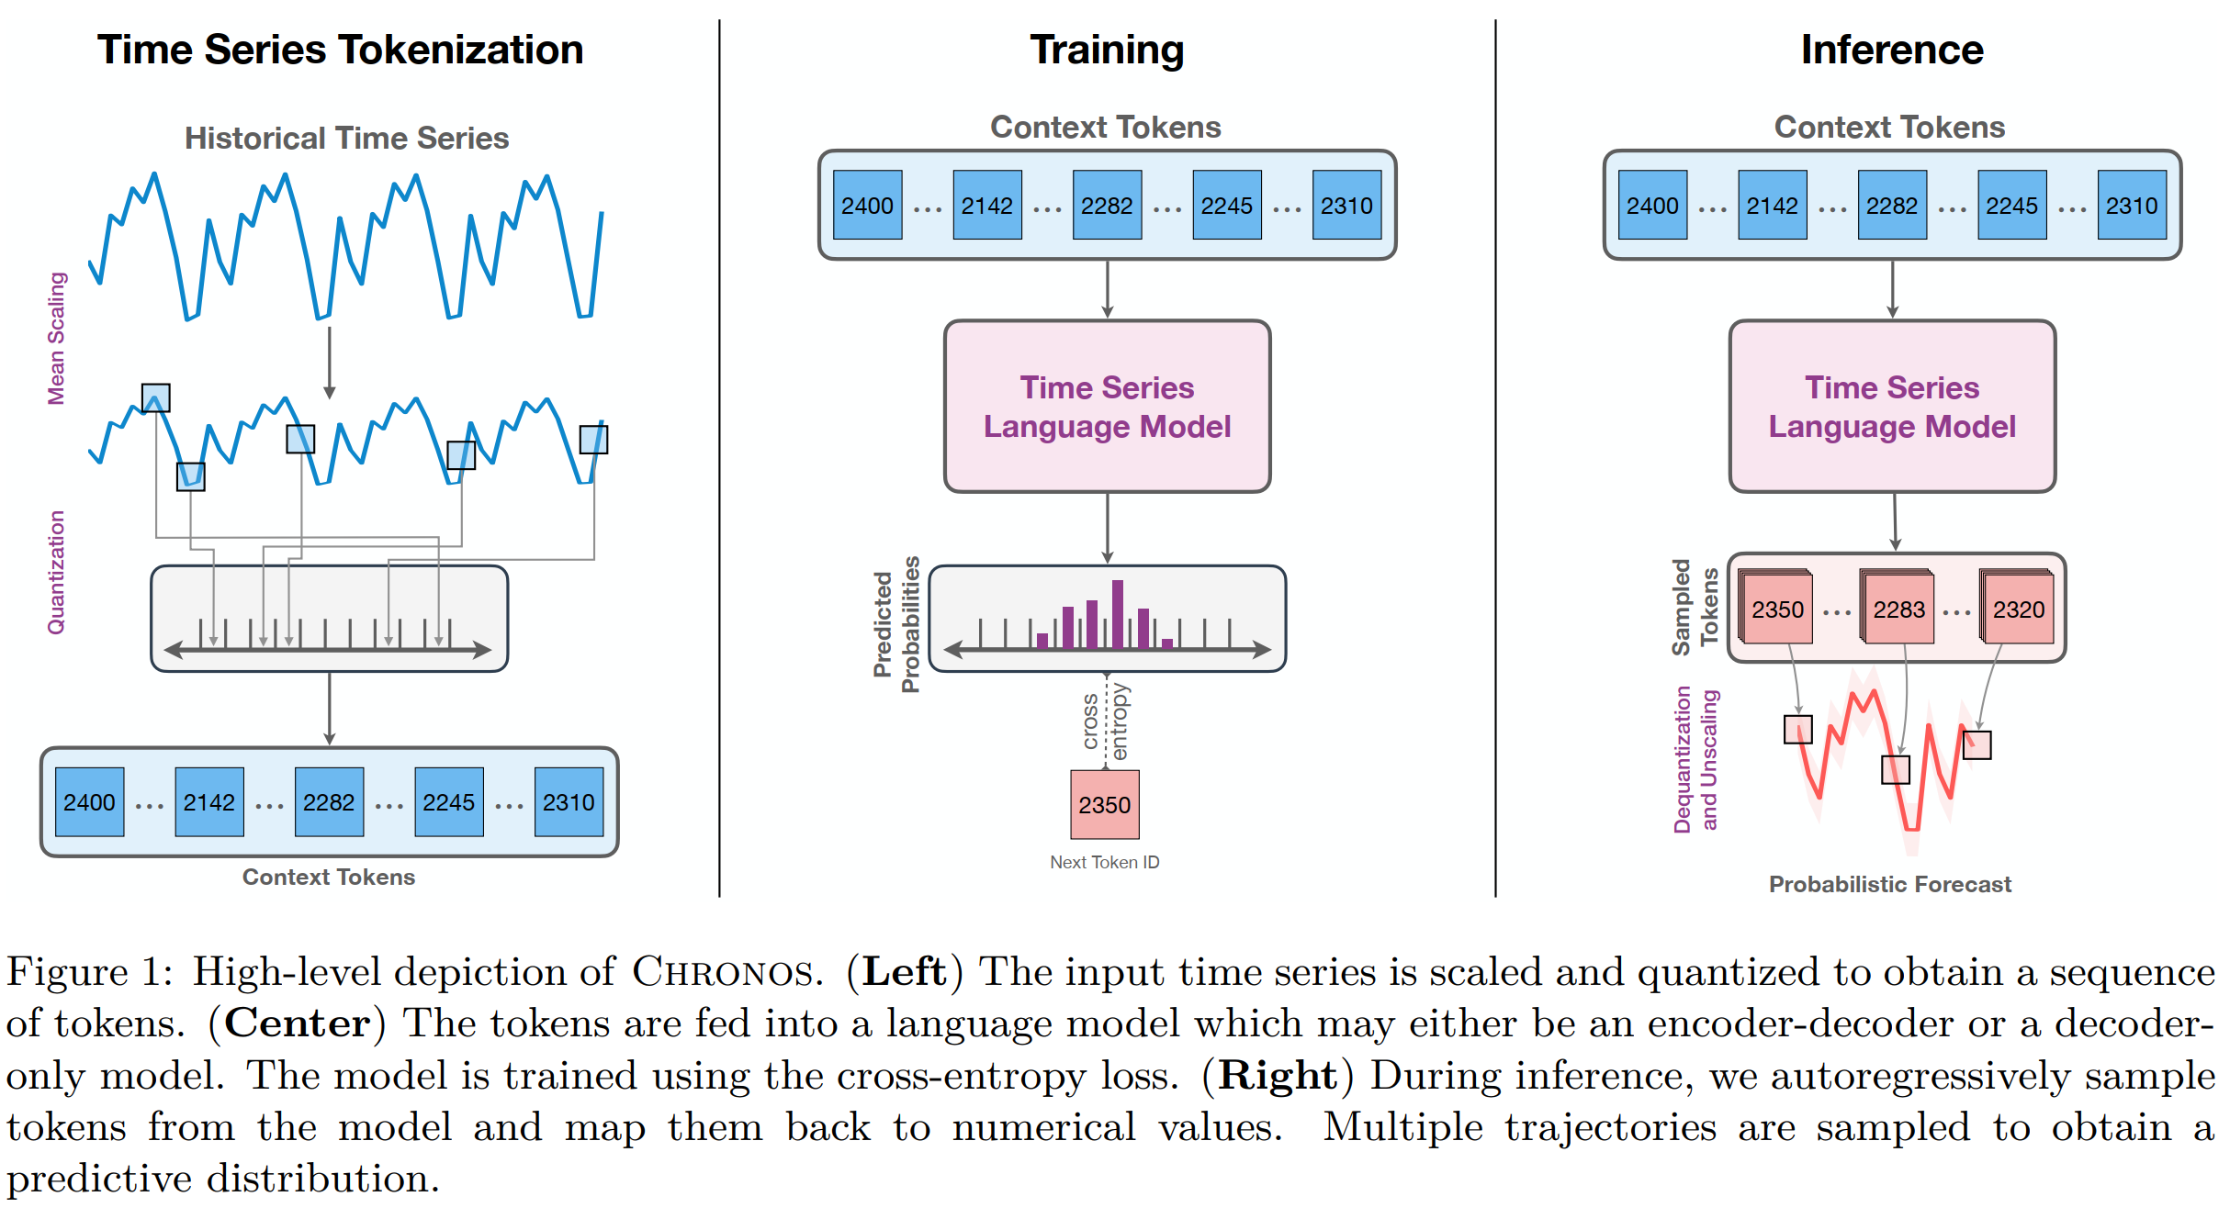
Chronos

Slide 4
Chronos
Quantization
<----- bin 1 ----->|<----- bin 2 ----->|<----- bin 3 ----->|<----- bin 4 ----->|<----- bin 5 ----->
-∞ b1 b2 b3 b4 +∞
centers:c1 c2 c3 c4 c5
Dequantization
TOKEN SPACE REAL SPACE (approximate reconstruction)
---------------------------------------------------------------------------------
Token 1 ───────────────────────────► c1 (leftmost bin center)
Token 2 ───────────────────────────► c2
Token 3 ───────────────────────────► c3
Token 4 ───────────────────────────► c4
Token 5 ───────────────────────────► c5 (rightmost bin center)

Slide 5
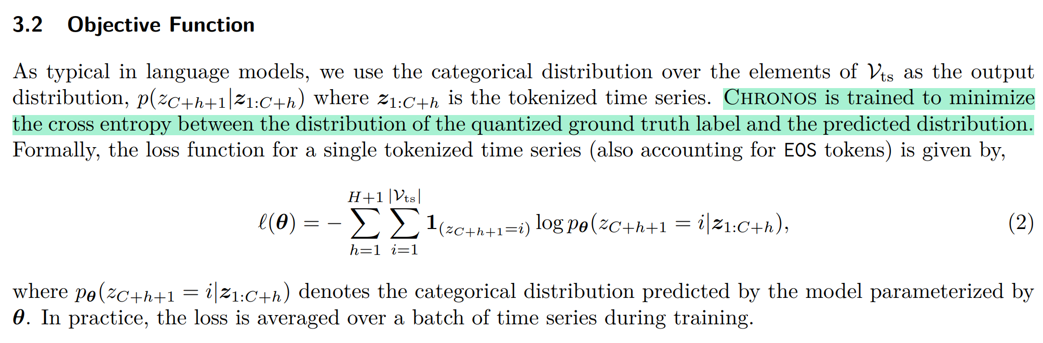
Chronos
Target backbone model: ﻿encoder-decoder and decoder only models﻿
requires no modification to the language model architecture or training objective

Slide 6
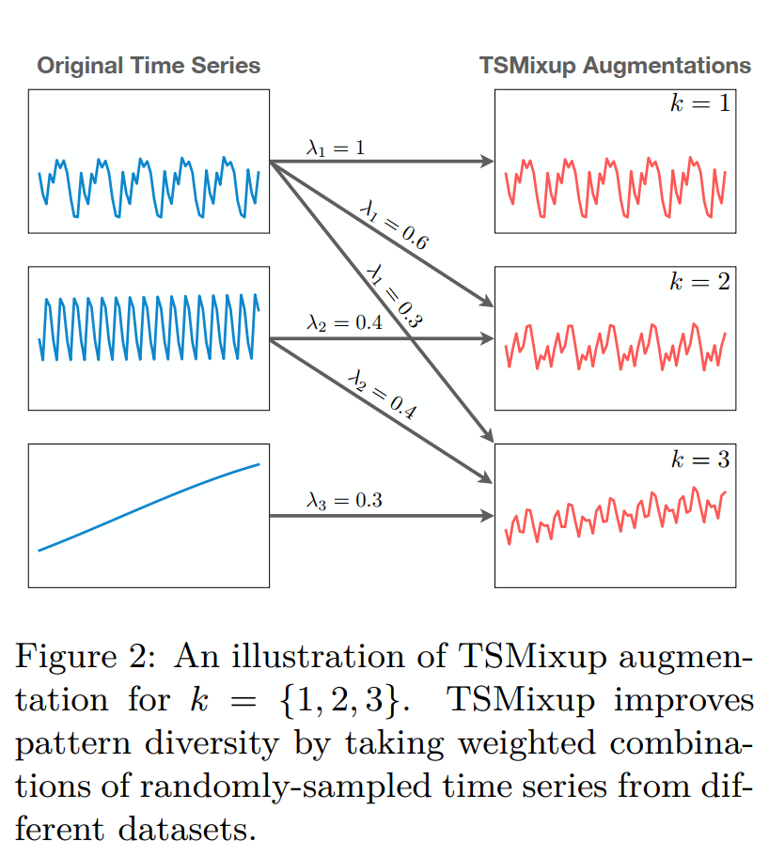
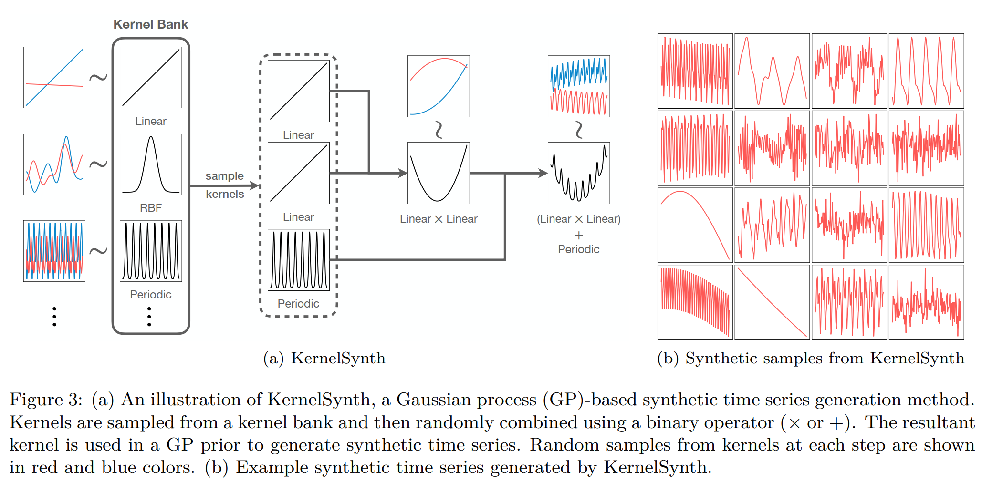
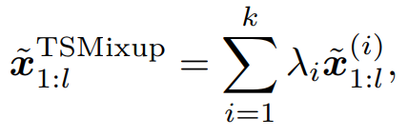
Chronos
﻿KernelSynth: Synthetic Data Generation using Gaussian Processes
TSMixup

Slide 7
Chronos2

Slide 8
Chronos2
Zero-shot multivariate forecaster (univariate/multivariate input, univariate/multivariate output)
Can handle categorical covariates
Performs time attention (across time axis) and group attention (across different signals within group)
Predicts quantiles instead of point estimates (good for ﻿rare events, anomaly detection and risk-aware forecasting.)

Slide 9
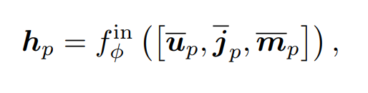
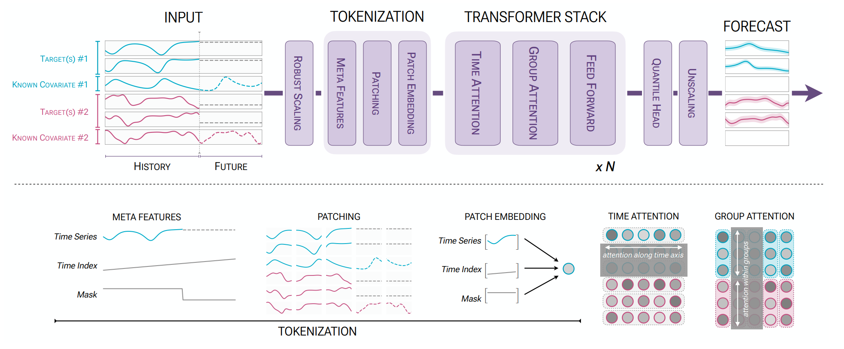
Chronos2

Slide 10
Chronos2
Residential utility demand
Commercial utility demand
City 1
City 1 temperature
Residential utility demand
City 2
Commercial utility demand
City 2temperature
humidity
Wind-speed

Slide 11
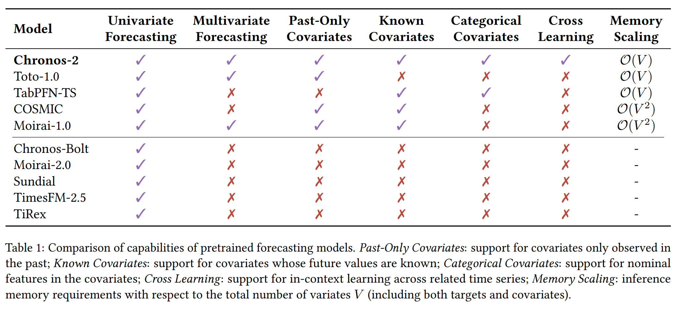
Chronos2

Slide 12
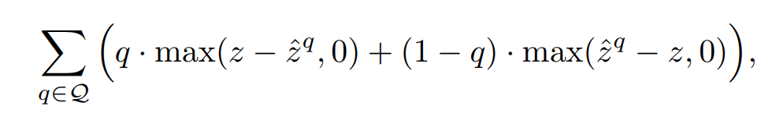
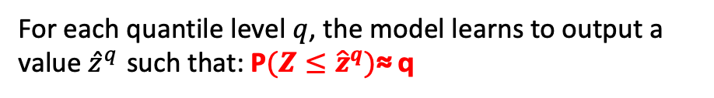
Chronos2
Quantile head prediction:
Instead of predicting point estimates, Chronos2 predicts 41 quantile heads
For each target timeseries D, for each timestamp H, it generates 41 quantile heads
1% chance demand<2k
values = [ 2k, 4k, 6k, 8k, 10k ]
levels = [0.01, 0.1, 0.5, 0.9, 0.99]
For each quantile level $q$, the model learns to output a value ${\hat{z}}^{q}$ such that: P$(Z≤{\hat{z}}^{q})$≈ q

Slide 13
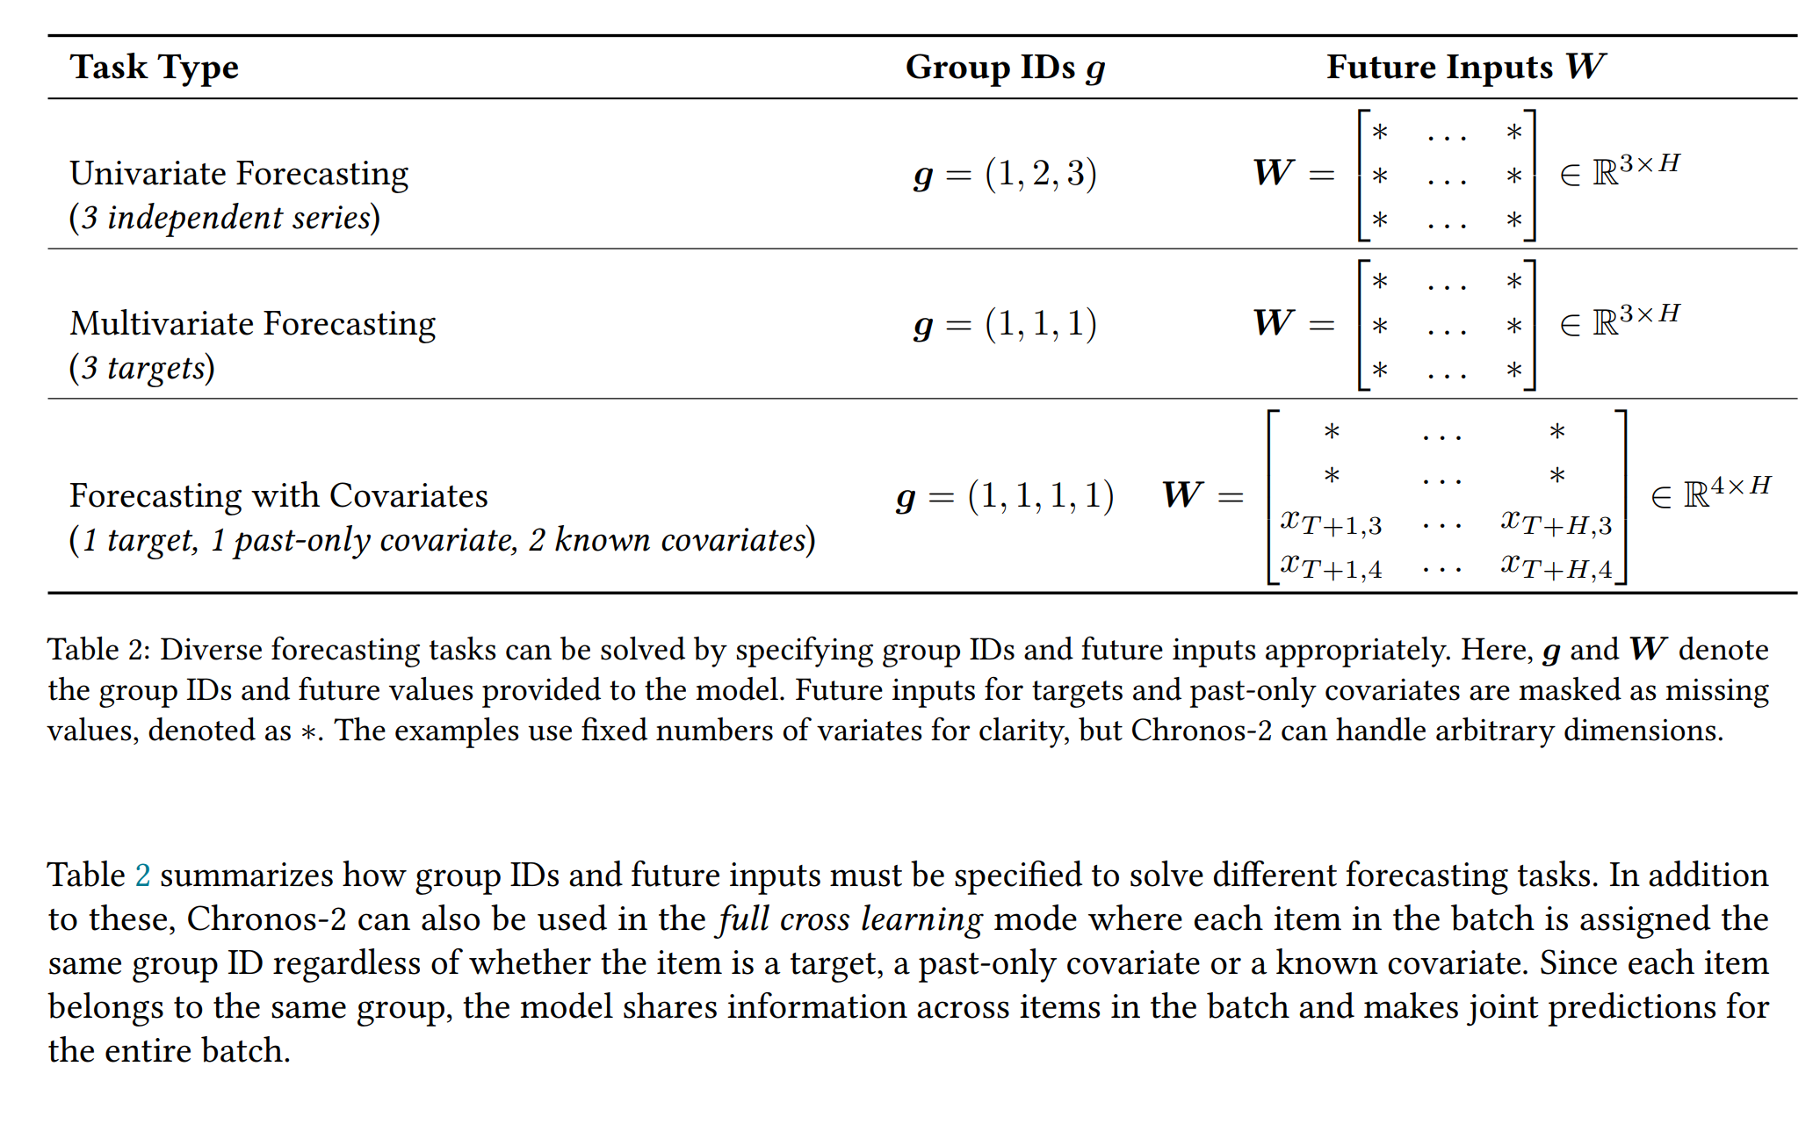
Chronos2

Slide 14
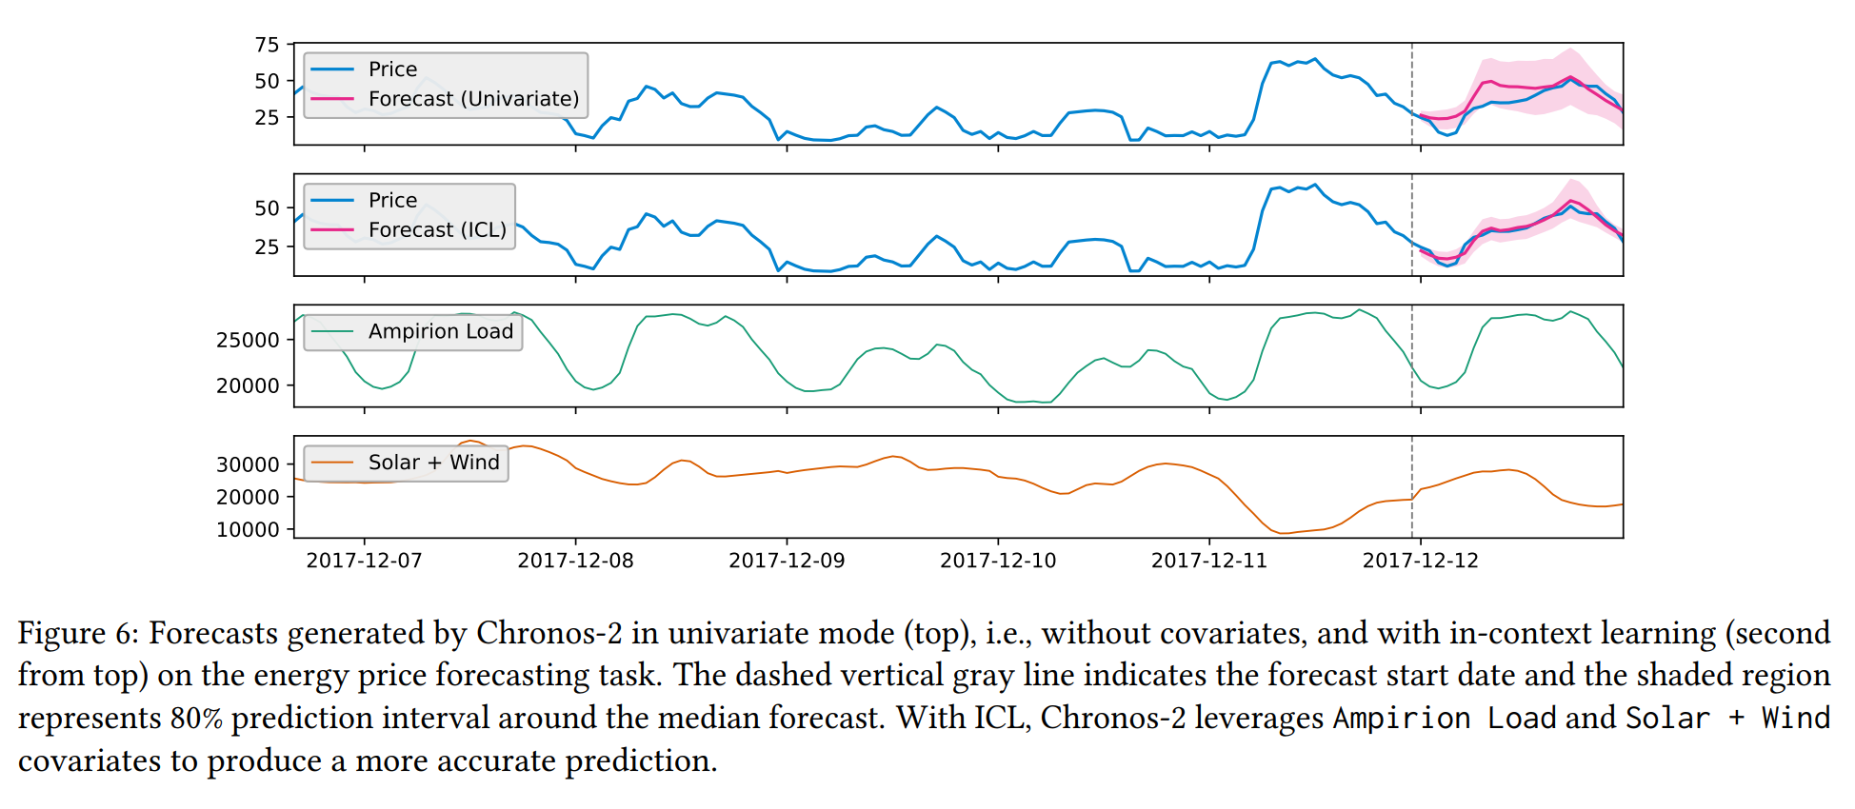
Chronos2

Slide 15
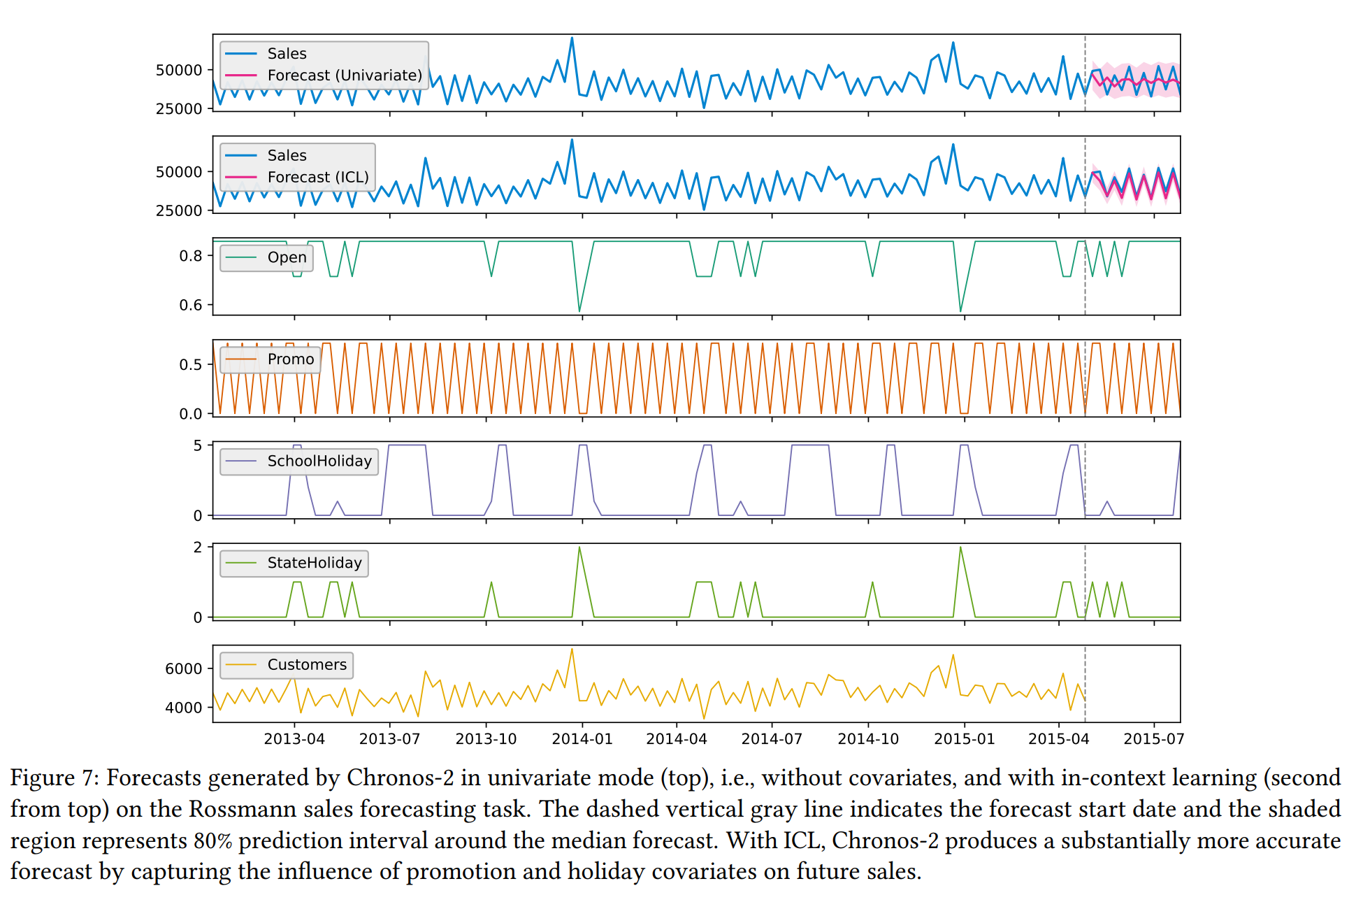
Chronos2

