Slide 1

#ArXiv
#October’24
#90_citations
#Time_series_foundation_model

Slide 2
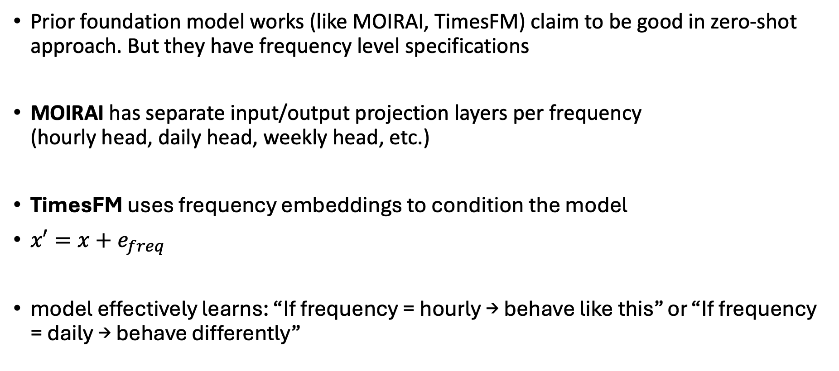
Motivation
Prior foundation model works (like MOIRAI, TimesFM) claim to be good in zero-shot approach. But they have frequency level specifications
MOIRAI has separate input/output projection layers per frequency (hourly head, daily head, weekly head, etc.)
TimesFM uses frequency embeddings to condition the model
$x′=x+e_{freq}​$
model effectively learns: “If frequency = hourly → behave like this” or “If frequency = daily → behave differently”

Slide 3
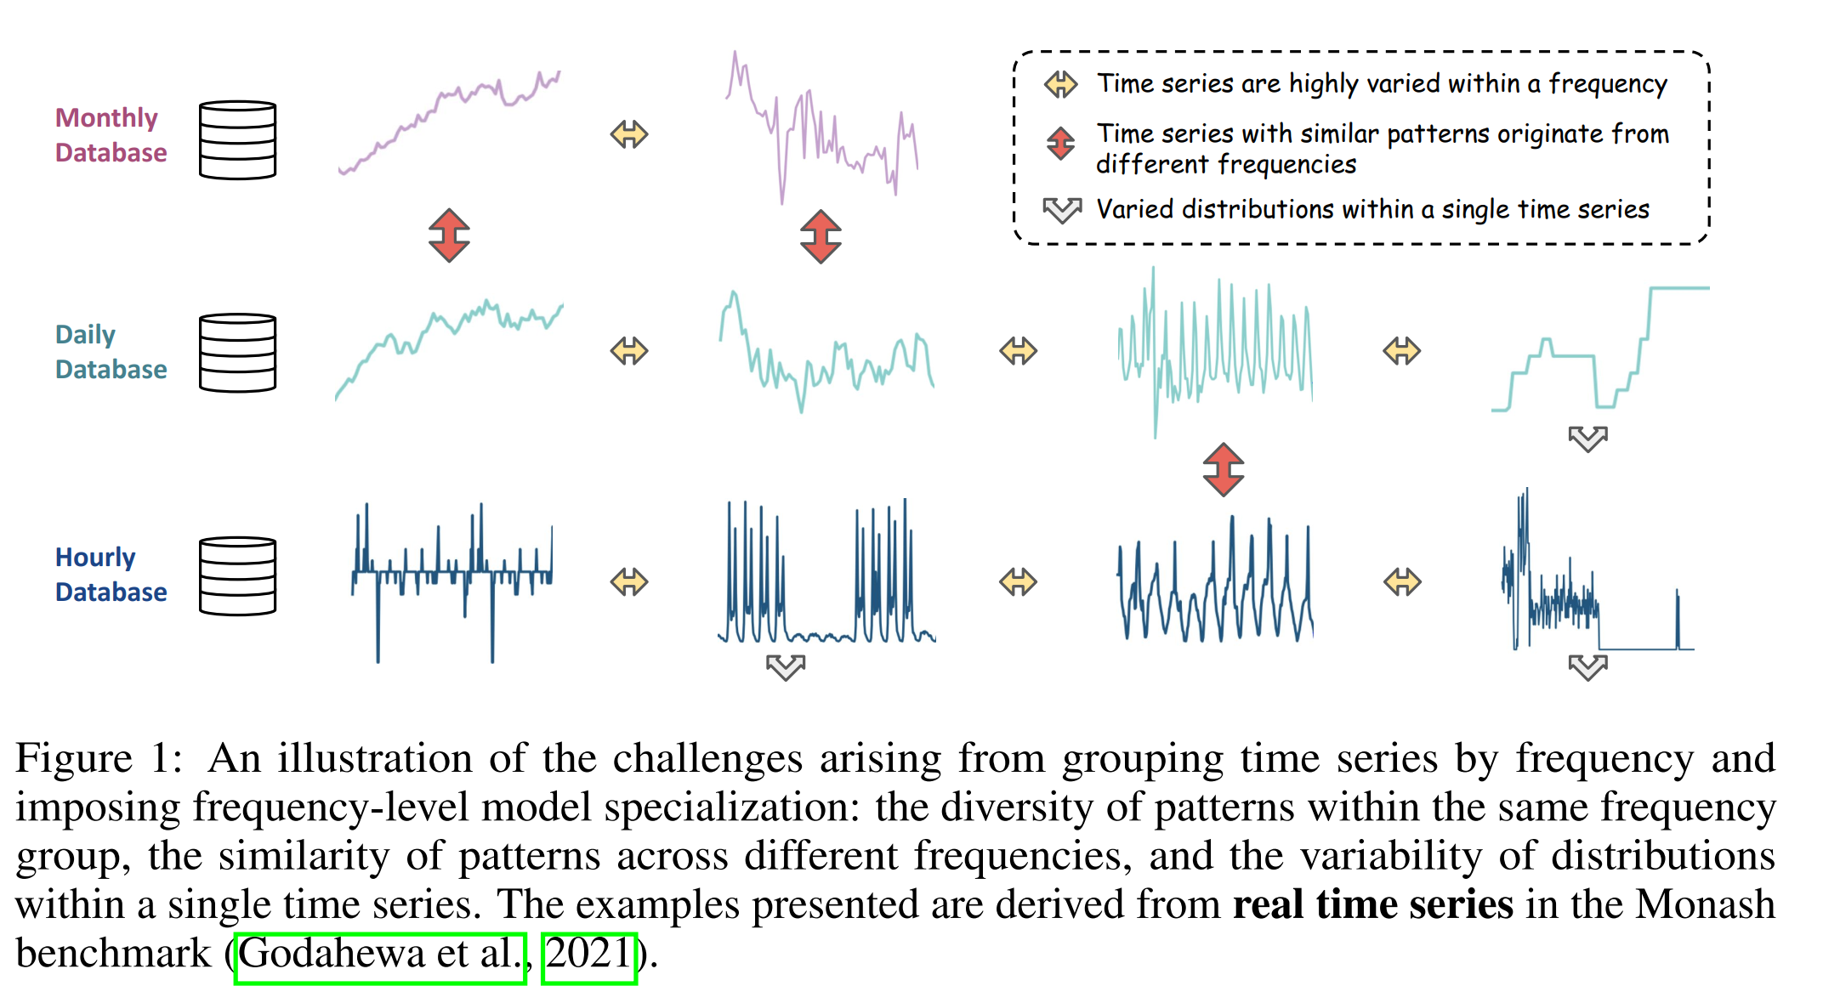
Motivation

Slide 4
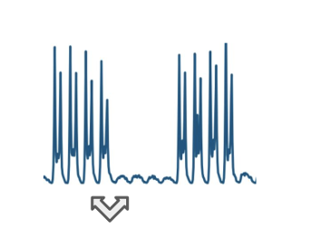
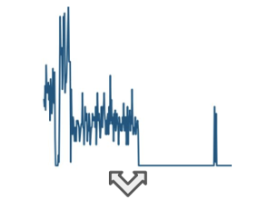
Motivation
﻿Frequency is not a reliable indicator and may not capture the true structure of time series data. ﻿Human-imposed mismatch between frequency and pattern undermines model specialization: results in inferior performance.
﻿Time series are inherently non-stationary, displays varied distributions even within a short context window of a single time series.
﻿Human imposed direction will not help. A data-driven solution is needed that operates at token level, not at output level

Slide 5
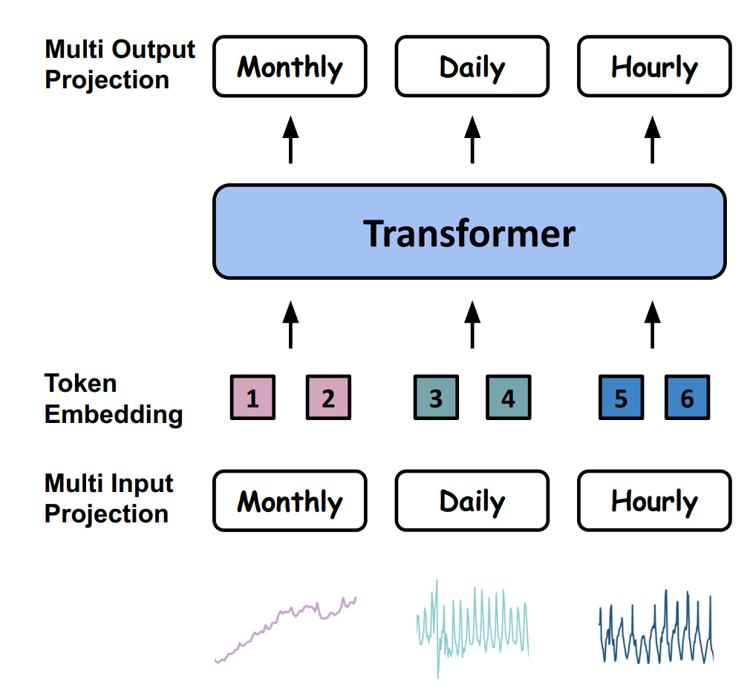
Method
A data-driven solution is needed that operates at token level
Tokens -- > Normalization -- > Transformer block -- > frequency specific output heads
Regular workflow

Slide 6
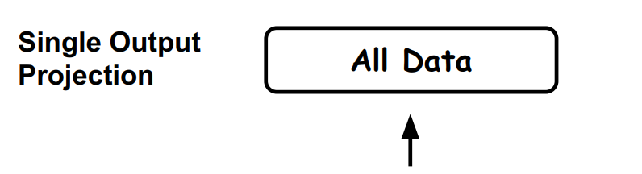
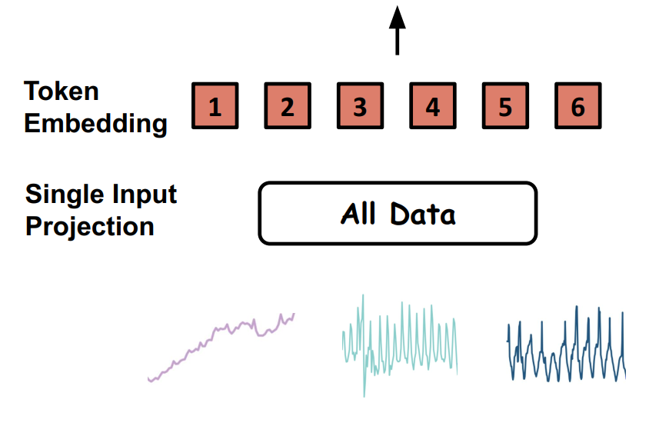
Method
Tokens -- > Normalization -- > Transformer block -- > frequency specific output heads
modify
One output head

Slide 7
Method
Tokens -- > Normalization -- > Transformer block -- > frequency specific output heads
modify
One output head
FFN
Self attention
Normalized token

Slide 8
Method
Tokens -- > Normalization -- > Transformer block -- > frequency specific output heads
modify
One output head
E6
E5
E7
E4
FFN
FFN
E3
E8
E9
E2
Self attention
Gate
Self attention
Normalized token
Normalized token

Slide 9

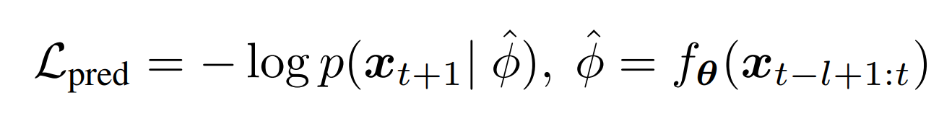

Method
Tokens -- > Normalization -- > Transformer block -- > frequency specific output heads
$$\hat{φ}$$
modify
One output head
E6
E5
E7
E4
FFN
E3
E8
E1
E2
Balances load distribution
 | .6 |  |  | 0.3
Probability via clustering
Gate
Autoregressive method
embedding
Self attention
Normalized token
Probability dist.
Point estimate

Slide 10
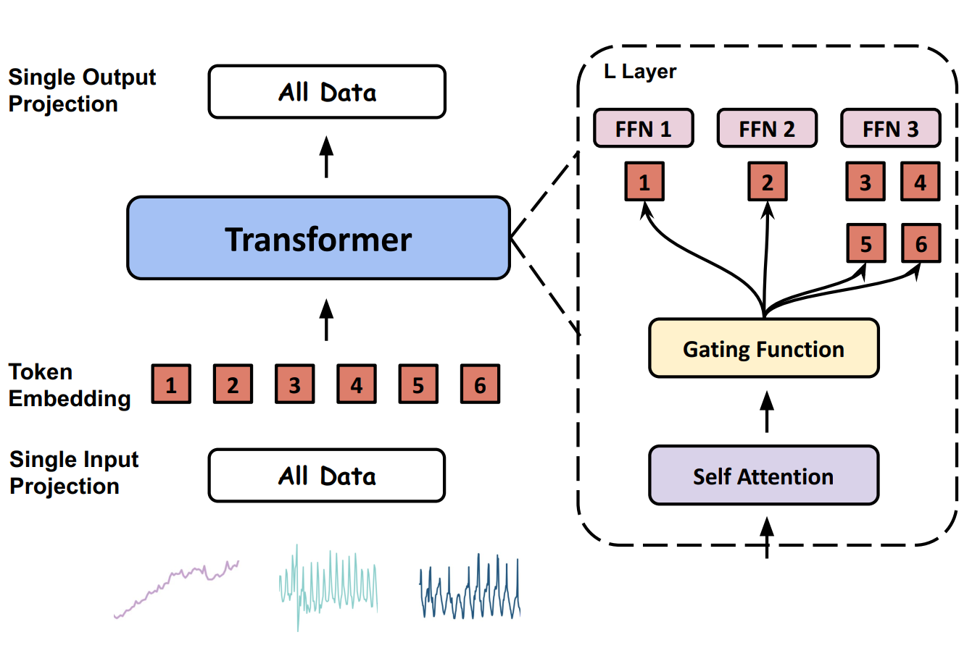
Method

Slide 11
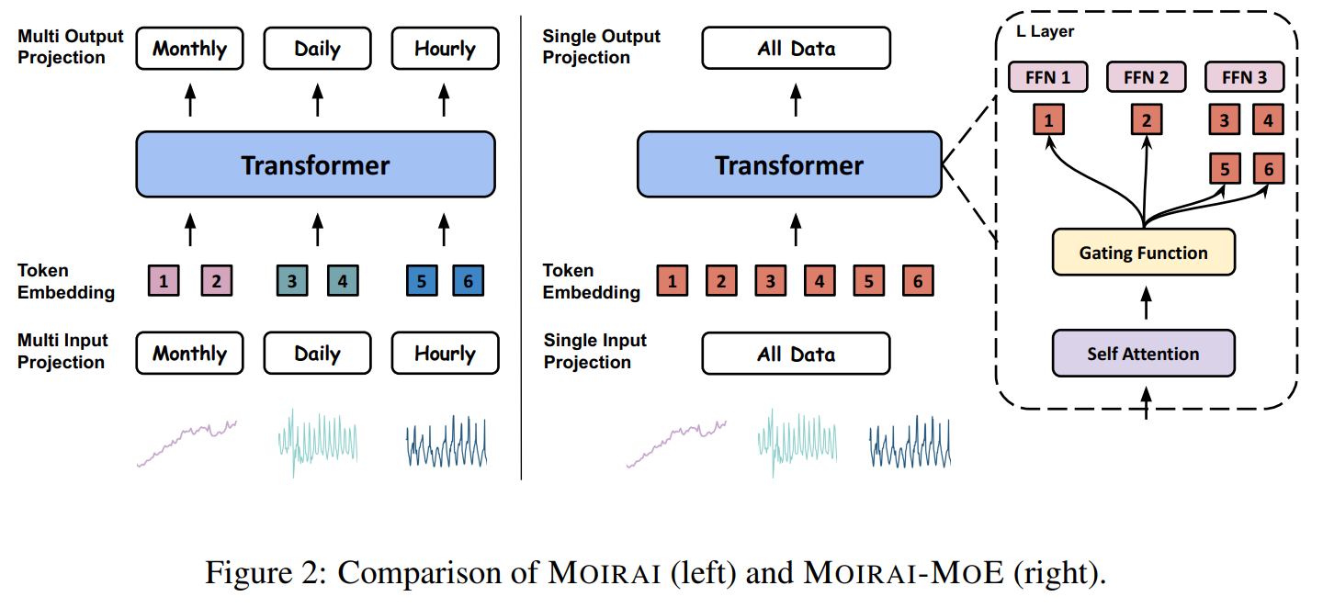
Comparison
Prior Works (MOIRAI, TimesFM) | MOIRAI-MOE
Frequency-level specialization | Token-level specialization
Human-defined routing | Learned routing
Static heads | Dynamic experts
Series-level modeling | Representation-level modeling

Slide 12
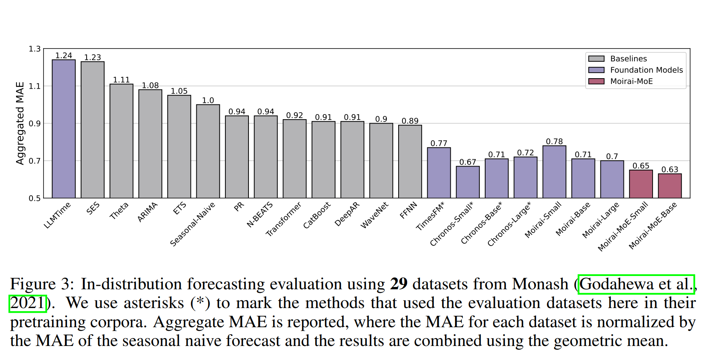
Results
﻿MOIRAI-MOE_{S} drastically surpasses its dense counterpart MOIRAI_{S} by 17%, and also outperforms the larger models MOIRAI_{B} and MOIRAI_{L} by 8% and 7%, respectively. MOIRAI-MOE_{B} delivers a further 3% improvement over MOIRAI-MOE_{S}. Compared to the foundation model Chronos, which MOIRAI could not surpass, MOIRAI-MOE successfully bridges the gap and delivers superior results with up to 65× fewer activated parameters
In distribution forecasting

Slide 13
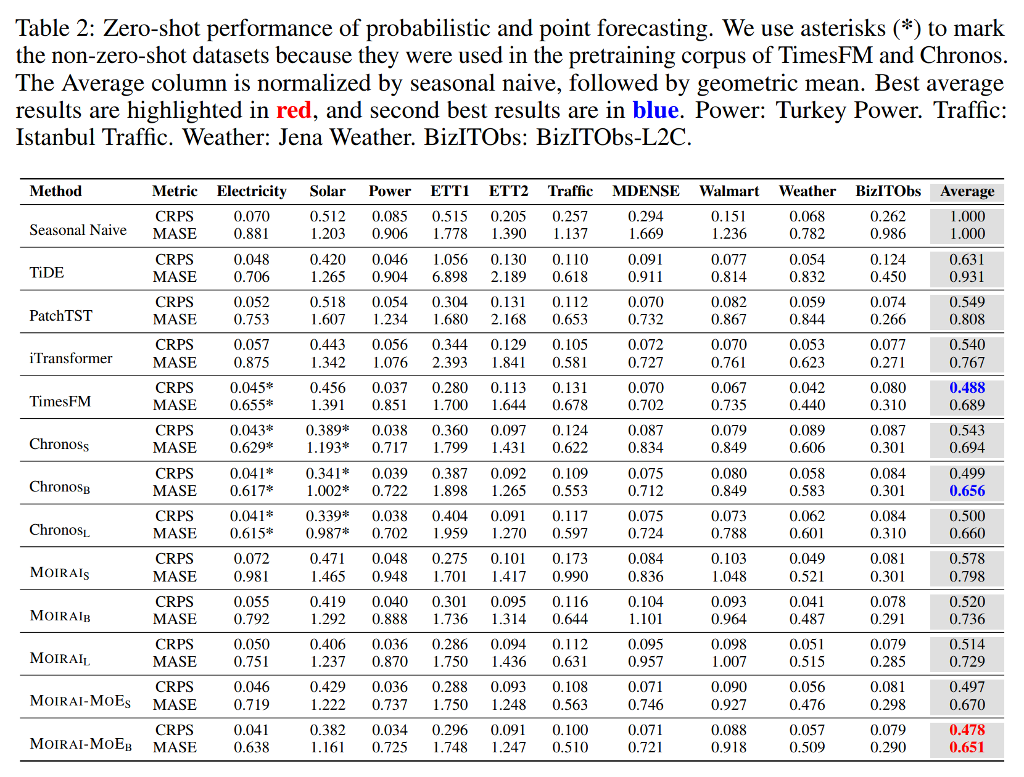
Results
Zero shot performance
﻿MOIRAI-MOE_{B} achieves the best zero-shot performance, even outperforming TimesFM and Chronos, which include partial evaluation data in their pretraining corpora. When compared to all sizes of MOIRAI, MOIRAI-MOE_{S} delivers a 3%–14% improvement in CRPS and an 8%–16% improvement in MASE. These improvements are remarkable, considering that MOIRAI-MOE_{S} has only 11M activated parameters – 28× fewer than MOIRAI_{L}.
﻿Continuous ranked probability score CRPS measures how close the entire predicted distribution is to the actual observed value.
rewards: Accurate central tendency (mean/median), Proper uncertainty (sharp but not overconfident)
penalizes: Distributions that are too wide, Distributions that put mass far from the truth

Slide 14
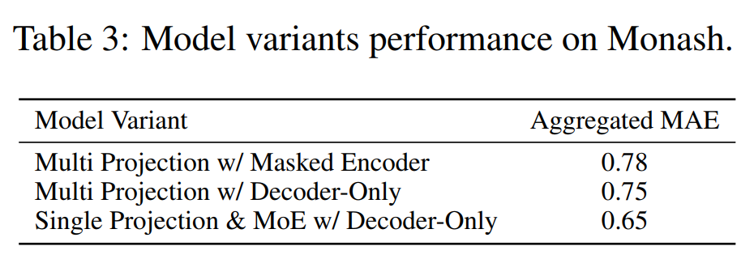
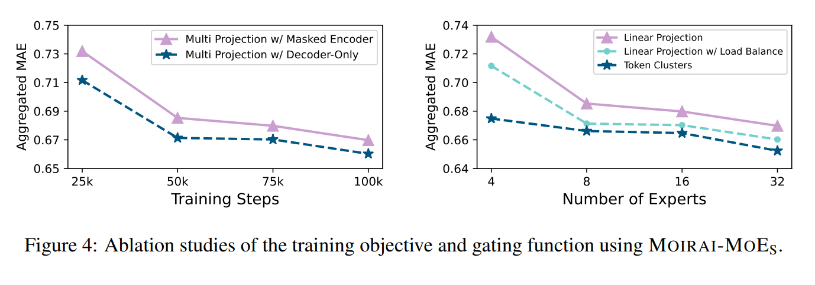
Results
Masked Encoder | Decoder-Only
Randomly mask parts of the input sequence | Predict the next token
Uses bidirectional context | Uses only past context

Slide 15
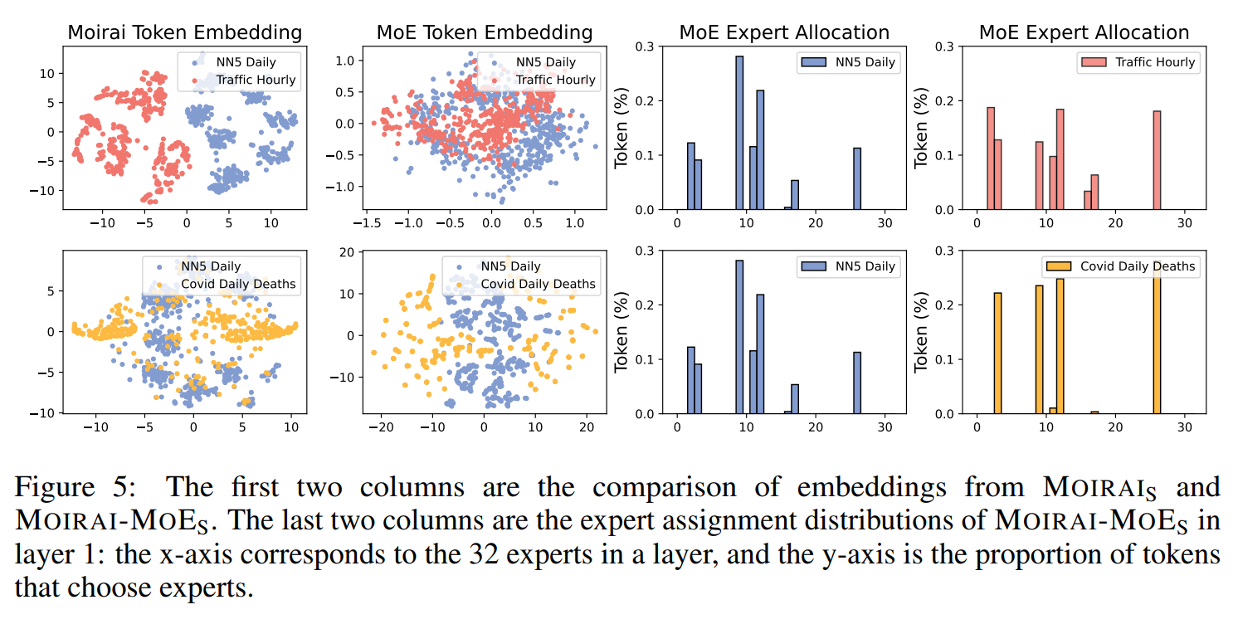
Results
Same frequency, different dynamics
Overlapping embedding
Non-overlapping embedding
Similar patterns, different frequencies

Slide 16
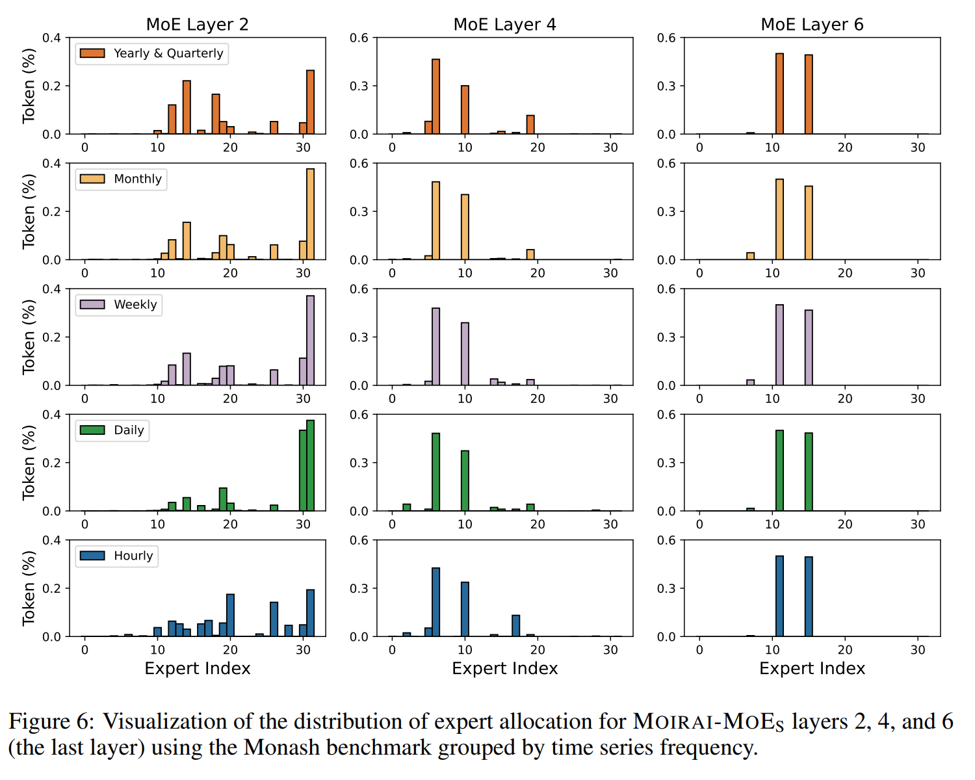
Results
where tokens route at different depths in a single trained model

