Slide 1
Clinical Trial for Digital Health Platform Assessment
Summer 25

Slide 2
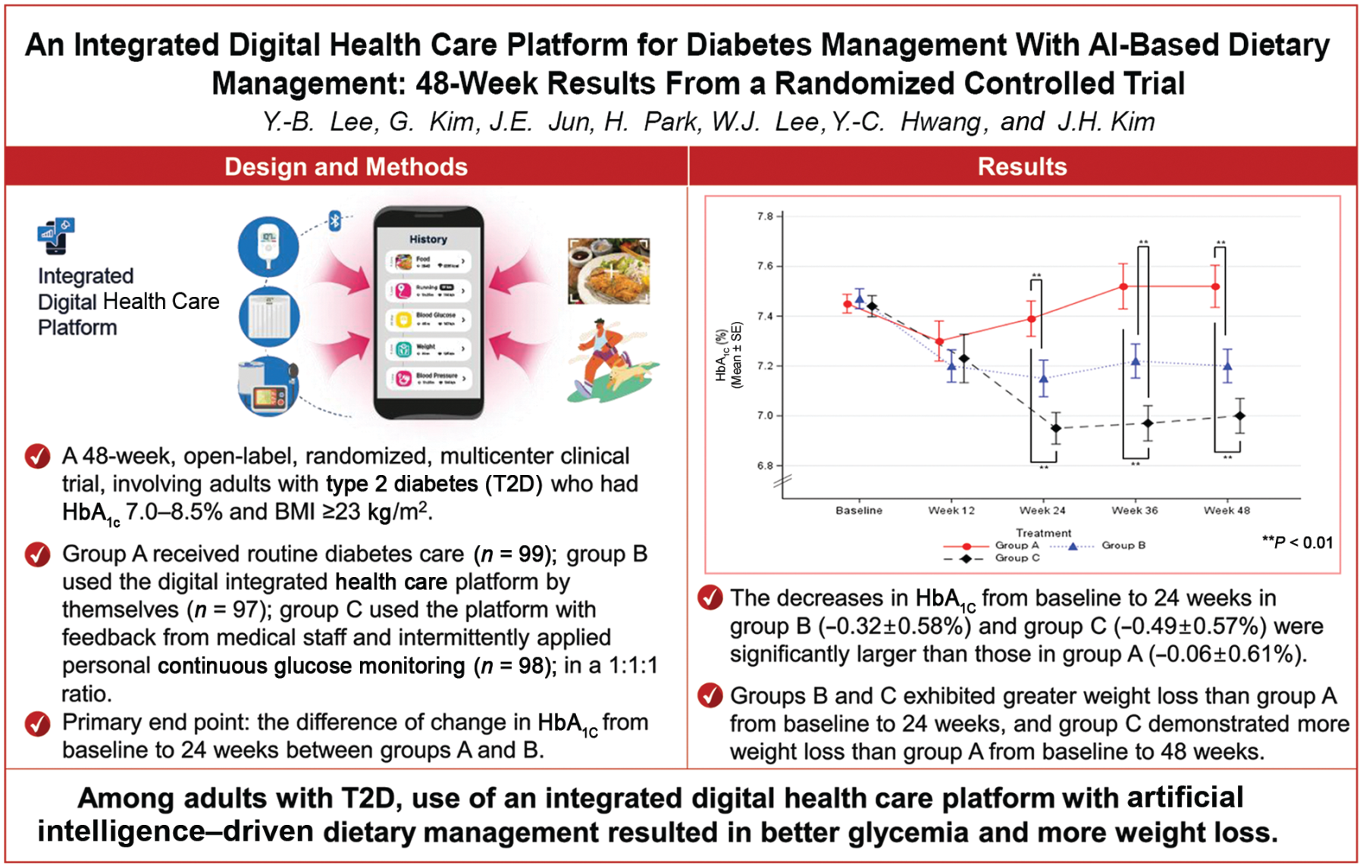

Slide 3
Overview
﻿Assessed whether or not an integrated digital health care platform with automatic integration of various biometric data and artificial intelligence (AI)–driven dietary management improves glycemic measures
﻿The developed and deployed a digital health platform with AI-driven food detection algorithm, which resulted in better glycemic control and more weight loss.
﻿Their platform with dietary management could be a great tool for improving T2D self-management.

Slide 4
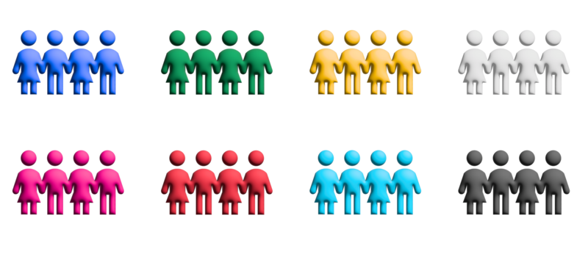


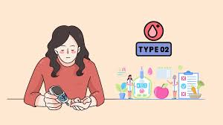
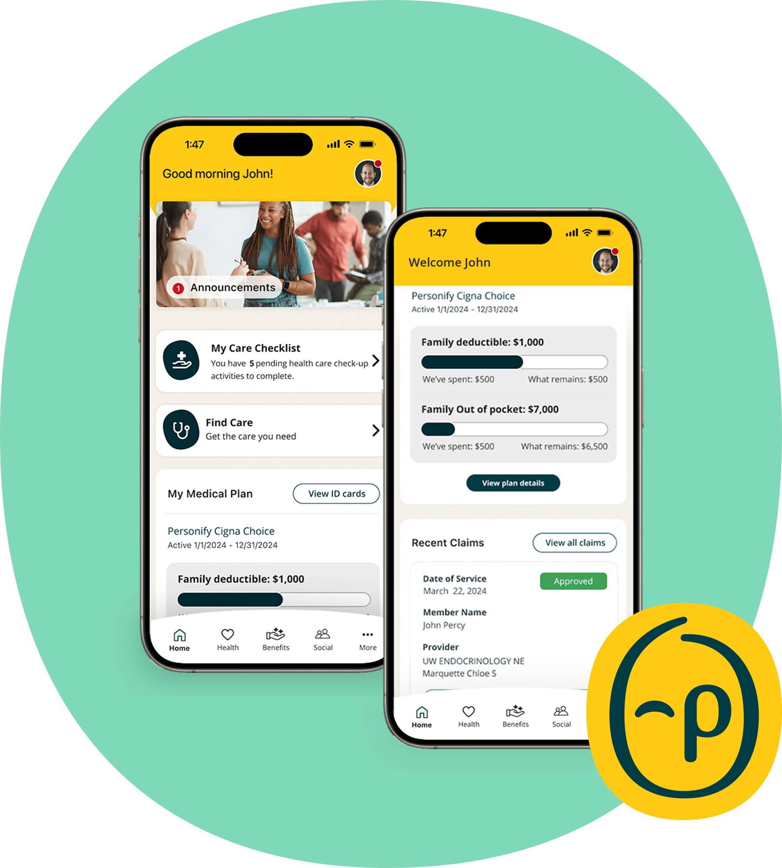

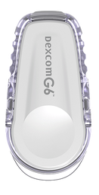
Cohort management
Cohort A
﻿Received routine diabetes care with hospital visits every 3 months
Assessment at 24, 36 and 48 weeks
HbA1C
Fasting glucose
Body weight
LDL cholesterol
# hypoglycemic events
Diabetes treatment satisfaction questionnaire
+
Cohort B
﻿self management with digital integrated health care platform without monitoring or assistance from medical personnel.
Patients with T2D
+
+
Cohort C
﻿personalized educational feedback via text messages were provided

Slide 5
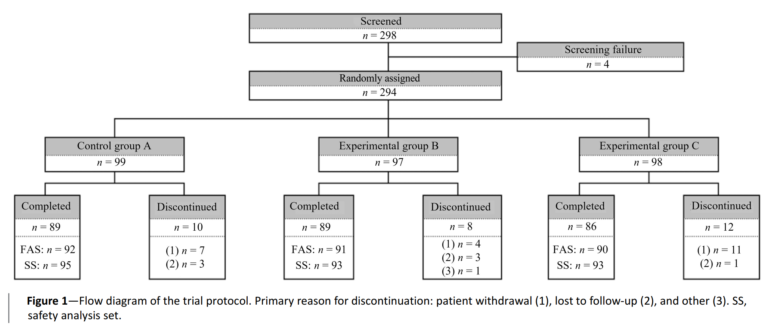
Randomization
Full analysis set (FAS) - all randomized participants who received at least one post-baseline efficacy assessment.
Safety Analysis set (SS) - all participants who received at least one dose of the intervention, analyzed according to the treatment they actually received.

Slide 6
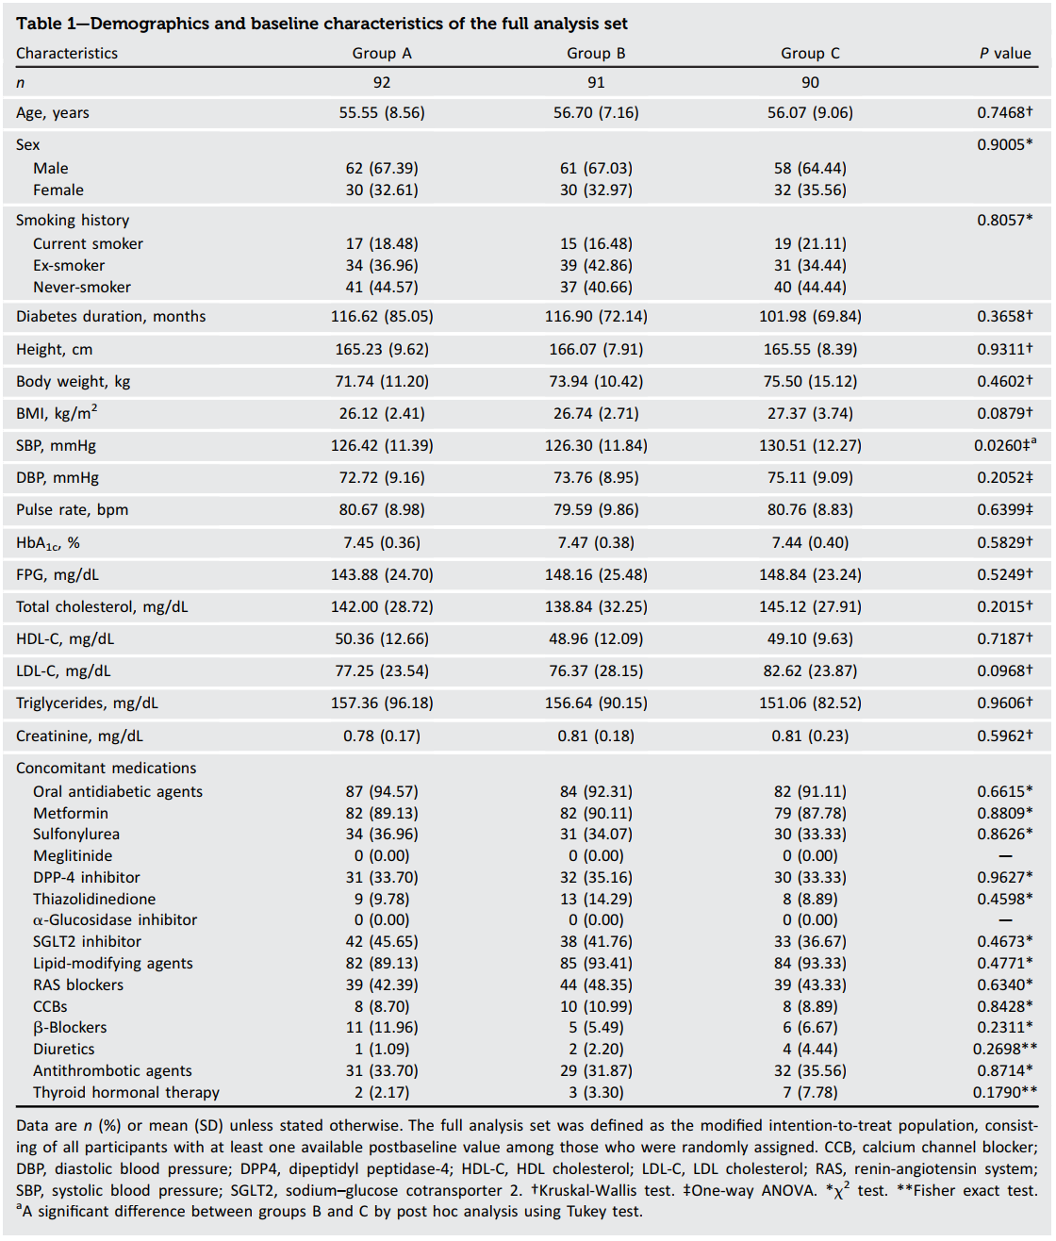
Cohort characteristics

Slide 7
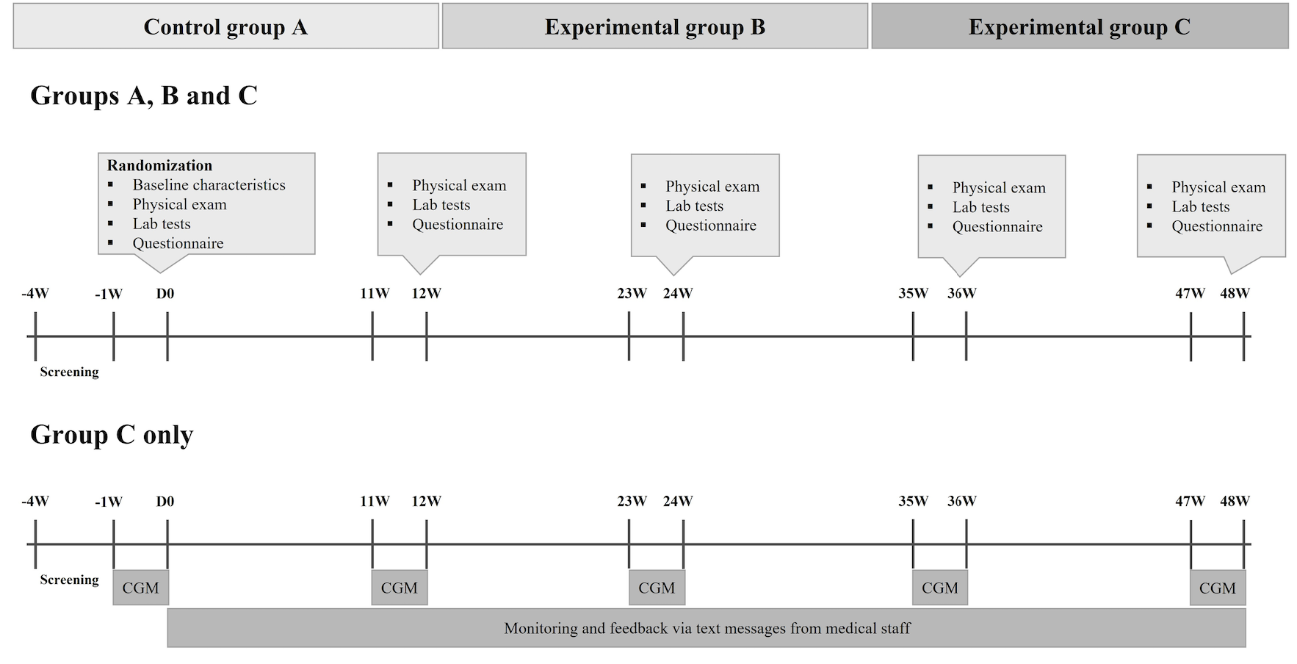
Chronicles

Slide 8
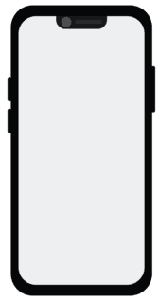

The digital health platform
Automatically collects and integrate all types of data
glucometer
Body composition
Blood pressure
Step counts
Chicken Ramen
Diary

Slide 9
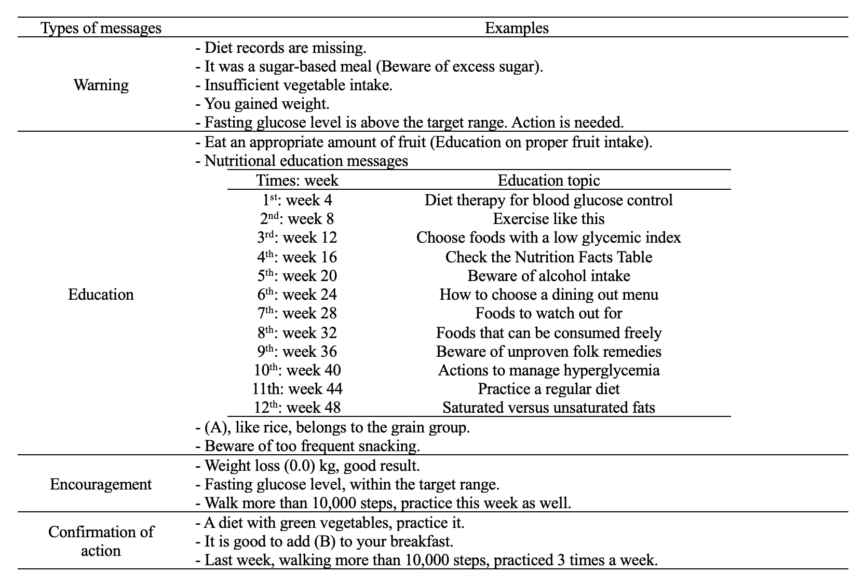
Messages

Slide 10
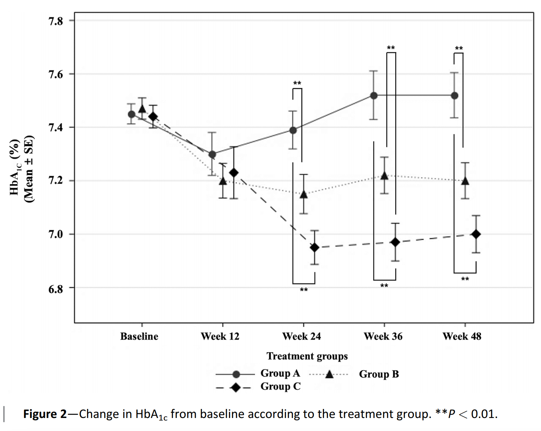
Results

Slide 11
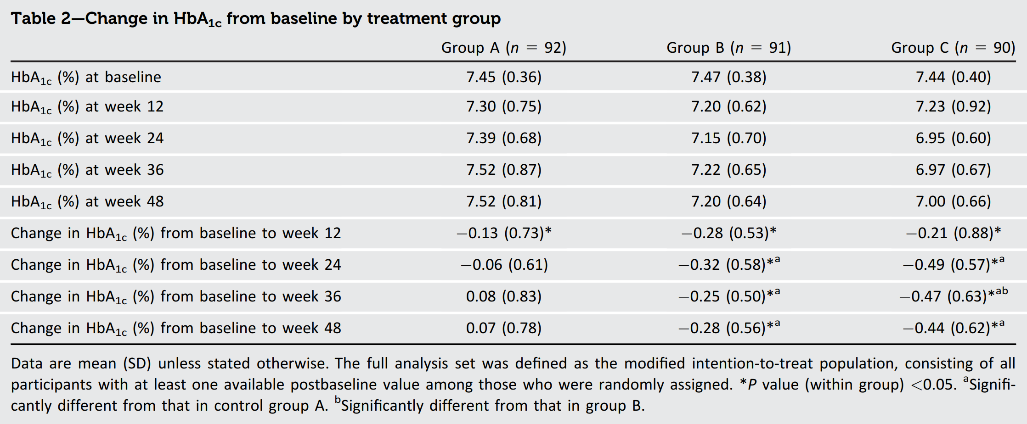
Numeric results
Change in HbA1C

Slide 12
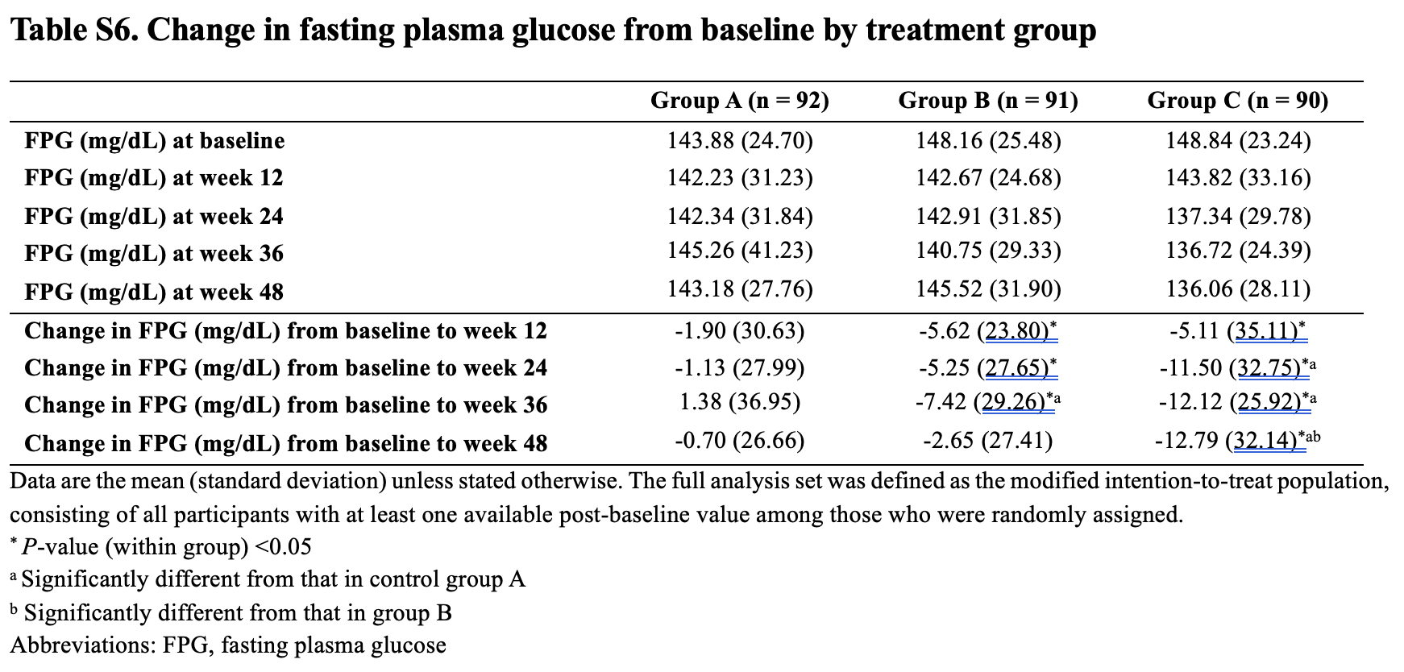
Secondary outcomes
Fasting BGL

Slide 13
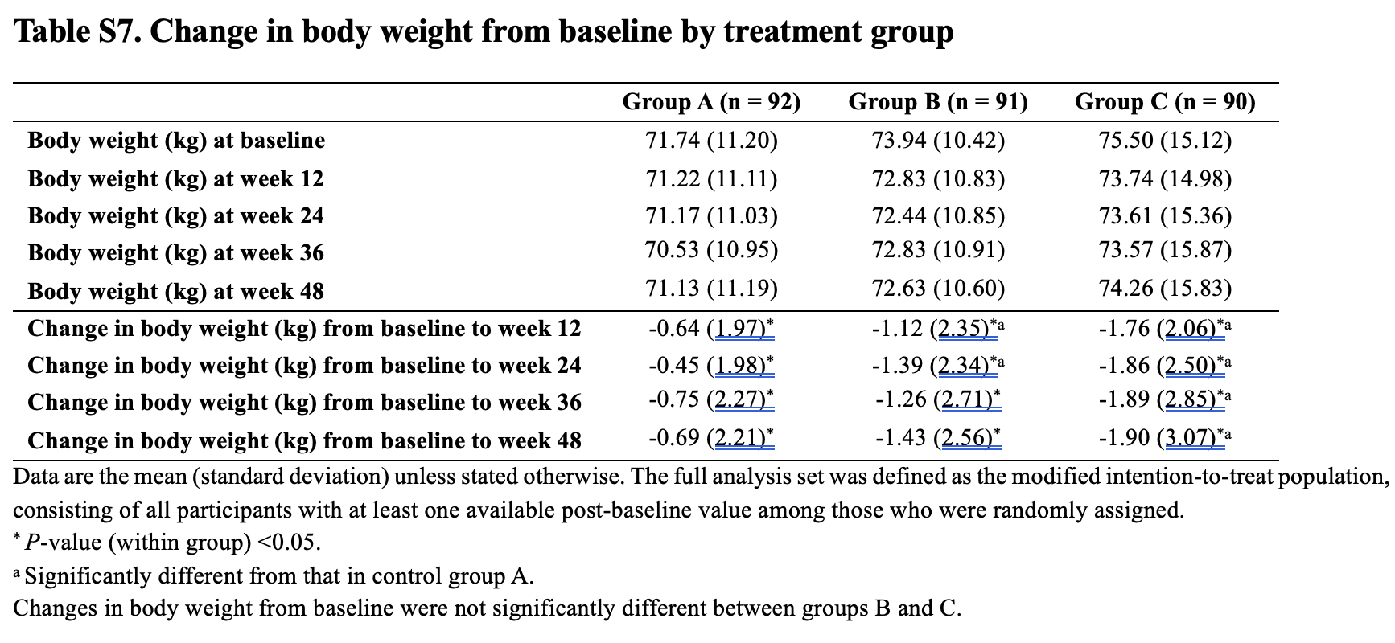
Secondary outcomes
Body weight

Slide 14
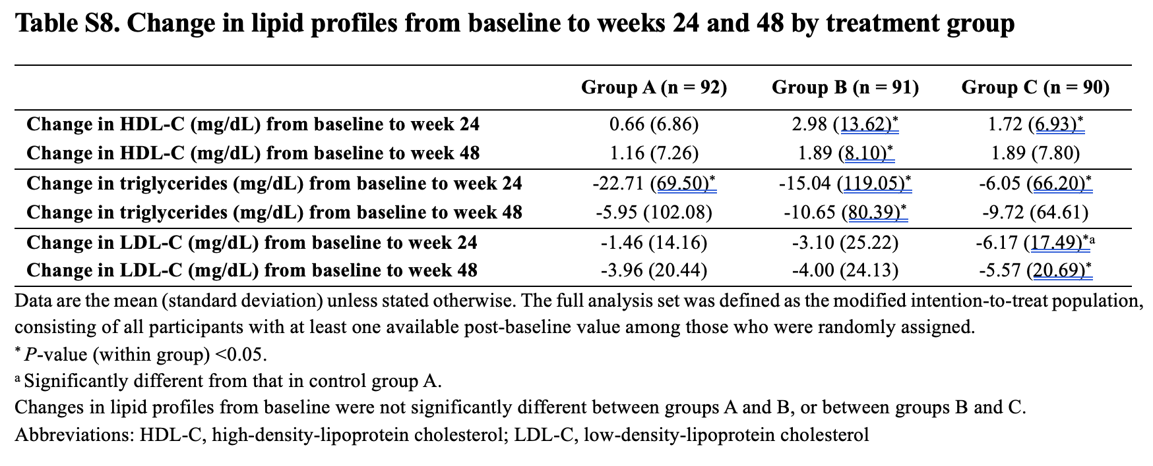
Secondary outcomes
Lipid profile

Slide 15
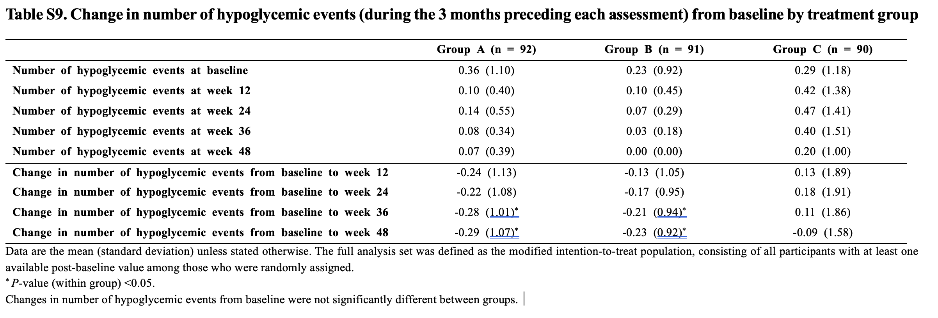
Secondary outcomes
Hypoglycemia

Slide 16
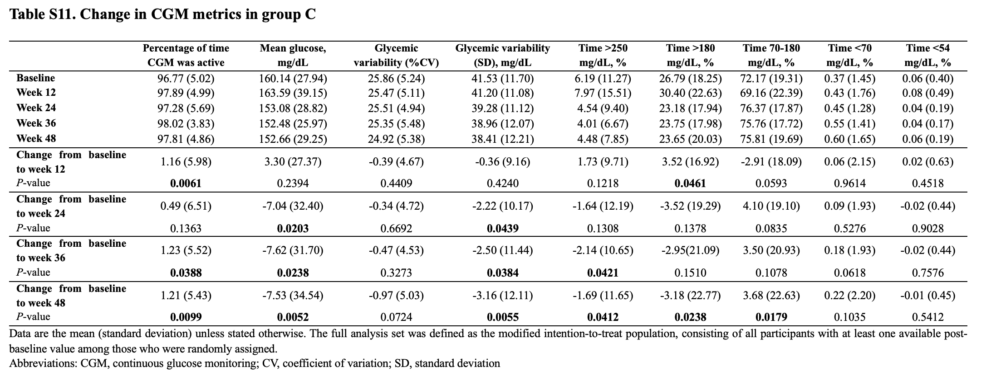
Secondary outcomes
Glycemic response

Slide 17
Limitations
Study population -- Only Korean adults
# of hypoglycemia was calculated based on questionnaire
Korea: has the Highest rate of smartphone users
Not many types of healthcare devices were available

