Slide 1
﻿A decoder-only foundation model for time-series forecasting
Google Research
ICML 2024
cited 427 times

Slide 2
Target/Requirements
Aim of this paper:
design a timeseries foundation model for forecasting ﻿
out-of-the-box zero-shot performance comes close to the accuracy of state-of-the-art supervised forecasting models.
Challenges:
﻿Such a model must support forecasting with varying history lengths (context) ,
prediction lengths (horizon) and
time granularities
Unlike text data, vast timeseries data is not available

Slide 3
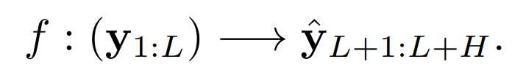
Problem statement
﻿The task is then to learn a foundation model that can map any time-series context to horizon,
Time: 1 L L+1 L+H
|---------- Context -----------| --> |----------- Horizon ------------|
Input: [ y_1 ... y_L ]
Output: [ y_L+1 ... y_L+H ]
Task: Learn f : (y_1:L) -> (ŷ_L+1:L+H)

Slide 4
Key components
Patching:
Patching in timeseries data is same as tokenizing in NLP
Size of Context input ﻿fed into the transformer is reduced by a factor of the patch length.
Time: 1 32 33 64 65 96 97 224
|----32----| |----32----| |----32----| --> |================= next 128 ==================|
Input: [ y1 .. Y32 ] [ y33 .. Y64 ] [ y65 .. y96 ]
Output: [ y97 .. y224 ]

Slide 5
Key components
Decoder-only model:
﻿given a sequence of input patches, the model is optimized to predict the next patch (autoregressively, same as LLMs) as a function of all past patches
Decoder-only models can work with variable-length context
A decoder-only Transformer takes a sequence of patches (or, just one patch). It doesn’t care whether you give it 1, 2, or 8 patches—so long as it’s ≤ the max context window.

Slide 6
Key components
Decoder-only model:
Time: 1 32 33 160
|----32----| --> |================= next 128 ==================|
Input: [ y1 .. y32 ]
Output: [ y33 .. y160 ]
Time: 1 32 33 64 65 192
|----32----| |----32----| --> |================= next 128 ==================|
Input: [ y1 .. y32 ] [ y33 .. y64 ]
Output: [ y65 .. y192 ]
Time: 1 32 33 64 65 96 97 224
|----32----| |----32----| |----32----| --> |================= next 128 ==================|
Input: [ y1 .. Y32 ] [ y33 .. Y64 ] [ y65 .. y96 ]
Output: [ y97 .. y224 ]

Slide 7
Key components
Masking:
﻿ If patches are used naively, the model might only learn to predict well for context lengths that are multiples of the input patch length.
﻿They make a careful use of masking during training. Parts of patches as well as entire patches from the beginning of the context window can be masked in a data batch.
﻿They employ a specific random masking strategy during training that helps the model see all possible context lengths starting from 1 to a maximum context length
Context length = 40 → last 32 points are fed, first 8 are masked.
Context length = 60 → last 32 fed, first 28 masked.
Context length = 80 → last 64 fed, first 16 are masked.

Slide 8
Key components
Masking:
A case without masking
[ input context (L=96) ] → [ tokens ]
|----32----|----32----|----32----| → [t1][t2][t3]
Patch 1 Patch 2 Patch 3 j=1 j=2 j=3
The same case with partial masking
Raw y: |----32----|----32----|----32----|
Mask m: |11110000..|0000000000|0000000000| (1=ignore, 0=keep)
After y*(1-m): first few positions of Patch 1 → zeroed
Patch 2, Patch 3 → unchanged
Tokens: t1 = MLP( masked Patch 1 ) + PE1
t2 = MLP( Patch 2 ) + PE2
t3 = MLP( Patch 3 ) + PE3

Slide 9
Key components
Masking:
A case with masking out an entire patch
Before: |----32----|----32----|----32----|
Masking: |1111111111|0000000000|0000000000| (Patch 1 masked out entirely)
Effective input seen by the model in this batch:
|----32----|----32----|
Patch 2 Patch 3
Tokens: [t2][t3] (positionally encoded as j=2,3 so the model “knows” where they sit)
Dropping (removing entirely) vs. Masking an entire patch (keeping position but hiding contents)
Dropping: Sequence length is only 2, and tokens [t2][t3] are at positions 1 and 2
Masking first patch: model still knows that patch 1 exists in the timeline (j=1) but that its content is “unknown”

Slide 10
Key components
Residual block:
Raw y: |----32----|----32----|----32----|
Mask m: |11110000..|0000000000|0000000000| (1=ignore, 0=keep)
After y*(1-m): first few positions of Patch 1 → zeroed
Patch 2, Patch 3 → unchanged
Tokens: t1 = MLP( masked Patch 1 ) + PE1
t2 = MLP( Patch 2 ) + PE2
t3 = MLP( Patch 3 ) + PE3
Residual block lets the model learn a rich embedding of different sized input

Slide 11
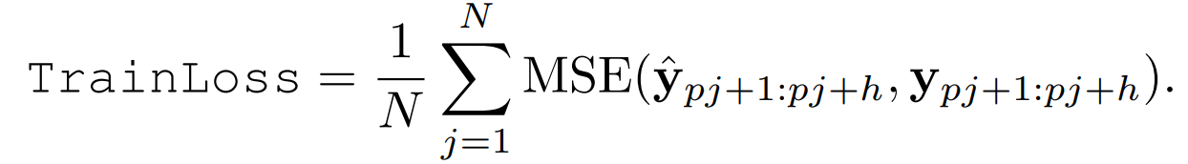
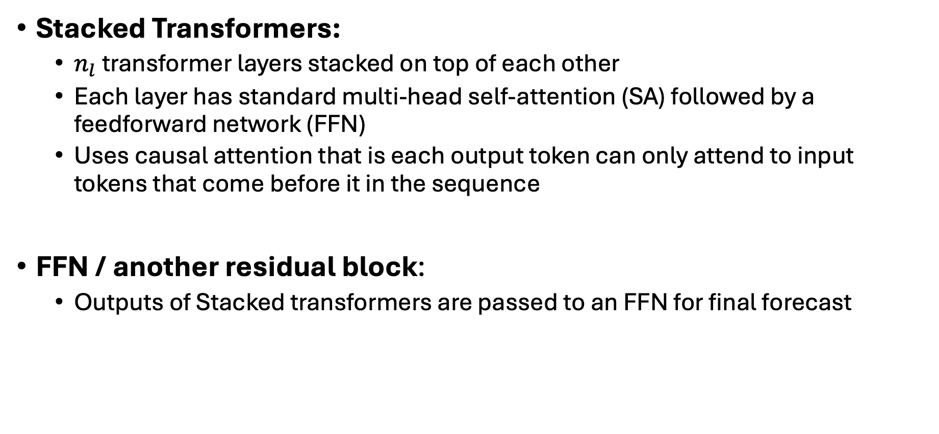
Key components
Stacked Transformers:
$n_{l}$transformer layers stacked on top of each other
Each layer has s﻿tandard multi-head self-attention (SA) followed by a feedforward network (FFN)
﻿Uses causal attention that is each output token can only attend to input tokens that come before it in the sequence
FFN / another residual block:
Outputs of Stacked transformers are passed to an FFN for final forecast
Loss Function

Slide 12
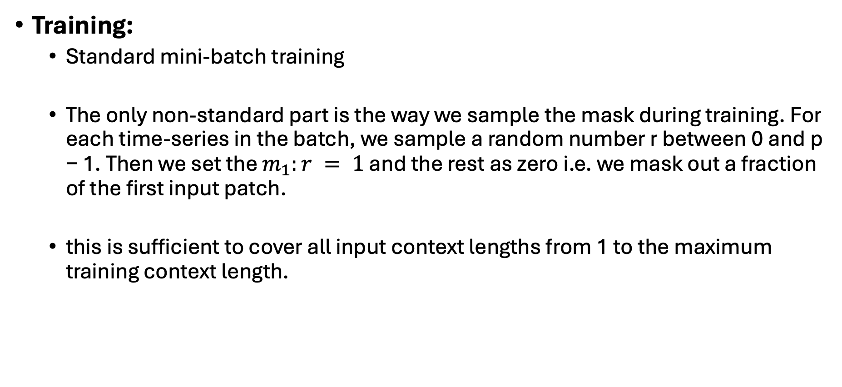
Key components
Training:
Standard mini-batch training
﻿The only non-standard part is the way we sample the mask during training. For each time-series in the batch, we sample a random number r between 0 and p − 1. Then we set the $m_{1}:r = 1$ and the rest as zero i.e. we mask out a fraction of the first input patch.
﻿this is sufficient to cover all input context lengths from 1 to the maximum training context length.

Slide 13
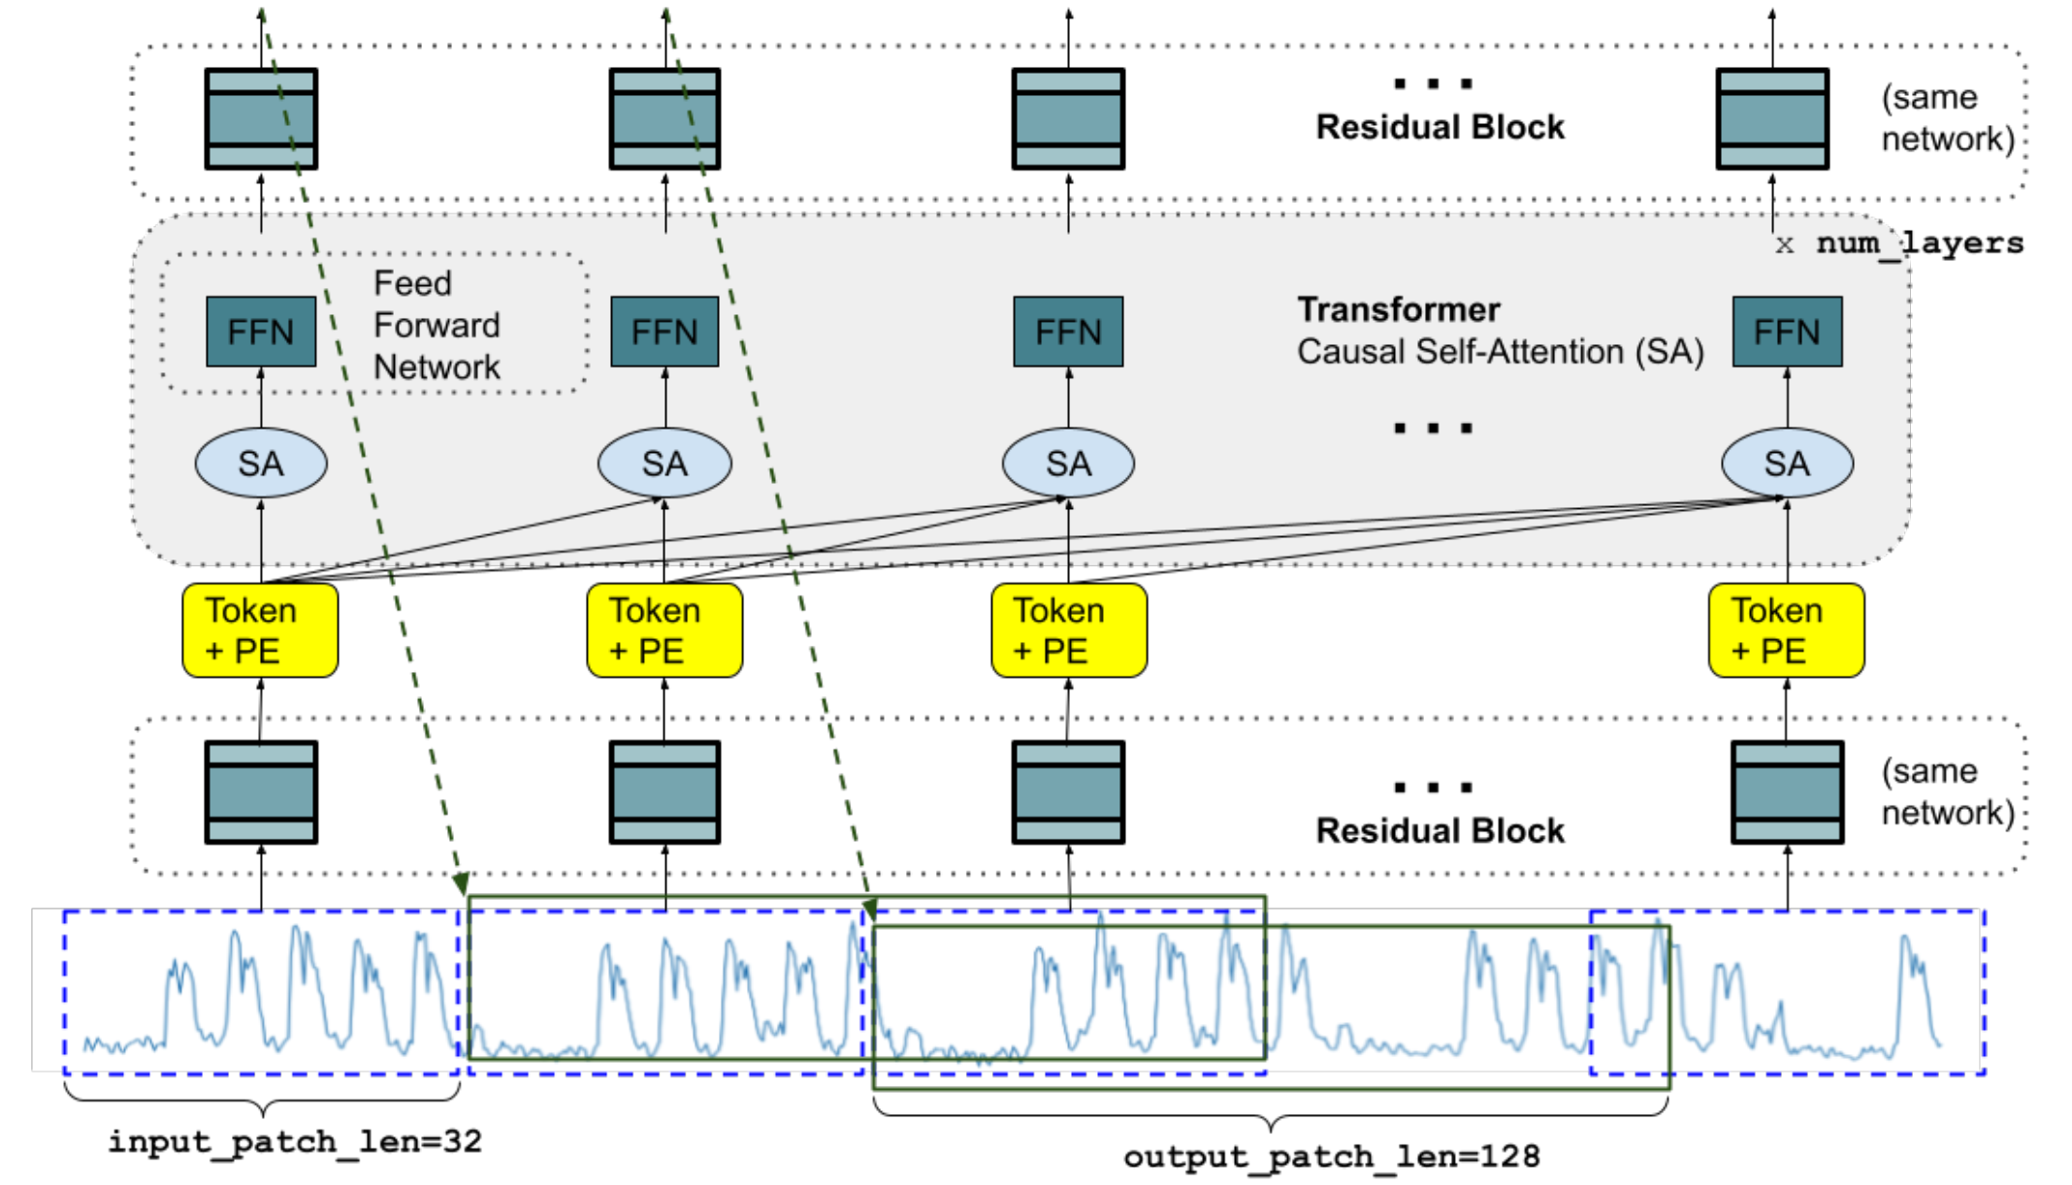
Key components

Slide 14
Dataset
Train:
Google trends (22k term queries, ﻿Jan. 2018 to Dec. 2019 for hourly and Jan. ﻿2007 to Dec. 2021 for the other granularities.)
Wiki pageviews (﻿all pageview data from Jan. 2012 to Nov. 2023, clean and aggregate the views by page into hourly, daily, weekly and monthly granularities)
Synthetic data ﻿(mixture of sines and cosines of different frequencies), trends (linear, exponential with a few change-points) and step functions. A synthetic time-series can be an additive combination of one or more of these processes
During training, a blend of 80% real and 20% synth. Data was used

Slide 15
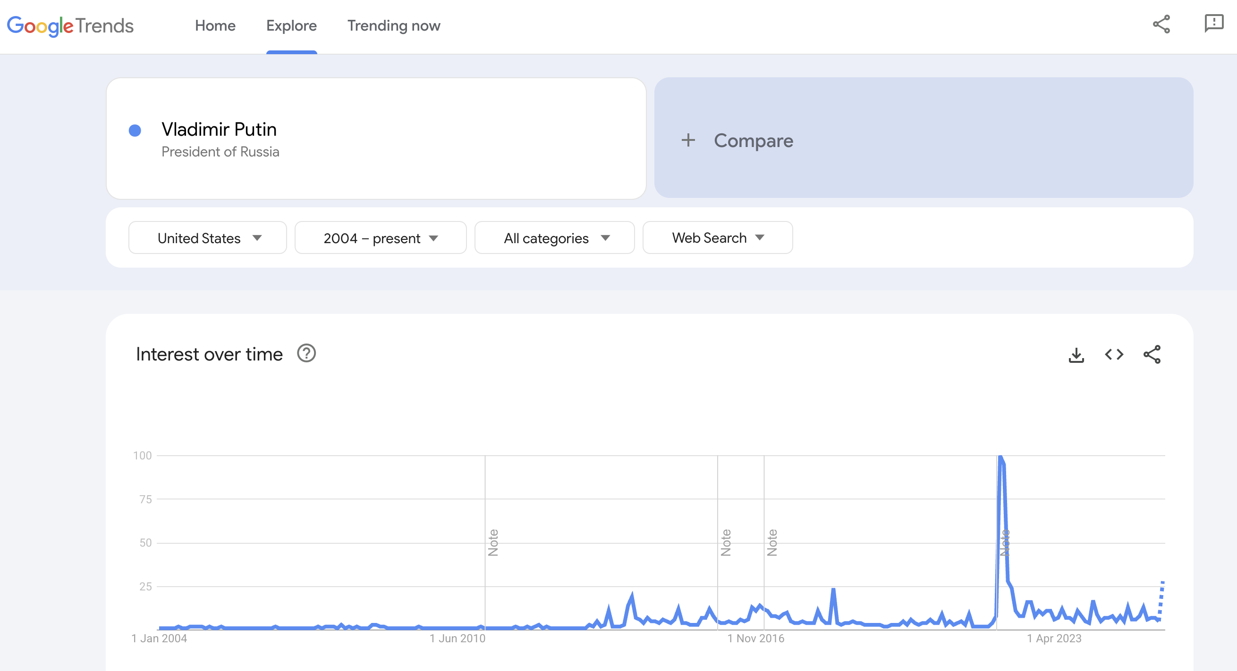
Dataset
Start of Ukraine war

Slide 16
Dataset
Test:
Monash archive: 30 datasets ﻿including finance, demand forecasting, weather and traffic at different granularities.
Darts: ﻿collection of 8 univariate datasets which include interesting seasonalities and additive + multiplicative trends.
Informer: datasets ﻿related to electricity transformer temperatures over a two year period in 1 hour and 15 minutes granularities.

Slide 17
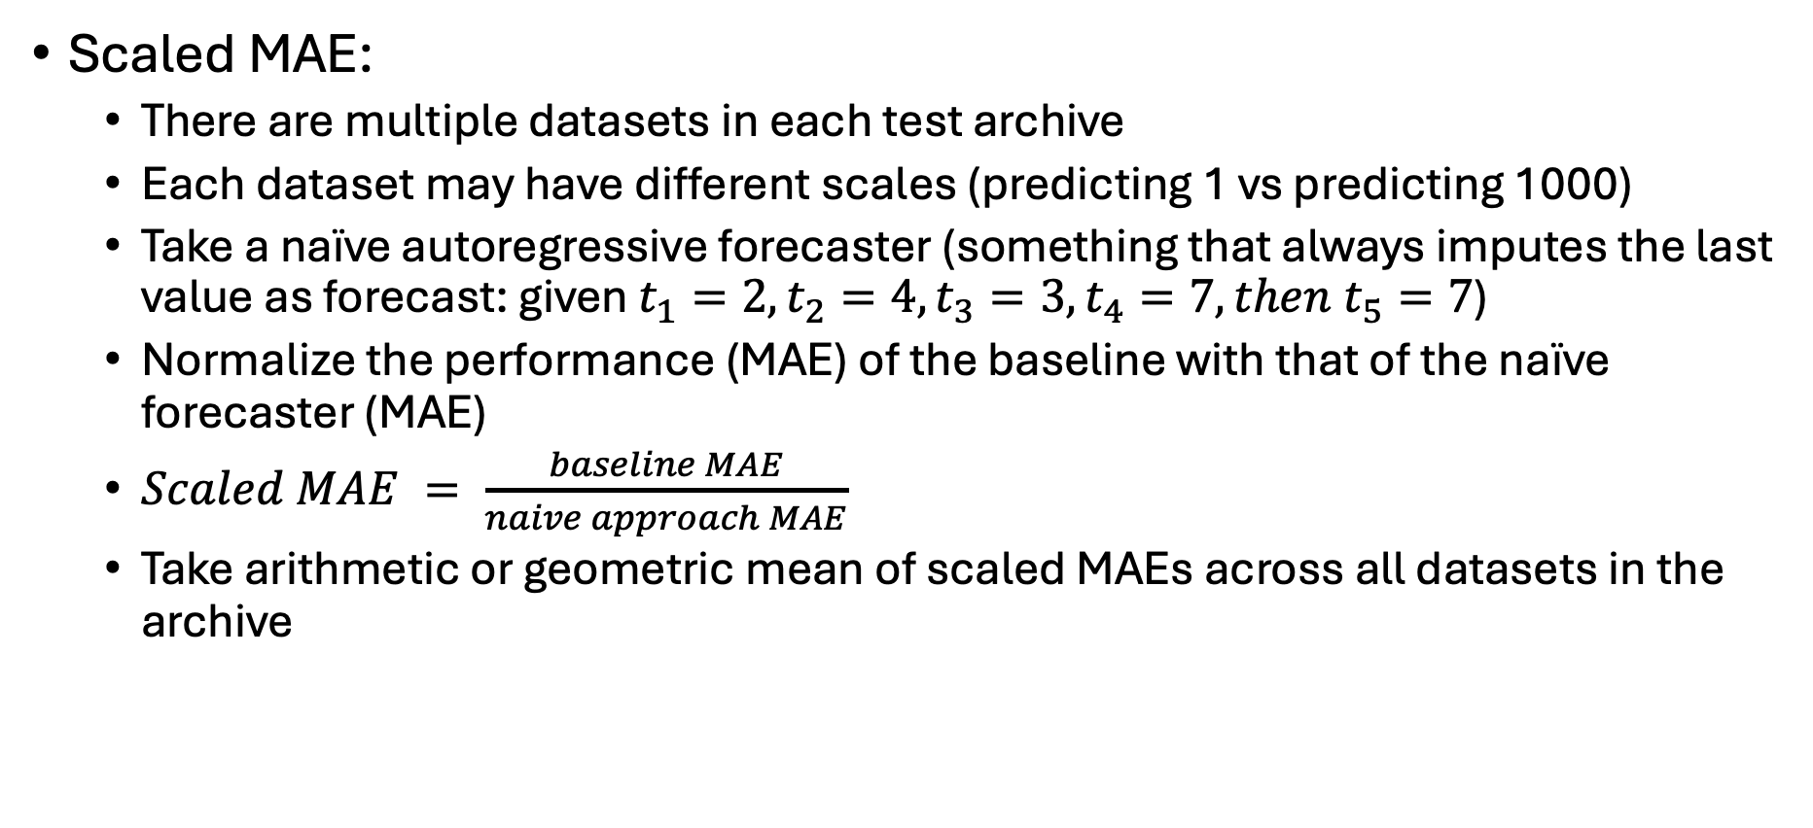
Metric
Scaled MAE:
There are multiple datasets in each test archive
Each dataset may have different scales (predicting 1 vs predicting 1000)
Take a naïve autoregressive forecaster (something that always imputes the last value as forecast: given $t_{1}=2, t_{2}=4, t_{3}=3, t_{4}=7, then t_{5}=7$)
Normalize the performance (MAE) of the baseline with that of the naïve forecaster (MAE)
$Scaled MAE = \frac{baseline MAE}{naive approach MAE}$
Take arithmetic or geometric mean of scaled MAEs across all datasets in the archive

Slide 18
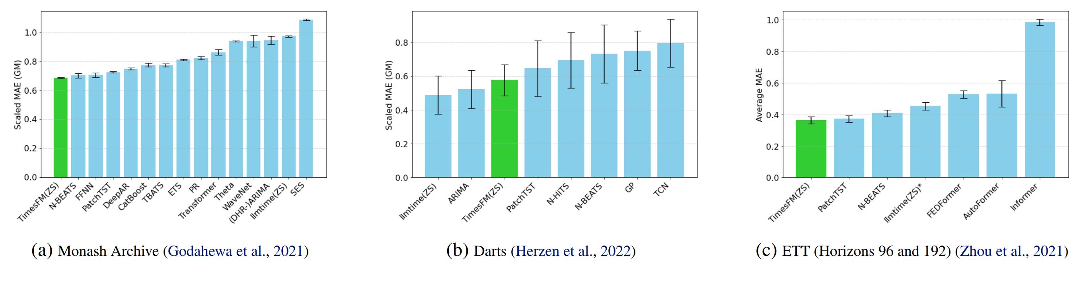
Results
Zero shot scaled MAE

Slide 19
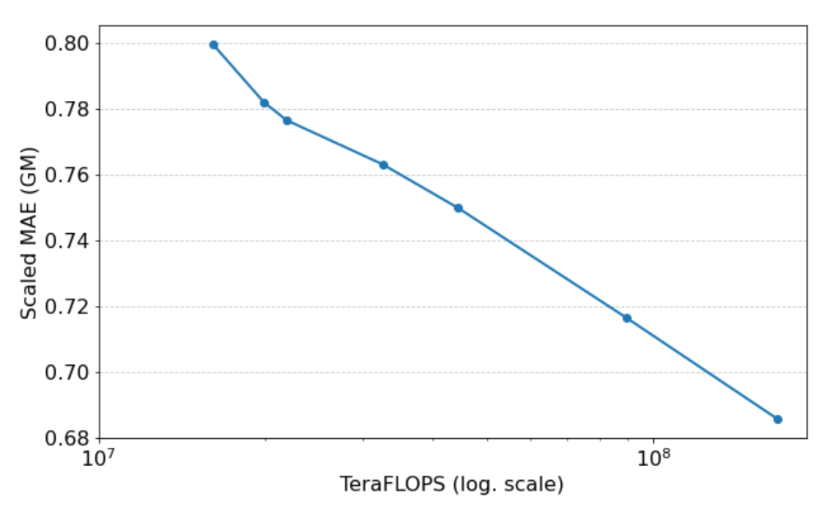
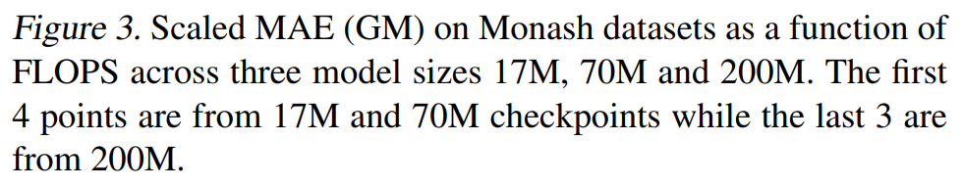
Ablation studies
More parameters = better result?
TimesFM models of sizes 17M, 70M and 200M parameters,
using the same pre-training dataset till 1.5M epochs
with a global batch-size of 4096.
Then we collect checkpoints (sMAE) that represent varying number of FLOPS

Slide 20
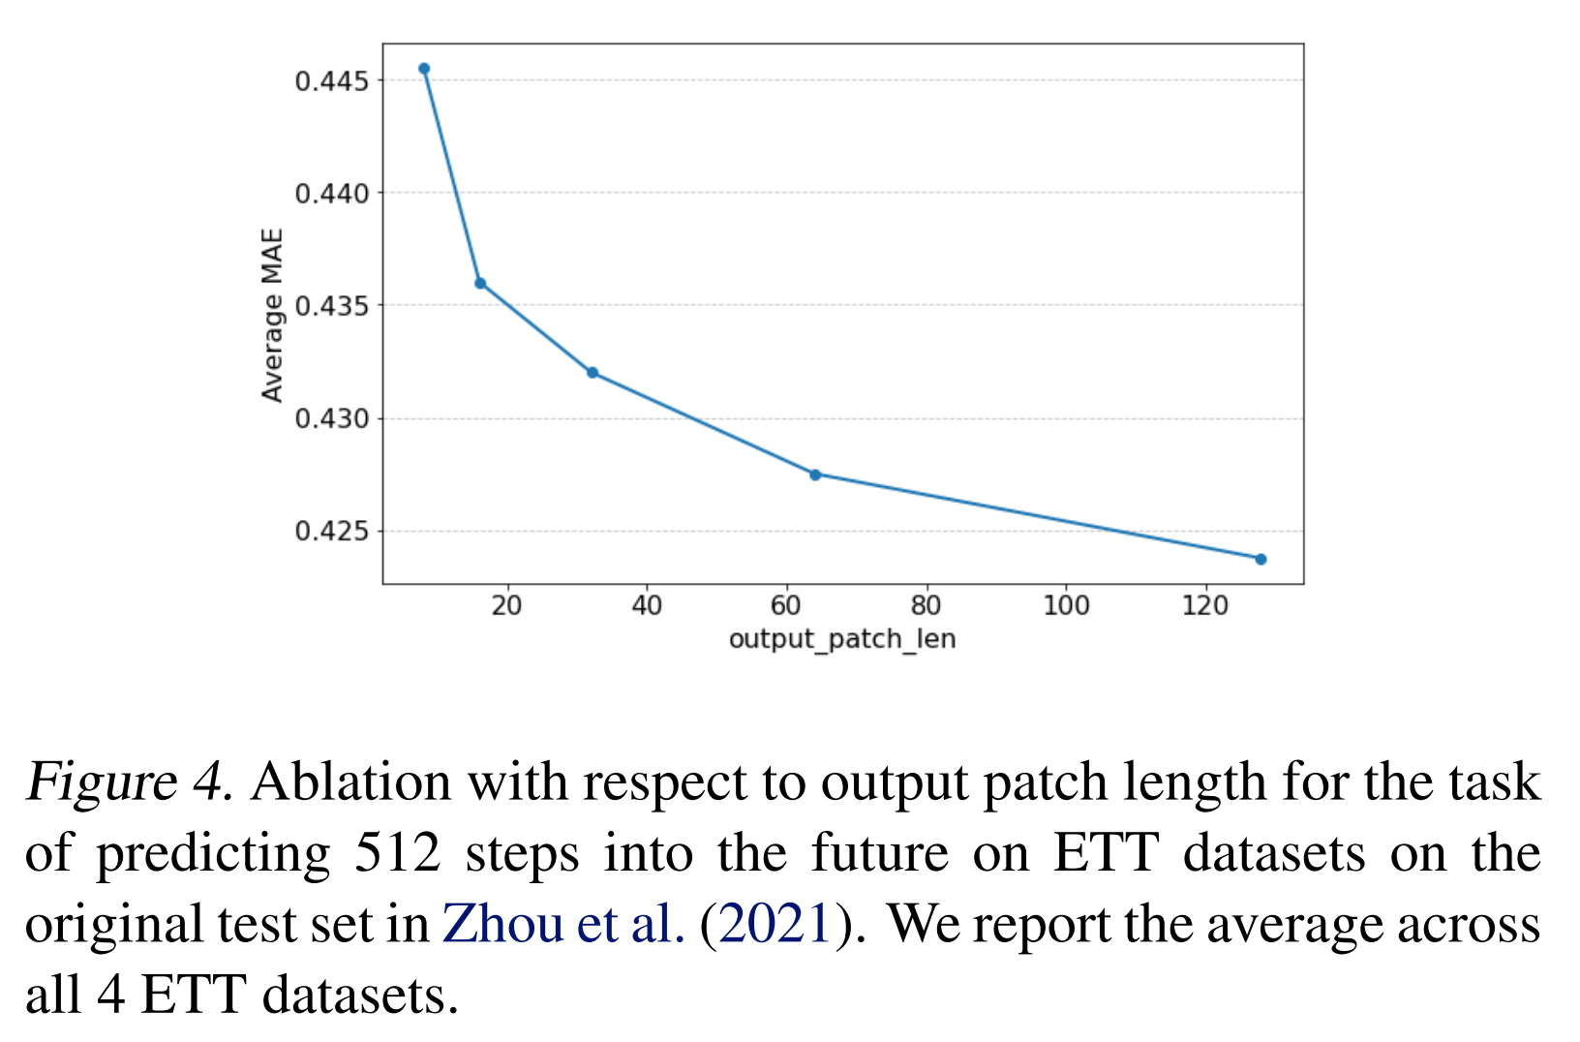
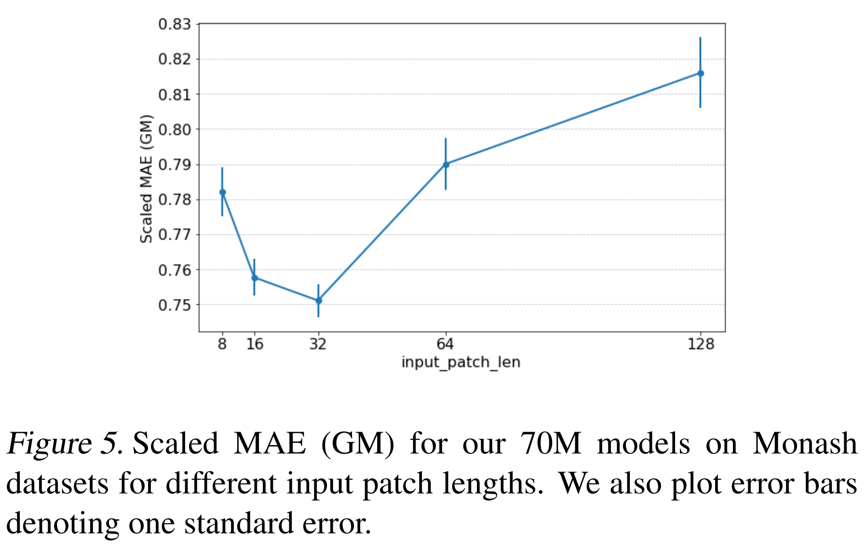
Ablation studies
What happens when input patch length and output patch length is changed?

Slide 21
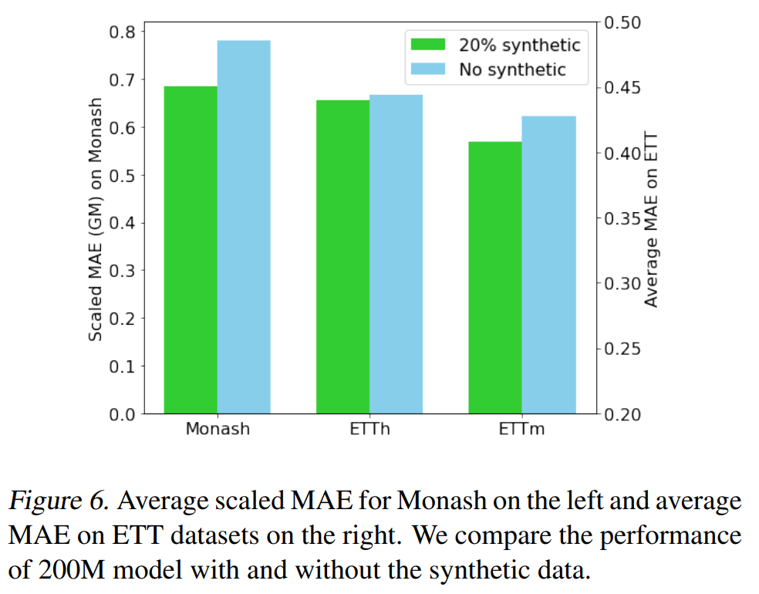
Ablation studies
Adding synthetic data helps?
Monash and ETTm has an imbalance in granularities (more hourly/daily data, less yearly, quarterly, 10-minute data)
Supplemented the underrepresented groups using synthetic data to see if performance improves

Slide 22
Limitations
﻿ Since we are building a single pre-trained model, we cannot have dataset specific dynamic or static covariates during training time.
TimesFM can work on univariate timeseries only

Slide 23
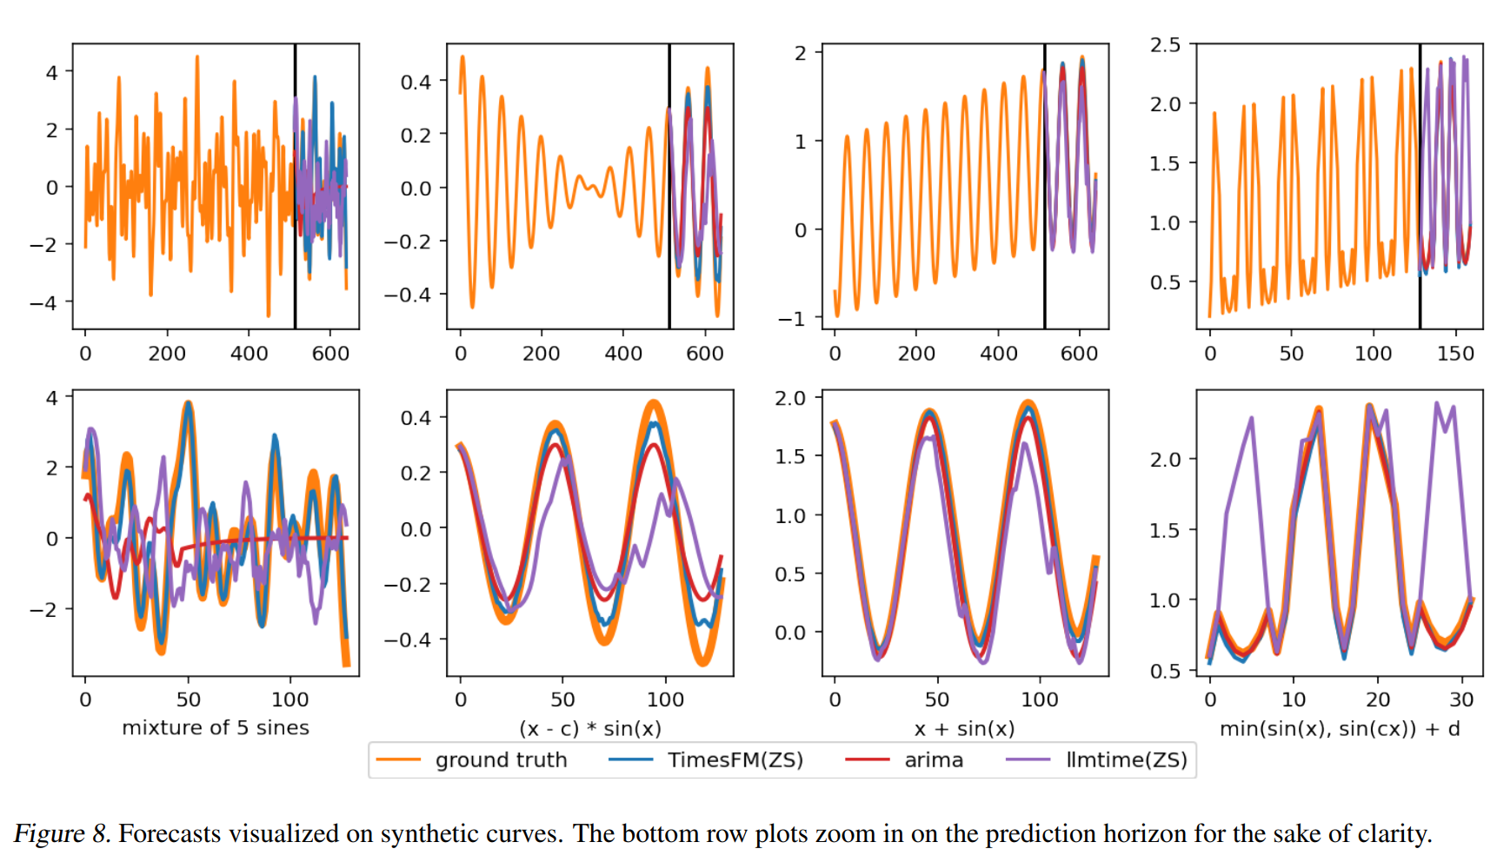
Examples

Slide 24
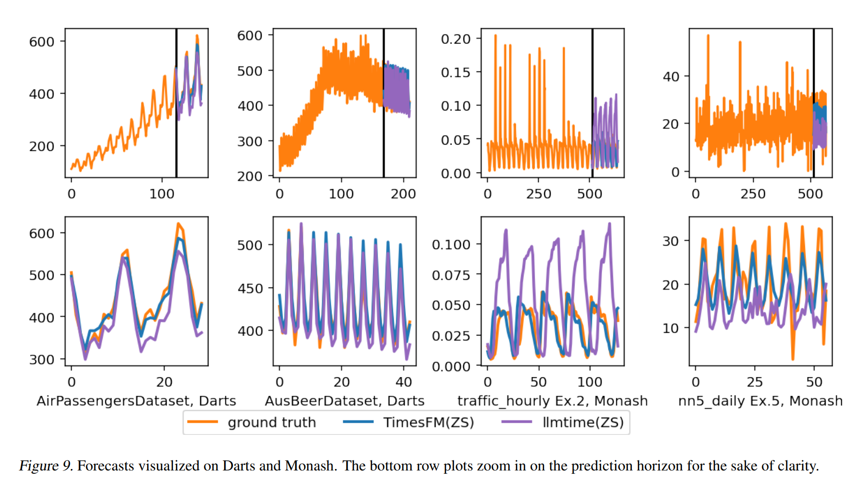
Examples

Slide 25
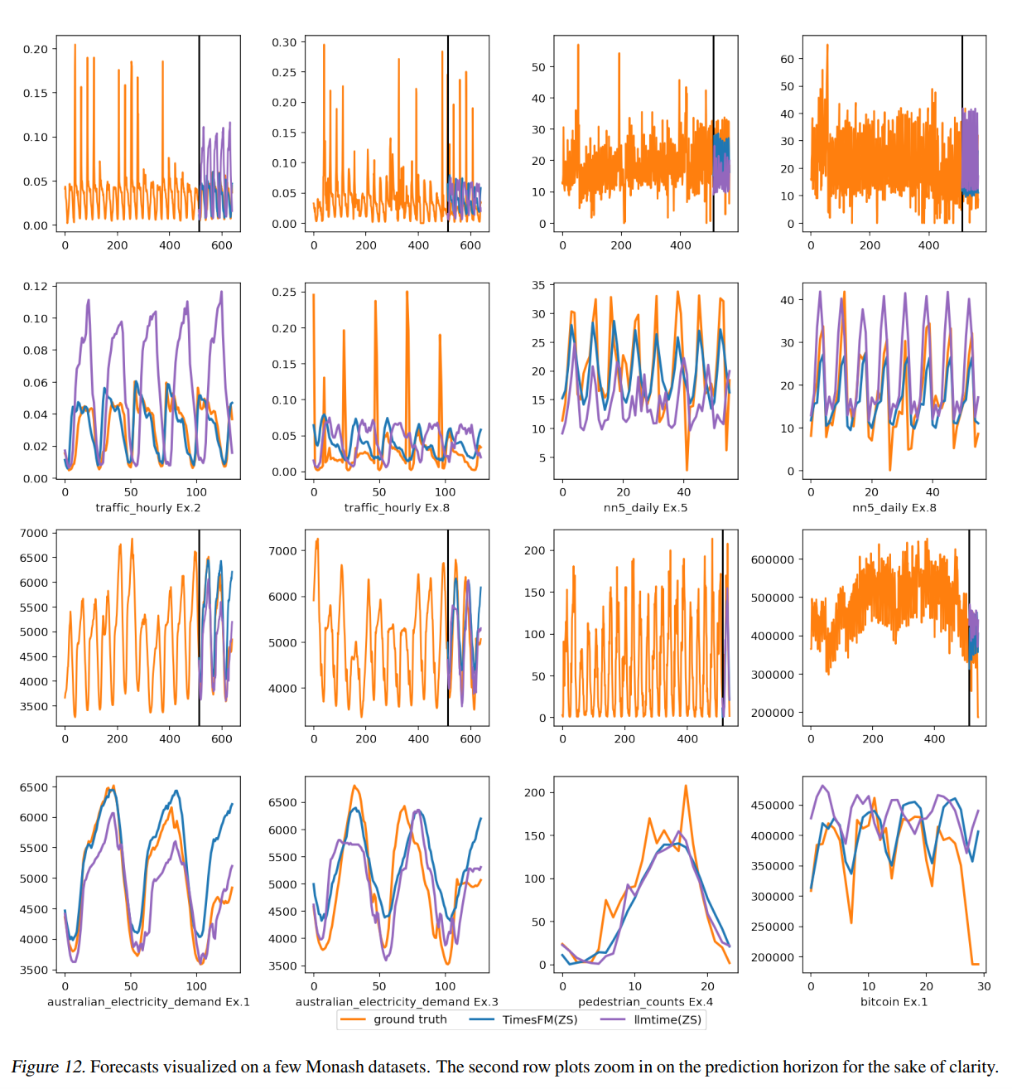
Examples

