Slide 1
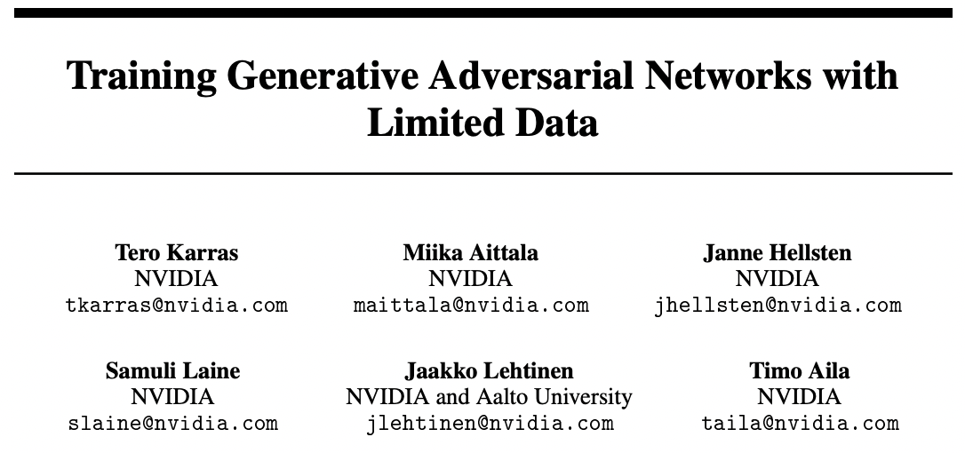
NeurIPS’2020
Cited over 880 times

Slide 2
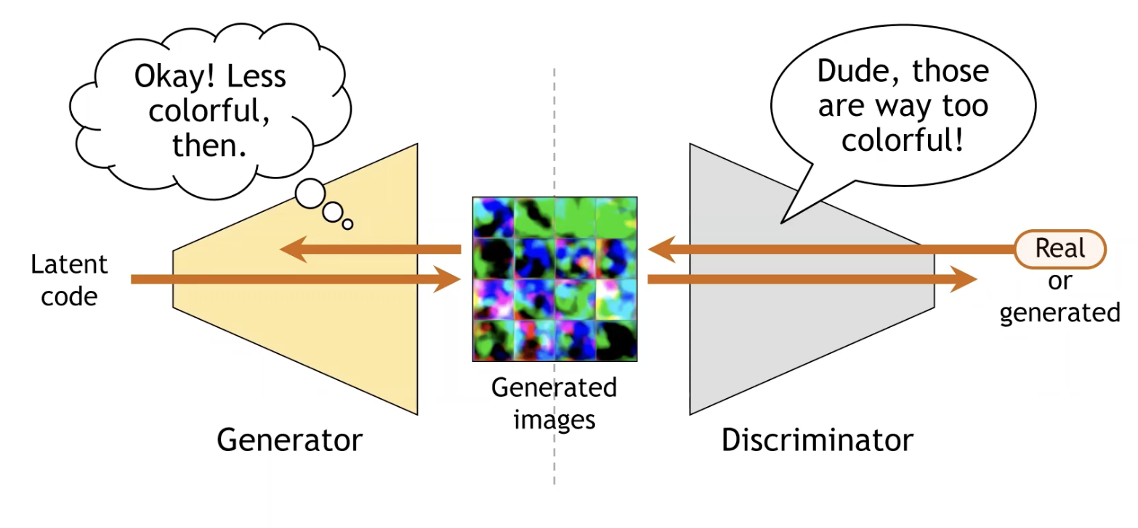
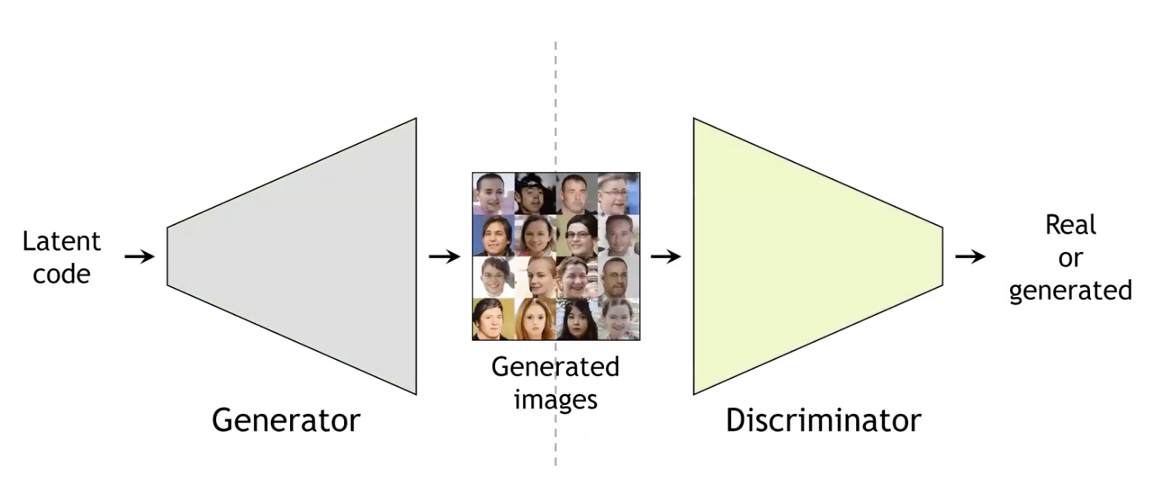
Overview of GAN

Slide 3
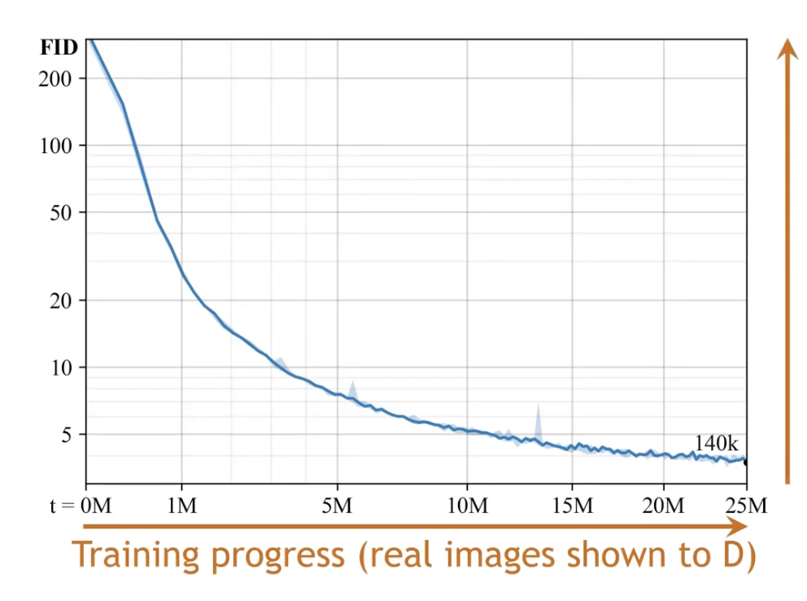
Problem of GAN
Very data hungry
Frechet inception distance (FID)
A measure for generated image quality
The lower the better
Enough data for convergence

Slide 4
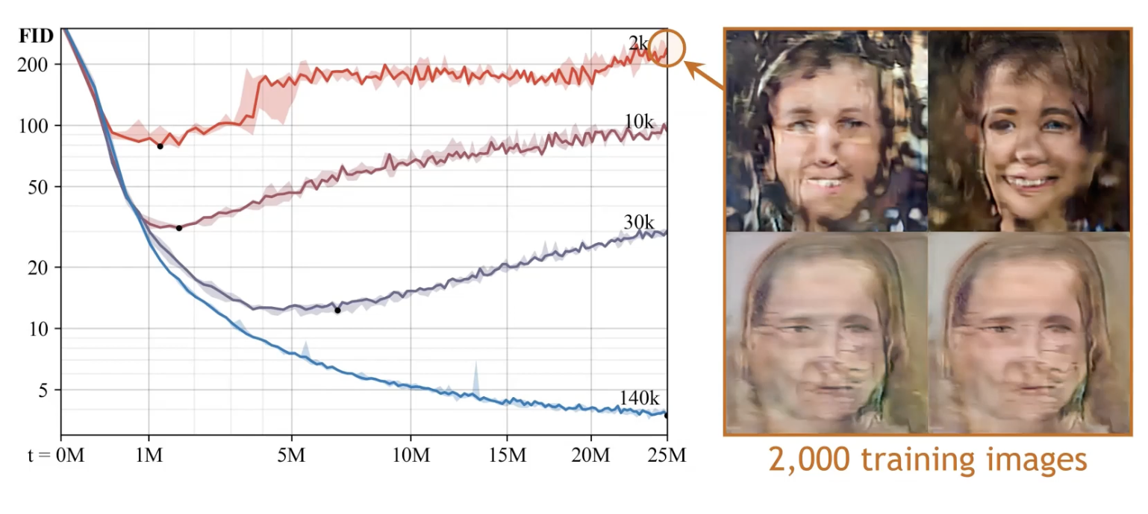
Problem of GAN
Very data hungry
Least FID point
Quality of generated samples deteriorate

Slide 5
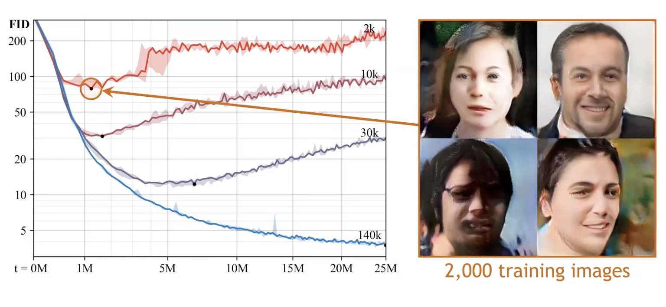
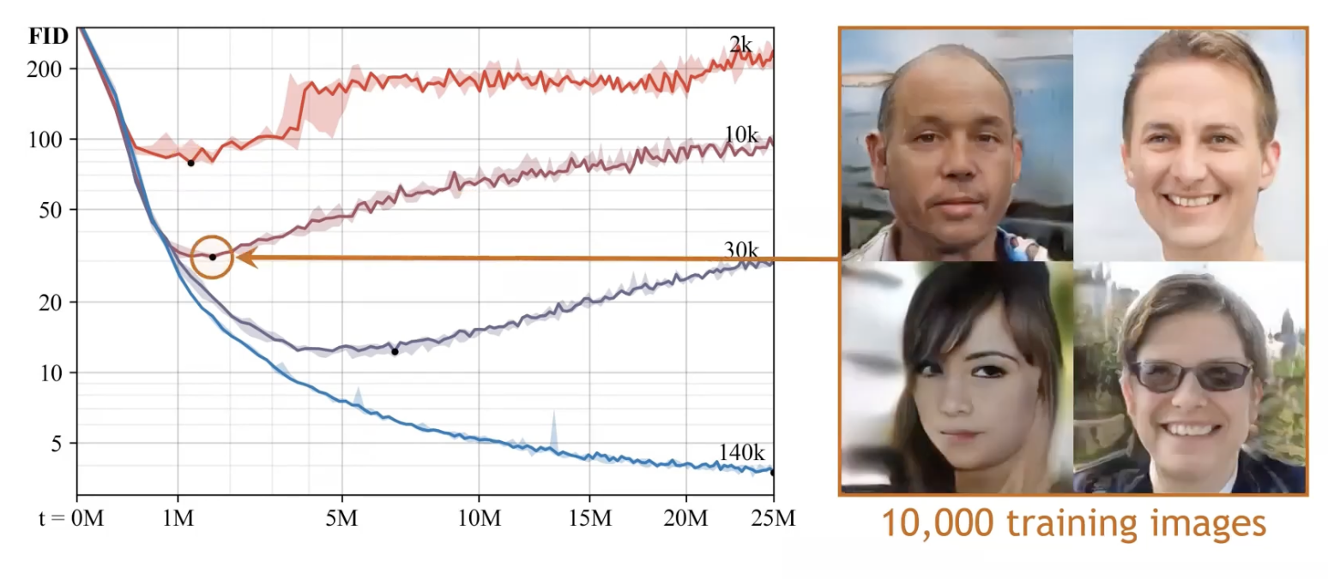
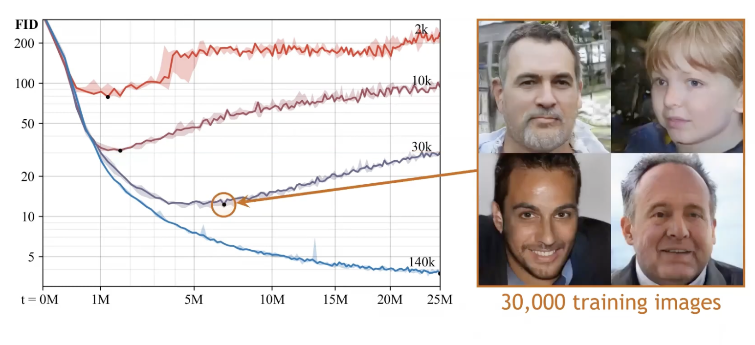
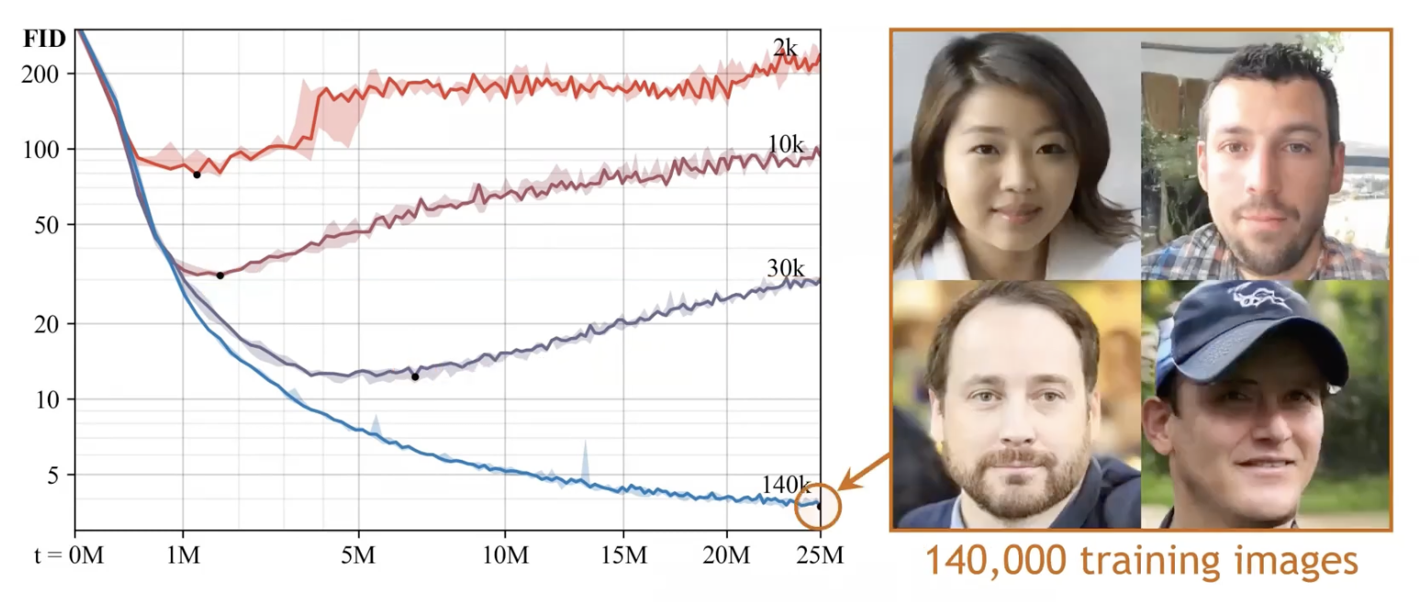
Problem of GAN
Things look a little bit better at minimum FID points, but not as good as the baseline
Very data hungry

Slide 6
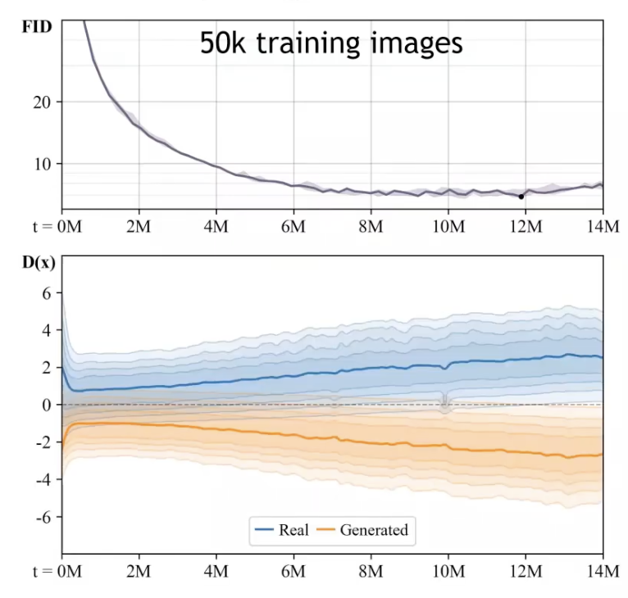
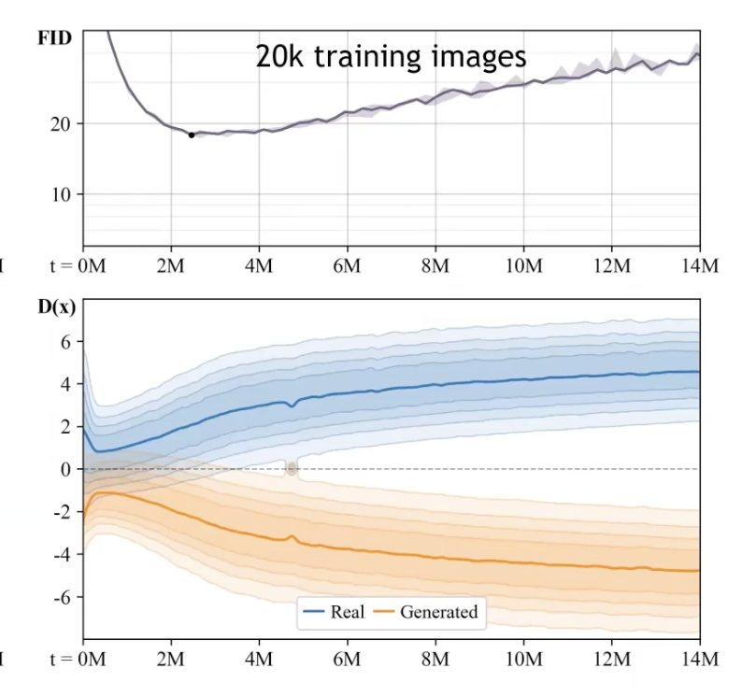
Why this problem happens?
Overall GAN loss
Discriminator loss

Slide 7
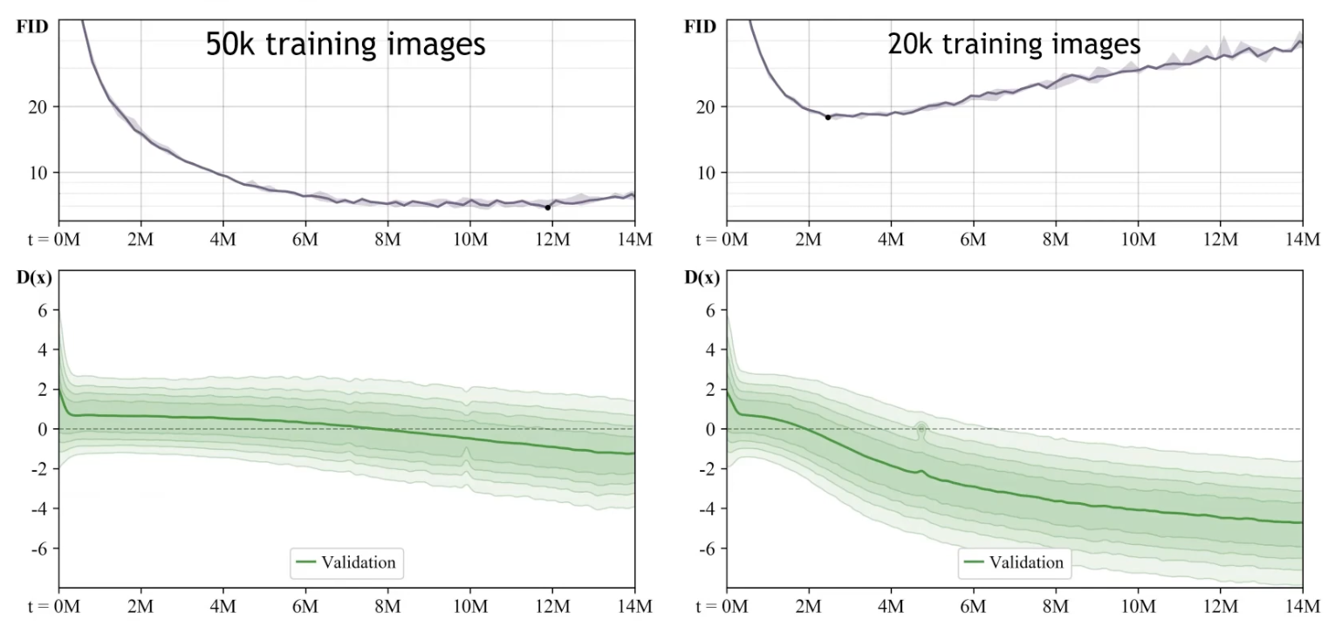
Why this problem happens?
GAN Memorizes the dataset

Slide 8
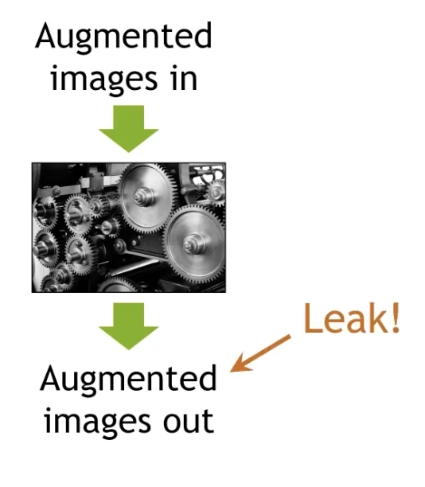
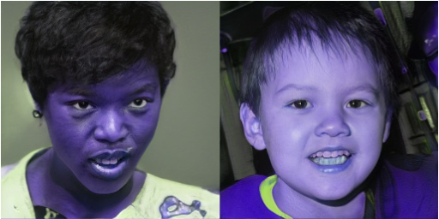

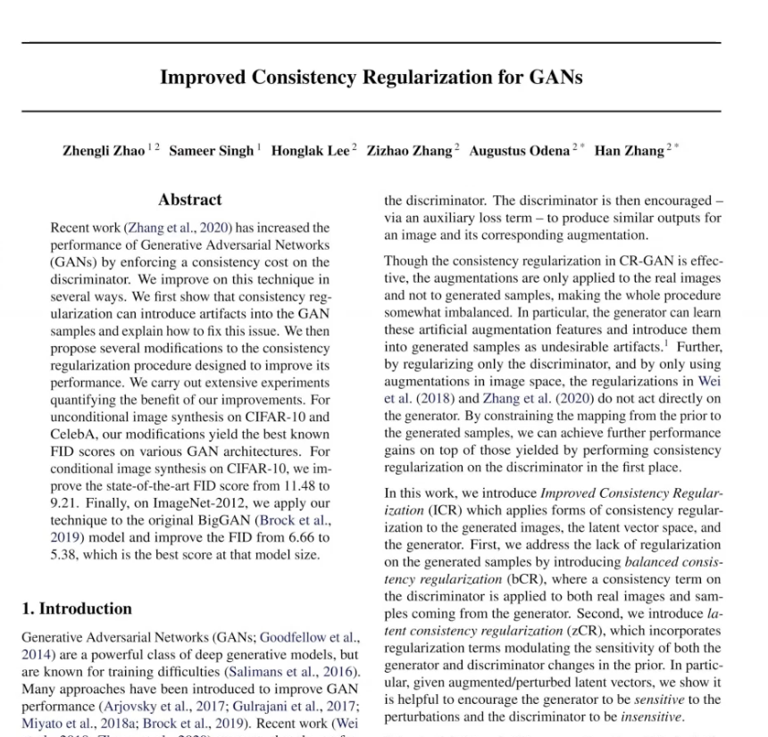
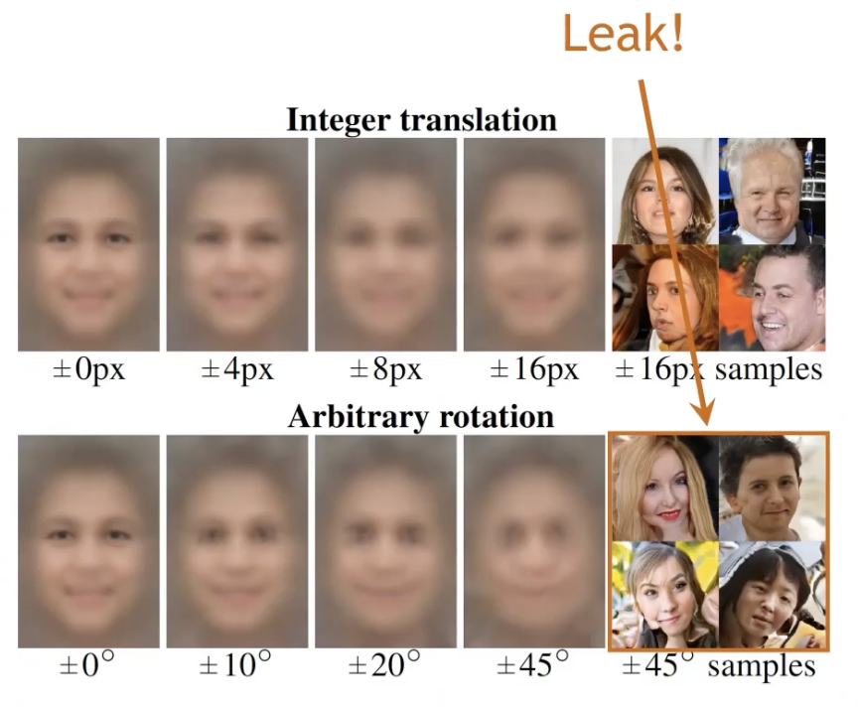
How to solve?
Augmentation
Regularization
Network depth
Dropout… etc.
Leak !

Slide 9

How to solve?
Augmentation
Regularization
Network depth
Dropout… etc.
Most used method for better generalization and training set enlargement
Let’s modify this in a way so that leaks don’t take place

Slide 10
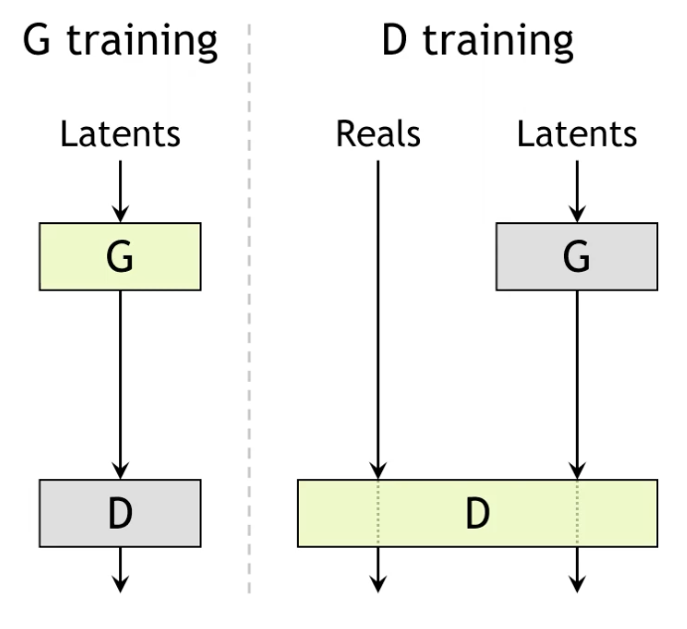
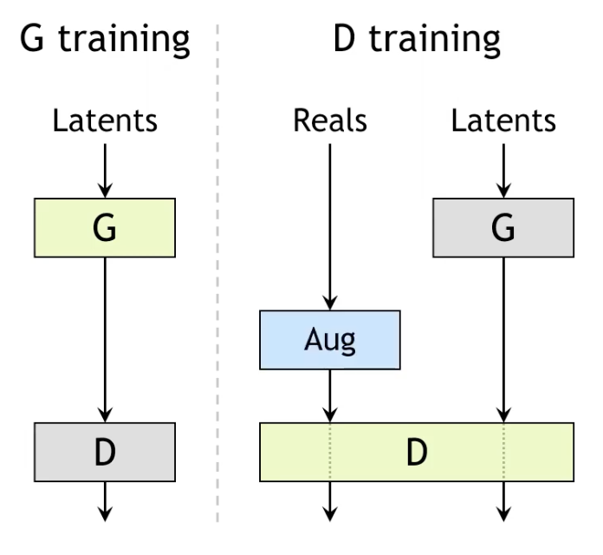
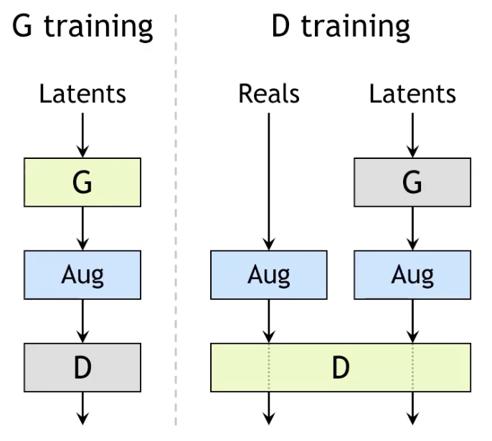
Solution # 1
A bit hypothetical
Baseline
Not this one
This is the one

Slide 11
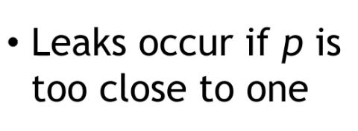
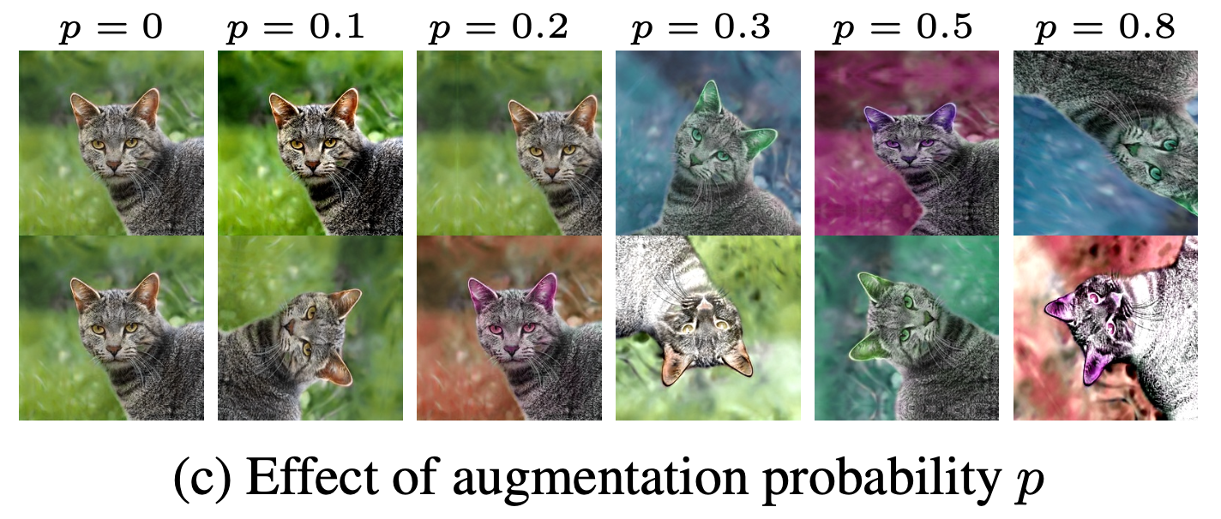
Solution # 2
Augmentation probability p defines how much distortion the augmented images will carry
ADA or Adaptive Data augmentation

Slide 12
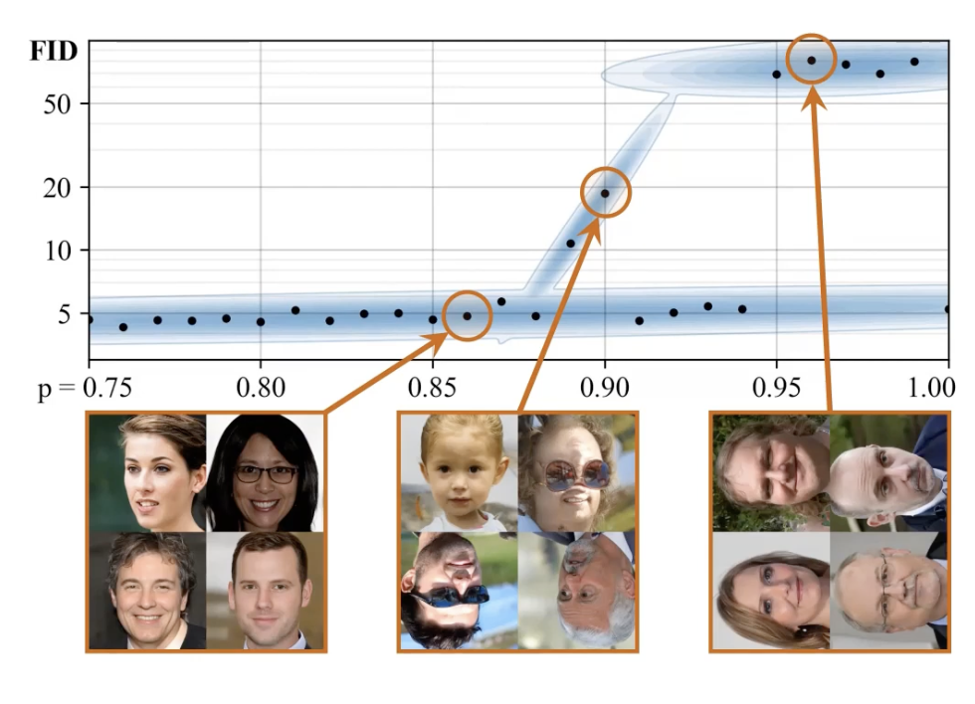

Solution # 2
Experiment
Individual trainings
Augmentation probability p
After repeated trials

Slide 13
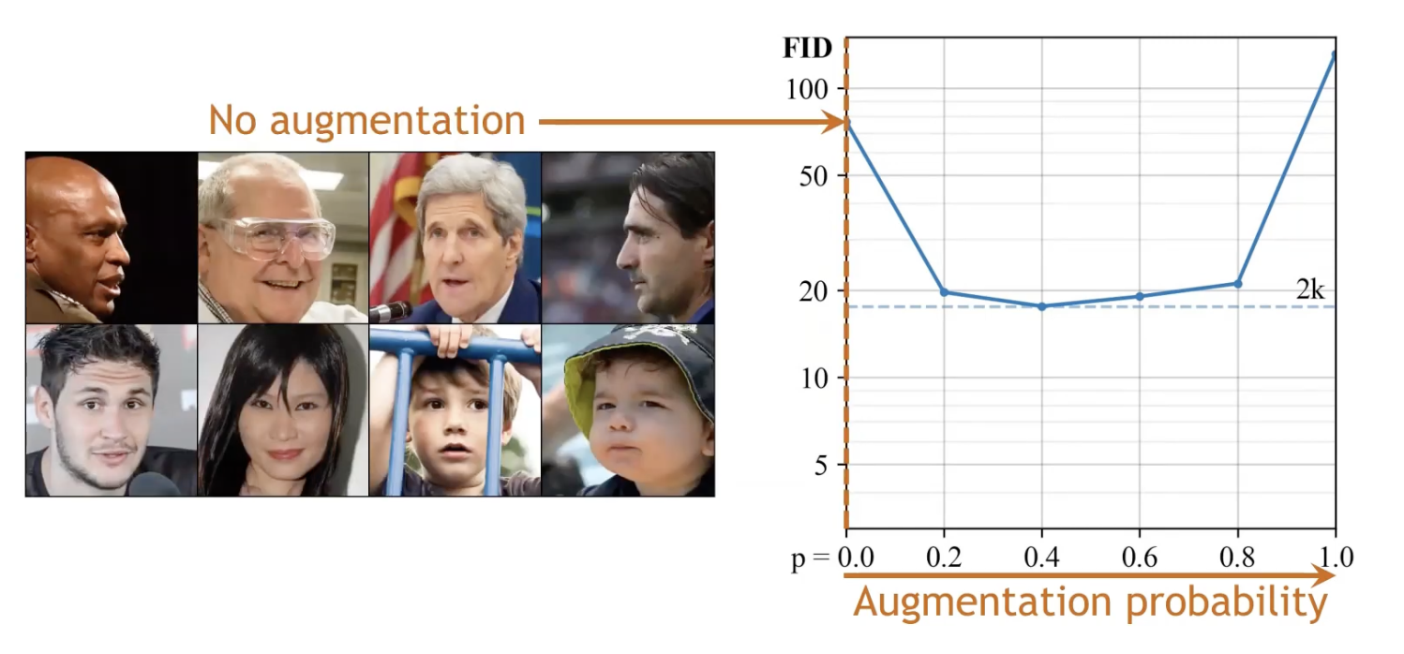
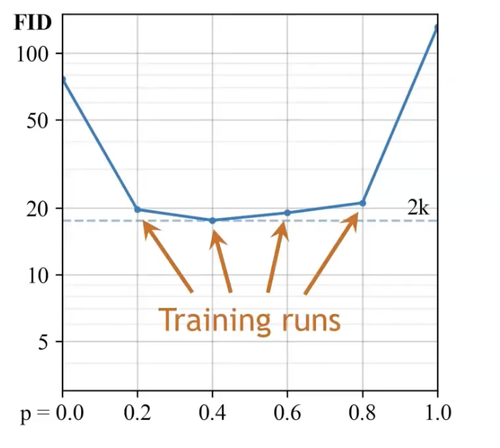
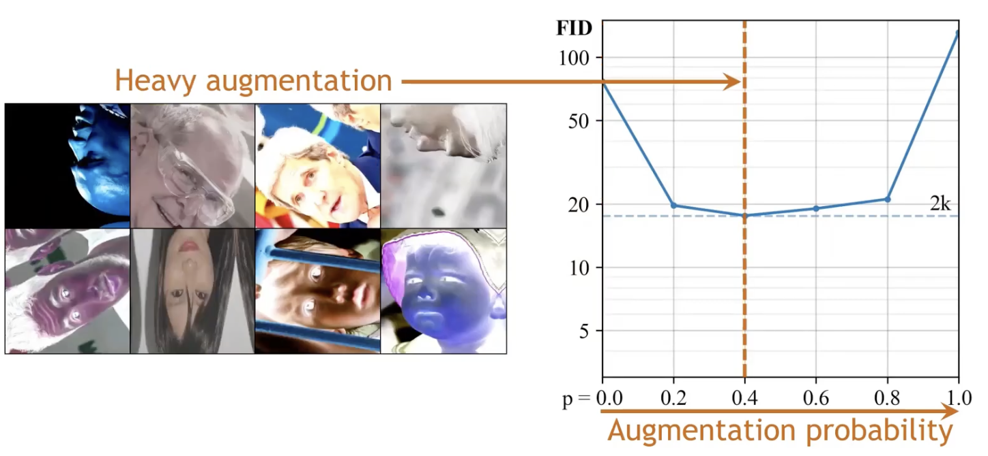
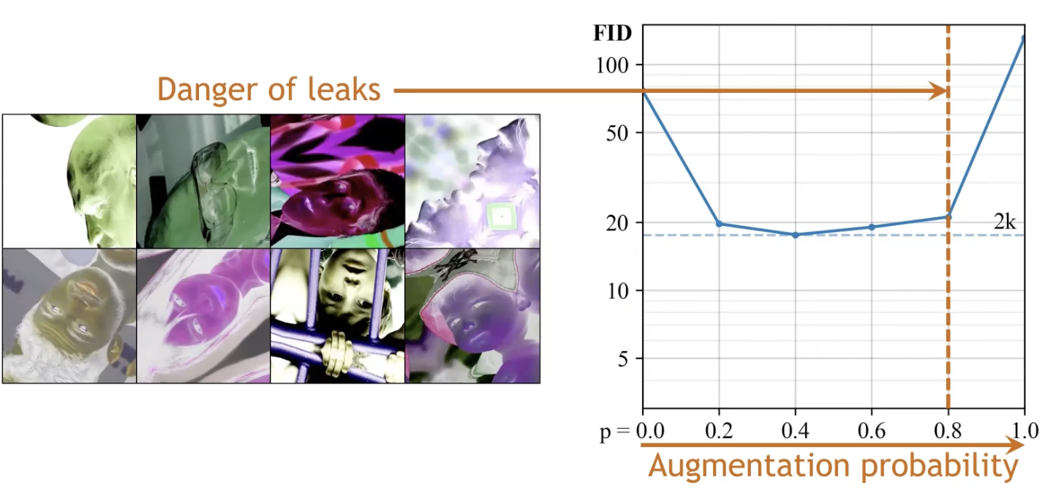
Solution # 2
To augment or not to augment??
Augmentation probability p

Slide 14
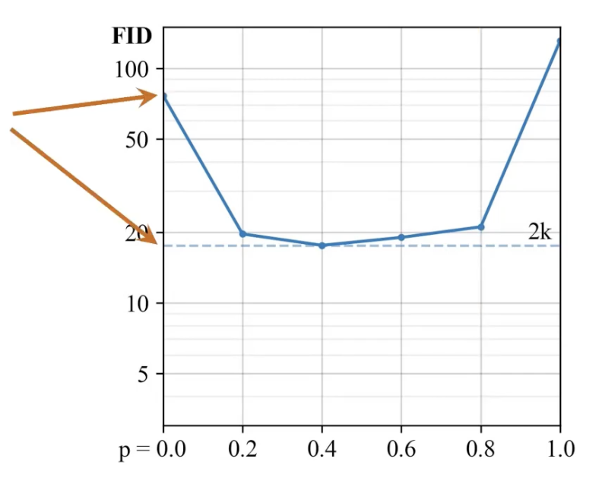
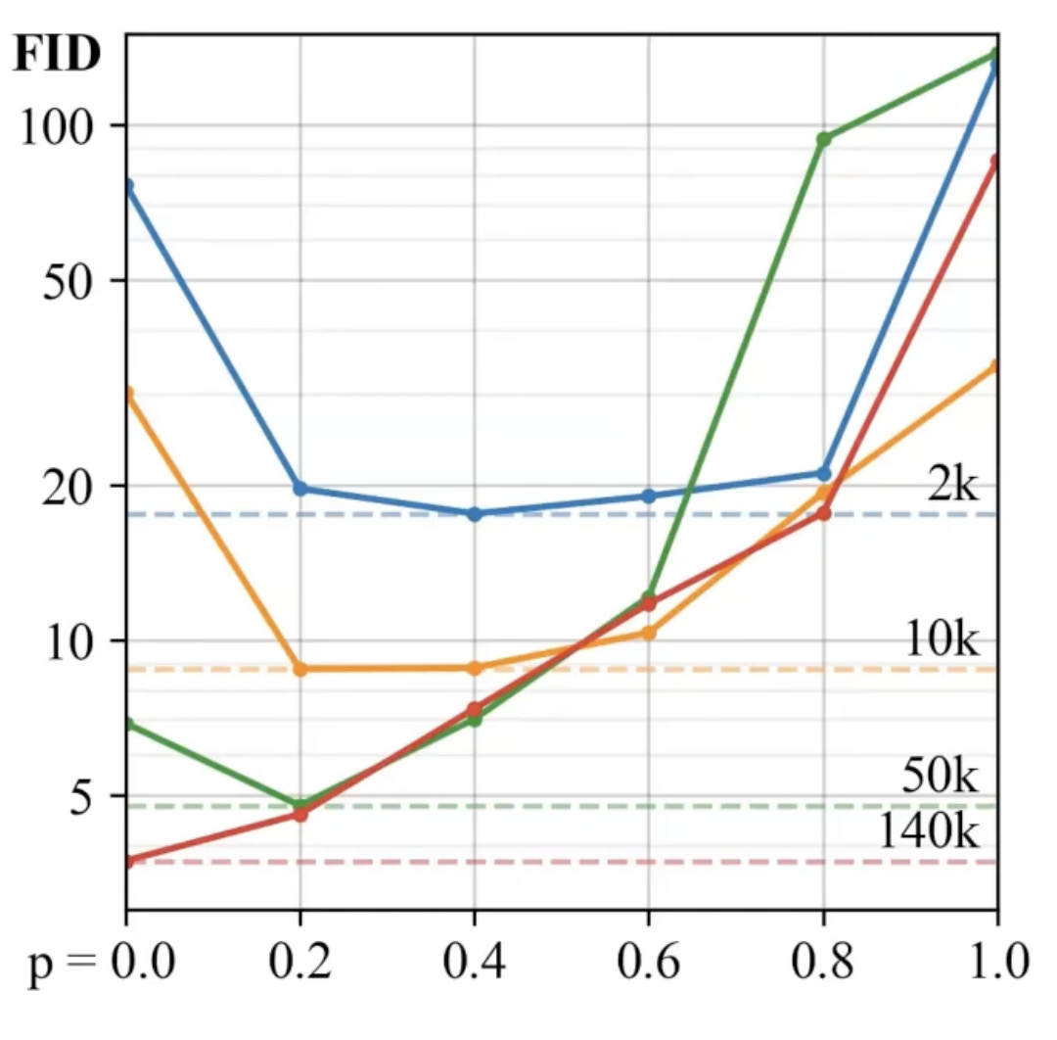
Solution # 2
To augment or not to augment??
4x improvement
Optimal p varies across dataset size
Grid search?

Slide 15
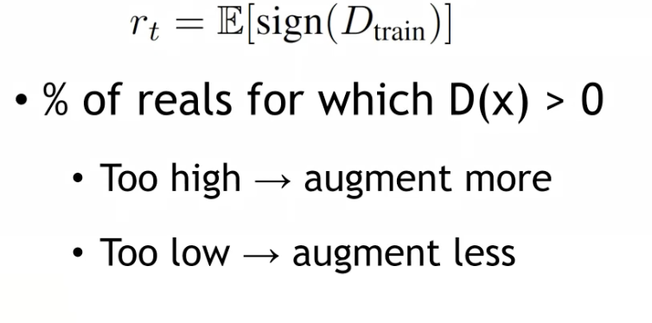
Solution # 2
To augment or not to augment??
Grid Search??
Or adaptive??
Keep track of 2 things:

Slide 16
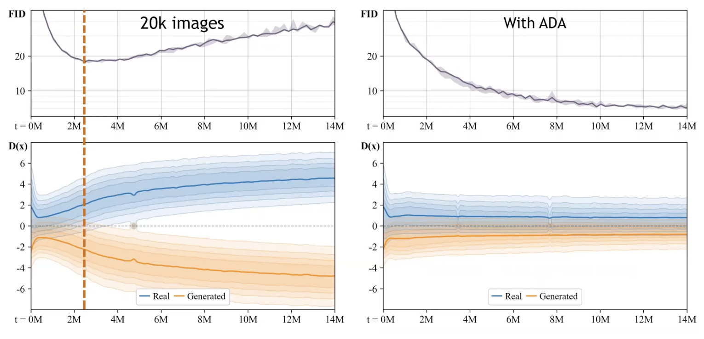
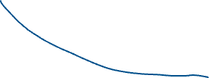
Solution # 2
Keep track of 2 things:
To augment or not to augment??
Grid Search??
Or adaptive??

Slide 17
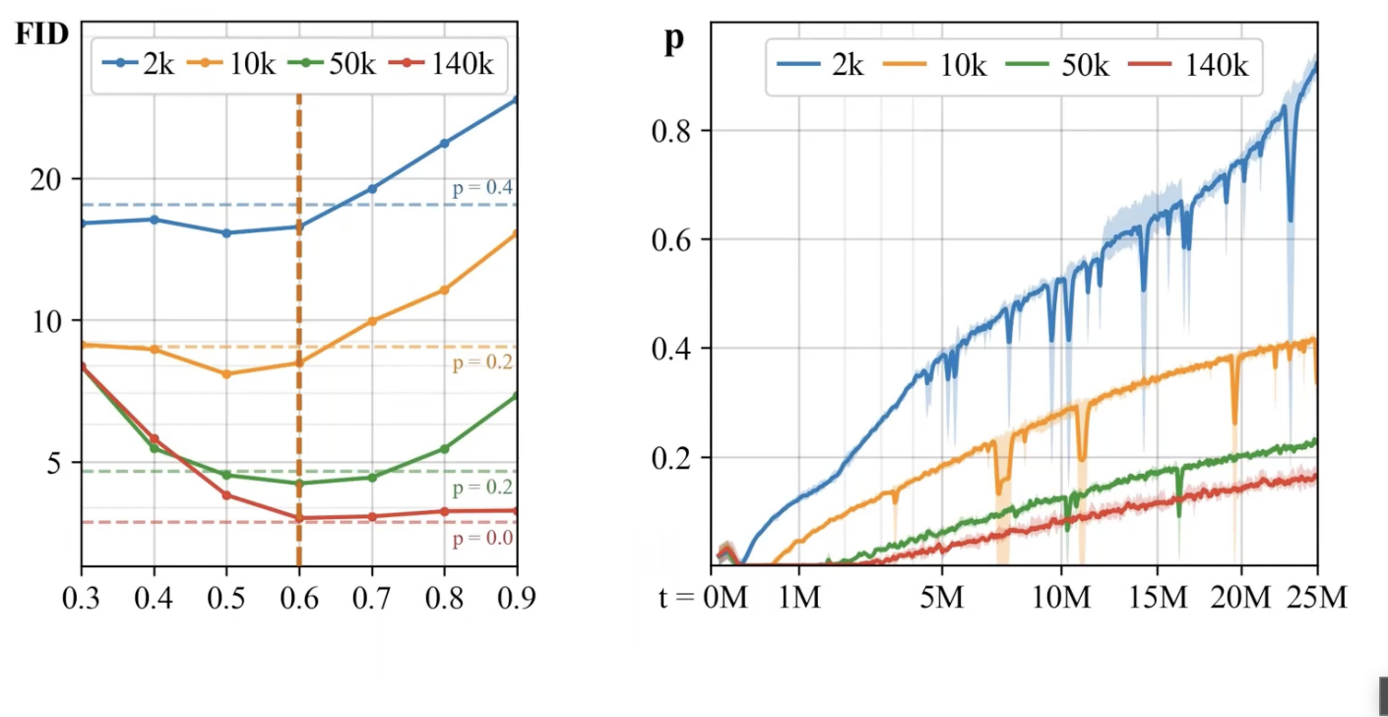
Solution # 2
Keep track of 2 things:
To augment or not to augment??
Grid Search??
Or adaptive??
p
Training progress

Slide 18
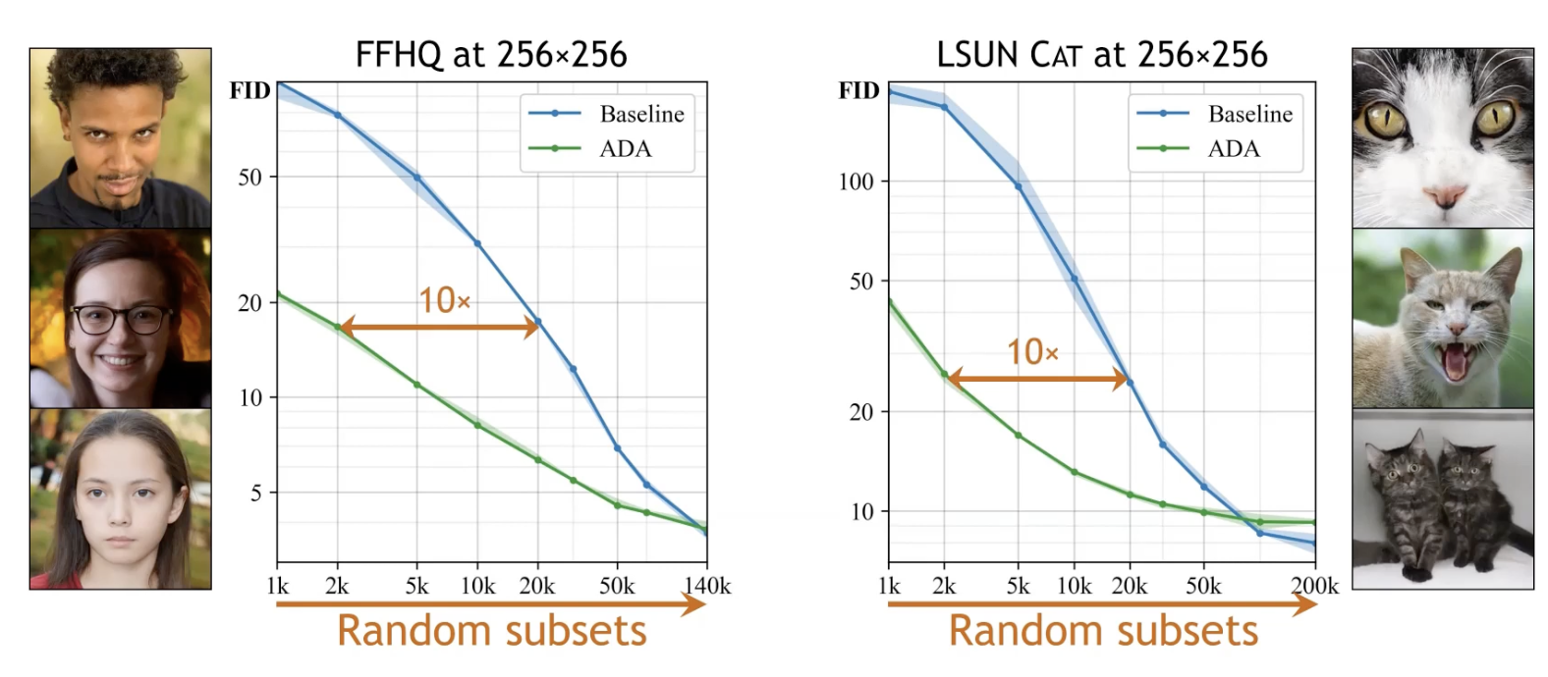
Solution # 2
ADA performance

Slide 19
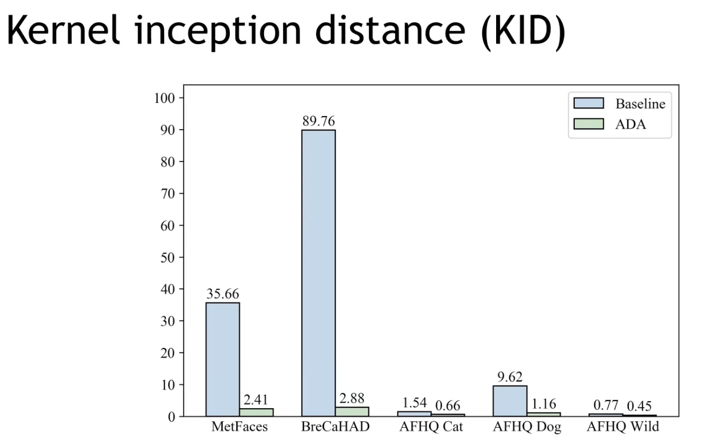
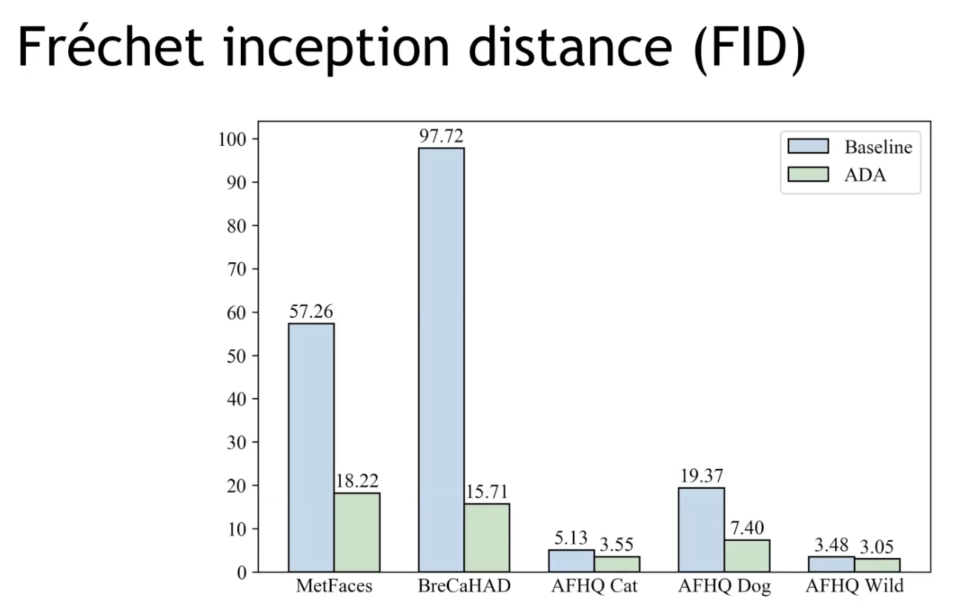
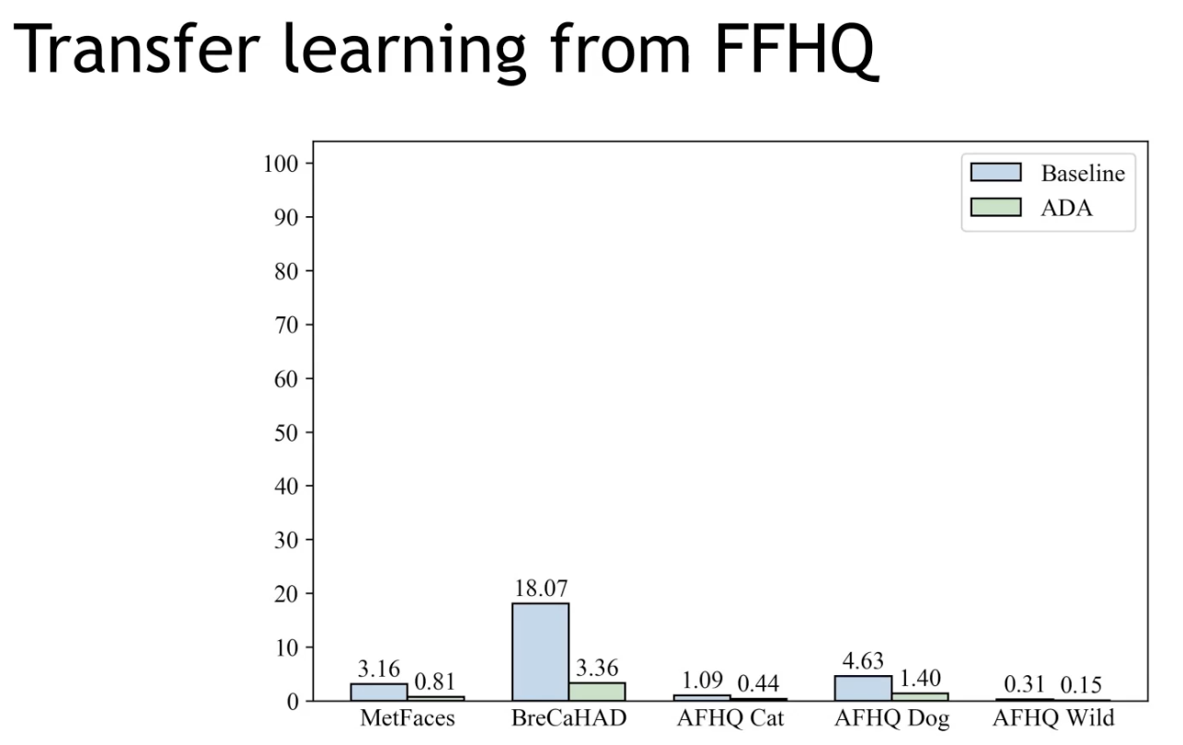
Solution # 2
ADA performance

Slide 20
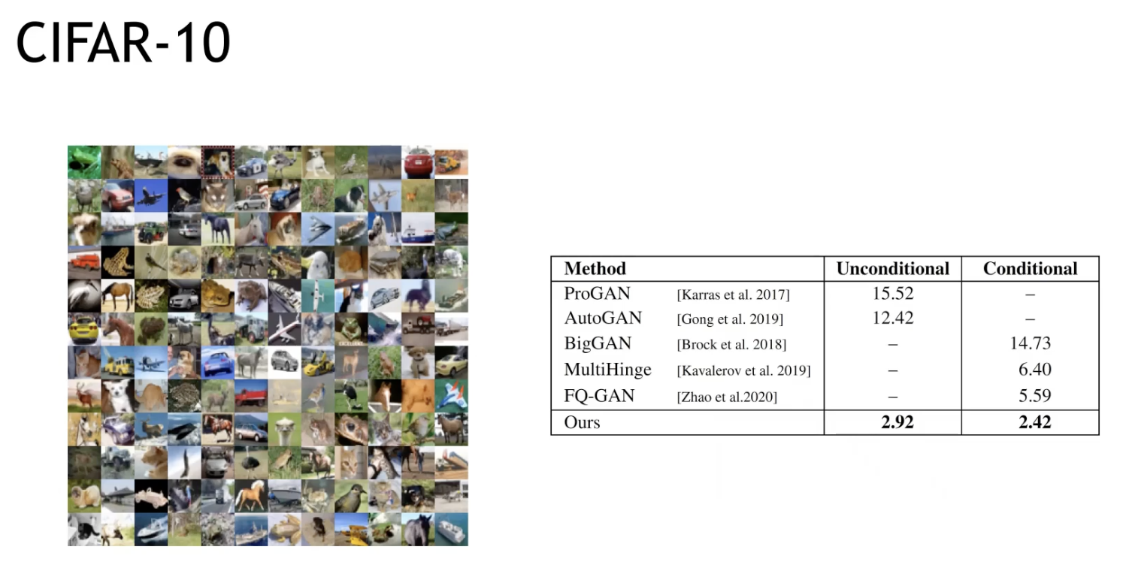
Solution # 2
ADA performance

