Slide 1
﻿CountERfactual Explainable Recommendation
﻿ACM International Conference on Information and Knowledge Management (CIKM ’21)

Slide 2
Counterfactual Explanation

Slide 3
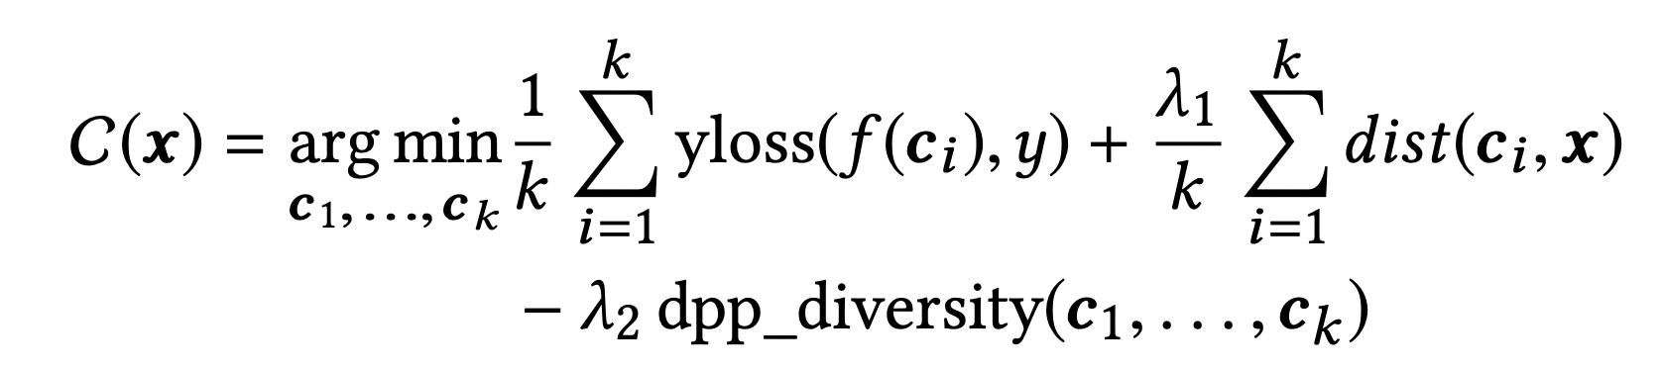
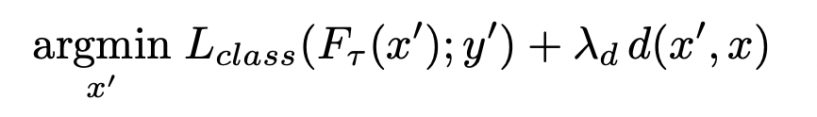
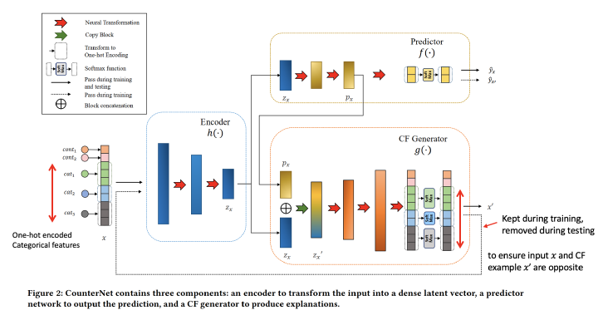
So far…
DiCE
Adversarial Counterfactual Visual Explanations
CounterNet

Slide 4
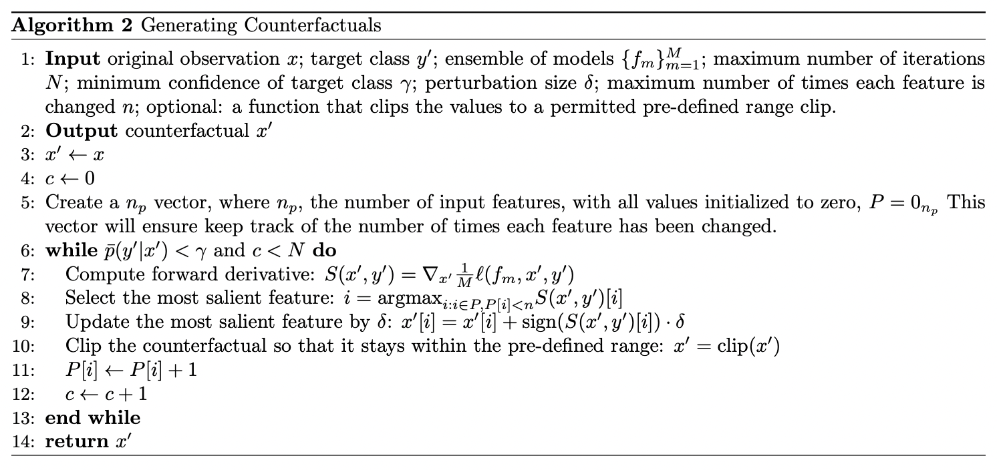
So far…
Generating Interpretable Counterfactual Explanations By Implicit Minimisation of Epistemic and Aleatoric Uncertainties

Slide 5
What’s new today?
CountER
Existing counterfactual techniques are not model agnostic
They do not consider the explanation complexity
Most models identify one feature and change the predicted class using that
They do not consider explanation strength
Their evaluation of the CFs are not profound

Slide 6
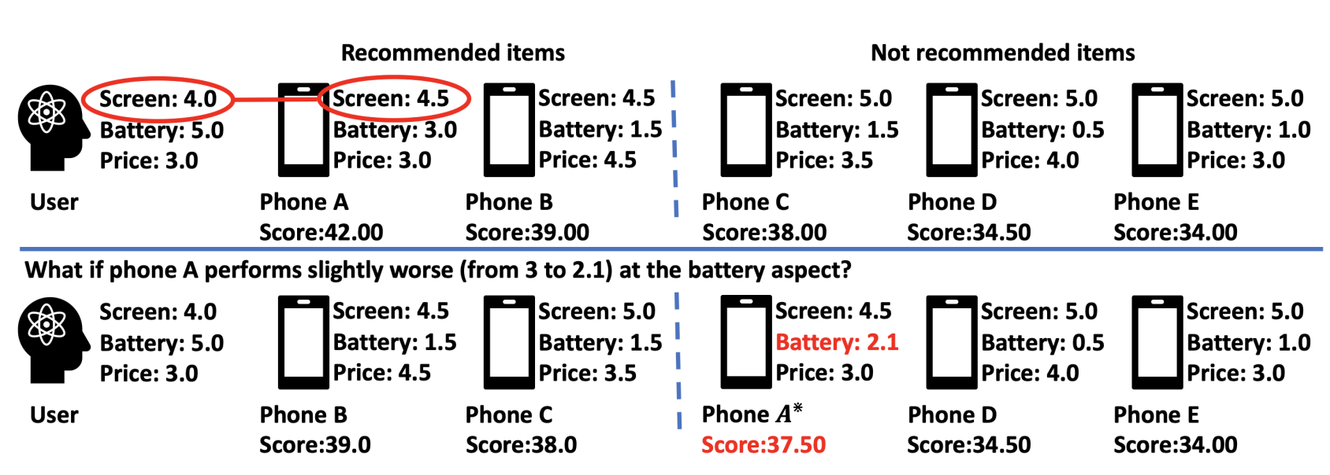
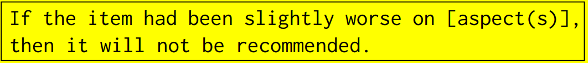
Overview of Counter
Others
Intervention
CountER
Solely explanation

Slide 7



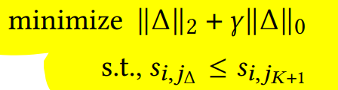
Overview of CountER
Complexity
Strength

Slide 8
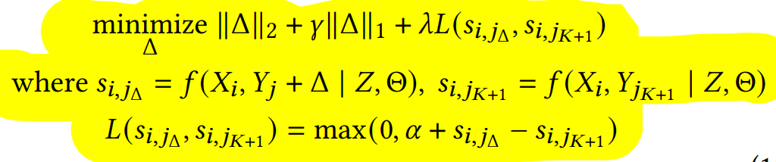
Relaxing the optimization

Slide 9
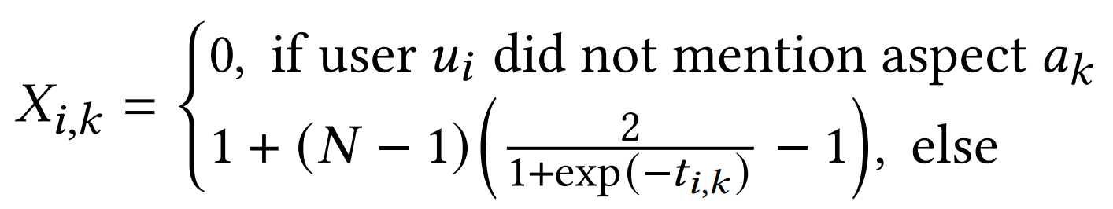
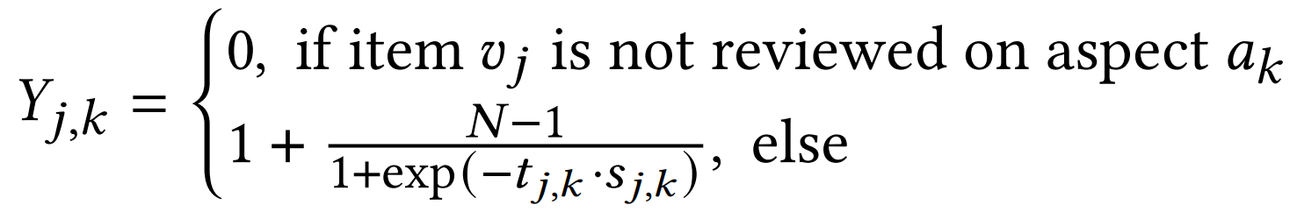

Model to predict the score
﻿𝑁 is the rating scale (5 stars)
﻿𝑡_{𝑖,𝑘} is the frequency that user 𝑢_{𝑖} mentioned aspect 𝑎_{𝑘}
﻿𝑡_{𝑗,𝑘} is the frequency that item 𝑣_{𝑗} is mentioned on aspect 𝑎_{𝑘}
﻿ 𝑠_{𝑗,𝑘} is the average sentiment of these mentions
﻿User-aspect preference matrix
﻿item-aspect quality matrix

Slide 10
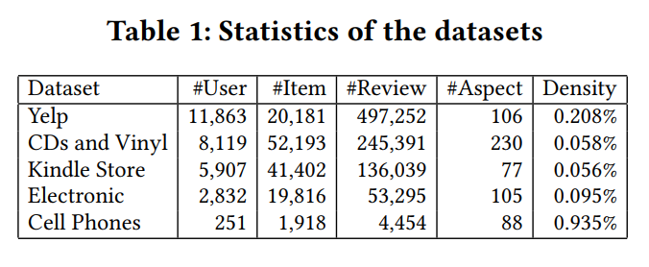
Datasets
Yelp
﻿contains users’ reviews on various kinds of businesses such as restaurants, dentists, salons
﻿Amazon dataset
﻿contains user reviews on products in Amazon e-commerce system
﻿contains 29 sub-datasets corresponding to 29 product categories
﻿Electronic, Cell Phones and Accessories, Kindle Store and CDs and Vinyl

Slide 11
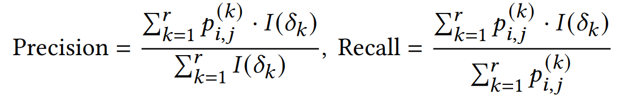
Evaluation
﻿User-oriented evaluation
F1 score

Slide 12
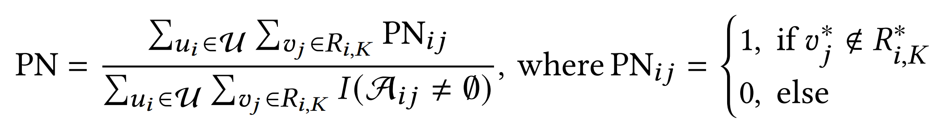
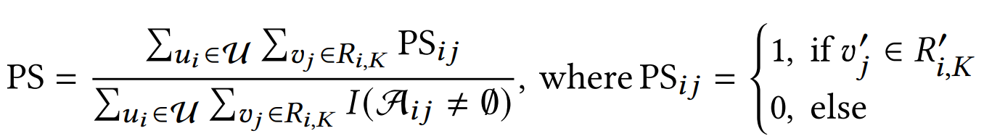
Evaluation
Model oriented evaluation
﻿Probability of Necessity (PN): To what extent, a condition is necessary?
﻿if in a counterfactual world, the aspects in A_{𝑖 𝑗} did not exist in the system, then what is the probability that item 𝑣_{𝑗} would not be recommended for user 𝑢_{𝑖}?
﻿Probability of Sufficiency (PS): To what extent a condition is sufficient?
﻿if in a counterfactual world, the aspects in A_{𝑖 𝑗} were the only aspects existed in the system, then what is the probability that item 𝑣_{𝑗} would still be recommended for user 𝑢_{𝑖}.

Slide 13
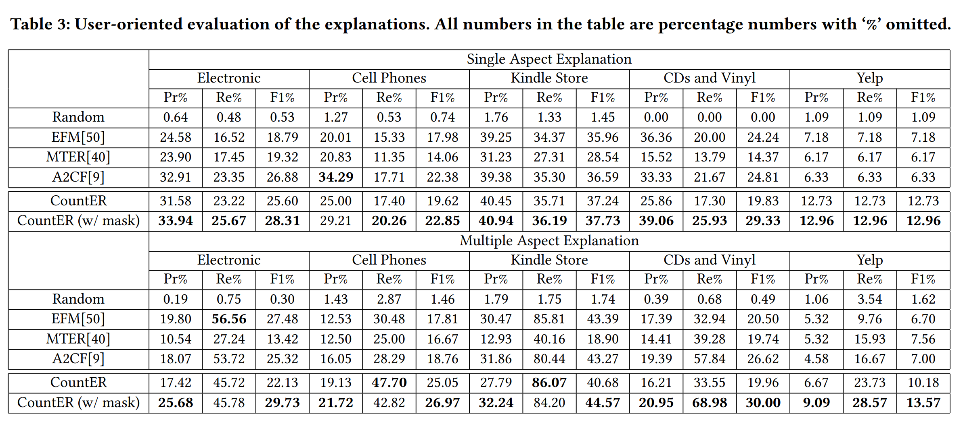
Evaluation

Slide 14
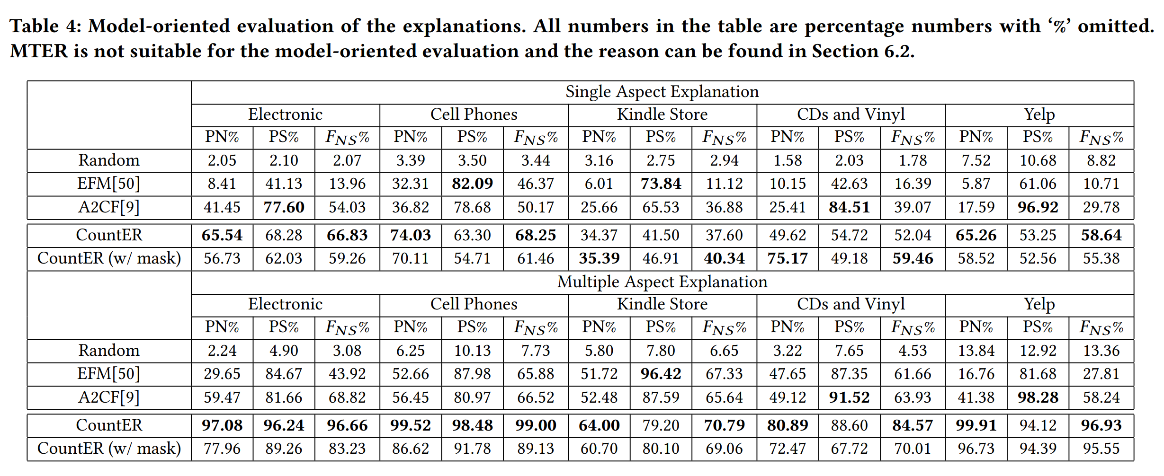
Evaluation

Slide 15
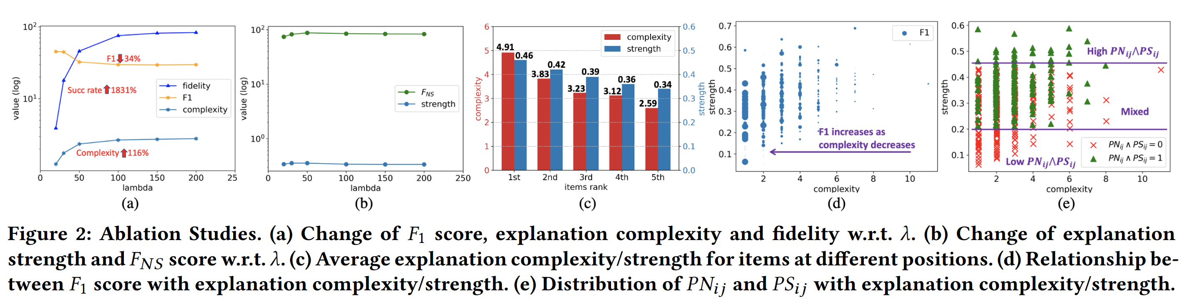
Evaluation

