Slide 1
﻿Domain Knowledge Aided Explainable Artificial Intelligence for Intrusion Detection and Response
AAAI-2020

Slide 2
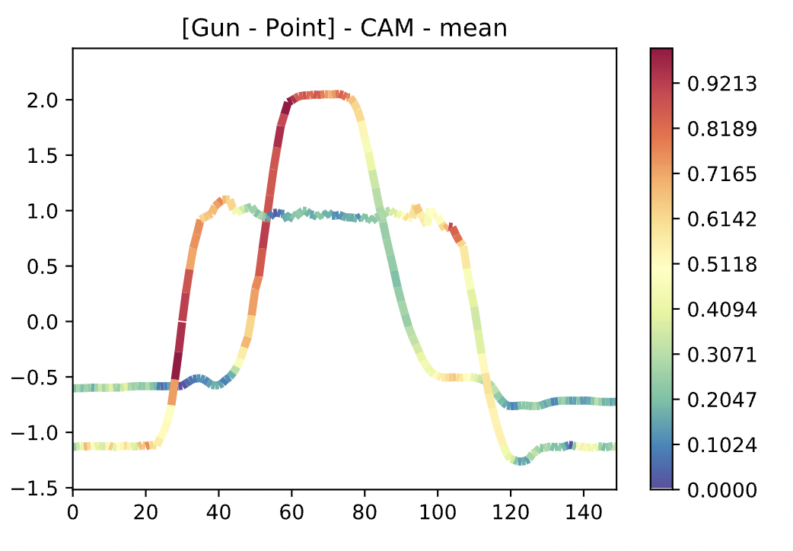
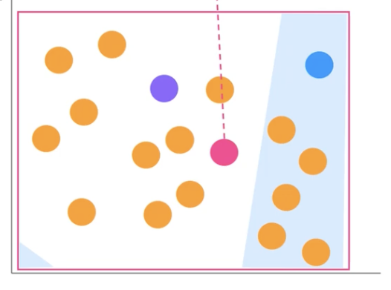
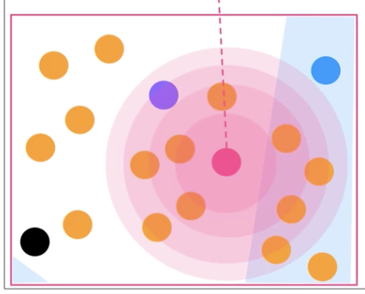
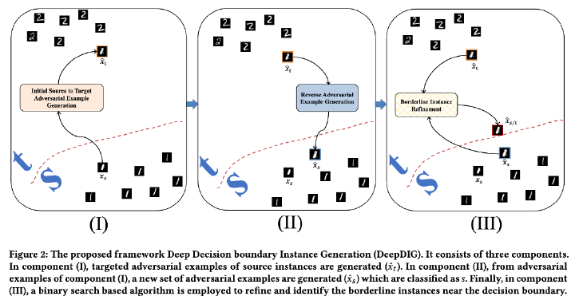
Endeavors in Explainable AI
Grad-CAM
Characterizing decision boundaries
LIME

Slide 3
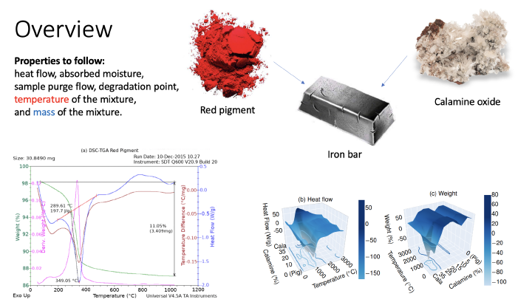
Endeavors in Domain knowledge-based AI
Incorporating domain knowledge from material science

Slide 4
Overview
Incorporates domain knowledge in a way that helps explainability
Mostly focused on preprocessing the data for better explainability
Used data from intrusion detection (Task: given the features of an attack, predict if its malignant or benign)
Claims: domain knowledge inclusion increases performance and explainability

Slide 5
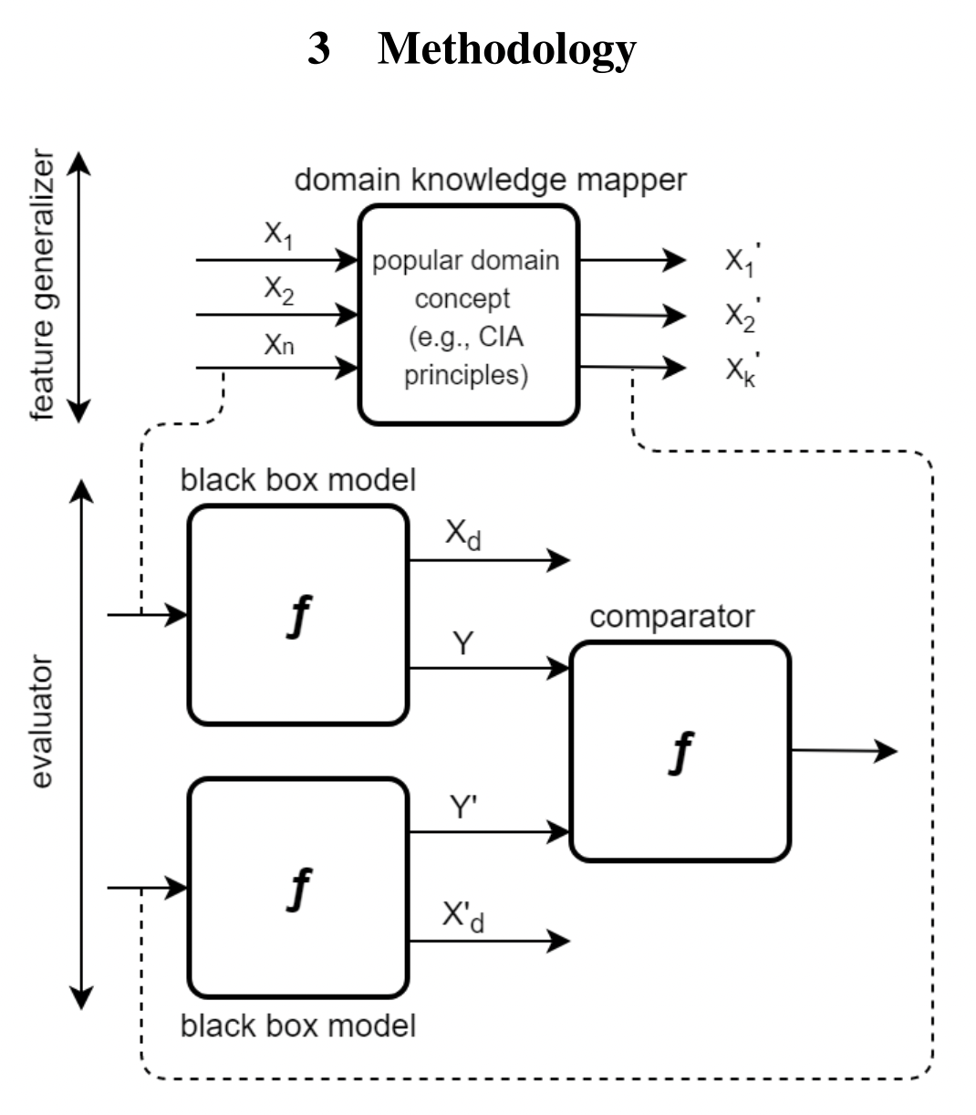
Technique

Slide 6
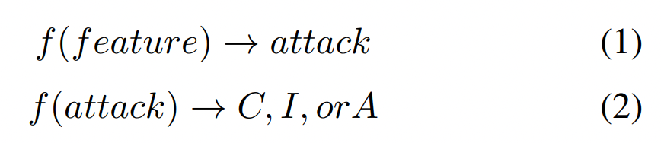
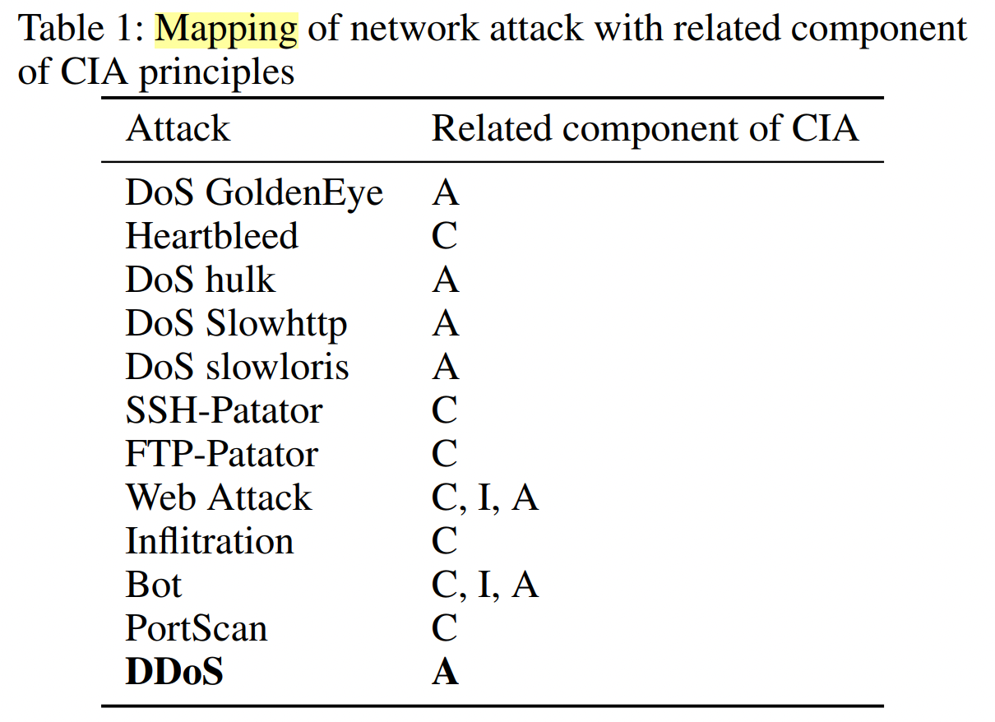
Domain knowledge mapper
What is being compromised?﻿
confidentiality, ﻿infiltration, availability

Slide 7
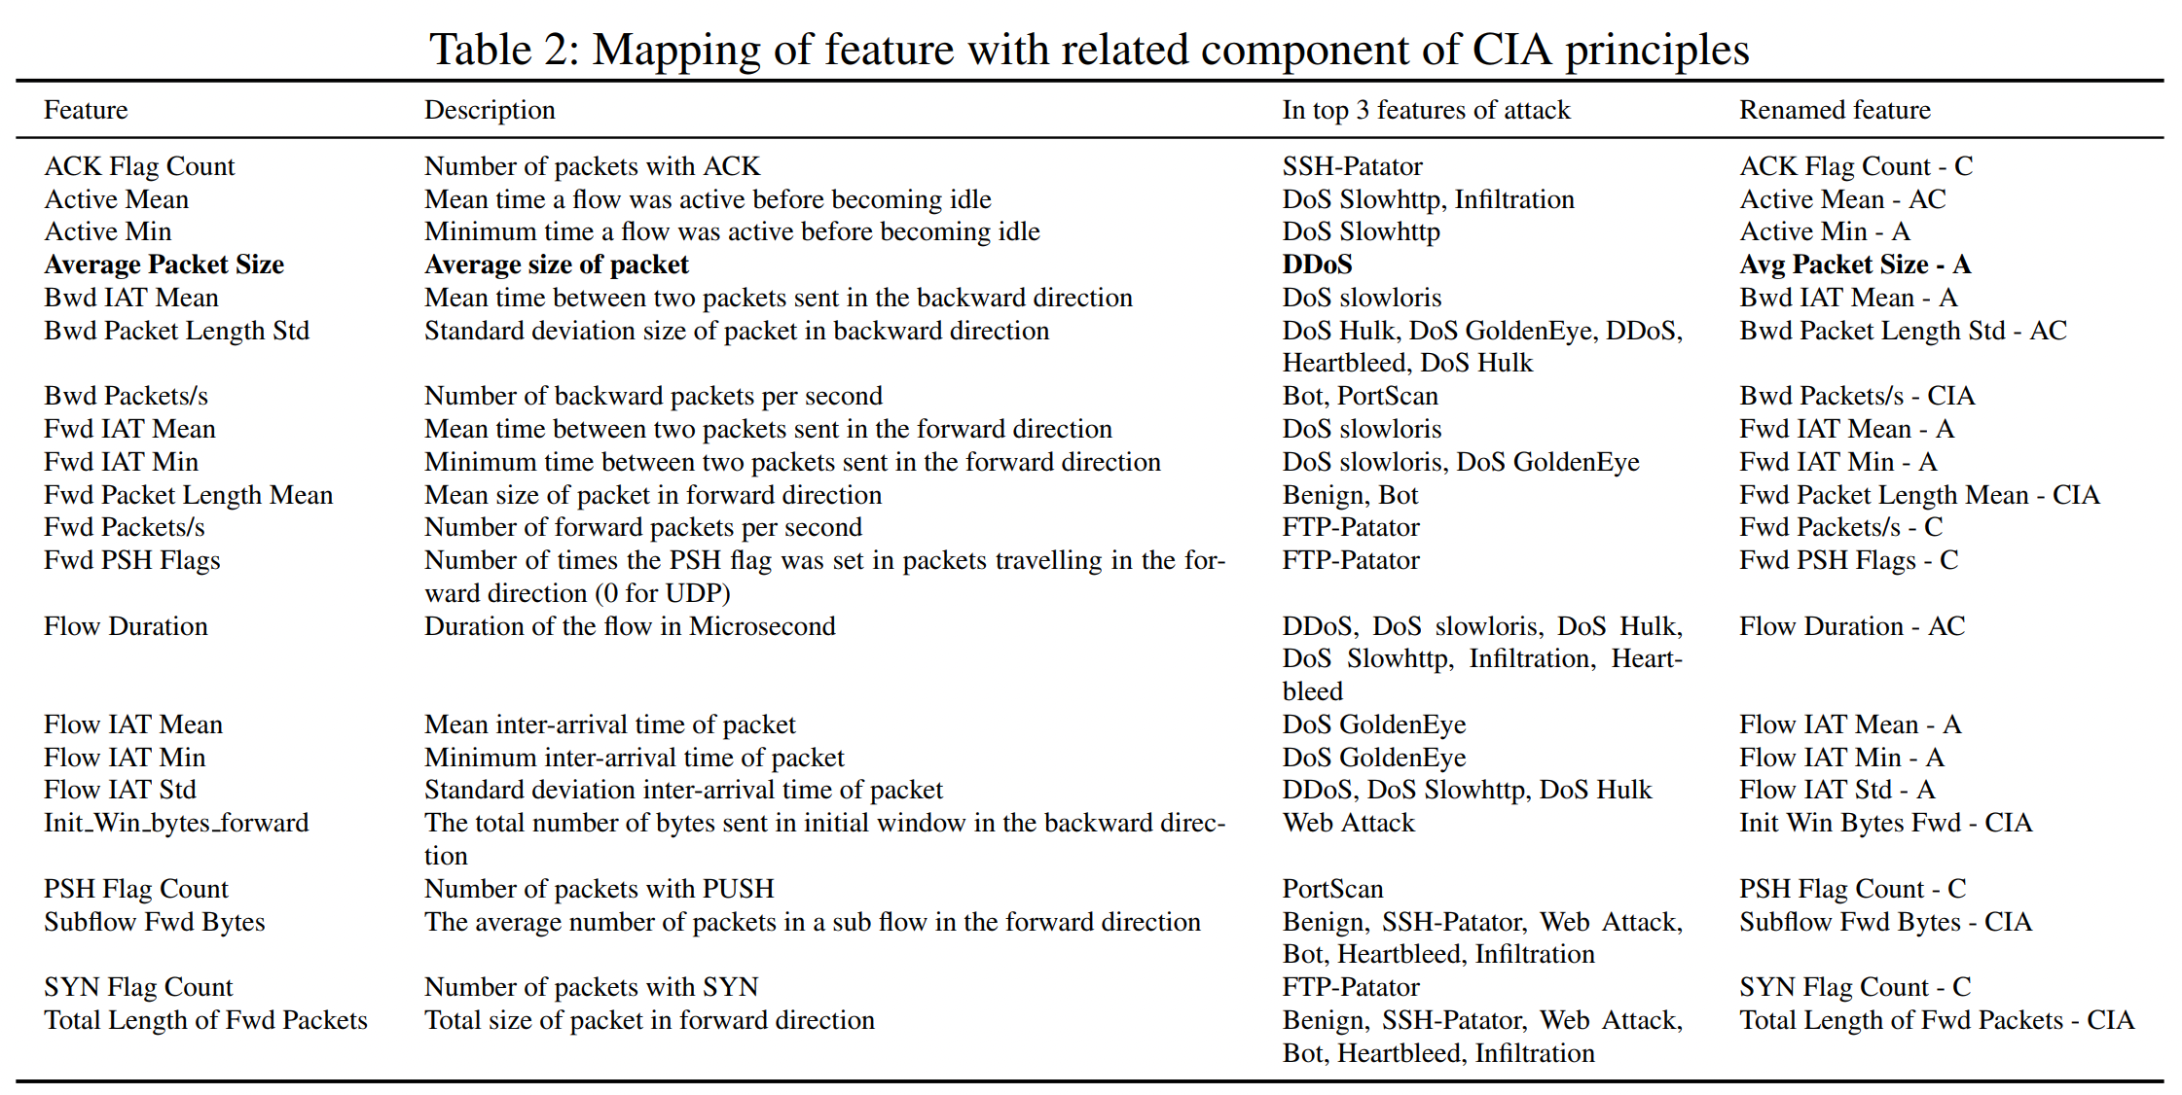
Domain knowledge mapper

Slide 8
Different inputs to the model
features | count
All features | 78
Selected features | 22
Domain knowledge infused features | 22
What is being compromised? (C,I,A) | 3
Best
Best
Domain knowledge
infused
selected

Slide 9
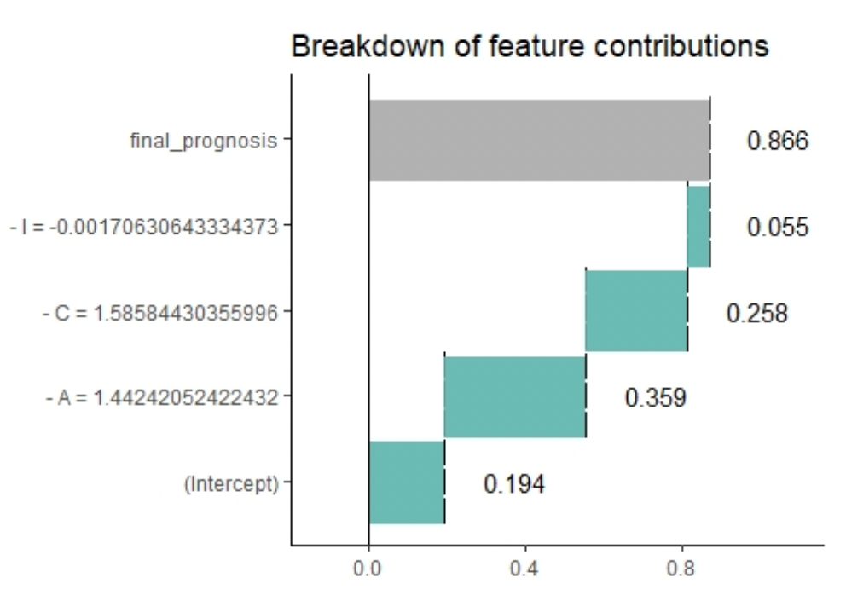
Different inputs to the model

Slide 10
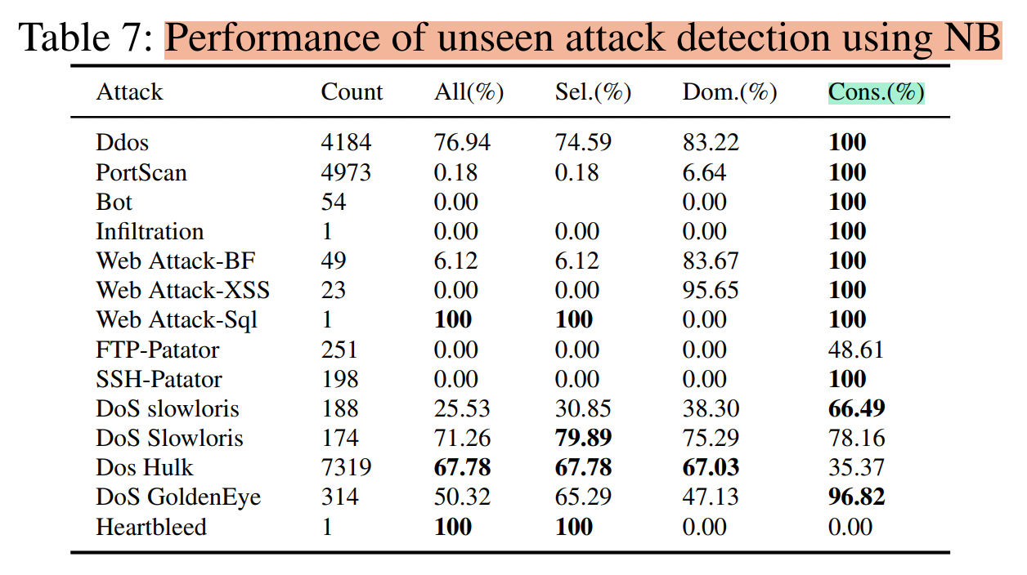
Different inputs to the model
NB – probability-based classification
– Highly explainable
C – 0.58
I – 0.23
A – 0.19

Slide 11
Implication in healthcare
In top 3 symptoms of disease
ICD codes
Treatment
What is the type of the disease? What treatment to follow? What ICD code contributing most to the disease?

