Slide 1
Grad-CAM for Interpreting DNN Model Decisions
Paper 1: Grad-CAM: Visual Explanations from Deep Networks via Gradient-based Localization
Paper 2: Explainable Deep Neural Networks for Multivariate Time Series Predictions (IJCAI 2019)

Slide 2
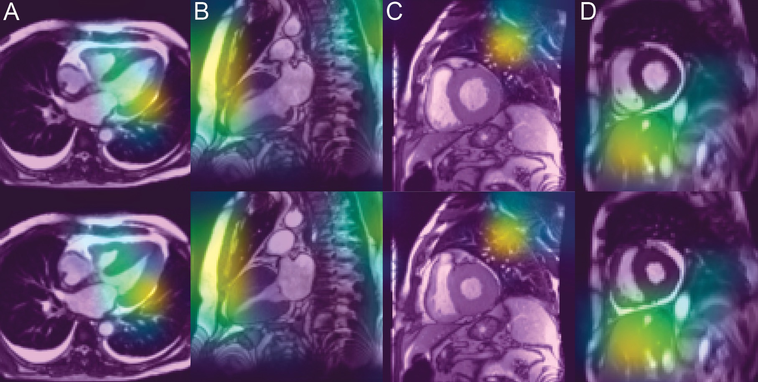
Grad-CAM
Gradient-weighted Class Activation Mapping (Grad-CAM)
Identifies regions that contribute most to decision making

Slide 3
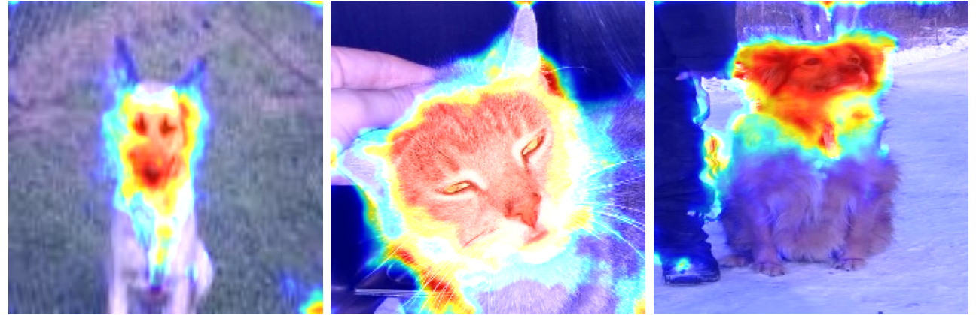
Grad-CAM
For cats and dogs

Slide 4
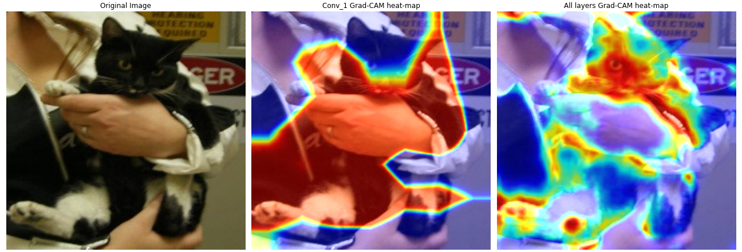
Grad-CAM
For cats and dogs

Slide 5
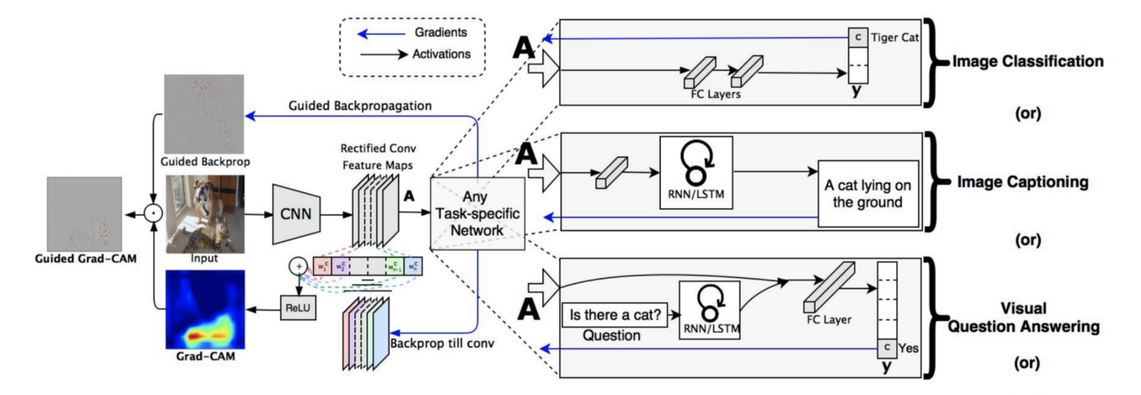
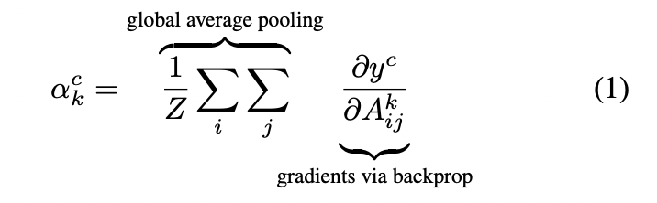
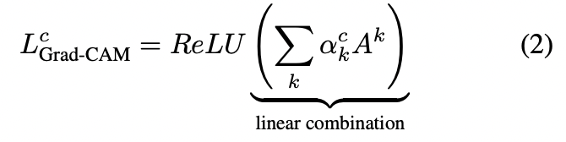
Grad-CAM (working principle)

Slide 6
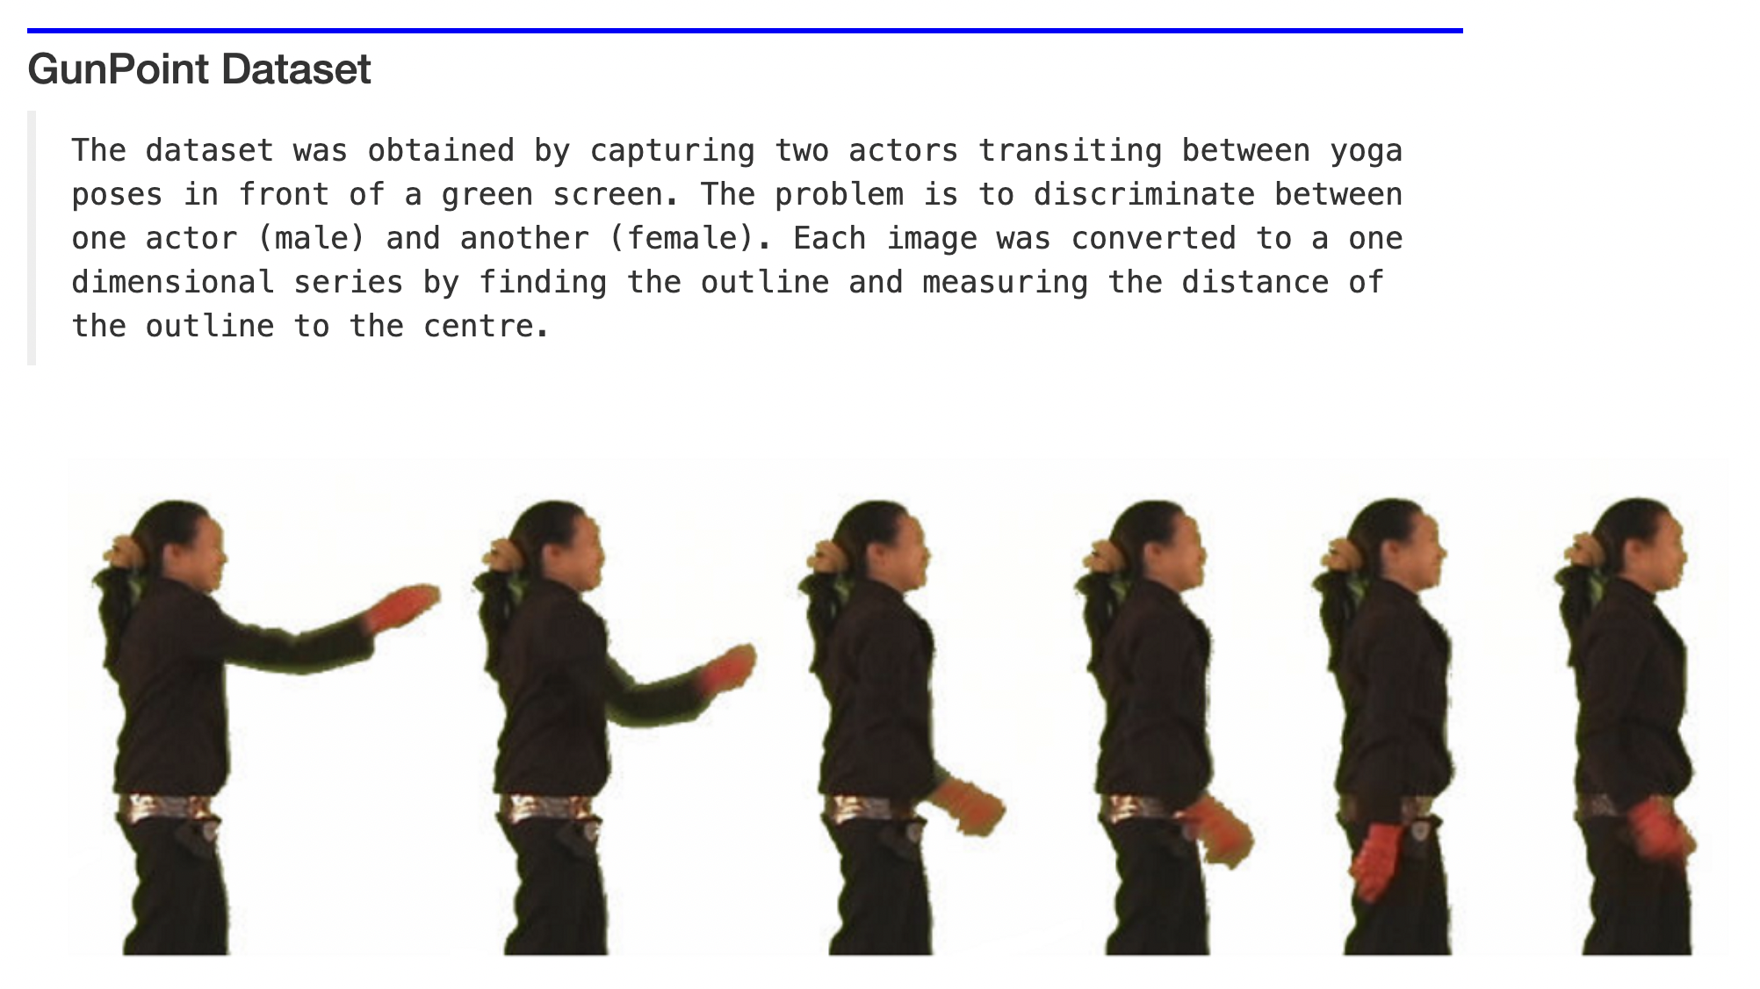
Grad-CAM for univariate time series

Slide 7
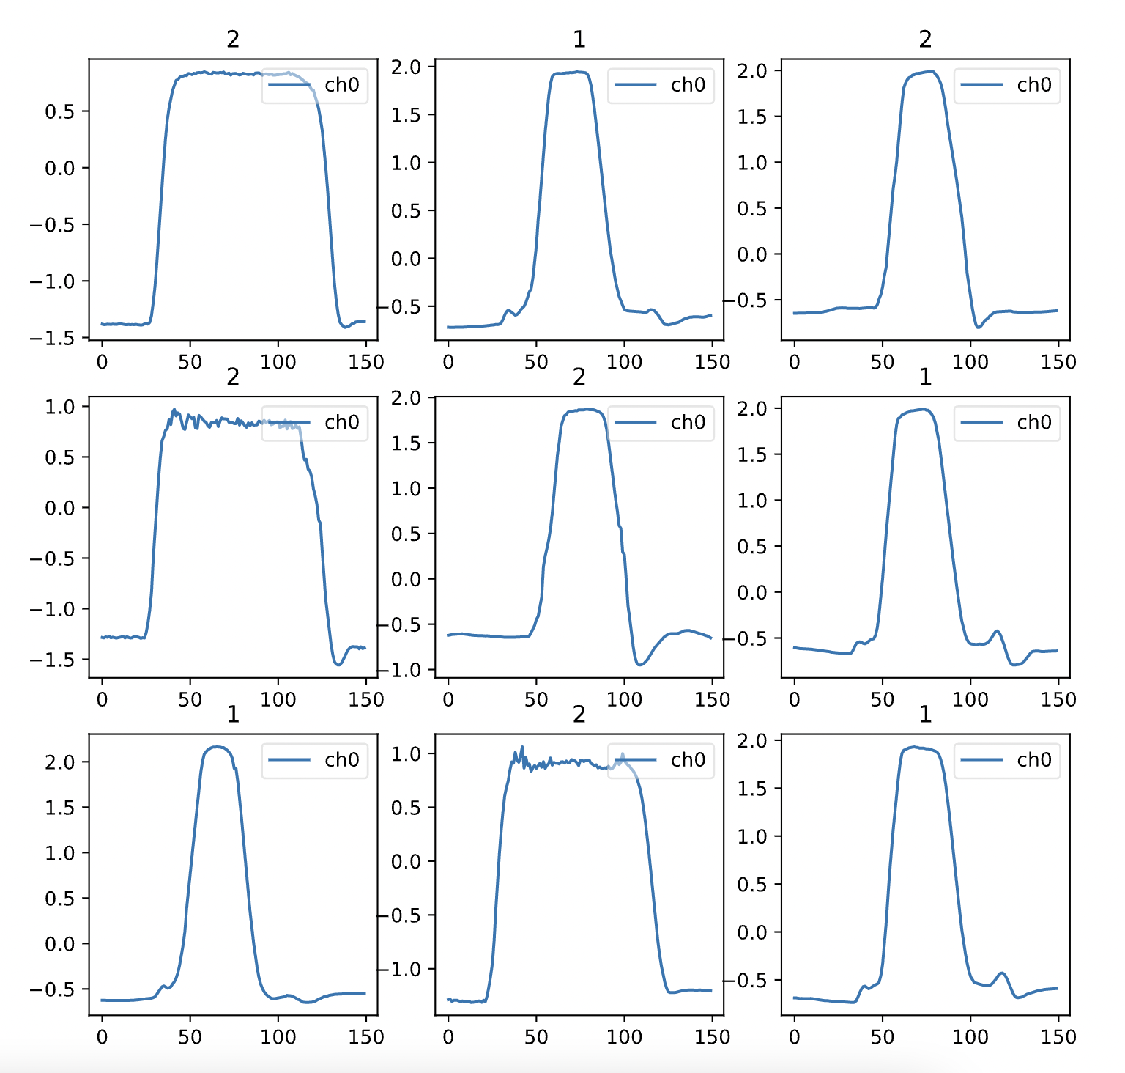
Grad-CAM for univariate time series

Slide 8
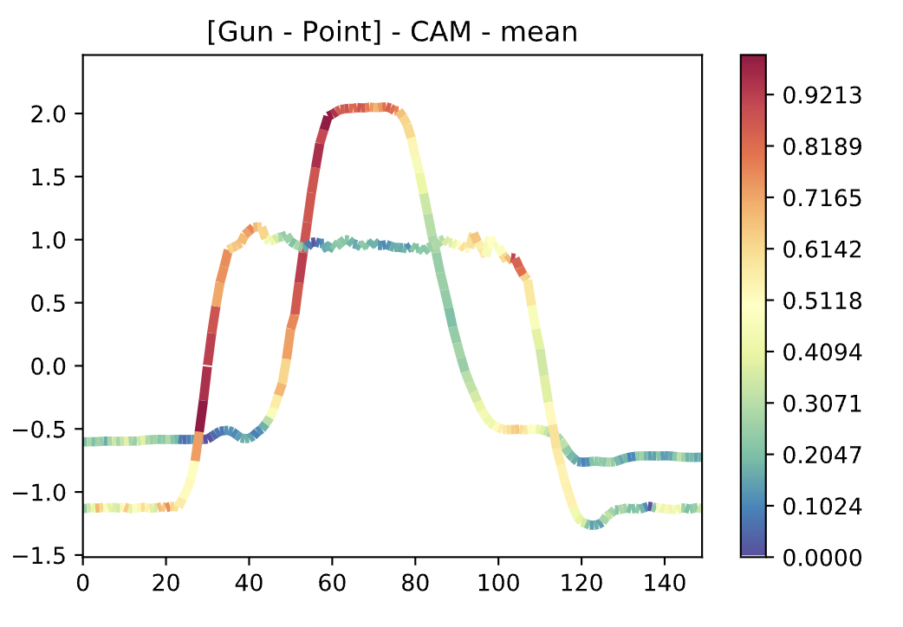
Grad-CAM for univariate time series

Slide 9
Grad-CAM for multivariate time series
Class
0

Slide 10
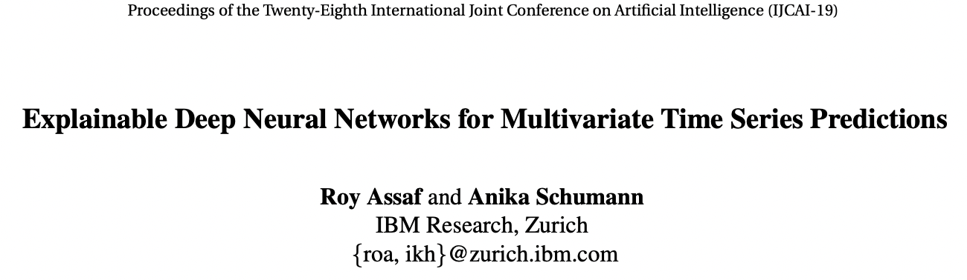
Grad-CAM for multivariate time series
Task:
1. Predicting power generation from solar panel plants
6 classes, 0-50, 50-100, 100-150, 150-200, 200-250, and 250-300
CNN network
Customized the kernel size to capture important features and important timeframes

Slide 11
Grad-CAM for multivariate time series
Task:
1. Predicting power generation from solar panel plants
6 classes, 0-50, 50-100, 100-150, 150-200, 200-250, and 250-300
CNN network
Customized the kernel size to capture important features and important timeframes

Slide 12
Grad-CAM for multivariate time series
Task:
1. Predicting power generation from solar panel plants
6 classes, 0-50, 50-100, 100-150, 150-200, 200-250, and 250-300
CNN network
Customized the kernel size to capture important features and important timeframes

Slide 13
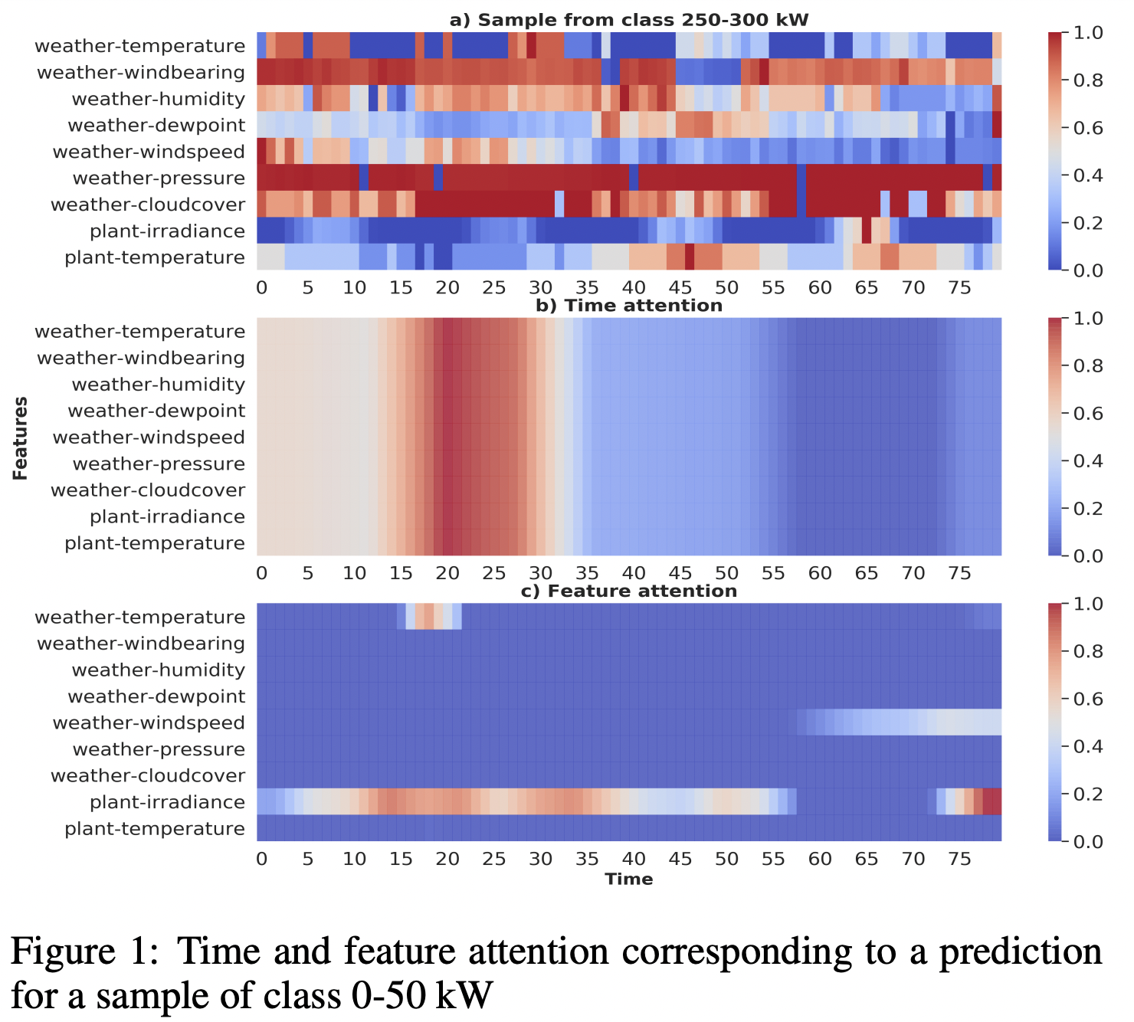
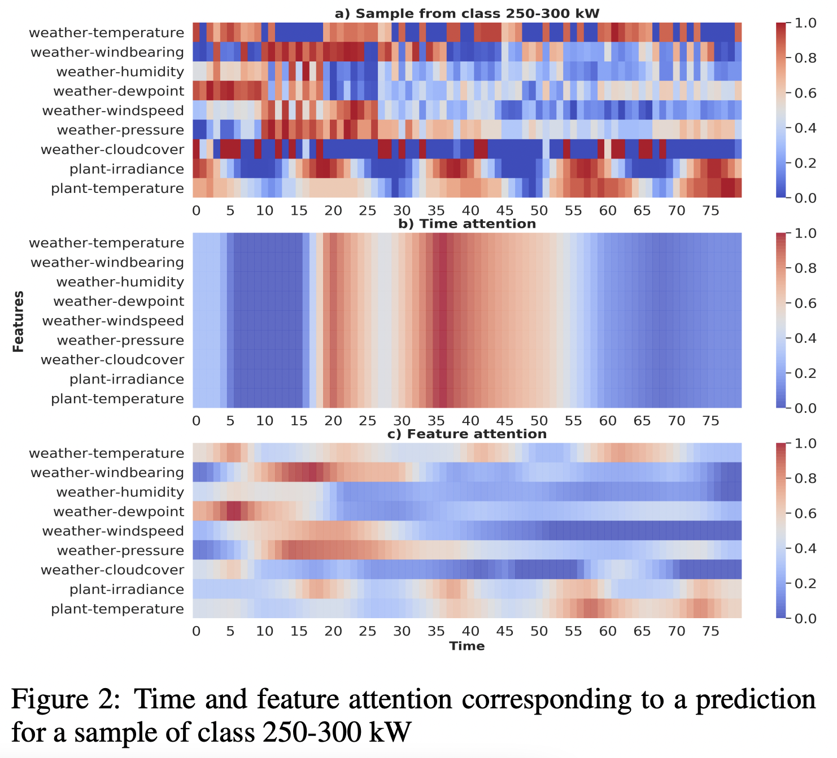
Grad-CAM for multivariate time series

