Slide 1
Explainable AI

Slide 2
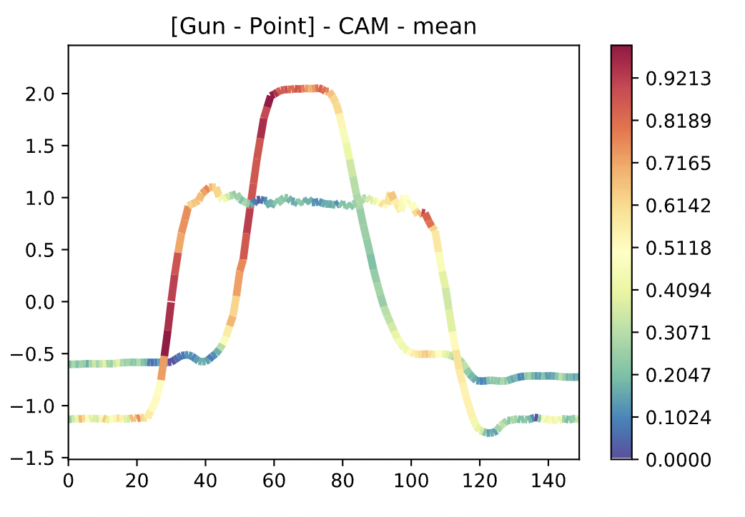
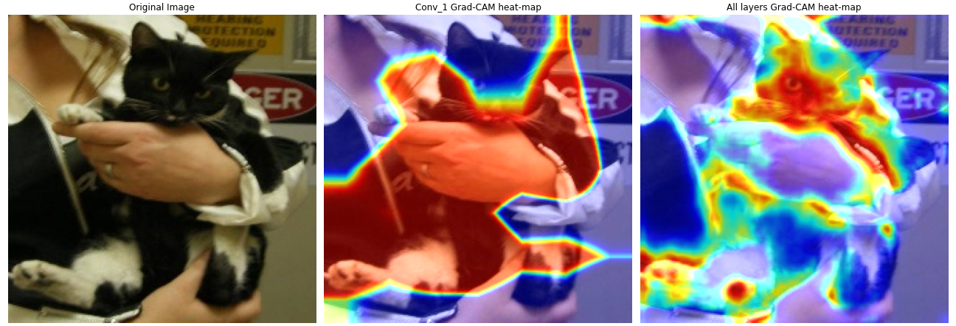
Grad-CAM (2016)
Grad-CAM for univariate timeseries
Grad-CAM for image data

Slide 3
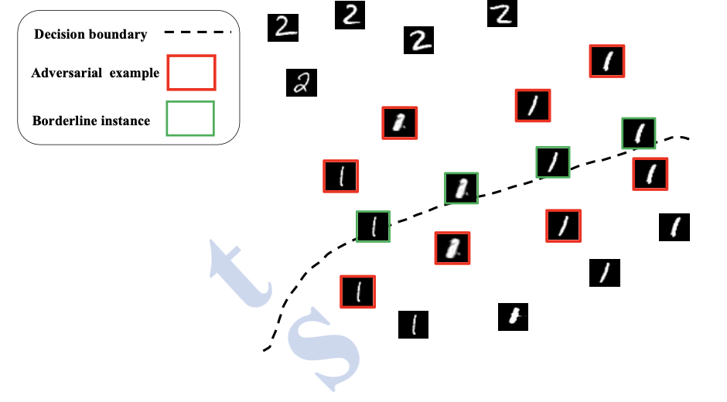
Characterizing decision boundaries in HD (2019)
Visualizing decision boundaries in HD is not possible
Thus, characterizing the decision boundary in HD could be an option

Slide 4
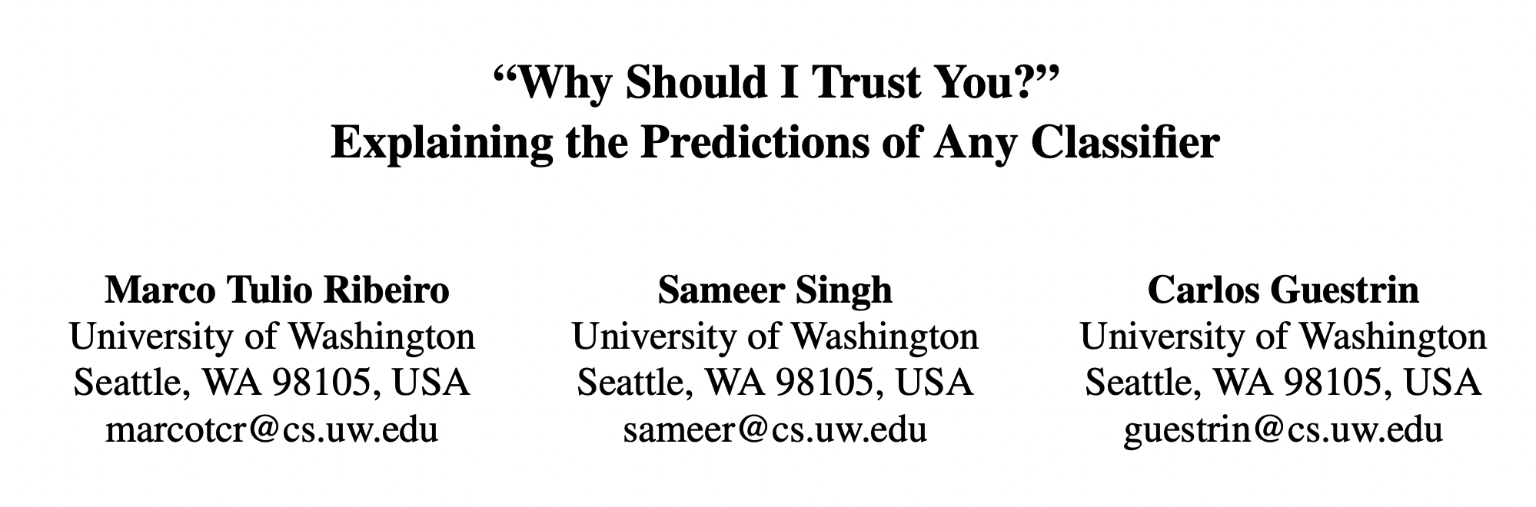
LIME (2016)
Local Interpretable Model-Agnostic Explanations
External tool for explaining any model
Works with tabular, image, text, graph data
Requires very high-level domain knowledge to validate the trustworthiness of models
If LIME tells ‘sports increases the risk of stroke’, there must be something wrong with the model
Explanations increases the acceptance of a predictive model
Published in: 22nd ACM SIGKDD
Cited 8,345 times

Slide 5
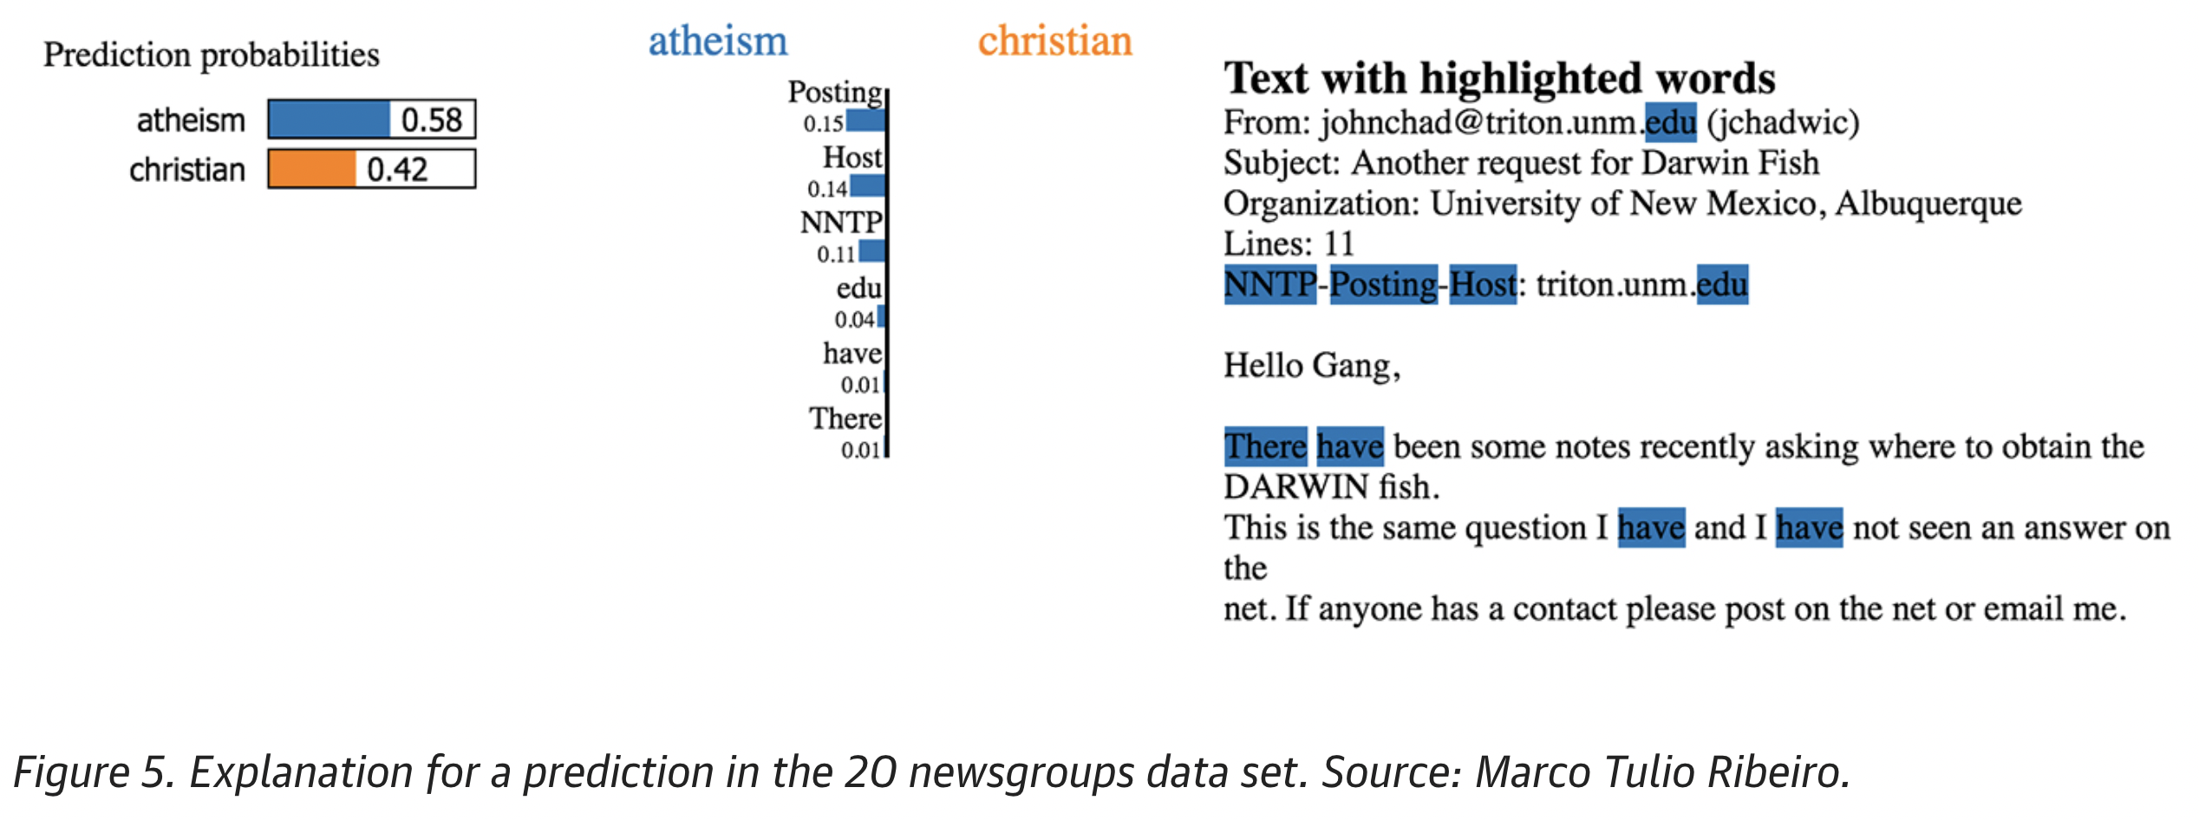
Motivations
To what extent a model can be trusted?
Model is making the right prediction in a wrong way
NOT trustworthy at all
A challenging example cited by Kaufman et al. [14] is one where the patient ID was found to be heavily correlated with the target class in the training and validation data. This issue would be incredibly challenging to identify just by observing the predictions and the raw data

Slide 6
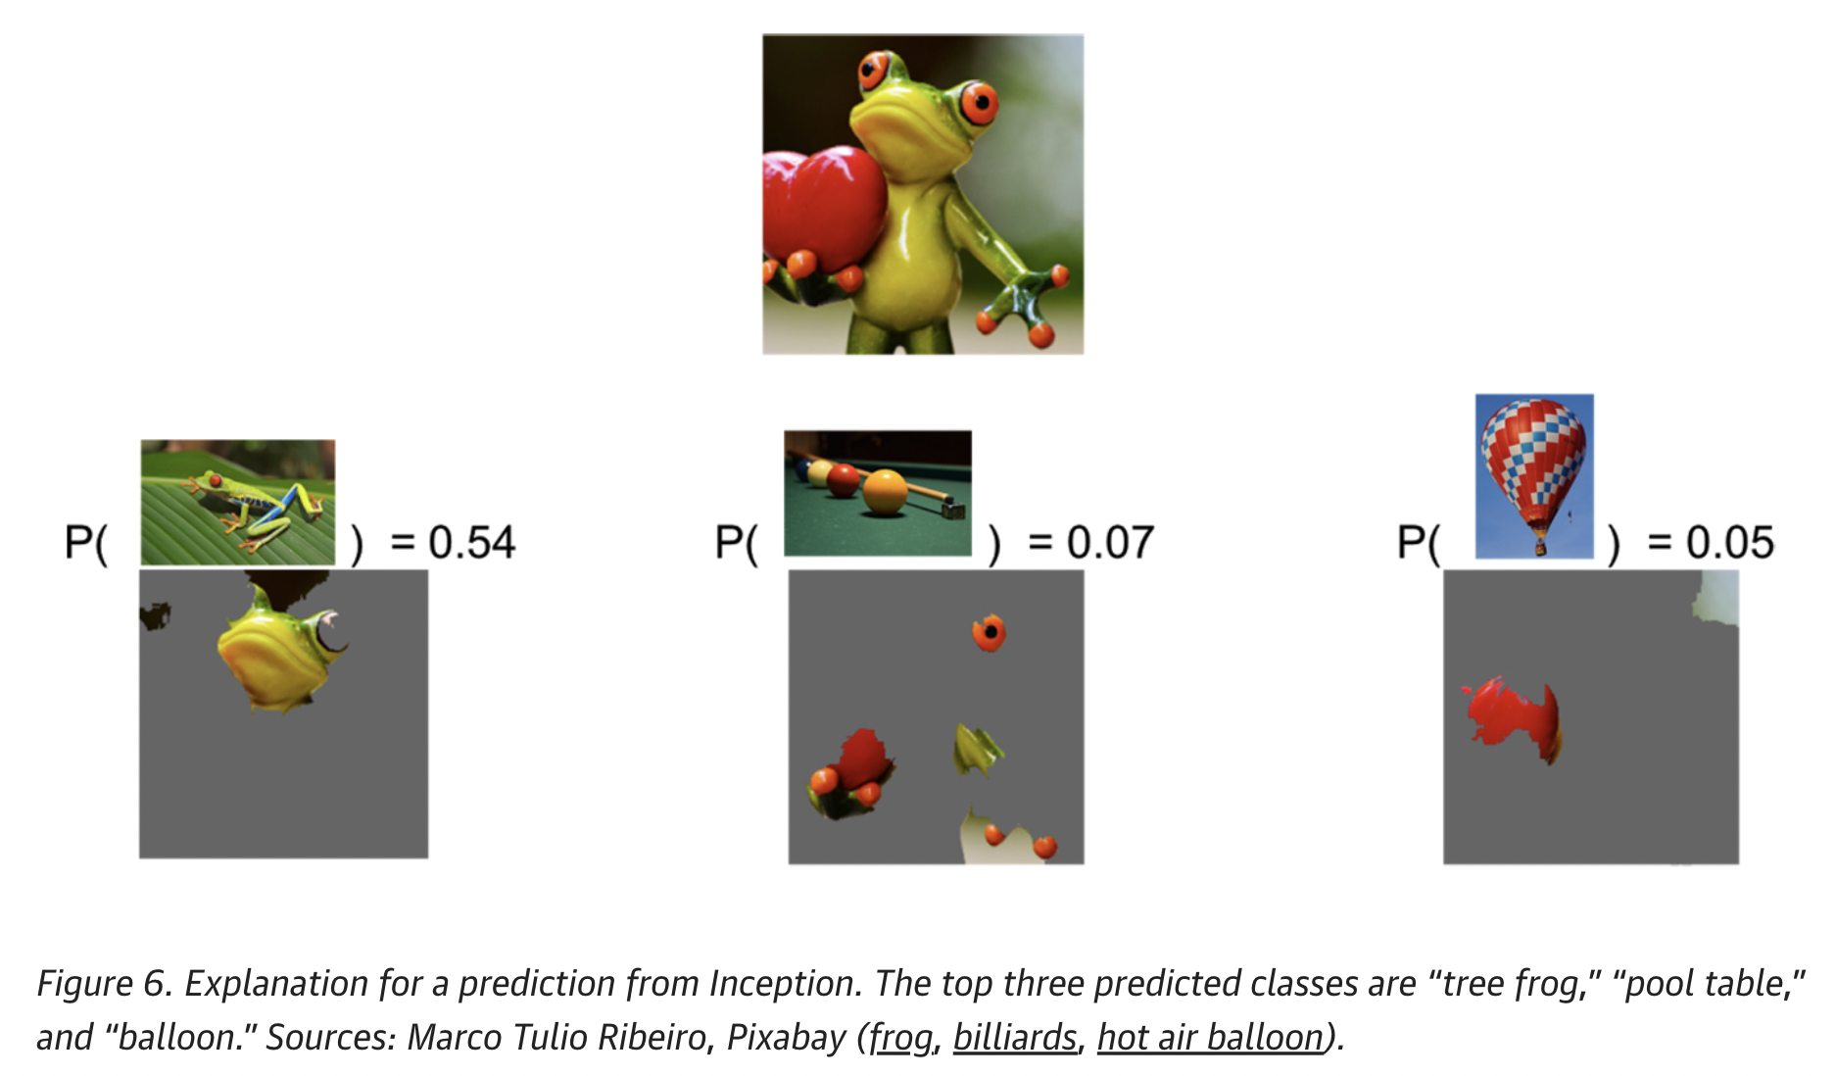
Motivations
To what extent a model can be trusted?
Model is making the right prediction in a right way
Trustworthy

Slide 7





Definition of “Explaining a prediction”
By “explaining a prediction”, we mean presenting any textual or visual artifacts that provide qualitative understanding of the relationship between the instance’s components (e.g. words in text, patches in an image) and the model’s prediction.
Desired characteristics
Iterpretability must take into account human limitations. If hundreds or thousands of features significantly contribute to a prediction, it is not reasonable to expect users to comprehend why the prediction was made, even if they can inspect individual weights.
Explanations should be easy to understand, not true for deep features
For an explanation to be meaningful it must at least be locally faithful - i.e. it must correspond to how the model behaves in the vicinity of the instance being predicted.
Explanations must be model agnostic
Building upon the explanations for individual predictions, we select a few
explanations to present to the user, such that they are representative of the model.

Slide 8
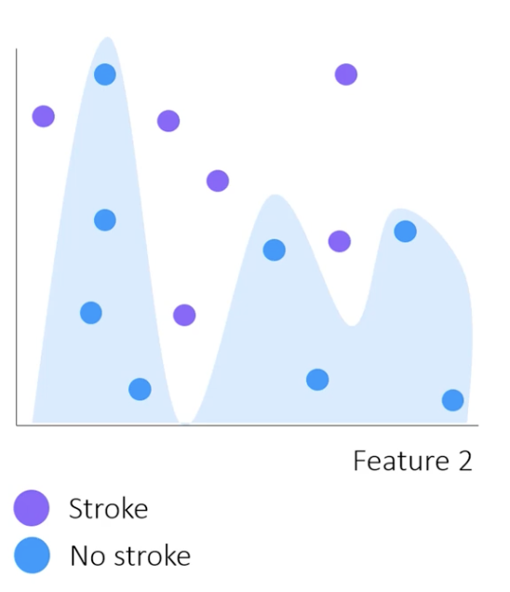
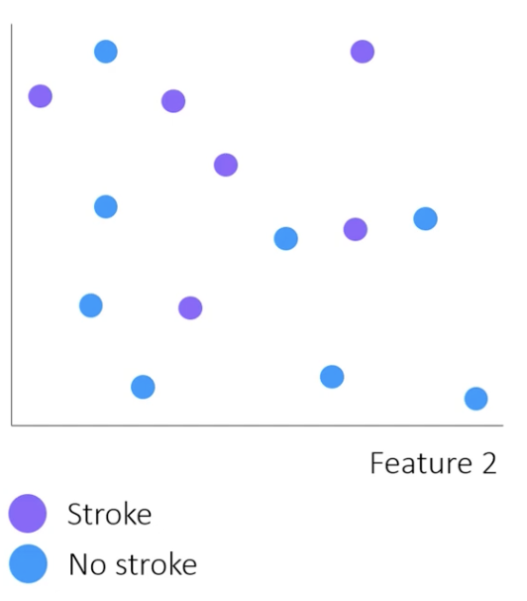
Digging deep
Feature 1
Feature 1
Feature 1

Slide 9
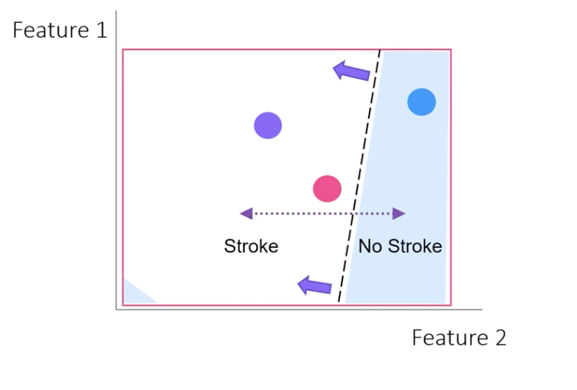
Digging deep
Feature 1
Linear Model
Local approximation of the global model
Feature 2

Slide 10
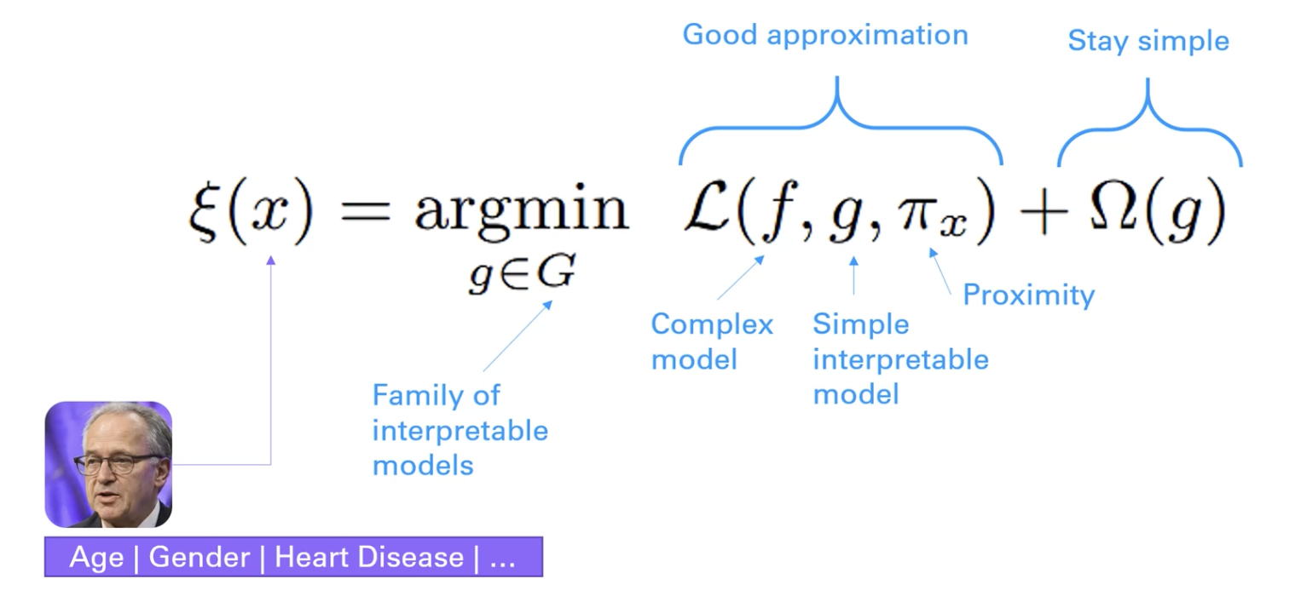
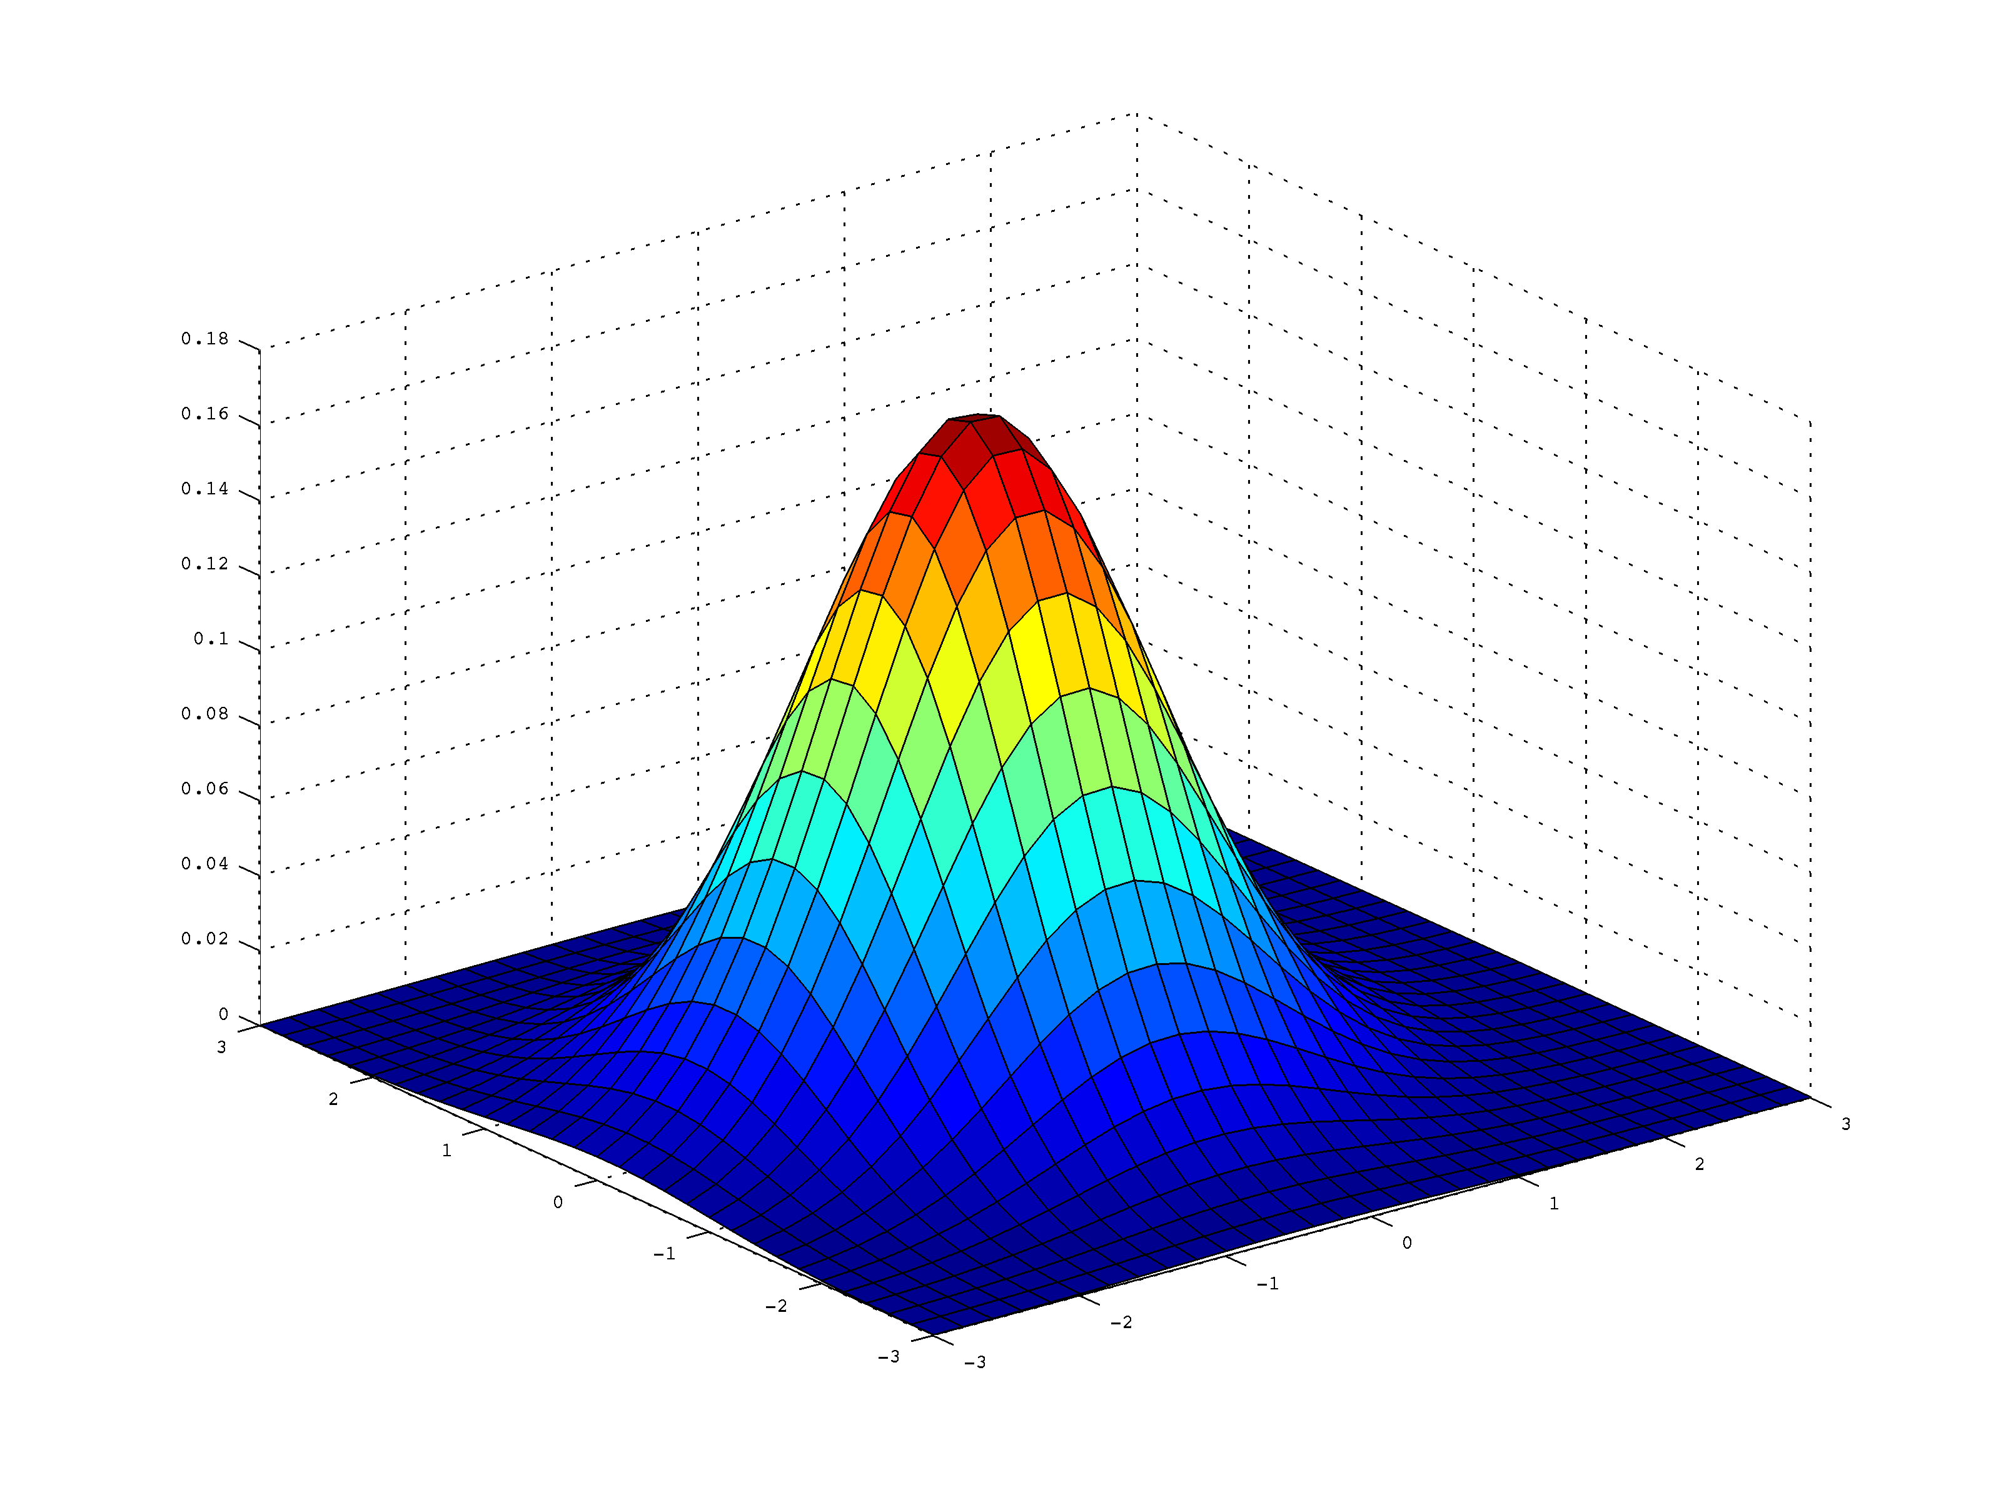
Digging deep
Gaussian kernel

Slide 11
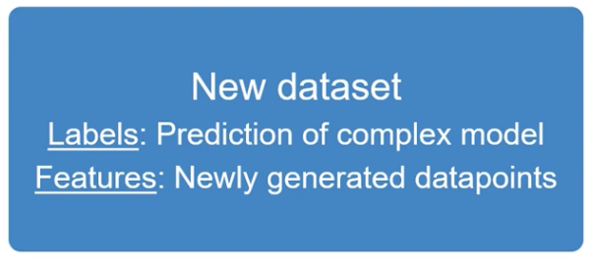

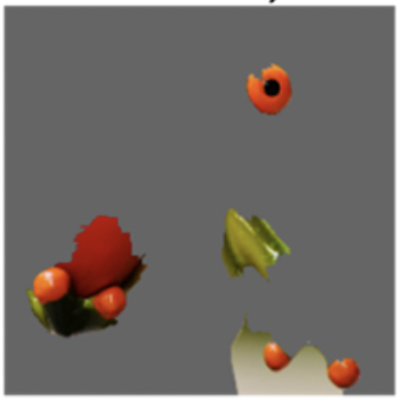

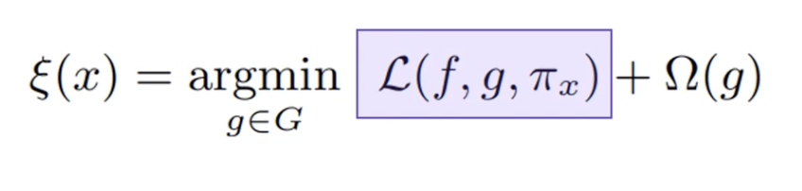

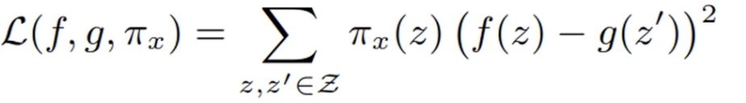
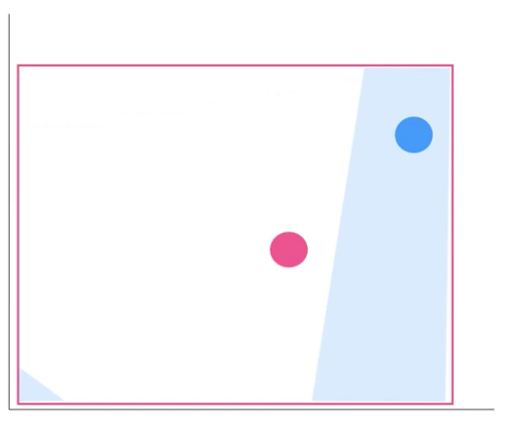
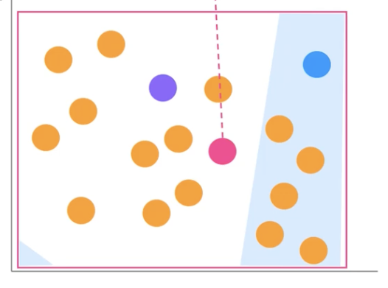
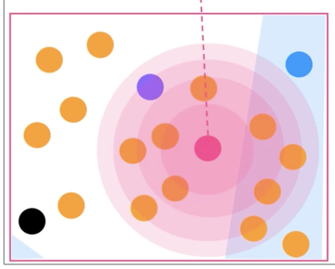
Digging deep
g= sparce linear model
How to calculate this loss function?
Feature 1
Feature 1
Feature 1
Feature 2
Feature 2
Feature 2

Slide 12
Summary
Motivations behind developing LIME
Definition of explainability
Desired characteristics of LIME
Examples of LIME working with different types of data
Local approximation of complex models
Developing linear models with optimization

