Slide 1
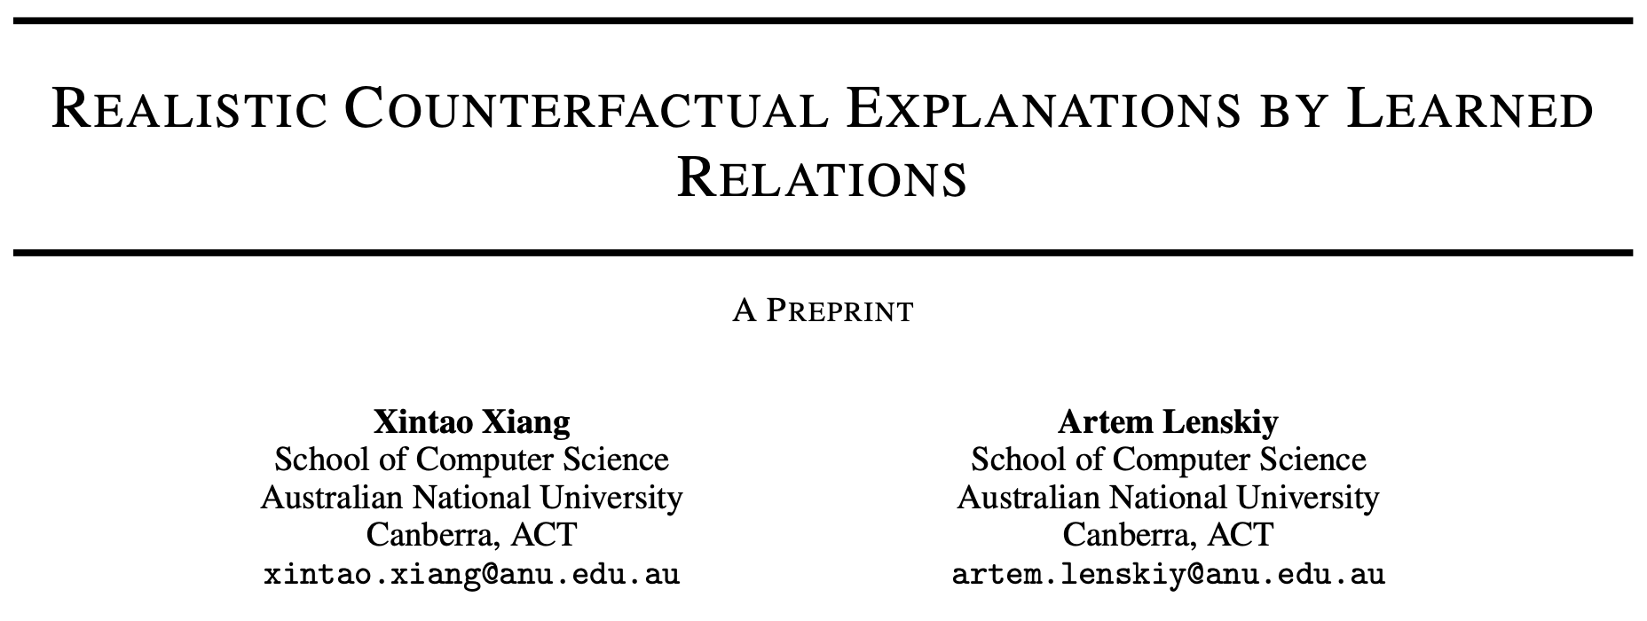
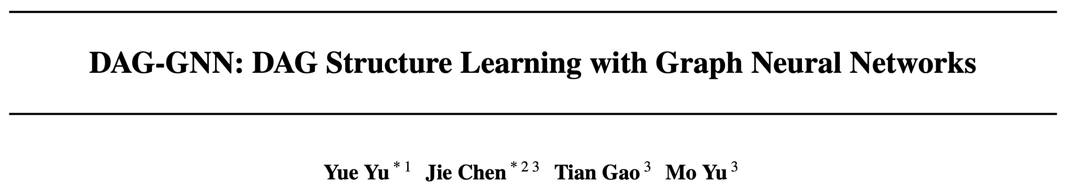
Lehigh University, MIT-IBM Watson AI Lab, IBM Research

Slide 2
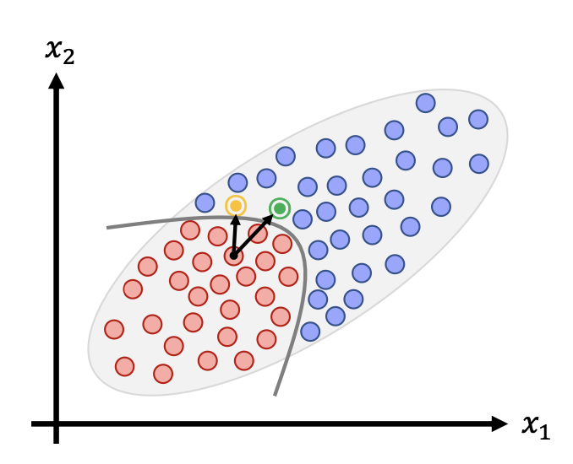
Motivation
Factual samples
Counterfactual samples
Age | BMI | BP | Steps | Distance | BGL | label
25 | 21 | 129 | 2500 | 1 | 4 | -
30 | 24 | 126 | 1800 | 0.8 | 7.2 | -
51 | 26 | 132 | 7200 | 3 | 6.8 | -
Age | BMI | BP | Steps | Distance | BGL | label
25 | 21 | 119 | 10000 | 2.2 | 4 | +
30 | 24 | 120 | 7000 | 0.5 | 5.5 | +
51 | 26 | 127 | 9000 | 1.1 | 5 | +
The counterfactuals cannot capture the realism from real world
Counterfactuals cannot recognize the inter-feature dependencies

Slide 3
What this paper offers?
A novel model that considers relationships between attributes and gives realistic counterfactual explanations
Does not need any prior domain knowledge on predictors’ correlation and is thus more useful in settings where prior knowledge is difficult to obtain.
Performed extensive experiments on both synthetic and real-world datasets

Slide 4
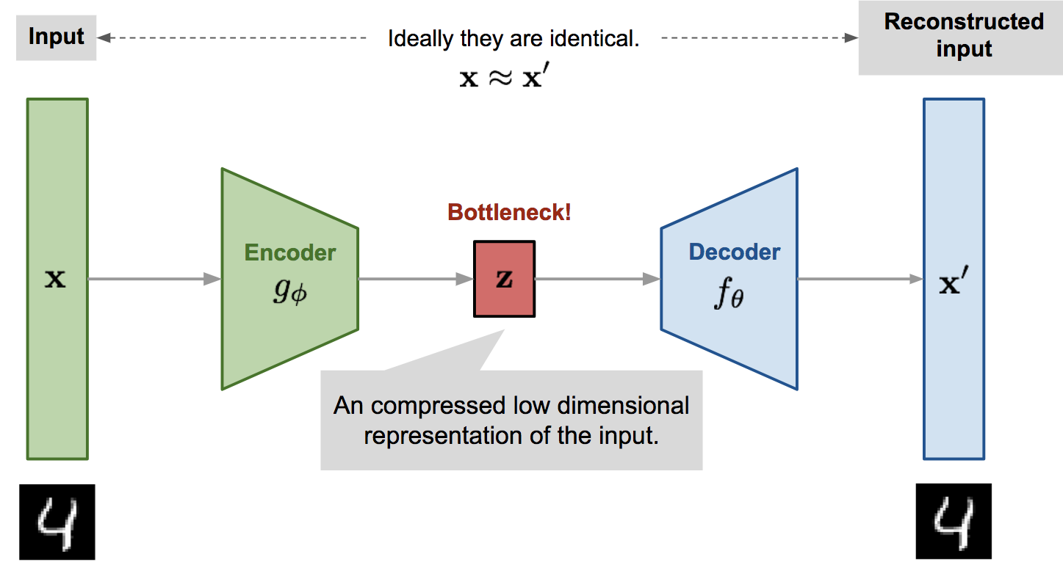
DAG-GNN VAE
AE
minimize |x-x’|
Minimizes reconstruction loss only

Slide 5
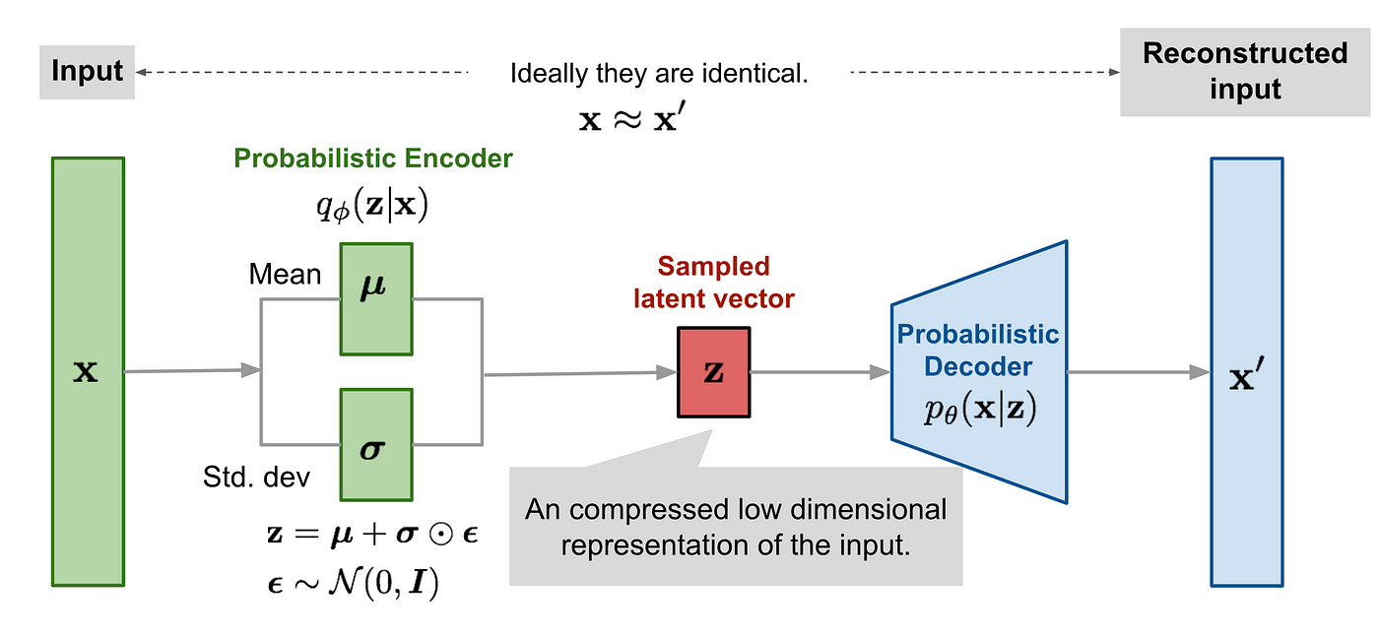



DAG-GNN VAE
VAE
encourages the VAE to learn a decoder that reconstructs the input data as accurately as possible
encourages the latent distribution q(z∣x) to be as close as possible to the prior distribution p(z)
minimize

Slide 6
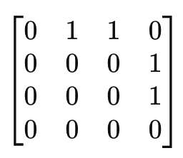
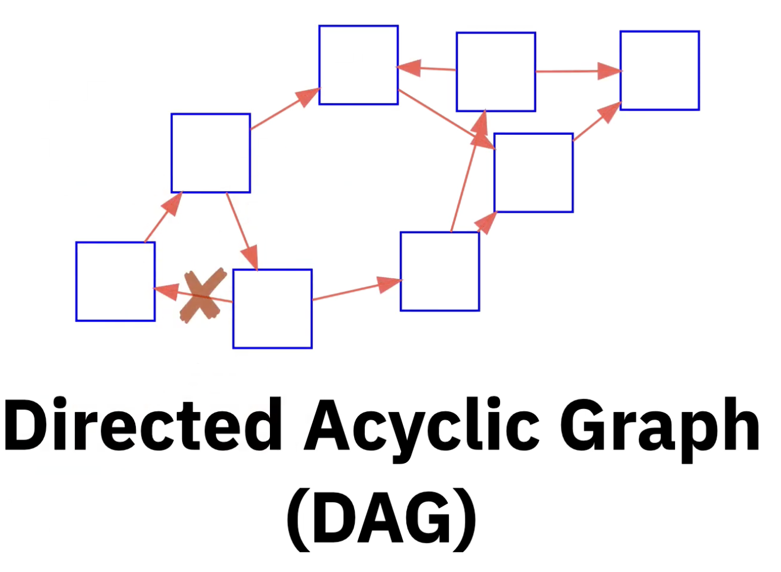



DAG-GNN VAE
A =
DAGs
Using structural equation model (SEM)
node
Adjacency matrix
encoder
decoder
encoder
decoder

Slide 7
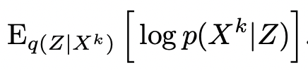
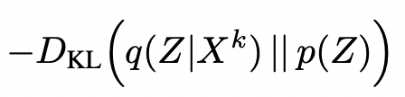

DAG-GNN VAE
How much perturbation should I do?
How can I control the quality of the CFs?
GNN (MLP)
$$z=μ+σ⋅ϵ$$
GNN (MLP)
x
x^{CF}
minimize
reconstruction
KL divergence
mxm
mxm
mxm

Slide 8
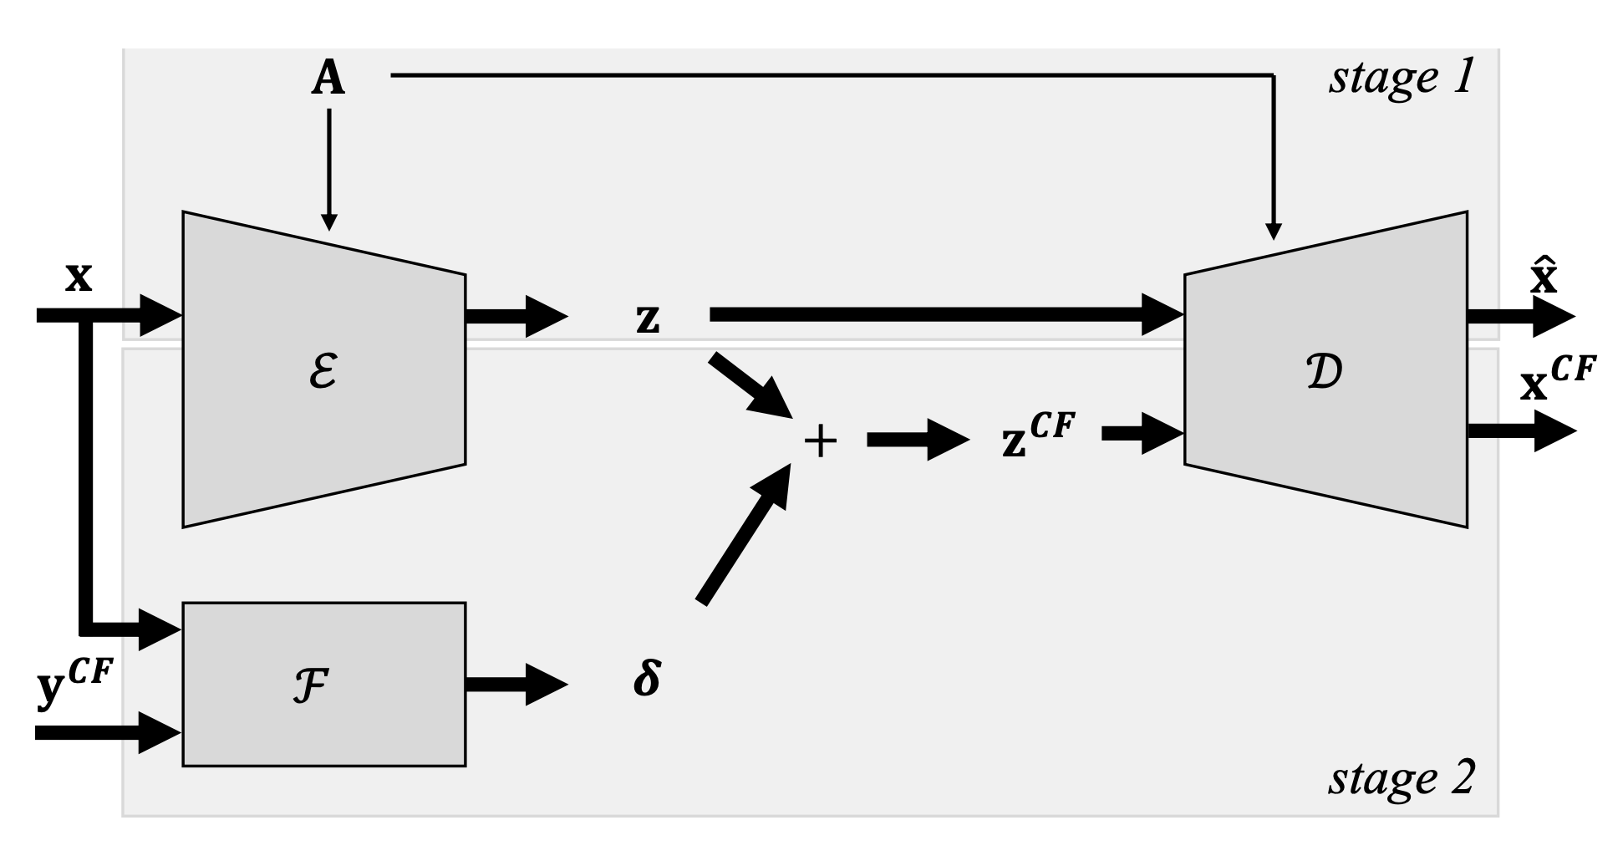


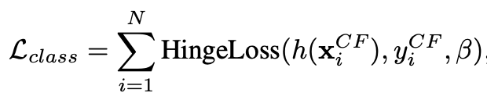
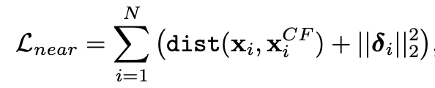
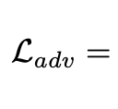


DAG-GNN VAE
Minimum probability transition is $β$
Minimally distant from test sample
$δ$ is small
z^{CF} is similar to z

Slide 9
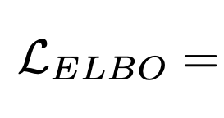
DAG-GNN VAE

Slide 10
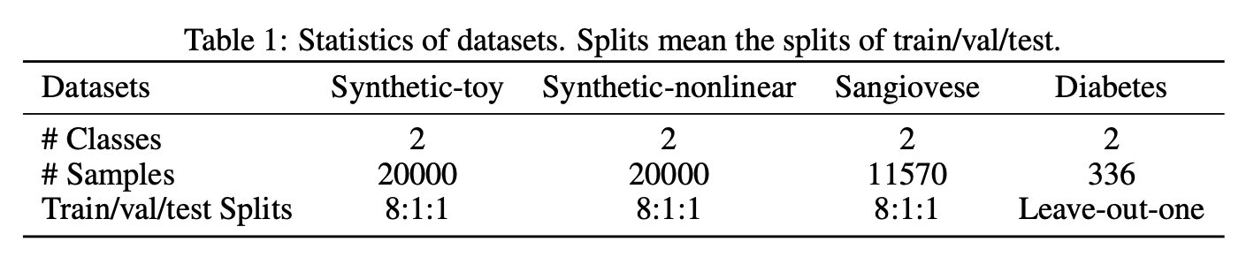
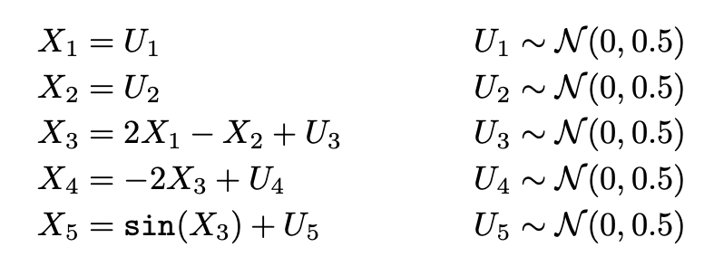
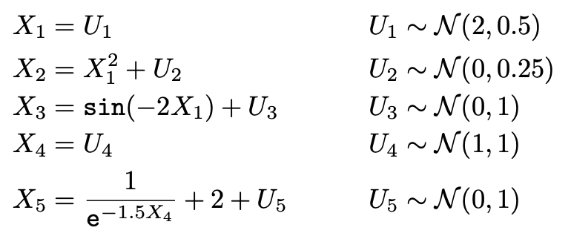
Experiment
• RQ1: How effective is our method in preserving the relationships when generating counterfactuals?
• RQ2: How can our method provide suggestions in a real-world machine learning application?
Datasets
If X3 decrease/increase, X4 increase/decrease.
X1 increase/decrease, X2 increase/decrease, and (2) if X4 increase/decrease, X5 increase/decrease
labeled to 1 when sin(Xi) > 0.5 for more than 2 variables
labeled to 1 when sin(Xi) > 0 for all the 5 variables

Slide 11
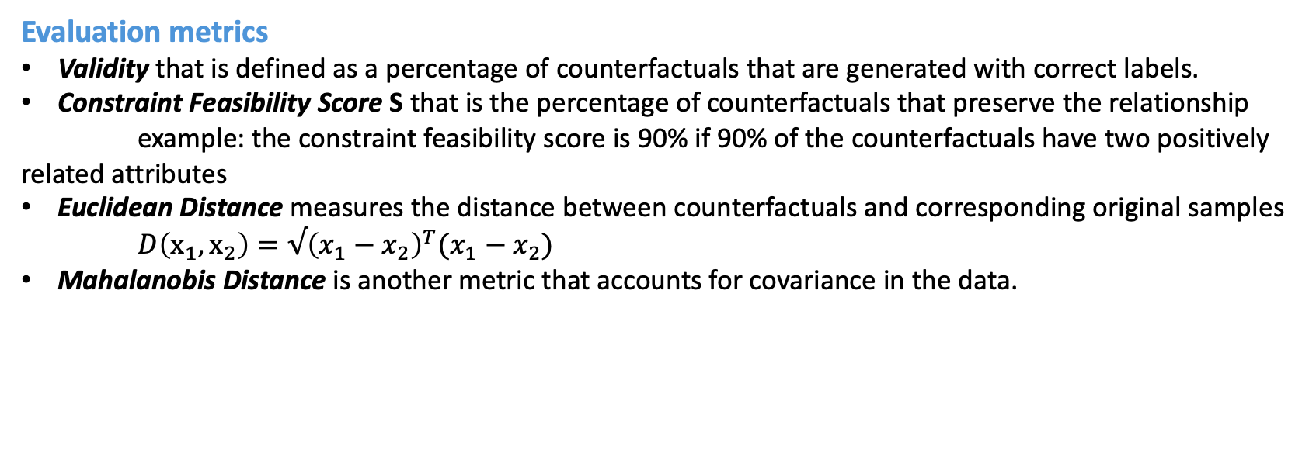
Experiment
Evaluation metrics
Validity that is defined as a percentage of counterfactuals that are generated with correct labels.
Constraint Feasibility Score S that is the percentage of counterfactuals that preserve the relationship
example: the constraint feasibility score is 90% if 90% of the counterfactuals have two positively related attributes
Euclidean Distance measures the distance between counterfactuals and corresponding original samples
$D\left(x_{1},x_{2}\right)=√{\left(x_{1}−x_{2}\right)}^{T}(x_{1}−x_{2})$
Mahalanobis Distance is another metric that accounts for covariance in the data.

Slide 12
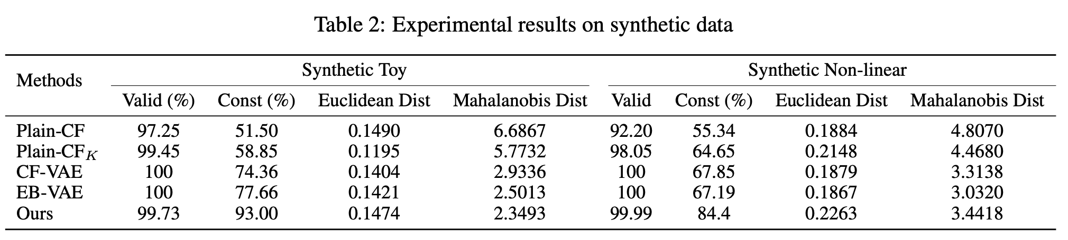
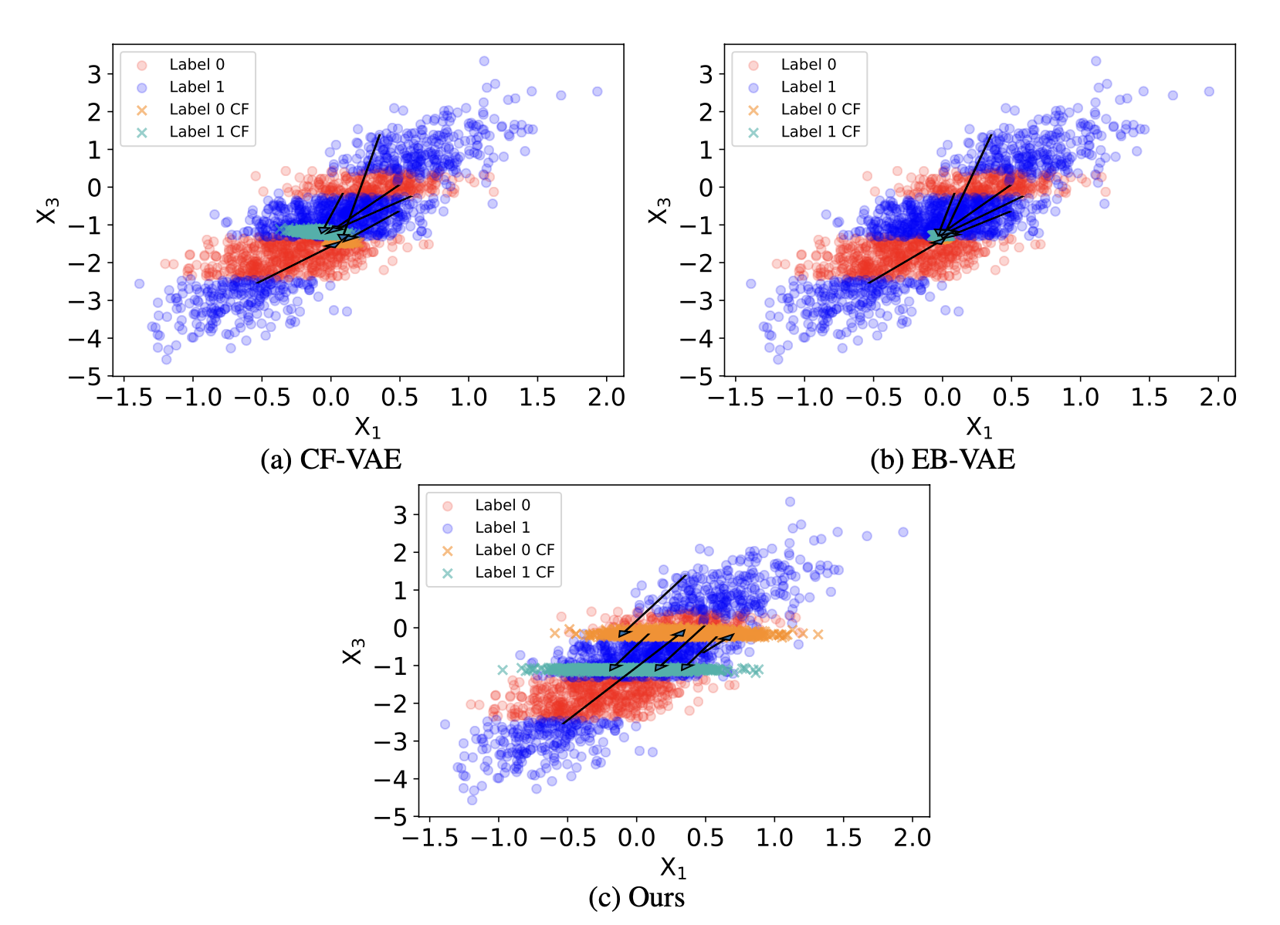
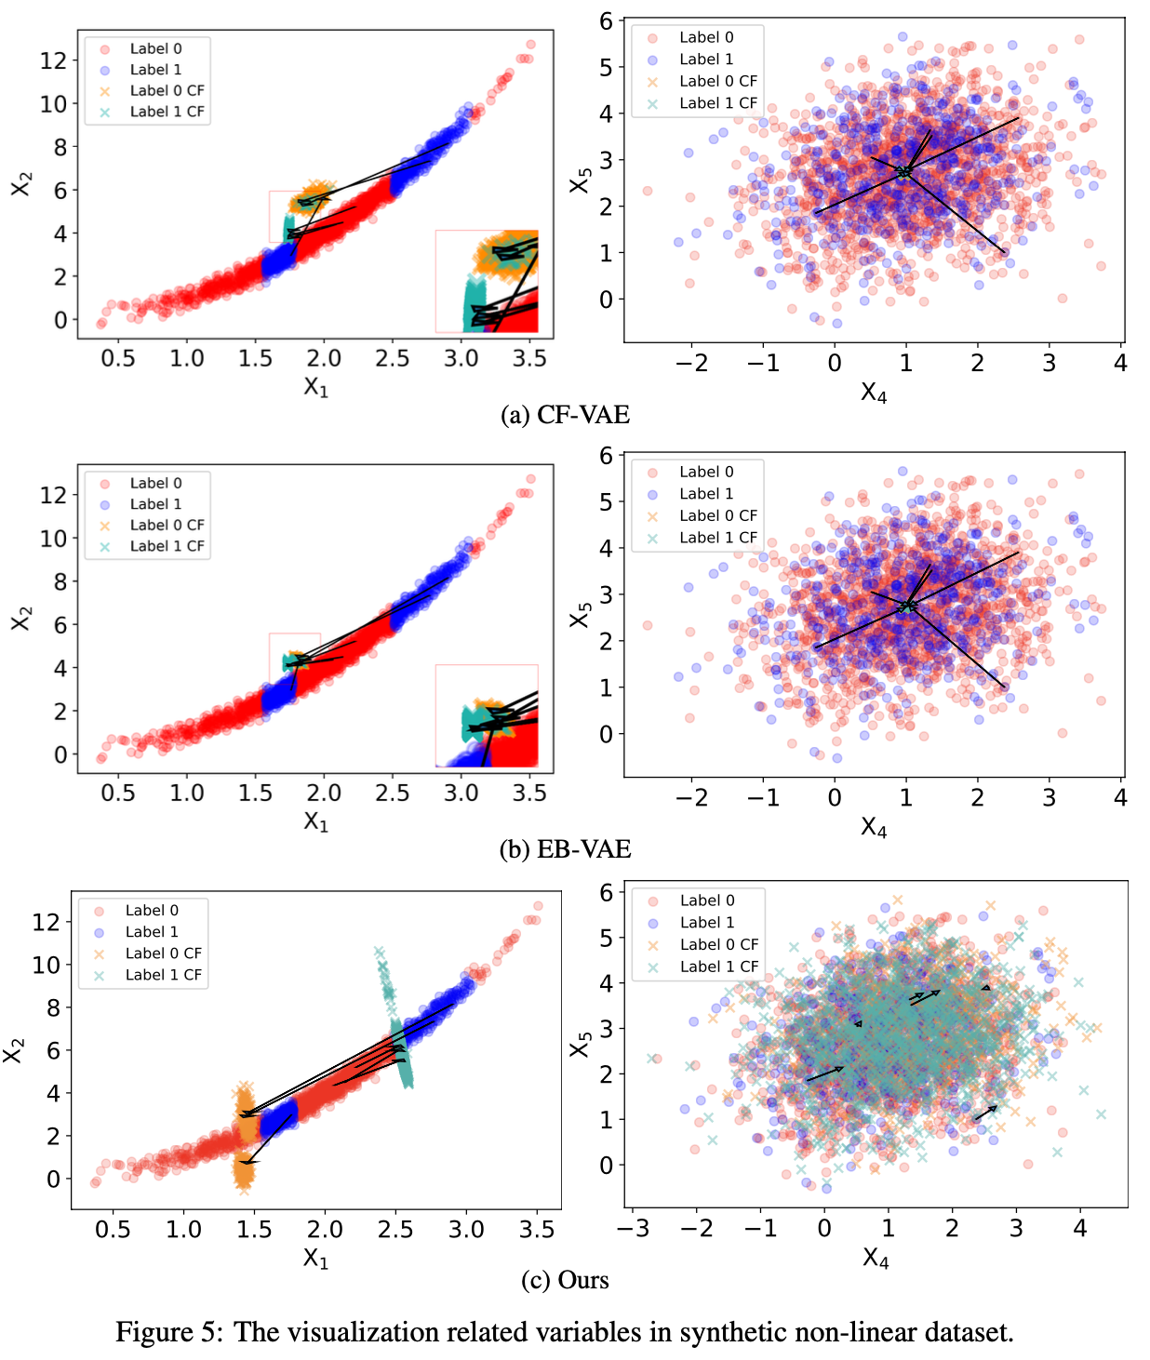
Results

Slide 13
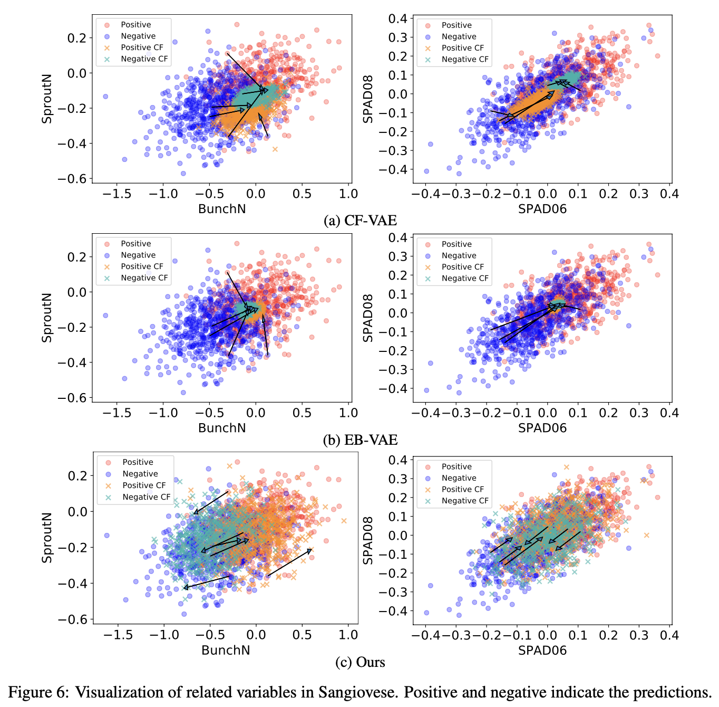
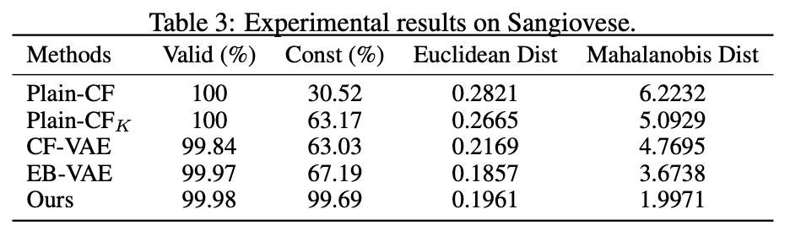
Results

Slide 14
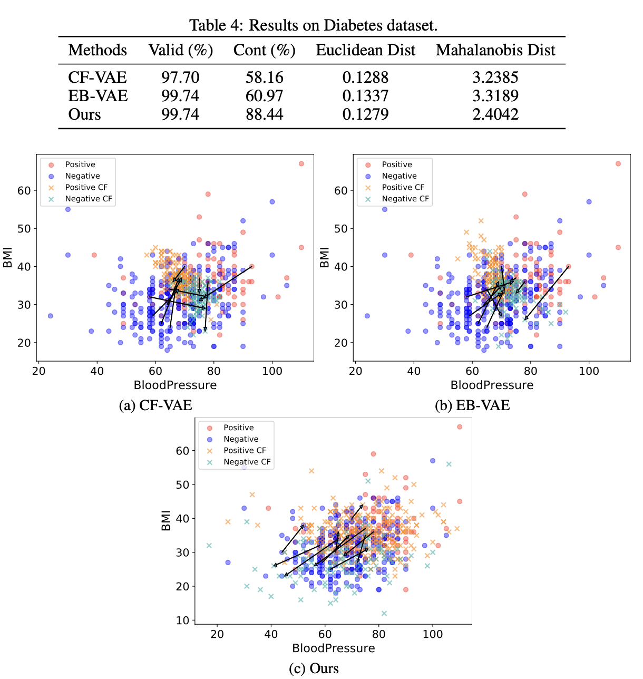
Results

Slide 15
Drawbacks
If features are highly correlated, why do we keep them in the first place?
Feature diversity is low
Overlooked other types of constraints
Meal composition |  |  | 2hrs before meal |  |  | 2hrs after meal
Carb | Protein | Fat | Steps | Sedentary mins | Active mins | Steps | Sedentary mins | Active mins | outcome
35 | 11 | 6 | 1100 | 101 | 19 | 350 | 82 | 38 | +
Sum to 120
Sum to 120

