Slide 1
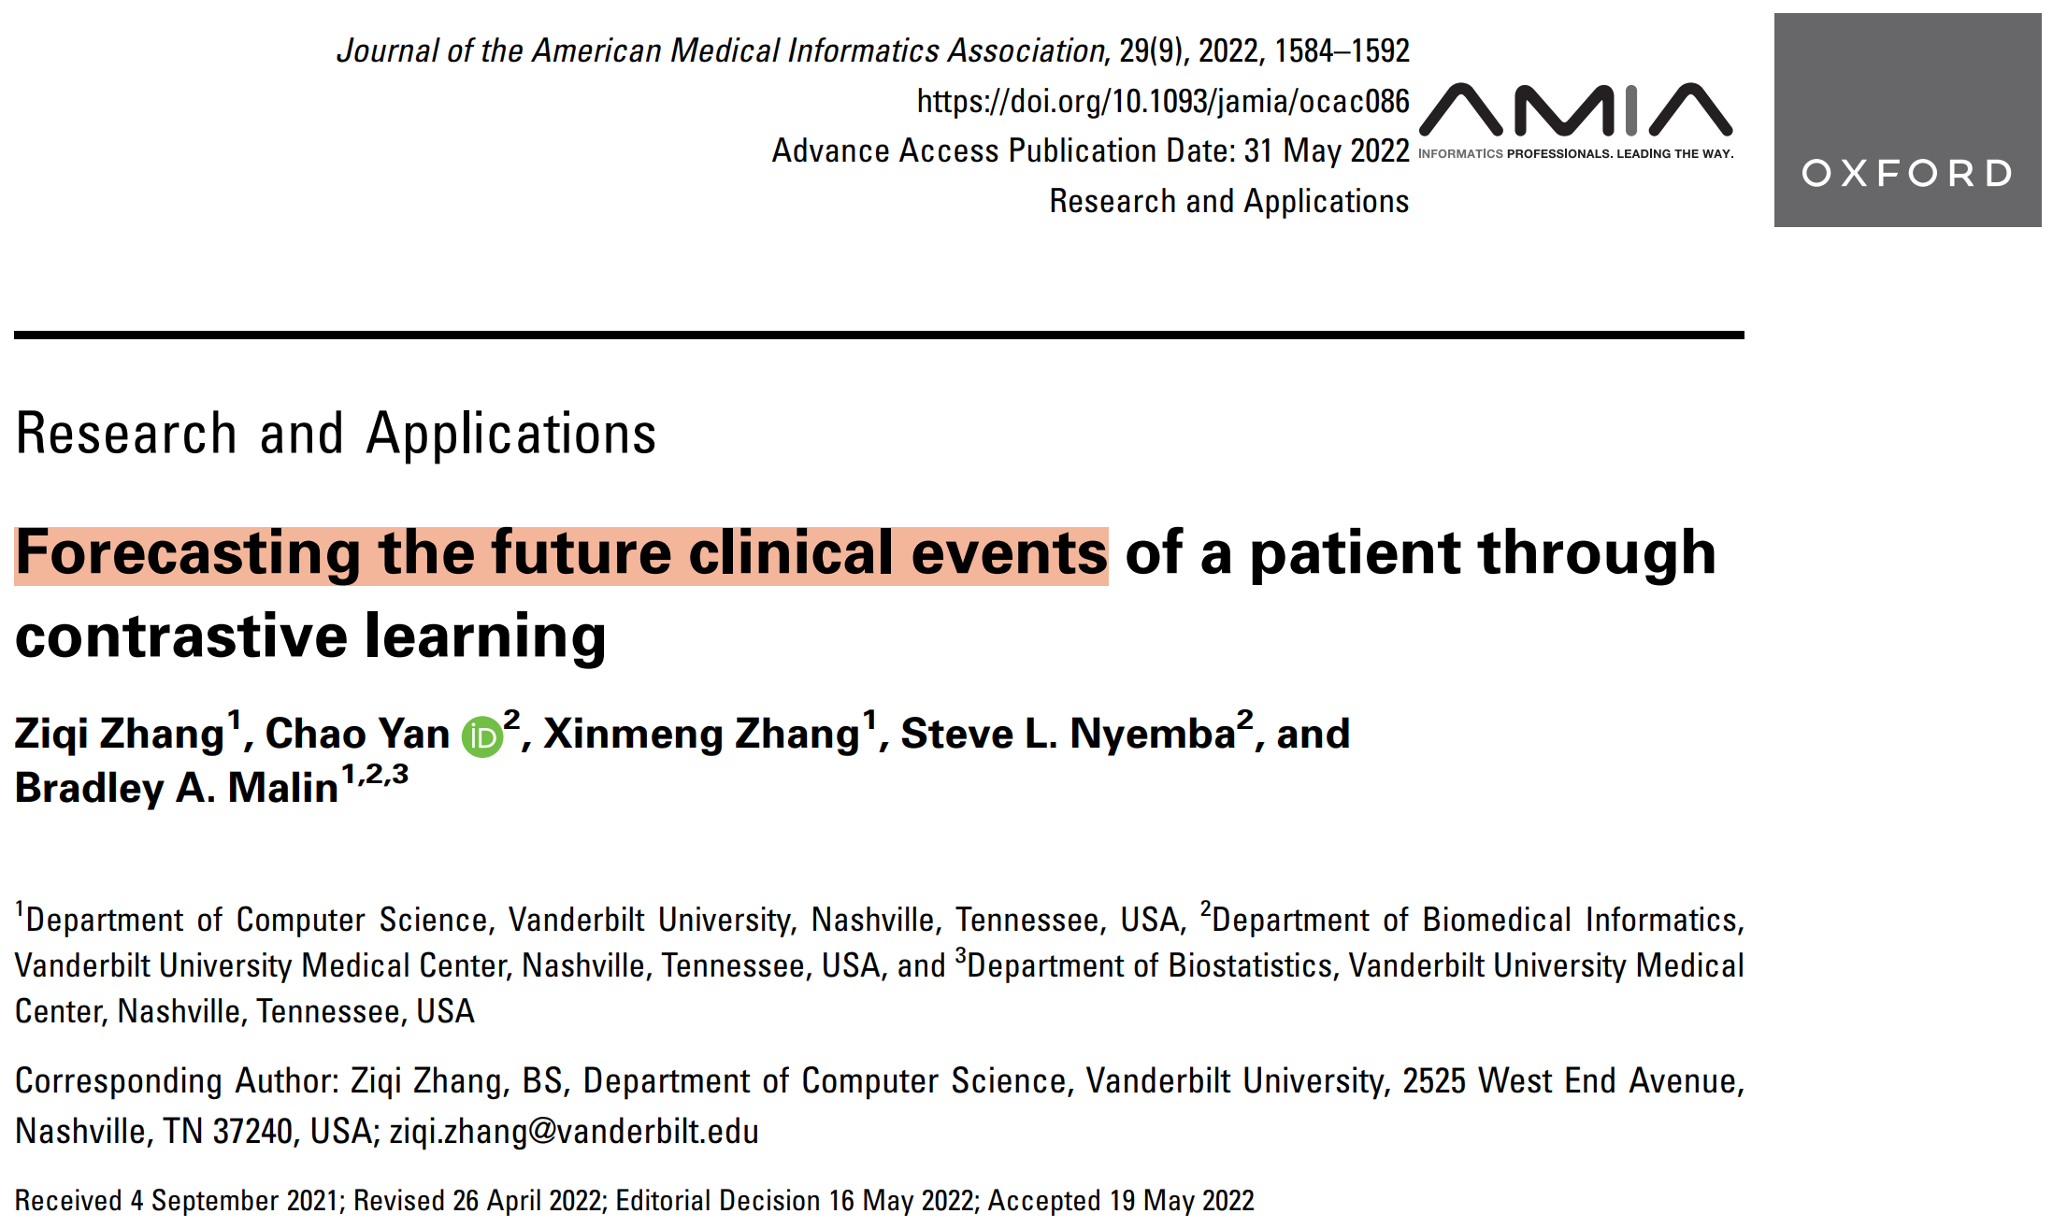

Slide 2
Basic Self-supervised learning
Plenty of unlabeled sample
A few labeled sample
Augment the unlabeled sample and design a model to go over the unlabeled sample (e.g. set a dummy task)
The model knows the dataset
Perform transfer learning (tune the final layer of the model using very few labeled sample)
Model ready to work

Slide 3
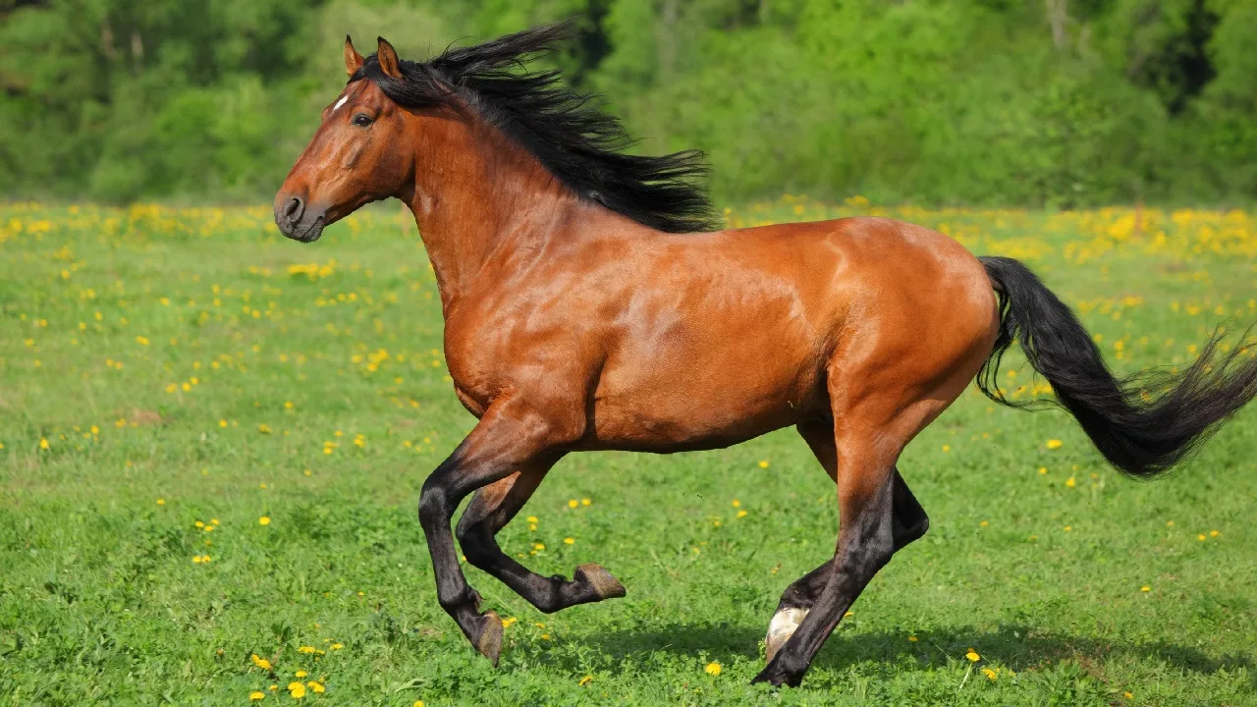
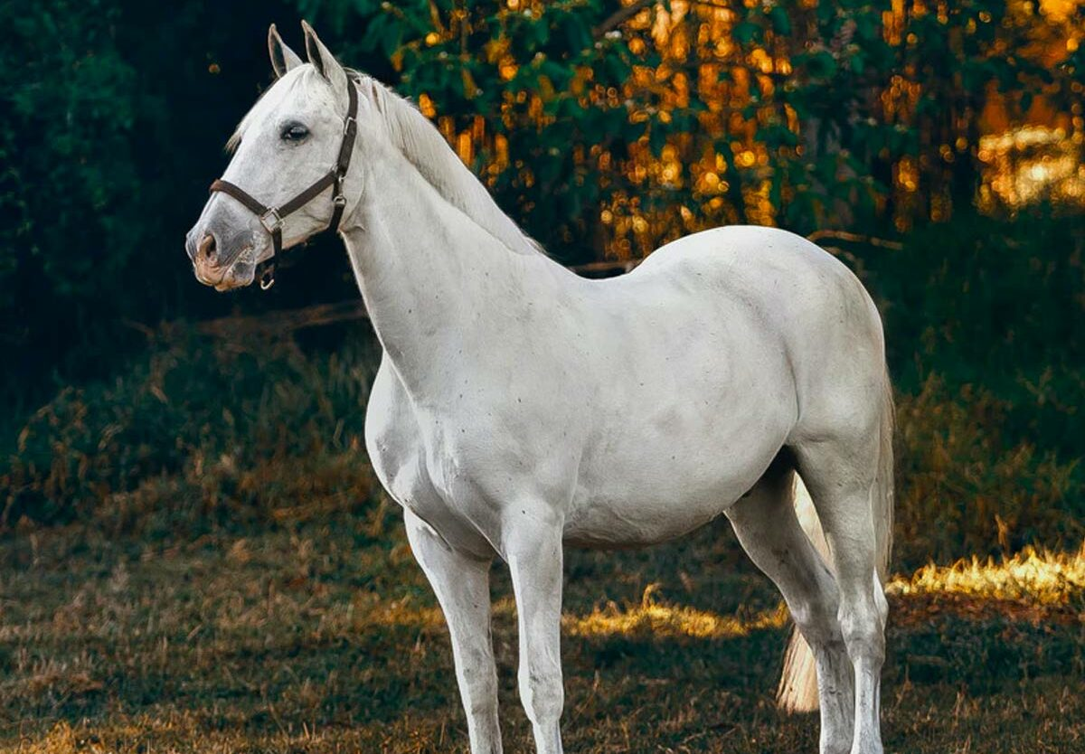
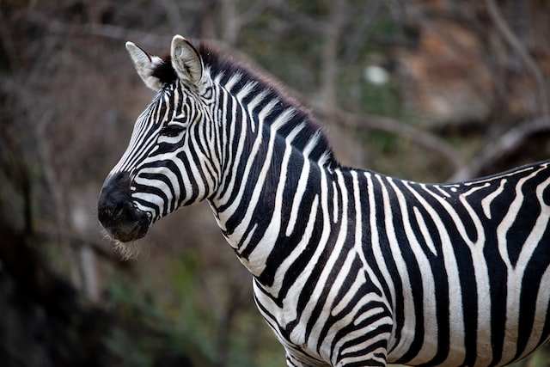
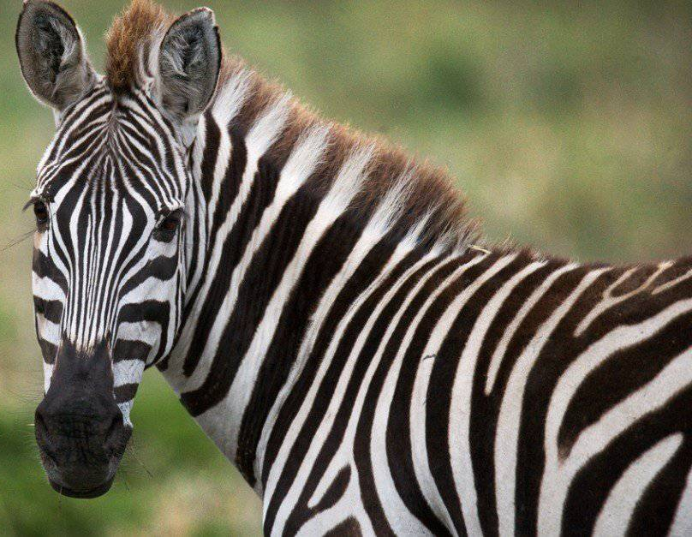
Basic Self-supervised learning
horse
zebra

Slide 4
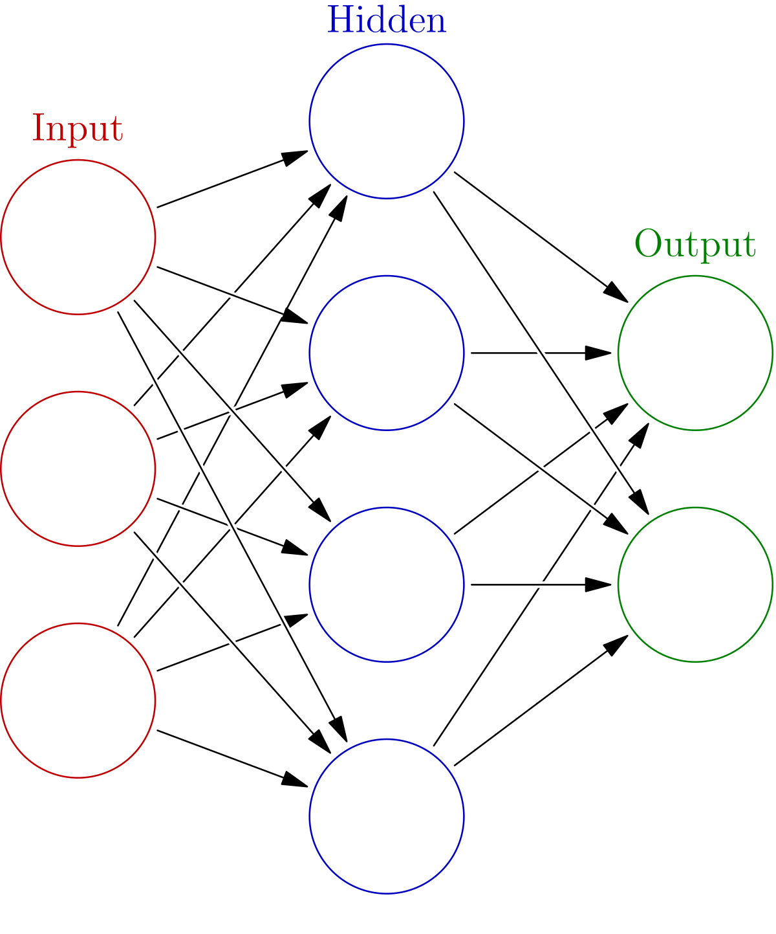
Basic Self-supervised learning
90
180
Dummy task to predict the degree of rotation
Transfer learning

Slide 5
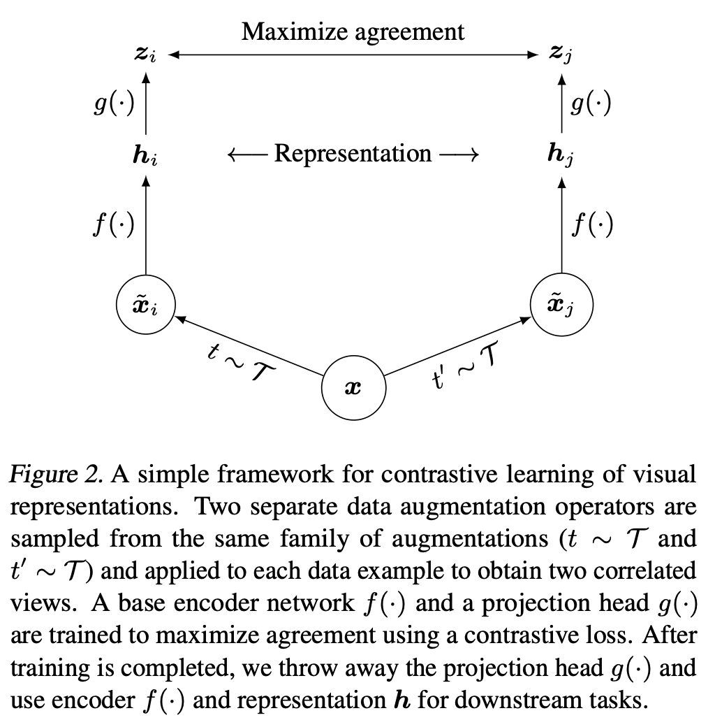
SimCLR
MLP
MLP
CNN
CNN
augmentation
augmentation
image

Slide 6
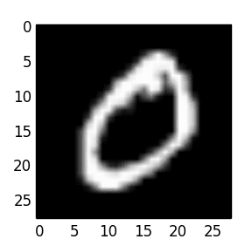
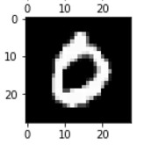
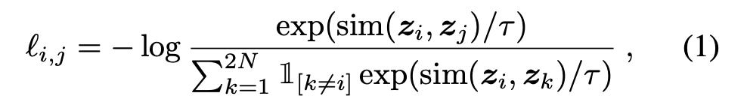
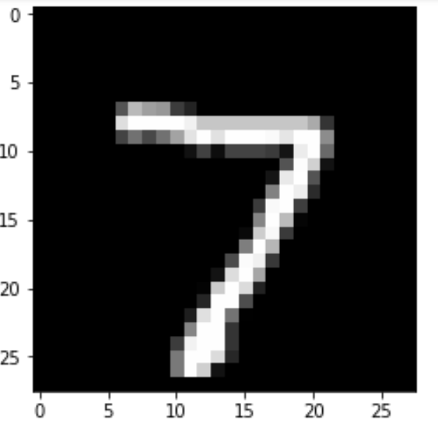
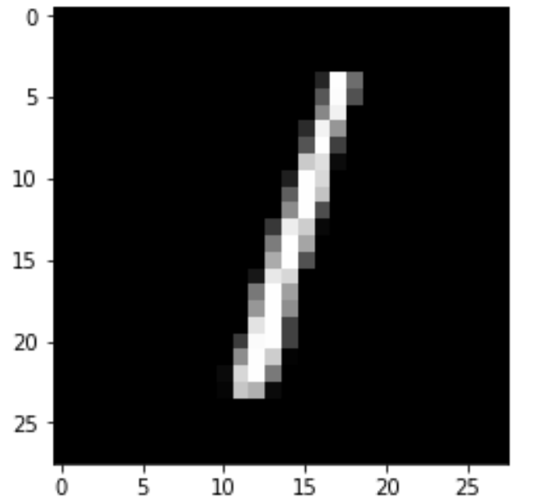
SimCLR
CNN
Two augments of the same image
All other images in the batch
CNN

Slide 7
SimCLR

Slide 8
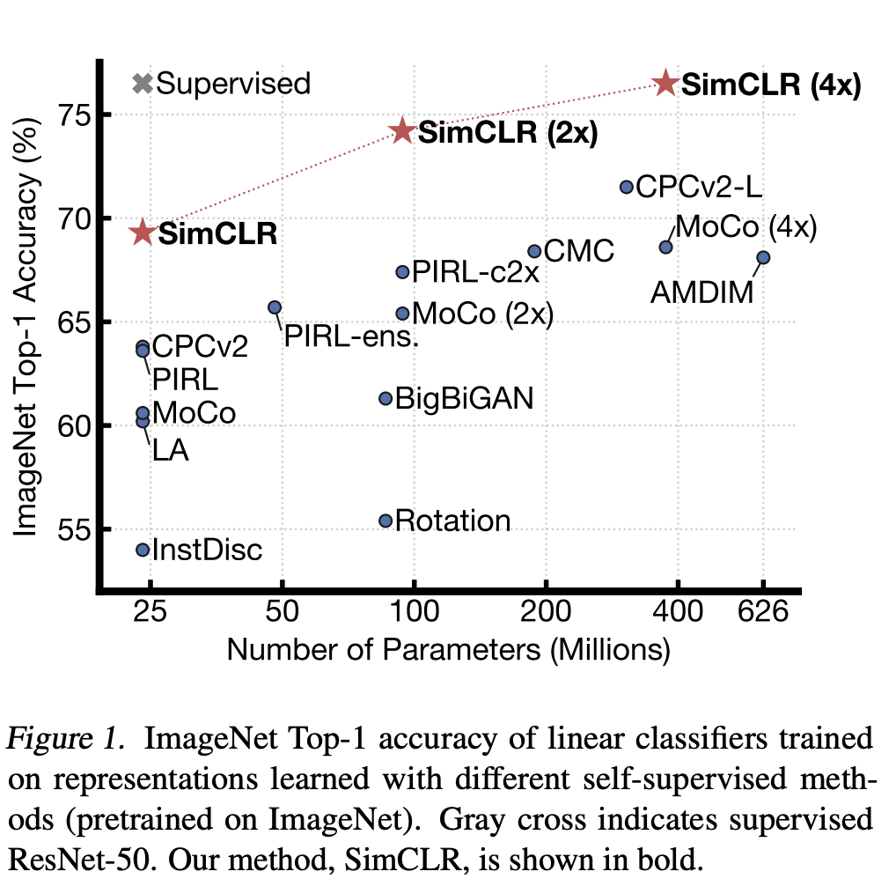
SimCLR

Slide 9
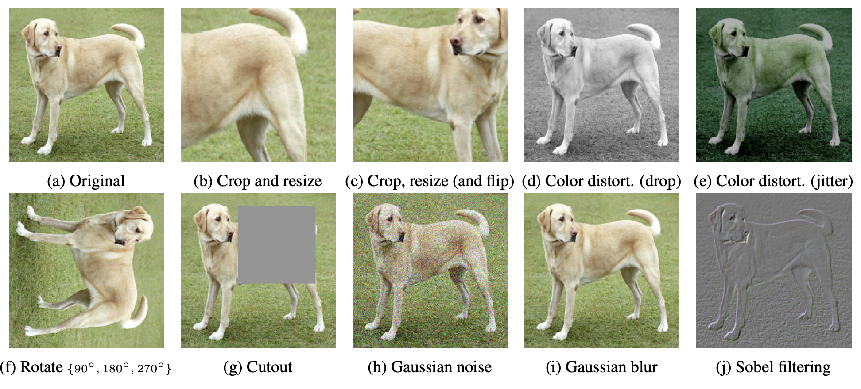
Augmentation type matters?

Slide 10
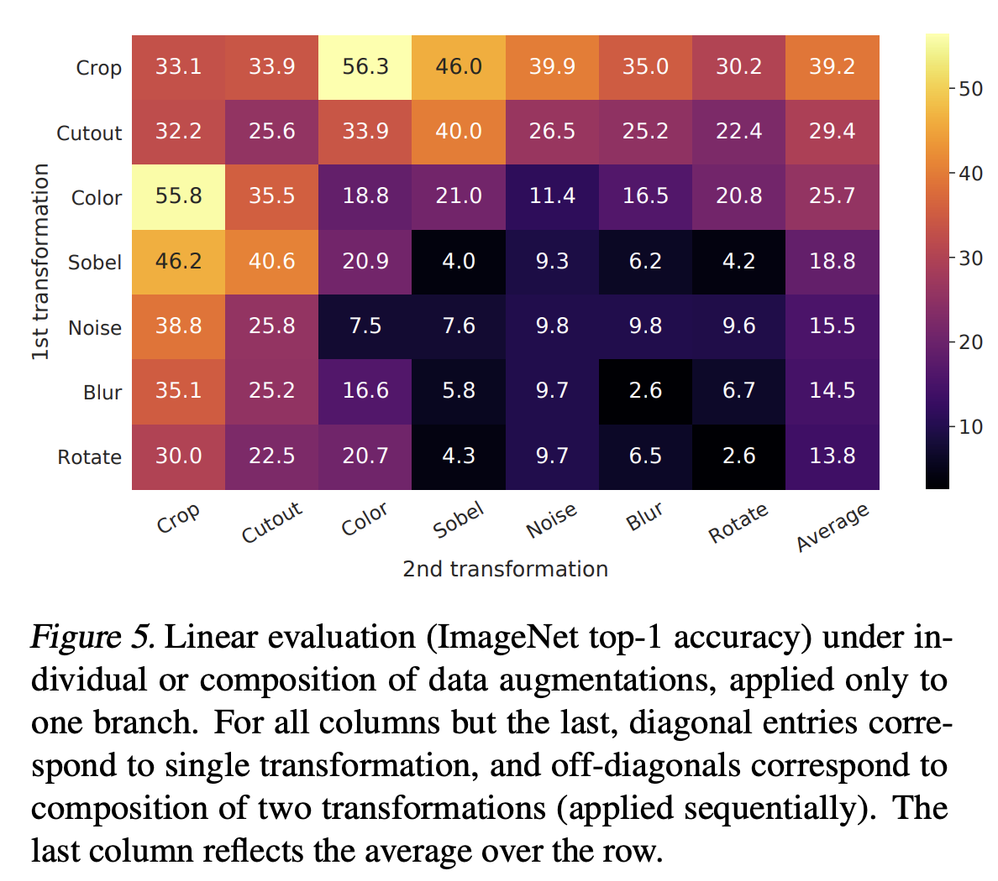
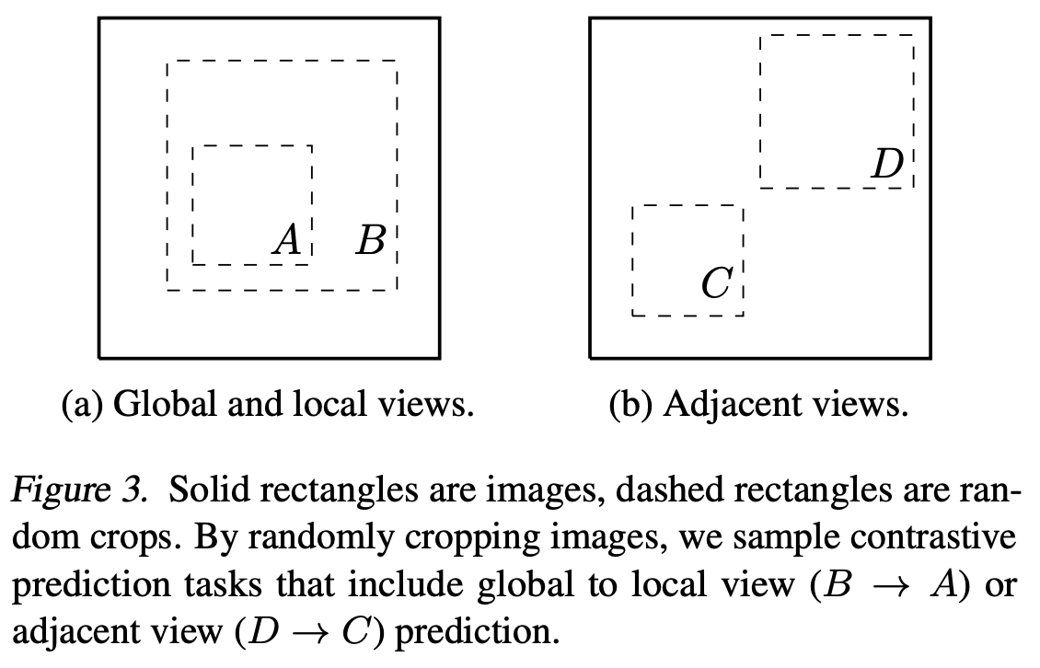
Augmentation type matters?
Controversies:

Slide 11
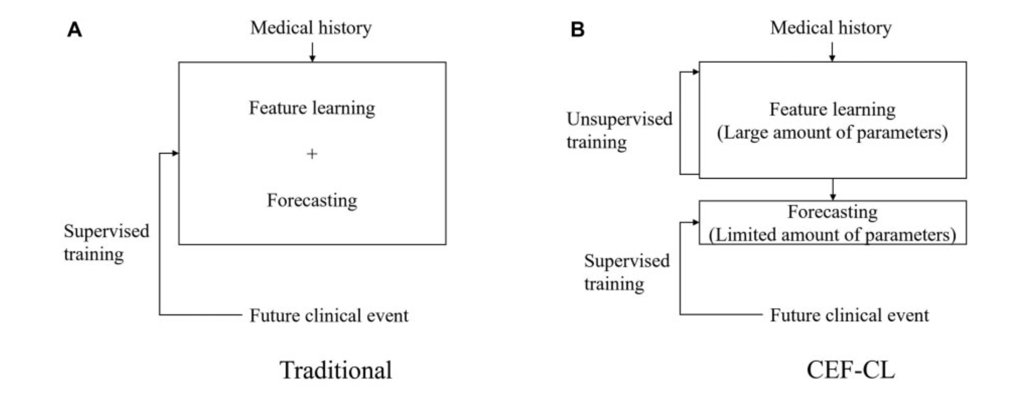
﻿Forecasting the future clinical events with contrastive learning
Issues with rare disease classification from EHRs-
﻿produce undesirable generalization behaviors
Memorization-overfits, overconfidence,
﻿instability: small perturbations to the input = induce large changes in the model’s output

Slide 12
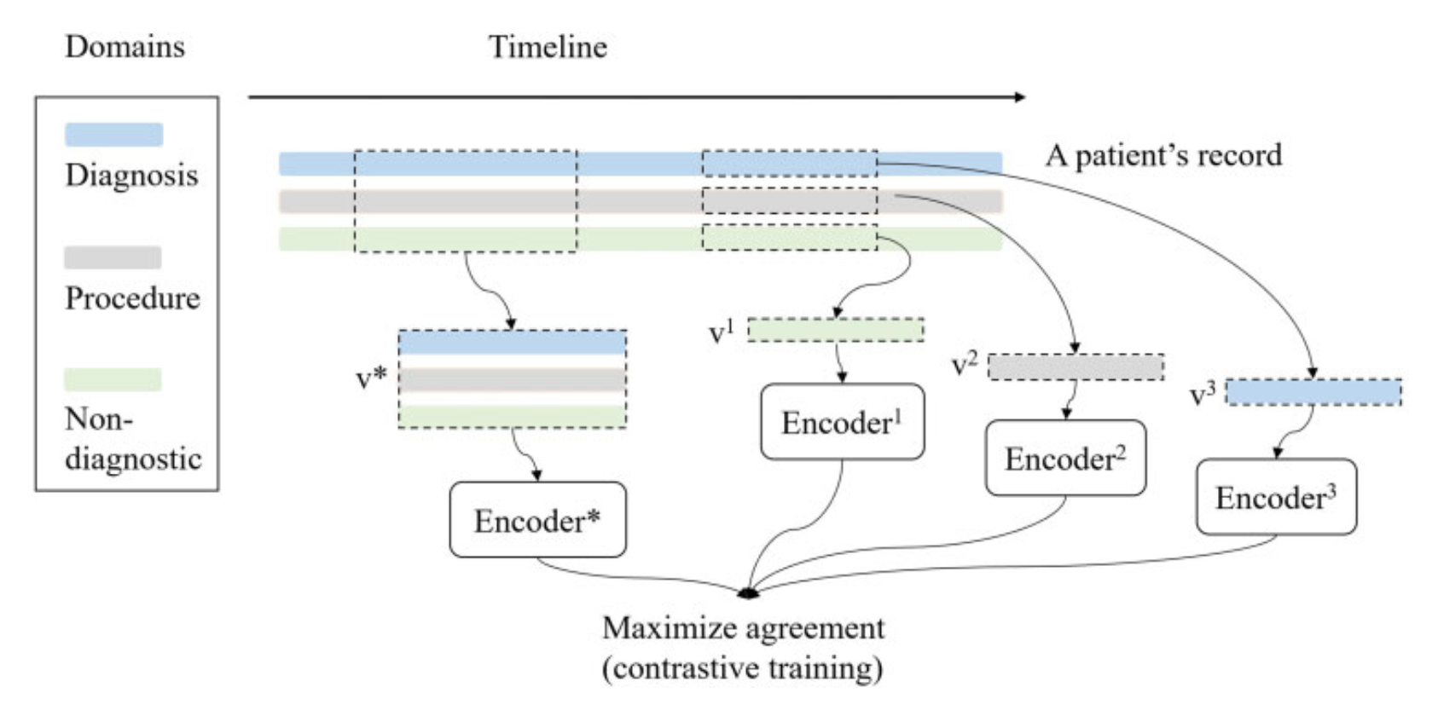
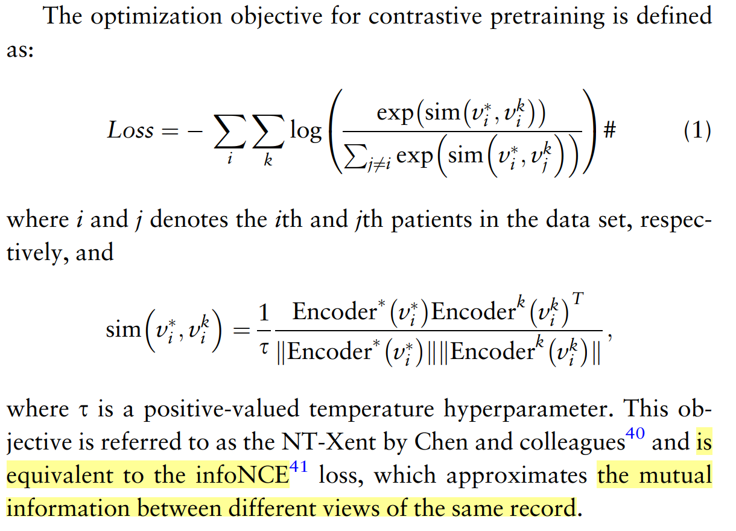
Setting dummy task

Slide 13
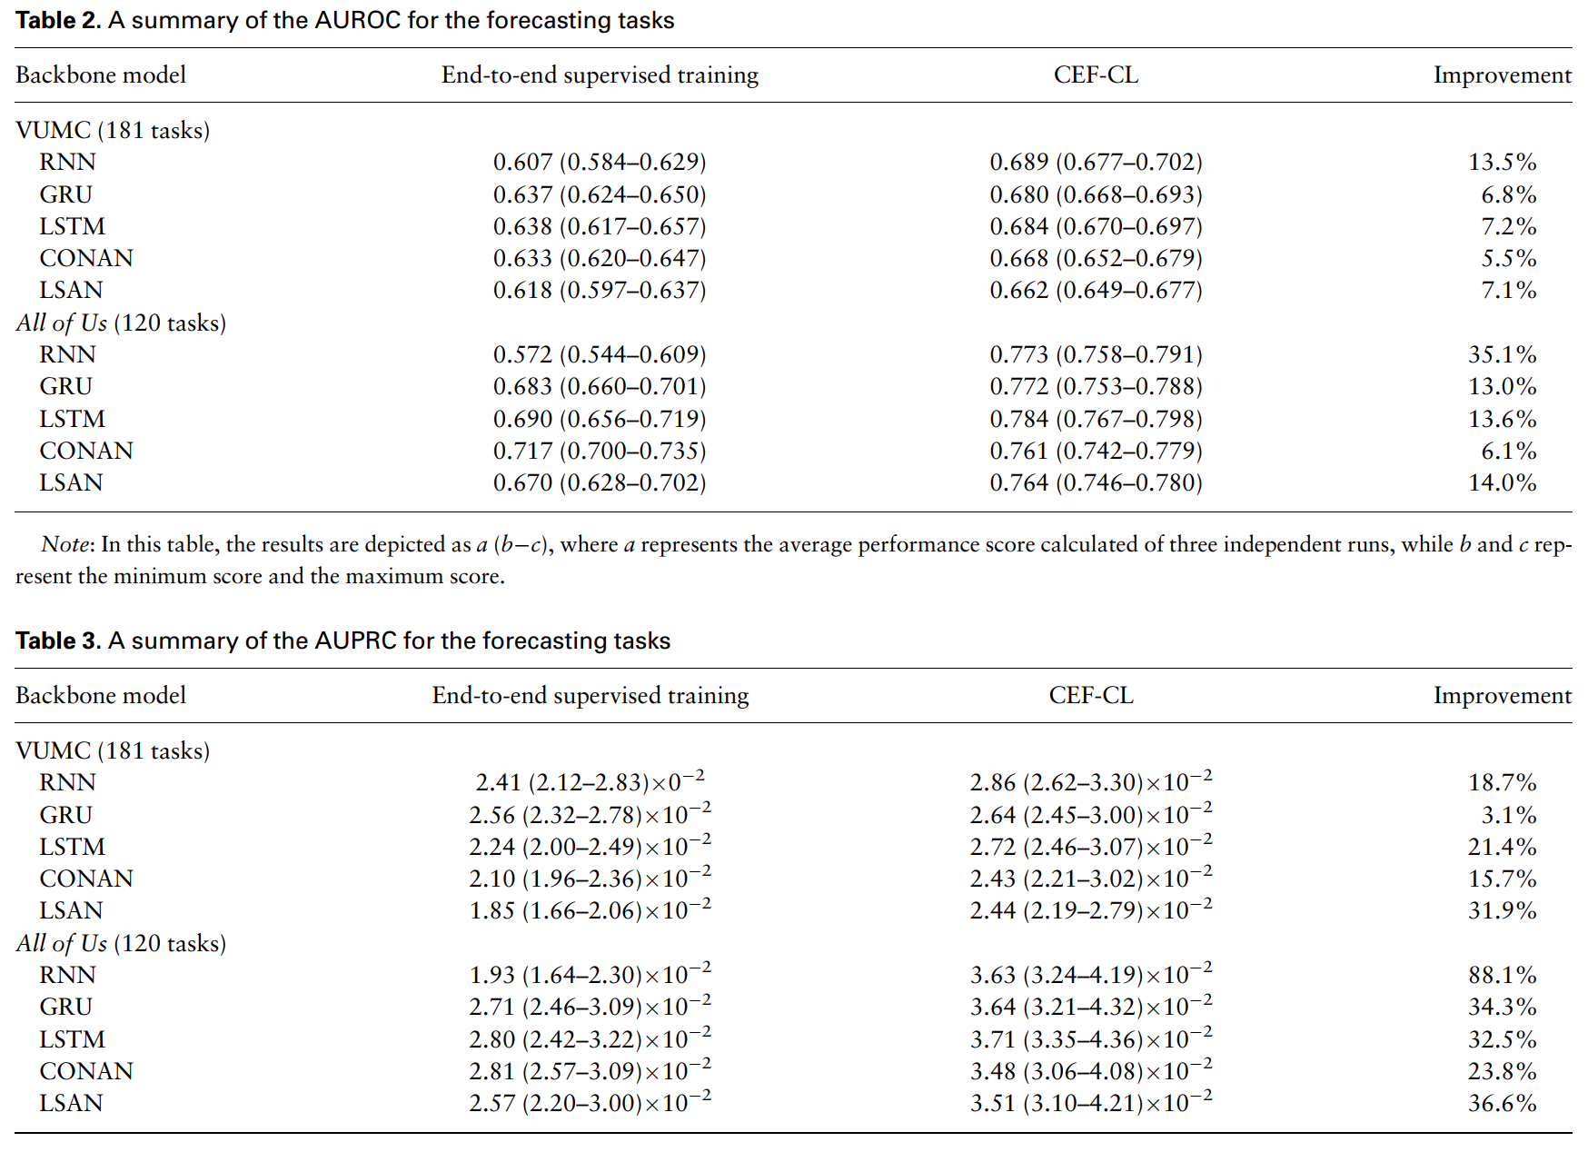
Results
2 datasets
181 tasks and 120 tasks
48k patients, 16k patients
Models tried: RNN, GRU,
LSTM, LSAN, CONAN

Slide 14
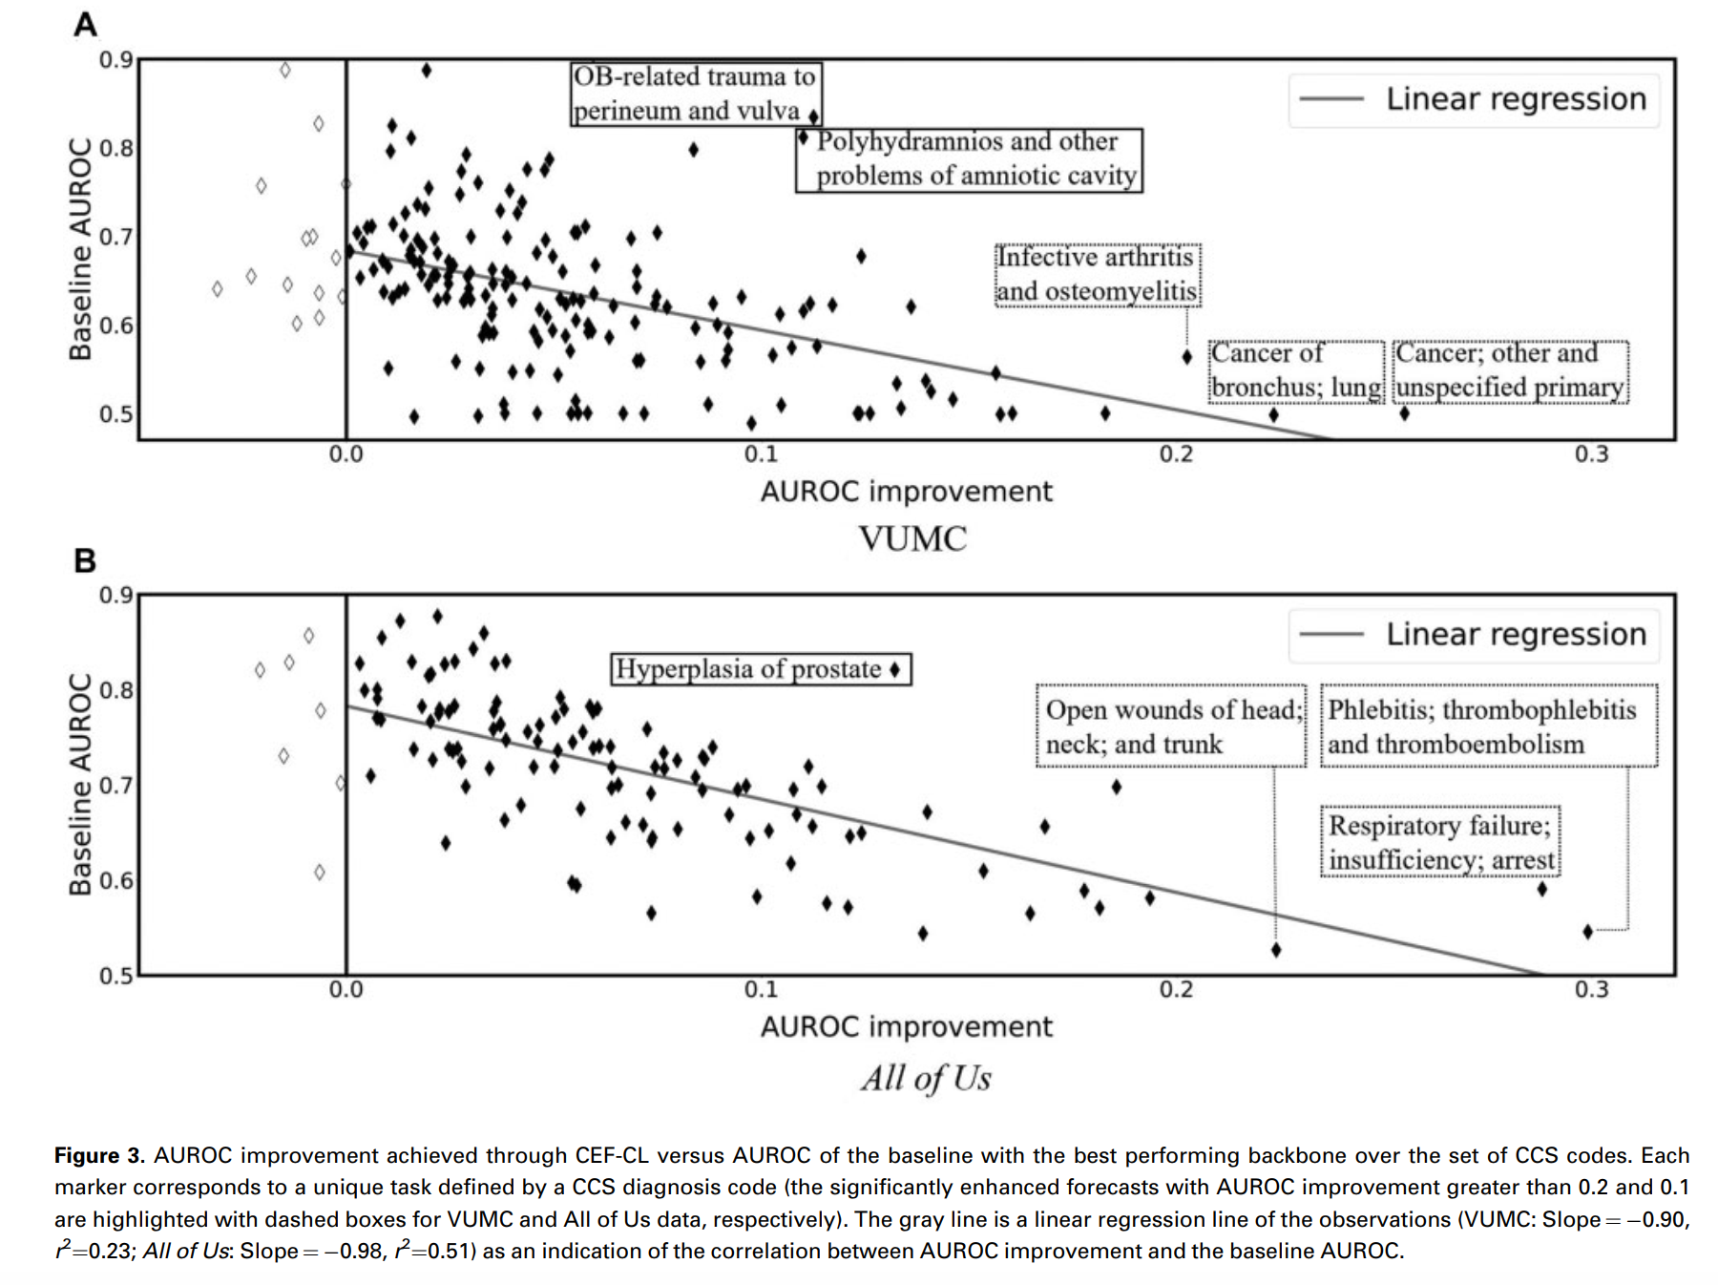
Results

