Slide 1


﻿Computational Framework for Sequential Diet Recommendation: Integrating Linear Optimization and Clinical Domain Knowledge
Asiful Arefeen, Niloo Jaribi, Bobak J. Mortazavi, Hassan Ghasemzadeh
Embedded Machine Intelligence Lab (EMIL)
Arizona State University
November 2022

Slide 2
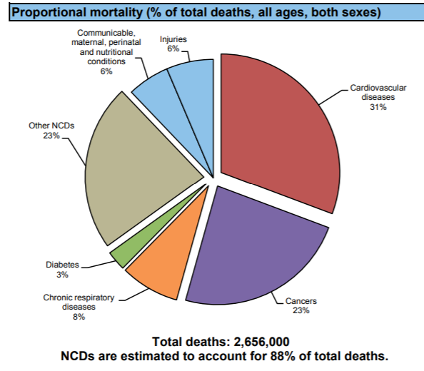
Facts and Motivations
Almost two thirds of all deaths in 21st century are due to diabetes, cancer and other chronic conditions
Risk from these disorders can be
minimized by maintaining proper diet,
reducing fats, carbs and ensuring
healthy lifestyle
There is a need to identify proper
location and method to channel effort
Correctly
Healthcare cost of chronic disease –
$4.1 trillion annually
Communicable, maternal, perinatal and nutritional conditions 6%
Injuries 6%
Cardiovascular disease 31%
Other NCDs 23%
Diabetes 3%
Chronic respiratory diseases 8%
Cancers 23%
According to CDC
USA
Image credit: https://ec.europa.eu/research/

Slide 3

Previous Work
Previous works/technologies/attempts were more interested in –
Keeping track of food intakes using apps and wearable sensors/cameras
Wrist worn IMU sensors and MyFitnessPal app
Used computationally expensive intelligent algorithms
One-one counselling
Issues
Not intelligent enough for portion control
Sometimes redundant to necessity and not best for mobile implementations
Very expensive
Image credit: https://blog.myfitnesspal.com/

Slide 4
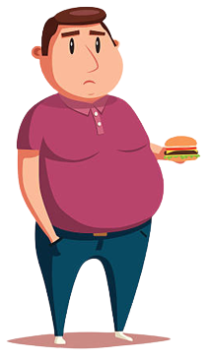
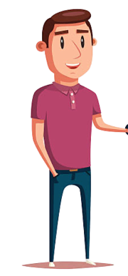

Our proposal
I need to get better shape…
3200 calorie
2200 calorie
Consumption (cal, protein, carb)
Our algorithm
Bob
obese
Food suggestions
Food suggestions
Food suggestions
Food suggestions
Food suggestions
Food suggestions
Intervention cycle 1
Intervention cycle 2
Intervention cycle 3
…..
…..
Intervention cycle T
Along the way, the algorithm will -
Help Bob reach his diet goal by gradually lowering his consumptions
Suggest food items from USDA dataset
Prevent drastic changes
Accommodate Bob’s adherence level
Optimizations for multiple macro/micronutrients (calorie, carb, fat…..) simultaneously
Image credit: https://www.istockphoto.com/

Slide 5
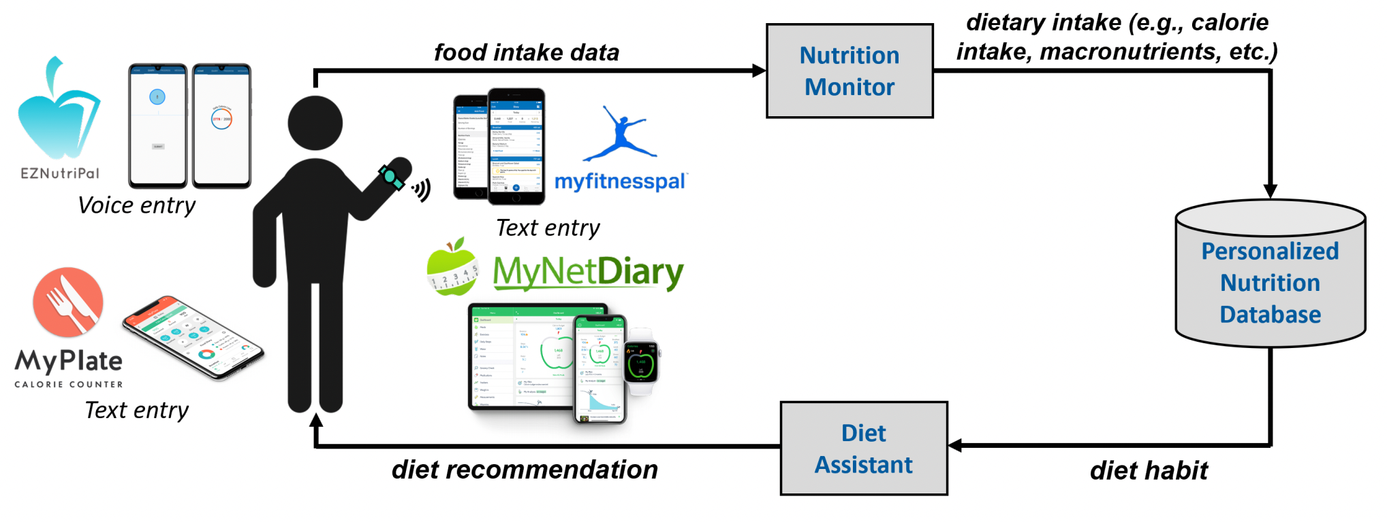
Our Proposal
Our method is-
inspired by human psychology
a linear optimization approach (thus lightweight)
able to make personalized diet recommendation based on user’s goal (thus intelligent)
flexible and robust against changes made during intervention periods (thus user friendly)
easy to implement (thus inexpensive)

Slide 6
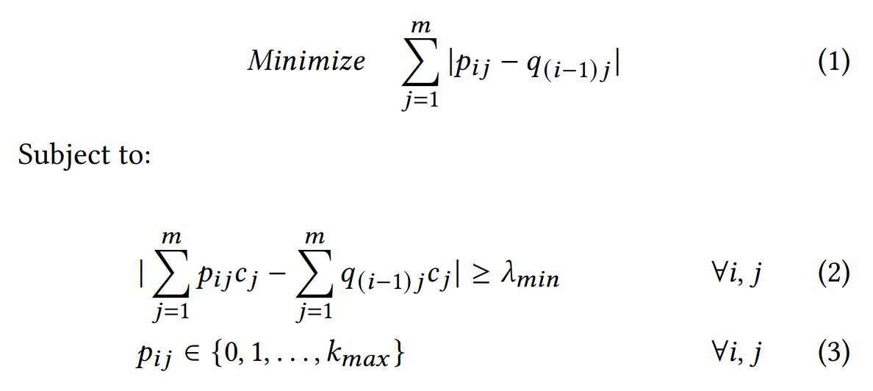
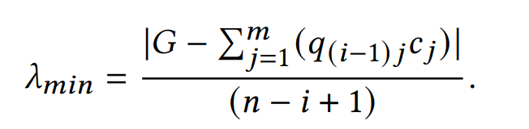
Linear Optimization
Amount of food j at i^{th} intervention cycle
Flow chart here
Amount of food j at (i-1)^{th} intervention cycle
Ensures change is not too small
Ensures suggestion is not unrealistic
After integer relaxation:
Round (p_{ij})
goal
Dynamically sets change limit based on distance from goal

Slide 7
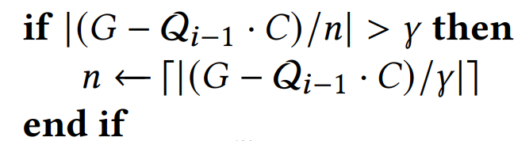

Detailed Features
Sequential Recommendation
Can handle user’s deviation from the suggested items/amounts given proper data
Takes on deviation data and produces new suggestions to meet goal in due time
Dynamic Convergence
Evaluates if goal is achievable in given time frame
If change per cycle is too drastic, increases the cycles
Adherence/Defiance
If user is d% defiant, algorithm adds d% to the suggested amount p_{ij}
We tried with
Energy, protein and sugar
Can work with other macro/micro-nutrients (e.g. fat, fiber, vitamins etc.)
Makes suggestion from USDA dataset

Slide 8
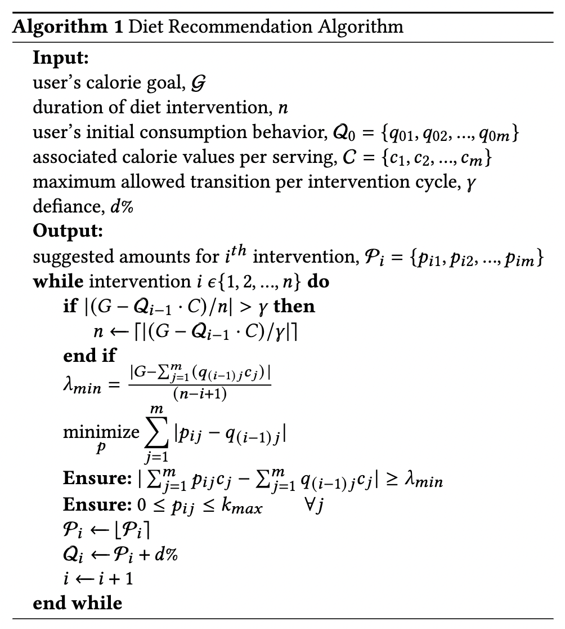
Algorithm
User’s goal
Desired number of intervention cycles (days/weeks)
User’s consumption behavior and their calorie values
Variables to prevent drastic change
defiance
Checks if goal is achievable without drastic change
Dynamically sets minimum change per cycle
Runs optimization
Rounds the amounts
Adds up defiance amounts

Slide 9
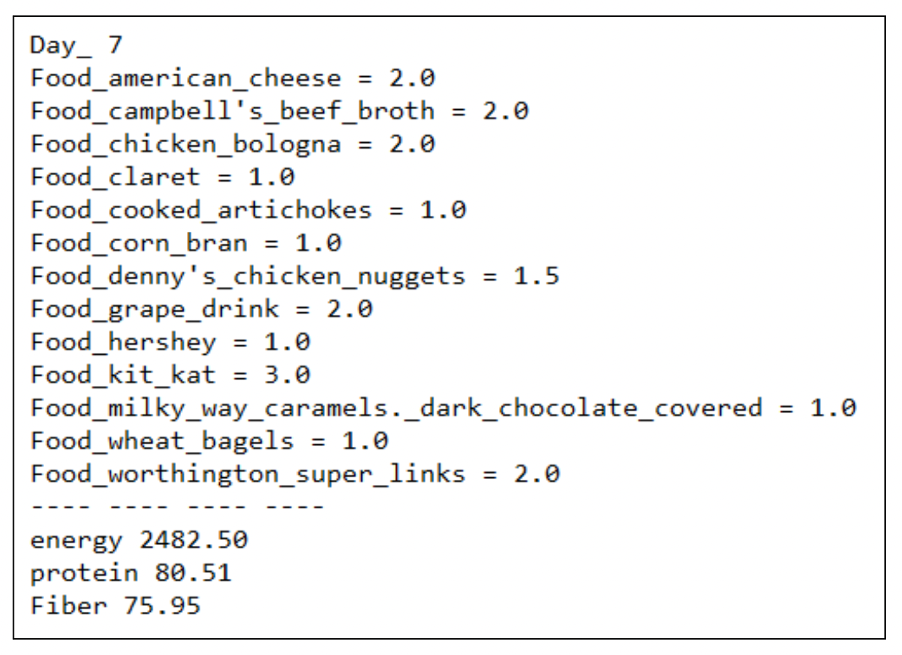
Output

Slide 10
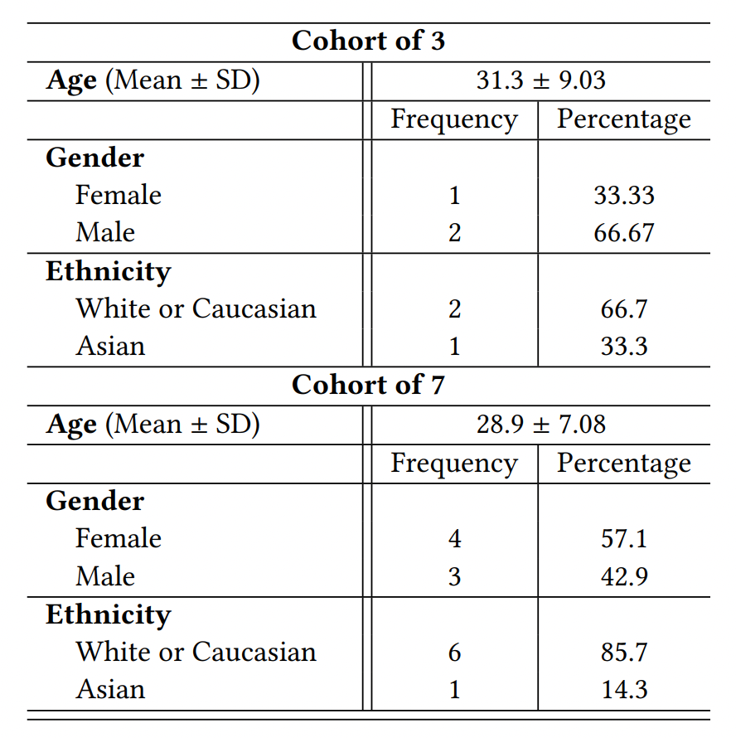
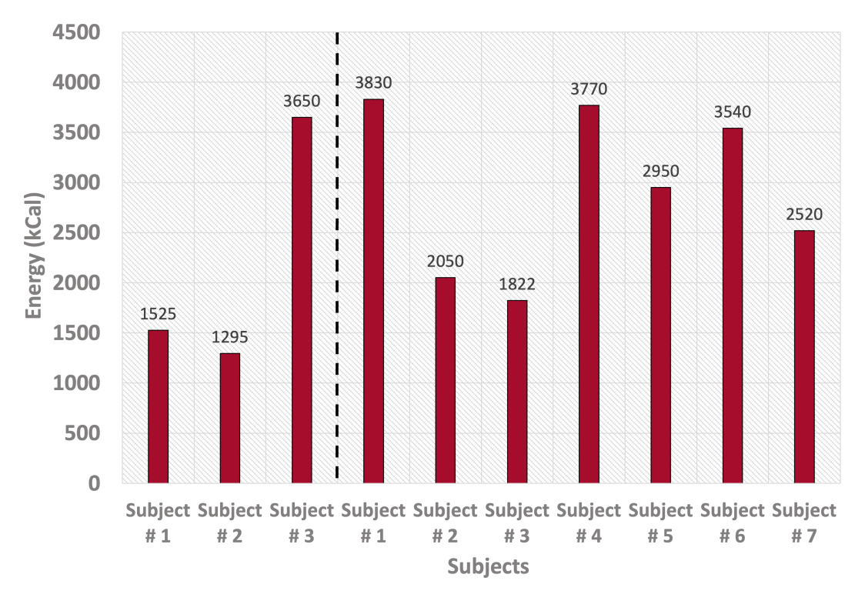
Evaluations (data)

Slide 11
Evaluations
Short-term diet management
Long-term diet management

Slide 12
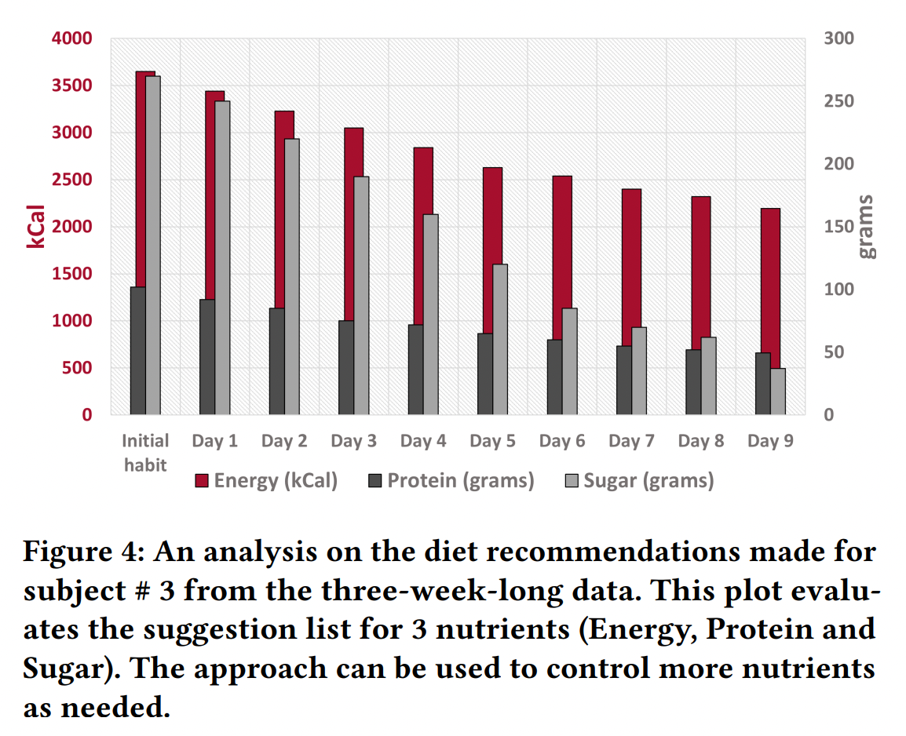
Evaluation (short term)
﻿Subject # 3 from 3-week cohort
Wants to reduce-
from 3650 kCal (average consumption behavior) to 2200 kCal
﻿protein (92.20g to 56g) and sugar (255.41g to 37.5g)
In a short period of 7 days
Algorithm detects drastic change.
Thus increases the intervention cycles (from 7 to 9 days)

Slide 13
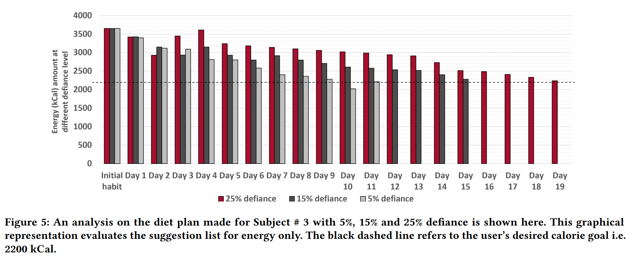
Evaluation (short term)
Multiple levels of defiance

Slide 14
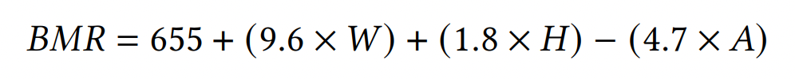

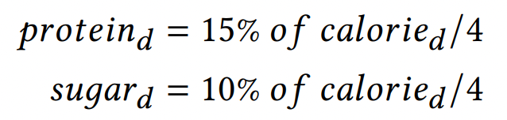
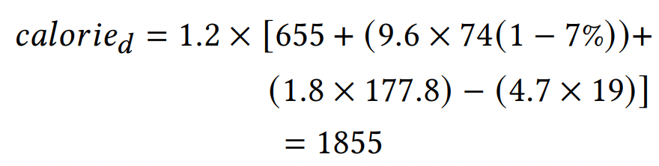
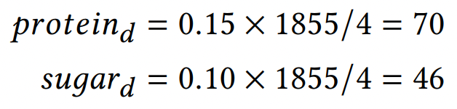
Evaluation (long term)
Goal setting- Harris-Benedict Equation
﻿a person’s age (A years), height (H centimeters) and weight (W kilograms), the basal metabolic rate (BMR) of a female subject is-
﻿calorie intake per day following pre-diabetic lifestyle with 𝜖% weight reduction in 𝑇 days-
﻿protein and sugar contribute roughly 15% and 10% of daily calorie requirement, respectively and ﻿each gram of both releases 4 kCal following the Atwater method
From literature, 𝜖 = 7% and T = 90 days are reasonable values.
﻿For a 19 years old female participant of 74 kilograms and 177.8 centimeters, if we focus solely on a diet intervention for weight reduction (with no association of physical exercise), her calorie goal would be-

Slide 15
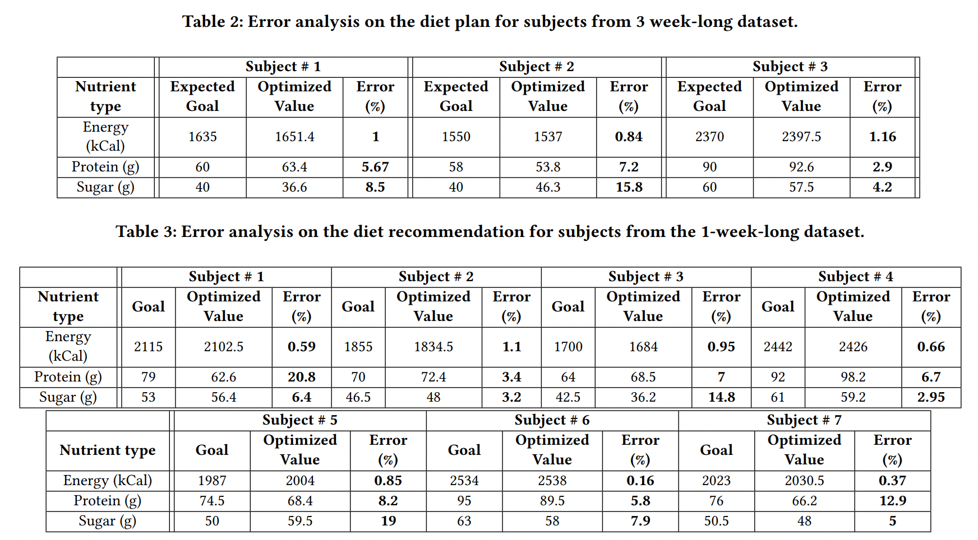
Results (long term)

Slide 16
Discussions and limitations
﻿Diet modification can be contingent upon more variables (e.g. physical activities, health conditions, cultural variance, etc.)
﻿Requires significant infrastructure development, user’s study, ﻿data collection, and algorithm design
We are more interested in ﻿behavioral change-based diet modification
Our proposal is solely consumption-based diet control
﻿significant and easily modifiable parameter
Intention was to develop a lightweight algorithm
Future work: Integrate ﻿retrospective details (HbA1c, deviations) into reinforcement learning models for diet-based behavioral interventions
Active intervention: Deploy this technology for calorie intake reduction in real world setting
Assess how to use this approach to improve other health outcomes such as weight and HbA1c

Slide 17




Thank You!
ghasemzadeh.com
aarefeen@asu.edu

