Slide 1
TABCF: Counterfactual Explanations for Tabular Data Using a Transformer-Based VAE
ICAIF ’24

Slide 2
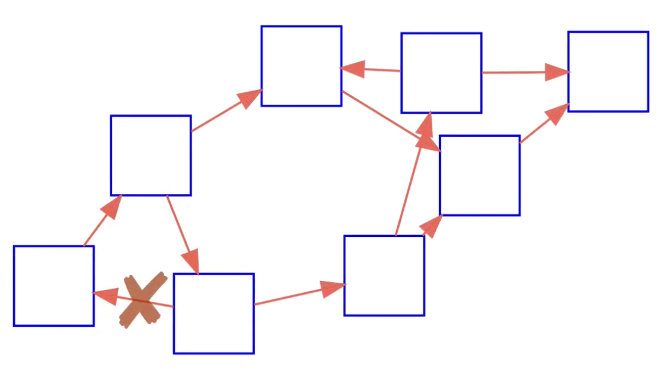


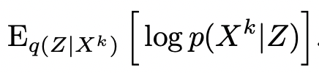
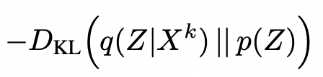

DAG-GNN VAE
How much perturbation should I do?
How can I control the quality of the CFs?
GNN (MLP)
$$z=μ+σ⋅ϵ$$
GNN (MLP)
x
x^{CF}
minimize
reconstruction
KL divergence
mxm
mxm
mxm

Slide 3
What TabCF offers?
Transformer based VAE
A new way to control the generated counterfactuals
Does not have any feature-type bias and works fine with categorical features.
Uses Gumbel-softmax activation to define an end-to-end differentiable pipeline

Slide 4
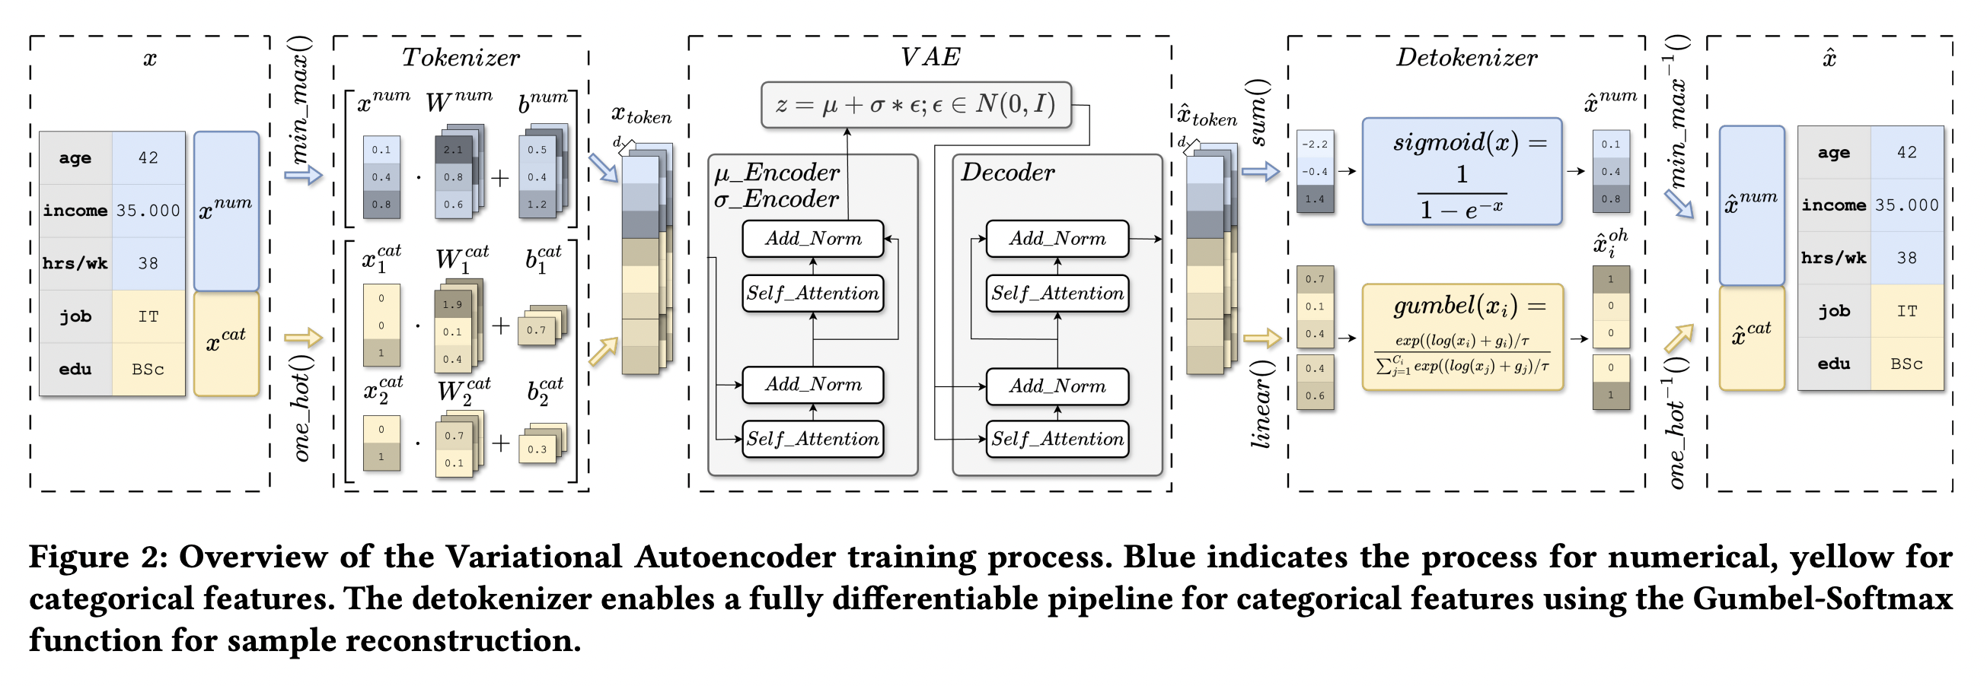

TabCF method: Transformer application

Slide 5
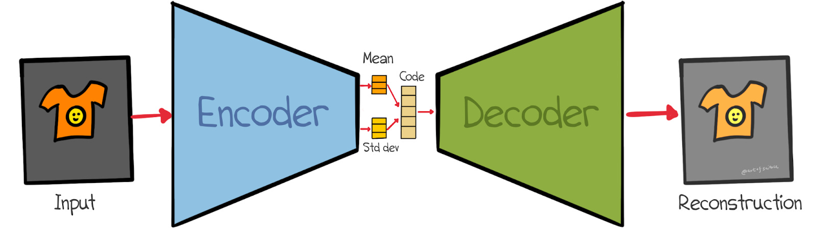
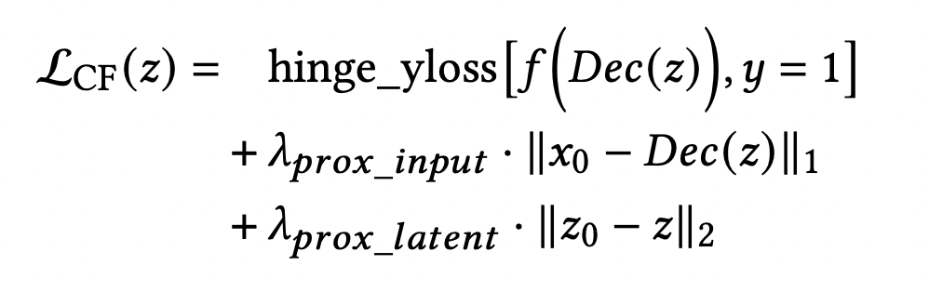
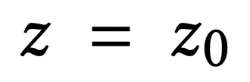
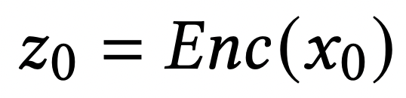
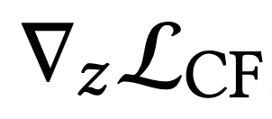
TabCF method: Perturbing the latent space
where
+

Slide 6
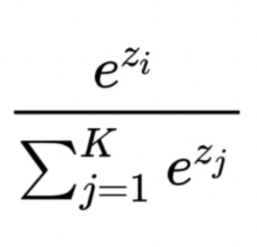
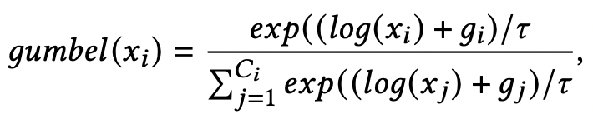

TabCF method:Using Gumbel-Softmax
$$Softmax\left(x_{i}\right)=$$
Gumbel softmax | Regular softmax
Generates hard one-hot-like outputs by sampling from a categorical distribution in a continuous and differentiable way. | Outputs a soft probability distribution across categories, but it does not directly sample distinct a specific category.
Directly outputs a discrete category | When backpropagating, softmax limits the network’s ability to recover discrete choices.
Uses noise and temperature to sample discrete numbers | Uses argmax to provide discrete number
Doesn’t use argmax | argmax is not differentiable

Slide 7
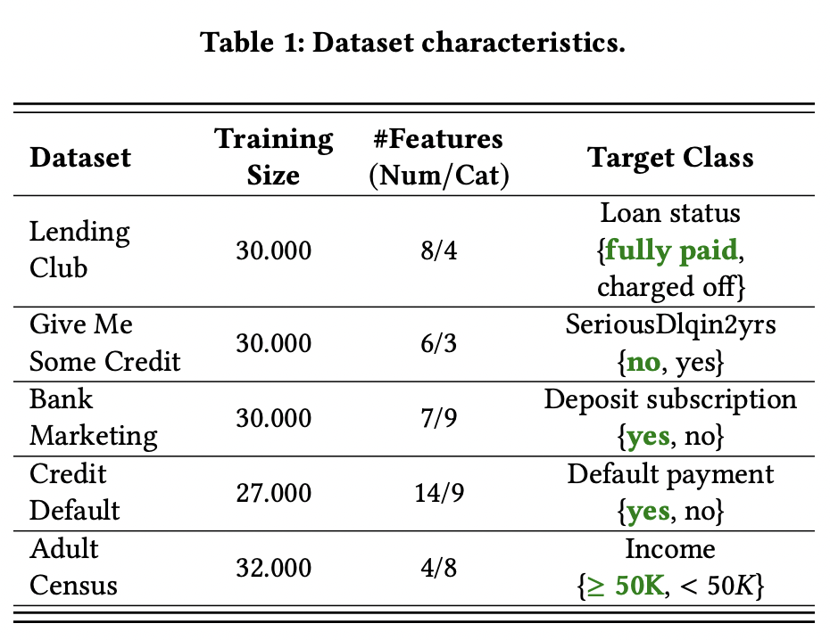
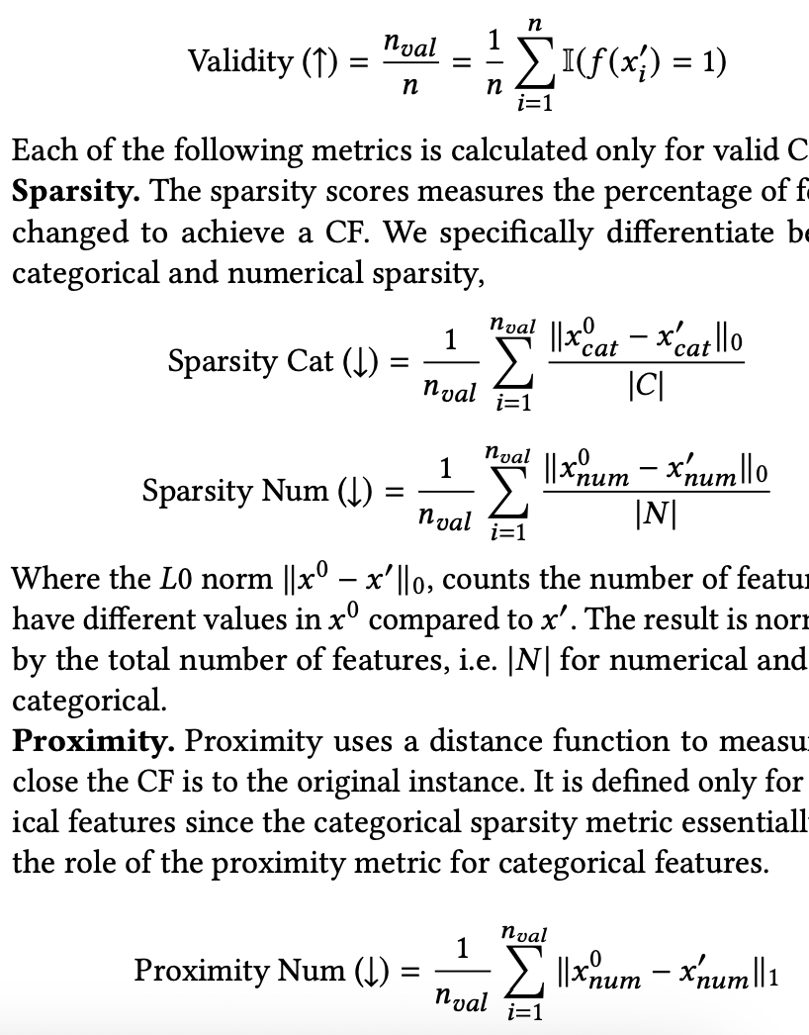
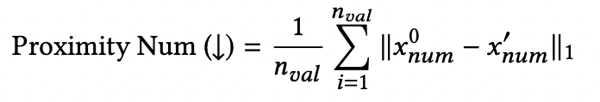
Datasets, validation metrics and baselines
REVISE: Uses fully-connected VAEs to learn latent representation. Uses gradient descent to update the latent representation
CCHVAE: uses conditional VAE. Doesn’t optimize a loss. Samples multiple points in the latent space until it finds one that fulfils the constraints.
Wachter: Uses Stochastic Gradient Descent (SGD) to optimize a loss function and generate CFs
DiCE: extends the Wachter method, add regularization loss for enforcing one-hot representations during optimization

Slide 8
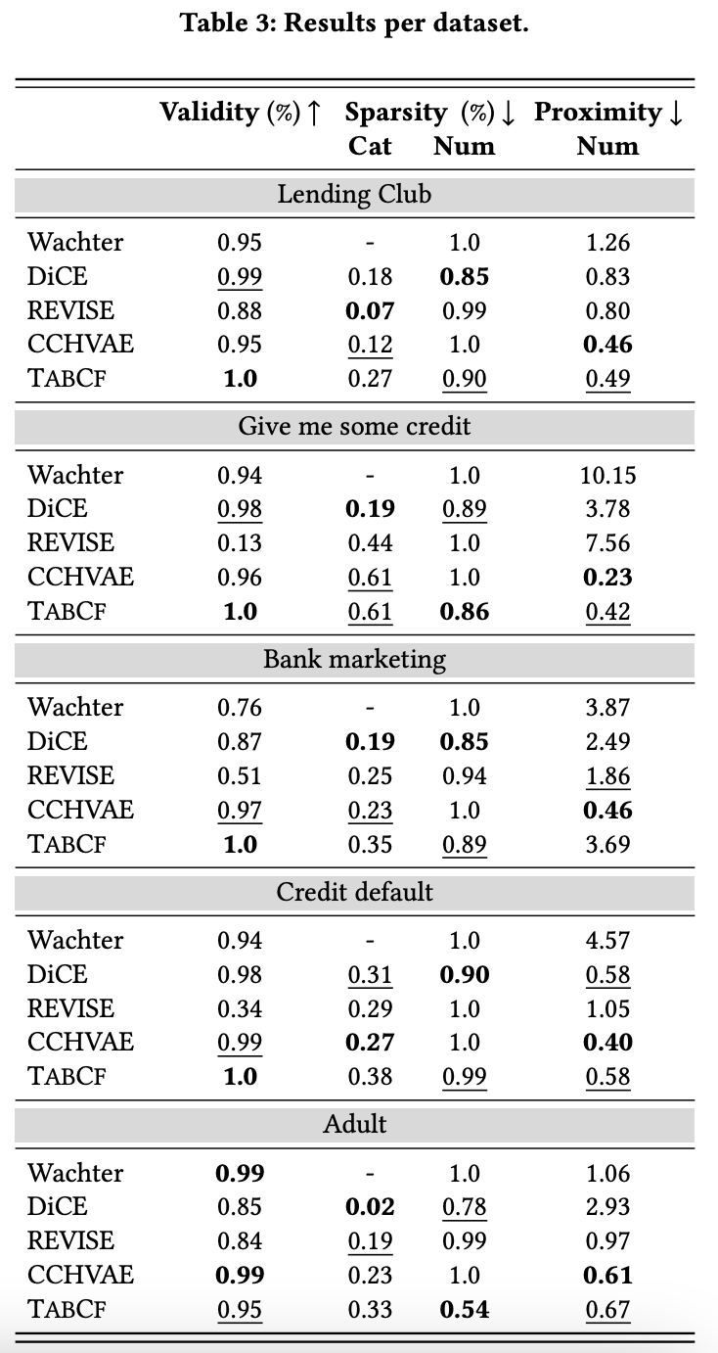
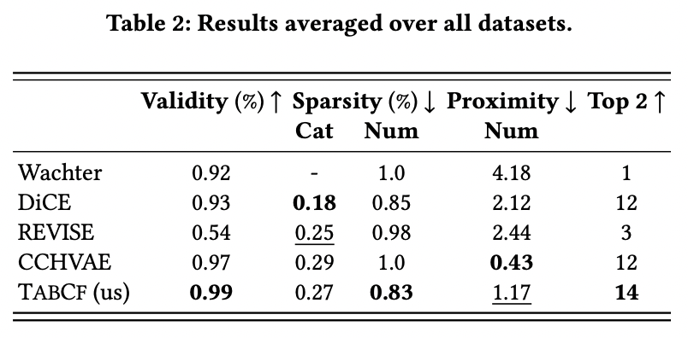
Results: Stats

Slide 9
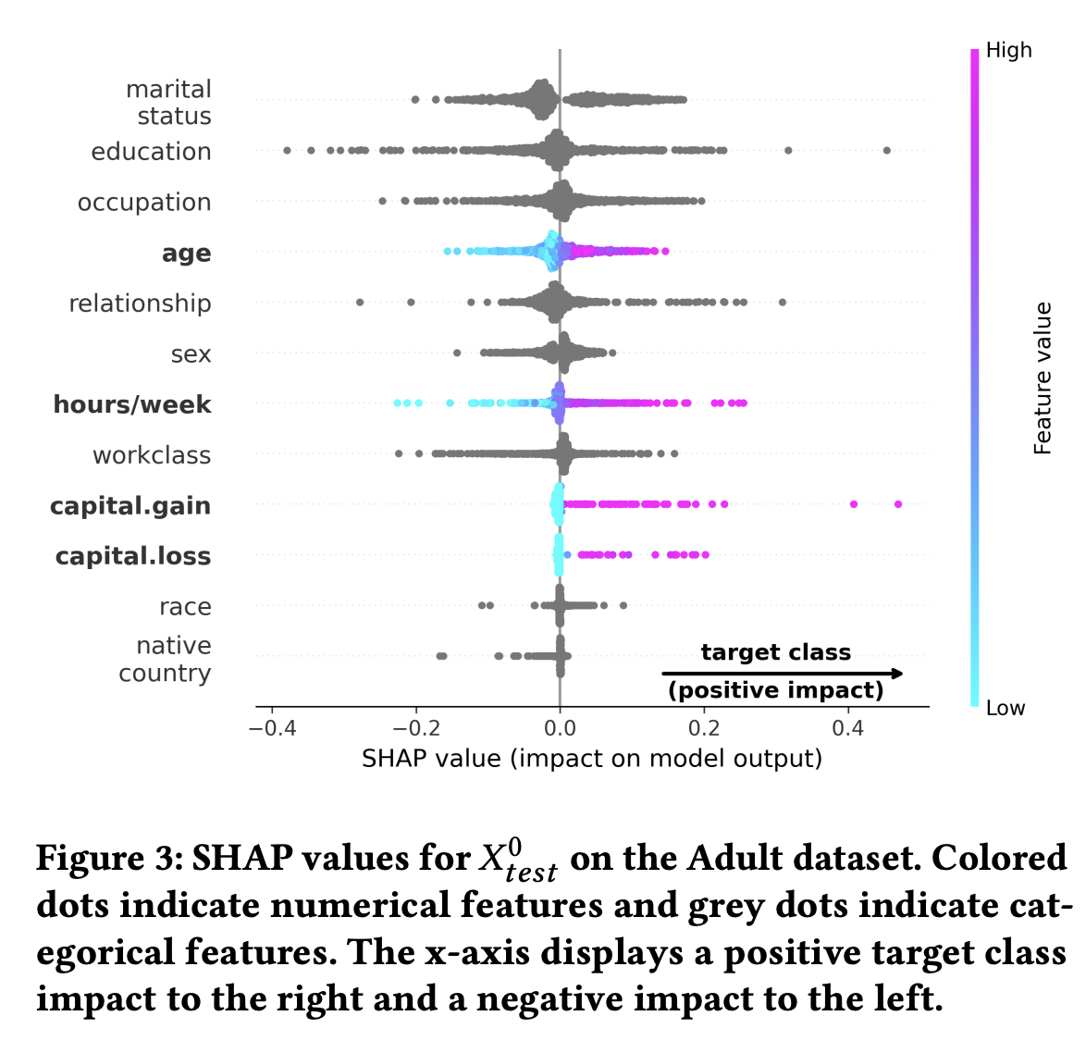
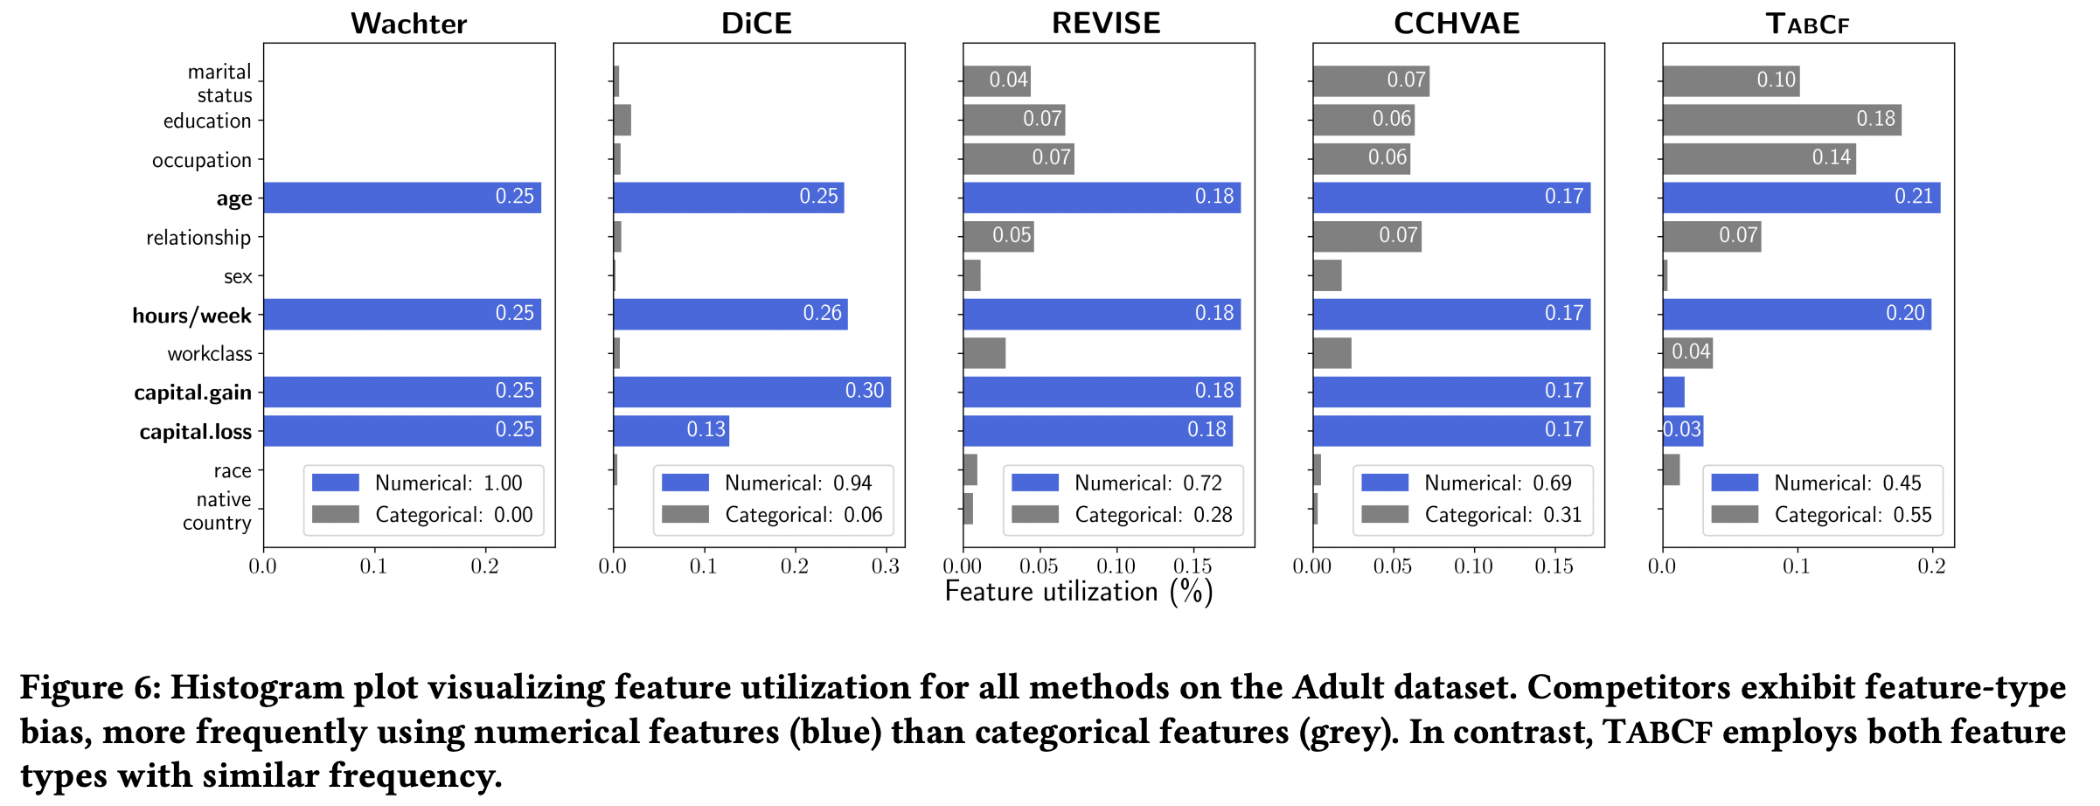
Results: Removing feature-type bias

Slide 10
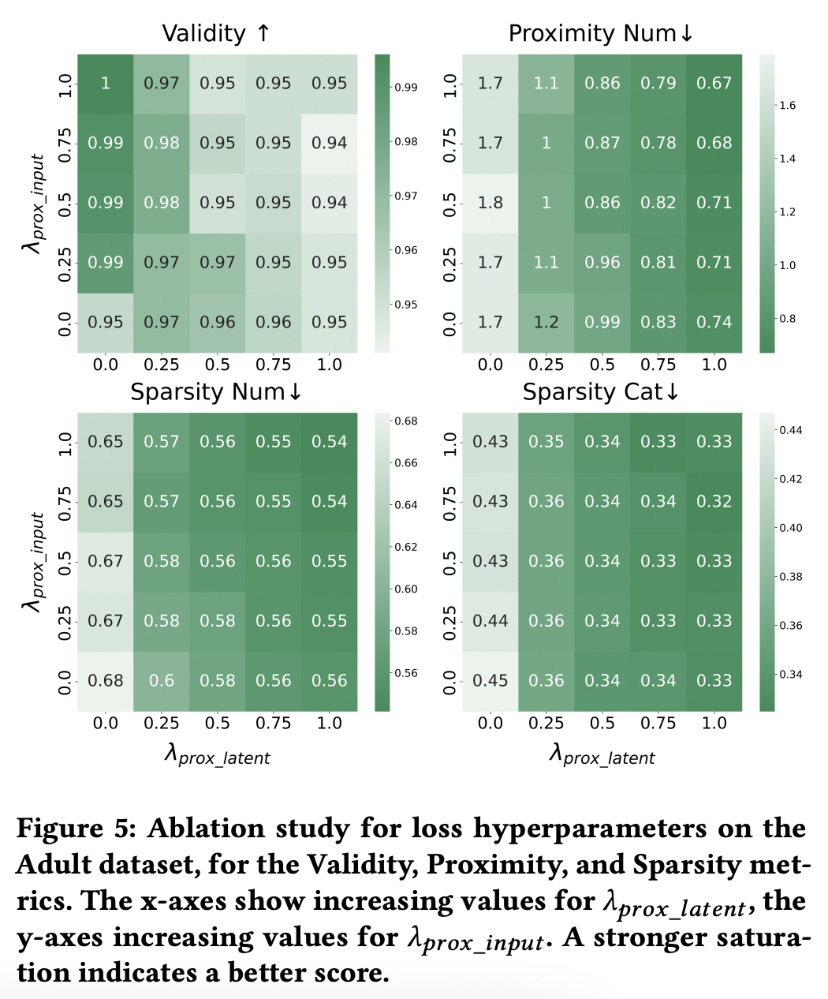
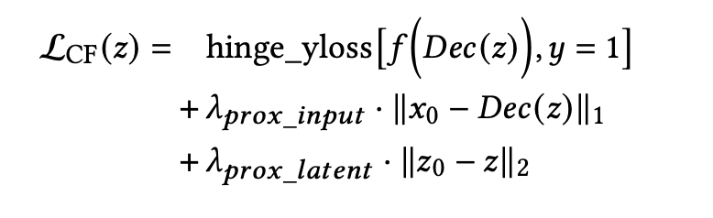
Results: Ablation Studies

