Slide 1


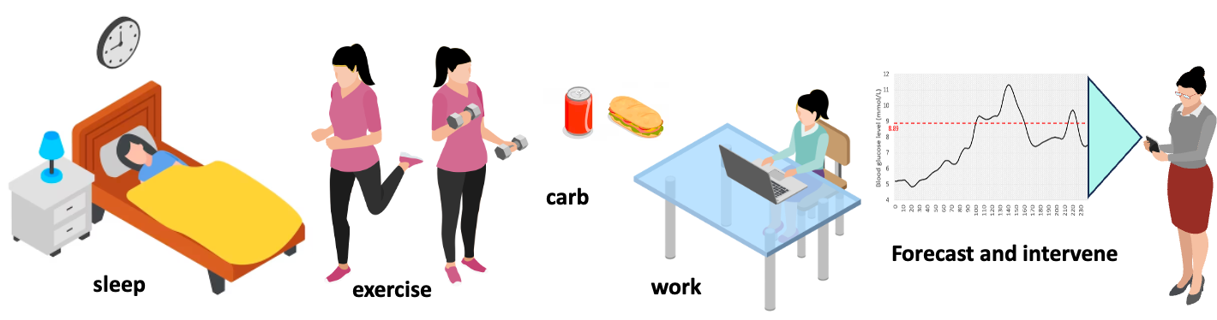
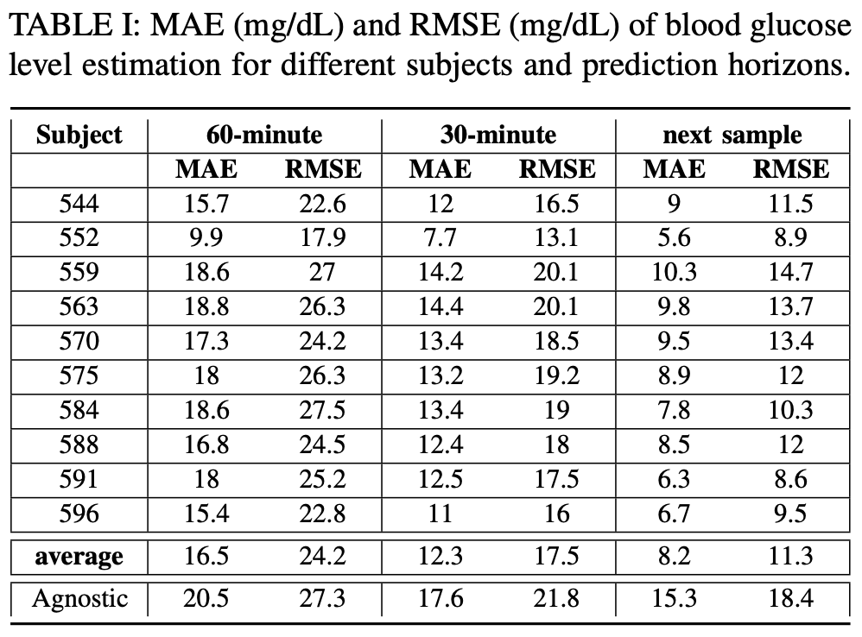
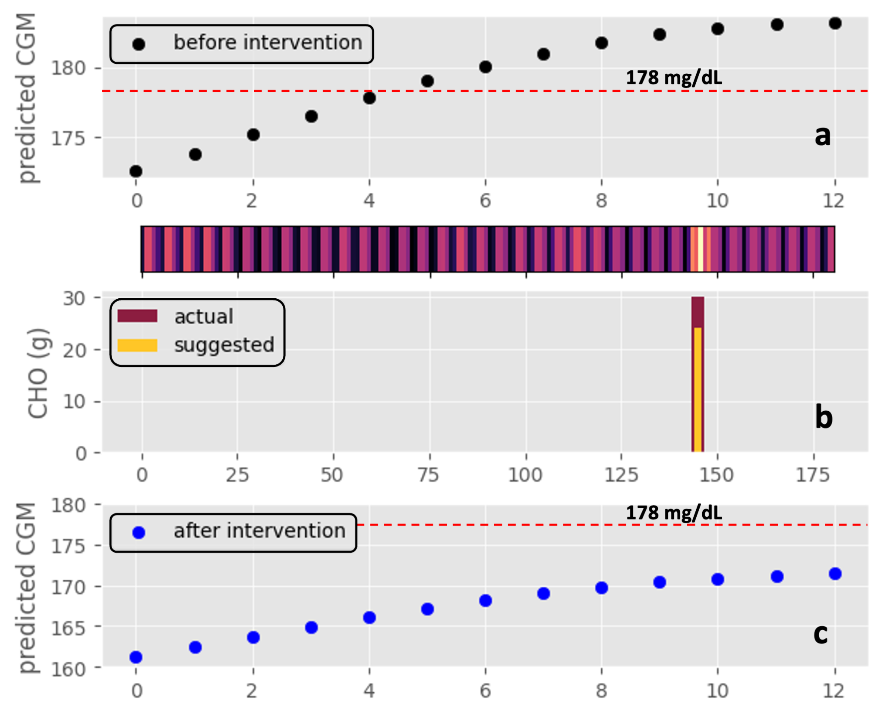

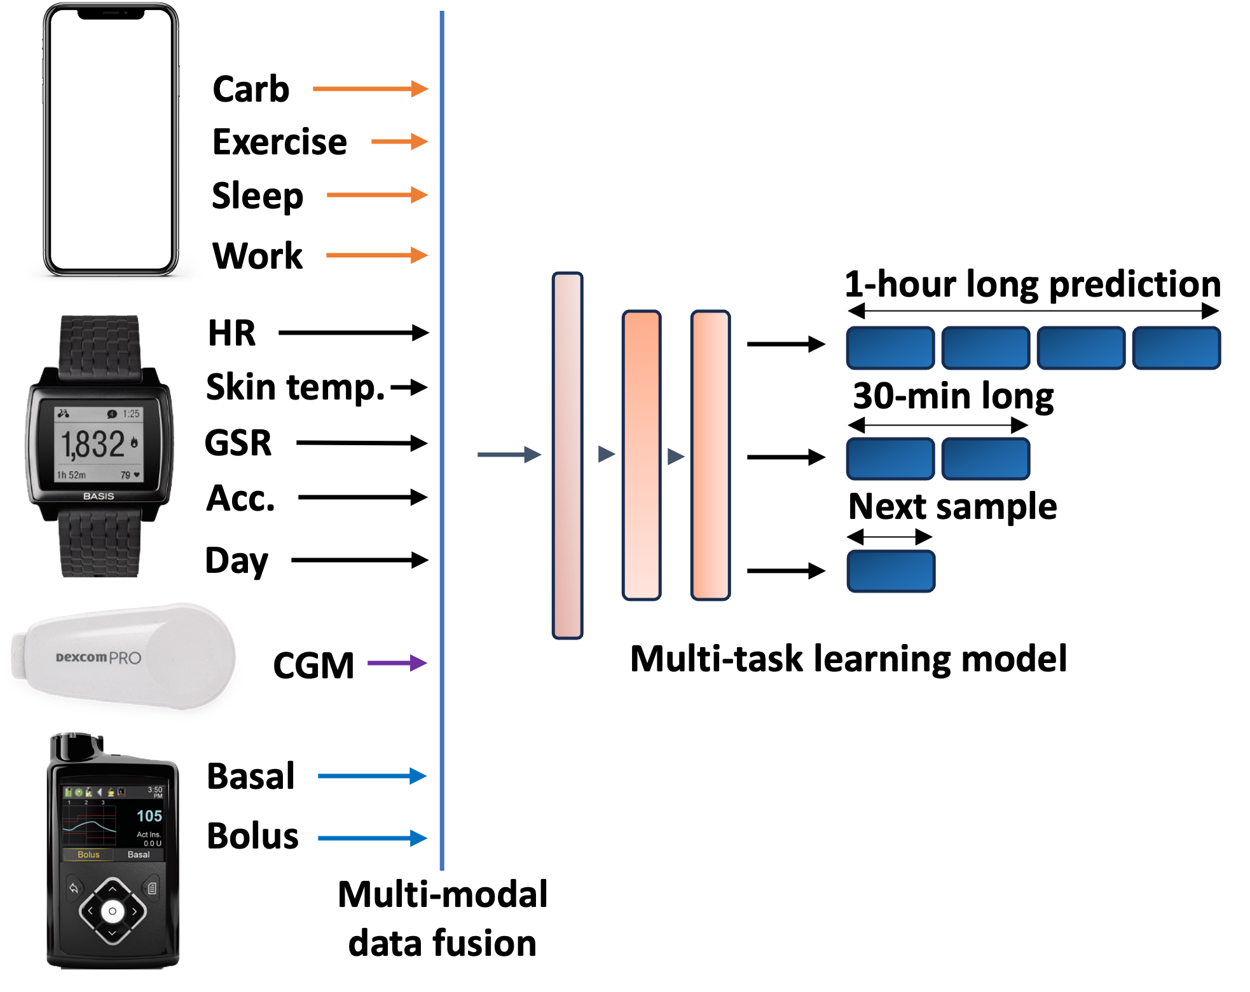
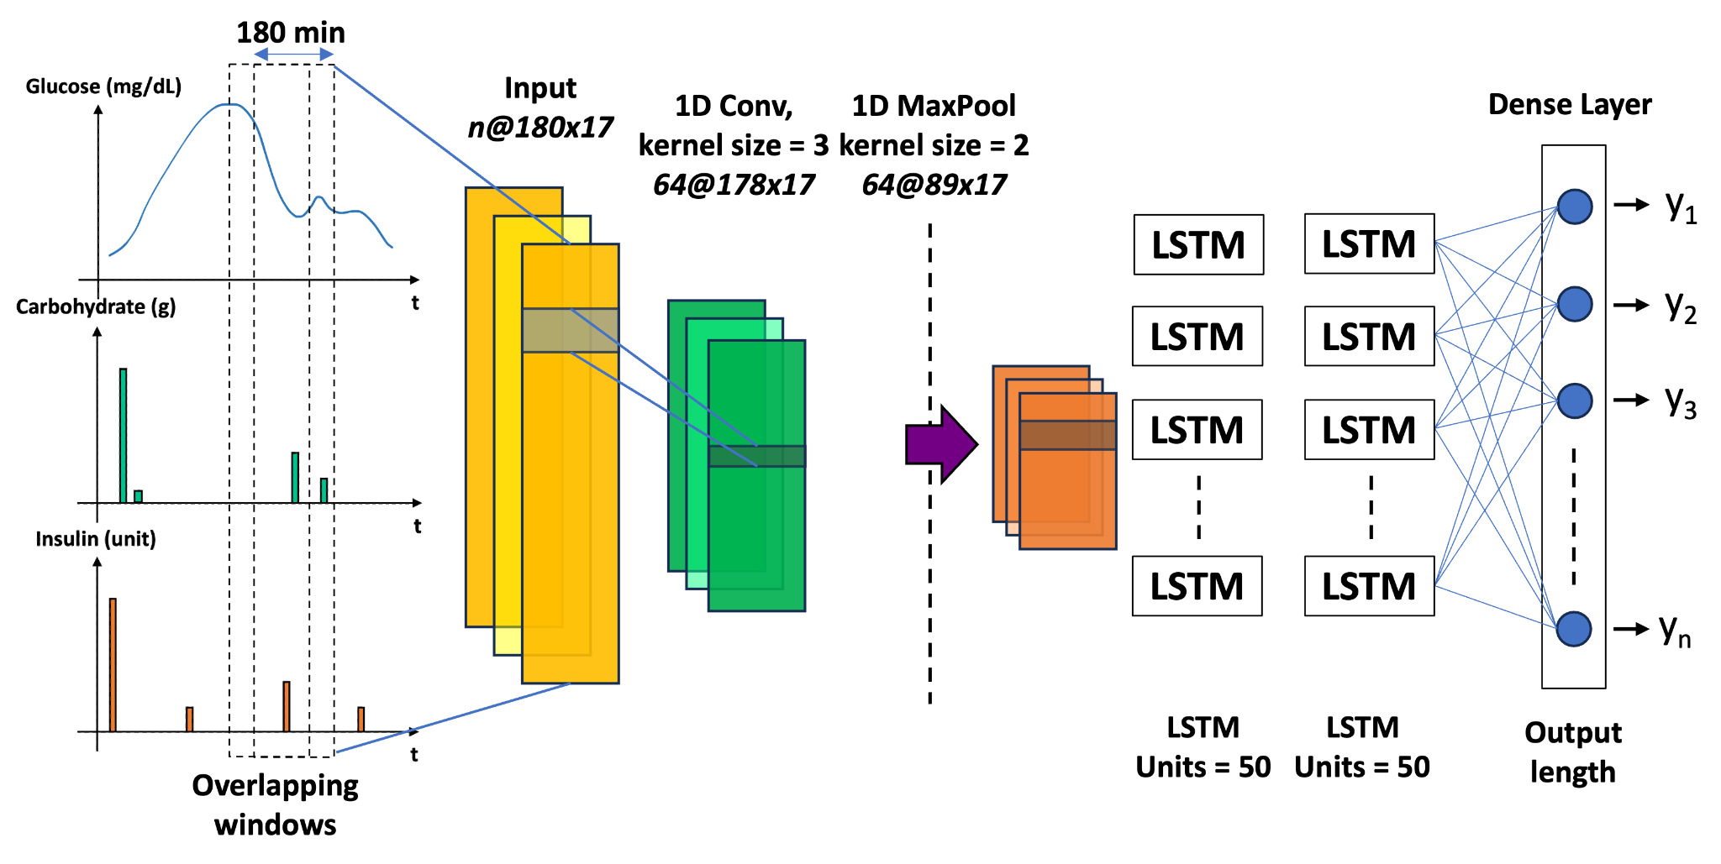
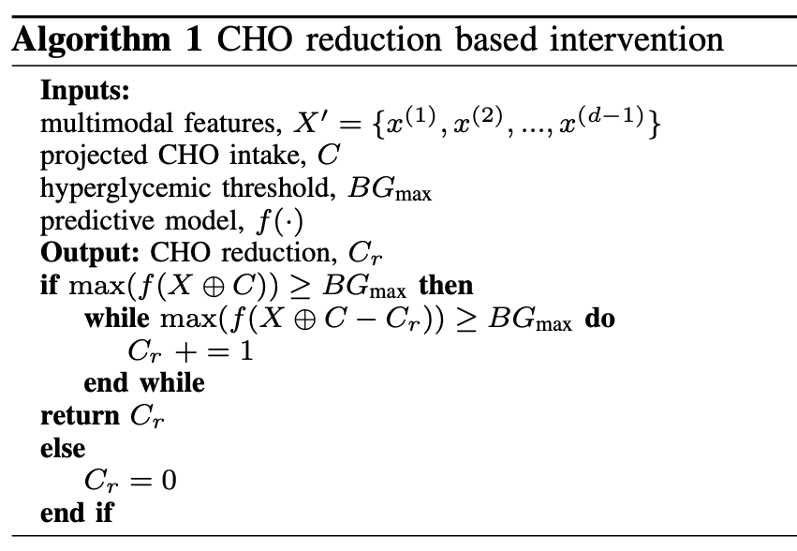
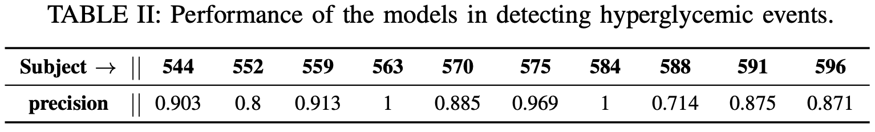
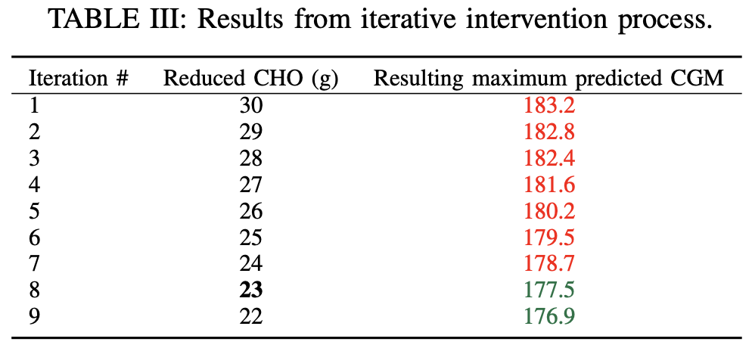
GlySim: Modeling and Simulating Glycemic Response for Behavioral Lifestyle Interventions
Asiful Arefeen and Hassan Ghasemzadeh Embedded Machine Intelligence Lab (EMIL), College of Health Solutions, Arizona State University
INTRODUCTION
Although Continuous Glucose Monitors (CGMs) are excellent tools for visualizing blood glucose levels, their computation ability is limited. CGMs cannot be used for interventions in advance to prevent abnormal events like hyperglycemia or hypoglycemia. We propose GlySim, an AI-driven algorithm that forecasts future blood glucose level and provides suggestions for behavioral modification if a dysglycemic event is imminent, allowing users to avoid dysglycemia.
GlySim achieves a small forecasting error (MAE) as low as 9.9 mg/dL and can detect dysglycemic events with an 89% accuracy rate.
AIMS
Develop a neural network to correctly forecast future glucose readings over a prediction horizon from users’ physiological, behavioral, medication data and to identify occurrences of impending dyslycemia.
Determine the most significant behavioral factor for an increase in glycemic response by analyzing the gradients of each target prediction.
Design an intervention plan by iteratively reducing the significant factor.
DATASET
OhioT1DM
12 Type 1 diabetes patients, monitored for 8 weeks
Self reported CHO amount, sleep hours, exercise and work intensity
Heart rate, skin response (GSR), acceleration, skin temperature were recorded on Empatica wristband
Participants wore Medtronic 530G/630G insulin pumps and Medtronic Enlite CGM that transmits blood glucose level every 5 minutes
Missing values were imputed with interpolation
2 subjects were removed from analysis for not having entries for CHO, work, sleep, and exercise sessions
44 days for training and 12 days for testing.
3 forecast horizon: 5, 30 and 60 minutes
METHOD
Design a Deep learning based forecasting model
• 1 convolution layer
• 2 LSTM layer
• Design includes a multi-task learning network with different prediction horizon for result comparison
The Neural Network works on multimodal timeseries data with a specific input horizon and forecasts blood glucose levels for a specific output horizon. The neural network is a function f that maps the d dimensional input features X of length t to the predicted blood glucose levels Y of length n.
Outlining the intervention with iterative reduction
• If an abnormal event is predicted, identify the most influential
factor (e.g. carbohydrate intake, past glucose level, insufficient
insulin, lack of exercise etc.) increasing the blood glucose level
• Gradient based methods like Grad CAM can be used to detect
the underlying factor
• Iteratively change the factor until normoglycemia is ensured
• Provide the user with optimal recommendations for achieving
normoglycemia
RESULTS
Forecasting
Mean-absolute-error to predict glucose level was 9.9 to 18.6 mg/dL (for 60 minute forecast horizon)
Results were better for shorter horizons
Abnormal event detection
Precision scores varied between 0.71 and 1 in detecting hyperglycemia
Intervention
Upon detection of an abnormal event, Grad-CAM pinpoints the most influential factor behind abnormality
RESULTS
Intervention
Once the significant factor is identified, GlySim keeps changing the value until normoglycemia is achieved
Stacked CNN-LSTM architecture of GlySim.
GlySim integrates data from smartphone, smartwatch, wearable CGM and insulin pump, and devises a multi-task learning model to predict glucose response
CONCLUSIONS
Our long-term objective is to create a simulator featuring a dashboard. The generalized model is not as effective as the subject-specific models, leading to generalization issues. Part of our follow-up work includes applying transfer learning and domain adaptation techniques.
ACKNOWLEDGEMENTS
This work was supported in part by the National Science Foundation, under grant CNS-2210133.
Asiful Arefeen, PhD Candidate, Biomedical Informatics. Website: asiful-arefeen.com, email: aarefeen@asu.edu
Embedded Machine Intelligence Lab (EMIL), Arizona State University. Website: ghasemzadeh.com

Slide 2
Template for a 48”x36” poster
Presenter name, Associates and Collaborators College of Health Solutions, Arizona State University
INTRODUCTION
This editable template is in the most common poster size (48” x 36”) and orientation (horizontal); check with the conference organizers for specific conference requirements regarding exact poster dimensions.
METHOD
Text
Be sure to spell check all text and have trusted colleagues proofread the poster. In general, authors should:
• Use the active tense
• Simplify text by using bullet points
• Use colored graphs and charts
• Use bold to provide emphasis; avoid capitals and underlining
• Avoid long numerical tables
Authors should rewrite their paper so that it is suitable for the brevity of the poster format. Respect your audience–as a general rule, less is more. Use a generous amount of white space to separate elements and avoid data overkill. Refer to Web sites or other sources to provide a more in-depth understanding of the research.
RESULTS
Images
Avoid the use of low-resolution images, especially those downloaded from the Internet, as they will reproduce poorly.
In order to insert an image, use the menu toolbar at the top of your screen.
Select:
1 Insert
2 Picture
3 From file
4 Find and select the correct file on your computer
5 Press OK
Be aware of the image size you are importing.
Captions set in a serif style font such as Times, 18 to 24 size, italic style.
Duis autem vel eum iriure dolor in hendrerit in vulputate velit esse molestie consequat.
Captions set in a serif style font such as Times, 18 to 24 size, italic style.
Duis autem vel eum iriure dolor in hendrerit in vulputate velit esse molestie consequat.
CONCLUSIONS
We have created this template with scientific researchers in mind and with the help of feedback we have received. We encourage any comments or suggestions so that we can continue to update and improve this template. To make a suggestion contact:
AIM
How to use this template
Highlight this text and replace it with new text from a Microsoft Word document or other text-editing program. The text size for body copy and headings and the typeface has been set for you. If you choose to change typefaces, use common ones such as Arial, or Helvetica and keep the body text between 26 and 32 points.
The text boxes and photo boxes may be resized, eliminated, or added as necessary.
Captions set in a serif style font such as Times, 18 to 24 size, italic style.
Duis autem vel eum iriure dolor in hendrerit in vulputate velit esse molestie consequat.
Captions set in a serif style font such as Times, 18 to 24 size, italic style.
Duis autem vel eum iriure dolor in hendrerit in vulputate velit esse molestie consequat.
ACKNOWLEDGEMENTS
Check to make sure you’ve acknowledged partner and funding agencies, either with text or with their logos.
Captions set in a serif style font such as Times, 18 to 24 size, italic style.
Duis autem vel eum iriure dolor in hendrerit in vulputate velit esse molestie consequat.
Captions set in a serif style font such as Times, 18 to 24 size, italic style.
Duis autem vel eum iriure dolor in hendrerit in vulputate velit esse molestie consequat.

