Slide 1

Navigating the Future of Metro Travel with Online Transaction Smart Cards
August 30th
Presentation on Capstone project
presented by,
Target_Blank (5th Group)
CAPSTONE ‘23

Slide 2
Submitted by,
Instructed by,
August 30th
Khan Md Hasib
Assistant Professor
Department of CSE, BUBT
Shahin Alam
ID: 19202103340
Md. Nafees Ashker
ID: 19202103403
Prionto Arefin Prio
ID: 19202103405
Mushfiq Alam Sami
ID: 19202103420
Md. Mamun Miah
ID: 19202103422
Supervised by,
Humayra Ahmed
Assistant Professor
Department of CSE, BUBT

Slide 3

Outline
August 30th
Introduction
Components
Motivation
Proposed Methodology
Objectives
Flow Chart
Literature Review
Conclusion
CAPSTONE ‘23
Problem Analysis
References

Slide 4
Introduction
August 30th
What it is?
Online transaction system/ application enabled Metro rail smart card system.
Allows faster payments from any location.
Reduced station entry traffic.
Secure passenger data protection and fraud prevention.
Account administration with balance monitoring and fare payment management.

Slide 5
Motivation
August 30th
Why it is needed?
Integration with online transactions for faster, convenient, and secure fare payments.
Centralized management through a secure server, reducing traffic at station.
Enhanced security measures to protect passenger data and prevent fraud.
Account administration features monitor balances and manage fare payments.
Customizable information sharing options, giving users control over their data.

Slide 6
Objectives
August 30th
What are the aims of the project?
Develop an Online Transaction system/ application.
Implement smooth and precise online Recharge Functionality.
Develop Card Balance and Transaction monitoring module.
To ensure Security and Privacy of users' and passengers'.
Integrate with Existing Metro Rail Infrastructure.

Slide 7
Literature Reviews
August 30th
Backed by several literature reviews!
[1] A.Shaik et al. proposed a new MRTS architecture, featuring modern mobile app for internet transactions in transportation. RFID technology for e-ticketing and offers insights into existing systems. The app offers better security and a comprehensive solution for a metro rail ticketing system, enhancing passenger experience and leveraging mobile technology.
[2] Marie-Pier Pelletier et al. Proposed a technique to collect revenues in public transit producing large quantities of detailed data communicating with a central server without physical contact. he smart card system is of a great service in this sector by adjusting systematic schedule adjustment, distinguishing planned and implemented systems, and survival models applied to ridership.

Slide 8
Literature Reviews
August 30th
Backed by several literature reviews!
[3] Lacmanović et al. Utilized embedded ac-RFID technology rather than contactless transactions, which do not call for physical contact. The main goal was to enhance customer satisfaction for retail transactions while retaining computing speed and RF sensitivity. The firm can tailor the forms of payment media thanks to the streamlined user experience with the payment system.
[4] Chau, Patrick Y. K. et al."Octopus," an automated fare collection system, is composed of three crucial components. By focusing on a narrow market with high transaction volumes, it offers users of various public transit modes convenience and cost-effectiveness. Transactions are accelerated and made simpler using contactless smart cards, whose independence from rival platforms ensures widespread acceptance and rapid uptake.

Slide 9
Literature Reviews
August 30th
Backed by several literature reviews!
[5] Olivier Caelen et al. introduced a fraud detection strategy for online credit card transactions using transaction qualities, customer spending patterns, and network features. The "six-seconds rule" enables accurate online and offline fraud detection.
[6] AL-Maliki et al. proposed a payment protocol with five methods: magnetic stripes, chip & PIN, chip & signature, contactless cards, and mobile payments. The focus was on security attacks to uncover vulnerabilities in the EMV payment protocol.

Slide 10
Problem Analysis
August 30th
Problem arose from analyzed reviews!
The existing systems need physical contact during balance recharges.
Integrating online transactions may cause data breaches.
The user experience is not so convenient account monitoring.
potential disparity in speed and efficiency.
Legacy infrastructure might cause compatibility issues with the new online system.

Slide 11










Hardwares
Softwares
August 30th
RFID Card & Reader
VS Code & Bash Terminal
NodeMCU
NodeJS
Intel Core i3 or AMD Ryzen 3
postgreSQL
Minimum of 4 GB of RAM
Git
OS: Windows or Linux
React Native

Slide 12
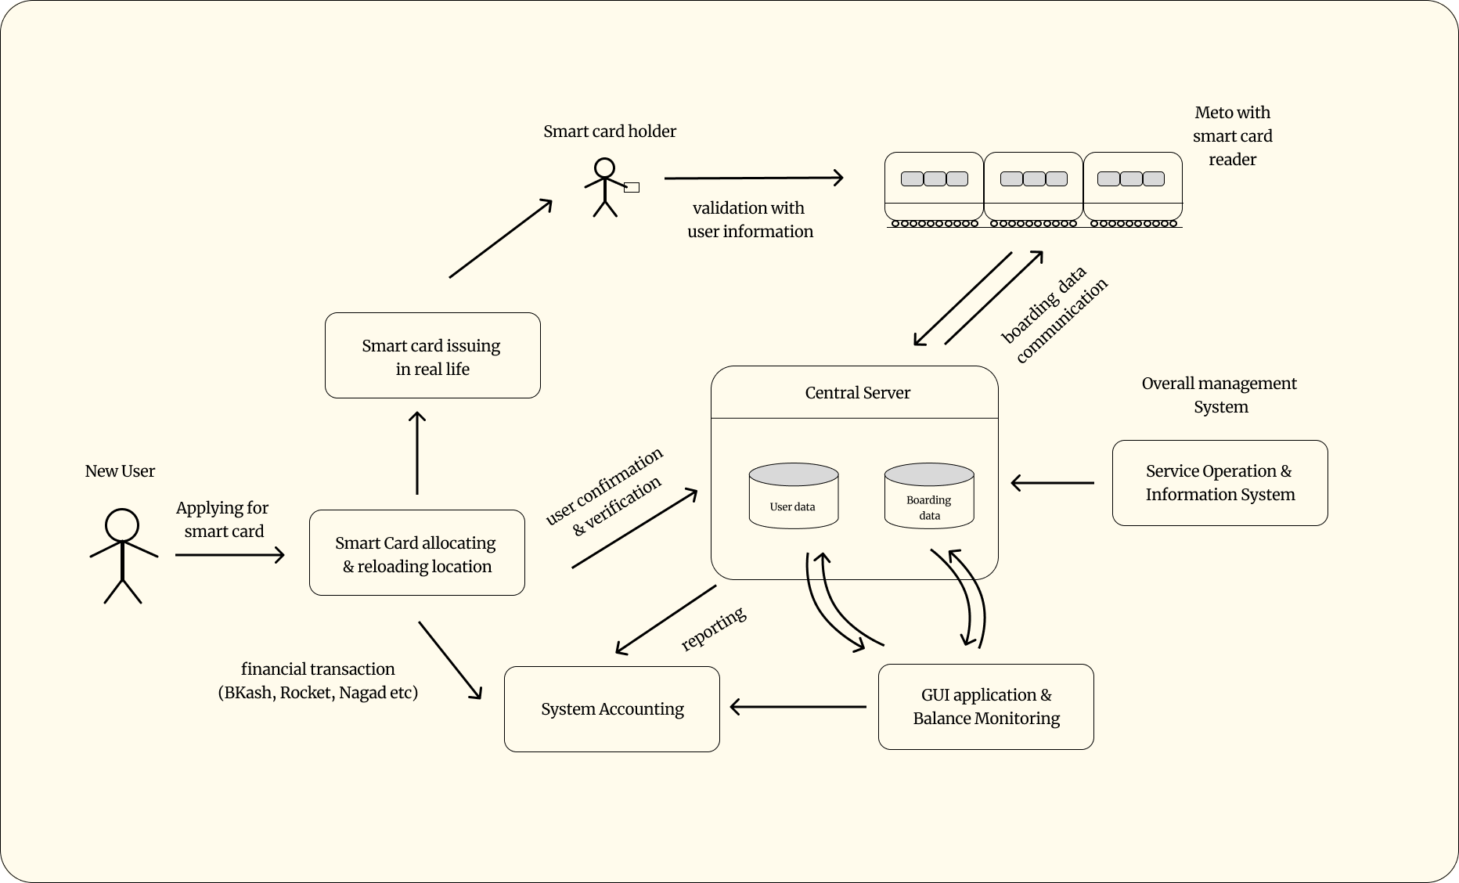
Proposed Methodology
CAPSTONE ‘23

Slide 13
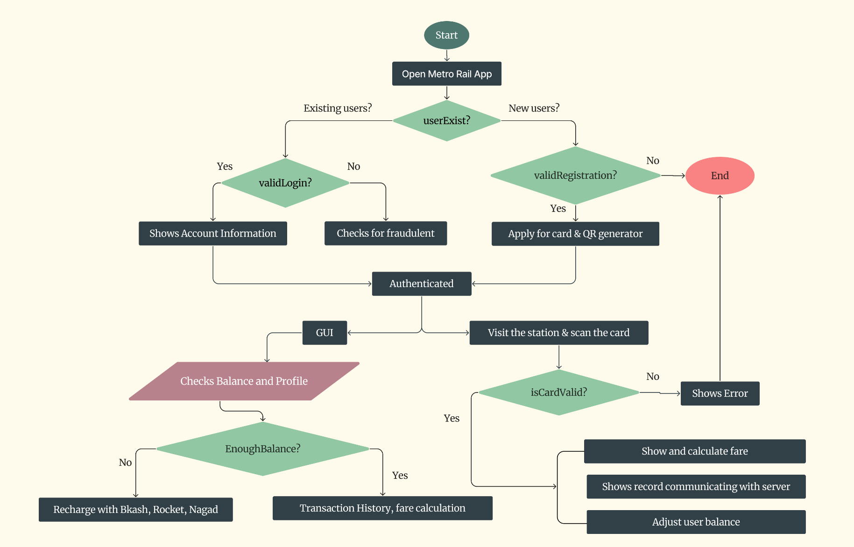
Flow Chart
August 30th

Slide 14
Conclusion
August 30th
Literature reviews explore metro implementation, benefits and user satisfaction.
Case studies analyze contactless cards, security measures and user feedback.
Integration potential transport and non-transport payment systems is studied.
The review notes setup costs, compatibility issues, and future trends like technology advancements and mobile usage expansion.

Slide 15
References
August 30th
[1] Anisha P R Ravi Shankar Reddy A Azmathulla Shaik, Kishor Kumar Reddy C. Mrts: A robust and scalable architecture for metro rail ticketing system. Pages 1–6, 01 2014.
[2] Marie-Pier Pelletier, Martin Tr ́epanier, and Catherine Morency. Smart card data use in public transit: A literature review. Transportation Research Part C: Emerging Technologies, 19(4):557–568, 2011.
[3] Izabela Lacmanovi ́c, Biljana Radulovi ́c, and Dejan Lacmanovi ́c. Contactless payment systems based on rfid technology. In The 33rd International Convention MIPRO, pages 1114–1119, 2010.
[4] Patrick Y. K. Chau and Simpson Poon. Octopus: An e-cash payment system success story. Commun. ACM, 46(9):129–133, sep 2003
[5] Olivier Caelen Tina Eliassi-Rad Leman Akoglu Monique Snoeck Bart Baesens Veronique Van Vlasselaer, Cristian Bravo. Apate: A novel approach for automated credit card transaction fraud detection using network-based extensions. 75, 04 2015
[6] Nicola Button AL-Maliki. Analysing and improving the security of contactless payment cards. 03 2020

Slide 16
August 30th
Thank You!
CAPSTONE, ‘23

