Slide 1
Online Transaction integrated Metro Rail Smart Card system
JULY 23th
Presentation on Capstone project
presented by,
Target_Blank ( 5th Group )
CAPSTONE ‘23

Slide 2
Submitted by,
JULY 23th
Submitted to,
Md. Nafees Ashker
ID: 19202103403
Prionto Arefin Prio
ID: 19202103405
Mushfiq Alam Sami
ID: 19202103420
Md. Mamun Miah
ID: 19202103422
Shahin Alam
ID: 19202103340
Khan Md Hasib
Course Instructor
Assistant Professor
Department of CSE
BUBT

Slide 3
Introduction
JULY 23th
What it is?
Metro rail online transaction system/ application enabled smart card system.
Allows faster payments from any location.
Reduced station entry traffic.
Secure passenger data protection and fraud prevention.
Account administration with balance monitoring and fare payment management.

Slide 4
Motivation
JULY 23th
Why it is needed?
Integration with online transactions for faster, convenient, and secure fare payments.
Centralized management through a secure server, reducing traffic at station.
Enhanced security measures to protect passenger data and prevent fraud.
Account administration features monitor balances and manage fare payments.
Customizable information sharing options, giving users control over their data.

Slide 5
Objectives
JULY 23th
What are the aims of the project?
Develop an Online Transaction system/ application.
Implement smooth and precise online Recharge Functionality.
Develop Card Balance and Transaction monitoring module.
To ensure Security and Privacy of users' and passengers'.
Integrate with Existing Metro Rail Infrastructure.

Slide 6
Literature Reviews
JULY 23th
Backed by several literature reviews!
Evolution of Smart Card Systems in Public Transportation.
Benefits of Online Transaction Systems.
User Adoption and Acceptance.
Security and Data Privacy.

Slide 7
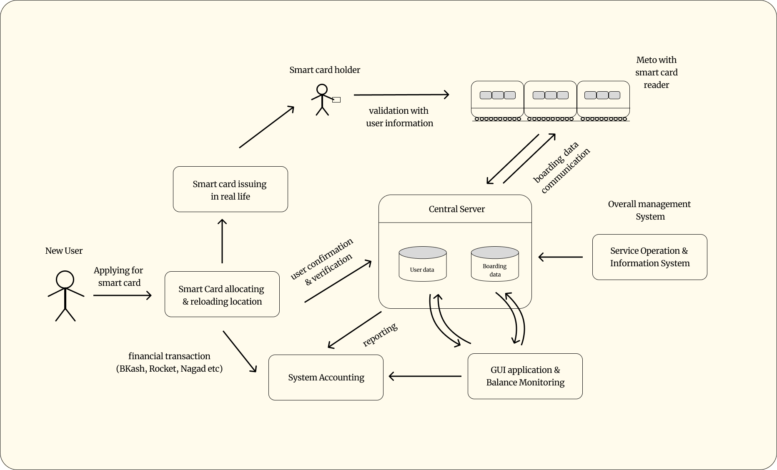
Proposed methodology
CAPSTONE ‘23

Slide 8
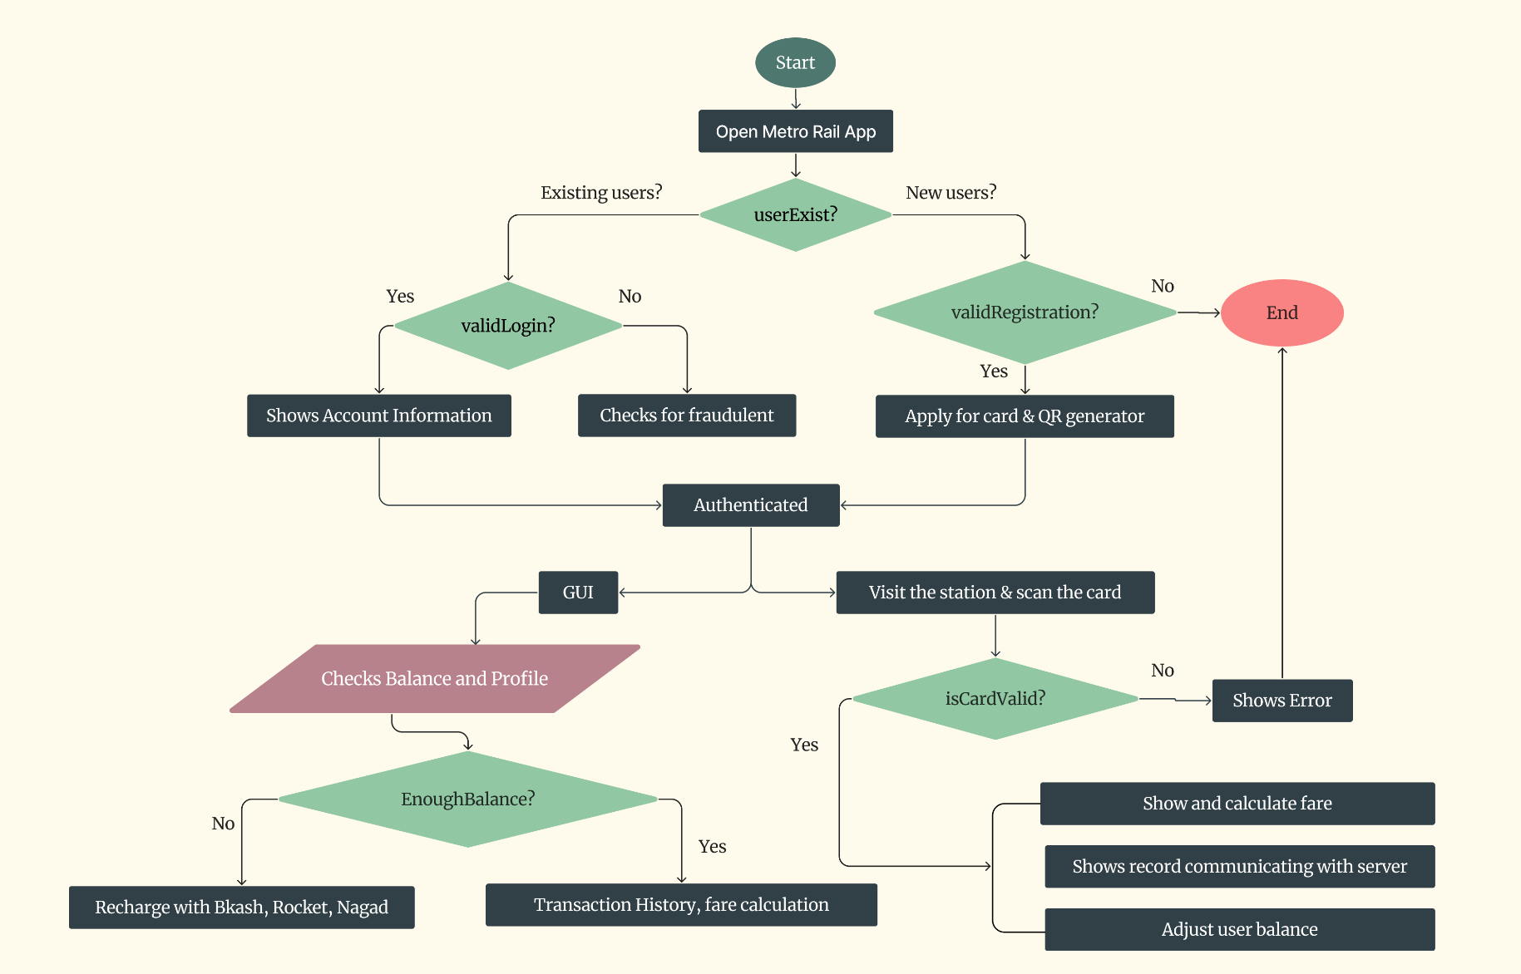
Flow Chart
JULY 23th

Slide 9
Conclusion
JULY 23th
Smart card system literature reviews explore metro implementation, benefits and user satisfaction.
Case studies analyze successful setups, contactless cards, security measures and user feedback.
Integration potential with other transport and non-transport payment systems is studied.
The review notes setup costs, compatibility issues, and future trends like technology advancements and mobile usage expansion.

Slide 10
JULY 23th
Thank You!
CAPSTONE, ‘23

