Slide 1

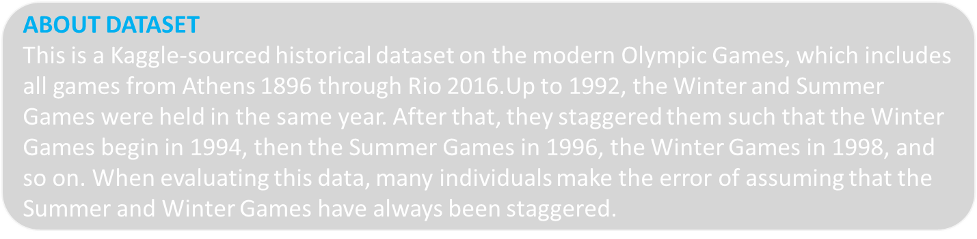

Connect
Gmail
LinkedIn
Github

Slide 2
The file athlete_events.csv contains 271116 rows and 15 columns. Each row corresponds to an individual athlete competing in an individual Olympic event (athlete-events). The columns are:
ID - Unique number for each athlete
Name - Athlete's name
Sex - M or F
Age - Integer
Height - In centimeters
Weight - In kilograms
Team - Team name
NOC - National Olympic Committee 3-letter code
Games - Year and season
Year - Integer
Season - Summer or Winter
City - Host city
Sport - Sport
Event - Event
Medal - Gold, Silver, Bronze, or NA
CONTENT

Slide 3

1. How many Olympic games have been held?
Problem Statement: Write a SQL query to find the total no of Olympic Games held as per the dataset.
SQL Script for Query
SQL Query Result
SELECT COUNT(DISTINCT Games) AS tolal_game
FROM athlete_events2$;

Slide 4
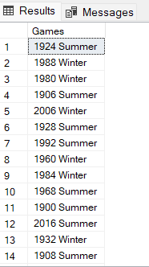
2. List down all Olympics games held so far.
Problem Statement: Write a SQL query to list down all the Olympic Games held so far.
SQL Script for Query
SQL Query Result
SELECT DISTINCT Games
FROM athlete_events2$;

Slide 5
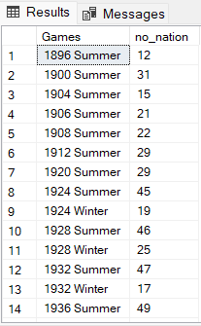
3. Mention the total no of nations who participated in each Olympic game?
Problem Statement: SQL query to fetch total no of countries participated in each Olympic games.
SQL Script for Query
SQL Query Result
SELECT DISTINCT Games, COUNT(DISTINCT NOC) AS no_nation
FROM athlete_events2$
GROUP BY Games
ORDER BY Games;

Slide 6
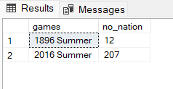
4. Which year saw the highest and lowest no of countries participating in Olympic?
Problem Statement: Write a SQL query to return the Olympic Games which had the highest participating countries and the lowest participating countries.
SQL Script for Query
SQL Query Result
-- Using a CTE
WITH max_min_participation(games, no_nation) AS (
SELECT DISTINCT Games, COUNT(DISTINCT NOC)
FROM athlete_events2$
GROUP BY Games
)
SELECT games, no_nation FROM max_min_participation
WHERE no_nation in
((SELECT MAX(no_nation) FROM max_min_participation),
(SELECT MIN(no_nation) FROM max_min_participation))

Slide 7
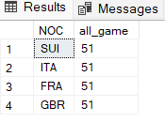
5. Which nation has participated in all of the Olympic games?
Problem Statement: SQL query to return the list of countries who have been part of every Olympics games.
SQL Script for Query
SQL Query Result
SELECT NOC, COUNT(DISTINCT Games) AS all_game
FROM athlete_events2$
GROUP BY NOC
HAVING COUNT(DISTINCT Games) = (SELECT COUNT(DISTINCT Games)
FROM athlete_events2$);

Slide 8
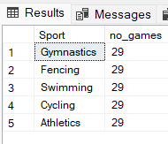
6. Identify the sport which was played in all summer Olympic.
Problem Statement: SQL query to fetch the list of all sports which have been part of every Olympics.
SQL Script for Query
SQL Query Result
SELECT Sport, COUNT(DISTINCT Games) AS no_games
FROM athlete_events2$
WHERE Season = 'Summer'
GROUP BY Sport
HAVING COUNT(DISTINCT Games) = (SELECT COUNT(DISTINCT Games)
FROM athlete_events2$
WHERE Season = 'Summer')

Slide 9
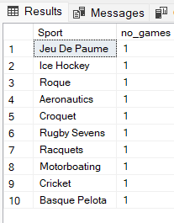
7. Which Sports were just played only once in the Olympics?
Problem Statement: Using SQL query, Identify the sport which were just played once in all of Olympics.
SQL Script for Query
SQL Query Result
SELECT Sport, COUNT(DISTINCT Games) AS no_games
FROM athlete_events2$
WHERE Season = 'Summer'
GROUP BY Sport
HAVING COUNT(DISTINCT Games) = 1;

Slide 10
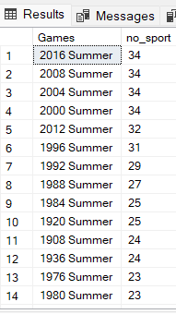
8. Fetch the total no of sports played in each Olympic games.
Problem Statement: Write SQL query to fetch the total no of sports played in each Olympics.
SQL Script for Query
SQL Query Result
SELECT Games, COUNT(DISTINCT Sport) AS no_sport
FROM athlete_events2$
GROUP BY Games
ORDER BY 2 DESC;

Slide 11
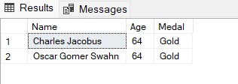
9. Fetch oldest athletes to win a gold medal
Problem Statement: SQL Query to fetch the details of the oldest athletes to win a gold medal at the Olympics.
SQL Script for Query
SQL Query Result
SELECT Name, Age, Medal
FROM athlete_events2$
WHERE Medal = 'Gold' AND Age = (SELECT MAX(Age)
FROM athlete_events2$
WHERE Medal = 'Gold')

Slide 12

10. Find the Ratio of male and female athletes participated in all Olympic games.
Problem Statement: Write a SQL query to get the ratio of male and female participants
SQL Script for Query
SQL Query Result
SELECT CONCAT(
CAST(
(CAST(COUNT(DISTINCT ID) AS DECIMAL(6, 0)))
/
((SELECT COUNT(DISTINCT ID) FROM athlete_events2$) - COUNT(DISTINCT ID))
AS DECIMAL(8, 4)),
' : 1') AS male_ratio_female
FROM athlete_events2$
WHERE Sex = 'M'

Slide 13
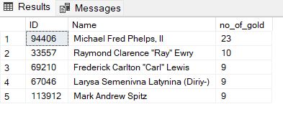
11. Fetch the top 5 athletes who have won the most gold medals.
Problem Statement: SQL query to fetch the top 5 athletes who have won the most gold medals.
SQL Script for Query
SQL Query Result
SELECT TOP 5 ID, Name, COUNT(Medal) AS no_of_gold
FROM athlete_events2$
WHERE Medal = 'Gold'
GROUP BY ID, Name
ORDER BY 3 DESC;

Slide 14
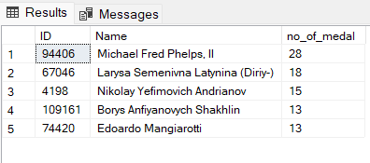
12. Fetch the top 5 athletes who have won the most medals (gold/silver/bronze).
Problem Statement: SQL Query to fetch the top 5 athletes who have won the most medals (Medals include gold, silver and bronze).
SQL Script for Query
SQL Query Result
SELECT TOP 5 ID, Name, COUNT(Medal) AS no_of_medal
FROM athlete_events2$
WHERE Medal != 'NA'
GROUP BY ID, Name
ORDER BY 3 DESC;

Slide 15
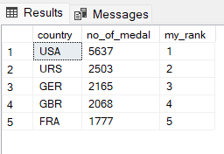
13. Fetch the top 5 most successful countries in Olympics. Success is defined by no of medals won.
Problem Statement: Write a SQL query to fetch the top 5 most successful countries in Olympics. (Success is defined by no of medals won).
SQL Script for Query
SQL Query Result
WITH top_countries(country, no_of_medal) AS (
SELECT NOC, COUNT(Medal)
FROM athlete_events2$
WHERE Medal != 'NA'
GROUP BY NOC)
SELECT TOP 5 country, no_of_medal, RANK() OVER (
ORDER BY no_of_medal DESC) AS my_rank
FROM top_countries;

Slide 16
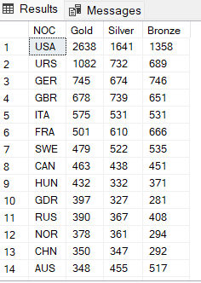
14. List down total gold, silver and bronze medals won by each country.
Problem Statement: Write a SQL query to list down the total gold, silver and bronze medals won by each country.
SQL Script for Query
SQL Query Result
-- Pivot table
SELECT NOC, Gold, Silver, Bronze
FROM
(
SELECT NOC, Medal, ID
FROM athlete_events2$
) P
PIVOT
(
COUNT(ID)
FOR Medal IN (Gold, Silver, Bronze)
) AS PVT
ORDER BY 2 DESC;

Slide 17
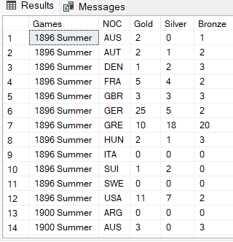
15. List down total gold, silver and bronze medals won by each country corresponding to each Olympic games.
Problem Statement: Write a SQL query to list down the total gold, silver and bronze medals won by each country corresponding to each Olympic games.
SQL Script for Query
SQL Query Result
-- Pivot Table
SELECT Games, NOC, Gold, Silver, Bronze
FROM(SELECT Games, NOC, Medal, ID
FROM athlete_events2$) P
PIVOT
(COUNT(ID)
FOR Medal IN (Gold, Silver, Bronze)
) AS PVT
ORDER BY Games, NOC;

Slide 18
16. Identify which country won the most gold, most silver and most bronze medals in each Olympic games.
Problem Statement: Write SQL query to display for each Olympic Games, which country won the highest gold, silver and bronze medals.
SQL Script for Query
SQL Query Result
Query IN NEXT SLIDE

Slide 19
SELECT T1.Games, T1.max_gold, T2.max_silver, T3.max_bronzeFROM((SELECT t0.Games, CONCAT(t0.NOC, ' - ', t1.max_gold) AS max_gold FROM(SELECT Games, NOC, Gold, Silver, Bronze FROM (SELECT Games, NOC, Medal, ID FROM athlete_events2$) PPIVOT (COUNT(ID) FOR Medal IN (Gold, Silver, Bronze) ) AS PVT ) t0 RIGHT JOIN (SELECT Games, MAX(Gold) AS max_gold FROM (SELECT Games, NOC, Medal, ID FROM athlete_events2$) PPIVOT (COUNT(ID) FOR Medal IN (Gold, Silver, Bronze) ) AS PVT
GROUP BY Games) t1ON t0.Games = t1.Games AND t0.Gold = t1.max_gold) T1INNER JOIN (SELECT t0.Games, CONCAT(t0.NOC, ' - ', t1.max_silver) AS max_silver FROM(SELECT Games, NOC, Gold, Silver, Bronze FROM (SELECT Games, NOC, Medal, ID FROM athlete_events2$) PPIVOT (COUNT(ID) FOR Medal IN (Gold, Silver, Bronze) ) AS PVT ) t0 RIGHT JOIN (SELECT Games, MAX(silver) AS max_silver FROM (SELECT Games, NOC, Medal, ID FROM athlete_events2$) PPIVOT (COUNT(ID) FOR Medal IN (Gold, Silver, Bronze) ) AS PVTGROUP
BY Games
) t1ON t0.Games = t1.Games AND t0.Silver = t1.max_silver) T2ON T1.Games = T2.Games)INNER JOIN(SELECT t0.Games, CONCAT(t0.NOC, ' - ', t1.max_bronze) AS max_bronze FROM(SELECT Games, NOC, Gold, Silver, Bronze FROM (SELECT Games, NOC, Medal, ID FROM athlete_events2$) PPIVOT (COUNT(ID) FOR Medal IN (Gold, Silver, Bronze) ) AS PVT ) t0 RIGHT JOIN (SELECT Games, MAX(Bronze) AS max_bronze FROM (SELECT Games, NOC, Medal, ID FROM athlete_events2$) PPIVOT (COUNT(ID) FOR Medal IN (Gold, Silver, Bronze) ) AS PVTGROUP BY Games) t1ON t0.Games = t1.Games AND t0.Bronze = t1.max_bronze) T3ON T1.Games = T3.GamesORDER BY Games;

Slide 20
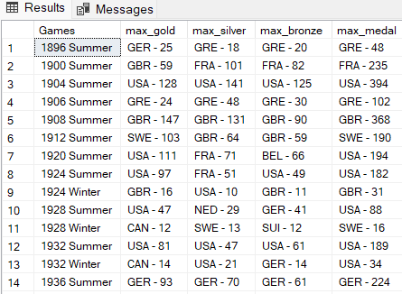
17. Identify which country won the most gold, most silver, most bronze medals and the most medals in each Olympic games.
Problem Statement: Similar to the previous query, identify during each Olympic Games, which country won the highest gold, silver and bronze medals. Along with this, identify also the country with the most medals in each Olympic games.
SQL Script for Query
SQL Query Result
Query IN NEXT SLIDE

Slide 21
SELECT T1.Games, T1.max_gold, T2.max_silver, T3.max_bronze, T4.max_medal FROM((SELECT t0.Games, CONCAT(t0.NOC, ' - ', t1.max_gold) AS max_gold FROM(SELECT Games, NOC, Gold FROM (SELECT Games, NOC, Medal, ID FROM athlete_events2$) PPIVOT (COUNT(ID) FOR Medal IN (Gold) ) AS PVT ) t0 RIGHT JOIN (SELECT Games, MAX(Gold) AS max_gold FROM (SELECT Games, NOC, Medal, ID FROM athlete_events2$) PPIVOT (COUNT(ID) FOR Medal IN (Gold) ) AS PVTGROUP BY Games) t1ON t0.Games = t1.Games AND t0.Gold = t1.max_gold) T1INNER JOIN (SELECT t0.Games, CONCAT(t0.NOC, ' - ', t1.max_silver) AS max_silver FROM(
SELECT Games, NOC, Silver FROM (SELECT Games, NOC, Medal, ID FROM athlete_events2$) PPIVOT
(COUNT(ID)
FOR Medal IN (Silver) ) AS PVT ) t0 RIGHT JOIN (SELECT Games, MAX(silver) AS max_silver FROM (SELECT Games, NOC, Medal, ID FROM athlete_events2$) PPIVOT (COUNT(ID) FOR Medal IN (Silver) ) AS PVTGROUP BY Games) t1ON t0.Games = t1.Games AND t0.Silver = t1.max_silver) T2ON T1.Games = T2.Games)INNER JOIN(SELECT t0.Games, CONCAT(t0.NOC, ' - ', t1.max_bronze) AS max_bronze FROM(SELECT Games, NOC, Bronze FROM (SELECT Games, NOC, Medal, ID FROM athlete_events2$) PPIVOT (COUNT(ID) FOR Medal IN (Bronze)
) AS PVT ) t0 RIGHT JOIN (SELECT Games, MAX(Bronze) AS max_bronze FROM
(SELECT Games, NOC, Medal, ID FROM athlete_events2$) PPIVOT (COUNT(ID) FOR Medal IN (Bronze) ) AS PVTGROUP BY Games) t1ON t0.Games = t1.Games AND t0.Bronze = t1.max_bronze) T3ON T1.Games = T3.GamesINNER JOIN (SELECT t0.Games, CONCAT(t0.NOC, ' - ', t1.max_medal) as max_medal FROM(SELECT Games, NOC, COUNT(Medal) AS medal_count FROM athlete_events2$WHERE Medal IN ('Gold', 'Silver', 'Bronze')GROUP BY Games, NOC) t0RIGHT JOIN (SELECT Games, MAX(Gold + Silver + Bronze) AS max_medal FROM (SELECT Games, NOC, Medal, ID FROM athlete_events2$) PPIVOT (COUNT(ID) FOR Medal IN (Gold, Silver, Bronze) ) AS PVTGROUP BY Games) t1ON t0.Games = t1.Games AND t0.medal_count = t1.max_medal) T4ON T1.Games = T4.GamesORDER BY Games;

Slide 22
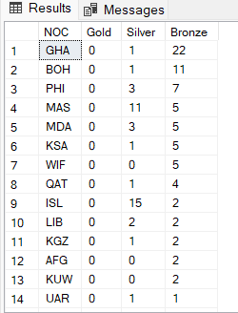
18. Which countries have never won gold medal but have won silver/bronze medals?
Problem Statement: Write a SQL Query to fetch details of countries which have won silver or bronze medal but never won a gold medal.
SQL Script for Query
SQL Query Result
SELECT NOC, Gold, Silver, Bronze
FROM(
SELECT Medal, NOC, ID
FROM athlete_events2$) P
PIVOT(
COUNT(ID)
FOR Medal IN (Gold, Silver, Bronze)
) AS PVT
WHERE Gold = 0
ORDER BY Bronze DESC;

Slide 23

19. In which Sport/event, India has won highest medals.
Problem Statement: Write SQL Query to return the sport which has won India the highest no of medals.
SQL Script for Query
SQL Query Result
WITH CTE(NOC, Event, medal_count) AS (
SELECT NOC, Event, COUNT(Medal) AS medal_count
FROM athlete_events2$
WHERE Medal IN ('Gold', 'Silver', 'Bronze')
GROUP BY NOC, Event)
SELECT t2.NOC, t1.Event, t1.max_medal
FROM(
SELECT Event, MAX(medal_count) max_medal
FROM CTE
GROUP BY Event) t1
LEFT JOIN (
SELECT * FROM CTE) t2
ON t1.Event = t2.Event AND t1.max_medal = t2.medal_count
WHERE NOC = 'IND'

Slide 24
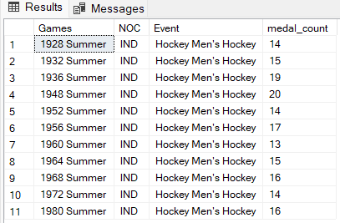
20. Break down all Olympic games where India won medal for Hockey and how many medals in each Olympic games
Problem Statement: Write an SQL Query to fetch details of all Olympic Games where India won medal(s) in hockey.
SQL Script for Query
SQL Query Result
SELECT DISTINCT t2.Games, t1.NOC, t1.Event, t2.medal_count
FROM (
SELECT NOC, Games, Event, Medal
FROM athlete_events2$
WHERE Event LIKE 'Hockey Men_s Hockey' AND Medal IN ('Gold', 'Silver', 'Bronze') AND NOC = 'IND') t1
RIGHT JOIN (
SELECT Games, COUNT(Medal) AS medal_count
FROM athlete_events2$
WHERE Event LIKE 'Hockey Men_s Hockey' AND Medal IN ('Gold', 'Silver', 'Bronze') AND NOC = 'IND'
GROUP BY Games) t2
ON t1.Games = t2.Games

