Slide 1
AGENTIC AI · SOFTWARE PROJECT
World In Brief
Agentic AI News Intelligence Platform
STUDENT NAME
[Student Name]
REGISTRATION NUMBER
[Registration Number]
COURSE
Software Engineering / Software Project Management
FACULTY
[Faculty Name]
INSTITUTION
VIT Chennai
ACADEMIC YEAR
2025 – 2026
01

Slide 2
PROJECT SUMMARY
Abstract
Conventional news platforms present articles individually, leaving readers to manually search, cross-reference, and interpret information across multiple sources. This creates information overload and limits quick, synthesized understanding of current events.
World In Brief addresses this gap through an agentic AI approach. The platform ingests live news continuously from BBC RSS feeds, stores structured articles in a SQLite database, and allows users to browse by category or search directly.
For natural-language queries, an AI agent plans the required actions, retrieves relevant stored articles as tool calls, constructs grounded context, and invokes a locally running Llama 3.2 model through Ollama to generate a traceable, evidence-based response.
This design is expected to reduce manual effort, improve transparency of AI reasoning through visible plans and run metadata, and demonstrate sound software engineering and project management practice.
Live
BBC RSS INGESTION
Local
LLAMA 3.2 VIA OLLAMA
Agentic
PLANNER + TOOL EXECUTION
Traceable
RUN IDS & SOURCES
World In Brief | Agentic AI News Intelligence Platform
02

Slide 3





CONTEXT & MOTIVATION
Introduction
Why intelligent news retrieval matters
Connection to Software Engineering
Digital news volume has grown far beyond what a reader can manually track across sources.
Software as an engineered product
Information overload makes it difficult to compare and synthesize coverage on a single topic.
Built through a defined process, not ad-hoc scripting.
Requirements
News browsing, search, and agentic Q&A capture user needs.
Manually searching, opening, and reading multiple articles is slow and repetitive.
Architecture
Layered design: frontend, REST API, agent layer, storage.
Users need assistance that retrieves relevant articles and produces a grounded synthesis, not just a list of links.
Testing
Node.js smoke tests validate core functionality.
Maintenance
Modular structure supports future enhancement.
World In Brief | Agentic AI News Intelligence Platform
03

Slide 4
BASELINE ANALYSIS
Existing System & Drawbacks
EXISTING APPROACH
PROPOSED APPROACH
Conventional News Aggregators
World In Brief
Keyword-based search only
Natural-language agent queries
User manually compares articles
Agent plans & executes retrieval
No intelligent task planning
Context constructed from live articles
Limited contextual synthesis
Grounded synthesis via Llama 3.2
Static, one-way interaction
Interactive conversational interface
Weak traceability of results
Visible plan, run ID & sources
World In Brief | Agentic AI News Intelligence Platform
04

Slide 5
PROPOSED SOLUTION
Proposed System & Research Gap
User Query
Research Gap
Agent Planner
Existing news aggregators focus primarily on delivering articles to the reader. They do not plan multi-step tasks, retrieve articles as explicit tool actions, or construct traceable context for an answer. The gap lies in agent-driven retrieval, contextual synthesis, and execution transparency.
News Retrieval Tool
BBC RSS
SQLite
Context Construction
Existing System
Delivers articles; user does the synthesis.
Llama 3.2 via Ollama
Research Gap
No agent planning or traceable retrieval.
Grounded Response
Proposed Contribution
Agent plans, retrieves, and grounds answers.
World In Brief | Agentic AI News Intelligence Platform
05

Slide 6
MODULE 1 · PROCESS MODELS
Software Engineering Process
An iterative, Agile-style approach fits a project whose scope (AI agent behaviour, model prompting) is refined through repeated feedback rather than fixed upfront.
Incremental Development Plan
Iteration 1
Basic news platform
Iteration 2
Live BBC RSS integration
Requirements
Iteration 3
AI assistant introduced
Review
Design
Iteration 4
Agent planning & tool execution
Continuous
Improvement
Iteration 5
Testing & deployment preparation
Agile Principles Applied
• Iterative development across capability layers
• Continuous feedback informing next iteration
• Incremental delivery of working functionality
• Adaptability as agent design evolved
Testing
Implementation
Note: formal Extreme Programming practices (e.g., pair programming, on-site customer) were not implemented; the project follows general Agile/iterative principles only.
World In Brief | Agentic AI News Intelligence Platform
06

Slide 7
TECHNICAL DESIGN
System Architecture
Input
Processing
External Source
Storage
AI Model
Output
User
Frontend
Express REST API
AI RESPONSE PATH
Agent Context
AGENT LAYER
Ollama
Planner
News Retrieval Tool
Comparison / Synthesis
Response Generation
Llama 3.2
Grounded Response
SQLite Database
BBC RSS Feeds
Frontend
World In Brief | Agentic AI News Intelligence Platform
07

Slide 8





SYSTEM BREAKDOWN
Module Decomposition
World In Brief Platform
Module 1 — News Intelligence
Module 2 — Agentic AI Intelligence
• BBC RSS ingestion
• Natural-language query
• Category handling
• Planner & action selection
• Article storage (SQLite)
• Context construction
• Search
• Ollama / Llama 3.2
• News retrieval
• Grounded response + run ID
Supporting Modules
REST API
Database
Frontend
Testing
Deployment
World In Brief | Agentic AI News Intelligence Platform
08

Slide 9

MODULE 1
News Intelligence & Retrieval
Purpose: continuously ingest live BBC news, organize it by category, and make it searchable and retrievable — both for direct browsing and as grounding material for the AI agent.
INPUT
PROCESS
OUTPUT
• BBC RSS feeds
• RSS parsing
• Structured articles displayed to user
• User search query
• Article extraction
• Articles supplied to AI agent
• Category assignment
• SQLite storage
• Search / filter / retrieval
World In Brief | Agentic AI News Intelligence Platform
09

Slide 10
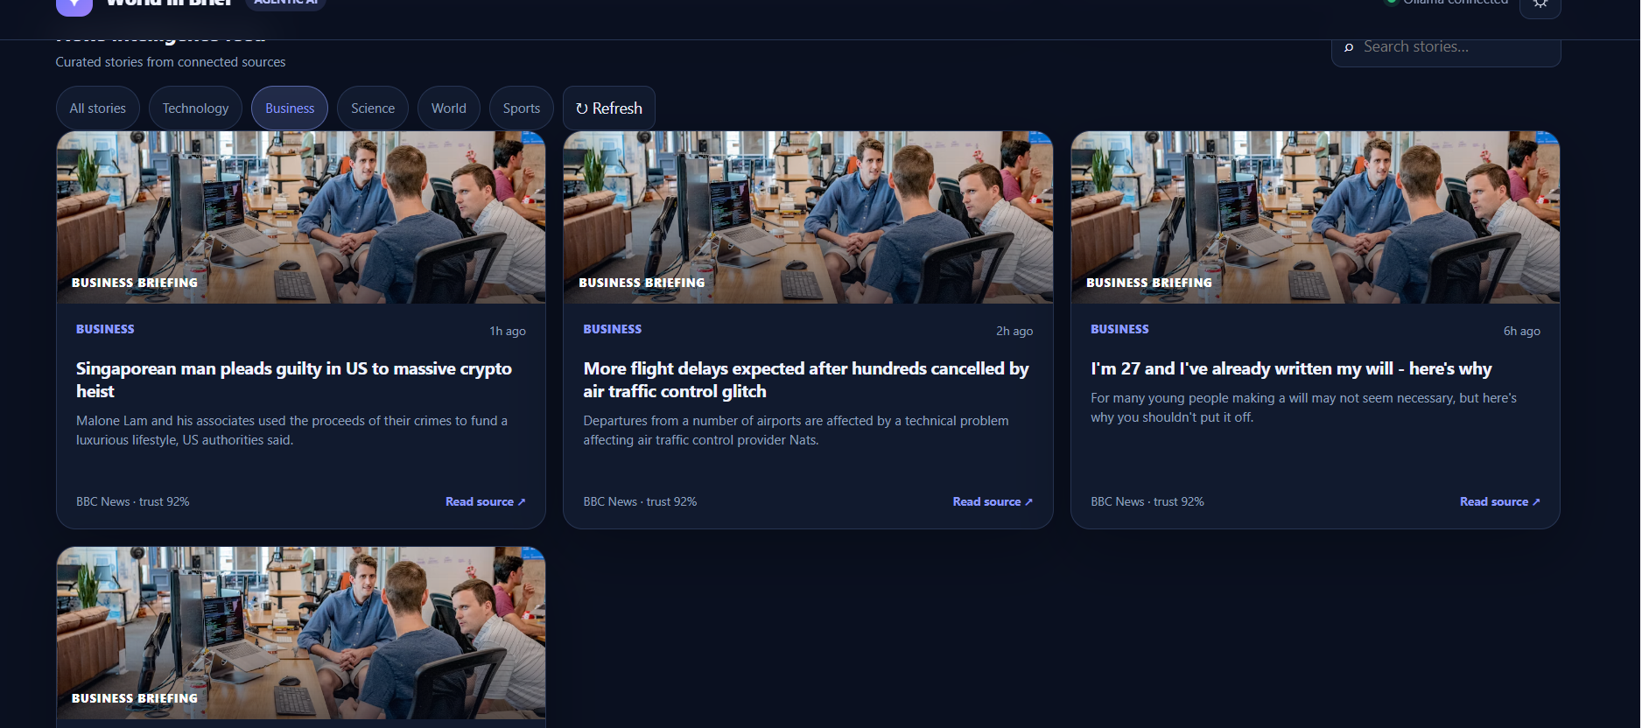
MODULE 1 · LIVE INTERFACE
News Dashboard — Workflow & Screenshot
BBC RSS
RSS Parser
Article Object
SQLite
News Retrieval API
News UI
Displayed article fields
Category · Title · Description · Source · Published time · Search
Live News Intelligence Feed — category filters, curated BBC stories, and source trust indicators.
World In Brief | Agentic AI News Intelligence Platform
10

Slide 11

MODULE 2
Agentic AI News Intelligence
The user gives a natural-language query. The agent determines which actions are required, retrieves relevant news, constructs context, and asks Llama 3.2 to produce a grounded answer.
Query
Planner
Action Selection
INPUT
OUTPUT
Natural-language
user query
News Retrieval
AI-generated answer,
retrieved articles, and
actions / run information
Context Construction
Ollama
Llama 3.2
Response Generation
World In Brief | Agentic AI News Intelligence Platform
11

Slide 12
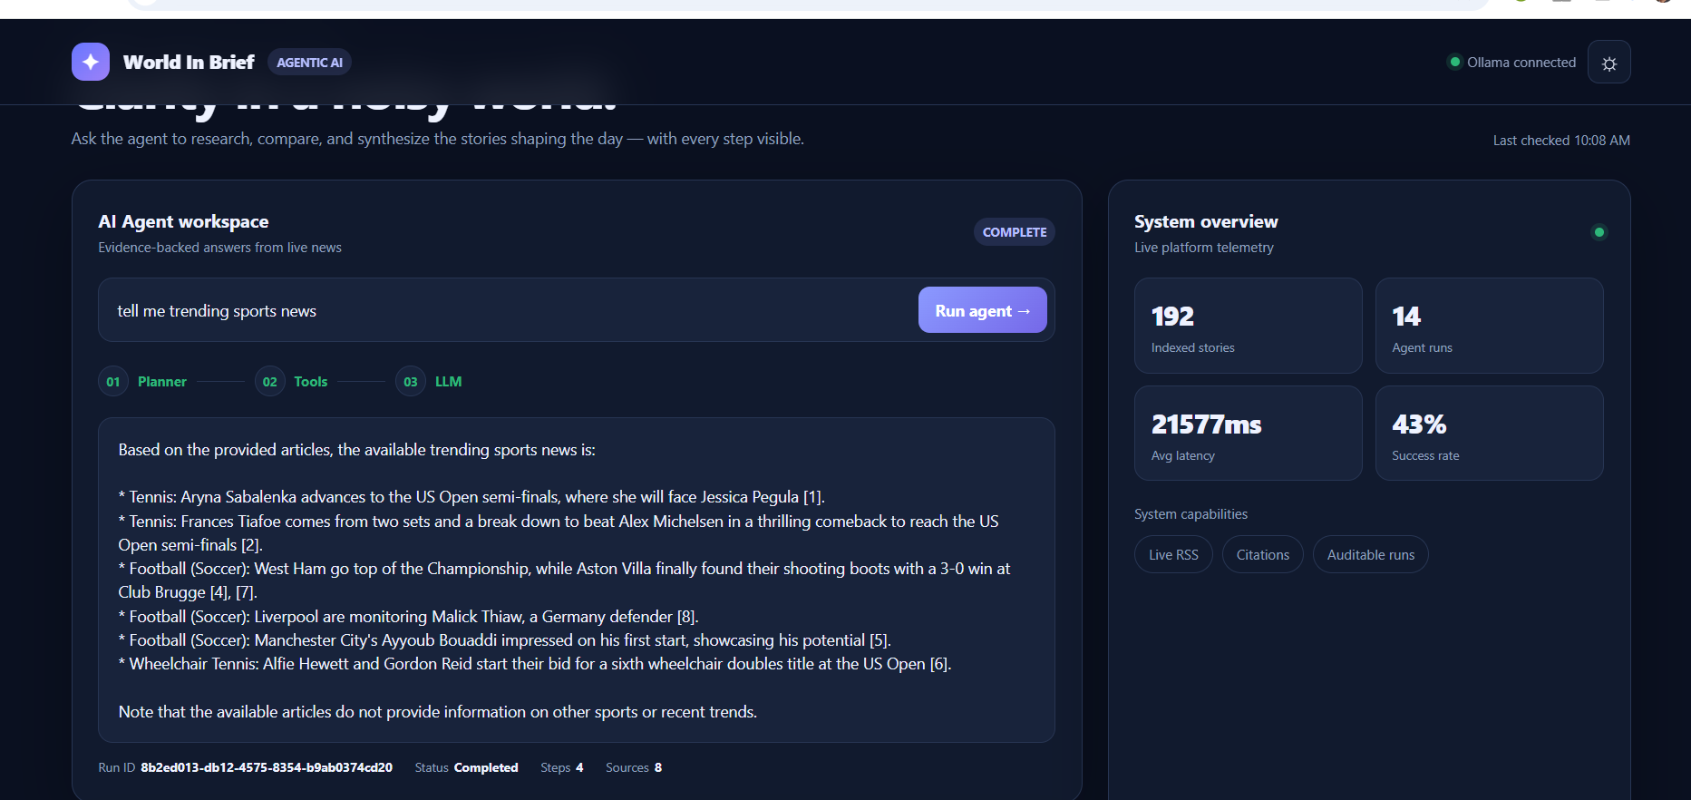
MODULE 2 · LIVE INTERFACE
AI Agent — Live Demonstration
Example 1
“What are the latest technology news stories?”
Plan: retrieve_news
Result: real BBC articles retrieved with an AI-generated grounded summary and article references.
Example 2
“Compare the latest technology and business news.”
Plan: retrieve_news → compare
Generated answer returned with a Run ID for traceability — evidence of agent planning rather than a simple chatbot reply.
Agent workspace: plan steps, sources retrieved, and grounded answer with a citation-backed summary.
World In Brief | Agentic AI News Intelligence Platform
12

Slide 13
MODULE 2 · PROJECT MANAGEMENT
Software Project Management
PROJECT SCOPE
MILESTONES
DELIVERABLES
• Live news ingestion
• M1 – Basic news application
• Working application
• News browsing / search
• M2 – RSS integration
• Source code
• Agentic AI assistant
• M3 – Agent implementation
• Database layer
• News retrieval
• M4 – LLM integration
• Agent system
• Documentation
• AI synthesis
• M5 – Testing
• Test suite
• Local LLM execution
• M6 – Documentation / deployment
• Deployment configuration
Work Breakdown Structure (WBS)
Team & Estimation Note
1. Requirements
2. UI development
Human resources, cost, and time-scale for this academic project are scoped to a single-developer / small-team effort delivered across the iterations above. Formal cost-estimation models (e.g., COCOMO) were studied as Module 2 concepts but not formally applied, since project size did not warrant them.
3. Backend / API
4. RSS integration
5. Database
6. Agent implementation
7. Ollama integration
8. Testing
9. Documentation
10. Deployment
World In Brief | Agentic AI News Intelligence Platform
13

Slide 14
RMMM PLAN & CLOSING
Risk Management & Conclusion
RISK
MITIGATION
Conclusion
Ollama unavailable
Fallback response / availability check
World In Brief demonstrates how Software Engineering and Software Project Management principles can be applied to build an agentic AI software system — from iterative process design through architecture, module decomposition, and risk planning.
RSS feed unavailable
Stored articles / fallback mechanism
LLM hallucination
Ground responses using retrieved articles
Database failure
Validation and controlled database access
High response latency
Local model optimization / concise prompts
Thank You
Dependency issues
package-lock.json / Docker configuration
Questions?
14

