Slide 1
Simple Performance Analysis Tool
Kyle Ray
CPE 631 Advanced Computer Architecture
Project
April 18, 2018

Slide 2
About Me
Earned B.S. in Computer Engineering from Tennessee Technological University in Cookeville TN in 2013
First engineering job Schneider Electric in Raleigh NC (1.5 years)
Systems Engineer
Software Developer for Building Automation Systems
HVAC
Security
Etc.
Current Job Dynetics Inc. Huntsville AL (3 years)
Software Engineer
Build software models of threat entities for use in verification of allied systems and training of allied personnel

Slide 3
Proposition

Slide 4
Mission Statement
In todays world, software developers cannot just rely on advances in hardware to offer “out of the box” speed-ups for their software
End of Moore’s Law
It is now a more Software-Hardware synergistic scheme
Problem:
Most software profilers/instrumentation frameworks are expensive and very difficult to use without proper training and/or existing experience
Intel PIN tool
Gprof
ATOM
Need for something quick and easy to use for initial software-hardware optimization information

Slide 5
Proposition
Create a tool that is easy to use and that would allow a developer to:
Easily gain information on the current system architecture
Easily gather performance information for their application running on the system of choice
Instructions Executed
Branch Prediction
Cache Information
Hits/Misses
Allow the above with little to no knowledge of any instrumentation/profiling tool suite
Tool could utilize a Graphical User Interface (GUI)
Could wrap an existing instrumentation/profiling tool set to an easy to interact with interface
Goal would be to use free / open-source tools to achieve the goal

Slide 6
Available Tools
GUI Development
GTK+ (formerly GIMP Toolkit)
Cross platform widget tool kit for creating graphical user interfaces
Open-source versions available
Qt (pronounced “cute”)
Cross platform application framework that is used for developing graphical application software
Qt Project is open-source
Instrumentation/Profiling Tools
Gprof
Perf
Likwid
Intel PIN

Slide 7
LIKWID (Like-I-Knew-What-I-Was-Doing)
Tool suite developed by the HPC group of the computing center at the university of Erlanger-Nuremburg
Light-weight set of tools for application developers and users
Purely command-line driven
Main tool is likwid-perfctr
Offers access to hardware performance counters via Linux MSR kernel and contains derived metrics.
Does require escalated privilege to access hardware counters
Offers four different modes
Wrapper Mode – Measure without altering code
Stethoscope Mode – Measure counters for a variable time duration independent of running code
Timeline Mode – Output performance metric in specified frequency
Marker API – Only measure regions in your code. Must add API calls inside to perform this function.
Offers an extension called likwid-perfscope
Real-time plotting of counter data
Graphing done with gnuplot
Utilizes feedGnuPlot to transfer likwid data to gnuplot

Slide 8
Project Results

Slide 9
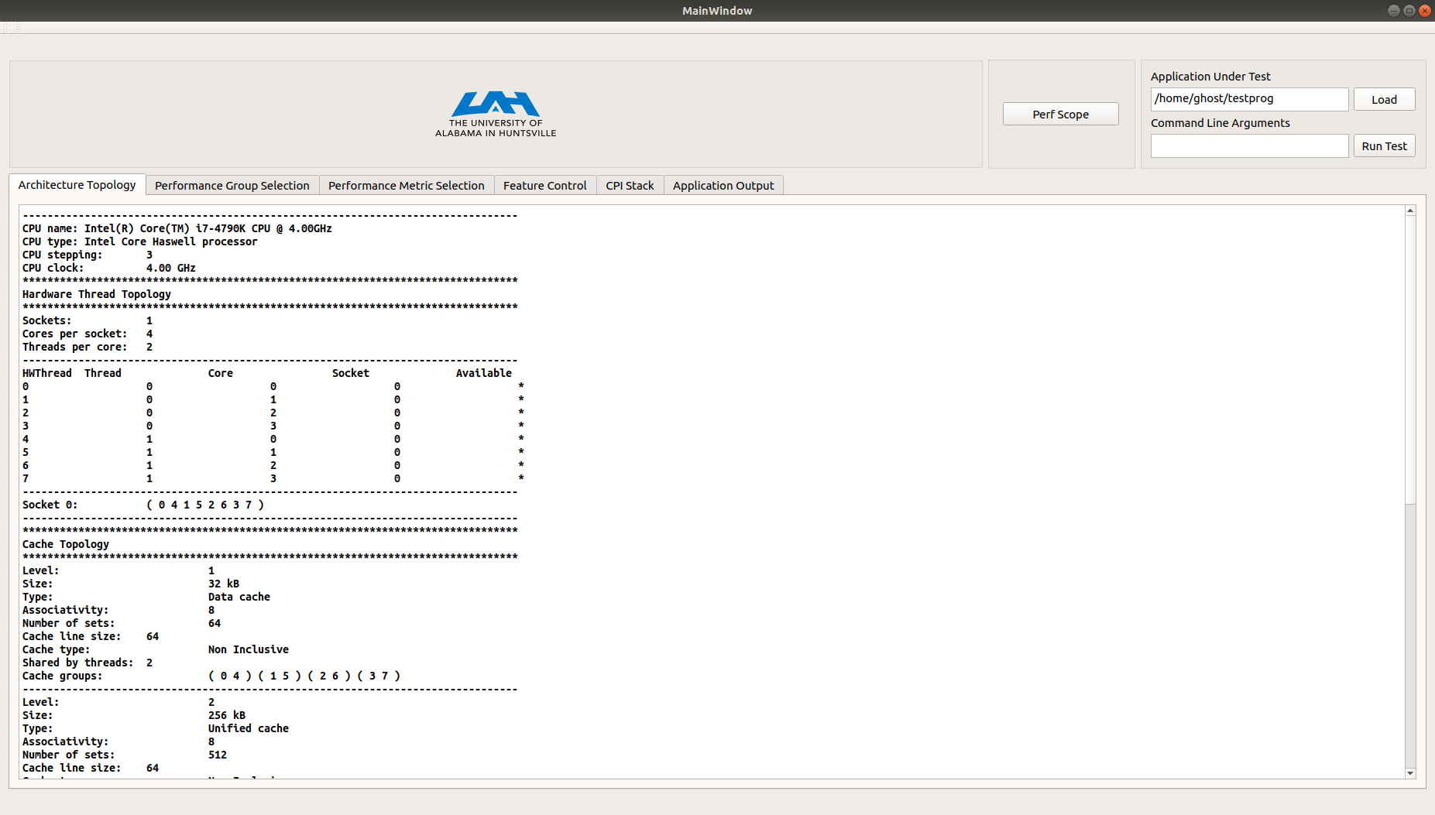
Simple Performance Analysis Tool

Slide 10
Architecture Information
The first tab of the application will give the user topology information about the current system.
Number of cores
Cache Information
Cache Topology
Cache Sizes
Cache Groups
Graphical Representation of Caches
Goal is to give the user preliminary hardware information

Slide 11
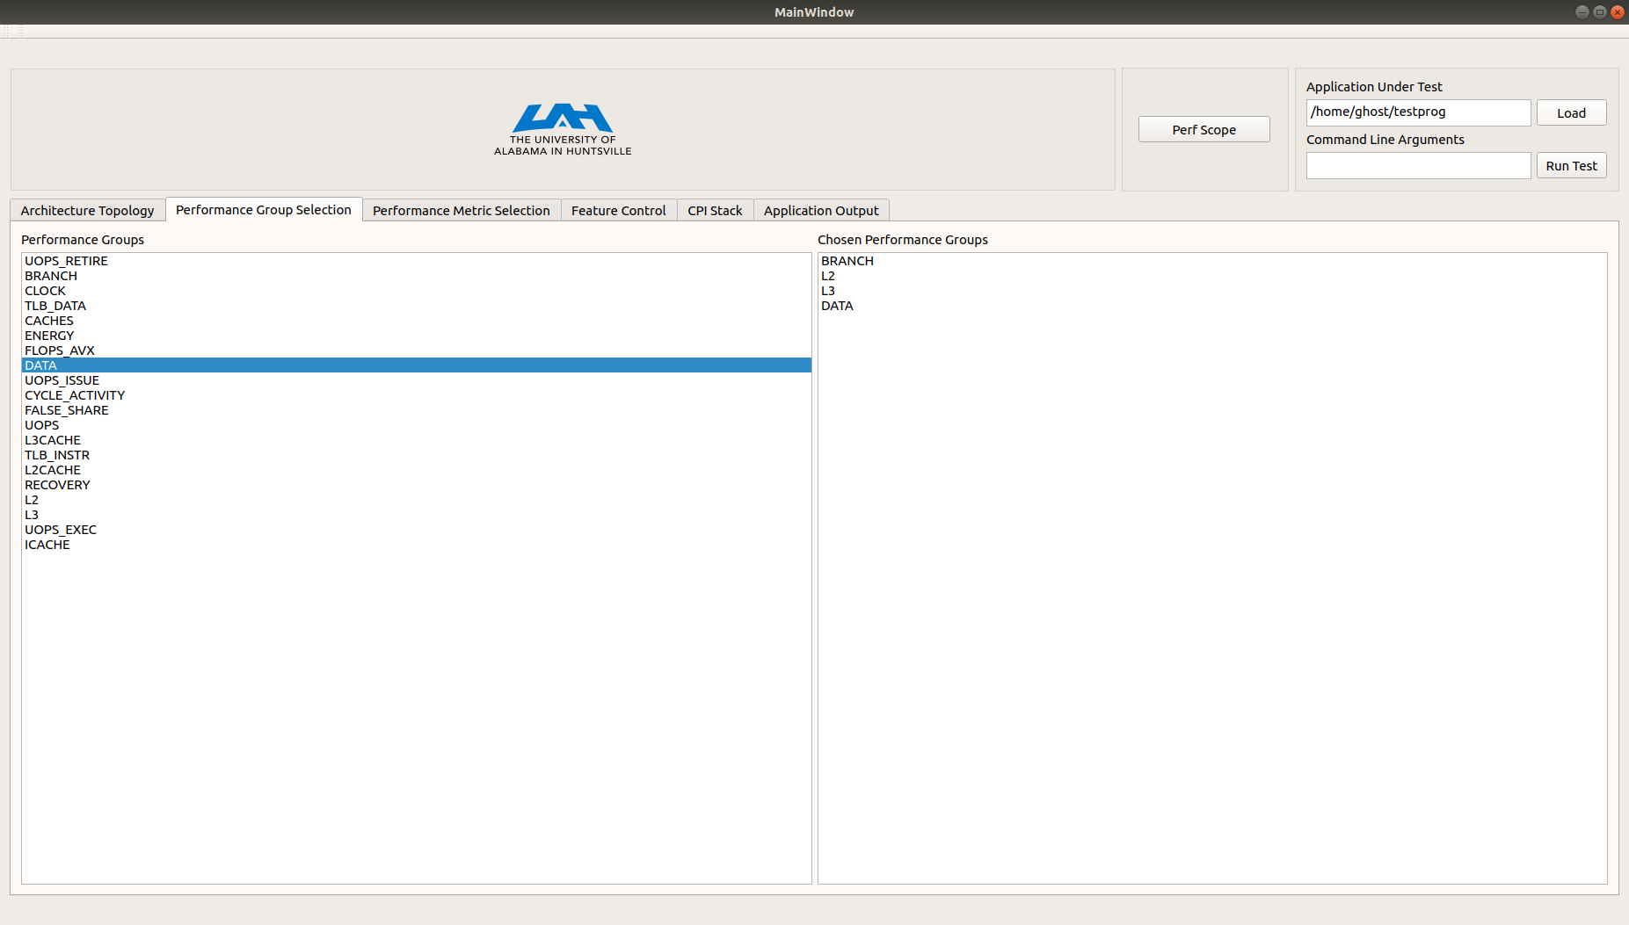

Performance Groups
Allow pre-defined event sets for the current system architecture
If already supported by Likwid
The tab allows the user to select from a variety of predefined performance groups for their architecture
Users can create new groups and add them to the Likwid installation and have them read and used by this UI.
When running this tool the user application with be pinned to a single processor
No multi-threaded support currently

Slide 12
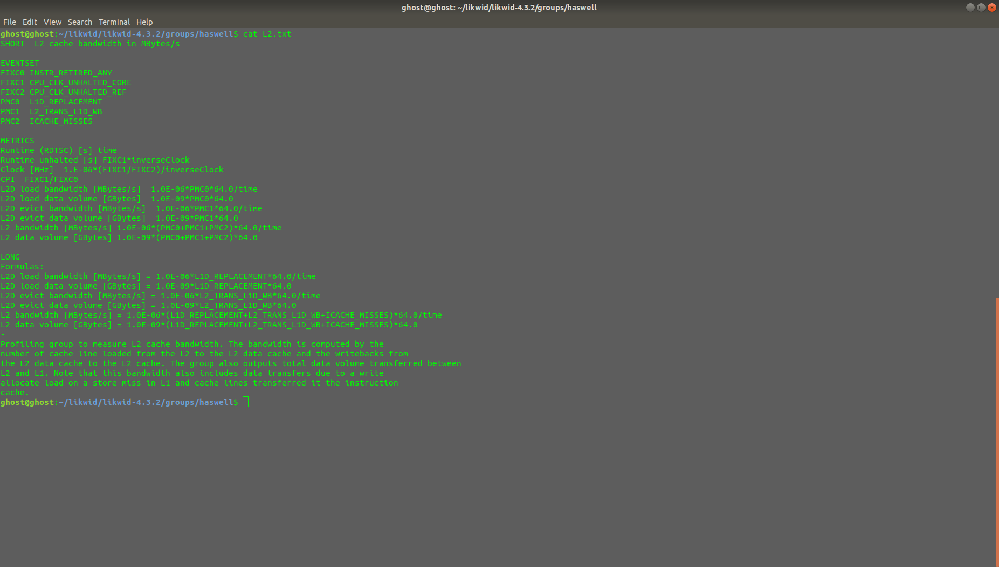
Example Performance Group (Haswell)

Slide 13
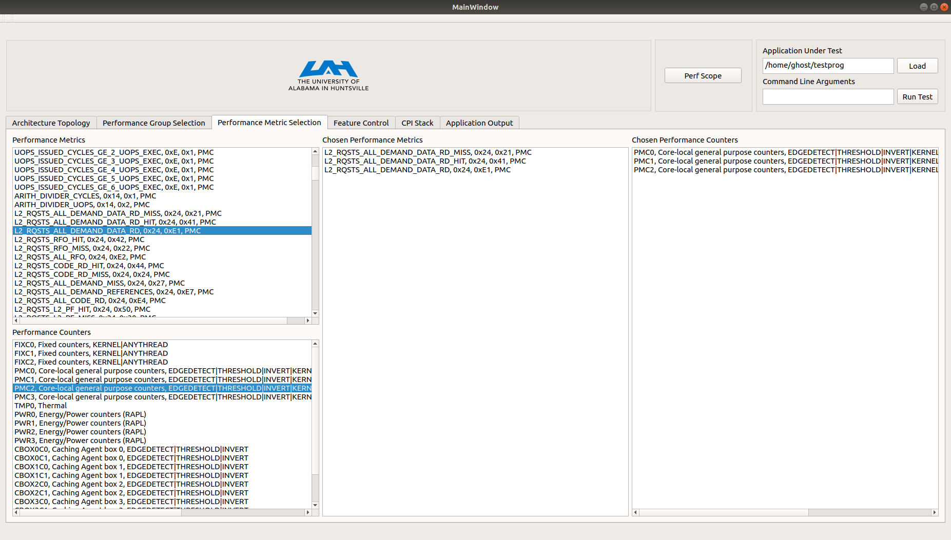
Performance Metrics

Slide 14
Performance Metrics
Allows the user to quickly create custom event sets utilizing architecture provided events
Can measure as many events in one event set as there are physical counters on an architecture
An event will have a string at the end indicating a counter type that needs to be used with it.
L2_RQSTS_MISS, 0x24, 0x3F, PMC
An event must be paired with a corresponding counter or it will not be used
Example
L2_RQSTS_MISS:PMC0

Slide 15
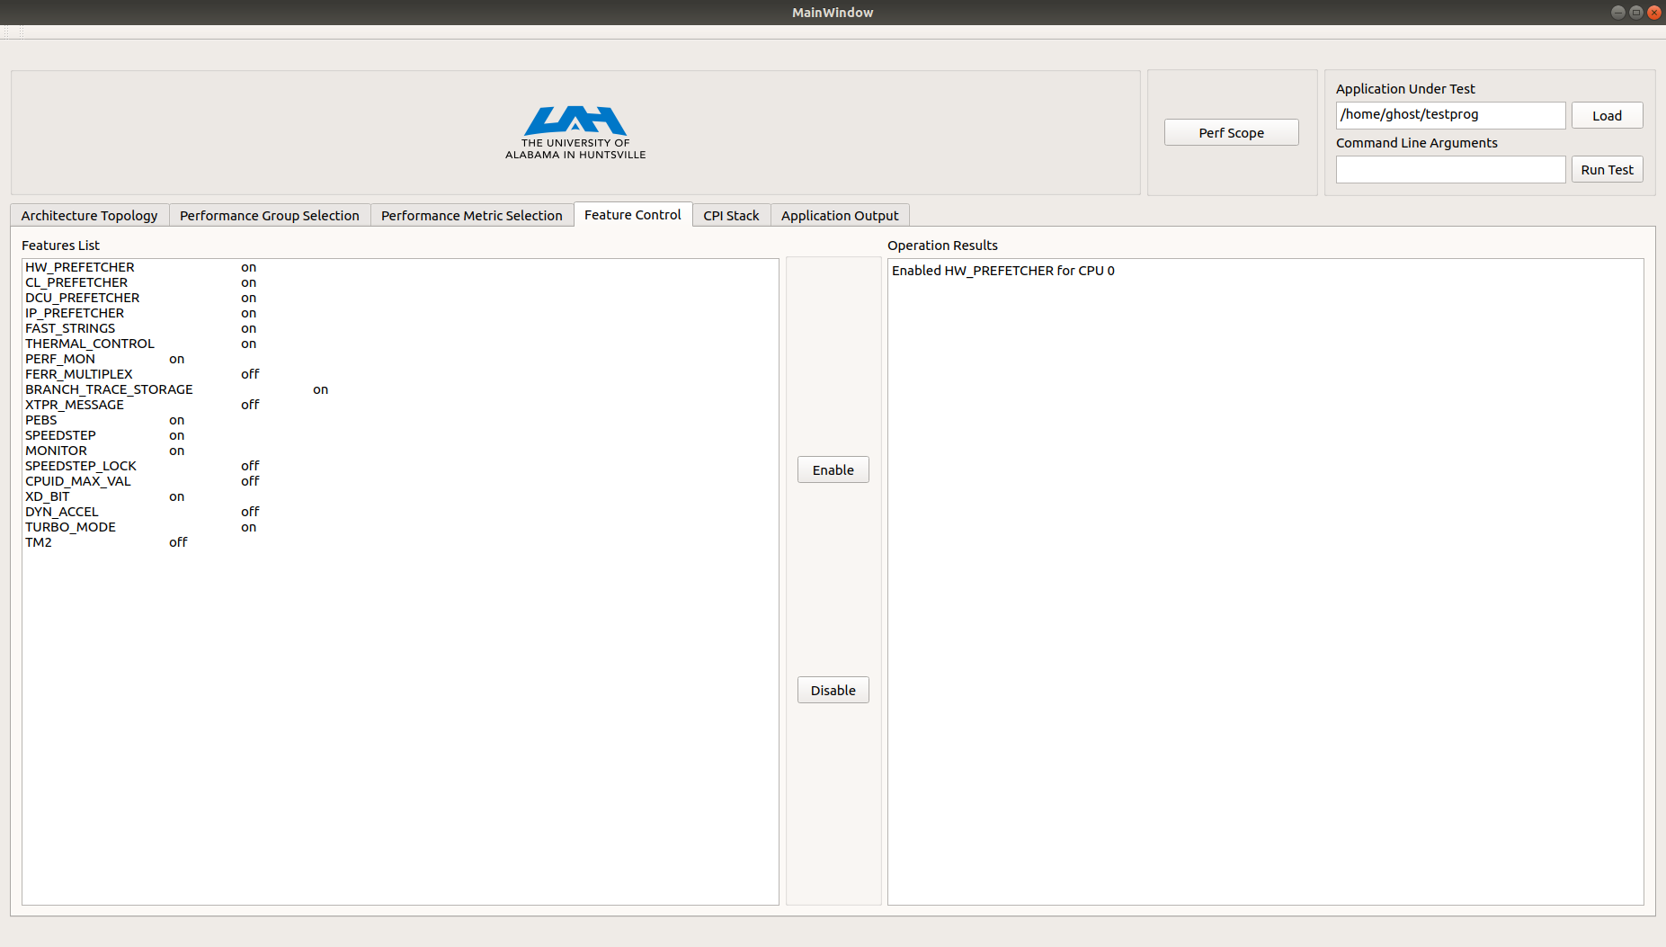
Feature Control
Allow the user to change current CPU features such as:
Hardware Prefetching
Software Prefetching
Thermal Control
This could allow for a more in-depth study of the user’s software and how some hardware features affect the outcome
Currently only a subset of the shown features are allowed to be changed
(Need better text processing – LOOK AT THOSE MIS-ALIGNED SPACES!)

Slide 16
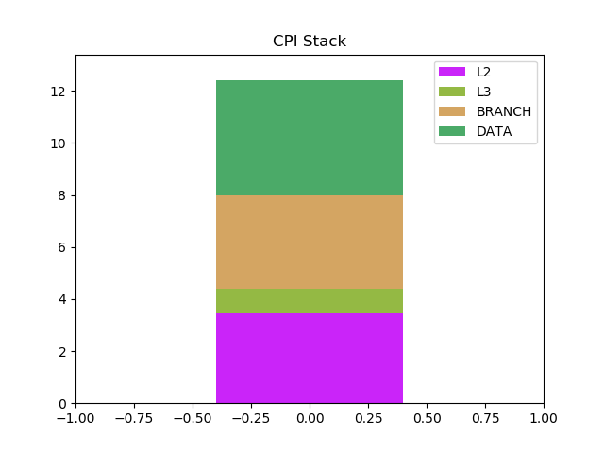
Cpi sTACK
In the current implementation of the Simple Performance Analysis Tool if the user selects from the performance groups when testing their application, they will be presented with a visual representation of the CPI Stack.
This output was generated from running mm_mult_serial 2048
Results are shipped from the UI application to a python script for post-processing
numpy (Numerical Analysis)
Matplotlib.pyplot is used to generate the stacked bars

Slide 17
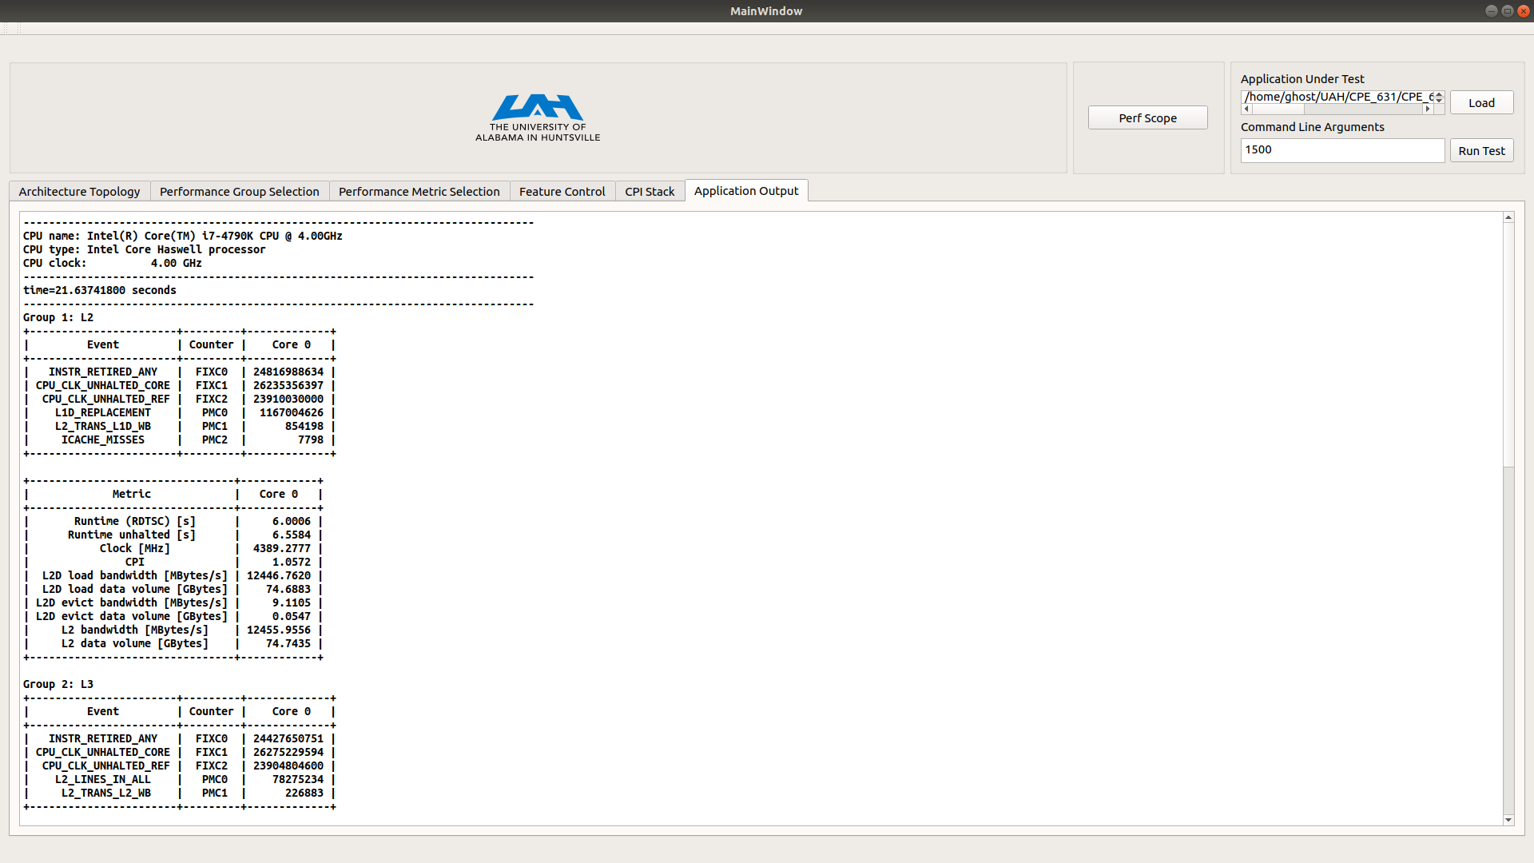
Application Output

Slide 18
Application Output
Encompasses results of the current test
User’s application output
All performance results provided from Likwid
Based on the user’s choice of metrics
Logged to a file for reference

Slide 19
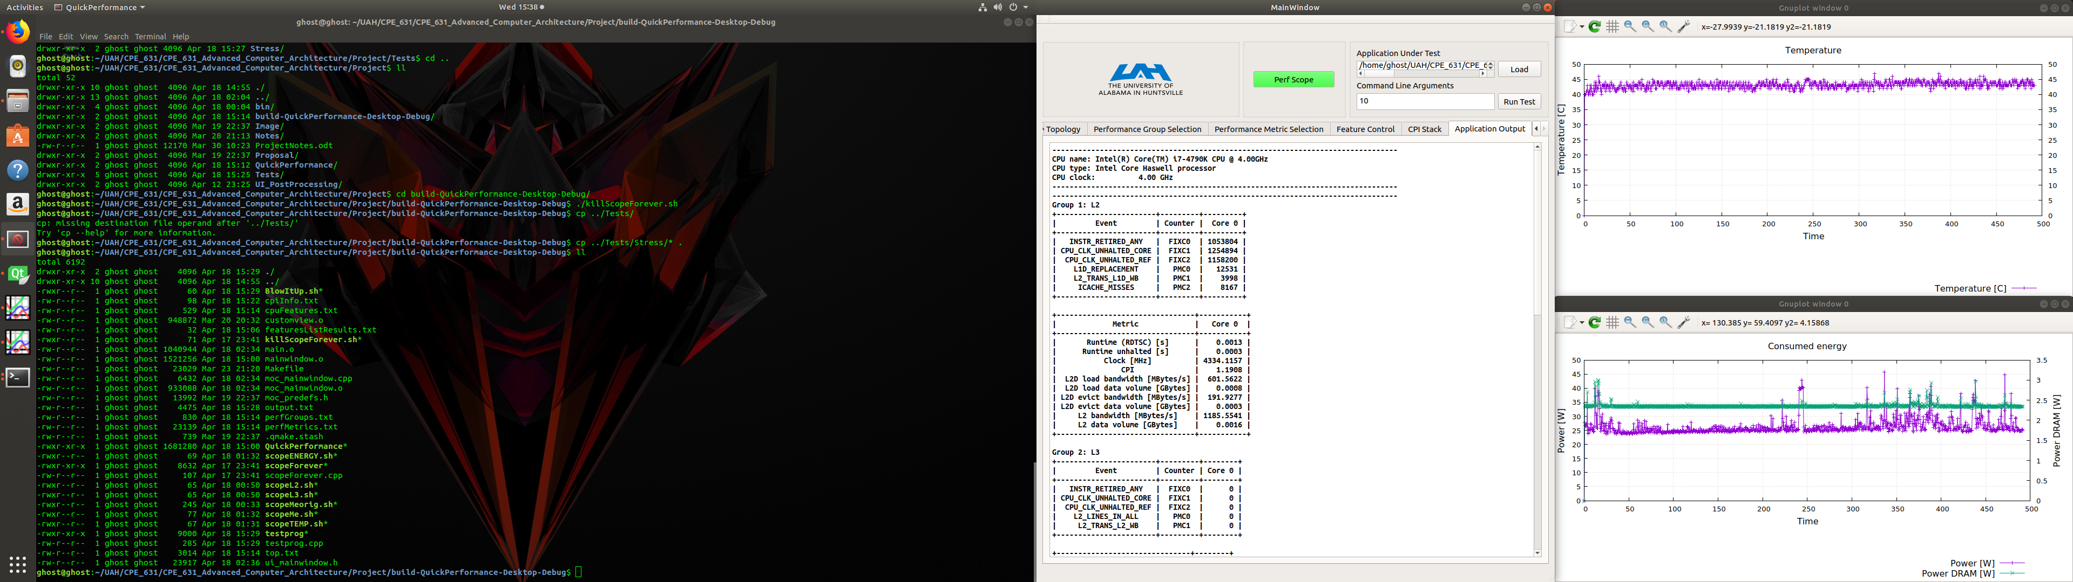
Perfscope fun!

Slide 20

Demo

Slide 21
Still Under Development
Timeline Mode
Code is written just hasn’t been thoroughly tested
Stethoscope Mode
Code is written and is undergoing testing
Brought out of this current release, being replaced by perfscope.
Marker API (Want to add this before delivery)
I would like to add a tab to provide what user’s need to do in order to utilize this functionality
I would include the ability to run against the Marker if the user chose to do so.
Perfscope
Because of the way the Likwid team has written their perl scripts this method is not very condusive to working with an external UI
Currently figuring out a work-around to include perfscope without modifications to Likwid

Slide 22
Future
Plan to use the tool to test some of the software optimization techniques
Loop Interchange
Loop Unrolling
Blocking Optimization
Future work could include:
Modifying the tool to work with multiple cores
Modifying the tool to work with multi-threaded applications
Integrating more of the Likwid tool suite
Likwid-powermeter
Likwid-memsweeper
Likwid-setFrequencies
Etc.

Slide 23

Questions?

