Slide 1
Designing Privacy into Internet Protocols
IAB Privacy Program

Slide 2
Agenda
Background IAB & IETF
(Relevant for audience not familiar with IETF.)
Security in the IETF
From Security to Privacy
Privacy Engineering
Our Privacy Guidelines
Examples

Slide 3
Background IAB & IETF

Slide 4
The Internet Architecture Board (IAB)
The IAB is chartered both as a committee of the Internet Engineering Task Force (IETF) and as an advisory body of the Internet Society (ISOC). Its responsibilities include architectural oversight of IETF activities, Internet Standards Process oversight and appeal, and the appointment of the RFC Editor. The IAB is also responsible for the management of the IETF protocol parameter registries.
The IAB charter with more details is available with RFC 2850.
More info is available at http://www.iab.org

Slide 5

Scope of the IETF
Application Layer
Area for innovation (mostly because of end-to-end principle)
Transport Layer
Large deployed base of core Internet infrastructure lead to slow change and evolutionary approach
Network Layer
Link Layer
Huge investment costs
(Innovation cycle: multiple years)
Not in scope of the IETF
Physical Layer
Innovation Cycles vary throughout the Layers

Slide 6
Classical Innovation Cycle
Service Providers
Deploy
Demand
Sell
Equipment
Vendors
Drive
Implement
Develop
SDOs
Time
Slides re-used from J. Rosenberg’s IAB technical plenary talk (IETF#80, Prague)

Slide 7
The Internet Software Innovation Cycle
Develop
Deploy
Publish
Service Providers
Equipment
Vendors
SDOs
Time
Slides re-used from J. Rosenberg’s IAB technical plenary talk (IETF#80, Prague)

Slide 8
IETF Work Style
Two main approaches for standardization in the IETF:
Standardize, then deploy (e.g., Diameter, SIP)
Standardize a deployed solution (e.g., TLS, SSH, OAuth).
Participants are volunteers (including those working in leadership positions, such as working group chairs, area directors, review teams, architecture board)
Barrier of entry into the IETF is low.
Everyone is welcome to participate.
No fees or other restrictions for participation.
No membership concept.

Slide 9
IETF Work Style, cont.
Due to the open nature and the relatively high quality standards the work is not necessary quickly completed.
At best the timeline is unpredictable.
Standardization efforts often try to focus on generic and reusable building blocks suitable for many different application contexts.
RFC 5218 talks about protocol success criteria.
A wildly successful protocol is “used for purposes outside their original design”.
Developing a wildly success protocol is good.

Slide 10
Move to Software Innovation Cylcle
The IAB organized a plenary talk on the “Future of Applications” at IETF#80.
Write up available:
http://tools.ietf.org/html/draft-tschofenig-post-standardization
Focus on the implications caused by the usage of JavaScript for mobile code distribution and the lower need for interoperability.
Very powerful model allowing fast innovation speed.
More decision making freedom given to companies deploying software
Cases of “design by committee” may decrease as a consequence.

Slide 11
Security in the IETF

Slide 12
Security in the IETF
All RFCs are required to have a Security Considerations section, as stated in RFC 1543 (and updated by RFC 2223).
At the beginning the quality of the write-ups in those security considerations sections was relatively weak, as confirmed in [1].
Neither RFC provides much guidance:
”All RFCs must contain a section near the end of the document that discusses the security considerations of the protocol or procedures that are the main topic of the RFC.”
[1] A. Rabkin, N. Doty, and D. K. Mulligan, “Facilitate, don’t mandate,” Dec. 2010, position Paper for the IAB/W3C/MIT/ISOC Internet Privacy Workshop, Boston, Dec. 2010, http://www.iab.org/about/workshops/privacy/papers/nick doty.pdf.

Slide 13
Security in the IETF, cont.
With the introduction of this mandatory security analysis a separate review group, called ”Security Area Directorate”, was established.
Goal was to review all IETF documents prior to publication.
Reviews provided input to the Area Directors in their review of the documents and offered feedback to the protocol authors from experienced standards experts.
Members of the directorate were typically cryptography experts and chairs of working groups from the IETF security area.
Group has a face-to-face meeting at every IETF to discuss current challenges and a separate mailing list.

Slide 14
Security in the IETF, cont.
Later, the following RFCs were written:
”Guidelines for Writing RFC Text on Security Considerations” RFC 3552,
”Internet Security Glossary” RFC 4949, and
”Writing Protocol Models” RFC 4101
These documents …
Introduce terminology,
Illustrate the security threat model, and
Provide guidance for incorporating security in the design protocols and architectures.
Public discussion about current security challenges at every IETF meeting: Security Area Open Meeting
Public mailing list: https://www.ietf.org/mailman/listinfo/saag

Slide 15
From Security to Privacy

Slide 16
The IAB Privacy Program
Olaf Kolkman, the IAB Chair at that time, announced a new way of working in time for the IETF#78 meeting*.
A few programs were created. For example,
Privacy: http://www.iab.org/activities/programs/privacy-program/
Emergency Services:http://www.iab.org/activities/programs/emergency-services/
Other programs: http://www.iab.org/activities/programs/
*: Olaf’s mail can be found here:http://www.ietf.org/mail-archive/web/ietf/current/msg62743.html

Slide 17
IAB Privacy Program - Roadmap
Education and awareness
Discussion List: https://www.ietf.org/mailman/listinfo/ietf-privacy
IAB technical plenary talk on privacy at IETF#81 (Quebec City, Canada, July 24-29, 2011)
Privacy plenary talk at IETF#77
IAB/W3C/ISOC/MIT Internet Privacy Workshop (Boston, Dec. 2010) http://www.iab.org/activities/workshops/internet-privacy-workshop-2010/
Privacy Area Directorate
Established in response to the Internet Privacy workshop by IETF Security Area Director Sean Turner and IETF chair Russ Housley.
Later dissolved…
Privacy Terminology & Privacy Guidelines
http://tools.ietf.org/html/draft-iab-privacy-considerations
Privacy Tutorial (this one)

Slide 18
How did we tackle Privacy in the IETF?
Privacy is being considered in IETF already, see position paper to the W3C workshop on “Advanced Device API”.
Our observations:
We need some terminology.
We need to be more systematic in analyzing protocols and architectures.
Questions:
Do we need new processes (e.g., review directorates)?
Is there a need for standardizing new technology?
How should privacy design guidelines look like?

Slide 19
What is Privacy?
Right to be let alone” (Warren & Brandeis)
Privacy requires that an individual has a means to exercise selective control of access to the self and is aware of the potential consequences of exercising that control (Altman).
Prosser focuses on a categorization of privacy based on four torts:
Intrusion upon an individual’s seclusion, solitude, or private affairs
Public disclosure of embarassing private facts
Publicity placing an individual in a false light
Appropriation of an individual’s likeness for advantage
Privacy is the claim of individuals, groups, or institutions to determine for themselves when, how, and to what extent information about them is communicated to others. (Westin)

Slide 20
What is Privacy? (cont.)
“Privacy is a complicated concept with a rich history that spans many disciplines. With regard to data, often it is a concept applied to ‘personal data’, information relating to an identified or identifiable individual.” (draft-iab-privacy-considerations)
“We recognize when we see it (or loose it).” concept.
In the end we decided not to define privacy explicitly. It is the sum of what is described in draft-iab-privacy-considerations
Similar approach token with RFC 3552 (Security)

Slide 21
Privacy Engineering
What can we re-use?

Slide 22
Existing Guidelines
Publications on privacy engineering exist:
Claudia Diaz, et al.https://www.cosic.esat.kuleuven.be/publications/article-1542.pdf
Lorrie Cranor, et al. http://papers.ssrn.com/sol3/papers.cfm?abstract_id=1085333
Challenge: We are not in control of the entire lifecycle
Many domain specific proposal for improving privacy
Example: EFF location privacy (with examples on road pricing)
http://www.eff.org/wp/locational-privacy
Challenge: We do not standardize domain specific solutions.
Privacy Impact Assessments
Challenge: Focus often on later stages of the development

Slide 23
Re-Using Existing Guidelines, cont.
Privacy Principles
Many available and they all provide valuable insight.
(e.g., FIPs, OECD Privacy Principles, Madrid Resolution)
Example: Fair Information Practices
Notice and Consent
Collection Limitation
Use/Disclosure Limitation
Retention Limitation
Accuracy
Access
Security
Challenge: Too abstract and largely outside the scope of protocol engineers.

Slide 24
Guidance from Regulators & Data Protection Authorities
European Commission:
Example: Directive 95/46/EC
Article 29 WP issue “opinions” on how different directives are applied to recent developments, such as changes in the business eco-system.
Example Opinion 2/2010 on Behavioural Advertising, which is an analysis of the “Cookie” Directive.
The International Working Group on Data Protection in Telecommunications (IWGDPT) (aka Berlin Group) goes a step further than the Article 29 WP and takes technology into consideration in their analysis.
Guidance is at a high level and often technology neutral.
Challenge: It cannot immediately be applied to technical standards and often talks to a different audience.

Slide 25
Our Privacy Guidelines

Slide 26
Privacy Considerations Document Content
Terminology
Threat model
Threat mitigation
Guidelines

Slide 27
Terminology
Initially terminology was taken from here: http://dud.inf.tu-dresden.de/literatur/
This was the terminology that researchers used in their publications.
Unfortunately, it was far too complex for the standardization context.
Example:
Pseudonym: “A pseudonym is an identifier of a subject other than one of the subject’s real names.”
Protocols may carry identifiers, such as the ‘username’, but there is no requirement that the text contains the subject’s real name.

Slide 28
Threat Model
Privacy threat models builds on security threat model and extends it.
Combined security-privacy threats
Surveillance
Stored data compromise
Intrusion
Misattribution
Privacy-specific threats
Correlation
Identification
Secondary use
Exclusion

Slide 29
Threat Mitigation
Data minimization
Anonymity
Pseudonymity
Identity Confidentiality
Data Minimization within Identity Management
User participation
Security (already described in RFC 3552)
Confidentiality
Peer entity authentication
Unauthorized usage limitation
Inappropriate usage limitation

Slide 30
Guidelines
Consists of questions to get protocol designers to think about privacy and to describe the tradeoff decisions.
Does not tell what the solution should be.
Example: Identifiers.
What identifiers does the protocol use for distinguishing initiators of communications?
Does the protocol use identifiers that allow different protocol interactions to be correlated?
What identifiers could be omitted or be made less identifying while still fulfilling the protocol's goals?

Slide 31
Challenges with the Development Process
The Internet protocol development process is not monolithic
Depending on the protocol layer it may take many, many years.
There is no single process for how to develop protocols and architectures.
Data minimization and purpose limitation principles are difficult to apply to IETF protocols
We do not necessarily know the detailed purpose of the applications our protocols are used with.
The building blocks can be used for many different purposes.
Next slides illustrate some examples.

Slide 32
Examples

Slide 33
Use Case: OAuth

Slide 34
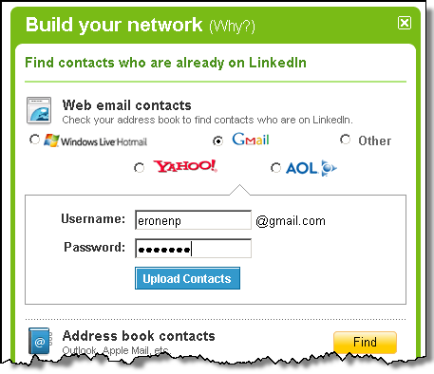
Protocol Development Example Stage 1: Identification of a problem
Web mash-ups use data from different sources.
No problem reading public data but protected data requires credentials.
Credential sharing leads to security and privacy problems.

Slide 35

Protocol Development Example Stage 2: Initial Deployment
Around 2006: Companies create ad-hoc solutions and offer them on their Web pages
Early 2007: Group of people gather to agree on a common solution. OAuth starts to exist.
Late 2007: Deployment of OAuth well on its way.

Slide 36
Protocol Development Example Stage 3: IETF Standardization/Deployment
Early 2009: Working group gets created.
2012: Working group still works on standardizing OAuth 2.0.
Protocol sees widespread deployment to enables data sharing on the Internet.
Working group has 850+ members.
50+ are actively contributing in the standardization process
10+ people belong to the inner core
Available implementations: thousands
Related groups start to appear:
IETF JavaScript Object Signing and Encryption (JOSE)
W3C JavaScript Crypto API
IETF Secure Cloud Identity Management (SCIM)
OAuth gets used by other SDOs in their architecture.
Examples: NIST GreenButton/Smart Grids, GSMA/OMA OneAPI

Slide 37
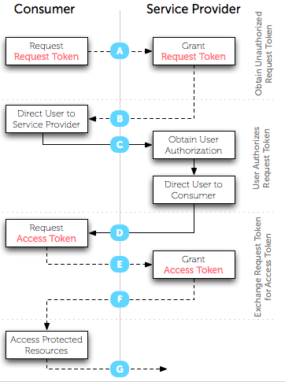


Protocol Development Example View of the Standardization Expert
This is how it is shown in presentations.

Slide 38
Protocol Development Example View of the Standardization Expert (2)
This is how it looks like in the standard:
HTTP/1.1 200 OK
Content-Type: application/json;charset=UTF-8
Cache-Control: no-store
Pragma: no-cache
{
"access_token":"2YotnFZFEjr1zCsicMWpAA",
"token_type":"example",
"expires_in":3600,
"refresh_token":"tGzv3JOkF0XG5Qx2TlKWIA",
"example_parameter":"example_value"
}

Slide 39
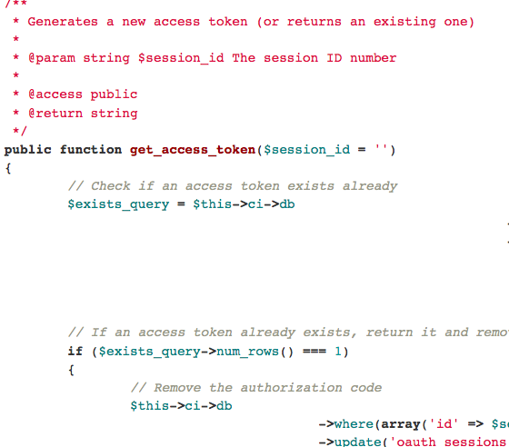
Protocol Development Example View of the Implementer
Example: Those who implement libraries, such as http://bit.ly/J82Riy
Library implementers typically do not know for what use cases their code will be utilized.

Slide 40
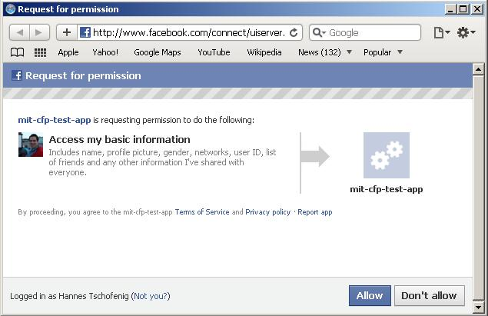
Protocol Development Example View of those who deploy
Those who deploy combine a number of protocols, decide about the configuration parameters, and design the user interface.
… and often do not read the specifications.

Slide 41
Lessons Learned
TBD.

Slide 42
Use Case: Network Access Authentication

Slide 43
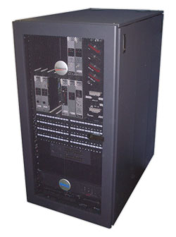

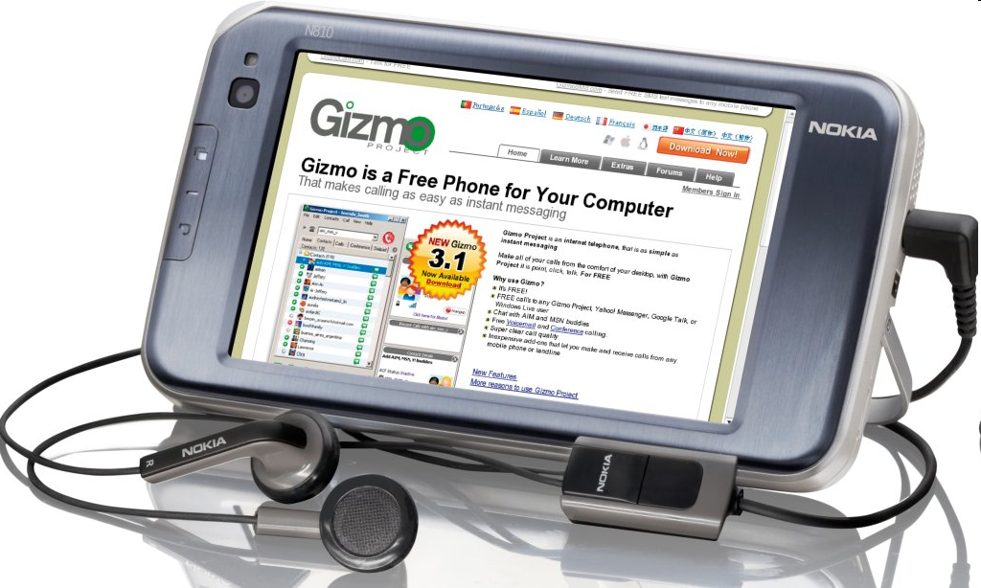
Architecture, cont.
Network
Access
Server
AAA Clearing House / Broker
AAA Server
End Host

Slide 44
Architecture, cont.
EAP Peer
Authenticator
EAP server
EAP peer (supplicant)
EAP server
AAA Client
AAA
Server
EAP MSK
EAP lower
Layer
(e.g.,
802.11i)
EAP lower
Layer
(e.g.,
802.11i)
EAP MSK
EAP method

Slide 45
Relevant Identifiers
The MAC address of the end device.
The IP address of the user, typically assigned after the EAP exchange has completed.
The EAP network access identifier (NAI) used in the EAP-Response/Identity exchange. The NAI is defined in RFC 4282.
The EAP NAI used within the (potentially protected) EAP method exchange
Network Access Server (NAS) identifiers carried by the AAA protocol. There include: NAS-Identifier, NAS-IPv4-Address (RFC 2865), NAS-IPv6-Address (RFC 3162) and Called-Station-Id (RFC 2865, 3580). In addition to identifying the NAS, these attributes can be used to infer the user's location.
User identifiers carried by the AAA protocol. These include the following attributes: User-Name (RFC 2865), Calling-Station-Id (RFC 3580) EAP-Message attribute (RFC 3579), Chargeable User Identity (RFC 4372).
Often ignored: intermediate AAA entities (like proxies and relays).

Slide 46
Lessons Learned
No privacy threat model was developed. Instead the debate occurred on a piecemeal basis across multiple documents and WGs.
Due to the piecemeal nature of the discussion, introduction of partial anonymity in one part of the system (e.g. user-NAS communications) resulted in issues arising for other actors (e.g. network providers, administrators).
No terminology was defined, nor were the goals laid out. Indeed the initial concerns seemed to be more about security than privacy, and subsequent arguments more about billing assurance than privacy.

Slide 47
Lessons Learned, cont.
Although regulatory requirements eventually loomed large in the debate, these were never referenced in any of the documents, or even comprehensively discussed. As a result, there were arguments within the IETF as well as IEEE 802 about what those requirements were real or imagined that were never put to rest (e.g., is a MAC address considered PII, and if so, in what countries? What other things in the EAP/AAA system are considered PII?).
The lack of a definition of privacy goals lead to somewhat odd design decisions that were not fully justified or even discussed.
The use of EAP and AAA data in other contexts has continued to grow.
For example, this data is a very popular source of location info as provided in location configuration protocols (e.g., HELD, DHCP).
It is also commonly used in response to security incidents (e.g., denying access to infected machines, detection of spoofing or bot infection, etc.).

Slide 48
Use Case: IPv6

Slide 49
History of IPv6 address assignment
In IPv4, we used static addresses or DHCP
Static is manually intensive and error prone
DHCP is state intensive, doesn’t have fate-sharing, and requires manual configuration on server
IPv6 then added (in addition) stateless address auto-configuration
Routers advertise on-link prefix (fate-sharing)
Hosts generate own suffix and append it to prefix

Slide 50
Privacy impact of prefix
Prefix reveals location
Initially same impact in IPv6 and IPv4
But if you NAT IPv4 and route IPv6, location granularity far more in IPv6
This is one motivation for NAT in IPv6 (see IAB RFC 5902, Section 2.4)

Slide 51
Suffix generation mechanisms
Many suffix generation mechanisms are defined:
Manual configuration
Link-layer address derived
MAC address (RFC 1972/2464)
IPv4 address (many RFCs)
IPv4 address + port (RFC 4380)
Random (RFC 3041/4941)
Hash of public key (RFC 3972)
Questions for each address generation method:
What do they reveal?
How long do they reveal it for?

Slide 52
MAC-derived suffixes
IPv6 (RFC 2462) specified creating suffix from (globally-unique) MAC address
IPv6 compliance suites now test for (require) this
MAC addresses have a “OUI” that identifies the vendor
Problems:
Unique suffix means can be tracked as move
Web sites (not just ones you authenticate to) can correlate where you’ve been
“Permanent” suffix means can be tracked over long timescales
Address scans are much easier if limit to popular OUIs
Correlating known OUIs to OSs/devices can be used to hint at possible vulnerabilities
Knowing MAC address can be used to remotely wake a machine (“magic packet”) and consume power.

Slide 53
IPv6 “Privacy Extensions”
RFC 3041 mainly addressed problems 1 & 2
Defines “temporary addresses” (aka “privacy addresses”) used for outbound connections
Randomly generated
Changes daily by default (1d preferred, 7d valid)
Idea was that you use temporary addresses for anonymous web browsing etc. and “public” addresses for advertising in DNS etc.
DON’T mix temporary & public addresses, or the temporary addresses become correlatable

Slide 54
Address Selection – RFC 3484
Public address used for outbound unless application opted in
RFC 3484: “Implementations for which privacy considerations outweigh these application compatibility concerns MAY reverse the sense of this rule and by default prefer temporary addresses over public addresses.”
Rationale unclear, but probably risk of breaking apps (e.g. servers that do reverse DNS resolution)

Slide 55
Lessons Learned
Think about privacy up front.
If you specify non-privacy solution first, it’ll be seen as required and there will be barriers to privacy.
Stable identifiers (incl. MAC address) often cause concerns.
Mixing stable identifiers and “privacy” identifiers is easy to do by accident.

Slide 56
Use Case: SIP-based Real-Time Communication

Slide 57
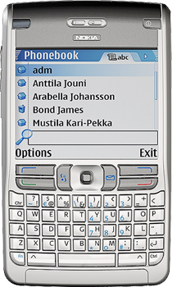

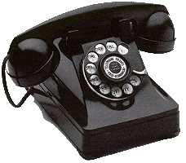
SIP in a Nutshell
Proxy A
Proxy B
SIP/SDP
SIP/SDP
SIP/SDP
RTP / RTCP
Alice
Bob
Session Initiation Protocol (SIP), RFC 3261
SIP is an application-layer control (signaling) protocol for creating, modifying, and terminating sessions with one or more participants.
These sessions include Internet telephone calls, multimedia distribution, and multimedia conferences.

Slide 58
Security Architecture
Proxy A
Proxy B
SIP/SDP
SIP/SDP
SIP/SDP
RTP / RTCP
Alice
Bob
User Authentication
(e.g. using SIP digest)

Slide 59
Security Architecture
Proxy A
Proxy B
SIP/SDP
SIP/SDP
SIP/SDP
RTP / RTCP
Alice
Bob
Asserting the user’s authenticated identity to others (e.g. using P-Asserted-Identity, RFC 3325, SIP Identity RFC 4474).

Slide 60
Security Architecture
Proxy A
Proxy B
SIP/SDP
SIP/SDP
SIP/SDP
RTP / RTCP
Alice
Bob
Media Security

Slide 61
How to build privacy into SIP? Privacy for the calling party
Prevent the called party to see who the calling party is
(built into PAI, SIP Identity)

Slide 62
Identity Hiding
From: Alice To: Bob
Proxy A
Proxy B
Alice
Bob
Please do not disclose my name.

Slide 63
Identity Hiding
From: anonymous To: Bob
Proxy A
Proxy B
Alice
Bob
Enforcement of identity hiding

Slide 64
How to build privacy into SIP? Privacy for the calling party
But my media traffic still reveals my IP address...
(see RFC 5767/RFC 5379 )

Slide 65
IP Address Hiding
From: Alice To: Bob
Proxy A
Proxy B
Alice
Bob
Please do not disclose my name
Route my traffic through a relay.
Enforcement of IP address hiding
Relay

Slide 66
How to build privacy into SIP? Privacy for the called party
I also want to provide some privacy properties for the receiver. They should be able to decide what calls to receive and how to treat them.

Slide 67
Unwanted Communication Attempts
Policies to control communication “Buddy List”
From: Alice To: Bob
Proxy A
Proxy B
Alice
Bob
Technical work in Common Policy, Presence Authorization Policy, etc. The entire presence architecture is applicable.

Slide 68
How to build privacy into SIP? Privacy for data sharing
I want to control how my information is shared when other request access to it.

Slide 69
Unwanted Communication Attempts
From: Alice To: Bob
Request data access
Policies to control data sharing
SIP Server
Proxy A
Alice
Bob
Technical work in Common Policy, Presence Authorization Policy, etc. The entire presence architecture is applicable.
For location specific applications see also Geolocation Policy, and the Geopriv privacy architecture.

Slide 70
Lessons Learned
TBD.

Slide 71
Summary
IETF protocols can implicate privacy . . .
Most protocols allow or require information about Internet endpoints to be shared (e.g., IP)
Some protocols allows for sharing of information specifically about people (e.g., XMPP)
Some protocols allows for direct communication between people (e.g., SIP)
We would like to provide IETF protocol designers guidelines to incorporate privacy into their work.
We described our guidelines indraft-iab-privacy-considerations
Apply these guidelines in your protocol design.

