Slide 1
Designing Privacy into Internet Protocols
IAB Privacy Program

Slide 2
Agenda
Netflix
What is privacy?
Examples & Guidelines
Network Access Authentication
IPv6
OAuth
SIP-based Real-Time Communication
Summary

Slide 3
Netflix
TBD.

Slide 4
What is Privacy?
“Right to be let alone” (Warren & Brandeis)
Privacy requires that an individual has a means to exercise selective control of access to the self and is aware of the potential consequences of exercising that control (Altman).
Prosser focuses on a categorization of privacy based on four torts:
Intrusion upon an individual’s seclusion, solitude, or private affairs
Public disclosure of embarrassing private facts
Publicity placing an individual in a false light
Appropriation of an individual’s likeness for advantage
Privacy is the claim of individuals, groups, or institutions to determine for themselves when, how, and to what extent information about them is communicated to others. (Westin)

Slide 5
What is Privacy? (cont.)
As an Internet protocol designer we look at a more narrow slice of privacy.
There are also additional privacy-related deployment choices that go beyond the ability of what an IETF specification can do.
We do not offer a one-sentence privacy definition.
Privacy is the sum of what is described in the document.
Similar approach followed with RFC 3552 (for security)
There is also an overlap between security and privacy.
Privacy threats extend security threats.
Privacy protection assumes that security protection is in place.

Slide 6
Threat Model
Privacy threat models builds on security threat model and extends it.
Generic enough to be applicable to a wide range of specifications.
Offer a list of typical concerns that arise during standardization and subsequent deployment.
Not all threats are applicable to all applications.
Threats fall into two categories:
Combined security-privacy threats
Privacy-specific threats

Slide 7
Combined Security-Privacy Threats
Surveillance
Stored data compromise
Intrusion: Consists of invasive acts that disturb or interrupt one's life or activities.
Misattribution: Occurs when data or communications related to one individual are attributed to another.

Slide 8
Privacy-Specific Threats
Correlation: Correlation is the combination of various pieces of information related to an individual.
Identification: Linking of information to a particular individual.
Secondary use: It the individual's consent for a purpose different from that for which the information was collected.
Disclosure: Revelation of information about an individual that affects the way others judge the individual
Exclusion: Is the failure to allow individuals to know about the data that others have about them.

Slide 9
Examples

Slide 10
Example: Network Access Authentication

Slide 11
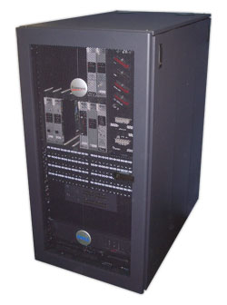

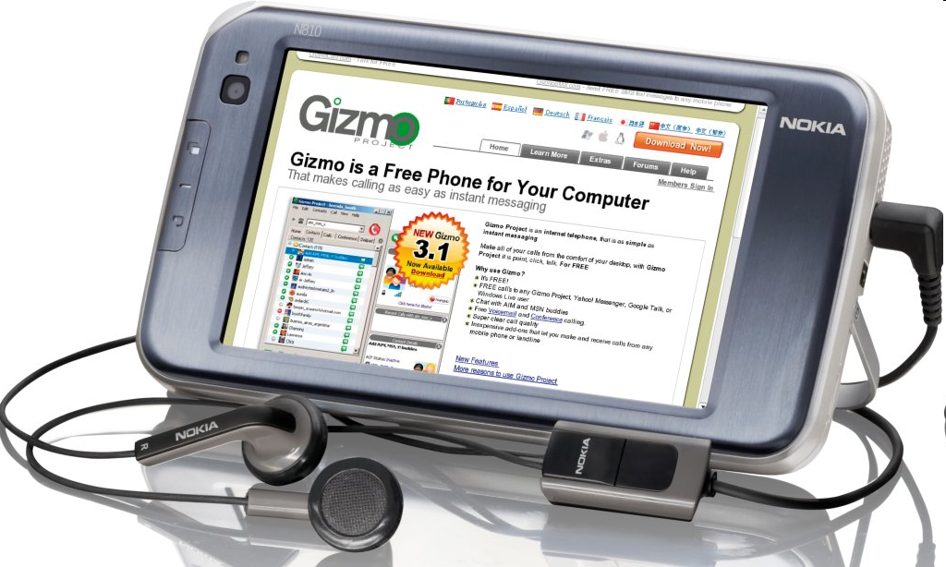
Architecture
Network
Access
Server
AAA Broker
AAA Server
End Host

Slide 12
Architecture, cont.
EAP Peer
Authenticator
EAP server
EAP peer (supplicant)
EAP server
AAA Client
AAA
Server
EAP MSK
EAP lower
Layer
(e.g.,
802.11i)
EAP lower
Layer
(e.g.,
802.11i)
EAP MSK
EAP method

Slide 13
Guideline
Identifiers. What identifiers does the protocol use for distinguishing initiators of communications?
Observers. Which information is exposed to other protocol entities?
Persistence of identifiers. What assumptions are made in the protocol design about the lifetime of the identifiers?
Correlation. Does the protocol allow for correlation of identifiers?

Slide 14
Identifiers
The MAC address of the end device.
The IP address of the user, typically assigned after the EAP exchange has completed.
The EAP network access identifier (NAI) used in the EAP-Response/Identity exchange. The NAI is defined in RFC 4282.
The EAP NAI used within the EAP method itself.
Network Access Server (NAS) identifiers carried by the AAA protocol. There include: NAS-Identifier, NAS-IPv4-Address (RFC 2865), NAS-IPv6-Address (RFC 3162) and Called-Station-Id (RFC 2865, 3580). In addition to identifying the NAS, these attributes can be used to infer the user's location.
User identifiers carried by the AAA protocol. These include the following attributes: User-Name (RFC 2865), Calling-Station-Id (RFC 3580) EAP-Message attribute (RFC 3579), Chargeable User Identity (RFC 4372).

Slide 15
Lessons Learned
No privacy threat model was developed. Instead the debate occurred on a piecemeal basis across multiple documents and WGs.
Due to the piecemeal nature of the discussion, introduction of identity confidentiality in one part of the system (e.g., user-NAS communications) resulted in issues arising for other actors (e.g., network providers, administrators).
No terminology was defined, nor were the goals laid out. The initial concerns seemed to be more about security than privacy, and subsequent arguments more about billing assurance than privacy.

Slide 16
Lessons Learned, cont.
Although regulatory requirements eventually loomed large in the debate, these were never referenced in any of the documents, or even comprehensively discussed. As a result, there were arguments within the IETF as well as IEEE 802 about what those requirements were real or imagined that were never put to rest (e.g., is a MAC address considered personal data? What other things in the EAP/AAA system are considered personal data?).
The lack of a definition of privacy goals lead to somewhat odd design decisions that were not fully justified or even discussed.
The use of EAP and AAA data in other contexts has continued to grow.
For example, this data is a very popular source of location info as provided in location configuration protocols (e.g., HELD, DHCP).
It is also commonly used in response to security incidents (e.g., denying access to infected machines, detection of spoofing or bot infection, etc.).

Slide 17
Use Case: IPv6

Slide 18
History of IPv6 address assignment
In IPv4, we used static addresses or DHCP
Static is manually intensive and error prone
DHCP is a statefull protocol and requires manual configuration on server
IPv6 then added (in addition) stateless address auto-configuration
Routers advertise on-link prefix
Hosts generate own suffix and append it to prefix

Slide 19
Suffix generation mechanisms
Many suffix generation mechanisms are defined:
Manual configuration
Link-layer address derived
MAC address (RFC 1972/2464)
IPv4 address (many RFCs)
IPv4 address + port (RFC 4380)
Random (RFC 3041/4941)
Hash of public key (RFC 3972)

Slide 20
Guidelines
Identifiers. What identifiers does the protocol use for distinguishing initiators of communications?
Persistence of identifiers. What assumptions are made in the protocol design about the lifetime of the identifiers? Does the protocol allow implementers or users to delete or replace identifiers? How often does the specification recommend to delete or replace identifiers by default? Can the identifiers, along with other state information, be set to automatically expire?

Slide 21
IPv6 Privacy Addresses
IPv6 (RFC 2462) specified creating suffix from (globally-unique) MAC address
Unique suffix means can be tracked as move
Web sites (not just ones you authenticate to) can correlate where you’ve been
“Permanent” suffix means can be tracked over long timescales
RFC 3041 defines “temporary addresses” (aka “privacy addresses”) used for outbound connections
Randomly generated
Changes daily by default (1d preferred, 7d valid)
Idea was that you use temporary addresses for anonymous web browsing etc. and “public” addresses for advertising in DNS etc.
DON’T mix temporary & public addresses, or the temporary addresses become correlatable

Slide 22
Lessons Learned
Think about privacy up front.
If you specify non-privacy solution first, it’ll be seen as required and there will be barriers to privacy.
Stable identifiers (incl. MAC address) often cause concerns.
Mixing stable identifiers and “privacy” identifiers is easy to do by accident.

Slide 23
Use Case: OAuth

Slide 24
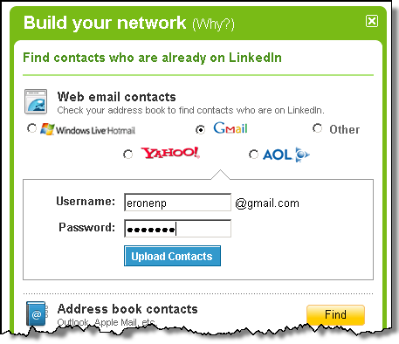
Protocol Development Example Stage 1: Identification of a problem
Web mash-ups use data from different sources.
No problem reading public data but protected data requires credentials.
Credential sharing leads to security and privacy problems.

Slide 25

Protocol Development Example Stage 2: Initial Deployment
Around 2006: Companies create ad-hoc solutions and offer them on their Web pages
Early 2007: Group of people gather to agree on a common solution. OAuth starts to exist.
Late 2007: Deployment of OAuth well on its way.

Slide 26
Protocol Development Example Stage 3: IETF Standardization/Deployment
Early 2009: Working group gets created.
2012: Working group still works on standardizing OAuth 2.0.
Protocol sees widespread deployment to enables data sharing on the Internet.
Working group has 850+ members.
50+ are actively contributing in the standardization process
10+ people belong to the inner core
Available implementations: thousands
Related groups start to appear:
IETF JavaScript Object Signing and Encryption (JOSE)
W3C JavaScript Crypto API
IETF Secure Cloud Identity Management (SCIM)
OAuth gets used by other SDOs in their architecture.
Examples: NIST GreenButton/Smart Grids, GSMA/OMA OneAPI

Slide 27
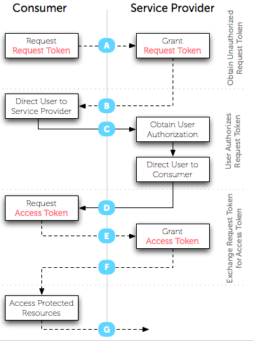


Protocol Development Example View of the Standardization Expert
This is how it is shown in presentations.

Slide 28
Protocol Development Example View of the Standardization Expert (2)
This is how it looks like in the standard:
HTTP/1.1 200 OK
Content-Type: application/json;charset=UTF-8
Cache-Control: no-store
Pragma: no-cache
{
"access_token":"2YotnFZFEjr1zCsicMWpAA",
"token_type":"example",
"expires_in":3600,
"refresh_token":"tGzv3JOkF0XG5Qx2TlKWIA",
"example_parameter":"example_value"
}

Slide 29
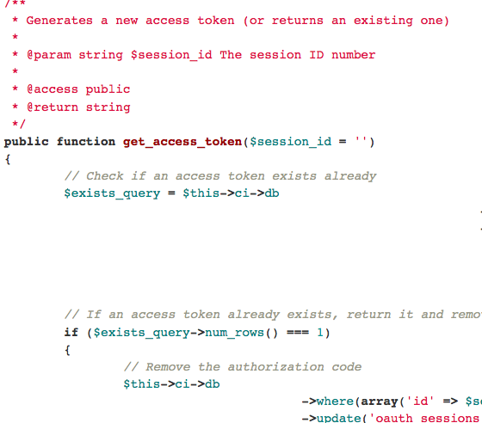
Protocol Development Example View of the Implementer
Example: Those who implement libraries, such as http://bit.ly/J82Riy
Library implementers typically do not know for what use cases their code will be utilized.

Slide 30
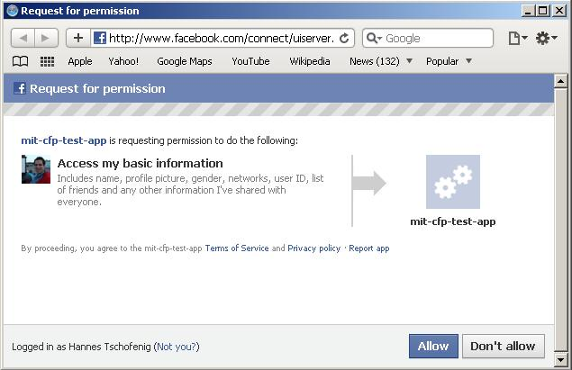
Protocol Development Example View of those who deploy
Those who deploy combine a number of protocols, decide about the configuration parameters, and design the user interface.
… and often do not read the specifications.

Slide 31
Lessons Learned
TBD.

Slide 32
Use Case: SIP-based Real-Time Communication

Slide 33
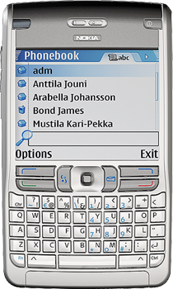

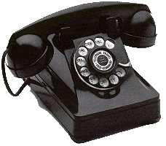
SIP in a Nutshell
Proxy A
Proxy B
SIP/SDP
SIP/SDP
SIP/SDP
RTP / RTCP
Alice
Bob
Session Initiation Protocol (SIP), RFC 3261
SIP is an application-layer control (signaling) protocol for creating, modifying, and terminating sessions with one or more participants.
These sessions include Internet telephone calls, multimedia distribution, and multimedia conferences.

Slide 34
Security Architecture
Proxy A
Proxy B
SIP/SDP
SIP/SDP
SIP/SDP
RTP / RTCP
Alice
Bob
User Authentication
(e.g. using SIP digest)

Slide 35
Security Architecture
Proxy A
Proxy B
SIP/SDP
SIP/SDP
SIP/SDP
RTP / RTCP
Alice
Bob
Asserting the user’s authenticated identity to others (e.g. using P-Asserted-Identity, RFC 3325, SIP Identity RFC 4474).

Slide 36
Security Architecture
Proxy A
Proxy B
SIP/SDP
SIP/SDP
SIP/SDP
RTP / RTCP
Alice
Bob
Media Security

Slide 37
How to build privacy into SIP? Privacy for the calling party
Prevent the called party to see who the calling party is
(built into PAI, SIP Identity)

Slide 38
Identity Hiding
From: Alice To: Bob
Proxy A
Proxy B
Alice
Bob
Please do not disclose my name.

Slide 39
Identity Hiding
From: anonymous To: Bob
Proxy A
Proxy B
Alice
Bob
Enforcement of identity hiding

Slide 40
How to build privacy into SIP? Privacy for the calling party
But my media traffic still reveals my IP address...
(see RFC 5767/RFC 5379 )

Slide 41
IP Address Hiding
From: Alice To: Bob
Proxy A
Proxy B
Alice
Bob
Please do not disclose my name
Route my traffic through a relay.
Enforcement of IP address hiding
Relay

Slide 42
How to build privacy into SIP? Privacy for the called party
I also want to provide some privacy properties for the receiver. They should be able to decide what calls to receive and how to treat them.

Slide 43
Unwanted Communication Attempts
Policies to control communication “Buddy List”
From: Alice To: Bob
Proxy A
Proxy B
Alice
Bob
Technical work in Common Policy, Presence Authorization Policy, etc. The entire presence architecture is applicable.

Slide 44
How to build privacy into SIP? Privacy for data sharing
I want to control how my information is shared when other request access to it.

Slide 45
Unwanted Communication Attempts
From: Alice To: Bob
Request data access
Policies to control data sharing
SIP Server
Proxy A
Alice
Bob
Technical work in Common Policy, Presence Authorization Policy, etc. The entire presence architecture is applicable.
For location specific applications see also Geolocation Policy, and the Geopriv privacy architecture.

Slide 46
Lessons Learned
TBD.

Slide 47
Summary

Slide 48
Terminology & Threats
Terminology to describe privacy considerations in an understandable way.
Threat model that lists
Combined security-privacy threats, and
Privacy-specific threats

Slide 49
Guidelines
Questions that
get protocol designers to think about design decisions that relate to privacy concerns, and
make authors describe their tradeoff decisions.
RFC 4101 describes an approach for providing protocol "models" that allow reviewers to quickly grasp the essence of a system.
Could be useful also for privacy-related review but is not mandated.
Guidelines does not tell what the solution should be.

Slide 50
Toolbox to Mitigate Threats
Data minimization
Anonymity
Pseudonymity
Identity Confidentiality
Data Minimization (within identity management)
User participation
Security (already described in RFC 3552)
Confidentiality
Peer entity authentication
Unauthorized usage limitation
Inappropriate usage limitation

Slide 51
Conclusion
IETF protocols can implicate privacy . . .
Most protocols allow or require information about Internet endpoints to be shared (e.g., IP)
Some protocols allows for sharing of information specifically about people (e.g., XMPP)
Some protocols allows for direct communication between people (e.g., SIP)
We would like to provide IETF protocol designers guidelines to incorporate privacy into their work.
Apply these guidelines in your protocol design.

