Slide 1
Designing Privacy into Internet Protocols
IAB Privacy Program

Slide 2
Agenda
Background
From Security to Privacy
Privacy Engineering
Our Privacy Guidelines
Examples
IPv6
OAuth
SIP-based Real-Time Communication
Network Access Authentication

Slide 3
Security in the IETF

Slide 4
Security in the IETF
All RFCs are required to have a Security Considerations section, as stated in RFC 1543 (and updated by RFC 2223).
At the beginning the quality of the write-ups in those security considerations sections was relatively weak, as surveyed in [1].
Neither RFC provides much guidance:
”All RFCs must contain a section near the end of the document that discusses the security considerations of the protocol or procedures that are the main topic of the RFC.”
[1] A. Rabkin, N. Doty, and D. K. Mulligan, “Facilitate, don’t mandate,” Dec. 2010, position Paper for the IAB/W3C/MIT/ISOC Internet Privacy Workshop, Boston, Dec. 2010, http://www.iab.org/about/workshops/privacy/papers/nick doty.pdf.

Slide 5
Security in the IETF, cont.
With the introduction of this mandatory security analysis a separate review group, called ”Security Area Directorate”, was established.
Goal was to review all IETF documents prior to publication.
Reviews provided input to the Area Directors in their review of the documents and offered feedback to the protocol authors from experienced standards experts.
Members of the directorate were typically cryptography experts and chairs of working groups from the IETF security area.
Group has a face-to-face meeting at every IETF to discuss current challenges and a separate mailing list:
http://trac.tools.ietf.org/area/sec/trac/wiki/SecurityDirectorate

Slide 6
Security in the IETF, cont.
Later, the following RFCs were written:
”Guidelines for Writing RFC Text on Security Considerations” RFC 3552,
”Internet Security Glossary” RFC 4949, and
”Writing Protocol Models” RFC 4101
These documents …
Introduce terminology,
Illustrate the security threat model, and
Provide guidance for incorporating security in the design protocols and architectures.
Practically, most authors just copy the security consideration text from other documents and adjust it slightly.
Public discussion about current security challenges at every IETF meeting: Security Area Open Meeting
Public mailing list: https://www.ietf.org/mailman/listinfo/saag

Slide 7
From Security to Privacy

Slide 8
The IAB Privacy Program
Olaf Kolkman, the IAB Chair at that time, announced a new way of working in time for the IETF#78 meeting*.
A few programs were created and the privacy program was among it**: http://www.iab.org/activities/programs/privacy-program/
*: Olaf’s mail can be found here:http://www.ietf.org/mail-archive/web/ietf/current/msg62743.html
**: Other programs can be found at http://www.iab.org/activities/programs/

Slide 9
IAB Privacy Program - Roadmap
Education and awareness
Discussion List: https://www.ietf.org/mailman/listinfo/ietf-privacy
IAB technical plenary talk on privacy at IETF#81 (Quebec City, Canada, July 24-29, 2011)
Privacy plenary talk at IETF#77
IAB/W3C/ISOC/MIT Internet Privacy Workshop (Boston, Dec. 2010) http://www.iab.org/activities/workshops/internet-privacy-workshop-2010/
Privacy Area Directorate
Established in response to the Internet Privacy workshop by IETF Security Area Director Sean Turner and IETF chair Russ Housley.
Later dissolved…
Privacy Terminology & Privacy Guidelines
http://tools.ietf.org/html/draft-iab-privacy-considerations
Privacy Tutorial (this one)

Slide 10
How did we tackle Privacy in the IETF?
Privacy is being considered in IETF already, see position paper to the W3C workshop on “Advanced Device API”.
Key observations:
We did add privacy features in IETF technology.
Authors were often confused regarding the terminology.
We need to be more systematic in analyzing protocols and architectures.
Questions raised at the time:
Do we need new processes (e.g., review directorates)?
Is there a need for standardizing new technology?
How should privacy design guidelines look like?

Slide 11
What is Privacy?
Right to be let alone” (Warren & Brandeis)
Privacy requires that an individual has a means to exercise selective control of access to the self and is aware of the potential consequences of exercising that control (Altman).
Prosser focuses on a categorization of privacy based on four torts:
Intrusion upon an individual’s seclusion, solitude, or private affairs
Public disclosure of embarrassing private facts
Publicity placing an individual in a false light
Appropriation of an individual’s likeness for advantage
Privacy is the claim of individuals, groups, or institutions to determine for themselves when, how, and to what extent information about them is communicated to others. (Westin)

Slide 12
What is Privacy? (cont.)
“Privacy is a complicated concept with a rich history that spans many disciplines. With regard to data, often it is a concept applied to ‘personal data’, information relating to an identified or identifiable individual.” (draft-iab-privacy-considerations)
In the end we decided not to define privacy explicitly. It is the sum of what is described in draft-iab-privacy-considerations
Similar approach token with RFC 3552 (Security)

Slide 13
Privacy Engineering
What can we re-use?

Slide 14
Existing Guidelines
Publications on privacy engineering exist:
Claudia Diaz, et al. https://www.cosic.esat.kuleuven.be/publications/article-1542.pdf
Lorrie Cranor, et al. http://papers.ssrn.com/sol3/papers.cfm?abstract_id=1085333
These documents typically assume that the designer is in full control of the entire application stack.
Unfortunately, we are not in control of the entire stack.
Many domain specific proposal for improving privacy
Example: EFF location privacy (with examples on road pricing)
http://www.eff.org/wp/locational-privacy
Challenge: We typically do not standardize specific applications like friend finder.
Privacy Impact Assessments
Challenge: Focus often on deployments; not standardization.

Slide 15
Re-Using Existing Guidelines, cont.
Privacy Principles
Many available and they all provide valuable insight.
(e.g., FIPs, OECD Privacy Principles, Madrid Resolution)
Example: Fair Information Practices
Notice and Consent
Collection Limitation
Use/Disclosure Limitation
Retention Limitation
Accuracy
Access
Security
Challenge: Too abstract and largely outside the scope of protocol authors.

Slide 16
Guidance from Regulators & Data Protection Authorities
European Commission:
Example: Directive 95/46/EC
Article 29 WP issue “opinions” on how different directives are applied to recent developments, such as changes in the business eco-system.
Example Opinion 2/2010 on Behavioural Advertising, which is an analysis of the “Cookie” Directive.
The International Working Group on Data Protection in Telecommunications (IWGDPT) (aka Berlin Group) goes a step further than the Article 29 WP and takes technology into consideration in their analysis.
Guidance is at a high level and often technology neutral.
Often cannot immediately be applied to technical standards and often talks to a different audience.

Slide 17
Our Privacy Guidelines

Slide 18
Privacy Considerations Document Content
Terminology
Threat model
Threat mitigation
Guidelines

Slide 19
Terminology
Initially terminology was taken from here: http://dud.inf.tu-dresden.de/literatur/
Terminology used in academic publications.
Unfortunately, it a bit too complex for the standardization context.
Sometimes tricky to apply the terminology to IETF standardization work.
Example:
Pseudonym: “A pseudonym is an identifier of a subject other than one of the subject’s real names.”
Protocols may carry identifiers, such as the ‘username’, but there is no requirement that the text contains the subject’s real name.

Slide 20
Threat Model
Privacy threat models builds on security threat model and extends it.
Generic enough to be applicable to a wide range of specifications.
Offer a list of typical concerns that arise during standardization and subsequent deployment.
Not all threats are applicable to all applications.
Threats fall into two categories:
Combined security-privacy threats
Privacy-specific threats

Slide 21
Threat Model, cont. Combined security-privacy threats
Surveillance
Stored data compromise
Intrusion: Consists of invasive acts that disturb or interrupt one's life or activities.
Misattribution: Occurs when data or communications related to one individual are attributed to another.
21

Slide 22
Threat Model, cont. Privacy-specific threats
Correlation: Correlation is the combination of various pieces of information related to an individual.
Identification: Linking of information to a particular individual.
Secondary use: It the individual's consent for a purpose different from that for which the information was collected.
Disclosure: Revelation of information about an individual that affects the way others judge the individual
Exclusion: Is the failure to allow individuals to know about the data that others have about them.

Slide 23
Threat Mitigation
Data minimization
Anonymity
Pseudonymity
Identity Confidentiality
Data Minimization (within identity management)
User participation
Security (already described in RFC 3552)
Confidentiality
Peer entity authentication
Unauthorized usage limitation
Inappropriate usage limitation

Slide 24
Guidelines
Consists of questions to
get protocol designers to think about design decisions that relate to privacy concerns, and
Make authors describe their tradeoff decisions.
Does not tell what the solution should be.
Does not require protocol designer to summarize the protocol description
Although RFC 4101 “Writing Protocol Models” suggests that this would be useful to help security expert to provide faster feedback.

Slide 25
Guidelines Example
Protocols use a lot of identifiers.
Identifiers may allow identification and correlation.
Questions for protocol designers are, for example:
What identifiers does the protocol use for distinguishing initiators of communications?
Does the protocol use identifiers that allow different protocol interactions to be correlated?
What identifiers could be omitted or be made less identifying while still fulfilling the protocol's goals?
Is there a risk of misattribution?

Slide 26
Challenges with the Development Process
The Internet protocol development process is distributed.
Different protocols are developed by different groups, organizations, and communities.
Development takes typically a long period of time. Depending on the protocol layer it may take many, many years.
The outcome is often hard to predict. Often, there are undesirable deployment developments.
Data minimization and purpose limitation principles are difficult to apply to IETF protocols
We do not necessarily know the detailed purpose of the applications our protocols are used with.
The building blocks can be used for many different purposes.

Slide 27
Examples

Slide 28
Use Case: OAuth

Slide 29
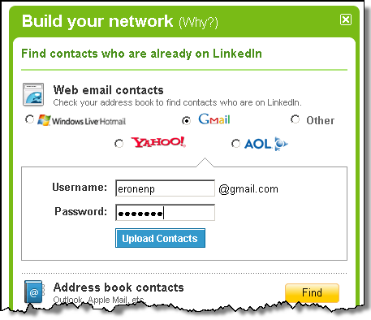
Protocol Development Example Stage 1: Identification of a problem
Web mash-ups use data from different sources.
No problem reading public data but protected data requires credentials.
Credential sharing leads to security and privacy problems.

Slide 30

Protocol Development Example Stage 2: Initial Deployment
Around 2006: Companies create ad-hoc solutions and offer them on their Web pages
Early 2007: Group of people gather to agree on a common solution. OAuth starts to exist.
Late 2007: Deployment of OAuth well on its way.

Slide 31
Protocol Development Example Stage 3: IETF Standardization/Deployment
Early 2009: Working group gets created.
2012: Working group still works on standardizing OAuth 2.0.
Protocol sees widespread deployment to enables data sharing on the Internet.
Working group has 850+ members.
50+ are actively contributing in the standardization process
10+ people belong to the inner core
Available implementations: thousands
Related groups start to appear:
IETF JavaScript Object Signing and Encryption (JOSE)
W3C JavaScript Crypto API
IETF Secure Cloud Identity Management (SCIM)
OAuth gets used by other SDOs in their architecture.
Examples: NIST GreenButton/Smart Grids, GSMA/OMA OneAPI

Slide 32
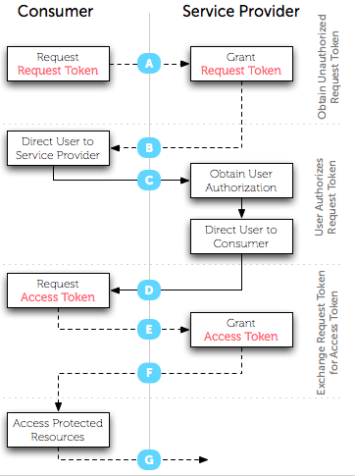


Protocol Development Example View of the Standardization Expert
This is how it is shown in presentations.

Slide 33
Protocol Development Example View of the Standardization Expert (2)
This is how it looks like in the standard:
HTTP/1.1 200 OK
Content-Type: application/json;charset=UTF-8
Cache-Control: no-store
Pragma: no-cache
{
"access_token":"2YotnFZFEjr1zCsicMWpAA",
"token_type":"example",
"expires_in":3600,
"refresh_token":"tGzv3JOkF0XG5Qx2TlKWIA",
"example_parameter":"example_value"
}

Slide 34
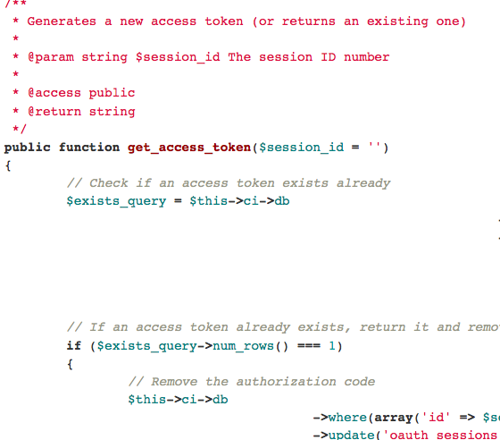
Protocol Development Example View of the Implementer
Example: Those who implement libraries, such as http://bit.ly/J82Riy
Library implementers typically do not know for what use cases their code will be utilized.

Slide 35
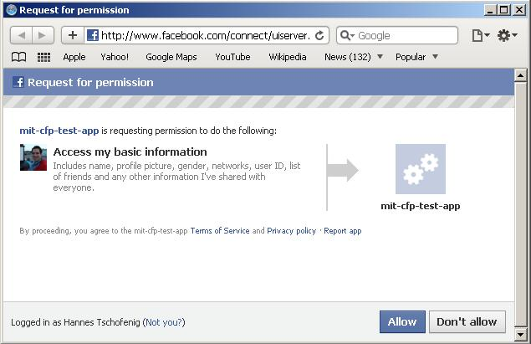
Protocol Development Example View of those who deploy
Those who deploy combine a number of protocols, decide about the configuration parameters, and design the user interface.
… and often do not read the specifications.

Slide 36
Lessons Learned
TBD.

Slide 37
Use Case: Network Access Authentication

Slide 38
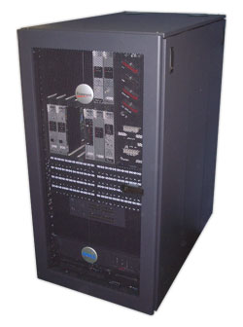

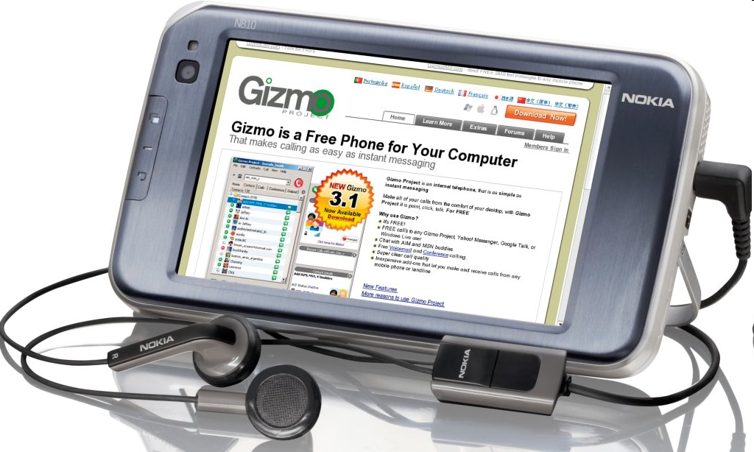
Architecture, cont.
Network
Access
Server
AAA Clearing House / Broker
AAA Server
End Host

Slide 39
Architecture, cont.
EAP Peer
Authenticator
EAP server
EAP peer (supplicant)
EAP server
AAA Client
AAA
Server
EAP MSK
EAP lower
Layer
(e.g.,
802.11i)
EAP lower
Layer
(e.g.,
802.11i)
EAP MSK
EAP method

Slide 40
Relevant Identifiers
The MAC address of the end device.
The IP address of the user, typically assigned after the EAP exchange has completed.
The EAP network access identifier (NAI) used in the EAP-Response/Identity exchange. The NAI is defined in RFC 4282.
The EAP NAI used within the (potentially protected) EAP method exchange
Network Access Server (NAS) identifiers carried by the AAA protocol. There include: NAS-Identifier, NAS-IPv4-Address (RFC 2865), NAS-IPv6-Address (RFC 3162) and Called-Station-Id (RFC 2865, 3580). In addition to identifying the NAS, these attributes can be used to infer the user's location.
User identifiers carried by the AAA protocol. These include the following attributes: User-Name (RFC 2865), Calling-Station-Id (RFC 3580) EAP-Message attribute (RFC 3579), Chargeable User Identity (RFC 4372).
Often ignored: intermediate AAA entities (like proxies and relays).

Slide 41
Lessons Learned
No privacy threat model was developed. Instead the debate occurred on a piecemeal basis across multiple documents and WGs.
Due to the piecemeal nature of the discussion, introduction of partial anonymity in one part of the system (e.g. user-NAS communications) resulted in issues arising for other actors (e.g. network providers, administrators).
No terminology was defined, nor were the goals laid out. Indeed the initial concerns seemed to be more about security than privacy, and subsequent arguments more about billing assurance than privacy.

Slide 42
Lessons Learned, cont.
Although regulatory requirements eventually loomed large in the debate, these were never referenced in any of the documents, or even comprehensively discussed. As a result, there were arguments within the IETF as well as IEEE 802 about what those requirements were real or imagined that were never put to rest (e.g., is a MAC address considered PII, and if so, in what countries? What other things in the EAP/AAA system are considered PII?).
The lack of a definition of privacy goals lead to somewhat odd design decisions that were not fully justified or even discussed.
The use of EAP and AAA data in other contexts has continued to grow.
For example, this data is a very popular source of location info as provided in location configuration protocols (e.g., HELD, DHCP).
It is also commonly used in response to security incidents (e.g., denying access to infected machines, detection of spoofing or bot infection, etc.).

Slide 43
Use Case: IPv6

Slide 44
History of IPv6 address assignment
In IPv4, we used static addresses or DHCP
Static is manually intensive and error prone
DHCP is state intensive, doesn’t have fate-sharing, and requires manual configuration on server
IPv6 then added (in addition) stateless address auto-configuration
Routers advertise on-link prefix (fate-sharing)
Hosts generate own suffix and append it to prefix

Slide 45
Privacy impact of prefix
Prefix reveals location
Initially same impact in IPv6 and IPv4
But if you NAT IPv4 and route IPv6, location granularity far more in IPv6
This is one motivation for NAT in IPv6 (see IAB RFC 5902, Section 2.4)

Slide 46
Suffix generation mechanisms
Many suffix generation mechanisms are defined:
Manual configuration
Link-layer address derived
MAC address (RFC 1972/2464)
IPv4 address (many RFCs)
IPv4 address + port (RFC 4380)
Random (RFC 3041/4941)
Hash of public key (RFC 3972)
Questions for each address generation method:
What do they reveal?
How long do they reveal it for?

Slide 47
MAC-derived suffixes
IPv6 (RFC 2462) specified creating suffix from (globally-unique) MAC address
IPv6 compliance suites now test for (require) this
MAC addresses have a “OUI” that identifies the vendor
Problems:
Unique suffix means can be tracked as move
Web sites (not just ones you authenticate to) can correlate where you’ve been
“Permanent” suffix means can be tracked over long timescales
Address scans are much easier if limit to popular OUIs
Correlating known OUIs to OSs/devices can be used to hint at possible vulnerabilities
Knowing MAC address can be used to remotely wake a machine (“magic packet”) and consume power.

Slide 48
IPv6 “Privacy Extensions”
RFC 3041 mainly addressed problems 1 & 2
Defines “temporary addresses” (aka “privacy addresses”) used for outbound connections
Randomly generated
Changes daily by default (1d preferred, 7d valid)
Idea was that you use temporary addresses for anonymous web browsing etc. and “public” addresses for advertising in DNS etc.
DON’T mix temporary & public addresses, or the temporary addresses become correlatable

Slide 49
Address Selection – RFC 3484
Public address used for outbound unless application opted in
RFC 3484: “Implementations for which privacy considerations outweigh these application compatibility concerns MAY reverse the sense of this rule and by default prefer temporary addresses over public addresses.”
Rationale unclear, but probably risk of breaking apps (e.g. servers that do reverse DNS resolution)

Slide 50
Lessons Learned
Think about privacy up front.
If you specify non-privacy solution first, it’ll be seen as required and there will be barriers to privacy.
Stable identifiers (incl. MAC address) often cause concerns.
Mixing stable identifiers and “privacy” identifiers is easy to do by accident.

Slide 51
Use Case: SIP-based Real-Time Communication

Slide 52
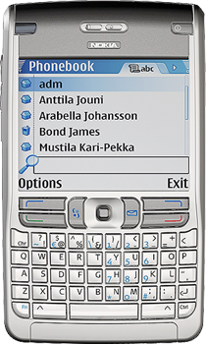

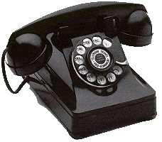
SIP in a Nutshell
Proxy A
Proxy B
SIP/SDP
SIP/SDP
SIP/SDP
RTP / RTCP
Alice
Bob
Session Initiation Protocol (SIP), RFC 3261
SIP is an application-layer control (signaling) protocol for creating, modifying, and terminating sessions with one or more participants.
These sessions include Internet telephone calls, multimedia distribution, and multimedia conferences.

Slide 53
Security Architecture
Proxy A
Proxy B
SIP/SDP
SIP/SDP
SIP/SDP
RTP / RTCP
Alice
Bob
User Authentication
(e.g. using SIP digest)

Slide 54
Security Architecture
Proxy A
Proxy B
SIP/SDP
SIP/SDP
SIP/SDP
RTP / RTCP
Alice
Bob
Asserting the user’s authenticated identity to others (e.g. using P-Asserted-Identity, RFC 3325, SIP Identity RFC 4474).

Slide 55
Security Architecture
Proxy A
Proxy B
SIP/SDP
SIP/SDP
SIP/SDP
RTP / RTCP
Alice
Bob
Media Security

Slide 56
How to build privacy into SIP? Privacy for the calling party
Prevent the called party to see who the calling party is
(built into PAI, SIP Identity)

Slide 57
Identity Hiding
From: Alice To: Bob
Proxy A
Proxy B
Alice
Bob
Please do not disclose my name.

Slide 58
Identity Hiding
From: anonymous To: Bob
Proxy A
Proxy B
Alice
Bob
Enforcement of identity hiding

Slide 59
How to build privacy into SIP? Privacy for the calling party
But my media traffic still reveals my IP address...
(see RFC 5767/RFC 5379 )

Slide 60
IP Address Hiding
From: Alice To: Bob
Proxy A
Proxy B
Alice
Bob
Please do not disclose my name
Route my traffic through a relay.
Enforcement of IP address hiding
Relay

Slide 61
How to build privacy into SIP? Privacy for the called party
I also want to provide some privacy properties for the receiver. They should be able to decide what calls to receive and how to treat them.

Slide 62
Unwanted Communication Attempts
Policies to control communication “Buddy List”
From: Alice To: Bob
Proxy A
Proxy B
Alice
Bob
Technical work in Common Policy, Presence Authorization Policy, etc. The entire presence architecture is applicable.

Slide 63
How to build privacy into SIP? Privacy for data sharing
I want to control how my information is shared when other request access to it.

Slide 64
Unwanted Communication Attempts
From: Alice To: Bob
Request data access
Policies to control data sharing
SIP Server
Proxy A
Alice
Bob
Technical work in Common Policy, Presence Authorization Policy, etc. The entire presence architecture is applicable.
For location specific applications see also Geolocation Policy, and the Geopriv privacy architecture.

Slide 65
Lessons Learned
TBD.

Slide 66
Summary
IETF protocols can implicate privacy . . .
Most protocols allow or require information about Internet endpoints to be shared (e.g., IP)
Some protocols allows for sharing of information specifically about people (e.g., XMPP)
Some protocols allows for direct communication between people (e.g., SIP)
We would like to provide IETF protocol designers guidelines to incorporate privacy into their work.
We described our guidelines indraft-iab-privacy-considerations
Apply these guidelines in your protocol design.

