Slide 1
Designing Privacy into Internet Protocols
IAB Privacy Program

Slide 2
Agenda
Netflix
What is privacy?
Examples & Guidelines
Network Access Authentication
IPv6
OAuth
SIP-based Real-Time Communication
Summary

Slide 3
Netflix

Slide 4
A Motivating Example
In October 2006 Netflix announced the $1-million Netﬂix Prize for improving their movie recommendation service:
“The Netflix Prize seeks to substantially improve the accuracy of predictions about how much someone is going to love a movie based on their movie preferences.”
It is a challenge to the world's researchers to improve the rental firm's movie-recommendation engine.
Netflix published the large database as part of its $1 million Netflix Prize.
The released data (from 480,000+ subscribers of Netﬂix) with 100,000,000+ video ratings between December 1999 and December 2005 was anonymized (by using pseudonyms).

Slide 5
Netflix, cont.
Two researchers from University of Texas have identified two people out of the dataset.
It is possible to learn sensitive non-public information about a person from his or her movie viewing history.
An adversary may have auxiliary information about a subscriber’s movie preferences (e.g., from the Internet Movie Database):
the titles of a few of the movies that this subscriber watched
maybe even approximate dates

Slide 6
What is Privacy?

Slide 7
What is Privacy?
We do not offer a one-sentence privacy definition.
Privacy is the sum of what is described in the document.
Similar approach followed with RFC 3552 (for security)
As an Internet protocol designer we look at a more narrow slice of privacy.
There are also additional privacy-related deployment choices that go beyond the ability of what an IETF specification can do.
There is also an overlap between security and privacy.
Privacy threats extend security threats.
Privacy protection assumes that security protection is in place.

Slide 8
Threat Model
Privacy threat models builds on security threat model and extends it.
Generic enough to be applicable to a wide range of specifications.
Offer a list of typical concerns that arise during standardization and subsequent deployment.
Not all threats are applicable to all applications.
Threats fall into two categories:
Combined security-privacy threats
Privacy-specific threats

Slide 9
Combined Security-Privacy Threats
Surveillance
Stored data compromise
Intrusion: Consists of invasive acts that disturb or interrupt one's life or activities.
Misattribution: Occurs when data or communications related to one individual are attributed to another.

Slide 10
Privacy-Specific Threats
Correlation: Correlation is the combination of various pieces of information related to an individual.
Identification: Linking of information to a particular individual.
Secondary use: It the individual's consent for a purpose different from that for which the information was collected.
Disclosure: Revelation of information about an individual that affects the way others judge the individual
Exclusion: Is the failure to allow individuals to know about the data that others have about them.

Slide 11
Examples

Slide 12
Example: Network Access Authentication

Slide 13
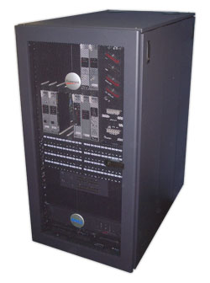

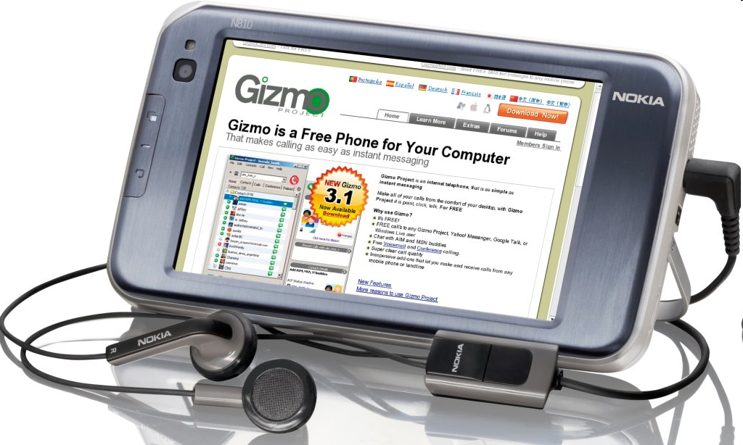
Architecture
Network
Access
Server
AAA Broker
AAA Server
End Host

Slide 14
Architecture, cont.
EAP Peer
Authenticator
EAP server
EAP peer (supplicant)
EAP server
AAA Client
AAA
Server
EAP MSK
EAP lower
Layer
(e.g.,
802.11i)
EAP lower
Layer
(e.g.,
802.11i)
EAP MSK
EAP method

Slide 15
Guideline
Identifiers. What identifiers does the protocol use for distinguishing initiators of communications?
Observers. Which information is exposed to other protocol entities?
Persistence of identifiers. What assumptions are made in the protocol design about the lifetime of the identifiers?
Correlation. Does the protocol allow for correlation of identifiers?

Slide 16
Identifiers
The MAC address of the end device.
The IP address of the user, typically assigned after the EAP exchange has completed.
The EAP network access identifier (NAI) used in the EAP-Response/Identity exchange. The NAI is defined in RFC 4282.
The EAP NAI used within the EAP method itself.
Network Access Server (NAS) identifiers carried by the AAA protocol. There include: NAS-Identifier, NAS-IPv4-Address (RFC 2865), NAS-IPv6-Address (RFC 3162) and Called-Station-Id (RFC 2865, 3580). In addition to identifying the NAS, these attributes can be used to infer the user's location.
User identifiers carried by the AAA protocol. These include the following attributes: User-Name (RFC 2865), Calling-Station-Id (RFC 3580) EAP-Message attribute (RFC 3579), Chargeable User Identity (RFC 4372).

Slide 17
Lessons Learned
No privacy threat model was developed. Instead the debate occurred on a piecemeal basis across multiple documents and WGs.
Due to the piecemeal nature of the discussion, introduction of identity confidentiality in one part of the system (e.g., user-NAS communications) resulted in issues arising for other actors (e.g., network providers, administrators).
No terminology was defined, nor were the goals laid out. The initial concerns seemed to be more about security than privacy, and subsequent arguments more about billing assurance than privacy.

Slide 18
Lessons Learned, cont.
Although regulatory requirements eventually loomed large in the debate, these were never referenced in any of the documents, or even comprehensively discussed. As a result, there were arguments within the IETF as well as IEEE 802 about what those requirements were real or imagined that were never put to rest (e.g., is a MAC address considered personal data? What other things in the EAP/AAA system are considered personal data?).
The lack of a definition of privacy goals lead to somewhat odd design decisions that were not fully justified or even discussed.
The use of EAP and AAA data in other contexts has continued to grow.
For example, this data is a very popular source of location info as provided in location configuration protocols (e.g., HELD, DHCP).
It is also commonly used in response to security incidents (e.g., denying access to infected machines, detection of spoofing or bot infection, etc.).

Slide 19
Use Case: IPv6

Slide 20
History of IPv6 address assignment
In IPv4, we used static addresses or DHCP
Static is manually intensive and error prone
DHCP is a statefull protocol and requires manual configuration on server
IPv6 then added (in addition) stateless address auto-configuration
Routers advertise on-link prefix
Hosts generate own suffix and append it to prefix

Slide 21
Suffix generation mechanisms
Many suffix generation mechanisms are defined:
Manual configuration
Link-layer address derived
MAC address (RFC 1972/2464)
IPv4 address (many RFCs)
IPv4 address + port (RFC 4380)
Random (RFC 3041/4941)
Hash of public key (RFC 3972)

Slide 22
Guidelines
Identifiers. What identifiers does the protocol use for distinguishing initiators of communications?
Persistence of identifiers. What assumptions are made in the protocol design about the lifetime of the identifiers? Does the protocol allow implementers or users to delete or replace identifiers? How often does the specification recommend to delete or replace identifiers by default? Can the identifiers, along with other state information, be set to automatically expire?

Slide 23
IPv6 Privacy Addresses
IPv6 (RFC 2462) specified creating suffix from (globally-unique) MAC address
Unique suffix means can be tracked as move
Web sites (not just ones you authenticate to) can correlate where you’ve been
“Permanent” suffix means can be tracked over long timescales
RFC 3041 defines “temporary addresses” (aka “privacy addresses”) used for outbound connections
Randomly generated
Changes daily by default (1d preferred, 7d valid)
Idea was that you use temporary addresses for anonymous web browsing etc. and “public” addresses for advertising in DNS etc.
DON’T mix temporary & public addresses, or the temporary addresses become correlatable

Slide 24
Lessons Learned
Think about privacy up front.
If you specify non-privacy solution first, it’ll be seen as required and there will be barriers to privacy.
Stable identifiers (incl. MAC address) often cause concerns.
Mixing stable identifiers and “privacy” identifiers is easy to do by accident.

Slide 25
Use Case: OAuth

Slide 26
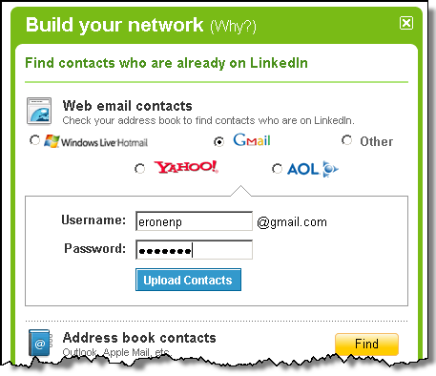
OAuth Background
Web mash-ups use data from different sources.
No problem reading public data but protected data requires credentials.
Credential sharing leads to security and privacy problems.

Slide 27
Guidelines
User Participation
User control. What controls or consent mechanisms does the protocol define or require before personal data or identifiers are shared or exposed via the protocol?
Control over sharing with individual recipients. Does the protocol provide ways for initiators to share different information with different recipients?

Slide 28
Lessons Learned
OAuth provided a significant improvement over earlier practices where long-term passwords were shared.
Provides a more privacy-friendly solution than CORS, backbone, etc.
Real-time user consent still presents challenges from a user-interface point of view:
http://zachholman.com/2011/01/oauth_will_murder_your_children/
Various insecure OAuth deployments lead to unauthorized access and stored data compromise.

Slide 29
Use Case: SIP-based Real-Time Communication

Slide 30
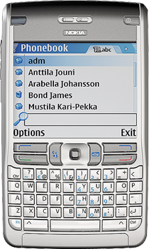

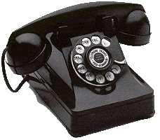
SIP in a Nutshell
Proxy A
Proxy B
SIP/SDP
SIP/SDP
SIP/SDP
RTP / RTCP
Alice
Bob
Session Initiation Protocol (SIP) -- RFC 3261
SIP is an application-layer control (signaling) protocol for creating, modifying, and terminating sessions with one or more participants.
These sessions include Internet telephone calls, multimedia distribution, and multimedia conferences.

Slide 31
Guidelines
Security
Surveillance. How do the protocol's security considerations prevent surveillance, including eavesdropping and traffic analysis?
Intrusion. How do the protocol's security considerations prevent or mitigate intrusion, including denial-of-service attacks and unsolicited communications more generally?

Slide 32
Guidelines, cont.
General
Trade-offs. Does the protocol make trade-offs between privacy and usability, privacy and efficiency, privacy and implementability, or privacy and other design goals?
Defaults. If the protocol can be operated in multiple modes or with multiple configurable options, does the default mode or option minimize the amount, identifiability, and persistence of the data and identifiers exposed by the protocol?

Slide 33
Guidelines, cont.
User Participation
Control over sharing with intermediaries. Does the protocol provide ways for initiators to limit which information is shared with intermediaries?
Preference expression. Does the protocol provide ways for initiators to express individuals' preferences to recipients or intermediaries with regard to the collection, use, or disclosure of their personal data?

Slide 34
Lessons Learned
SIP is a powerful communication protocol that raises a broad range of privacy concerns.
Various privacy-enabling techniques have been specified but in the majority of deployments these privacy features are not available.
The choice of defaults had a big (negative) impact on what has been deployed (e.g., in the e2e security context).
A success, however, was the ability to introduce a consent-based mechanism (buddy list) – a concept unknown in the legacy telephony world.
With subsequent work on XMPP and WebRTC some of these privacy questions are re-considered.

Slide 35
Summary

Slide 36
Guidelines
Questions that
get protocol designers to think about design decisions that relate to privacy concerns, and
make authors describe their tradeoff decisions.
RFC 4101 describes an approach for providing protocol "models" that allow reviewers to quickly grasp the essence of a system.
Could be useful also for privacy-related review but is not mandated.
Guidelines does not tell what the solution should be.

Slide 37
Toolbox to Mitigate Threats
Data minimization
Anonymity
Pseudonymity
Identity Confidentiality
Data Minimization (within identity management)
User participation
Security (already described in RFC 3552)
Confidentiality
Peer entity authentication
Unauthorized usage limitation
Inappropriate usage limitation

Slide 38
Conclusion
IETF protocols can implicate privacy . . .
Most protocols allow or require information about Internet endpoints to be shared (e.g., IP)
Some protocols allows for sharing of information specifically about people (e.g., XMPP)
Some protocols allows for direct communication between people (e.g., SIP)
We would like to provide IETF protocol designers guidelines to incorporate privacy into their work.
Apply these guidelines in your protocol design.

