Slide 1
ADVANCED TRACK
167,812
Weather Trend Forecasting
— Global Weather Repository
rows after cleaning
268
cities worldwide
Manuel Vargas Alvarez
PM Accelerator — Data Scientist technical assessment (Advanced track)
Dataset: Global Weather Repository
~2.5°C
day-ahead MAE (Kyiv)

Slide 2
MISSION
PM Accelerator mission
“
“We are committed to offering free Product Management education to teenagers from underserved families. Our mission is to break down financial barriers and achieve educational fairness… empower more kids for a better future… fostering a diverse landscape in the tech industry.”
— PMA KIDS, pmaccelerator.io
Product Manager Accelerator also serves a global community of aspiring and current product managers with training and career programs in product and AI.
2 / 14

Slide 3
OVERVIEW
Objective & approach
Goal: Forecast weather trends and demonstrate end-to-end data science on a real-world weather panel dataset.
Advanced track delivered:
1
2
3
4
5
Cleaning & EDA (temperature, precipitation)
Anomaly / outlier analysis
Multiple forecasting models + ensemble
Feature importance
Environmental (air quality) & geographical analysis
Primary series: Kyiv · target temperature_celsius · time index last_updated
3 / 14

Slide 4
DATA
Data overview
167,812
41
Data caveats (read before models):
Day-ahead evaluation: each holdout step is a one-step-ahead forecast (yesterday → today), not multi-day open-loop.
Observation-time drift: rows are ~24 h apart (mean gap 24 h 03 m on Kyiv); Kyiv’s observation hour drifted from afternoon (≈15–17 h, 2024) to morning (≈9 h, 2026)—morning readings run colder, which partly affects year-over-year comparisons.
Snapshot quirk: Kyiv 2026-08-17 shows 1.1°C at 09:00 (feels-like −4.3) between days at 21–24°C—likely a scrape error; falls in the forecast test window and inflates naive RMSE (≈3.75 → ≈2.97 without that day).
rows after cleaning (167,813 raw)
columns (features)
268
~863
locations (cities)
daily-ish observations per city (panel)
Cleaning: Parsed last_updated to datetime (0 failures); no imputation; no min–max/z-score scaling (values kept in °C; outliers analyzed in notebook 03); removed 1 duplicate (location_name, last_updated) (Nan, Thailand).
4 / 14

Slide 5
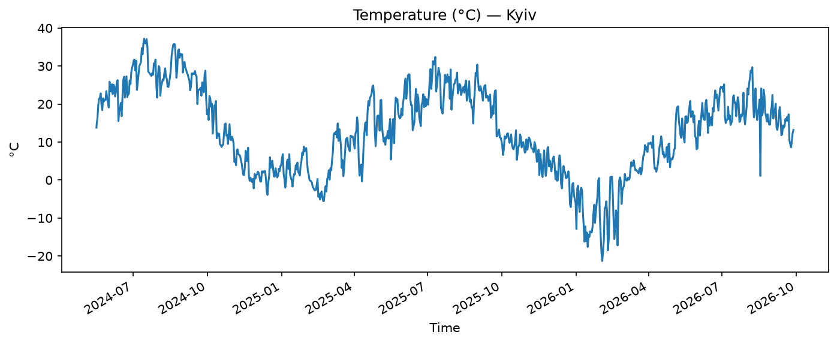
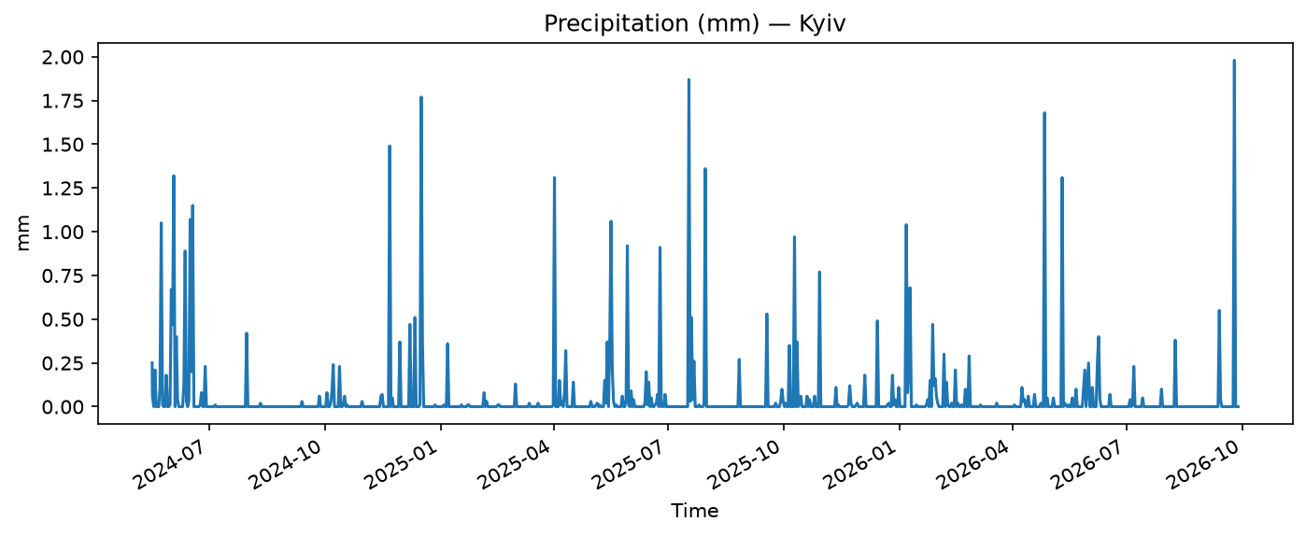
EDA
EDA — Kyiv time series
863 points · 2024-05-16 → 2026-09-27
Median spacing ≈ 24 h (some gaps 5 h – 3 days)
Temperature: strong seasonality (~−21°C to ~37°C in sample)
Precipitation: mostly dry, spiky events (precip_mm = reading at observation time, not a daily total — EDA only, not forecast)
5 / 14

Slide 6
MODELS
Forecasting methodology
80% / 20% chronological split (no shuffle — avoids leakage)
Models compared on holdout:
1
2
3
4
Naive
(persistence)
Seasonal naive
(365-row lag)
Ridge regression
on lags [1, 2, 3, 7, 14, 28]
Ensemble
= unweighted mean of Ridge + naive (the two lowest holdout MAE models)
Metrics: MAE and RMSE (°C)
6 / 14

Slide 7
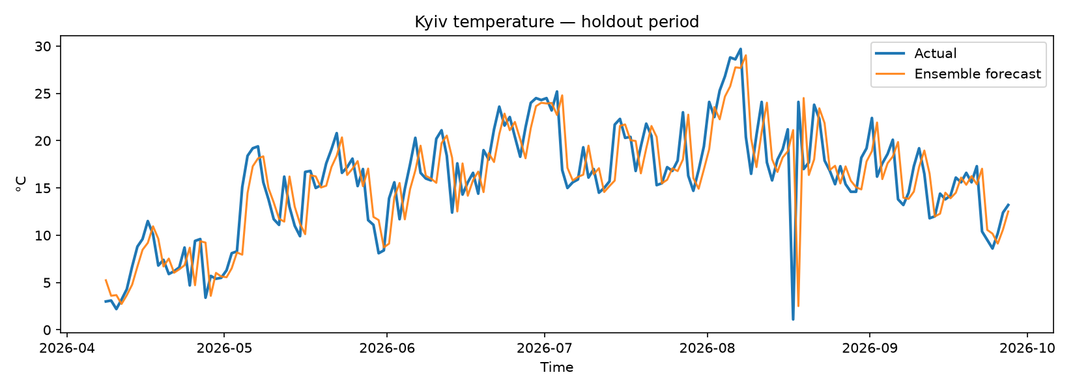
RESULTS
Forecasting results
Model | MAE (°C) | RMSE (°C)
Naive | 2.509 | 3.753
Seasonal naive (365) | 5.993 | 7.528
Ridge (lags) | 2.474 | 3.599
Ensemble | 2.474 | 3.653
Takeaways:
Ridge best on RMSE (3.599°C); naive close.
Seasonal naive loses: last year’s same date (within ~1 day) ≠ today’s weather; Kyiv’s observation hour drift adds time-of-day bias to year-over-year comparisons (MAE 5.99°C).
Ensemble MAE ties Ridge at 2.474°C (rounding); Ridge remains primary model.
2.474°C
3.599°C
MAE — Ridge (ensemble ties)
RMSE — Ridge (lowest)
7 / 14

Slide 8
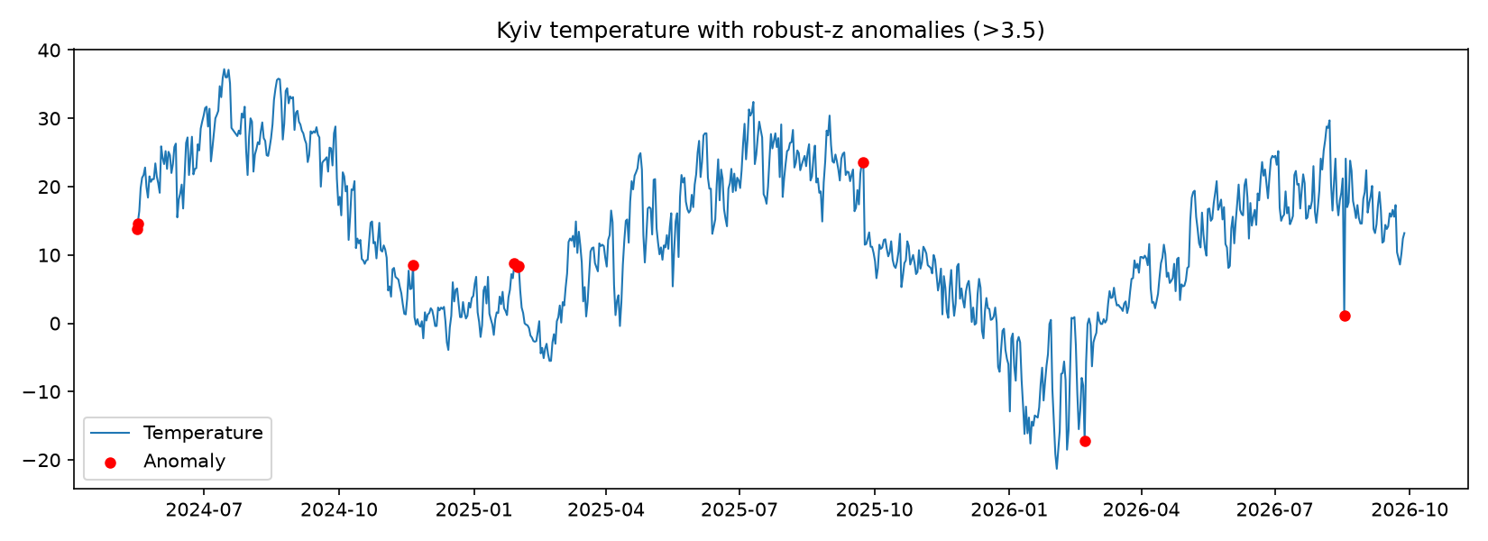
ANOMALIES
Anomaly detection
9
Robust z-score (30-day rolling median / MAD, threshold 3.5): 9 flagged days
Example: 2026-08-17 reads 1.1°C in the test window (likely scrape error). The two 2024-05-16 flags are edge effects of the centered window at the series start.
18
Isolation Forest (temp + precip, 2% contamination): 18 points (top 2% by construction)
Different methods → different counts (univariate local vs joint extremes)
8 / 14

Slide 9
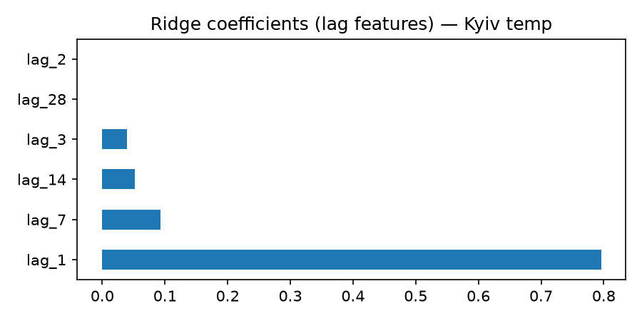
FEATURE IMPORTANCE
Feature importance
Ridge coefficients on lag features (Kyiv, full series):
lag_1: 0.796 — yesterday dominates
lag_7: 0.093 — week-scale signal
lag_14 / lag_3: smaller
lag_28 / lag_2: coefficients ≈ 0 — lag_2 is almost perfectly correlated with lag_1 (r ≈ 0.96); coefs from full-series fit (shift if refit on train only)
Aligns with notebook 02: persistence baseline almost matches Ridge.
9 / 14

Slide 10
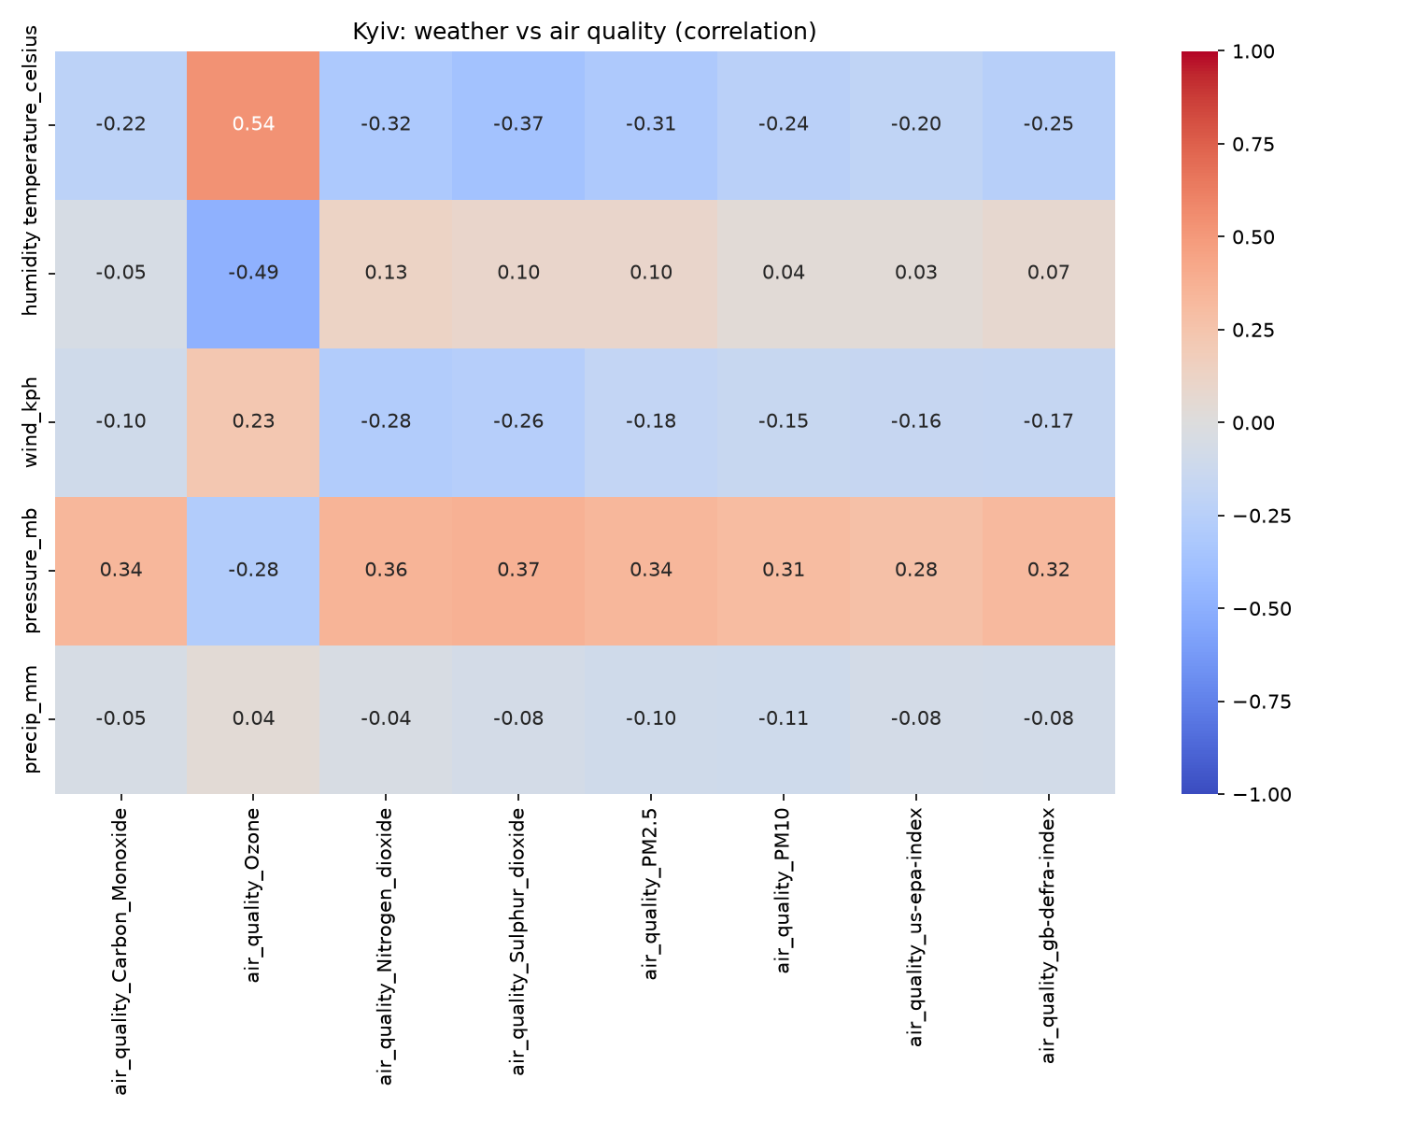
ENVIRONMENT
Environmental analysis (Kyiv)
Correlation (not causation) — strongest pairs:
Temperature ↔ ozone
r ≈ +0.54
Humidity ↔ ozone
r ≈ −0.49
Pressure ↔ SO₂ / NO₂
r ≈ +0.36–0.37
10 / 14

Slide 11
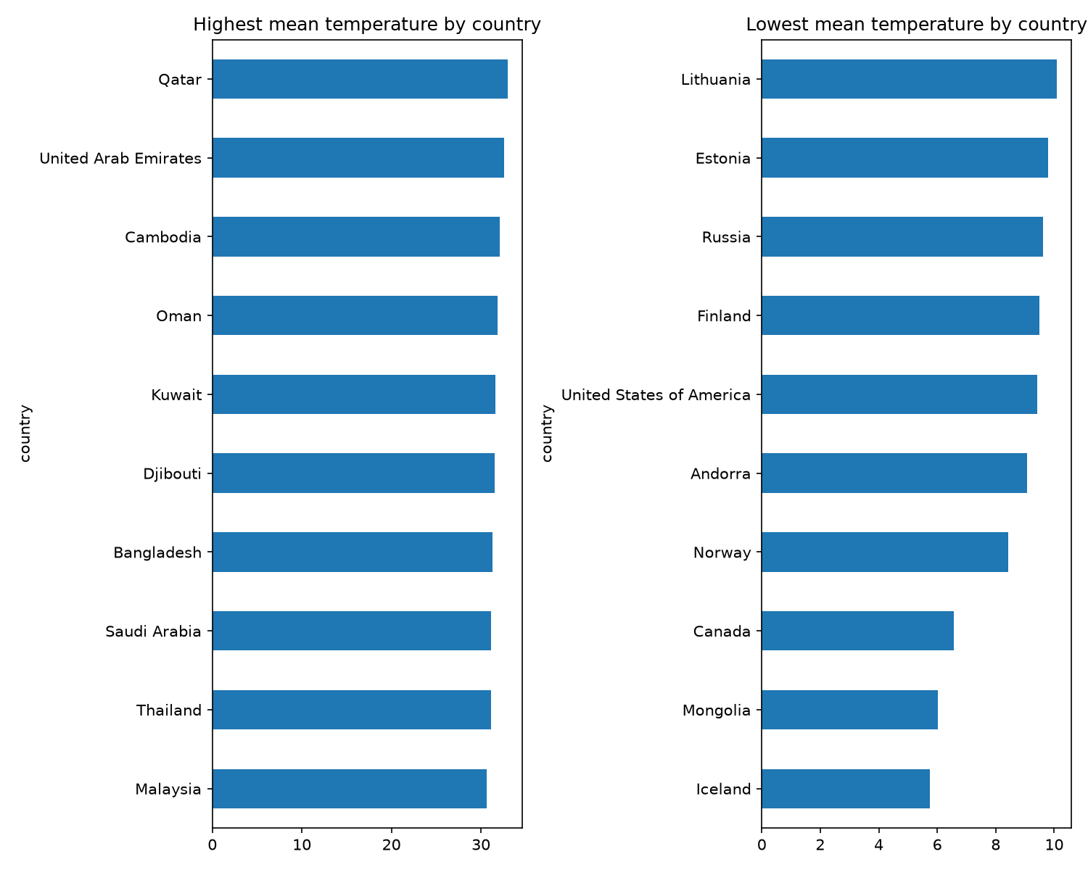
GEOGRAPHY
Geographical patterns
Mean temperature_celsius by country, only countries with ≥100 rows (186 included; 25 sparse excluded):
Highest
Qatar, United Arab Emirates, Cambodia (~32–33°C mean)
Lowest
Iceland, Mongolia, Canada (~5.7–6.6°C mean)
Limitations: Mixed-language country labels; means over scrape snapshots, not WMO climate normals.
11 / 14

Slide 12
WRAP-UP
Limitations & next steps
Limitations
Single-city forecast for submission depth; global model would need hierarchy or many series
Observation-hour drift biases year-over-year baselines
Correlations ≠ causal air-quality mechanisms
Next steps
Calendar-aware features / proper time-series CV
Normalize country names; continent-level aggregates
Precipitation forecasting with zero-inflated models
12 / 14

Slide 13
REPRODUCE
Repository & reproduction
GitHub
ArepaMan/weather-trend-forecasting: Public Repo for Data Scientist application project to PM Accelerator
Run
pip install -r requirements.txt → Jupyter notebooks 01 → 02 → 03
Data
Download Kaggle CSV to data/raw/GlobalWeatherRepository.csv
Demo video
[video-url]
13 / 14

Slide 14
Thank you
Questions?
manuel@manuelvargas.dev · https://github.com/ArepaMan · Manuel Vargas Alvarez | LinkedIn
Manuel Vargas Alvarez · PM Accelerator — Data Scientist technical assessment (Advanced track)
14 / 14

