Slide 1

The sparse and low-rank interpretation of SVD-based denoising for vibration signals
22MAT230 Mathematics for Computing 4
By:
Arepalle Charan Kumar Reddy(CB.SC.U4AIE24207)

Slide 2
Problem Statement
Vibration signals acquired from rotating machinery are typically contaminated by strong background noise, making condition monitoring and fault diagnosis difficult.
Existing SVD methods can enhance fault-related components but often lead to amplitude distortion and inconsistent denoising performance.
Early-stage bearing faults generate weak impulsive components in vibration signals that are masked by noise and cannot be extracted using raw time-domain or frequency-domain analysis.

Slide 3
OBJECTIVES
To model vibration signal denoising as a sparse and low-rank optimization problem using a matrix representation of time-series data.
To analyze and compare classical TSVD, heuristic reweighted SVD (RSVD), and weighted soft-threshold SVD (WSSVD)
To implement fault classification using machine learning models trained on features extracted from WSSVD-denoised signals.

Slide 4
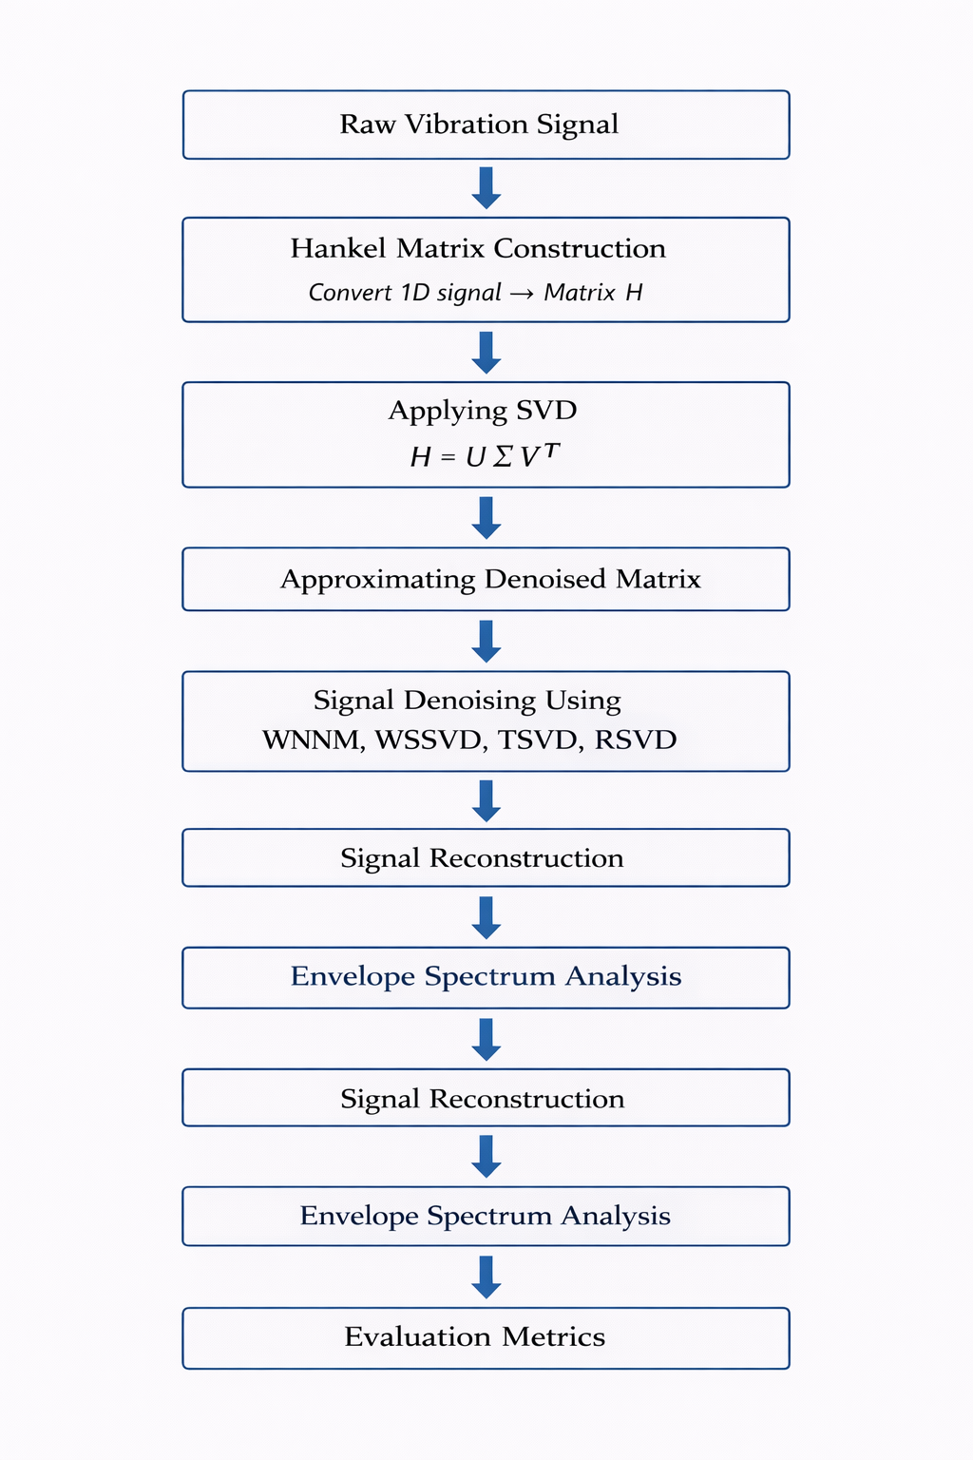
Project Pipeline

Slide 5
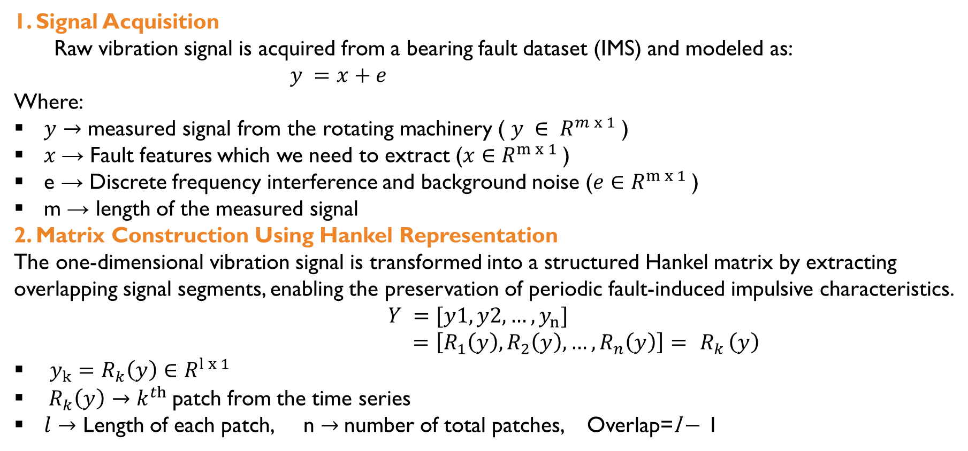
Methodology
1. Signal Acquisition
Raw vibration signal is acquired from a bearing fault dataset (IMS) and modeled as:
$y =x+e$
Where:
$y→\text{measured signal from the rotating machinery}$ ( $y ∈ R^{m x 1}$)
$x$→ Fault features which we need to extract ($x∈R^{m x 1}$)
e → Discrete frequency interference and background noise ($e∈R^{m x 1}$)
m → length of the measured signal
2. Matrix Construction Using Hankel Representation The one-dimensional vibration signal is transformed into a structured Hankel matrix by extracting overlapping signal segments, enabling the preservation of periodic fault-induced impulsive characteristics.
$Y =[y1,y2,…,y_{n}]$
$=\left[R_{1}\left(y\right),R_{2}\left(y\right),…,R_{n}\left(y\right)\right]= { R}_{k}\left(y\right)$
$y_{k}=R_{k}\left(y\right)∈R^{l x 1}$
${ R}_{k}\left(y\right)→k^{th}$patch from the time series
$l$ $→$ Length of each patch, n $→$number of total patches, Overlap=l − 1

Slide 6
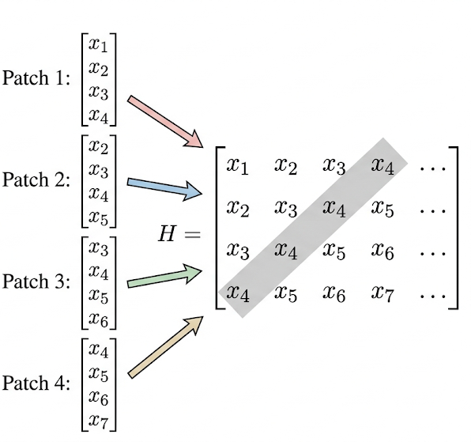
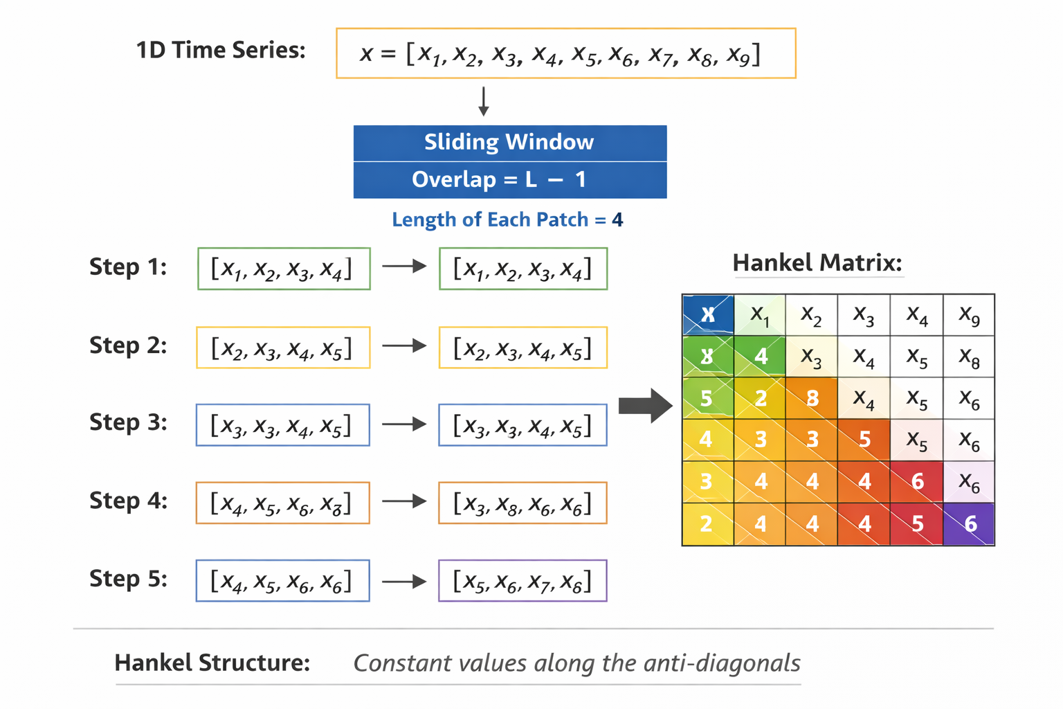
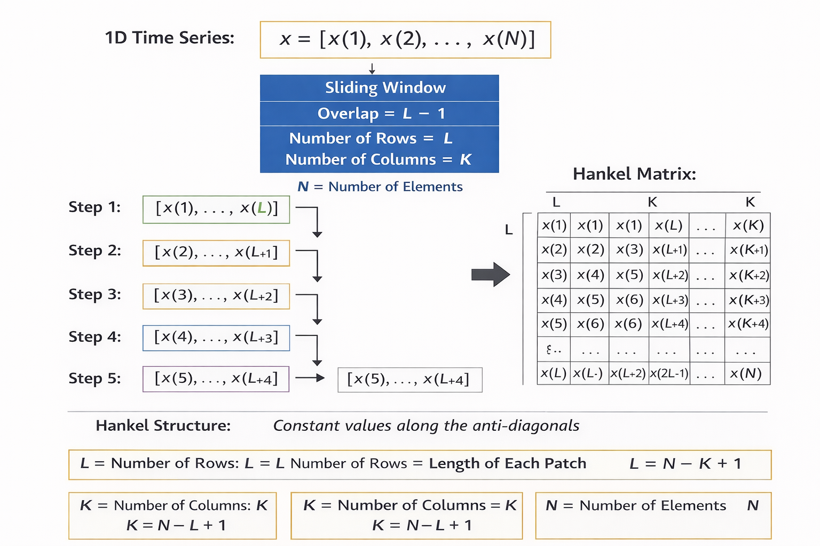
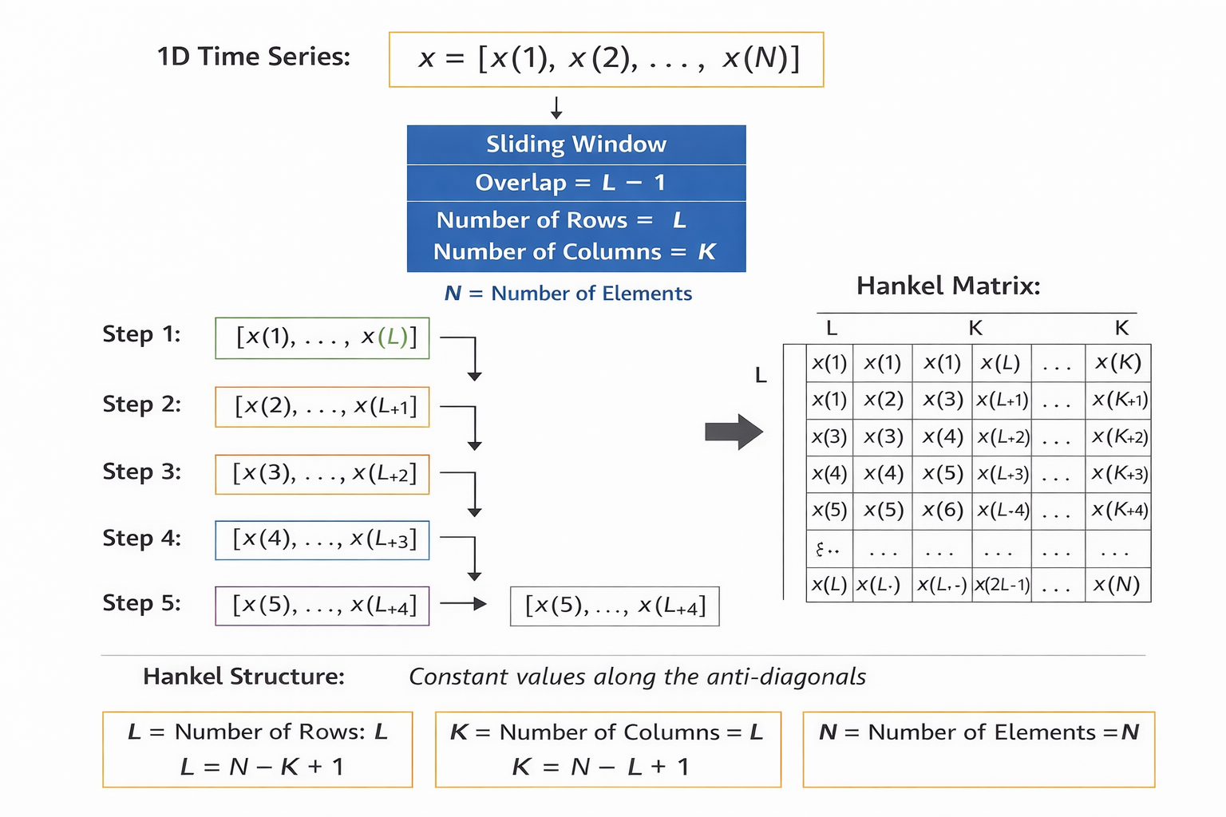

Slide 7
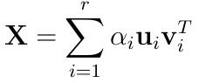
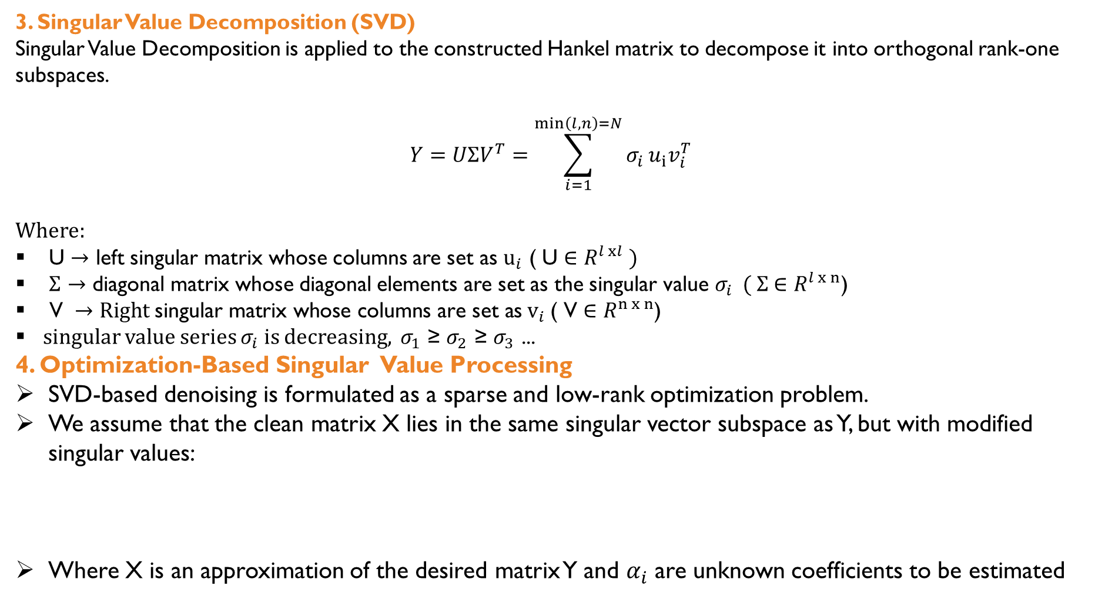
3. Singular Value Decomposition (SVD) Singular Value Decomposition is applied to the constructed Hankel matrix to decompose it into orthogonal rank-one subspaces.
$$Y=UΣV^{T}=\sum_{i=1}^{\min\left(l,n\right)=N}{σ_{i}}u_{i}v_{i}^{T}$$
Where:
U $→$ left singular matrix whose columns are set as $u_{i}$ ( U ∈ $R^{l xl} )$
$Σ$ $→$ diagonal matrix whose diagonal elements are set as the singular value $σ_{i}$ ( $Σ$ ∈ $R^{l x n}$)
$\text{V }→Right \text{singular matrix} \text{whose columns are set as}{ v}_{i} \text{( }\text{V}\text{ ∈ }R^{n x n}$)
singular value series $σ_{i}$ is decreasing, $σ_{1}$ ≥ $σ_{2}$ ≥ $σ_{3}$ ...
4. Optimization-Based Singular Value Processing
SVD-based denoising is formulated as a sparse and low-rank optimization problem.
We assume that the clean matrix X lies in the same singular vector subspace as Y, but with modified singular values:
Where X is an approximation of the desired matrix Y and $α_{i}$ are unknown coefficients to be estimated

Slide 8
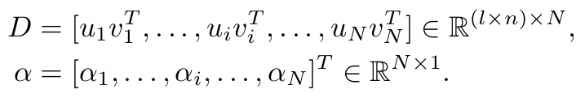

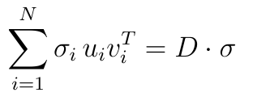

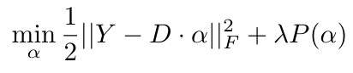

Representing as dictionary
Let
So
Let formulate as an optimization problem
and
Where:
is the Frobenius norm
λ is the trade-off parameter,
P(α) is the regularization of α.

Slide 9
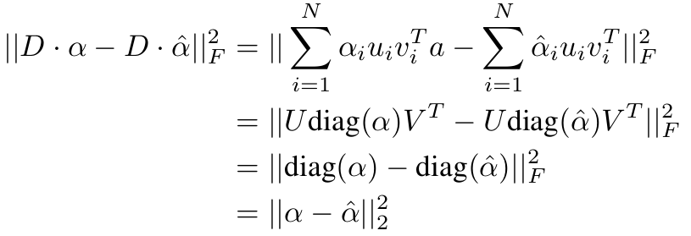



So
1.Truncated SVD (ℓ₀ norm minimization)

Slide 10
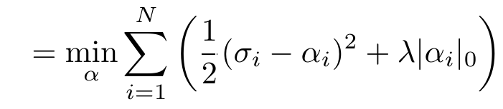
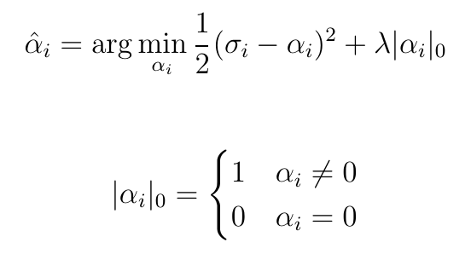

for each $i$:

Slide 11
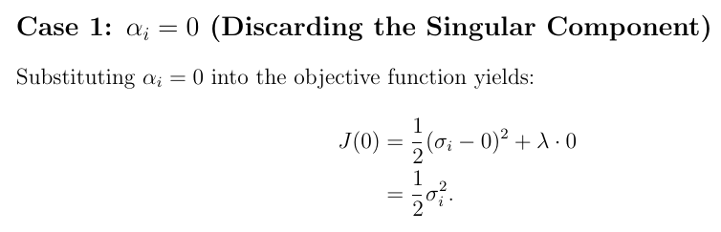
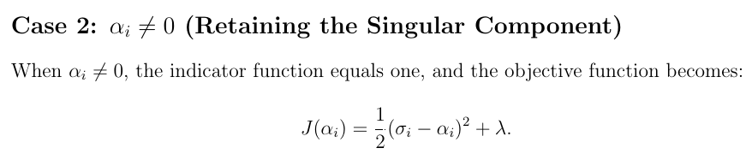
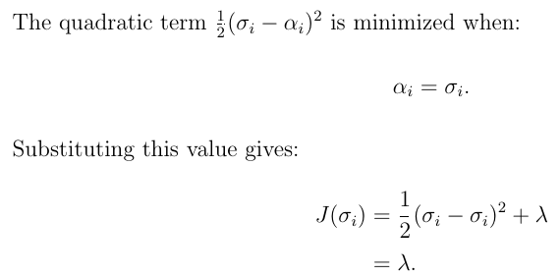


Slide 12
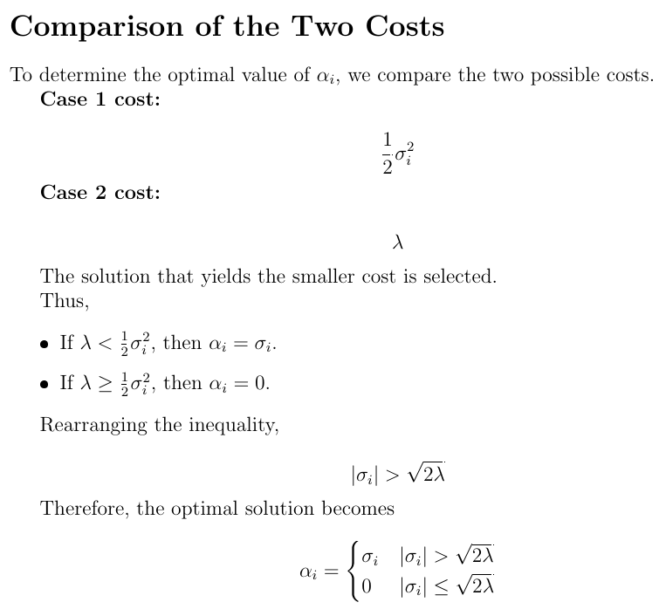

Slide 13

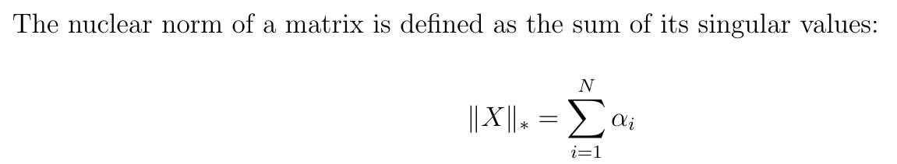
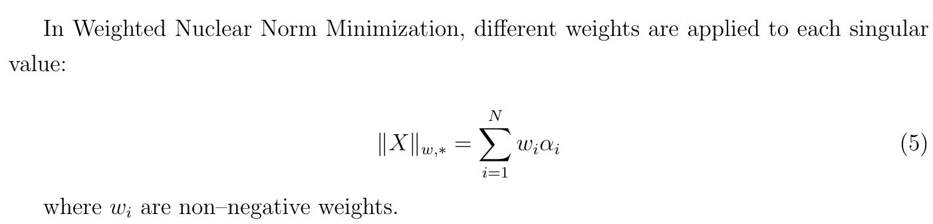
2. Weighted Nuclear Norm Minimization (WNNM)

Slide 14
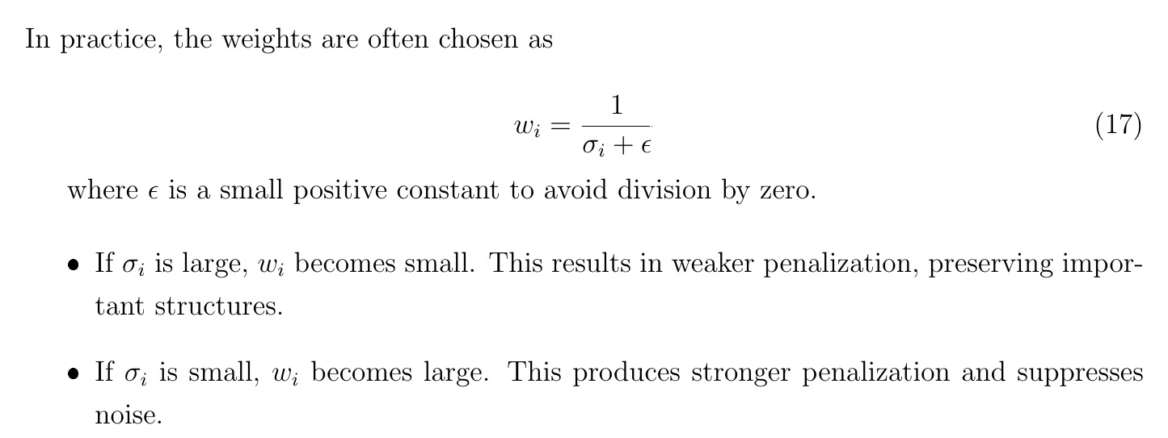
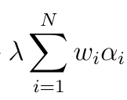

Slide 15
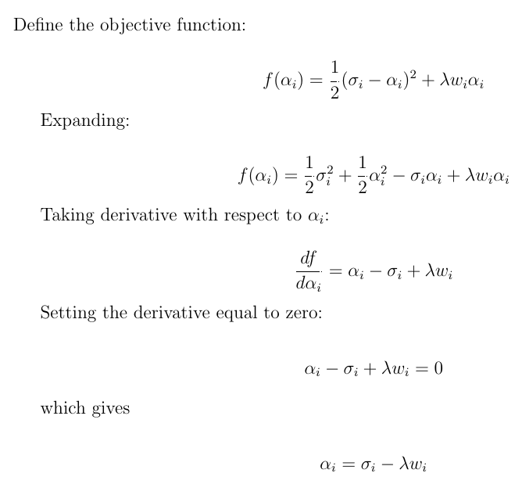

Slide 16
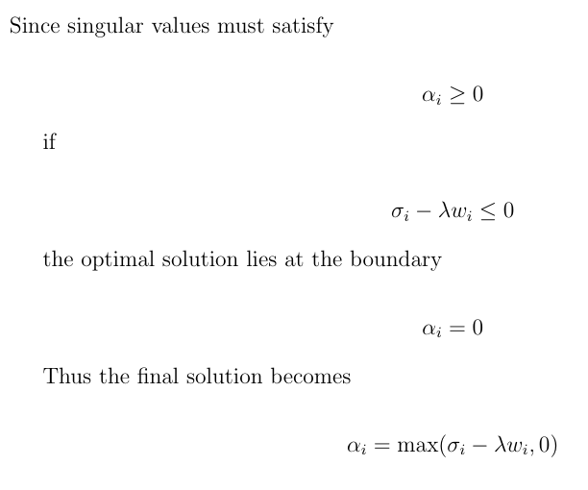

Slide 17
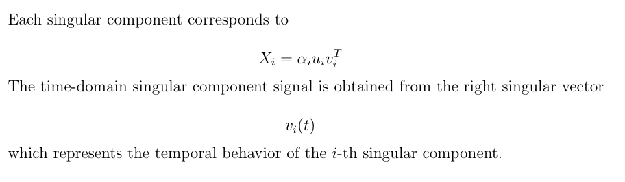
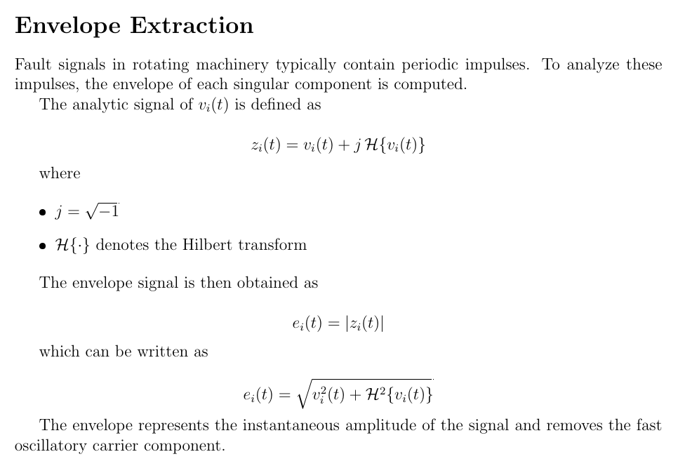
3. Reweighted Singular Value Decomposition (RSVD)

Slide 18
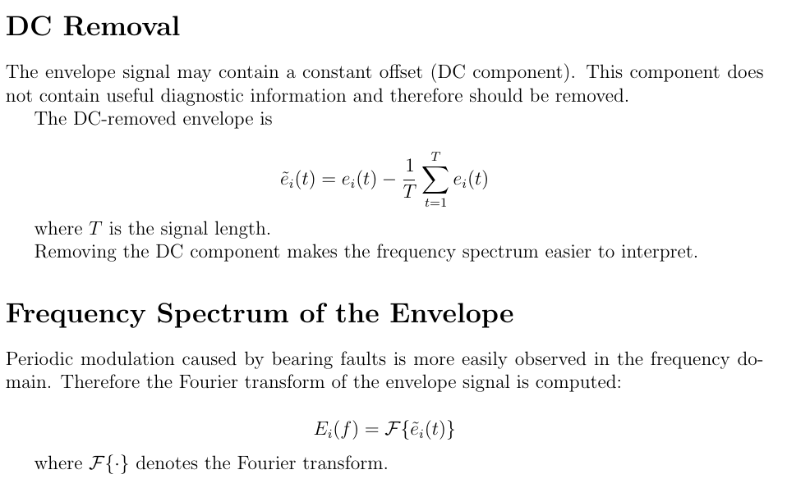

Slide 19
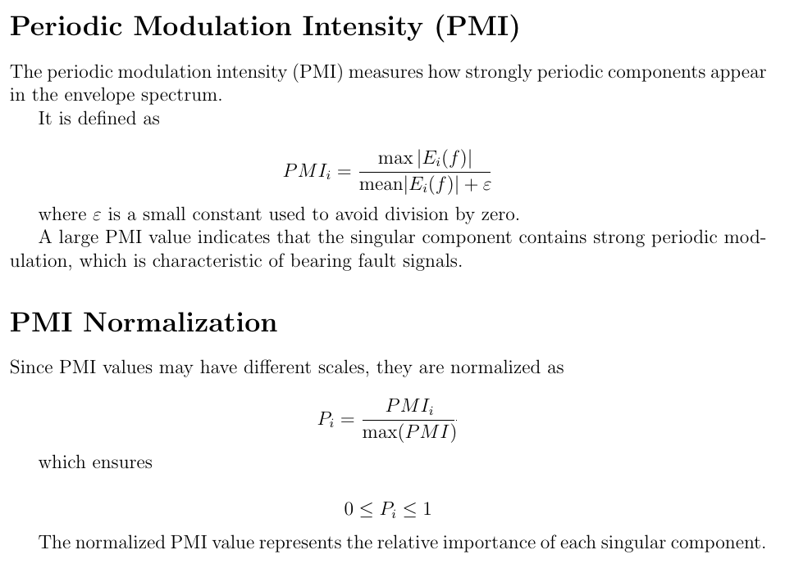
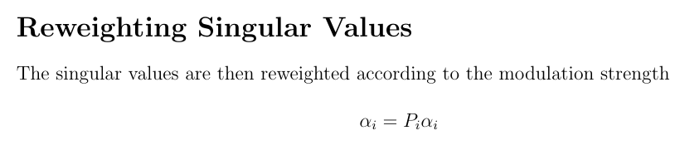

Slide 20

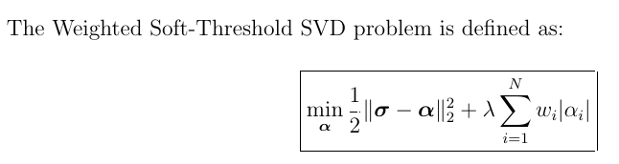
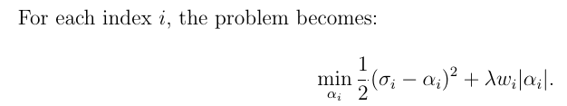
4. Weighted Soft SVD ( weighted ℓ₁-norm minimization )
Standard ℓ₁ regularization treats all singular values equally and leads to uniform soft thresholding. This causes fault-related components to be penalized in the same manner as noise.
To address this limitation, fault-related information is introduced through component dependent weights.

Slide 21
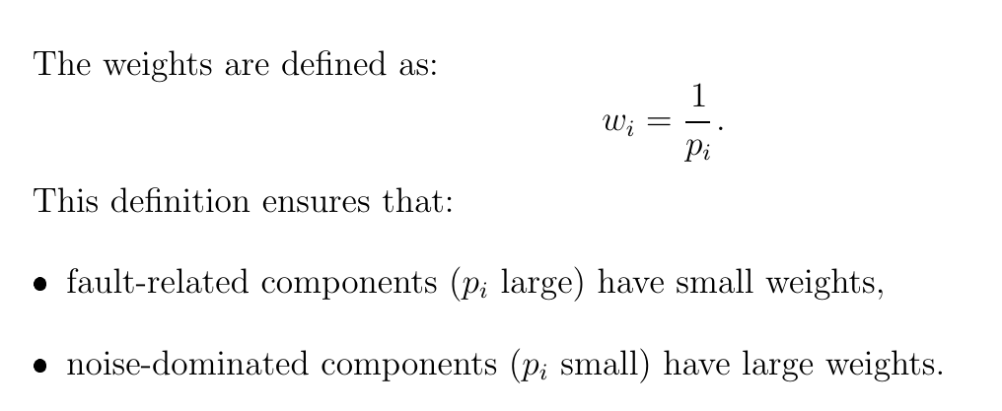
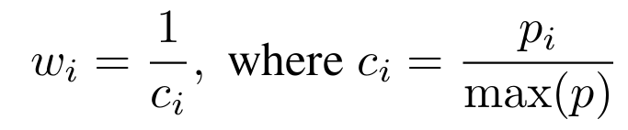
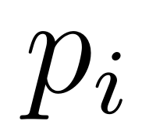
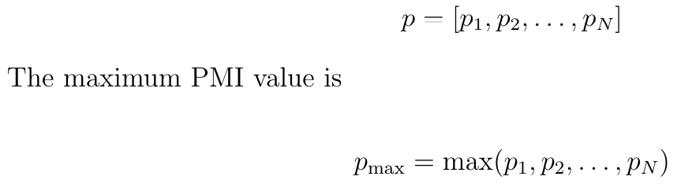
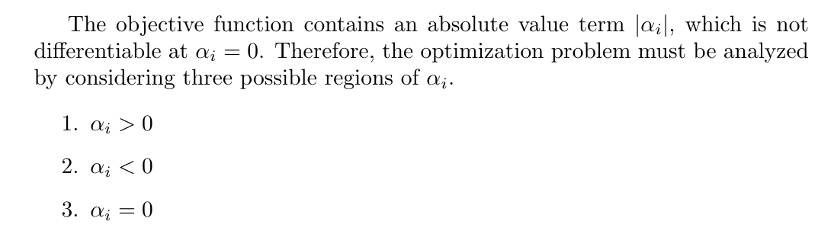
Pi​ is called the Periodic Modulation Intensity (PMI) of the $i^{th}$singular component.

Slide 22
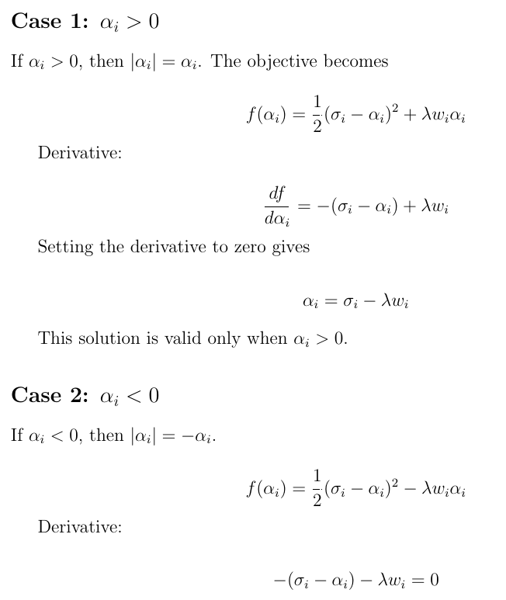

Slide 23
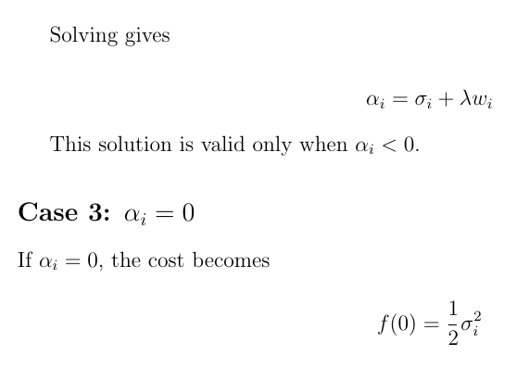
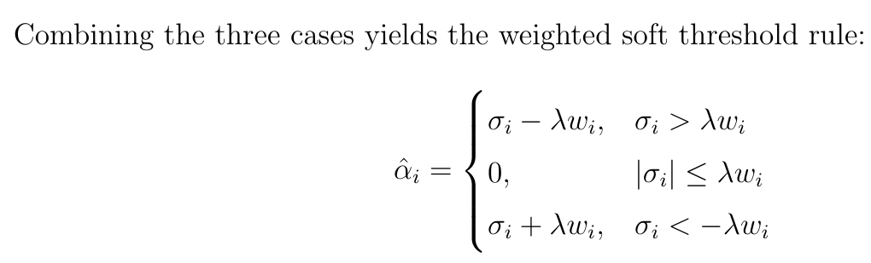
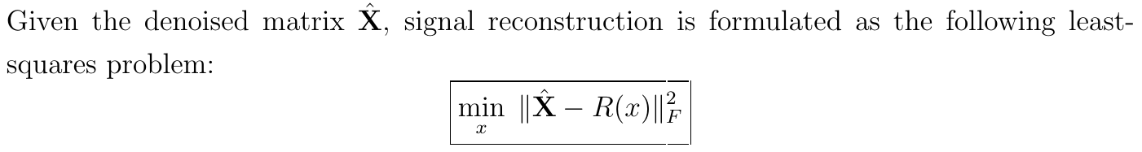
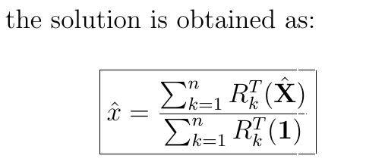
5. Signal Reconstruction

Slide 24
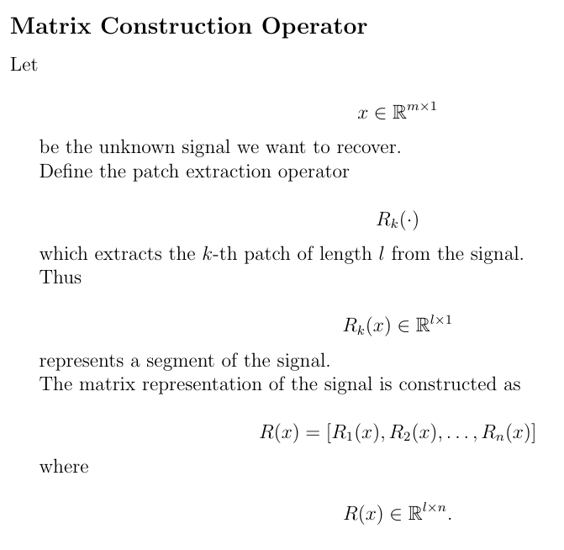
Signal Reconstruction

Slide 25
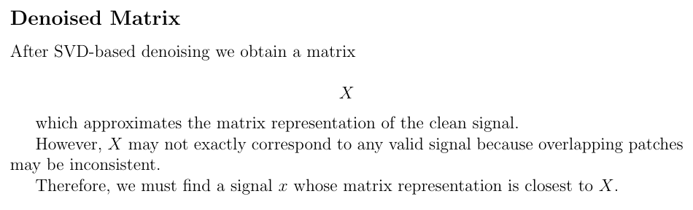
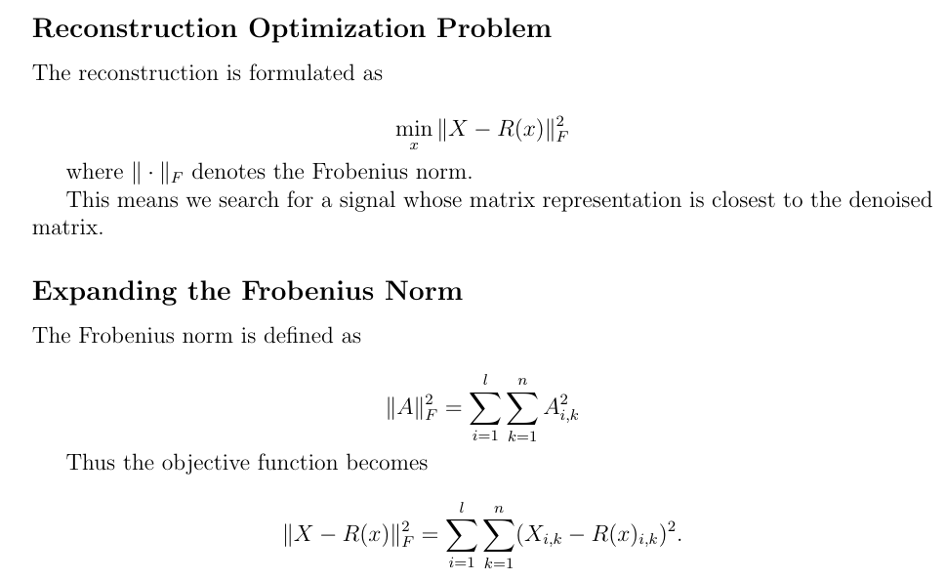

Slide 26
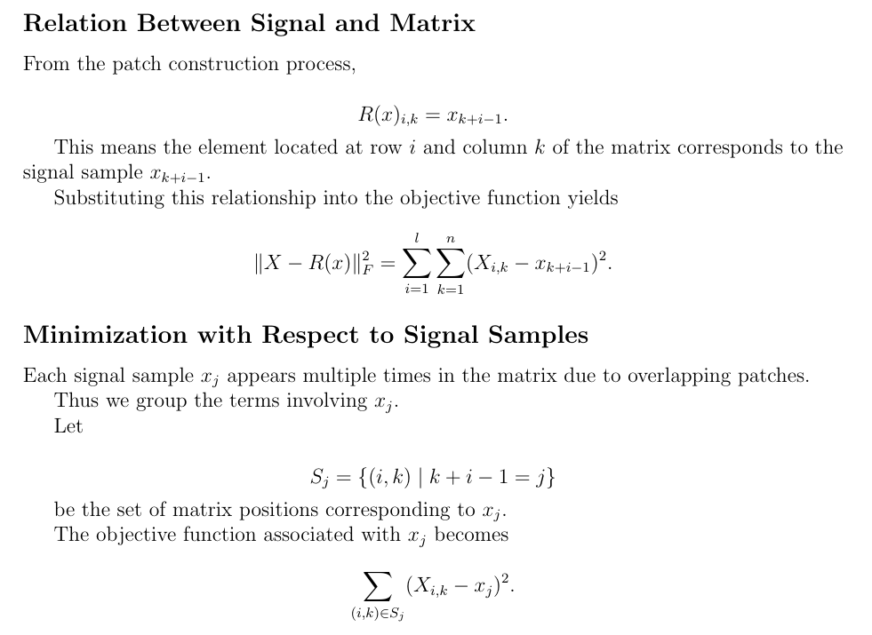

Slide 27
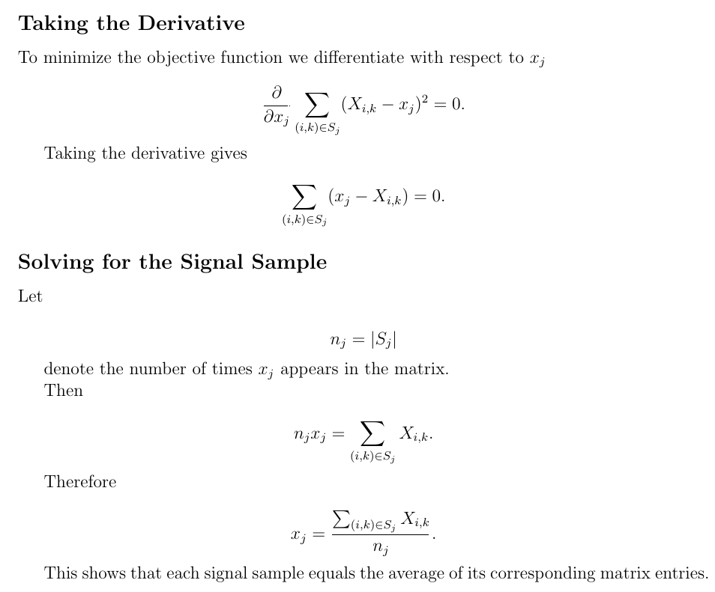

Slide 28
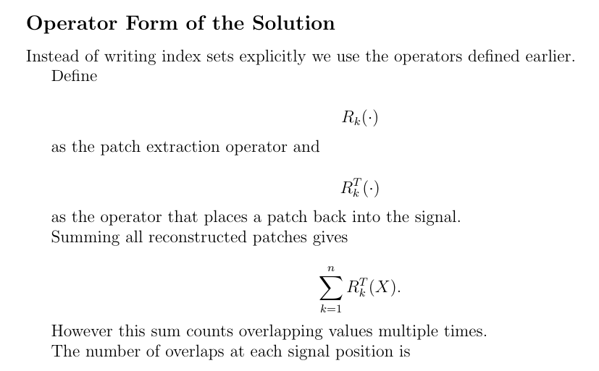
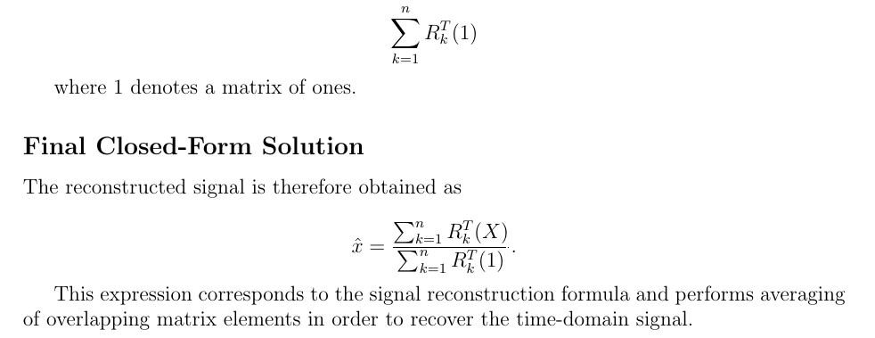

Slide 29
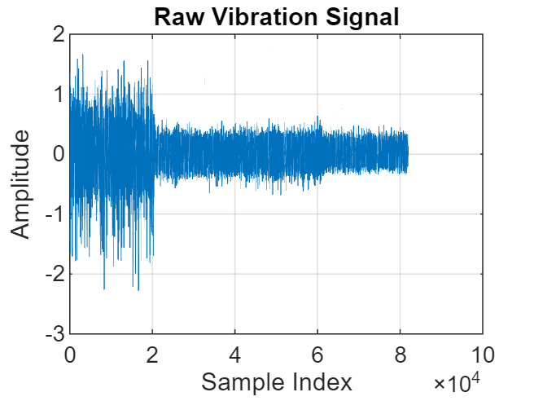
Results
Raw vibration signal acquired from the IMS bearing dataset, sampled at 1000 kHz. The signal is heavily contaminated by noise, making early-stage fault-related impulses difficult to observe directly.

Slide 30
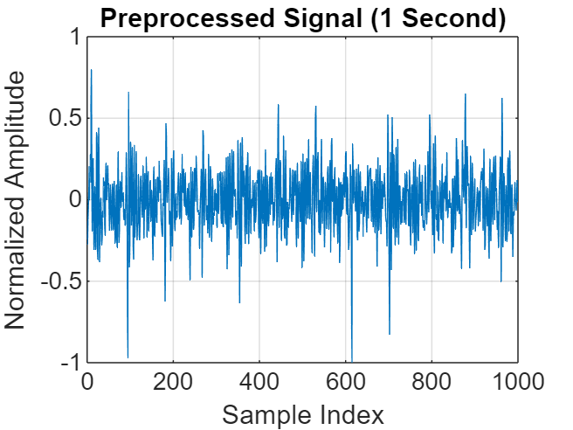

Preprocessed vibration signal after DC removal, normalization, and segmentation to one second
Hankel matrix constructed from the vibration signal using overlapping patches (overlap = l − 1), preserving temporal correlation and enabling low-rank analysis. (Constructed matrix size: 40 x 961)

Slide 31



Slide 32



Slide 33
3. QUANTITATIVE AMPLITUDE FIDELITY METRICS
RMS Preservation Ratio
This metric quantifies how well the overall vibration amplitude is preserved after denoising.
A value close to one indicates minimal amplitude distortion, ensuring that the denoising process does not excessively attenuate the true signal strength.
Peak-to-Peak Preservation Ratio
This metric evaluates the preservation of maximum impulse amplitude in the signal.
a ratio close to one confirms that fault-related impulses are not suppressed during denoising.
Energy Retention Ratio
This metric measures how much of the original signal energy is retained after denoising.
It reflects the balance between effective noise suppression and preservation of physically meaningful vibration energy.
Kurtosis (Impulsiveness)
Kurtosis characterizes the impulsive nature of the signal, which is a key indicator of bearing faults.
Preserving or enhancing kurtosis after denoising confirms that fault-induced impulsive components remain intact.

Slide 34
Method | RMS Preservation | Peak-to-Peak Preservation | Energy Retention | Kurtosis
TSVD | 1.0000 | 1.0000 | 1.0000 | 5.1116
RSVD | 0.5579 | 0.4588 | 0.3112 | 3.7839
WSSVD | 0.9827 | 0.9704 | 0.9656 | 4.9769
WNNM | 0.9986 | 0.9977 | 0.9972 | 5.1007

Slide 35



Slide 36




Slide 37





Slide 38





Slide 39

BEARING FAULT CLASSIFICATION using random forest
Classes:
InnerRaceFault
OuterRacefault
Accuracy: 0.9375

Slide 40
Thank you

