Slide 1

IoT Platform for data processing and access.
Master Practical Course WS 2017

Slide 2

Contents
Introduction
Sensors
Data Storage & Processing
API and Data Access
Performance Testing
Notes:
What are the exact points that we need to explain ?

Slide 3
Goals to Achieve
Out-of-the-Box Highly-Available & Fault-Tolerant system that can collect, store and provision data from sensors in a unified format.
Guaranteed single message delivery.
Possibility to permanently store the data.
High-speed data compression.
Secure data access using User Authentication.
Collect performance data and visualize it.
Notes:
What are the exact points that we need to explain ?

Slide 4
Information flow through the system
Layer 2
Layer 1 Hardware
Sensor data
Data stream
Sensor data in json format
Data processing
Values to store per index/data type
Data Storage
Publish
stream data to channel
Output batch data per request
Layer 3 - API
Data access
Notes:
What are the exact points that we need to explain ?

Slide 5
Sensor Layer
Erkin Kirdan
Mikayil Murad
Hakan Uyumaz
Ali Naci Uysal

Slide 6

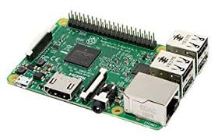
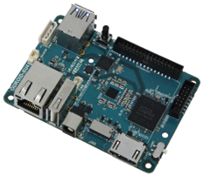
Overview
Team I:
Responsible for the development of the on-board part of the platform.
Goals:
Support data transmission for as many different boards and sensors out-of-the-box as possible
Support easy deployment and setup
Raspberry PI 3
Odroid-XU 40

Slide 7
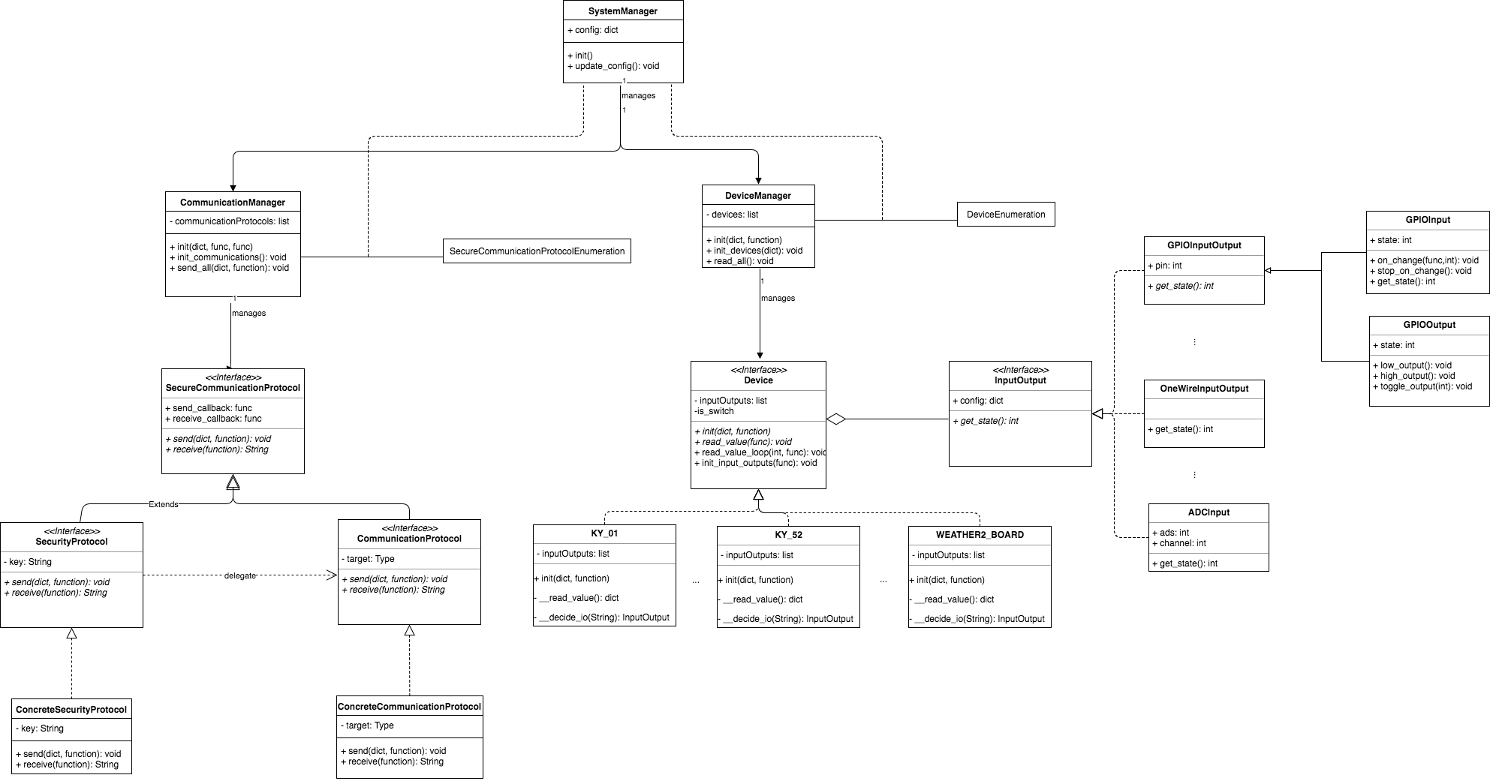
Architecture

Slide 8
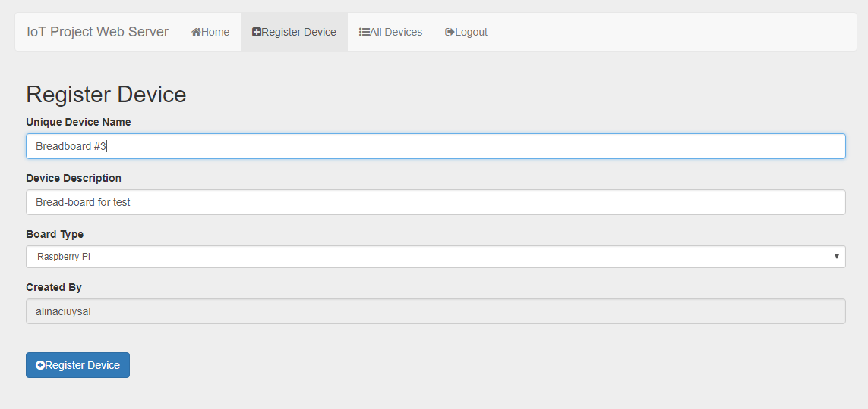
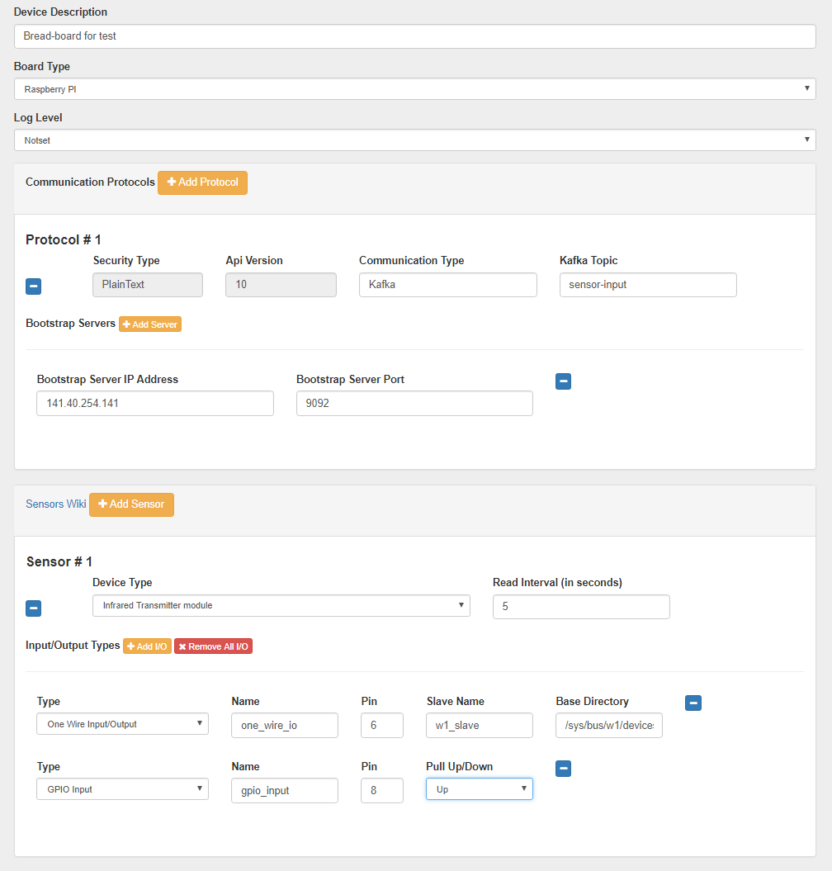
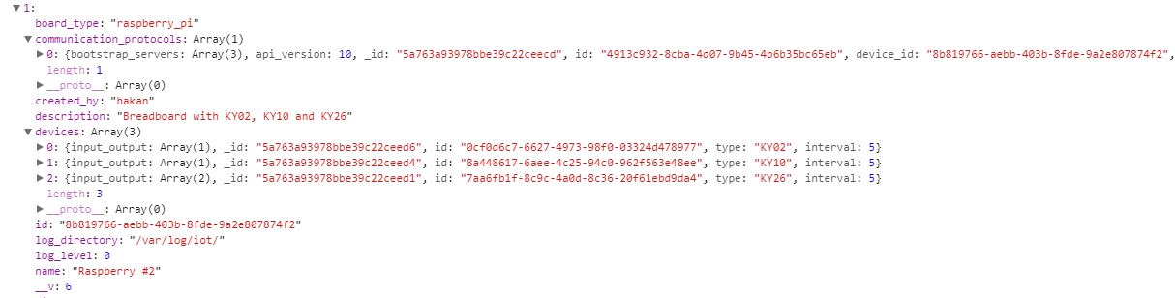
MEAN Stack Web Application

Slide 9
Results
1. Provision of the data messages from sensors in the unified format including timestamps and values of the corresponding metrics
2. Basic out-of-the-box-deployed drivers for different types of single-board computers with different types of sensors connected
3. Adjustments of the layer configuration via settings files
4. Additionally built web application for easy configuration
5. Basic data pre-processing according to settings (e.g. use every n-th measure)
6. Easy to extend architecture for new types of boards and sensors

Slide 10
Data storage & processing layer
Yesika Ramirez
Moawiah Assali
Atakan Yenel
Sergey Nasonov

Slide 11
Contents
Deployment Diagram
Configurations
Streaming & Processing
ElasticSearch
Advantages and Challenges
Notes:
What are the exact points that we need to explain ?

Slide 12
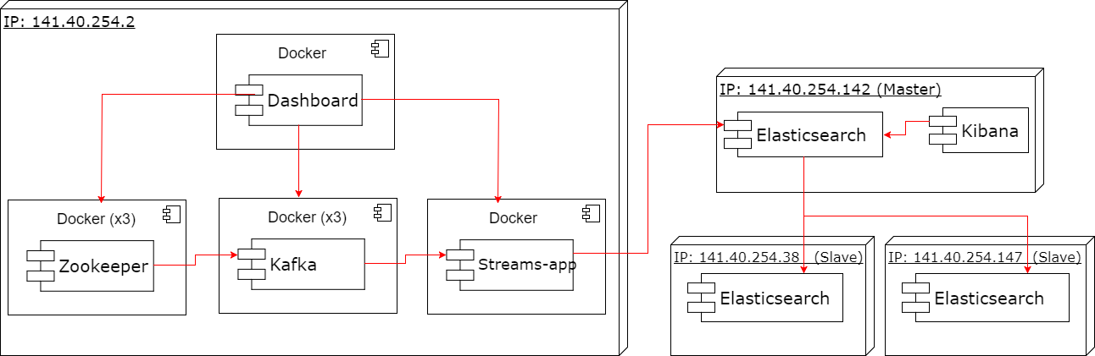
Deployment Diagram

Slide 13
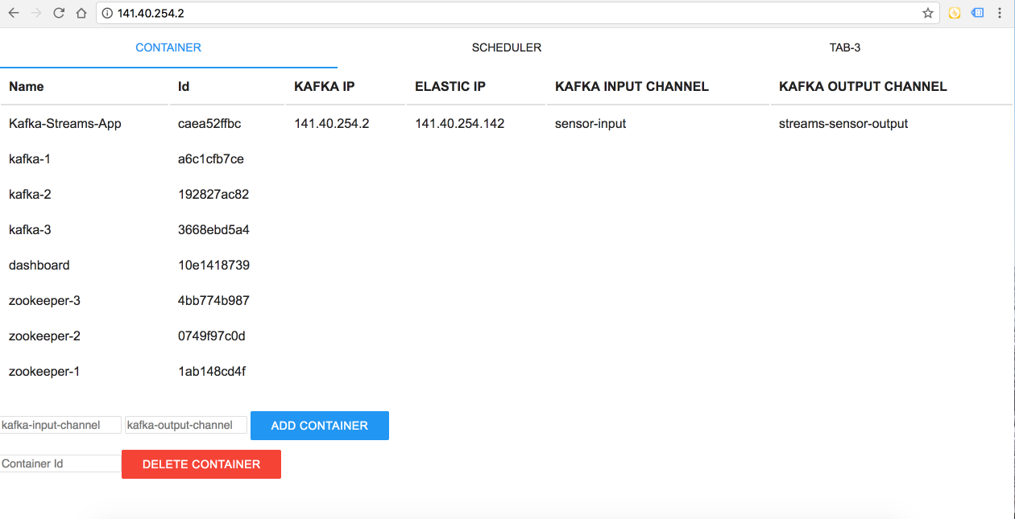
Configuration
Input Channel
Output Channel
Database Index
Database Document type
The running process
Kafka broker IP
Elasticsearch IP

Slide 14
Streaming & Processing
Zookeeper -1
Zookeeper -2
Zookeeper -3
Producer 1
Consumer 1
Producer 2
Consumer 2
Kafka Broker 1
Kafka Broker 2
Kafka Broker 3
Producer n
Consumer n
*Producer API *Consumer API *Stream API *Connector API

Slide 15
ElasticSearch
Ports: 9200/9300
Master Node 141.40.254.142
Index
Shards
Slave Data Node 141.40.254.38
Slave Data Node 141.40.254.147
Replicas
*Master Eligible Node
*Zen Discovery
*Election Process

Slide 16
Advantages
Challenges
Fault Tolerance & High Availability
Scalability of processing engines
Easy to deploy
Low cost
Flexibility via configuration files
Complexity:
Different vendors/versions of the used Software
Connectors between streams and ElasticSearch
Technology Choice
Security

Slide 17
API Layer
Sergei Drugalev
Faisal Hafeez

Slide 18
Contents
HTTPS
User authentication
User Authorization
API
MQTT
Notes:
What are the exact points that we need to explain ?

Slide 19
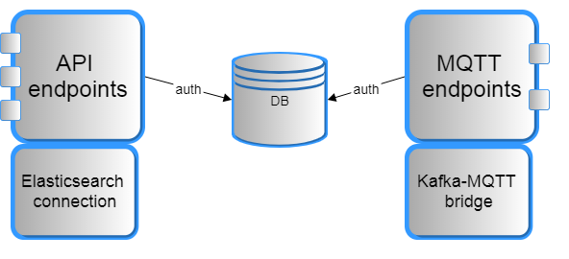
Basic architecture

Slide 20
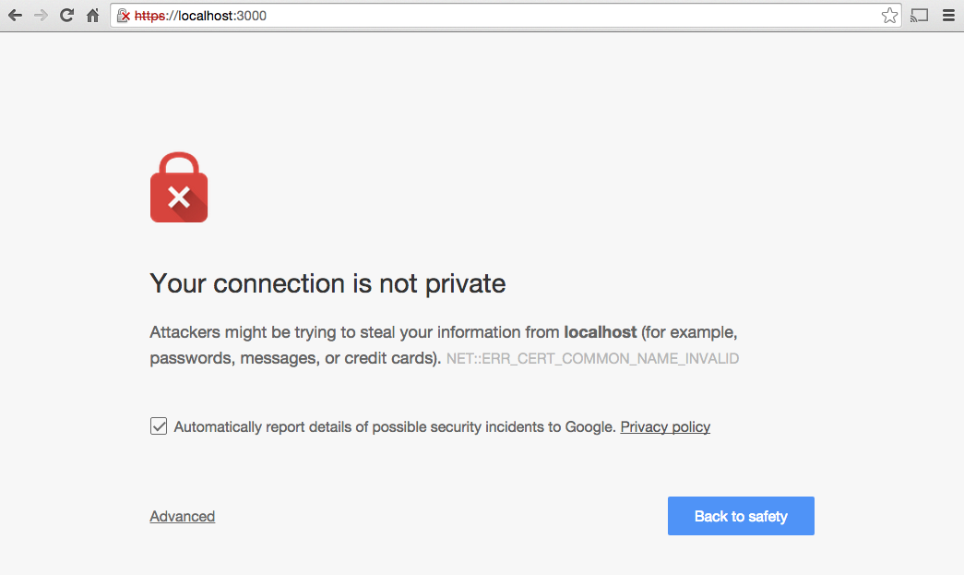
HTTPS
Notes:
What are the exact points that we need to explain ?

Slide 21

User Authentication
RQlite relational database
Young project (~1 year old)
SQLite storage engine
Extremely compact and lightweight
Doesn’t support clustering
RQLite does!

Slide 22
User Authentication
Basic HTTP authentication (login:password)
Why not Facebook or Google?
Not everybody want/like using their private accounts
No web client
API server is not a website
Still easily doable
Credentials -> ask your system administrator

Slide 23
User authorization
Wait… Is it different?
Users have configurable access rights
Ordinary users cannot alter the data

Slide 24

MQTT
RABBITMQ broker
Same authentication AND authorization scheme
Advantages
Lightweight
Easy to parse
Very little resources on client-side
Reliable (QoS 1 and 2)
Secure (user authentication + TLS, authorization)
Topic wildcards!!

Slide 25
MQTT - topic structure
TOPIC
/ {board ID} / {sensor ID} / {Data Type}
PAYLOAD
{ value: {}, unit: {} }

Slide 26
API
9200
10010
ElasticSearch
NodeJs API
Consumer
Linux
Linux

Slide 27
API Endpoints
/get_all_boards
/get_sensor_data/:board_id
/get_sensor_data/:board_id/:sensor_id
/get_sensor_data/:board_id/:sensor_id/:from
/get_sensor_data/:board_id/:sensor_id/:from/:to

Slide 28
Challenges
Dynamic IPs
Backup machines
Elasticsearch server down
Disk Storage

Slide 29
Performance Testing
Shumail Mohyuddin
Muhammad Razzaque Bhatti
Zaryab Khan

Slide 30
Goals
Monitor the platform and its performance
Alerts based on threshold values
Visualize the collected data
Highlight bottlenecks and recommend possible improvements

Slide 31
Technology stack
K6
Generate load via virtual users - Behavior test cases written in JavaScript
Test platform performance under stress
InfluxDB, Prometheus
Time based database and metrics storage from multiple sources
Grafana
Data visualization across multiple sources
Swagger API Framework middlewares with ExpressJS
Intercepting the API requests for event logging
Node Exporter - Infrastructure monitoring and alerts

Slide 32
Workflow
Behavior Test cases
K6
InfluxDB
API
(Layer 3)
Grafana
Middleware
(Swagger)
Prometheus
Data Processing
(Layer 2)
Node Exporter

Slide 33
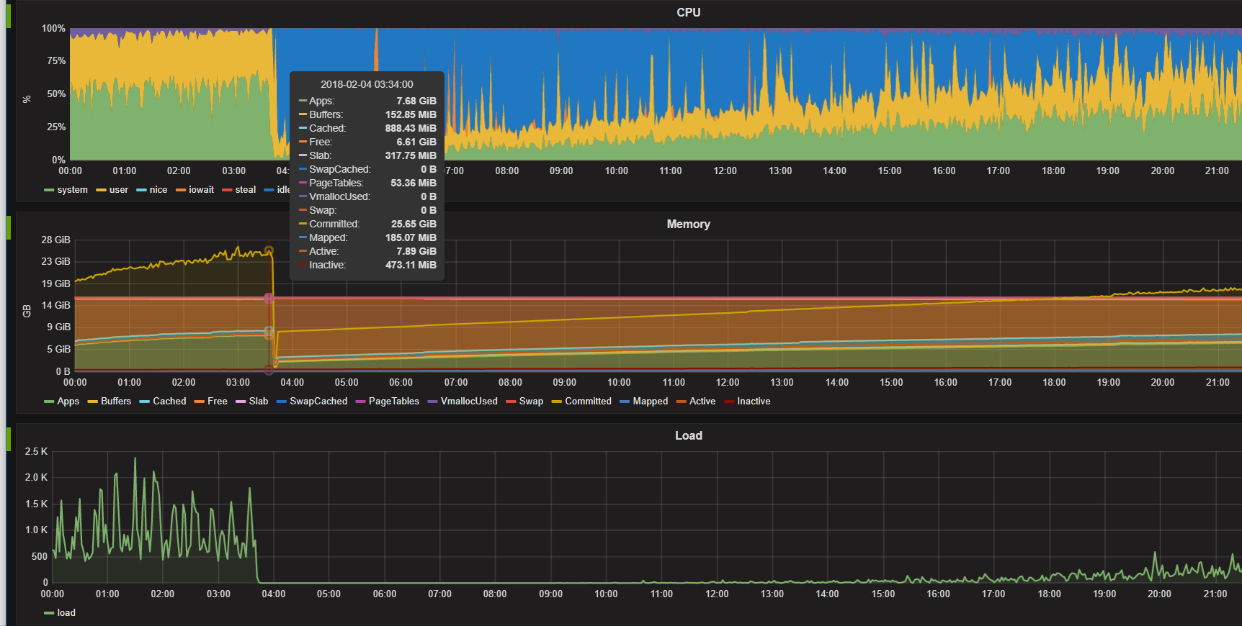
Data storage and processing monitoring
Notes:
http://141.40.254.2:3000/dashboard/db/node-exporter-server-metrics

Slide 34
Stress Testing
Virtual Users - 35
Increased Dynamically over time
Behavior:
First request on to get list of boards
Select a board and send second request for getting sensors
3rd Request for fetching values from sensors
2 more requests for fetching sensors data
One request sent by each VU for this behavior in every second.
~8000 API calls in 30 seconds
Results:
Alert generated when avg RTT over test > 3s
Threshold reached at VU= 30
RTT averages from 20 milliseconds to ~3 seconds under max stress.
Notes:
Todo: add urls here with timestamp parameters

Slide 35
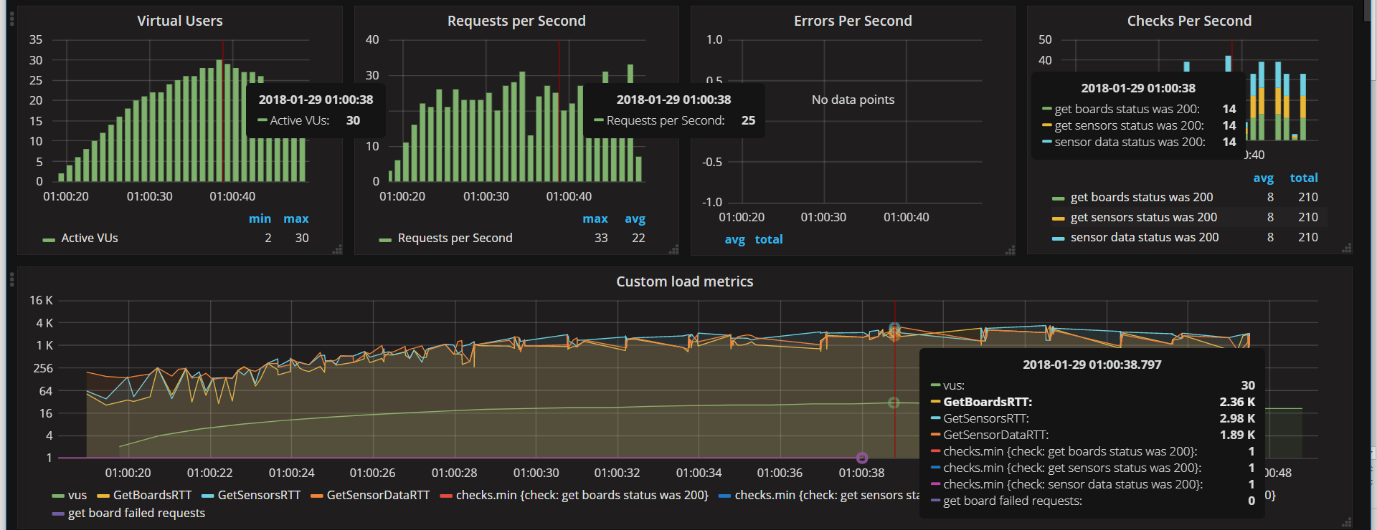
Stress Testing
Notes:
http://141.40.254.123:4000/dashboard/db/k6-load-testing-results?orgId=1

Slide 36
Monitoring Statistics Interfaces
REST API
GET on <api-url>/swagger-stats/stats
Prometheus Metrics
Available on <api-url>/swagger-stats/metrics
Visualisation Dashboard
Available on <api-url>/swagger-stats/ui

Slide 37
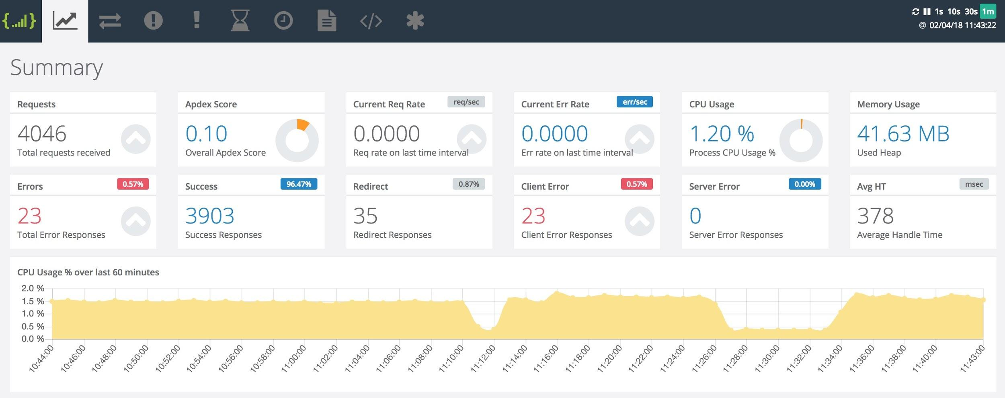
API Realtime Monitoring
Notes:
http://141.40.254.131:10010/swagger-stats/ui#sws_summary

Slide 38
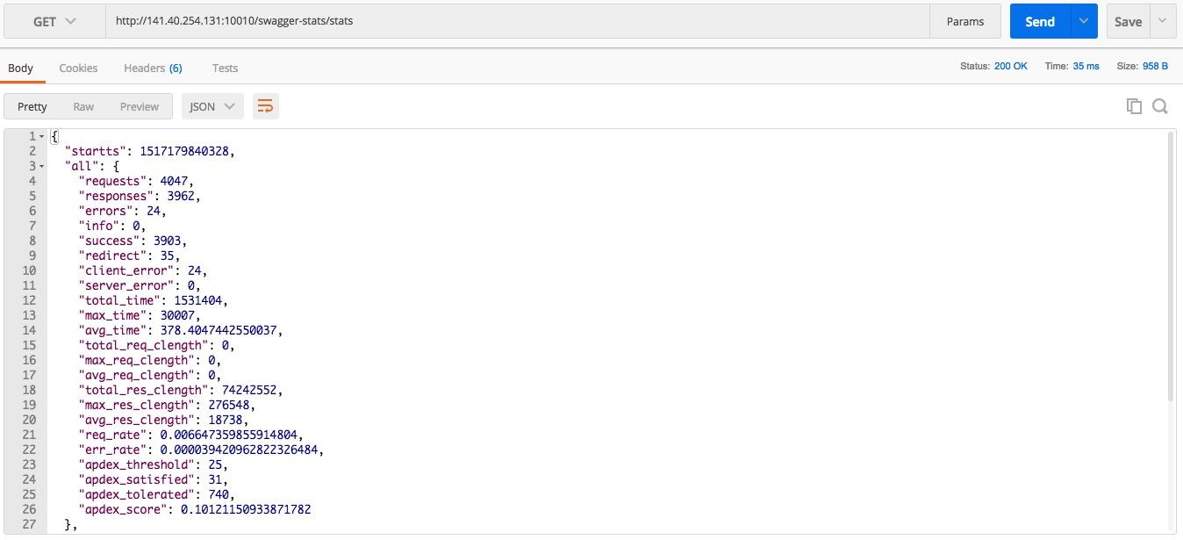
API Statistics via API

Slide 39
Performance Recommendations
Though current platform “survived” and didn’t crash...But.
More resources (especially compute power) overall
CPU usage reached 100% under heavy stress on Layer-2
Similar recommendation for Layer-3
Load-balancer behind Layer-3 (API) Entry point to have more worker nodes for fault-tolerance and scalability.
Massive Scalability? Microservices architecture

Slide 40
Live Previews

