Slide 1


Slide 2
Powerful and economic
For example : Apple migrated his password monitoring service from Java to Swift
and is now 40% more powerful with a decreasing of 40% of codes lines.

Slide 3
Main features :
Simplicity
Performance
Security
Open source

Slide 4
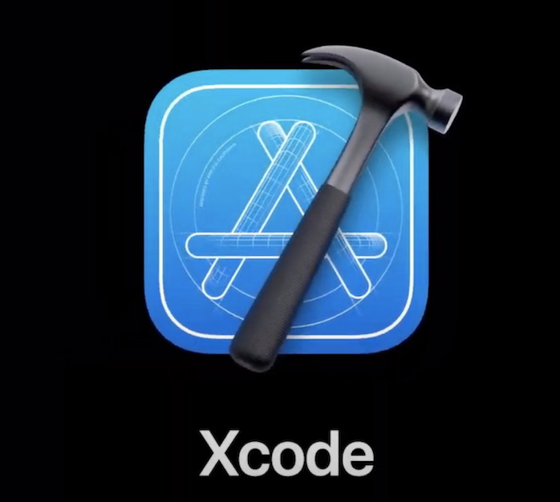
Powerful tool
Instant preview
Easy to handle

Slide 5
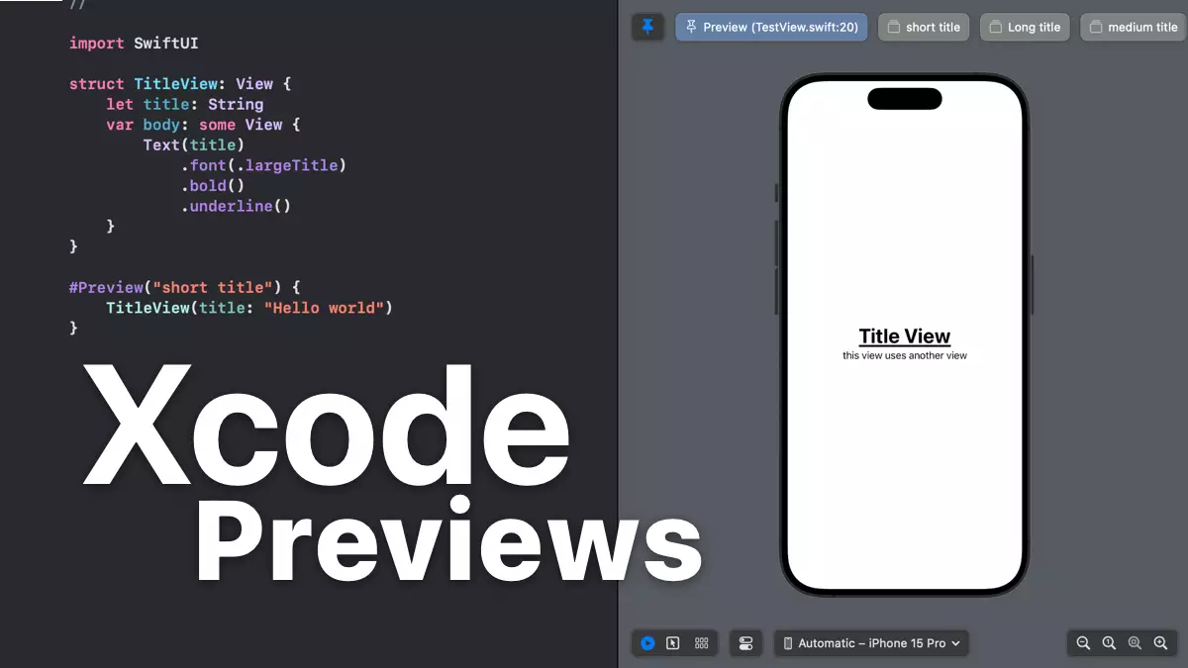

Slide 6
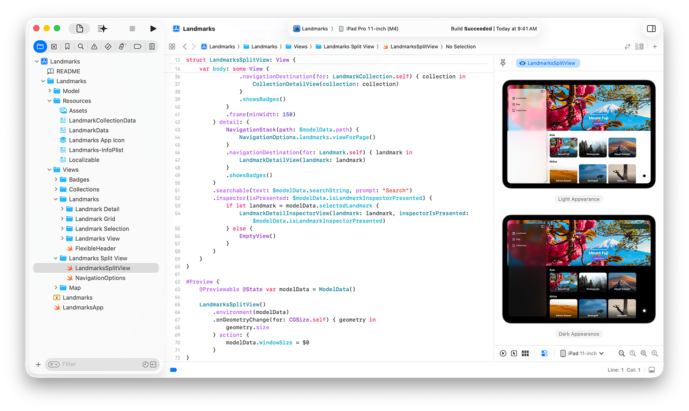

Slide 7
Area of uses
iOS Mobile applications
Application development for MacOS
Applications for tvOS and watchOS

Slide 8
Swift Playground
Easy to learn
Quick result
Ludic

Slide 9
