Slide 1


Slide 2

Powerful tool
Instant preview
Easy to handle

Slide 3
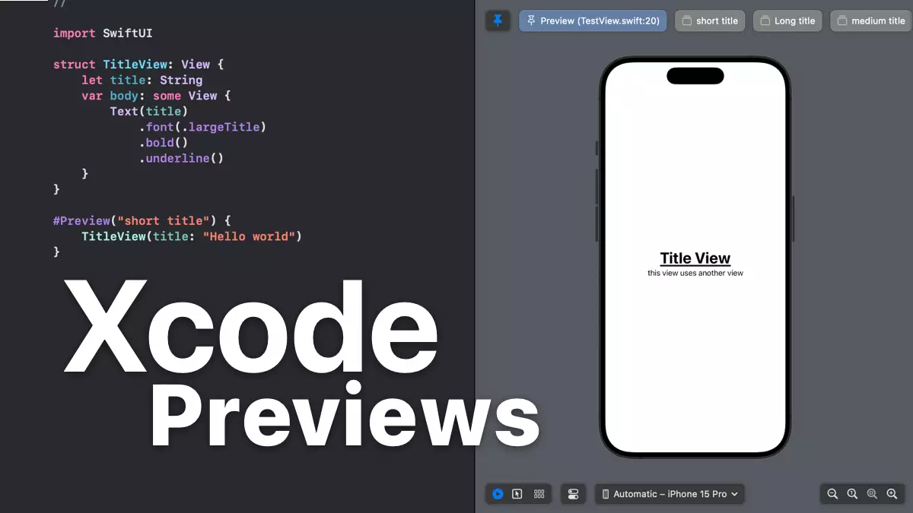

Slide 4
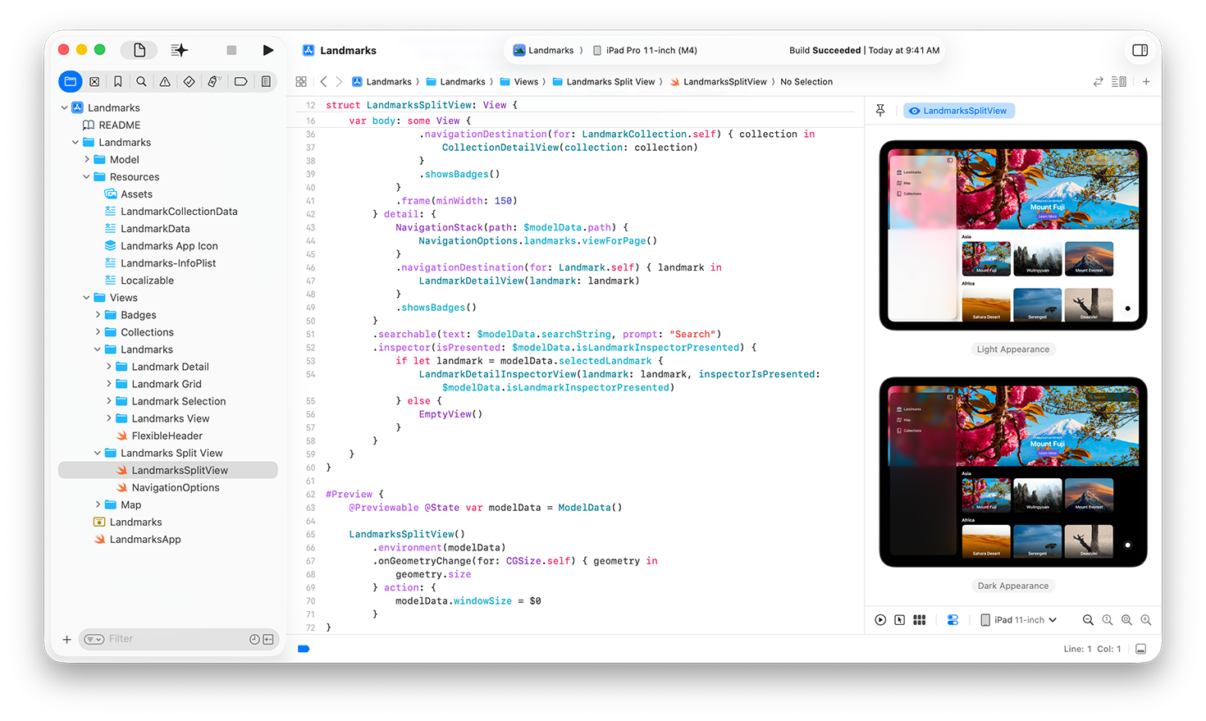

Slide 5
Main features :
Performance
Security
Interoperability
Open source
Security

Slide 6
Area of uses
iOS Mobile applications
Application development for MacOS
Applications for tvOS and watchOS

Slide 7
Swift Playground
Easy to learn
Quick result
Ludic

Slide 8
