Slide 1
BRM-Net
Fusion-Compatible Budgeted Compact Export with Degradation-Supervised Reliability
for Multimodal Remote Sensing Classification
Core question
Main evidence
Report scope
Can a multimodal RS model be physically compact and robust to missing/degraded modalities?
Actual MAC budget agreement + robustness under controlled modality states.
Submission-oriented story; thesis extensions remain future work.
Graduation pre-defense / group meeting / submission report

Slide 2
MOTIVATION
Research motivation: why lightweight multimodal RS matters
Deployment pressure
2+
80%
3
Edge/onboard inference needs lower MACs, parameters, memory traffic, and stable behavior.
sensor branches
target MAC setting
dataset roles
HSI provides rich spectral signatures but is high-dimensional.
LiDAR or auxiliary sensors add geometry and spatial cues.
Multi-branch fusion improves accuracy but raises cost and failure modes.
A deployable method must report measured compact resources, not only training-time gates.
BRM-Net | academic presentation
02

Slide 3
PROBLEM
Problem: resource budget + missing/degraded modality
Budget constraint
Missing modality
Degraded modality
The final network should satisfy a target resource ratio rho measured by actual MACs/params.
A modality can be physically unavailable and must be excluded from fusion competition.
A modality can remain available but become noisy, low-resolution, or occluded.
Desired behavior
Keep complete-modality accuracy competitive.
Export a physically smaller compact model.
Handle full, main-only, auxiliary-only, and corrupted auxiliary inputs.
Treat reliability as a degradation-supervised diagnostic signal.
BRM-Net | academic presentation
03

Slide 4
GAP
Key gap in existing work
Method family | Budget | Compact export | Missing | Degraded | Fusion interface
Structured pruning | Yes | Yes | No | No | Usually single-backbone
Elastic networks | Yes | Partial | No | No | Width-adaptive only
Multimodal RS fusion | No | No | Limited | Limited | Accuracy-first
Missing-modality RS | Limited | No | Yes | Partial | Often heavier
BRM-Net | Yes | Yes | Yes | Yes | Explicitly preserved
Gap 1
Gap 2
Gap 3
Compression rarely respects multimodal fusion interfaces.
Missing-modality methods often rely on reconstruction or heavier modules.
Degraded-but-available modalities are under-tested.
BRM-Net | academic presentation
04

Slide 5
METHOD
BRM-Net overview
Inputs
Gated encoders
Reliability
Masked fusion
Compact export
HSI/main Auxiliary
Hard-concrete channel gates
Quality scores q_m
Availability-aware softmax
Physical channel removal
Training
Compact Export
Inference
Main design principle: compress internal channels while preserving the terminal fusion feature interface.
BRM-Net | academic presentation
05

Slide 6
METHOD
Problem formulation
Constrained objective
x^(1), x^(2): heterogeneous aligned observations such as HSI-LiDAR.
a_m in {0,1}: availability mask; missing modalities are excluded from fusion.
g in G: controlled degradation: noise, downsampling, occlusion.
f_theta^c: physically compact model after structural projection.
Deployment target
min E[L_cls(f_theta(g(x), a), y)] subject to R(f_theta^c) <= rho R(f_theta)
Narrow claim
BRM-Net does not claim physical sensor calibration. It evaluates degradation-supervised reliability as a diagnostic fusion signal under controlled modality states.
BRM-Net | academic presentation
06

Slide 7
METHOD
Budget-aware channel gating
Gate definition
Training estimate
Export rule
Each gated layer has z_l in [0,1]^C. Features are multiplied channel-wise before export.
Hard-concrete probabilities estimate expected channel usage and resource cost.
Threshold gates are binarized to meet target MACs while respecting minimum widths.
Resource loss penalizes mismatch between expected and target MAC ratio.
Gating is only an intermediate training mechanism.
The final report evaluates exported compact models.
BRM-Net | academic presentation
07

Slide 8
METHOD
Fusion-compatible compact export
Why compatibility matters
Structural projection
Terminal constraint
Independent branch pruning can break the feature dimensions expected by the fusion head.
Remove output channels, dependent input slices, BN parameters, and classifier weights.
Preserve fusion-consumed terminal representations through tied or protected gates.
State | Source OA | Compact OA | Delta | MACs
Full | 86.15 | 86.90 | +0.75 | 80.01
HSI only | 78.18 | 80.04 | +1.86 | 80.01
Noise-high | 84.26 | 84.55 | +0.29 | 80.01
Occlusion-50 | 84.59 | 85.57 | +0.98 | 80.01
Source gated model and physically exported compact model remain close, supporting the compact-export claim.
BRM-Net | academic presentation
08

Slide 9
METHOD
Availability-aware reliability fusion
Reliability scores
Availability mask
Fusion weights
Each modality produces q_m, a learned quality score used in fusion weighting.
Unavailable modalities receive a large negative logit before softmax.
alpha_m = softmax(log q_m + mask(a_m)) over usable modalities.
State | BRM-Net | w/o mask | Delta
Full | 86.90 | 87.02 | +0.12
HSI only | 80.04 | 76.72 | -3.32
LiDAR only | 38.04 | 37.59 | -0.45
Occlusion-50 | 85.57 | 85.67 | +0.10
Interpretation: the mask mainly protects physically missing modalities, not every degraded-but-available case.
BRM-Net | academic presentation
09

Slide 10
METHOD
Degradation-supervised quality learning
Clean / available
Missing
Noise / occlusion
Downsample x4
target t_m = 1
target t_m = 0
intermediate target
lower target
Training loss
Degraded modalities remain available during fusion.
The reliability branch must learn to down-weight corrupted inputs.
This is not a calibrated physical sensor-quality estimator.
Objective
L = L_cls + lambda_b L_bud + lambda_q L_qual
BRM-Net | academic presentation
10

Slide 11
METHOD
Training and export pipeline
1. Source training
2. Gate projection
3. Compact export
4. Fine-tune
5. Evaluate
Modality dropout + degradation sampling + budget loss
Select threshold eta to match target MAC ratio
Remove channels and dependent parameters
Recover accuracy in the compact architecture
Full, missing, degraded, MACs, params, latency
Algorithmic emphasis
The export stage is essential: the deployment model has physically fewer channels rather than merely soft gates in the source network.
BRM-Net | academic presentation
11

Slide 12
EXPERIMENTS
Experimental protocol and datasets
Dataset | Role | Train/Test | Why included
Houston2013 | Main benchmark | 2,832 / 12,197 | Official split; full ablation protocol
Trento | External validation | 819 / 29,395 | Near-saturated HSI-LiDAR accuracy test
MUUFL | Stress test | 1,550 / 52,137 | Imbalanced scene; weak auxiliary modality
Metrics
States
Reporting rule
OA, AA, Kappa, MAC ratio, parameter ratio, latency where available.
Full, main-only, auxiliary-only, noise, downsampling, occlusion.
Use fixed seeds and avoid leaderboard-style cross-dataset overclaiming.
BRM-Net | academic presentation
12

Slide 13
RESULTS
Budget agreement results
64.96%
80.01%
90.07%
actual MAC at 65 target
actual MAC at 80 target
actual MAC at 90 target
Target | Source OA | Compact OA | Params | MACs
65 | 85.98 | 85.53 | 64.79 | 64.96
80 | 85.79 | 85.84 | 79.92 | 80.01
90 | 85.33 | 85.74 | 89.78 | 90.07
Main claim: target budgets can be materialized as measured compact networks.
BRM-Net | academic presentation
13

Slide 14
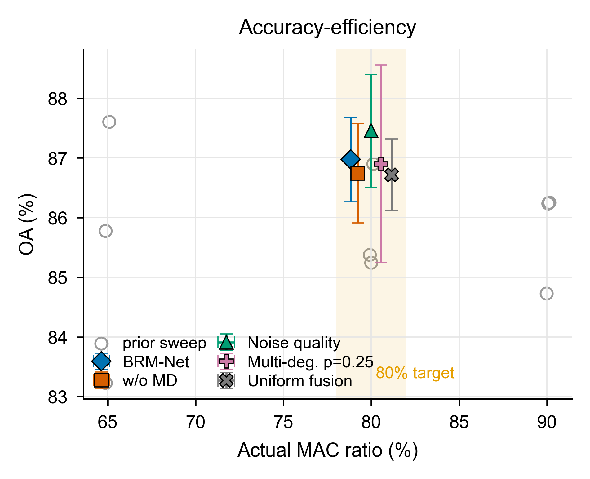
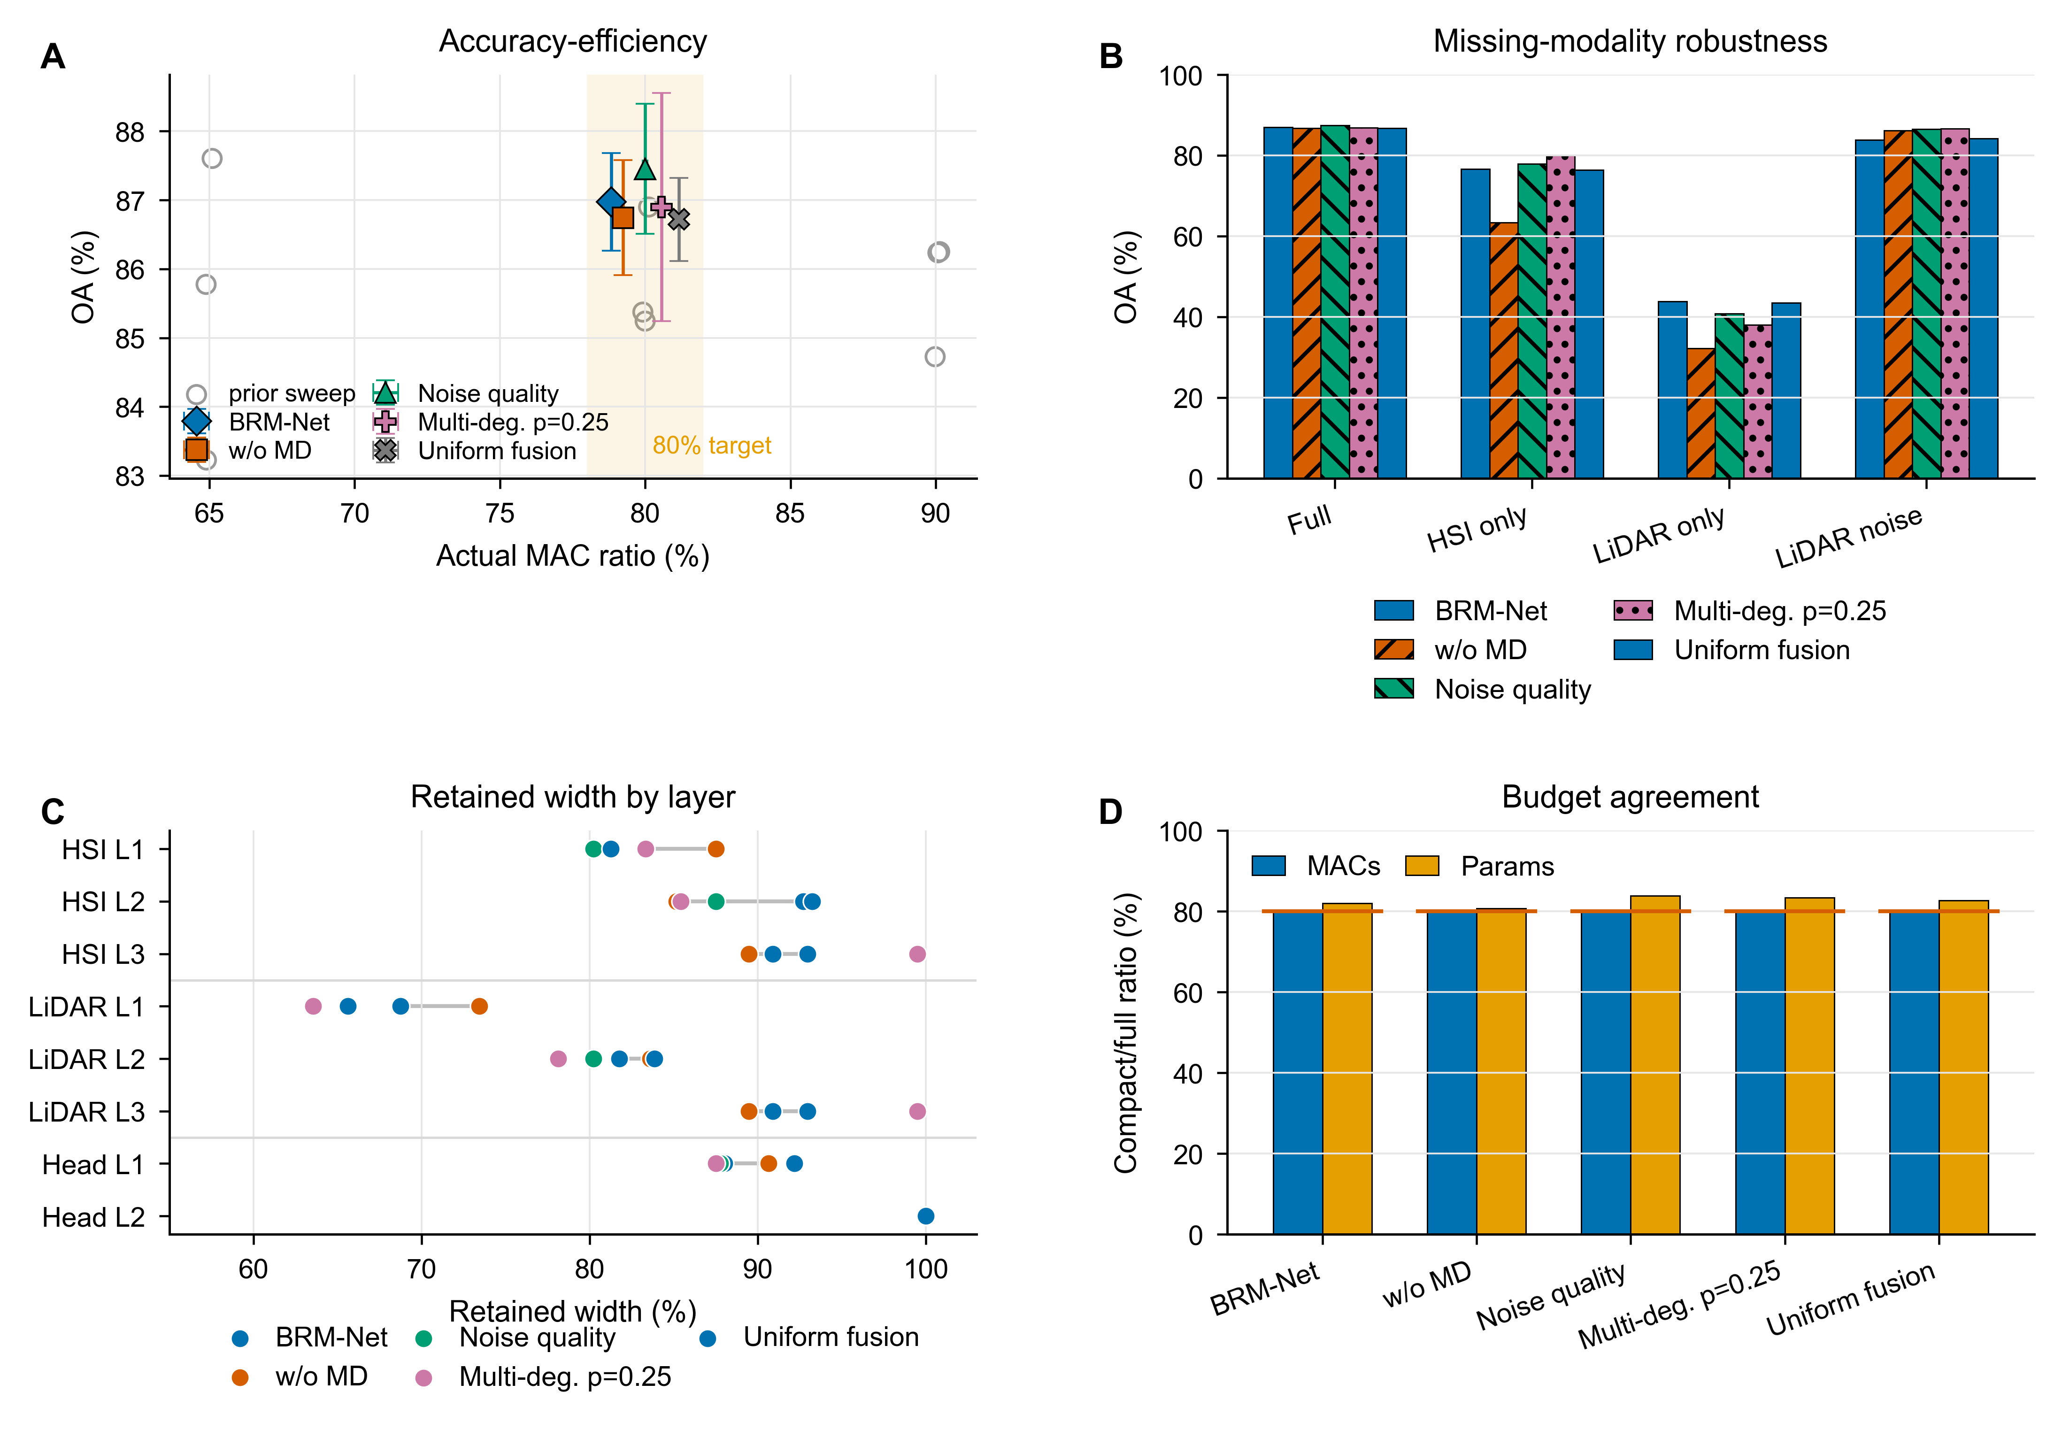
RESULTS
Accuracy-efficiency trade-off
Evidence combines Pareto-style accuracy-efficiency view and the paper overview figure.
BRM-Net | academic presentation
14

Slide 15
RESULTS
Missing-modality robustness
Training | Full | HSI only | LiDAR only | LiDAR noise
no dropout | 86.74 | 63.34 | 32.27 | 86.13
dropout 0.25 | 87.01 | 75.84 | 42.95 | 84.09
Observation
Training-time modality dropout greatly improves single-modality fallback.
Boundary
Availability masking protects missing modalities; degradation needs quality supervision.
BRM-Net | academic presentation
15

Slide 16
RESULTS
Degraded-modality robustness
Method | Full | Noise-high | Down-4 | Occ-50 | Adverse
Full baseline | 86.97 | 72.08 | 78.37 | 74.21 | 74.89
Uniform fusion | 86.72 | 77.01 | 78.35 | 73.87 | 76.41
Noise quality | 87.45 | 85.15 | 80.14 | 73.32 | 79.54
Multi-deg p=.50 | 85.99 | 85.11 | 84.38 | 84.66 | 84.72
Multi-deg p=.25 | 86.90 | 84.55 | 84.15 | 85.57 | 84.76
Key result
Adverse-state average improves from 74.89 to 84.76 under the 80% MAC setting.
BRM-Net | academic presentation
16

Slide 17
RESULTS
Multi-dataset evidence: Houston / Trento / MUUFL
Dataset | Full OA | Main-only | Occlusion-50 | MACs
Houston2013 | 86.90 ± 1.65 | 80.04 ± 1.93 | 85.57 ± 1.64 | 80.01
Trento | 98.94 ± 0.94 | 92.89 ± 3.15 | 98.16 ± 1.87 | 79.90
MUUFL | 86.87 ± 1.79 | 83.03 ± 2.14 | 85.99 ± 2.08 | 79.97
Interpretation
Houston supports the main ablation story; Trento supports efficiency preservation; MUUFL exposes clean-robustness trade-off.
BRM-Net | academic presentation
17

Slide 18
RESULTS
Ablation study
Ablation | What is removed/changed | Observed effect
Uniform fusion | No reliability weighting | Limited corruption robustness
Noise quality | Only noise-supervised quality | Noise improves; occlusion remains weak
Multi-deg p=.50 | Stronger degradation schedule | Robust but slightly hurts full OA
Multi-deg p=.25 | Light multi-degradation schedule | Best adverse-state average
w/o mask | Disable availability mask | HSI-only OA drops by 3.32 pp
Conclusion
Submission boundary
Robustness comes from degradation-supervised reliability, not from a reliability scalar alone.
Routing, weighted CE, and profile label stabilization remain thesis extensions.
BRM-Net | academic presentation
18

Slide 19
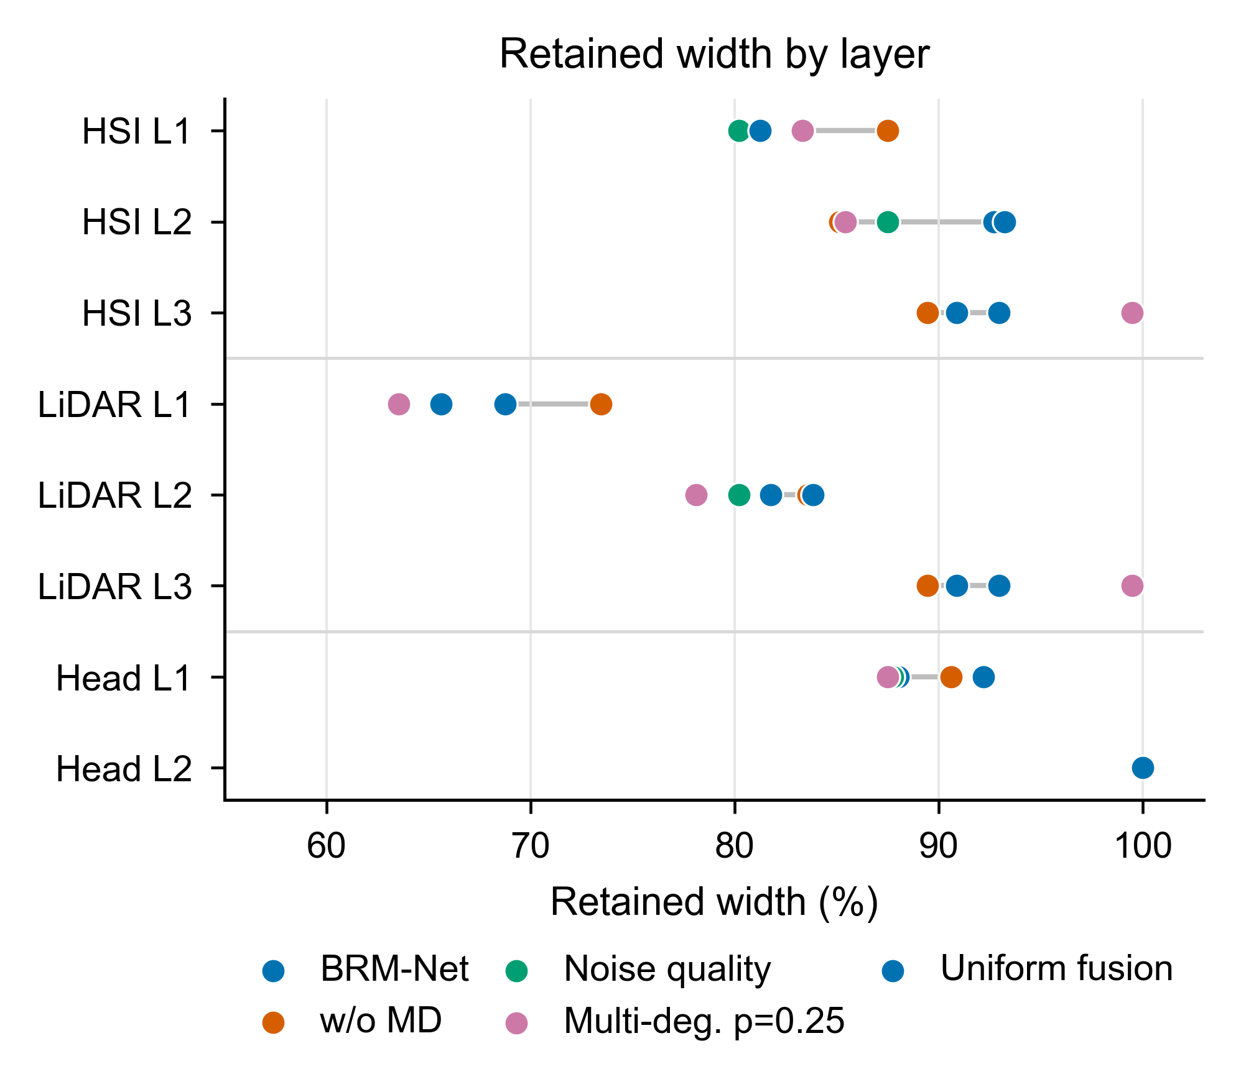
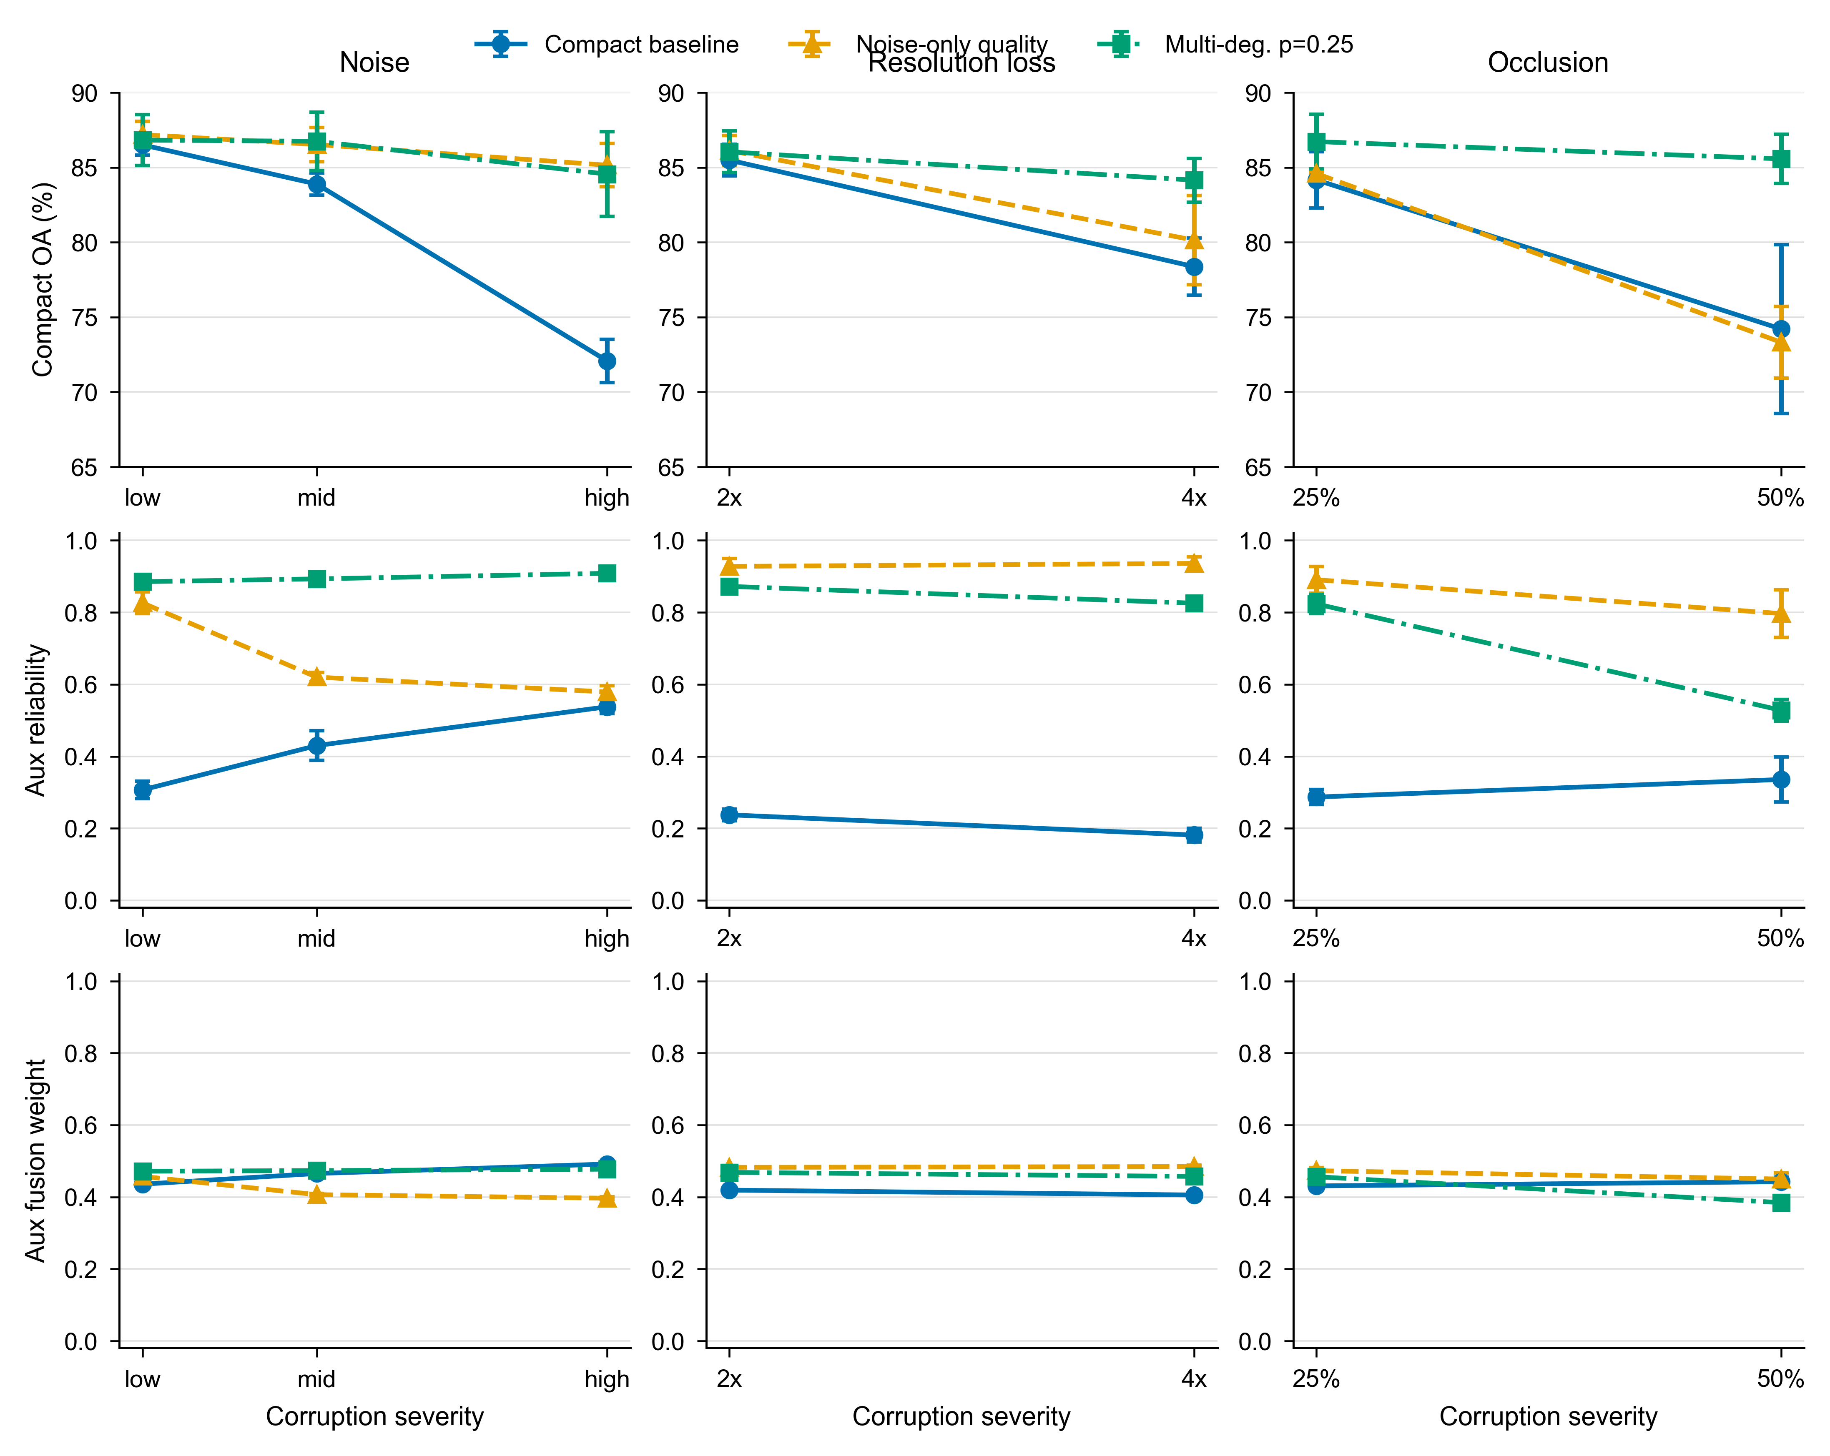
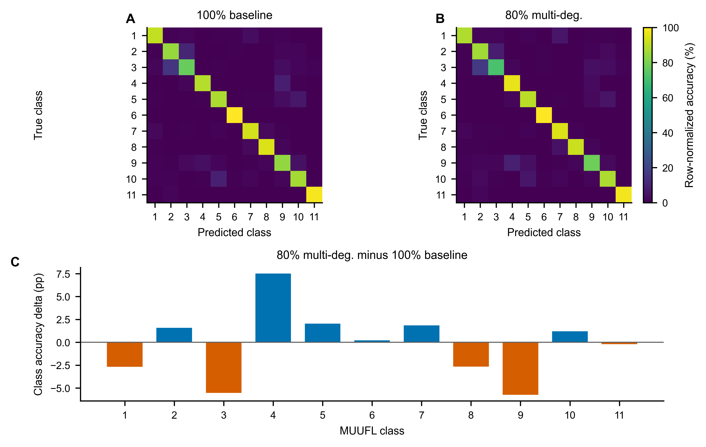
VISUALIZATION
Visualization: retained width / reliability diagnostic / MUUFL error
Visuals should be read as mechanism diagnostics; reliability is degradation-aware, not physically calibrated.
BRM-Net | academic presentation
19

Slide 20
DISCUSSION
Discussion: clean-robustness trade-off and limitations
Supported
Nuanced
Limited
Target MAC agreement and compact export are well supported on Houston2013.
MUUFL improves robustness but sacrifices 1.64 pp clean full-modality OA.
Current datasets are still HSI-LiDAR style; HS-MS and HS-SAR remain future evidence.
A single full-modality OA is not enough for deployment-oriented evaluation.
Reliability weighting is useful only when trained with corrupted-but-available states.
The paper should avoid claims of real onboard deployment or physical sensor calibration.
Larger backbones and stronger lightweight baselines would strengthen submission impact.
BRM-Net | academic presentation
20

Slide 21
CLOSING
Contribution summary
1
2
3
compact export
reliability fusion
joint evaluation
Fusion-compatible budgeted compact export
Degradation-supervised reliability fusion
Accuracy-efficiency-robustness evaluation
Learns gates and materializes compact models while preserving the fusion interface.
Uses quality targets for corrupted-but-available modalities without reconstruction modules.
Reports actual MACs, missing-modality states, degraded states, and multi-dataset evidence.
BRM-Net | academic presentation
21

Slide 22
Future work
Extended thesis exploration
Stronger evidence
Demo system
Dynamic routing, weighted CE, profile label stabilization, class-wise diagnostics.
Larger-backbone transfer, stronger lightweight baselines, denser corruption curves.
Interactive dataset/state/budget selector for thesis defense demonstration.
Q&A
Main message: BRM-Net targets deployable compact multimodal classification under budget, missing-modality, and degraded-modality constraints.
TODO: final confusion matrix / final latency table / denser corruption grid remain outside this PPT's confirmed evidence.

