Slide 1
CSE4020 - Machine Learning Winter Semester 2019 – 2020 B.Tech. (CSE) Programme
Dr. V. Vijayarajan

Slide 2
5.2 Hierarchical: AGNES & DIANA

Slide 3
Hierarchical Clustering Techniques
Hierarchical approach:
Create a hierarchical decomposition of the set of data (or objects) using some criterion (distance matrix )
Examples: Diana, Agnes, and ROCK.

Slide 4
Hierarchical Clustering
Use distance matrix as clustering criteria.
This method does not require the number of clusters k as an input.
It needs a termination condition

Slide 5
Contd….
Two types of Hierarchical Clustering: Agglomerative (bottom-up) and Divisive (top-down).
Agglomerative (AGNES): begin with each element as a separate cluster and merge them into successively larger clusters
Divisive (DIANA): begin with the whole set and proceed to divide it into successively smaller clusters.
Notes:
Probably the simplest clustering technique – very straightforward.

Slide 6
Contd….
Step 0
Step 1
Step 2
Step 3
Step 4
agglomerative
(AGNES)
a
a b
b
a b c d e
c
c d e
d
d e
e
divisive
(DIANA)
Step 4
Step 3
Step 2
Step 1
Step 0

Slide 7
AGNES (Agglomerative Nesting)
Agglomerative, Bottom-up approach
Initially each item in its own cluster
Iteratively clusters are merged together

Slide 8
DIANA (Divisive Analysis)
Initially all items in one cluster
Large clusters are successively divided
Top Down

Slide 9
Comments on the Hierarchical Clustering
Weaknesses:
do not scale well: time complexity of at least O(n²), where n is the number of total objects
can never undo what was done previously

Slide 10
Examples for Hierarchical Clustering
Hierarchical Clustering
ROCK

Slide 11
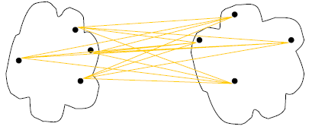
Cluster Distance Measures
Single link: smallest distance between an element in one cluster and an element in the other, i.e., d(C_{i}, C_{j}) = min{d(x_{ip}, x_{jq})}
Complete link: largest distance between an element in one cluster and an element in the other, i.e., d(C_{i}, C_{j}) = max{d(x_{ip}, x_{jq})}
Average: avg distance between elements in one cluster and elements in the other, i.e.,
d(C_{i}, C_{j}) = avg{d(x_{ip}, x_{jq})}
single link
(min)
complete link
(max)
average
Notes:
Define D(C, C)=0, the distance between two exactly same clusters is ZERO!

Slide 12

Contd….
method | Algorithm for computing distance between clusters.
Method | Description
'average' | Unweighted average distance (UPGMA)
'centroid' | Centroid distance (UPGMC), appropriate for Euclidean distances only
'complete' | Furthest distance
'median' | Weighted center of mass distance (WPGMC), appropriate for Euclidean distances only
'single' | Shortest distance
'ward' | Inner squared distance (minimum variance algorithm), appropriate for Euclidean distances only

Slide 13
Cluster Distance Measures
Example: Given a data set of five objects characterised by a single feature, assume that there are two clusters: C1: {a, b} and C2: {c, d, e}.
1. Calculate the distance matrix. 2. Calculate three cluster distances between C1 and C2.
 | a | b | c | d | e
Feature | 1 | 2 | 4 | 5 | 6
Single link
Complete link
Average
 | a | b | c | d | e
a | 0 | 1 | 3 | 4 | 5
b | 1 | 0 | 2 | 3 | 4
c | 3 | 2 | 0 | 1 | 2
d | 4 | 3 | 1 | 0 | 1
e | 5 | 4 | 2 | 1 | 0

Slide 14
Distance Measurements Between Data Points
This parameter specifies how the distance between data points in the clustering input is measured. The options are:
Euclidean: Use the standard Euclidean (as-the-crow-flies) distance.
Euclidean Squared: Use the Euclidean squared distance in cases where you would use regular Euclidean distance in Jarvis-Patrick or K-Means clustering.
Manhattan: Use the Manhattan (city-block) distance.
Pearson Correlation: Use the Pearson Correlation coefficient to cluster together genes or samples with similar behavior; genes or samples with opposite behavior are assigned to different clusters.
Pearson Squared: Use the squared Pearson Correlation coefficient to cluster together genes with similar or opposite behaviors (i.e. genes that are highly correlated and those that are highly anti-correlated are clustered together).
Chebychev: Use Chebychev distance to cluster together genes that do not show dramatic expression differences in any samples; genes with a large expression difference in at least one sample are assigned to different clusters.
Spearman: Use Spearman Correlation to cluster together genes whose expression profiles have similar shapes or show similar general trends (e.g. increasing expression with time), but whose expression levels may be very different.

Slide 15
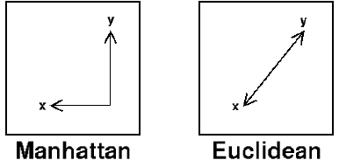


Distance Measurements Between Data Points
This parameter specifies how the distance between data points in the clustering input is measured. The options are:
Euclidean: Use the standard Euclidean (as-the-crow-flies) distance.
Euclidean Squared: Use the Euclidean squared distance in cases where you would use regular Euclidean distance in Jarvis-Patrick or K-Means clustering.
Manhattan: Use the Manhattan (city-block) distance.
.

Slide 16

Metrics for hierarchical clustering
Metric | Description
'euclidean' | Euclidean distance (default).
'seuclidean' | Standardized Euclidean distance. Each coordinate difference between rows in X is scaled by dividing by the corresponding element of the standard deviation S=nanstd(X). To specify another value for S, useD=pdist(X,'seuclidean',S).
'cityblock' | City block metric.
'minkowski' | Minkowski distance. The default exponent is 2. To specify a different exponent, use D = pdist(X,'minkowski',P), where P is a scalar positive value of the exponent.
'chebychev' | Chebychev distance (maximum coordinate difference).
'mahalanobis' | Mahalanobis distance, using the sample covariance of X as computed bynancov. To compute the distance with a different covariance, use D = pdist(X,'mahalanobis',C), where the matrix C is symmetric and positive definite.
'cosine' | One minus the cosine of the included angle between points (treated as vectors).
'correlation' | One minus the sample correlation between points (treated as sequences of values).
'spearman' | One minus the sample Spearman's rank correlation between observations (treated as sequences of values).
'hamming' | Hamming distance, which is the percentage of coordinates that differ.
'jaccard' | One minus the Jaccard coefficient, which is the percentage of nonzero coordinates that differ.
custom distance function | A distance function specified using @: D = pdist(X,@distfun) A distance function must be of form d2 = distfun(XI,XJ) taking as arguments a 1-by-n vector XI, corresponding to a single row ofX, and an m2-by-n matrix XJ, corresponding to multiple rows of X.distfun must accept a matrix XJ with an arbitrary number of rows.distfun must return an m2-by-1 vector of distances d2, whose kth element is the distance between XI and XJ(k,:).

Slide 17
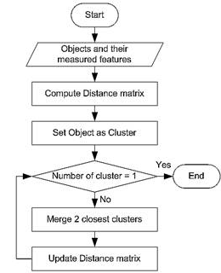
Agglomerative Algorithm
The Agglomerative algorithm is carried out in three steps:
Convert object attributes to distance matrix
Set each object as a cluster (thus if we have N objects, we will have N clusters at the beginning)
Repeat until number of cluster is one (or known # of clusters)
Merge two closest clusters
Update distance matrix

Slide 18
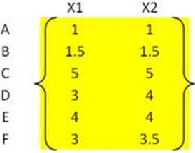
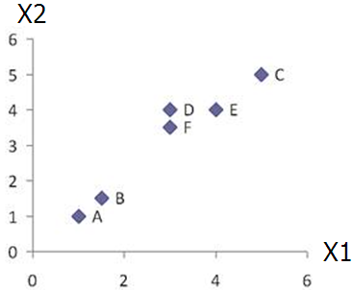
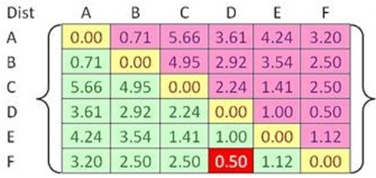


Example
Problem: clustering analysis with agglomerative algorithm
data matrix
Euclidean distance
distance matrix

Slide 19
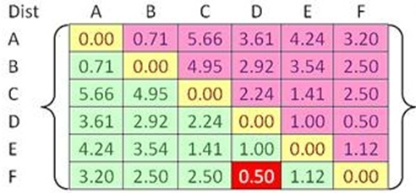
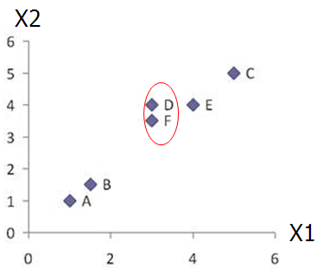
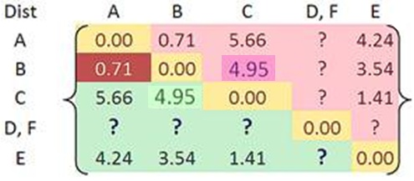

Example
Merge two closest clusters (iteration 1)

Slide 20
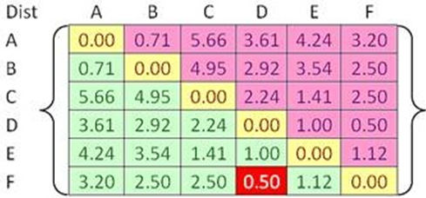

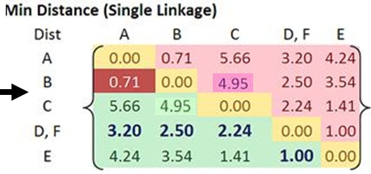
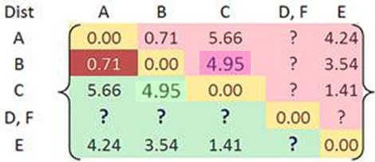
Example
Update distance matrix (iteration 1)

Slide 21
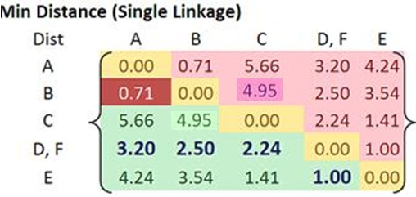
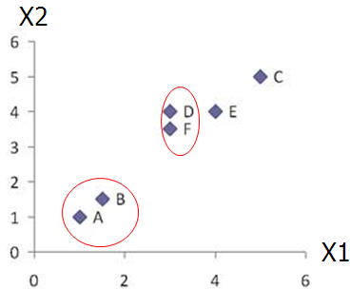
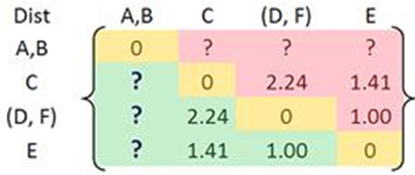
Example
Merge two closest clusters (iteration 2)

Slide 22
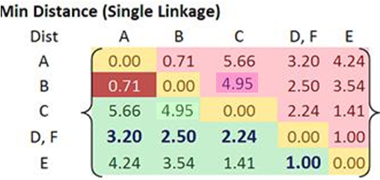
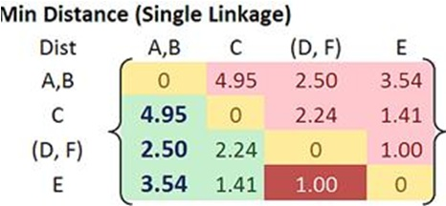

Example
Update distance matrix (iteration 2)

Slide 23
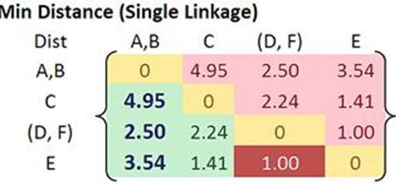
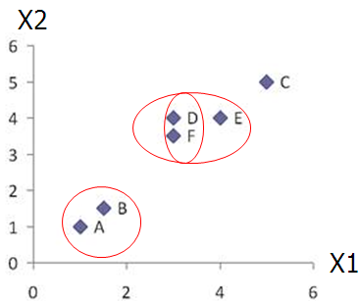
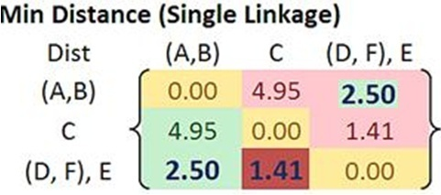

Example
Merge two closest clusters/update distance matrix (iteration 3)

Slide 24
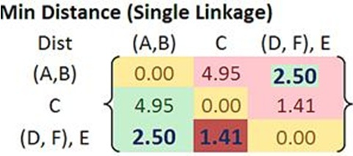
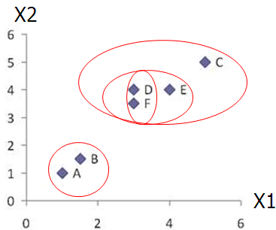
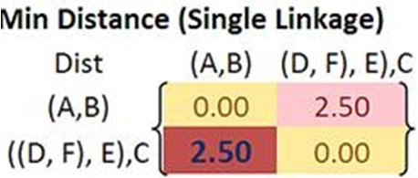

Example
Merge two closest clusters/update distance matrix (iteration 4)

Slide 25
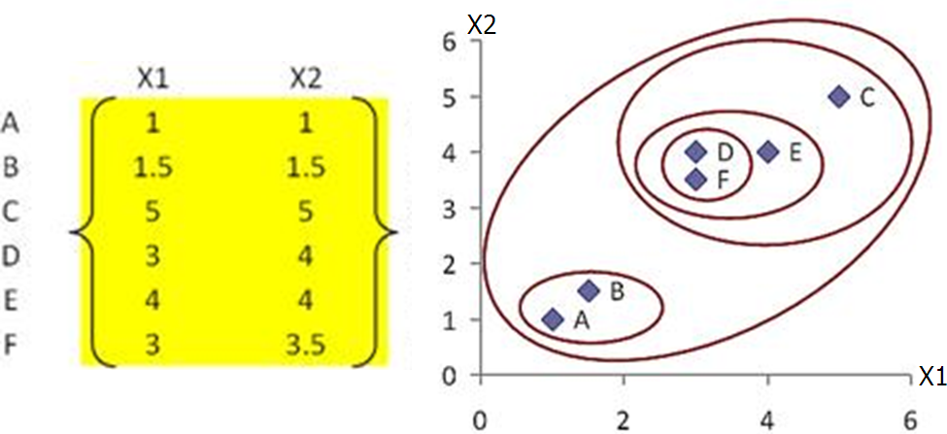
Example
Final result (meeting termination condition)

Slide 26
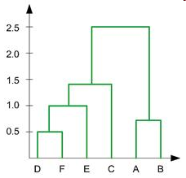
Example
Dendrogram tree representation
In the beginning we have 6
clusters: A, B, C, D, E and F
We merge clusters D and F into
cluster (D, F) at distance 0.50
We merge cluster A and cluster B
into (A, B) at distance 0.71
We merge clusters E and (D, F)
into ((D, F), E) at distance 1.00
We merge clusters ((D, F), E) and C
into (((D, F), E), C) at distance 1.41
We merge clusters (((D, F), E), C)
and (A, B) into ((((D, F), E), C), (A, B))
at distance 2.50
The last cluster contain all the objects,
thus conclude the computation
6
lifetime
5
4
3
2
object
Notes:
For a dendrogram tree, its horizontal axis indexes all objects in a given data set, while its vertical axis expresses the lifetime of all possible cluster formation.
The lifetime of a cluster in the dendrogram is defined as a distance interval from the moment that the cluster is created to the moment that it disappears by merging with other clusters.

