Slide 1


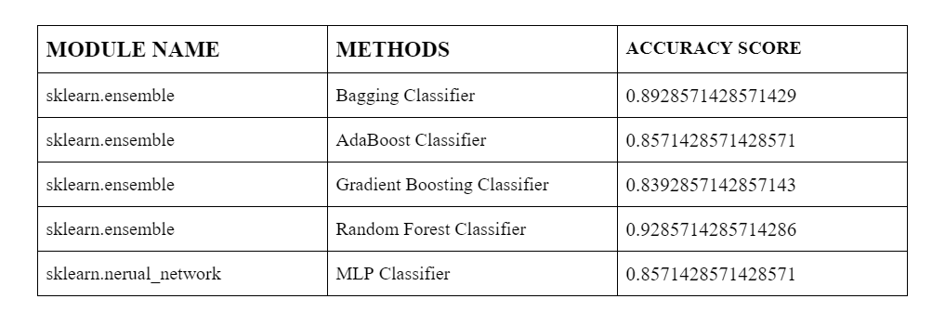
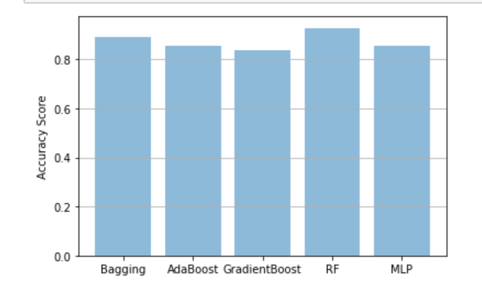

PREDICTION OF DYNAMIC CLOUD RESOURCES
PROVISIONING FOR WORKFLOWS
Yashkumar Jain, Kesava Durga Prasad, Anuj Sharma, Bhumika Agrawal
Mentor: - Dr. Indrajeet Gupta
Abstract
After running different methods we got this results :-
This is a project in which we have to predict the resources used by any virtual machine provisioning for workflow. The prediction is affected by many factors including CPU core, CPU capacity, CPU usage, Memory capacity, Memory usage and Network throughput. We have created a Model which predicts a good accuracy score. We have used MLP Classifier, Gradient Boosting Classifier, AdaBoost Classifier, Bagging Classifier and Random Forest Classifier.
Introduction
Cloud computing is a new trend in Internet computing where resources like storage, computation power, network, applications etc. are delivered as a service.
It basically gives three types of services i] IaaS (Infrastructure as a service) ii] SaaS(Software as a service) iii] PaaS(Platform as a service). The IaaS delivery model provides storage, hardware and networks as the basic subcomponents of services. It offers on-demand creation of virtual machines (VMs) for various users and applications, which enables dynamic management of VMs for maximizing the resource utilization in the data centers (DCs).
With the increase in cloud computing the load on the cloud has also increased. Every company is using the cloud for many purposes. So the resources available on the cloud for so many companies needs to be predicted otherwise the company will go in loss. In our machine learning model we have used some methods like ensemble and neural network method to predict the resources available for a company specially on the working days because on working day the resources required is very high and on the weekends its very low.
And if we see this scores in a graphical form then it would look like this :-
From the results we can clearly state that Random Forest Classifier is the best method for our model as it is giving an accuracy score of 92.857%.
Other methods used in the model produces an accuracy score of 85 -90 %. Like :-
1] Bagging Classifier – 89.285%
2] AdaBoost Classifier – 85.714%
3] Gradient Boosting Classifier – 83.928%
4] MLP Classifier – 85.714%
This tells us that our model is able to predict the resources required by the companies up to 85 – 92 % on the working days and on the weekends as well.
Proposed Method
The main of this project is to predict the resources used my different companies for there work. We have used many modules(Bagging Classifier, AdaBoost Classifier, Gradient Boosting Classifier and MLP Classifier) for the prediction but the most effective method was Random Forest Classifier. Random forest classifier creates a set of decision trees from randomly selected subset of training set. It then aggregates the votes from different decision trees to decide the final class of the test object. Basic parameters to Random Forest Classifier can be the total number of trees to be generated and decision tree related parameters like minimum split, split criteria etc.
Conclusions
In this project, the dataset provided by the GWA GitHub was preprocessed and then used in the model. Many modules were used on the dataset to get the highest prediction accuracy score for resources required by the companies. The random forest method give’s accuracy score of 92.857%. Therefore we recommend a random forest classifier method for this problem statement.
Experimental Results and Discussion
After using the above mention methods we got some accuracy score. And after converting that score into percentage we can clearly see that all the methods give accuracy above than 80% but random forest method gives the accuracy above 90%.
References
https://github.com/kwananth/VMWorkloadPredictor
https://scikit-learn.org/stable/modules/classes.html
Team No. - 54

