Slide 1


PREDICTION OF DYNAMIC CLOUD RESOURCES PROVISIONING FOR WORKFLOWS
Yashkumar Jain Dr.Indrajeet Gupta
Tumpala Kesava Durga Prasad
Anuj Sharma
Bhumika Agrawal

Slide 2
Introduction
Cloud computing is a new trend in Internet computing.
The IaaS delivery model provides storage, hardware and networks as the basic subcomponents of services.
In our machine learning model we have used some methods like ensemble and neural network method.
we have to predict the resources required by the companies for their work on cloud.

Slide 3
Dataset Used
We are using the dataset provided by the GWA.
There are many features like :- Timestamp, CPU cores, CPU capacity, CPU usage, CPU usage (%), memory provisioned, memory usage, disk read and write , network in and out.
The structured data and the network columns are the dependent variables.
Rest all other columns are independent variables.
we split them into training sets and test sets.

Slide 4
Methodology / Model Used
1.Bagging classifier
2.AdaBoost Classifier
3.Gradient Boosting Classifier
4.Random Forest Classifier
5.MLP Classifier

Slide 5
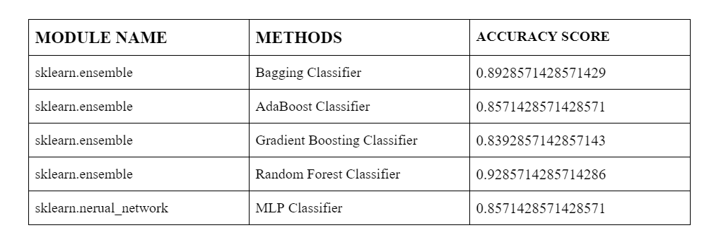
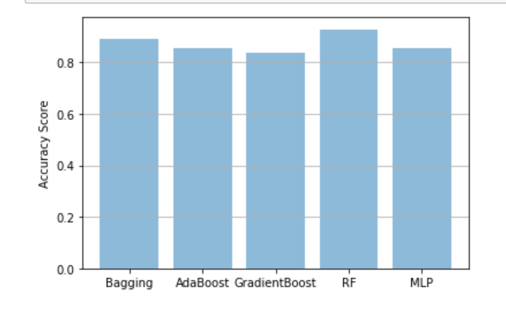
Results Achieved
After using the above mention methods we got some accuracy score. And after converting that score into percentage we can clearly see that all the methods give accuracy above than 80% but random forest method gives the accuracy above 90%.
Tabular Format
Graphical Format

Slide 6
Conclusion
The dataset provided by the GWA GitHub was preprocessed and then used in the model.
Many modules were used on the dataset to get the highest prediction accuracy score for resources required by the companies.
The random forest method give’s accuracy score of 92.857%. Therefore we recommend a random forest classifier method.

Slide 7
References
https://github.com/kwananth/VMWorkloadPredictor
Gopal Kirshna Shyam and Sunilkumar S. Manvi, Virtual Resource Prediction in Cloud Environment: A Bayesian Approach, Journal of Network and Co
https://scikit-learn.org/stable/modules/classes.html
https://github.com/Azure/AzurePublicDataset

Slide 8
Thank You

