Slide 1
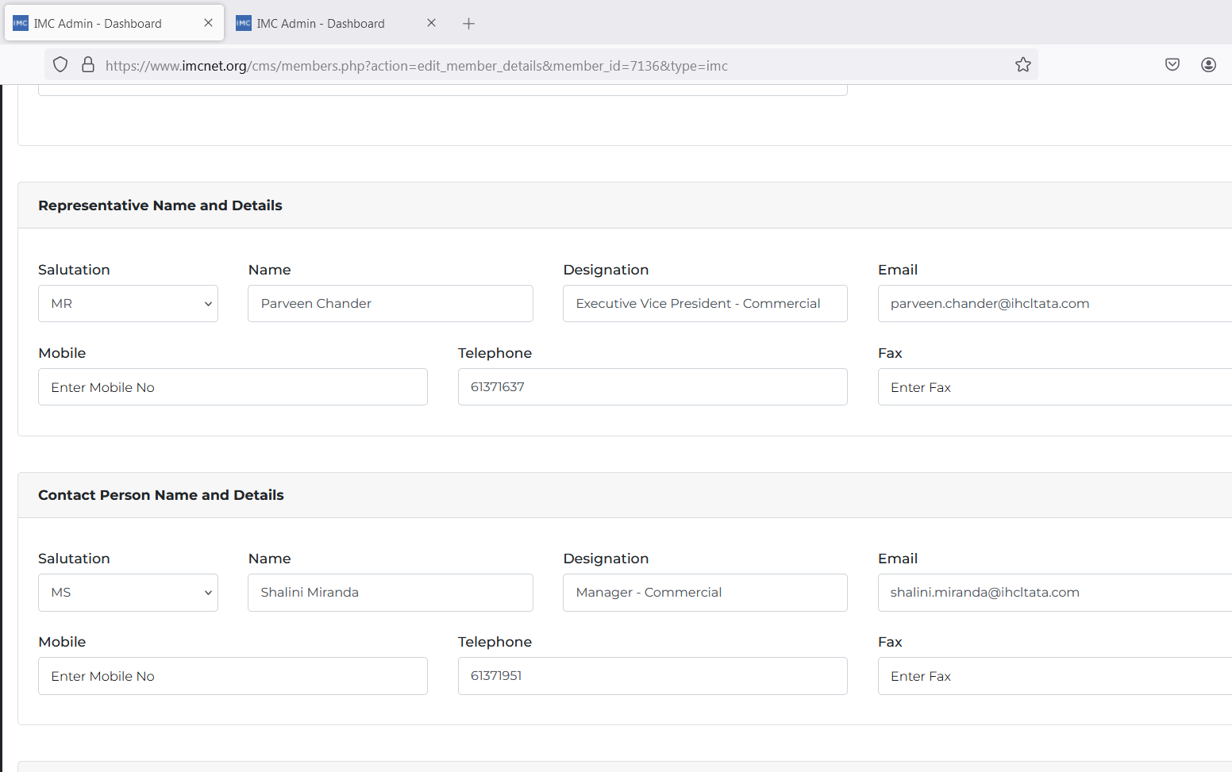
URL - https://www.imcnet.org/cms/members.php?action=edit_member_details&member_id=7136&type=imc
The data in Overview tab of the Membership -> New Applications -> Overveiw

Slide 2
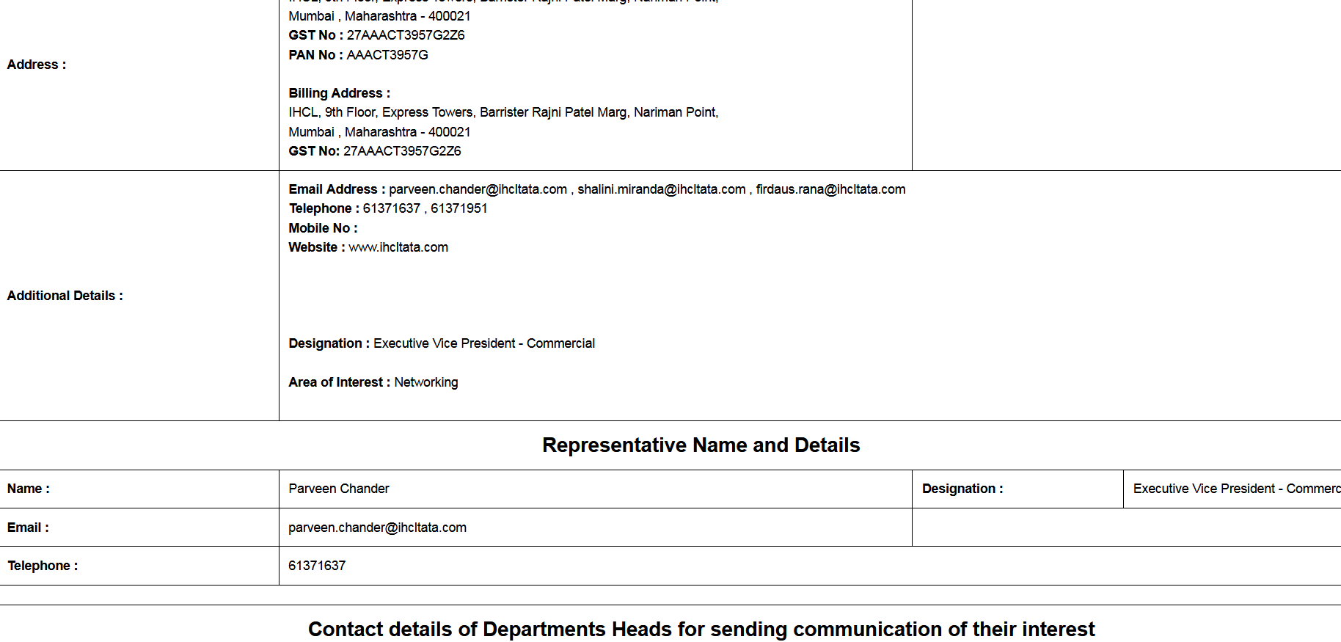
Under Membership -> New Applications - The Contact Person Name and Details is not being picked below Representative Name and Details
URL - https://www.imcnet.org/cms/member_data_print.php?member_id=7136

