Slide 1










$$L$$
$$v_{c}$$
$$ω_{r}$$
$$v_{r}$$
$$ω_{c}$$
$$v_{r}$$
$$v_{l}$$
$$x_{c},y_{c}$$
$$R$$
$$D$$

Slide 2
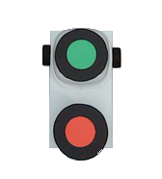

Way Point 1
Way Point 2
Start Position
Expected Position

Slide 3
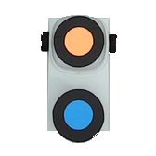
Enemy Robot
Self Robot

Slide 4
Enemy Robot
Self Robot

Slide 5
Enemy Robot
Self Robot

Slide 6
Nearest Position
Self Robot
Enemy Robot

Slide 7
Y axis
Positive theta
pi
0
X axis
-pi
Negative theta

Slide 8
Input RGB image
Labeling objects
Identifying objects
Convert RGB image to Grey image
Dilation: Filling objects
Calculating robots’ directions
Scaling the grey image to (0-255)
Erosion: denoising the image, removing small objects
Self position, enemy position, and obstacles positions
Appling Lowpass filter to keep areas with intense gradient
Threshold: binarization (180)

Slide 9
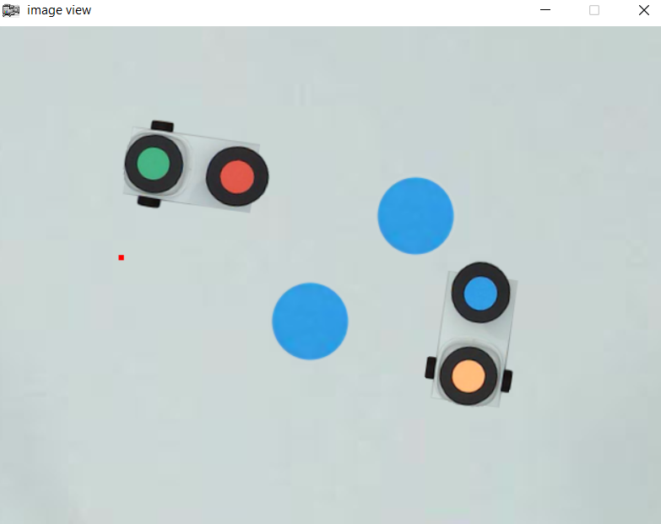

Slide 10
C
O
A
B

