Slide 1
Fault in our pong
Remake of the ping pong game
By:
Jean Luo
Arfa Amer
Adwity Sharma

Slide 2

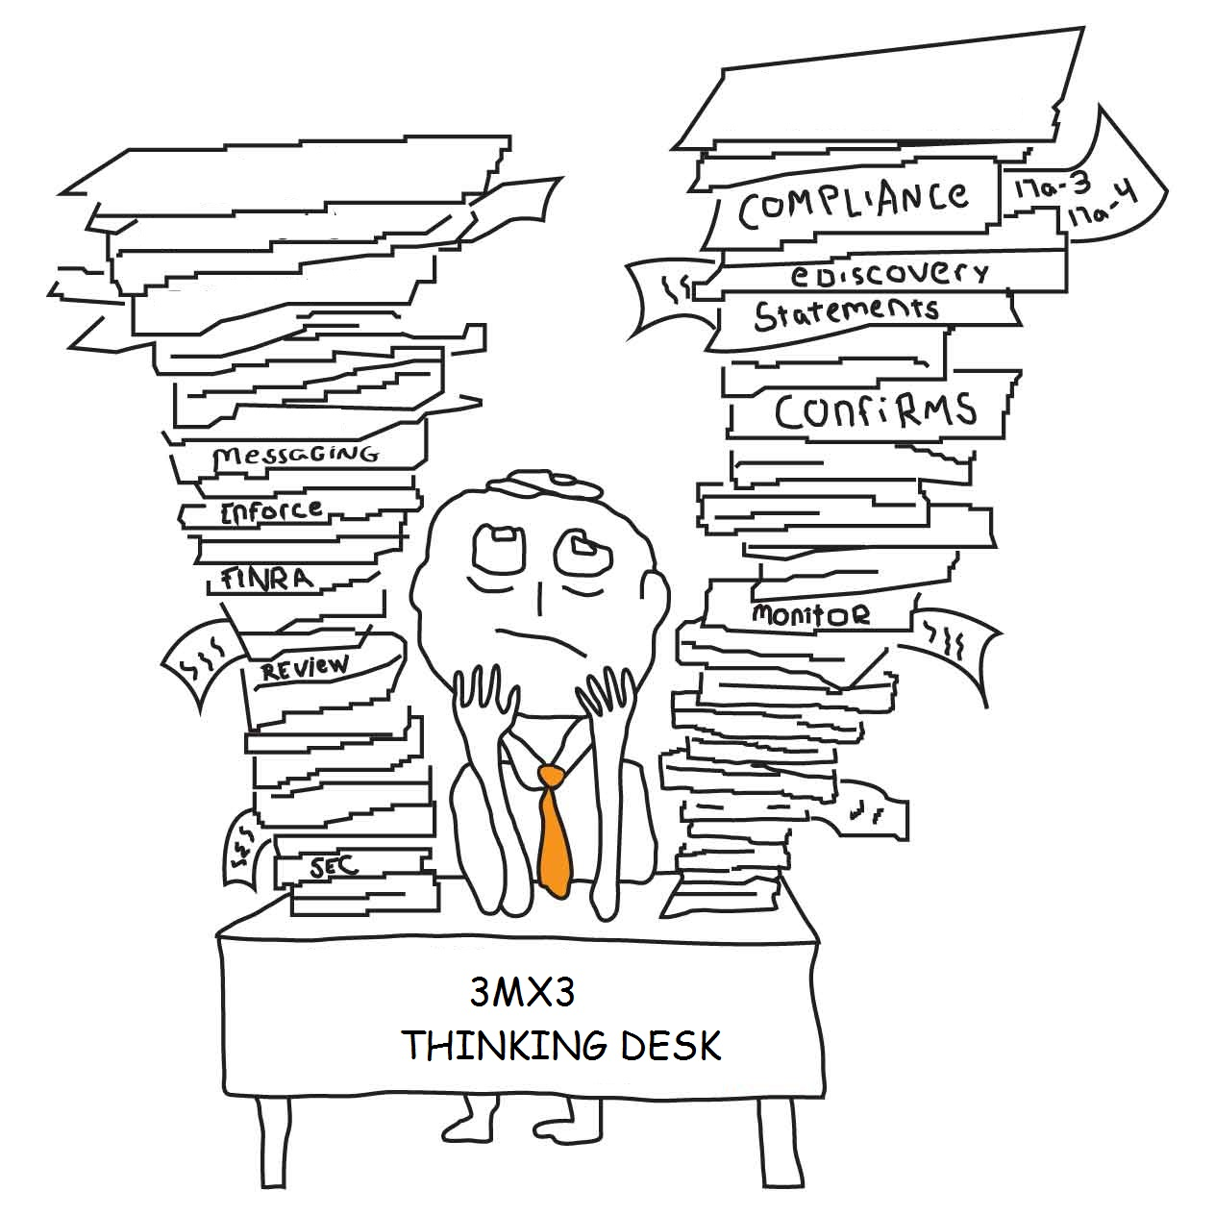
purpose
Increase our skills with documentation
Develop team work and communication skills
To make the existing game more fun
Improve interface design
Improve skills in testing

Slide 3
scope
Played against computer
Keyboard left and right arrows to change paddle directions
Fun single player game
With easy and difficult modes
Can be played by people of all ages

Slide 4

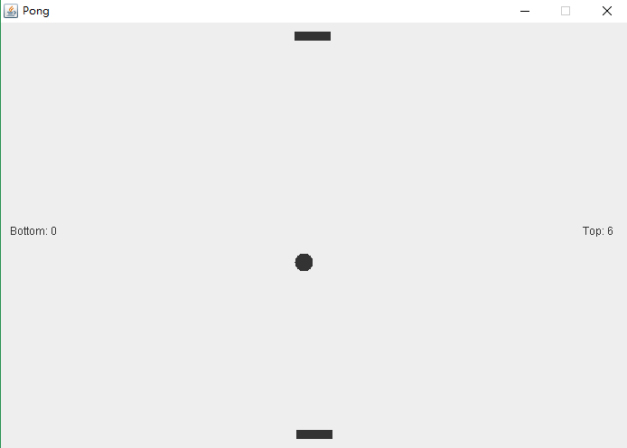
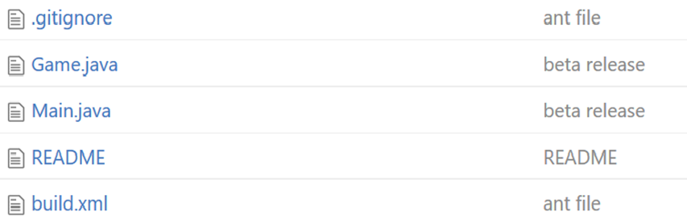

Remake of : pong

Slide 5
Changes we made
Enforcements in software design pattern (MVC)
Algorithms on the ball and paddle movements
More game features
Improvements of game view
Changes in layout of the game
Improved coding style
Test cases to ensure robustness

Slide 6
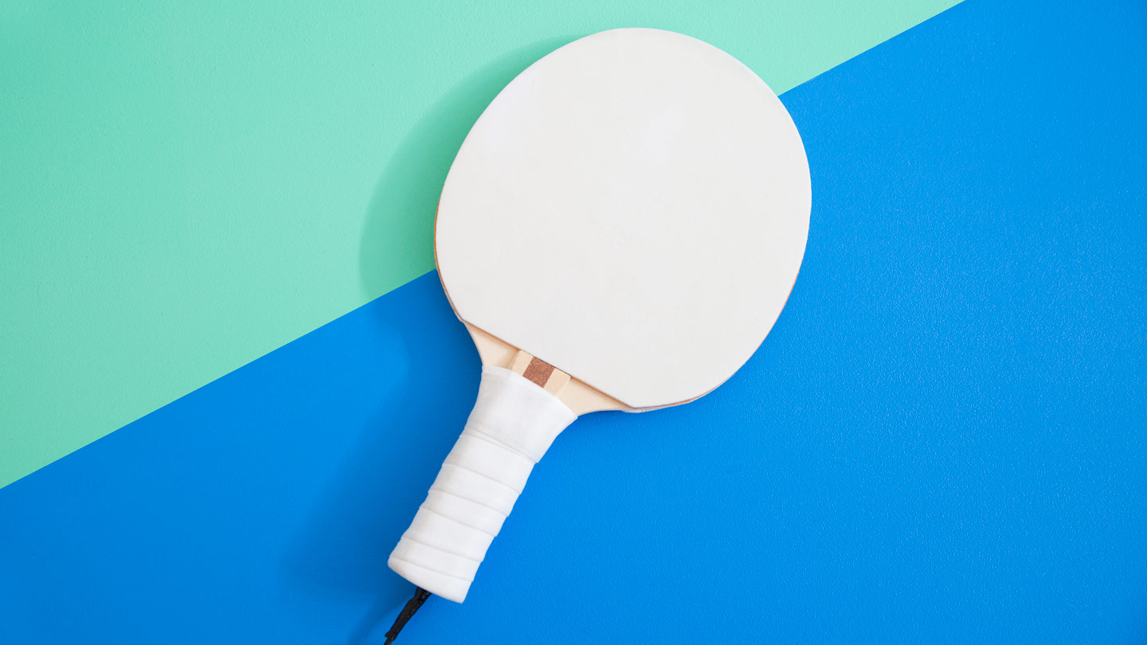
Game demo

Slide 7
USER REVIEWS/feedbacks

Slide 8
conclusion
Challenges
Multi-player game implementation
Algorithmic challenges
Test cases
Things we learnt
Documentation skills
Project management skills
Interface design
Test cases

Slide 9
Thank you!

