Slide 1
SRS – Hostel management system
Version: 1.0

Slide 2
01
Introduction

Slide 3
1.1 Purpose of HMS V-1.0
Efficient Operations
Enhanced Resident Experience
Improved Incident Management
Feedback-Driven Improvements
Financial Accountability

Slide 4


1.3 Project Scope
Inclusions:
Exclusions:
Incident Management Module
Room Allocation Module
Feedback Module
Staff Management Module
Mess Management Module
Fee Submission Module
Authentication Module
Financial Systems Integration
Advanced Analytics

Slide 5
1.4 References
Relevant Documents
01
IEEE Std 830-1998 university polocies
External References
02
DBMS, Django, Web browsers

Slide 6
02
Overall Description

Slide 7
2.1 Product perspective
Standalone software for hostel management
Components: UI, Database, Functional Modules
Subsystem Interconnections and External Interfaces

Slide 8
2.2 User classes and characteristics
Staff
Support/IT personal
University students
Administrator
System Quests

Slide 9
2.3 Operating Environment
1
2
3
Server requirements
Client Devices
University environment
Modern web browsers
Windows, Linux

Slide 10
2.4 Design & Implementation Constraints
$83
$78
Regulatory Compliance
Hardware Limitations
Database Technology
Integration with Existing Systems
Design Conventions and Programming Standards
$102
$93

Slide 11
2.5 Assumptions and Dependencies
Assumptions about third-party components, regulatory compliance, hardware stability, user availability, and development resources.
Dependencies on external system integration, web browser compatibility, university policies, and external software updates

Slide 12
03
System Features

Slide 13
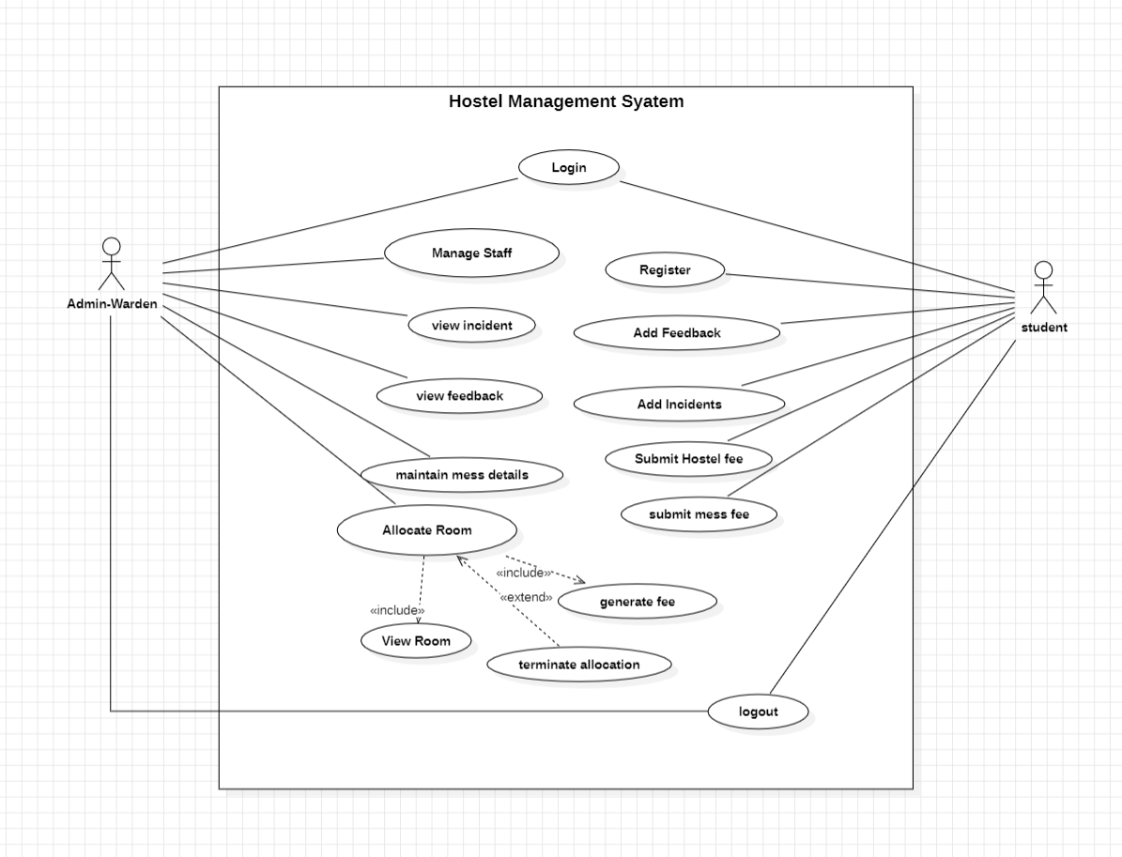
Usecase Diagram
Actors
Admin
student
Requirements Use cases
Login/logout
Register
Allocate room
Manage staff
Maintain mess
Add incident
Add feedback
Submit fee
Figure 1 Use case diagram

Slide 14
3.1 Login/Logout
Description This feature enables users to log in and out of the Hostel Management System securely.
Functional Requirements
Secure Authentication
Session Management

Slide 15
3.2 Register
Description This feature allows users to register for the Hostel Management System.
Functional Requirements
User Registration Form
Verification Process

Slide 16
3.3 Allocate Room
Description This feature manages the allocation of rooms to residents efficiently, ensuring a smooth and organized hostel living experience.
Functional Requirements
Room Availability Check
Room Allocation
Room Transfer

Slide 17
3.4 Add incident
Description This feature allows authorized users to record and track incidents that occur within the hostel. Incidents may include maintenance issues, rule violations, or any other noteworthy occurrences.
Functional Requirements
User Authentication
Incident Recording
Incident Tracking

Slide 18
3.5 Add Feedback
Description This feature enables residents to provide feedback on hostel services, contributing to continuous improvement.
Functional Requirements
User Interface
Feedback Categories
Anonymous Feedback

Slide 19
3.6 Manage Staff
Description This feature is designed for administrators to oversee and manage details and roles of hostel staff.
Functional Requirements
Staff Information
Role Assignment
Staff Performance Tracking

Slide 20
3.7 Maintain Mess
Description This feature handles the planning and maintenance of hostel mess operations, including menu planning and food quality management.
Functional Requirements
Menu Planning
Mess Attendance
Feedback Integration

Slide 21
3.8 Submit Fee
Description This feature manages the submission and tracking of fees by residents.
Functional Requirements
Fee Details
Payment Options
Late Fee Calculation

Slide 22
State Table
Current state | Event | Next state | Action
User not authenticated | Login | User authenticated | Allow user to log in
Room allocation module active | Allocate Room | Room allocated | Assign specified room to the requested user
Feedback submission page open | Add Feedback | Feedback recorded | Record user feedback and send confirmation
Staff management module active | Manage Staff | Staff details updated | Allow add, edit, or remove staff members
Mess management module active | Maintain Mess | Mess updated | Update menu, track inventory, manage payments
Fee submission module active | Submit Fee | Fee submitted | Process fee payment, update user's account
Registration page open | Register | User registered | Capture user details, create new user account
No active incident | Add Incident | Incident logged | Log incident details

Slide 23
04
Data Requirements

Slide 24
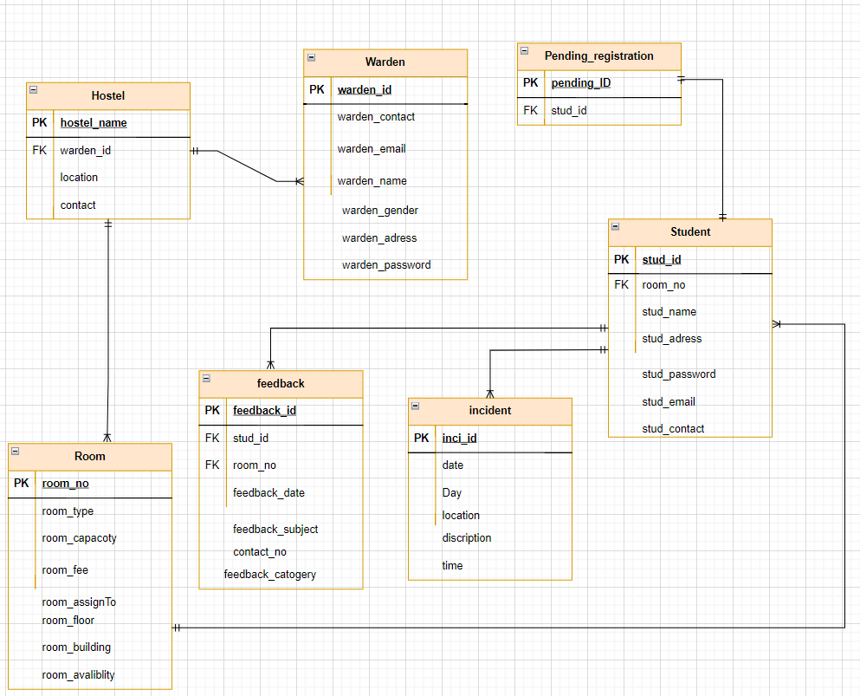
4.1 Logical Data Model
Figure 7 ER diagram

Slide 25
4.2 Reports
Overview The reporting system within the HMS provides administrators with valuable insights into hostel operations. Various reports aid in decision-making and performance assessment.
Key Reports
Occupancy Report
Incident Summary Report
Fee Submission Report
Feedback Analysis Report
Maintenance History Report

Slide 26
4.3 : Data Acquisition, Integrity, Retention, and Disposal
Data Acquisition: User Registration, Incident Recording, Room Allocation
Data Integrity: Referential Integrity, Validation Rules
Data Retention: Archiving Historical Data, Retention Policies
Data Disposal: Secure Deletion, Compliance with Regulations

Slide 27
05
External Interface Requirements

Slide 28
5.1 User Interfaces
Seamless and intuitive interfaces for administrators, staff, residents, system guests, support/IT personnel
User Classes and Interfaces:
Specific features for each user class

Slide 29
5.2 Software Interfaces
Database Management System (DBMS): Interaction for data storage
Web Browsers: Compatibility with major browsers.
Third-Party Integrations: Integration with financial systems

Slide 30
5.3 Hardware interfaces
Server Hardware: Robust server for data management
Client Devices: Access through various devices

Slide 31
5.4 Communications Interfaces
Internet Communication: Communication over the internet
Email Notifications: Important updates via email
API Integration: Potential integration with university systems
Security Protocols: Secure communication protocols

Slide 32
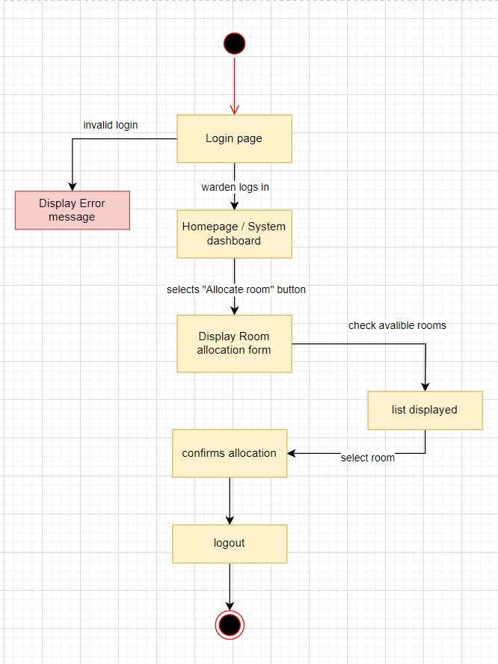

Dialogue Map
Figure 1 Dialogue Map Of ALLOCATE ROOM
Figure 1 Dialogue Map Of ADD FEEDBACK

Slide 33
06
Quality Attributes

Slide 34
Quality Attributes
Availability
Portability
Aim for 99.9% availability
Compatibility with major browsers and operating systems
Correctness
Reliability
Consistent and correct results
Minimize system failures and errors
Flexibility
Reusability
Customizable settings
Modular and well-documented code

Slide 35
Thanks!
laibabintatahir@gmail.com
arfahali@gmail.com

Slide 36
Market Segmentation
Venus
Mars
Mercury
Age
Brand Loyalty
Jupiter
Saturn
Gender
Benefits Sought
Nationality
Lifestyle
Age
User Status
Occupation
Personality
Gender
Usage Rate
Ethnicity
Interests
Nationality
Occasion
Income
Climate

Slide 37

A picture is worth a thousand words

Slide 38
AWESOME WORDS

Slide 39
Psychographic Segmentation
Saturn
Mercury
Saturn is a gas giant made of hydrogen and helium
Mercury is the smallest planet in the Solar System
Jupiter
Neptune
Jupiter is a gas giant and the biggest planet
Neptune is the farthest planet from the Sun
Venus
Mars
Venus is the second planet from the Sun
Despite being red, Mars is actually a cold place

Slide 40
Marketing Launch Plan
Venus
Saturn
Neptune
Venus has a very beautiful name
Saturn is a gas giant and has rings
Neptune is the farthest planet
Mercury
Mars
Jupiter
Mercury is the smallest planet
Despite being red, Mars is a cold place
Jupiter is a gas giant and the biggest

Slide 41
Repositioning Product
Mercury
Venus
Mercury is the closest planet to the Sun and the smallest one in the Solar System—it’s a bit larger than the Moon
Venus has a very beautiful name and is the second planet from the Sun. It’s hot and has a very poisonous atmosphere

Slide 42
Operations Plans
 | Category | Key Initiatives | Prioritization | Project Lead
 | Sales
 | Marketing
 | Operation
 | People
 | Financial

Slide 43
Business & Financial Analysis
45%
80%
65%
Mercury
Venus
Mars
Mercury is the smallest planet
Venus has a beautiful name
Despite being red, Mars is very cold

Slide 44
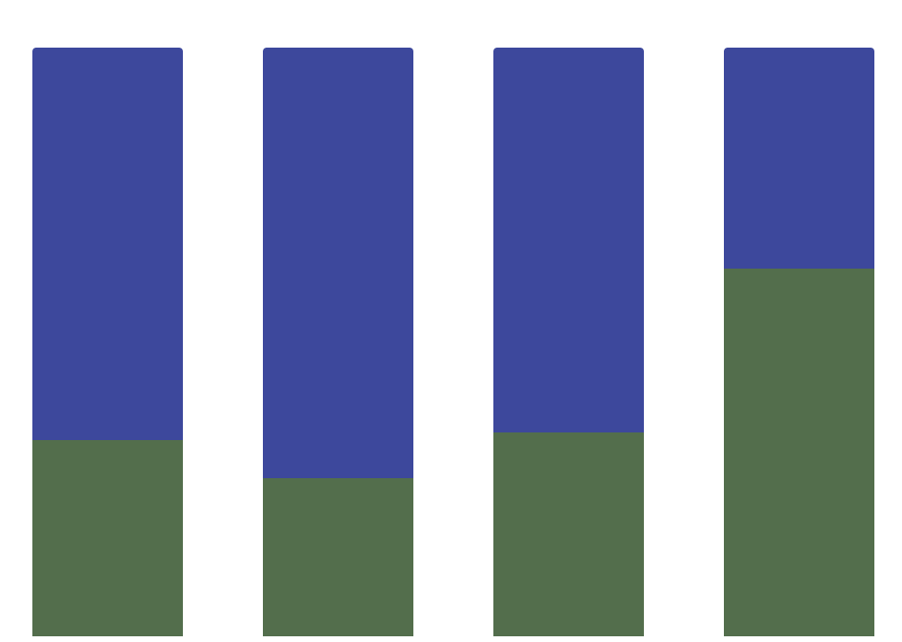
Budget
Mercury
Mercury is the closest planet to the Sun and the smallest one of them all
A
B
C
D
Jupiter
Venus has a very beautiful name and is the second planet from the Sun
Follow the link in the graph to modify its data and then paste the new one here. For more info, click here

Slide 45
Feasibility Review
Mercury
Saturn
Mercury is the smallest planet
Saturn is a gas giant and has rings
Neptune
Jupiter
Neptune is very far away from Earth
Jupiter is the biggest planet of them all
Venus
Mars
Venus has a very beautiful name
Despite being red, Mars is cold

Slide 46
Feasibility Review
Neptune
Mercury
Neptune is very far away from Earth
Mercury is the
Smallest planet
Jupiter
It’s a gas giant and the biggest planet

Slide 47

Mobile Web
You can replace the image on the screen with your own work. Just delete this one, add yours and center it properly

Slide 48
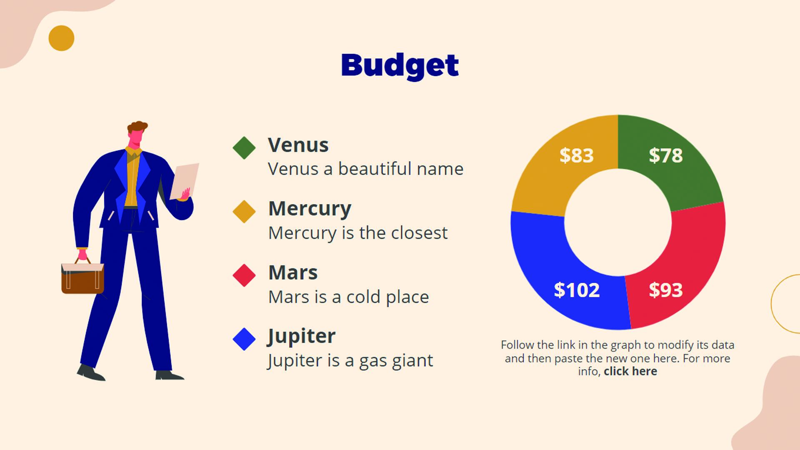
Laptop
You can replace the image on the screen with your own work. Just delete this one, add yours and center it properly

Slide 49
Setup and Settings Icon Pack

Slide 50
Alternative Resources

Slide 51
Alternative Resources

Slide 52
Alternative Resources

Slide 53
Alternative Infographic Elements

Slide 54
Use our editable graphic resources...
You can easily resize these resources without losing quality. To change the color, just ungroup the resource and click on the object you want to change. Then, click on the paint bucket and select the color you want. Group the resource again when you’re done. You can also look for more infographics on Slidesgo.

