Slide 1
SRS – Hostel management system
Version: 1.0

Slide 2
01
Introduction
Enter a subtitle here if you need it

Slide 3
Purpose of HMS V-1.0
Streamlining hostel operations. Modules:
Incident
Room Allocation
Feedback
Staff Management
Mess
Fee Submission
Authentication

Slide 4
Project Scope
Inclusions:
Exclusions:
Modules overview
No financial system integration, limited analytics

Slide 5
References
Relevant Documents
01
IEEE Std 830-1998 university polocies
External References
02
DBMS, Django, Web browsers

Slide 6
02
Overall Description
Enter a subtitle here if you need it

Slide 7
2.1 Product perspective
Standalone software for hostel management
Components: UI, Database, Functional Modules
Subsystem Interconnections and External Interfaces

Slide 8
2.2 User classes and characteristics
Staff
Support/IT personal
University students
Administrator
System Quests

Slide 9
2.3 Operating Environment
1
2
3
Server requirements
Client Devices
University environment
Modern web browsers
Windows, Linux

Slide 10
2.4 Design & Implementation Constraints
Regulatory Compliance
Hardware Limitations
Database Technology
Integration with Existing Systems
Design Conventions and Programming Standards
$83
$78
$102
$93

Slide 11
2.5 Assumptions and Dependencies
Assumptions about third-party components, regulatory compliance, hardware stability, user availability, and development resources.
Dependencies on external system integration, web browser compatibility, university policies, and external software updates

Slide 12
03
System Features
Enter a subtitle here if you need it

Slide 13
3.1 Add incident
Description This feature allows authorized users to record and track incidents that occur within the hostel. Incidents may include maintenance issues, rule violations, or any other noteworthy occurrences.
Functional Requirements
User Authentication
Incident Recording
Incident Tracking

Slide 14
3.2 Allocate Room
Description This feature manages the allocation of rooms to residents efficiently, ensuring a smooth and organized hostel living experience.
Functional Requirements
Room Availability Check
Room Allocation
Room Transfer

Slide 15
3.3 Add Feedback
Description This feature enables residents to provide feedback on hostel services, contributing to continuous improvement.
Functional Requirements
User Interface
Feedback Categories
Anonymous Feedback

Slide 16
3.4 Manage Staff
Description This feature is designed for administrators to oversee and manage details and roles of hostel staff.
Functional Requirements
Staff Information
Role Assignment
Staff Performance Tracking

Slide 17
3.5 Maintain Mess
Description This feature handles the planning and maintenance of hostel mess operations, including menu planning and food quality management.
Functional Requirements
Menu Planning
Mess Attendance
Feedback Integration

Slide 18
3.6 Submit Fee
Description This feature manages the submission and tracking of fees by residents.
Functional Requirements
Fee Details
Payment Options
Late Fee Calculation

Slide 19
3.7 Register
Description This feature allows users to register for the Hostel Management System.
Functional Requirements
User Registration Form
Verification Process

Slide 20
3.8 Login/Logout
Description This feature enables users to log in and out of the Hostel Management System securely.
Functional Requirements
Secure Authentication
Session Management

Slide 21
04
Data Requirements

Slide 22
05
External Interface Requirements

Slide 23
External Interface Requirements
User Interfaces
Hardware Interfaces
Jupiter is a gas giant and the biggest planet
Neptune is the farthest planet from the Sun
Software Interfaces
Communications Interfaces
Saturn is a gas giant made of hydrogen and helium
Despite being red, Mars is actually a cold place

Slide 24
5.1 User Interfaces
Seamless and intuitive interfaces for administrators, staff, residents, system guests, support/IT personnel
User Classes and Interfaces:
Specific features for each user class

Slide 25
5.2 Software Interfaces
Database Management System (DBMS): Interaction for data storage
Web Browsers: Compatibility with major browsers.
Third-Party Integrations: Integration with financial systems

Slide 26
5.3 Hardware interfaces
Server Hardware: Robust server for data management
Client Devices: Access through various devices

Slide 27
5.4 Communications Interfaces
Internet Communication: Communication over the internet
Email Notifications: Important updates via email
API Integration: Potential integration with university systems
Security Protocols: Secure communication protocols

Slide 28
06
Quality Attributes

Slide 29
Quality Attributes
Availability
Portability
Aim for 99.9% availability
Compatibility with major browsers and operating systems
Correctness
Reliability
Consistent and correct results
Minimize system failures and errors
Flexibility
Reusability
Customizable settings
Modular and well-documented code

Slide 30
You Have Three Columns Here
Mercury
Saturn
Jupiter
It’s the closest planet to the Sun
Saturn is a gas giant and has rings
It’s a gas giant and the biggest planet

Slide 31
Market Segmentation
Venus
Mars
Mercury
Age
Brand Loyalty
Jupiter
Saturn
Gender
Benefits Sought
Nationality
Lifestyle
Age
User Status
Occupation
Personality
Gender
Usage Rate
Ethnicity
Interests
Nationality
Occasion
Income
Climate

Slide 32
Sector News
Venus
Mars
Mercury
Venus has a beautiful name and is the second planet from the Sun
Despite being red, Mars is actually a cold place full of iron oxide dust
Mercury is the closest planet to the Sun and the smallest of them all

Slide 33
Sector News
Jupiter
Mars
Venus
Neptune
Mercury
Saturn
Jupiter is the biggest planet of them all
Despite being red, Mars is a cold place
Venus has a poisonous atmosphere
Neptune is the farthest planet from the Sun
Mercury is the smallest planet of them all
Saturn is a gas giant and has several rings

Slide 34

A picture is worth a thousand words

Slide 35

A picture is worth a thousand words

Slide 36

A picture reinforces the concept
Images reveal large amounts of data, so remember: use an image instead of a long text

Slide 37
AWESOME WORDS

Slide 38
Psychographic Segmentation
Saturn
Mercury
Saturn is a gas giant made of hydrogen and helium
Mercury is the smallest planet in the Solar System
Jupiter
Neptune
Jupiter is a gas giant and the biggest planet
Neptune is the farthest planet from the Sun
Venus
Mars
Venus is the second planet from the Sun
Despite being red, Mars is actually a cold place

Slide 39
Marketing Launch Plan
Venus
Saturn
Neptune
Venus has a very beautiful name
Saturn is a gas giant and has rings
Neptune is the farthest planet
Mercury
Mars
Jupiter
Mercury is the smallest planet
Despite being red, Mars is a cold place
Jupiter is a gas giant and the biggest

Slide 40
Marketing Communication Mix
Project Manager
Content Manager
It’s the second-brightest natural object
Despite being red, Mars is a very cold place
Publicist
Graphic Team
It’s a gas giant and the
biggest planet
Yes, this is the ringed one. It’s a gas giant

Slide 41
Repositioning Product
Mercury
Venus
Mercury is the closest planet to the Sun and the smallest one in the Solar System—it’s a bit larger than the Moon
Venus has a very beautiful name and is the second planet from the Sun. It’s hot and has a very poisonous atmosphere

Slide 42
Operations Plans
 | Category | Key Initiatives | Prioritization | Project Lead
 | Sales
 | Marketing
 | Operation
 | People
 | Financial

Slide 43
Business & Financial Analysis
Investments | Venus | Mercury | Mars | Jupiter
Equipment | $21.00 | $29.00 | $35.00 | $14.00
Land Cost | $9.00 | $6.00 | $21.00 | $17.00
Interior Cost | $13.00 | $11.00 | $10.00 | $21.00
Employee Cost | $18.00 | $14.00 | $6.00 | $27.00
Marketing Cost | $5.00 | $3.00 | $12.00 | $15.00
Other Cost | $12.00 | $20.00 | $9.00 | $8.00
Total | $78.00 | $83.00 | $93.00 | $102.00

Slide 44
Business & Financial Analysis
45%
80%
65%
Mercury
Venus
Mars
Mercury is the smallest planet
Venus has a beautiful name
Despite being red, Mars is very cold

Slide 45
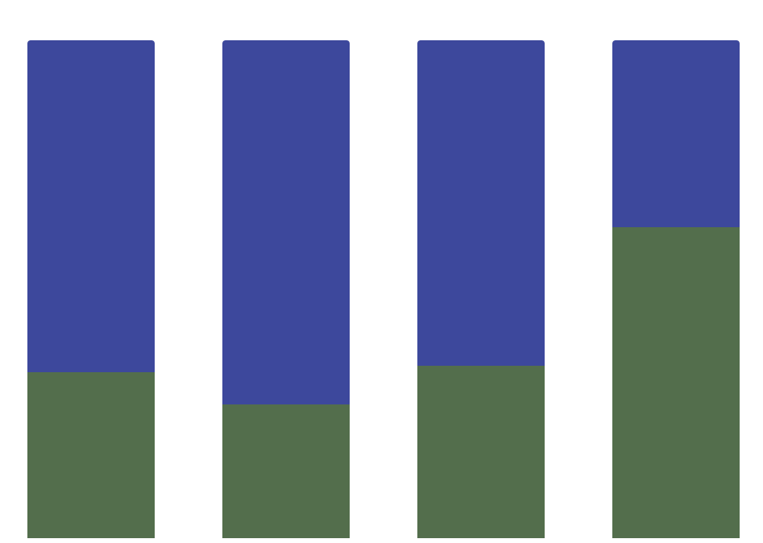
Budget
Mercury
Mercury is the closest planet to the Sun and the smallest one of them all
A
B
C
D
Jupiter
Venus has a very beautiful name and is the second planet from the Sun
Follow the link in the graph to modify its data and then paste the new one here. For more info, click here

Slide 46
Feasibility Review
Mercury
Saturn
Mercury is the smallest planet
Saturn is a gas giant and has rings
Neptune
Jupiter
Neptune is very far away from Earth
Jupiter is the biggest planet of them all
Venus
Mars
Venus has a very beautiful name
Despite being red, Mars is cold

Slide 47
Feasibility Review
Neptune
Mercury
Neptune is very far away from Earth
Mercury is the
Smallest planet
Jupiter
It’s a gas giant and the biggest planet

Slide 48
Launch Monitoring Dashboard
Project
Priority
Status
It’s the only one that harbors life
High
In Progress
It’s a gas giant and has several rings
Low
Completed
It’s a gas giant and the biggest planet
Normal
Not Started
It’s the fourth-largest planet of them all
High
Done

Slide 49
Launch Monitoring Dashboard
Structure
Systems
Mars is the fourth planet from the Sun
It is the fourth-largest planet by diameter
25%
80%
Low
In progress
High
Completed

Slide 50

External Interface Requirements
Internet Communication: Communication over the internet
Email Notifications: Important updates via email
API Integration: Potential integration with university systems
Security Protocols: Secure communication protocols

Slide 51
Tablet App
You can replace the image on the screen with your own work. Just delete this one, add yours and center it properly

Slide 52
Mobile Web
You can replace the image on the screen with your own work. Just delete this one, add yours and center it properly

Slide 53
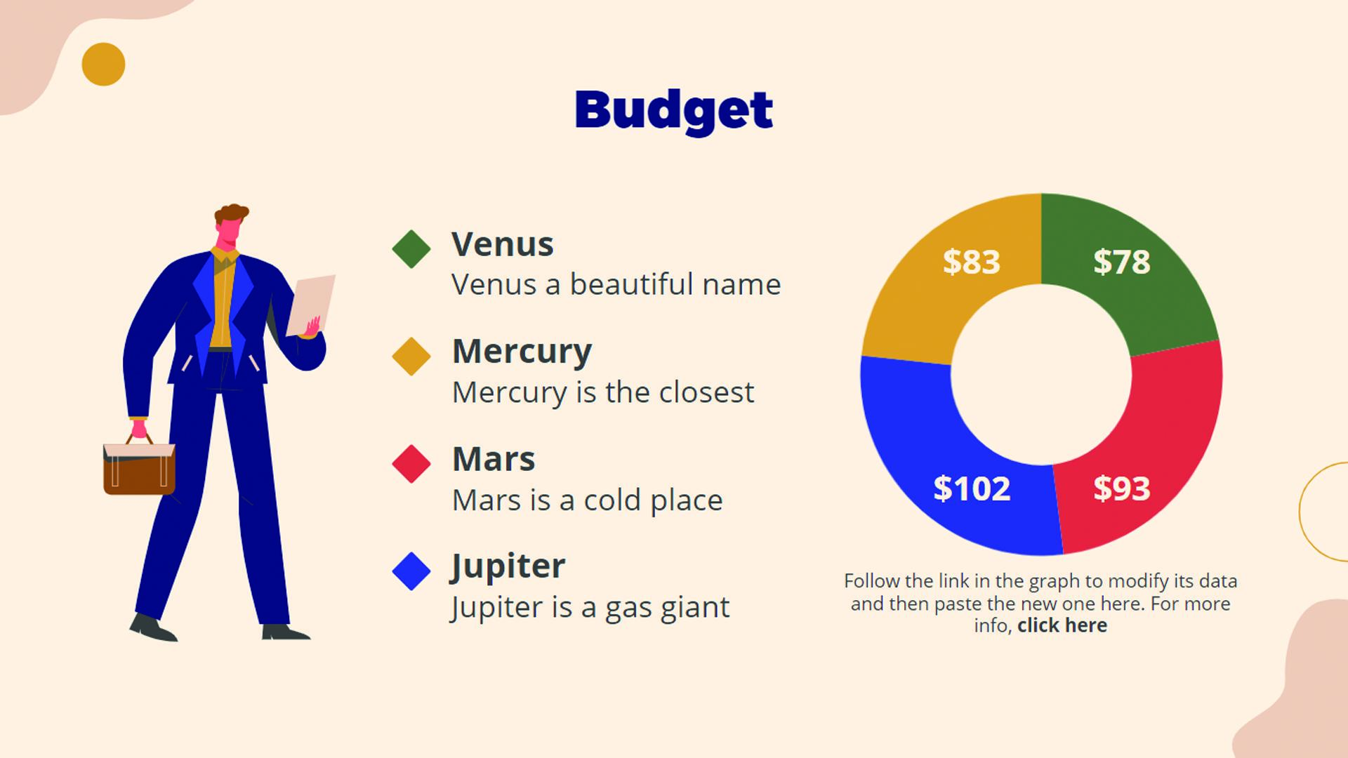
Laptop
You can replace the image on the screen with your own work. Just delete this one, add yours and center it properly

Slide 54
Thanks!
laibabintatahir@gmail.com
arfahali@gmail.com

Slide 55
Setup and Settings Icon Pack

Slide 56
Alternative Resources

Slide 57
Alternative Resources

Slide 58
Alternative Resources

Slide 59
Alternative Infographic Elements

Slide 60
Alternative Resources
Photos
Multiracial employees shaking hands in office
Colleagues in contemporary office coworking
African american man sitting copy space
Colleagues in contemporary office coworking
Smiling young businessman and businesswoman giving high five in front of corporate building
Man looking at watch and talking on phone on his way to work

Slide 61
Resources
Vectors
Business infographic design
Business infographic template with puzzle
Businesswomen and businessmen with devices
Businesswomen and businessmen working
Copyright landing page template
Round infographic of human brain
People with technology devices
Photos
Event manager showing laptop to happy woman
Group of three modern architects

Slide 62
Use our editable graphic resources...
You can easily resize these resources without losing quality. To change the color, just ungroup the resource and click on the object you want to change. Then, click on the paint bucket and select the color you want. Group the resource again when you’re done. You can also look for more infographics on Slidesgo.

