Slide 1
SRS – Hostel management system
Version: 1.0

Slide 2
01
Introduction

Slide 3
1.1 Purpose of HMS V-1.0
Efficient Operations
Enhanced Resident Experience
Improved Incident Management
Feedback-Driven Improvements
Financial Accountability

Slide 4
1.2 Vision of HMS
1.3 Mission of HMS
“Transforming hostel living into a seamless and secure experience at the heart of university life.”
"Simplify hostel management for everyone - administrators, staff, and residents - to create a hassle-free and enjoyable living environment."

Slide 5


1.3 Project Scope
Inclusions:
Exclusions:
Incident Management Module
Room Allocation Module
Feedback Module
Staff Management Module
Mess Management Module
Fee Submission Module
Authentication Module
Financial systems integration
Advanced analytics

Slide 6
1.4 References
Relevant Documents
01
IEEE Std 830-1998 university polocies
External References
02
DBMS, Django, Web browsers

Slide 7
02
Overall Description

Slide 8
2.1 Product perspective
Standalone software for hostel management
Components: UI, Database, Functional Modules
External Interfaces

Slide 9
2.2 User classes and characteristics
Staff
System Quests
Administrator
University students

Slide 10
2.3 Operating Environment
1
2
3
Server requirements
Client Devices
University environment
Modern web browsers
Windows, Linux

Slide 11
2.4 Design & Implementation Constraints
$83
$78
Regulatory Compliance
Hardware Limitations
Integration with Existing Systems
Design Conventions and Programming Standards
$102
$93

Slide 12
2.5 Assumptions and Dependencies
Assumptions about third-party components, hardware stability, user availability, and development resources.
Dependencies on external system integration, web browser compatibility, university policies, and external software updates

Slide 13
03
System Features

Slide 14
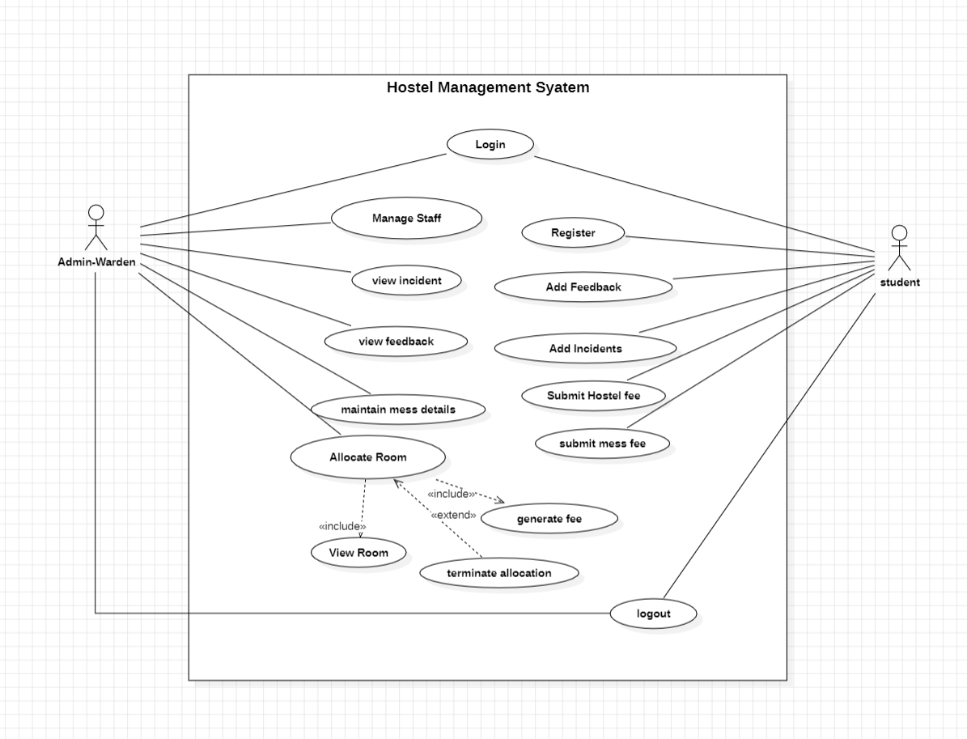
Usecase Diagram
Actors
Admin
student
Requirements Use cases
Login/logout
Register
Allocate room
Manage staff
Maintain mess
Add incident
Add feedback
Submit fee
Figure 1 Use case diagram

Slide 15
3.1 Login/Logout
Description This feature enables users to log in and out of the Hostel Management System securely.
Functional Requirements
Secure Authentication
Session Management

Slide 16
3.2 Register
Description This feature allows users to register for the Hostel Management System.
Functional Requirements
User Registration Form
Verification Process

Slide 17
3.3 Allocate Room
Description This feature manages the allocation of rooms to residents efficiently, ensuring a smooth and organized hostel living experience.
Functional Requirements
Room Availability Check
Room Allocation
Room Transfer

Slide 18
3.4 Maintain Mess
Description This feature handles the planning and maintenance of hostel mess operations, including menu planning and food quality management.
Functional Requirements
Menu Planning
Mess Attendance
Feedback Integration

Slide 19
3.5 Manage Staff
Description This feature is designed for administrators to oversee and manage details and roles of hostel staff.
Functional Requirements
Staff Information
Role Assignment
Staff Performance Tracking

Slide 20
3.6 Add incident
Description This feature allows authorized users to record and track incidents that occur within the hostel. Incidents may include maintenance issues, rule violations, or any other noteworthy occurrences.
Functional Requirements
User Authentication
Incident Recording
Incident Tracking

Slide 21
3.7 Add Feedback
Description This feature enables residents to provide feedback on hostel services, contributing to continuous improvement.
Functional Requirements
User Interface
Feedback Categories
Anonymous Feedback

Slide 22
3.8 Submit Fee
Description This feature manages the submission and tracking of fees by residents.
Functional Requirements
Fee Details
Payment Options
Late Fee Calculation

Slide 23
State Table
Current state | Event | Next state | Action
User not authenticated | Login | User authenticated | Allow user to log in
Room allocation module active | Allocate Room | Room allocated | Assign specified room to the requested user
Feedback submission page open | Add Feedback | Feedback recorded | Record user feedback and send confirmation
Staff management module active | Manage Staff | Staff details updated | Allow add, edit, or remove staff members
Mess management module active | Maintain Mess | Mess updated | Update menu, track inventory, manage payments
Fee submission module active | Submit Fee | Fee submitted | Process fee payment, update user's account
Registration page open | Register | User registered | Capture user details, create new user account
No active incident | Add Incident | Incident logged | Log incident details

Slide 24
04
Data Requirements

Slide 25
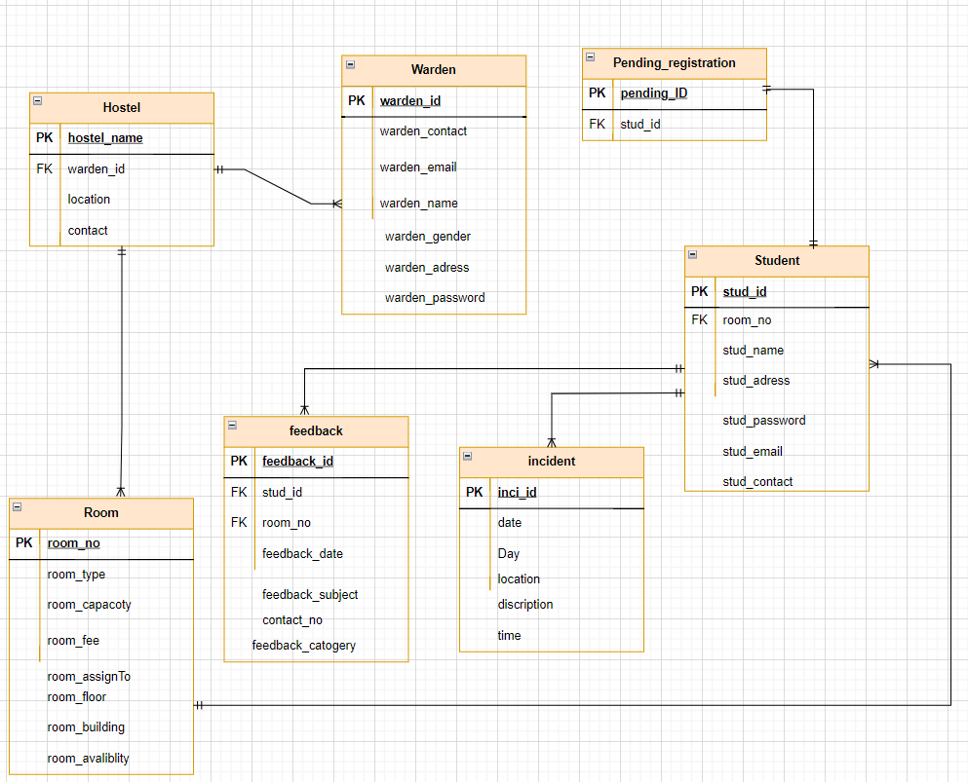
4.1 Logical Data Model
Entities
Hostel
Warden
Student
Room
Feedback
Incident
Pending Registration
Figure 7 ER diagram

Slide 26
4.2 Reports
Overview The reporting system within the HMS provides administrators with valuable insights into hostel operations. Various reports aid in decision-making and performance assessment.
Key Reports
Occupancy Report
Incident Summary Report
Fee Submission Report
Feedback Analysis Report
Maintenance History Report

Slide 27
4.3 : Data Acquisition, Integrity, Retention, and Disposal
Data Acquisition: User Registration, Incident Recording, Room Allocation
Data Integrity: Referential Integrity, Validation Rules
Data Retention: Archiving Historical Data, Retention Policies
Data Disposal: Secure Deletion, Compliance with Regulations

Slide 28
05
External Interface Requirements

Slide 29
5.1 User Interfaces
Seamless and intuitive interfaces for administrators, residents, system guests, support/IT personnel
User Classes and Interfaces:
Specific features for each user class

Slide 30
5.2 Software/Hardware Interfaces
Database Management System (DBMS)
Web Browser
Third-Party Integrations
Server Hardware: centralized server for data management
Client Devices: Access through various devices

Slide 31
5.4 Communications Interfaces
Internet Communication: Communication over the internet
Email Notifications: Important updates via email
API Integration: Potential integration with university systems
Security Protocols: Secure communication protocols

Slide 32
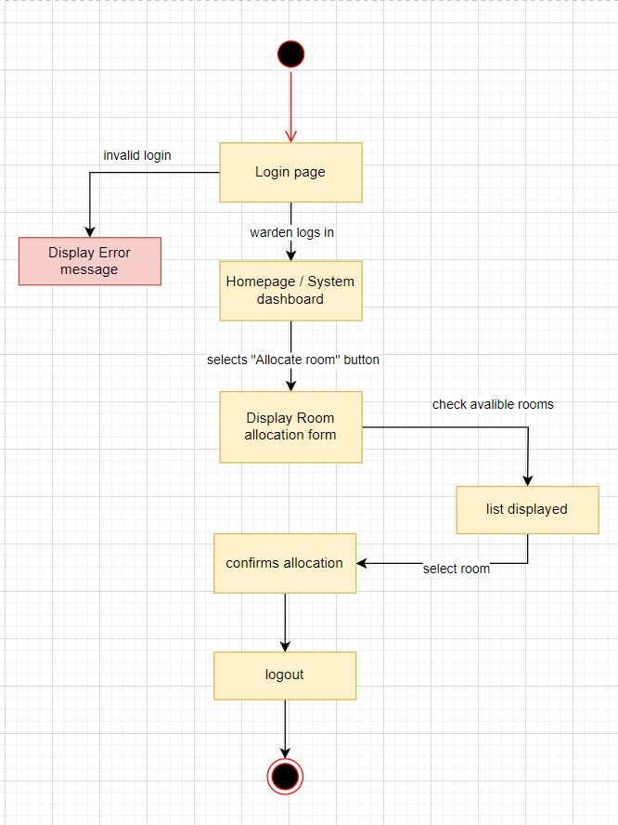

Dialogue Map
Figure 1 Dialogue Map Of ALLOCATE ROOM
Figure 1 Dialogue Map Of ADD FEEDBACK

Slide 33
06
Quality Attributes

Slide 34
Quality Attributes
Availability
Portability
Aim for 99.9% availability
Compatibility with major browsers and operating systems
Correctness
Reliability
Consistent and correct results
Minimize system failures and errors
Flexibility
Reusability
Customizable settings
Modular and well-documented code

Slide 35
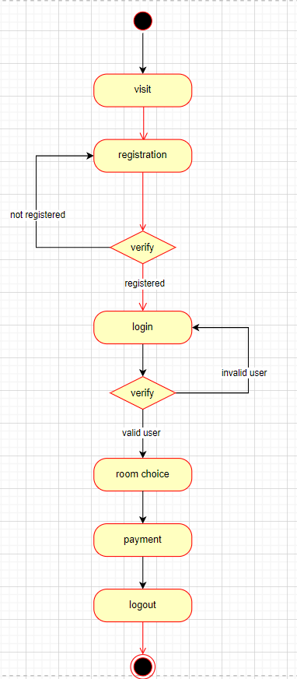
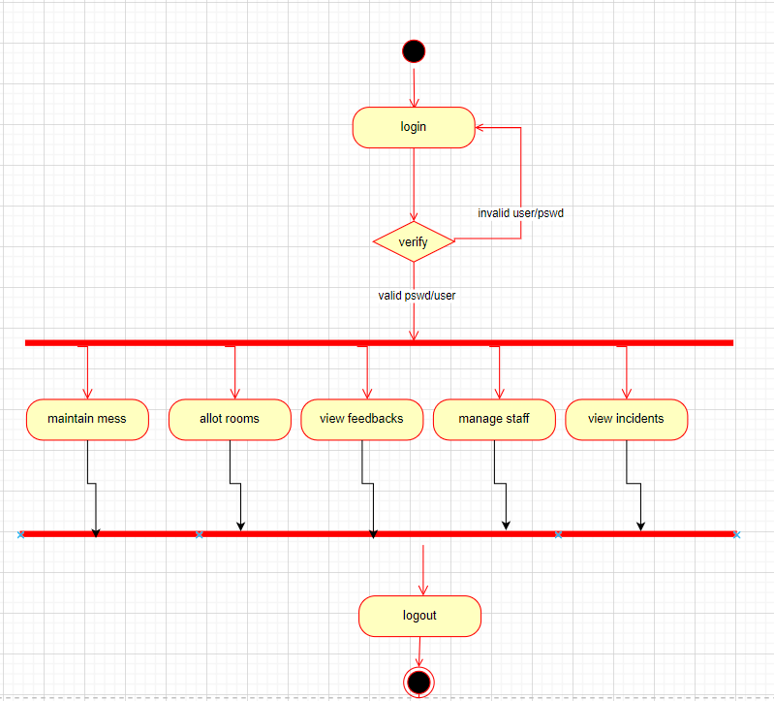
Activity Diagram
Figure 1 Activity diagram - student activity
Figure 2 Activity diagram - admin activities

Slide 36
Thanks!
laibabintatahir@gmail.com
arfahaliqureshi@gmail.com

