Slide 1

Total Wellness
By Ashley Fellows

Slide 2
Mission statement
Total Wellness is designed to create a lifelong transformation. It provides a community that gives support and that shares tips and experiences to help you along your health journey.

Slide 3
Why did I create a health app?

Slide 4
Planning & Organization
https://trello.com/b/T5zbgoQy/total-wellness
Total_Wellness_Planning (Repaired).docx

Slide 5
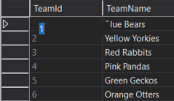
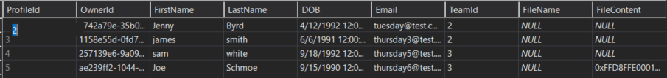
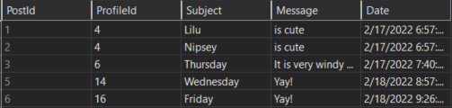
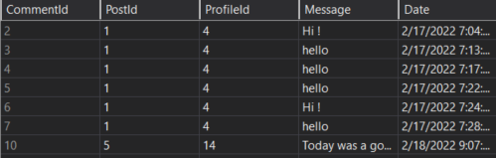






Database tables
ONE TO MANY
ONE TO MANY
ONE TO MANY
ONE TO MANY

Slide 6
Endpoints
Totalwellness/profile/create
Totalwellness/post/index
Totalwellness/comment/details/{id}

Slide 7
Version 2.0
Implement direct messaging between users
More styling
Create a role for coach
Coach can remove members or edit team name

Slide 8
portfolio
I am proud of…
My portfolio overall – first draft was very bare and had no bootstrap at all / did not look professional
Version 2.0…
More styling

Slide 9
Ending…
Take away…
This is not easy!! But I am very proud of myself for sticking with it… ask questions & network!
Goal after graduation…
Expand my knowledge more and…. Get a job!

