Slide 1
Travel agent
CAPSTONE PROJECT
Presented By:
Student name :Shaik. Arfiya Anjum
College Name & Department : Madanapalle Institute of technology And Science ,Computer Science & Engineering

Slide 2
OUTLINE
Problem Statement
Technology used
Wow factor
End users
Result
Conclusion
Git-hub Link
Future scope
IBM Certifications

Slide 3
Problem Statement
Faculty members and accreditation coordinates often face difficulties in preparing for NBA accreditation due to the large volume of data, documentation , compliance requirements ,and continuous updates. Manually gathering and mapping Course Outcomes(Cos),Program Outcomes(POs), assessments, and evidence is time-consuming and error-prone.

Slide 4
Technology used
IBM cloud lite services
Natural Language Processing (NLP)
Retrieval Augmented Generation (RAG)
IBM Granite Foundation model

Slide 5
IBM cloud services used
IBM Cloud Watsonx AI Studio
IBM Cloud Watsonx AI runtime
IBM Cloud Agent Lab
IBM Granite Foundation model

Slide 6
Wow factors
Significantly reduces manual effort in accreditation preparation.
Generates draft NBA SAR (Self Assessment Report) components.
Supports mapping of CO-PO-PIs with visualization.
Identifies missing evidence or weak areas in criteria.
Uses semantic search to retrieve previous accreditation documents.
Helps maintain continuous quality improvement documentation

Slide 7
End users
Faculty and Accreditation Coordinators
NBA Committees
College Management
Department Heads

Slide 8
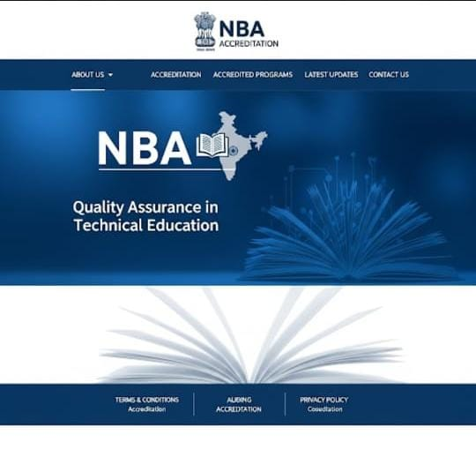
Results

Slide 9
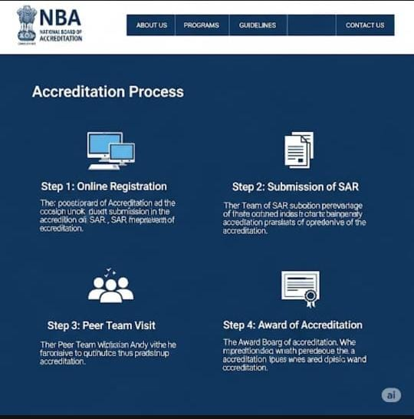
Results

Slide 10
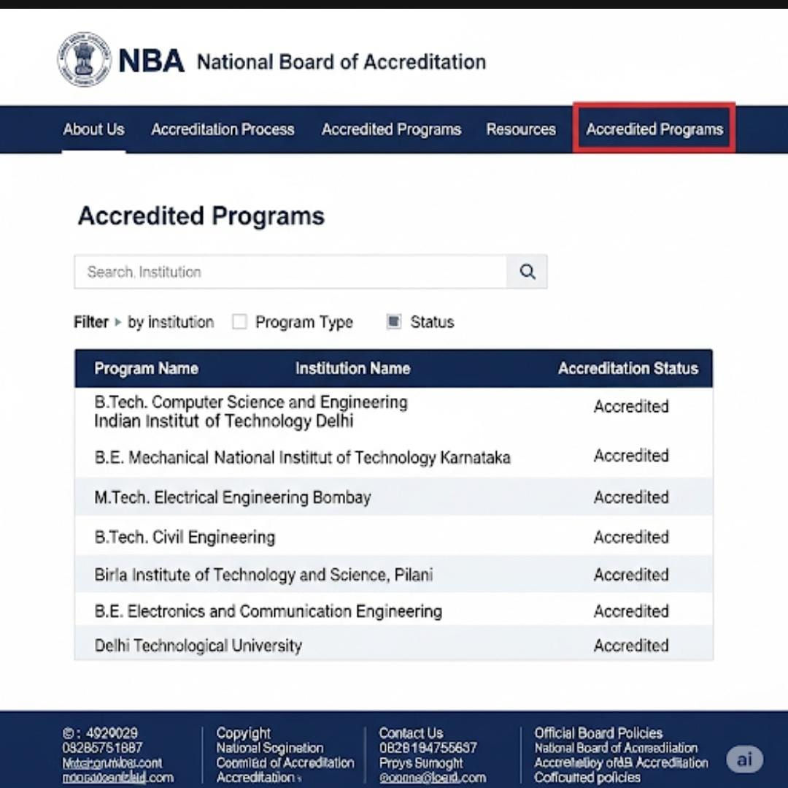
Results

Slide 11
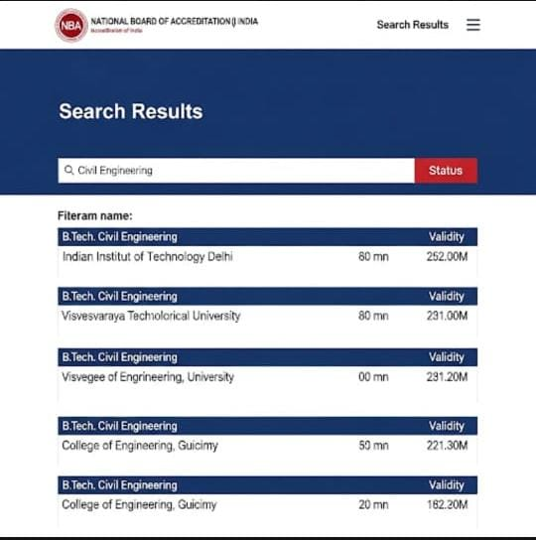
Results
Deployed AI Agent

Slide 12
Conclusion
The AI agent reduces administrative burden for NBA documentation.
Promotes continuous improvement through analytics and insights.
Increases accuracy in report preparation.
Enhances overall readiness for audits and visits

Slide 13
Future scope
Multilingual support for vernacular institutions
Voice-based assistant for faculty queries
Real-Time Collaboration Features
Integration with ERP systems or LMS platforms
Auto-checking for NBA compliance gaps
Continuous improvement suggestion engine

Slide 14
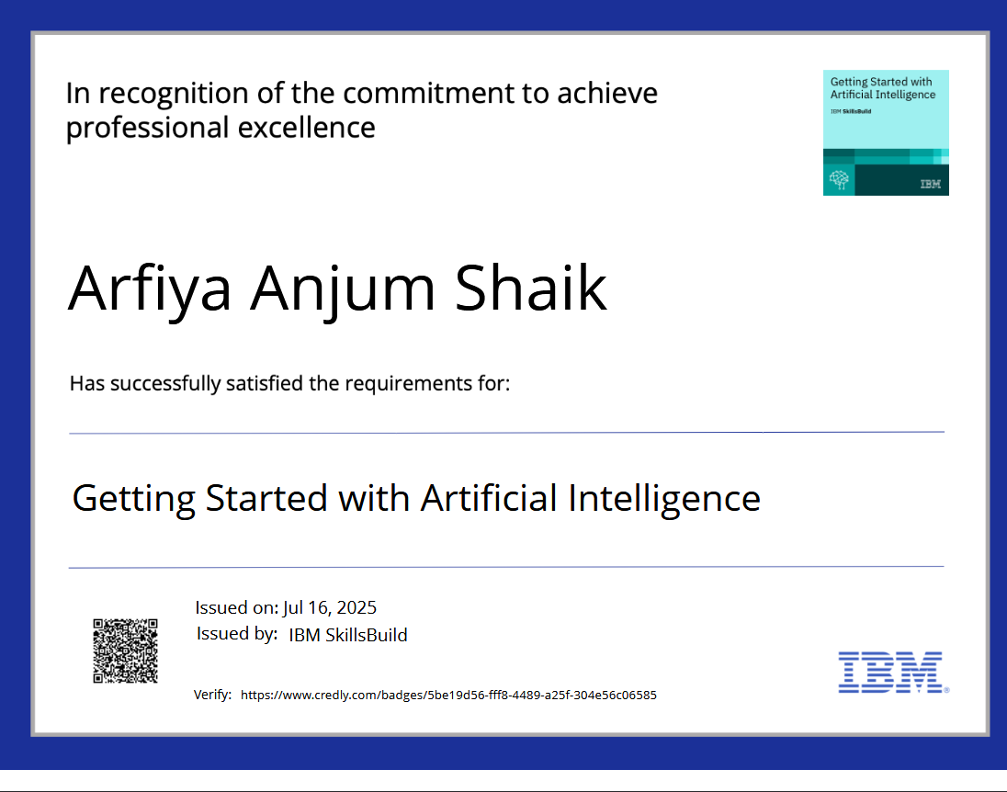
IBM Certifications

Slide 15
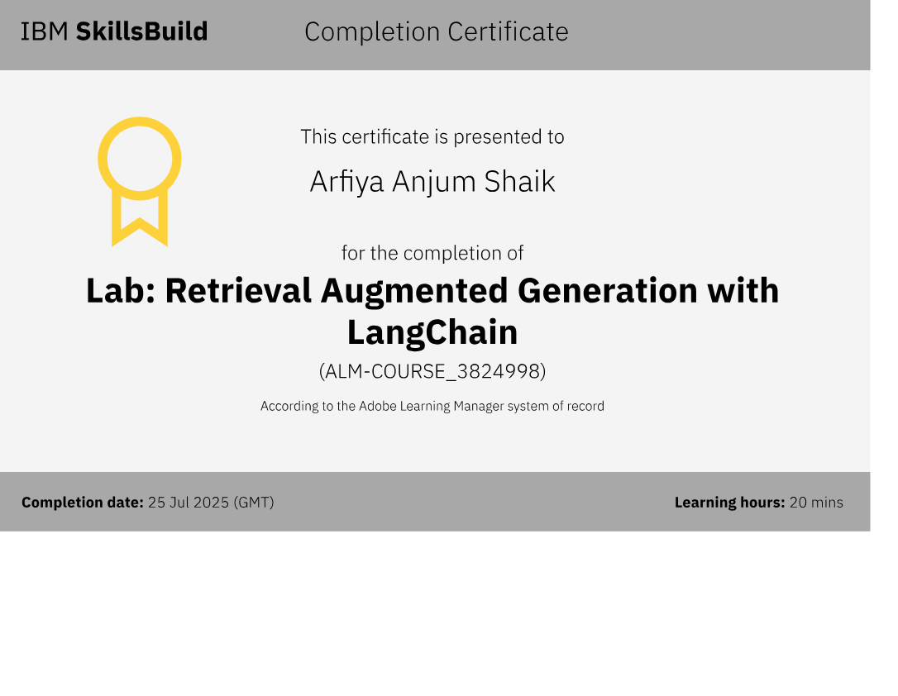

Slide 16
Git hub link : https://github.com/ArfiyaAnjum07

Slide 17
GitHub Link
Make sure that there should be readme file

Slide 18
THANK YOU

