Slide 1
Juice Inc.

Slide 2



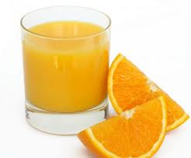
Summary
Recommendations
Motivation
The company wants to launch a new product. For this management wants
to find out how do social life, wealth and healthy life style influence the
amount of juice that people drink
Data
Analysys
Conclusions
Common cense
analisys
LPM model
Logit model
Probit model
Based on models
results make
a conclusion
if different factors
influence
how much people
drink juice
2

Slide 3
Summary
Recommendations
Motivation
Judging by regression outputs, it is good advice to target well-off people, and
at the same time emphasize the role of healthy lifestyle in marketing campaign.
max
Mean
0
Significance
Company should collaborate with some large fitness centers.
3

Slide 4
Summary
Recommendations
Motivation
Our approach was to first analyze descriptive statistics and then analyze the results of a probit, logit and LPM model
1
Make our distribution closer to normal probability distribution
ln(income)
2
Devide people by income into 3 groups
“poor”
“rich”
500
1000
2
Analyze different models and make a conclusion
LPM
Logit
Probit
Eventually, the more a person earns and exercises, the more he or she is likely to be buying juice
Insignificant
—
—
0.103
0.184
0.241
0.193
0.197
0.198
4

Slide 5
Thank you

