Slide 1

ANALYSING WEBTRAFFIC

Slide 2
Case summary
WHAT DRIVES THE VISITORS TO OUR WEBSITE…
1
Available data
2
Questions asked
5000 Sources
Source Visitors
My Visitors
Ad Intensity
Theme
News
Sports
General
0..5
What drives the visitors to your website?
How can you optimize the visibility of your website?

Slide 3
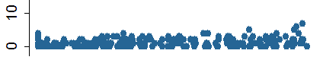
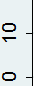
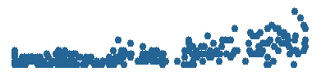
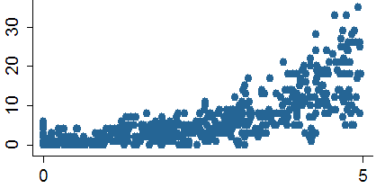
DATA RESUME
1
Dependent variable – number of visitors
2
General
News
My visitors
Sports
Ad intensity
Comments:
Poisson-ish distribution of number of clients, but with small overdispersion => maybe Neg-Binomial model is better;
Different effect of advertisement on different site themes => Interaction terms

Slide 4
Suggestion
ADVERTISE ON SPORTS SITES!
What drives the visitors to your website?
How can you optimize the visibility of your website?
Theme
Focus your advertisement campaign on sports sites
Advertisement
More visitors come from sports sites rather than from general theme sites and news sites
Sports’ sites audience is more responsive to our advertisement
0.16 / 0.38 / 0.73 for general / news / sports ad-intensity response
Conversion is also higher: 3.0, 2.9, 4.7
E(myvisitors|theme) = {0.77, 0.75, 1.22}

