Slide 1

Οικονομικο πανεπιστημιο αθηνων MSC BUSINESS ANALYTICS
BUSINESS ANALYTICS PRACTICUM 2
PROJECT 1
Argyrios Taklakoglou Chidiroglou, f2822114

Slide 2
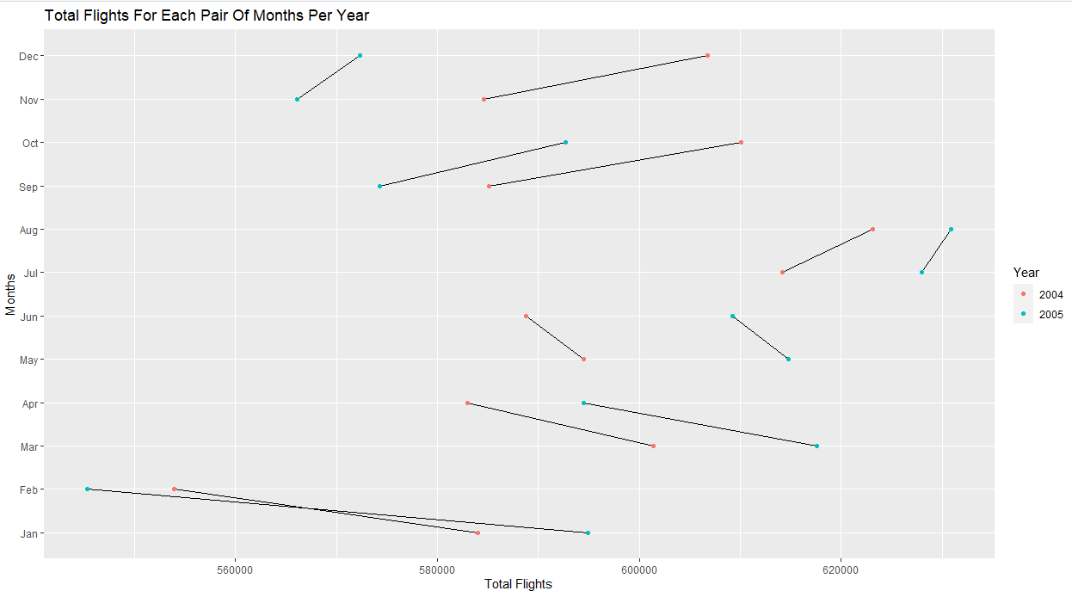
Total Flights For Each Pair Of Months Per Year
From the above graph we observe that the biggest reduction in total flights from one month to the next one was between January and February of 2005. We also observe big reduction between January and February of 2004, between April and March of 2005. We observe an increase in total flights between September and October of 2004 , between November and December of 2004.

Slide 3
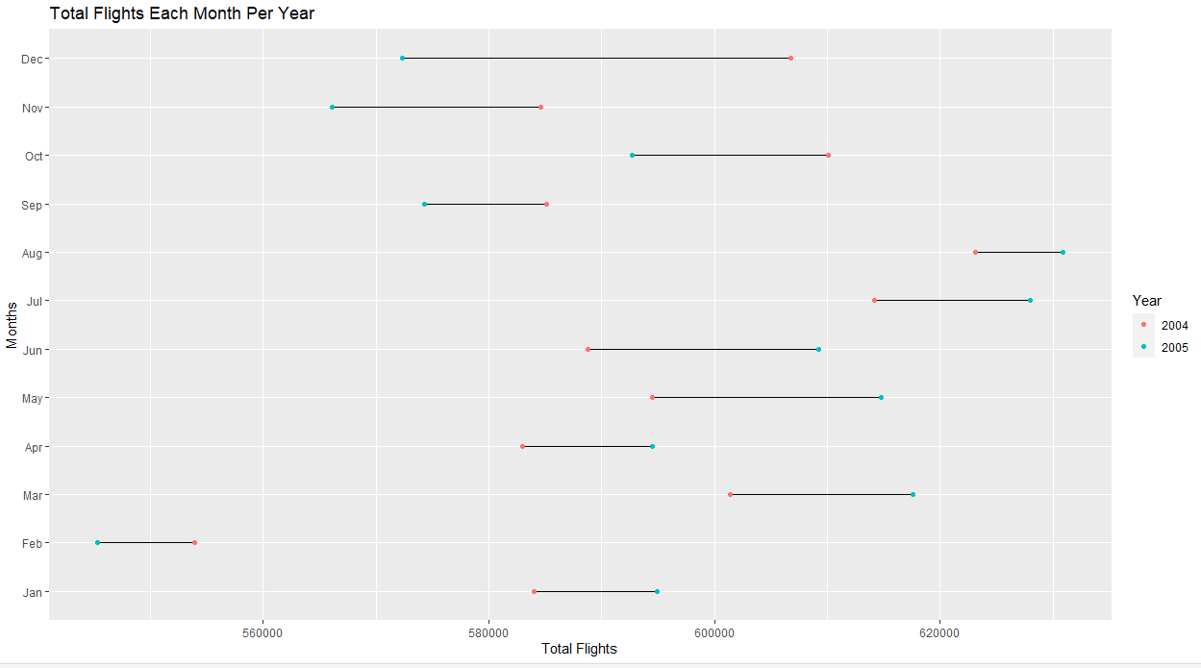
Total Flights from and to each Airport
From the above graph we notice that the summer months of 2004 and of 2005 took place more flights in comparison to all the other months of the year. For example, we notice that in August of 2005 the total flights were more than 630.000 and in July of the same year the total flights were more than 625.000. In addition, in February took place less than 555.000 flights. Finally, we observe big change in total flights between 2004 and 2005 in December, June and May.

Slide 4
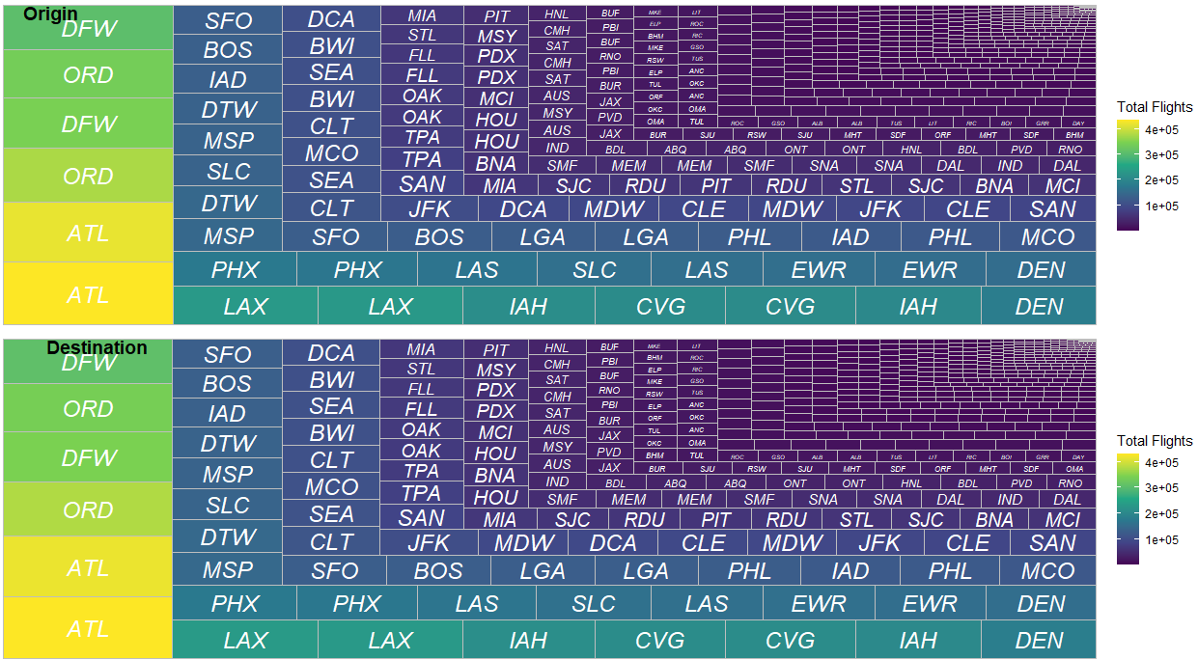
Total Flights from and to each Airport
From the above graph we observe that the airports in which came and went, the majority of flights of 2004 and 2005, were the Atlanta airport (ATL) , the Chicago O'Hare Airport (ORD) and the Dallas Fort Worth Airport (DFW).

Slide 5
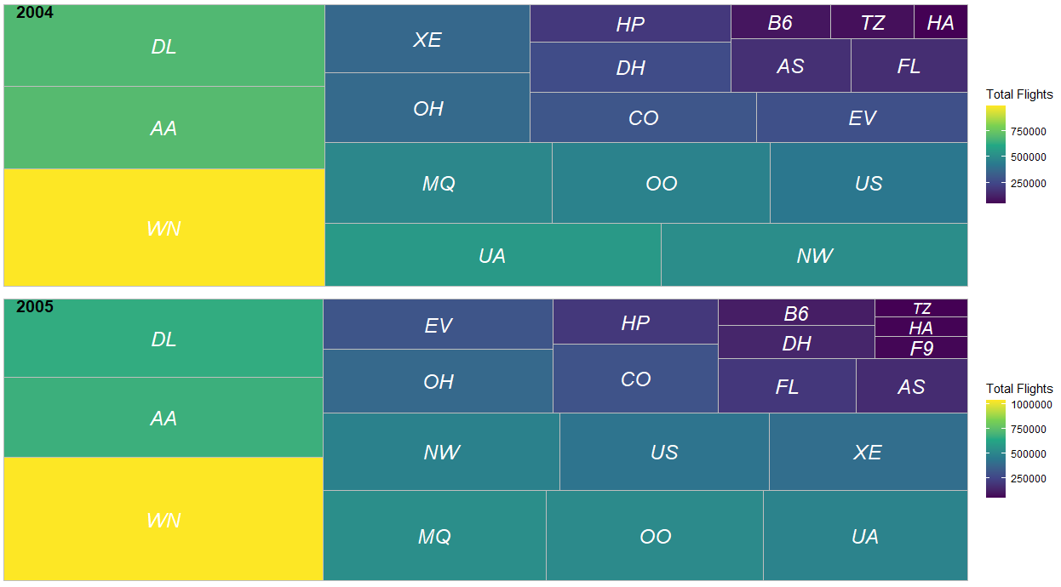
Total Flights for each Airline per Year
From the above graph we conclude that the SouthWest Airline (WN) was the airline with most flights in 2004 and in 2005. The 2nd airline with most flights was American Airlines (AA) and the 3rd was Delta Air Lines (DL). We also notice that the total flights for SouthWest Airline increased in 2005 while the total flights for American Airlines and Delta Air Lines decreased in 2005 in comparison to 2004.

Slide 6
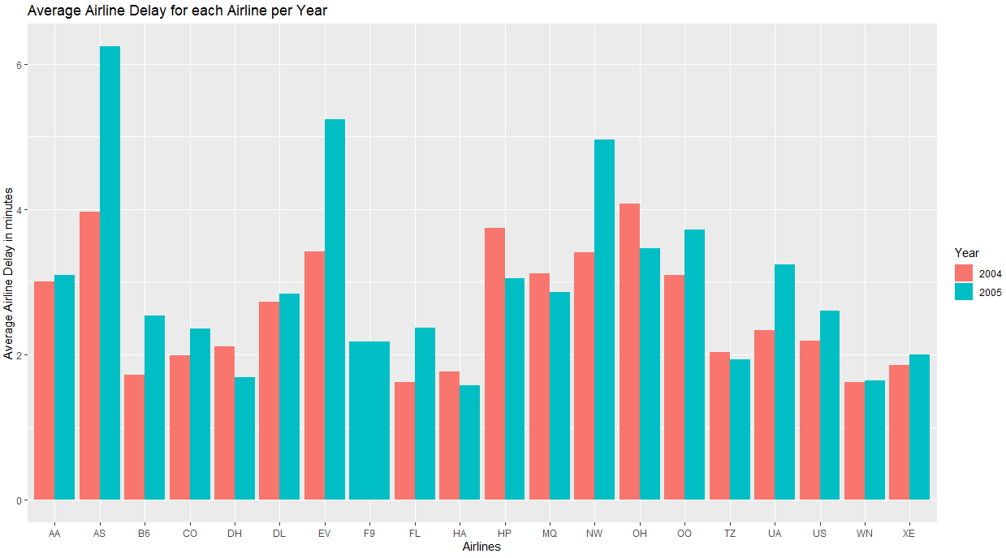
Average Airline Delay for each Airline per Year
From the above graph we observe that the longest average delay due to the airline was in 2005 from Alaska Airlines (AS) with 6,2 minutes delay per flight, followed by ExpressJet (EV) with 5,1 minutes delay per flight and Northwest Airlines (NW) with 5 minutes delay per flight.

Slide 7
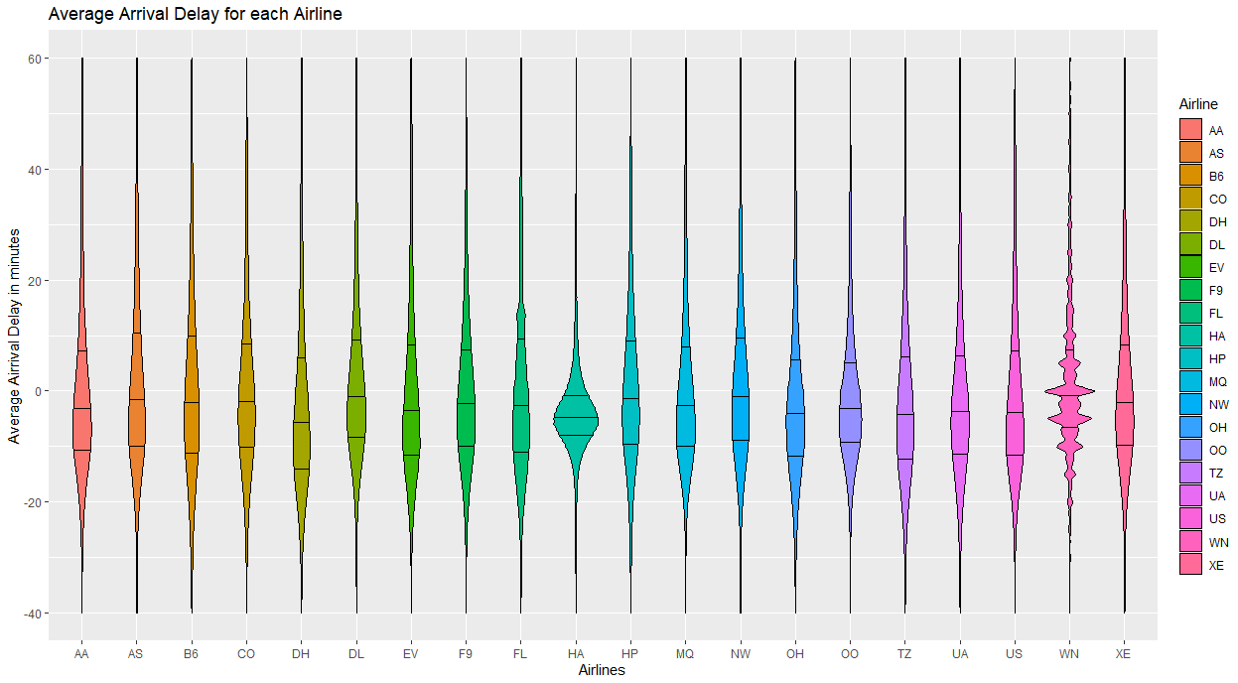
Average Arrival Delay for each Airline
From the above graph we observe that the Airline with the least average minutes of arrival delay per flight in 2004 and in 2005 was Hello Airline (HA) because 50% of the flights arrived at their destination 1 to 9 minutes before the scheduled time. Besides, 45% of the flights arrived 10 or more minutes before the scheduled time or 1 to 10 minutes after the scheduled time. Also, 50% of the flights of Atlantic Coast Airline (DH) in 2004 and 2005 arrived up to 13 minutes before the scheduled time or up to 8 minutes after the scheduled time.

Slide 8
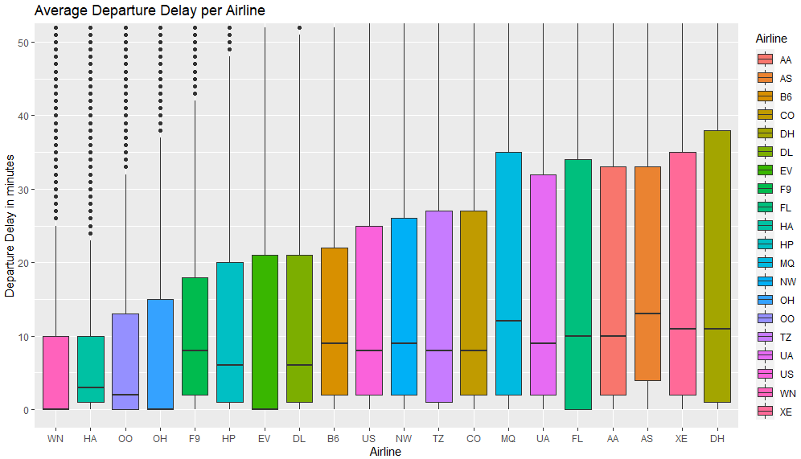
Average Departure Delay per Airline
From the above graph we observe that SouthWest Airlines (WN), Hawaiian Airlines (HA), SkyWest Airlines (OO), PSA Airlines (OH), are the 4 airlines with the least average departure delay because the median value for the first one is at 0 minutes and the 50% of the flights had delay between 0 and 10 minutes, the median value of the second is at 2.5 minutes and the 50% of the flights had delay between 1 and 10 minutes, the median value of the third is at 2 minutes and the 50% of the flights had delay between 0 and 13 minutes, the median value for the fourth is at 0 minutes and the 50% of the flights had delay between 0 and 15 minutes

Slide 9
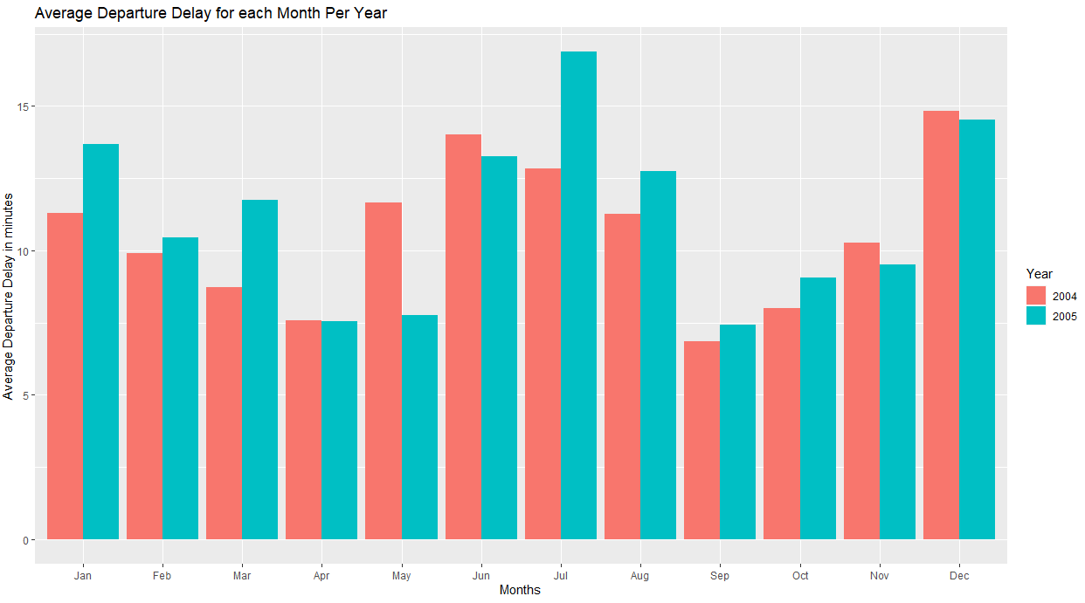
Average Departure Delay per Month
From the above graph we observe that the greatest average departure delay was in July of 2005. There were a noticeable increase in average departure delay in July of 2004 and of 2005. Also, in months December and June the average departure delay was also high regardless the year.

Slide 10
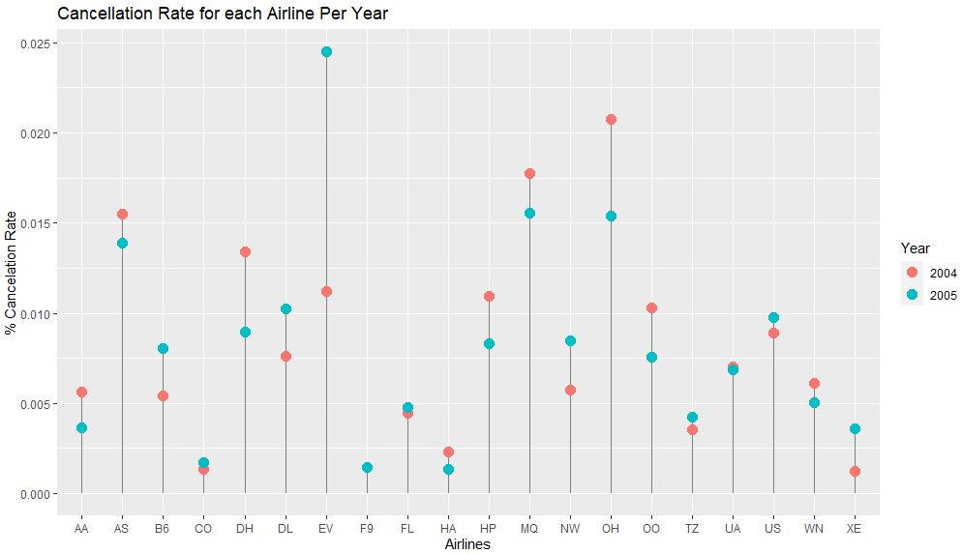
Cancellation Rate per Airline per Year
From the above graph we observe that the airline with the smallest % of cancellation rate is Continental Airlines (CO) with rate smaller than 0.0025% along with Frontier Flight (F9) which has a rate smaller than 0.0025% and Hawaiian Airlines (HA) which has a rate smaller than 0.003%. We also notice that ExpressJet (EV) had a noticeable increase in the % of cancellation rate from 2004 (0.012%) to 2005 (0.024%)

Slide 11
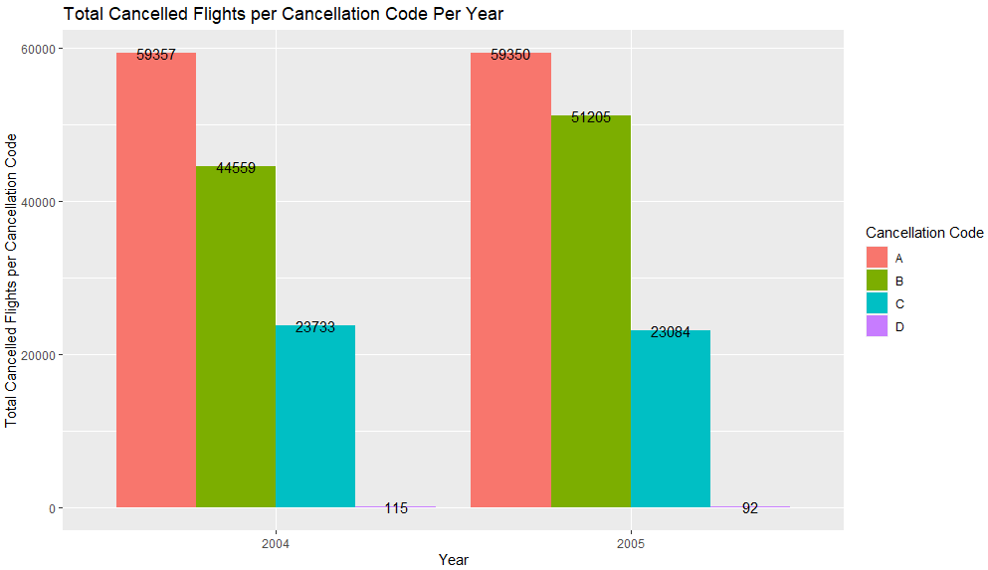
Total Cancelled Flights per Cancellation Code Per Year
A = carrier
B = weather
C = NAS
D = security
From the above graph we observe that in both 2004 and 2005 the reason why 59.357 (2004) + 59350 (2005) flights were cancelled was due to Cancellation Code A (= due to the airline). The second most crucial reason for the cancellation of 44.559 (2004) + 51.205 (2005) was the cancellation code B (=due to weather).

Slide 12
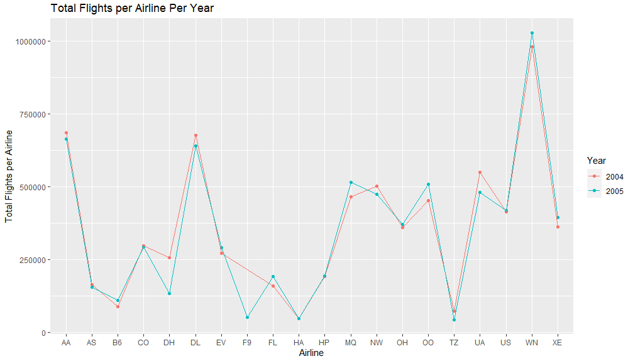
Total Flights per Airline Per Year
From the above graph we observe that the airline with the most flights in 2004 and in 2005 was SouthWest Airline (WN) with more than 1.000.000 flights in 2005 and almost 980.000 flights in 2004. The airlines with the fewest total flights in 2004 and in 2005 were Hello Airlines (HA) and Air Tanzania (TZ) with less than 100.000 flights in each year.

Slide 13
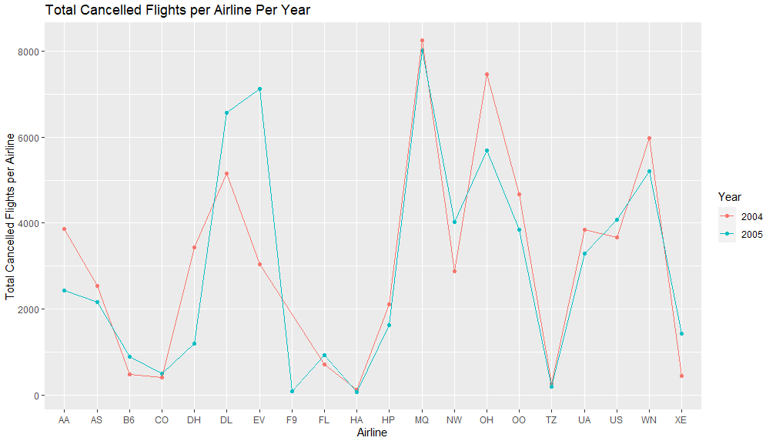
Total Cancelled Flights per Airline Per Year
From the above graph we observe that the airline with the most cancelled flights in 2004 and in 2005 was Tri-MG Airlines Flight Tracker (MG) with more than 8.000 cancelled flights. We also notice a reduction in cancelled flights for PSA Airlines (OH) from 2004 (7.400) to 2005 (5.900). Finally, the airline with the biggest increase in cancelled flights was ExpressJet (EV) with 3.000 cancelled flights in 2004 and 7.000 cancelled flights in 2005.

