Slide 1

SISTEM PEMBERI PAKAN AYAM BERBASIS INTERNET OF THINGS (IOT) DENGAN BLYNK
Group 15

Slide 2
SUPERVISOR
Frengki Simatupang, S.Tr.Kom., M.T.

Slide 3


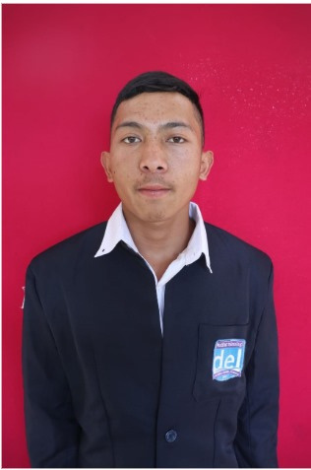
OUR TEAM
Arga Bona Nainggolan
13323001
Rahel Priyanka Napitupulu
13323019
Rejeki Adi Putra Lumbanbatu
13323038

Slide 4

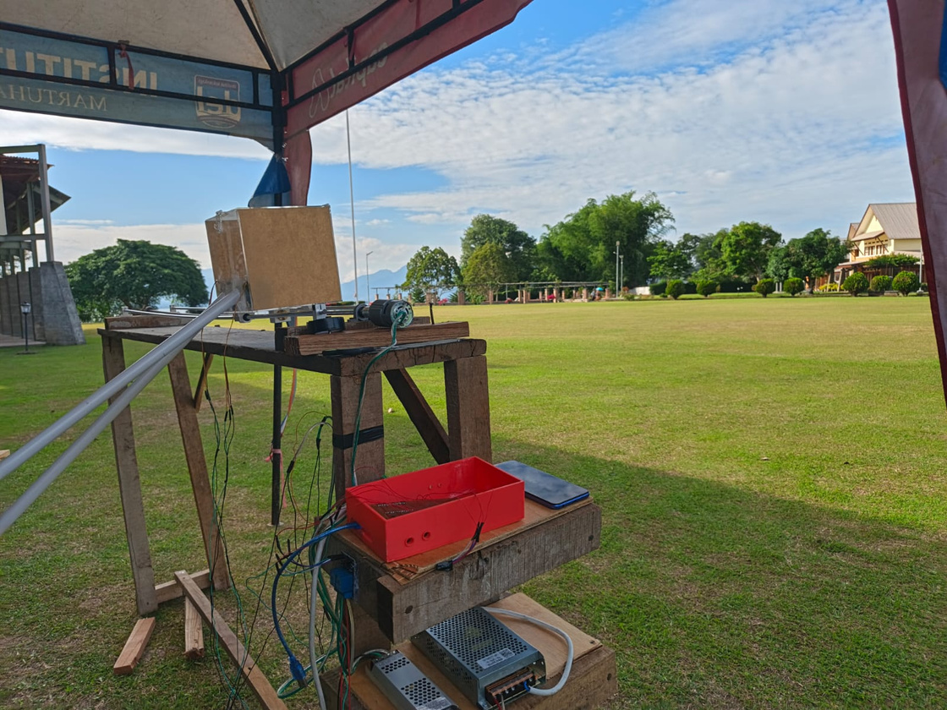
BACKGROUND
  Problems with Conventional Systems,
  Need for Efficiency and Remote Monitoring,
  Utilization of IoT and Automation Technology,

Slide 5

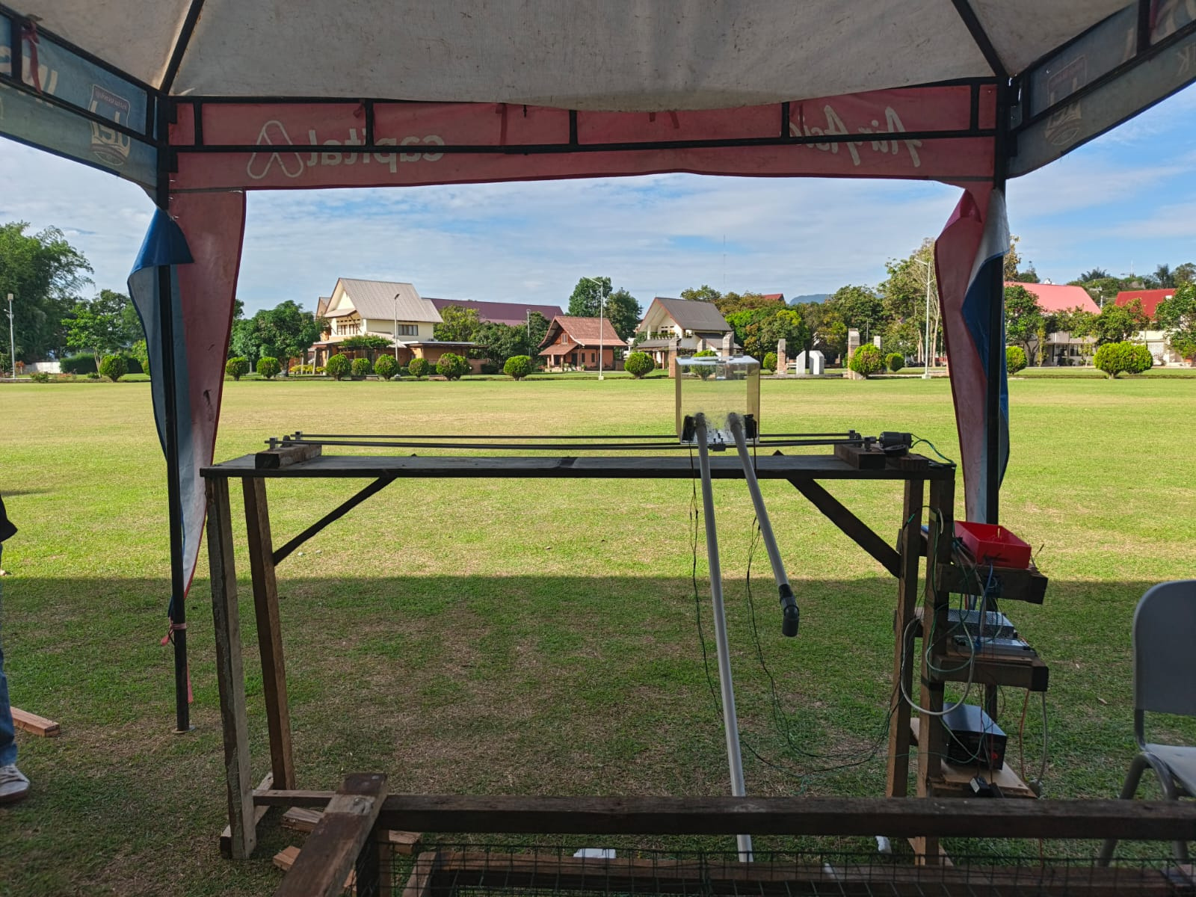
OBJECTIVES
  To automate the feeding and watering process
  To increase efficiency and reduce labor dependency
  To provide real-time monitoring and control
  To support small to medium-scale poultry farmers

Slide 6
PRODUCT BENEFITS
  Consistency and Accuracy
2. Labor Savings
  3. Remote Monitoring and Control
  4. Improved Poultry Growth and Health
  5. Cost Efficiency

Slide 7
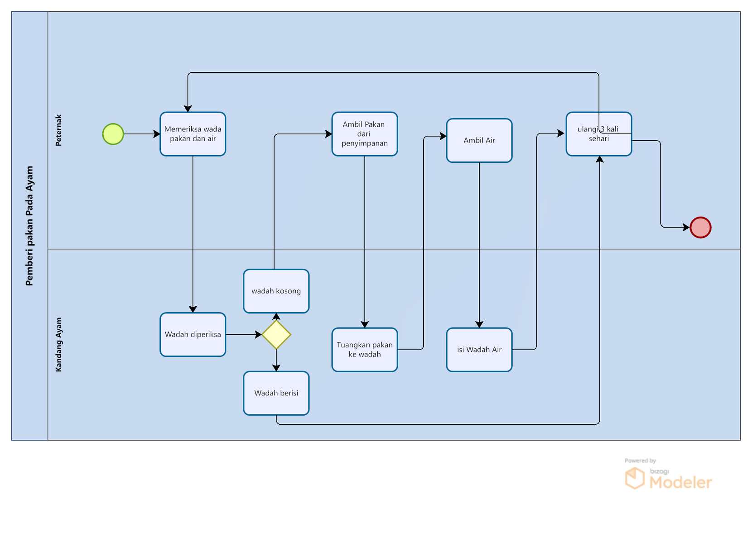
CURRENT SYSTEM

Slide 8
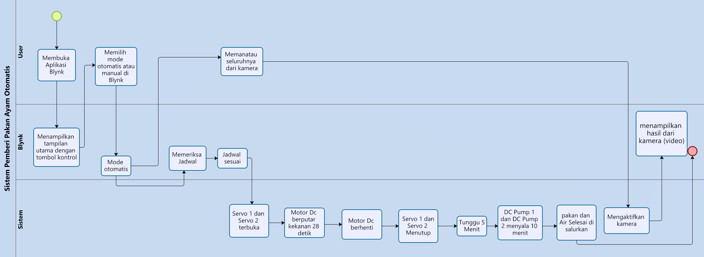
TARGET SYSTEM

Slide 9
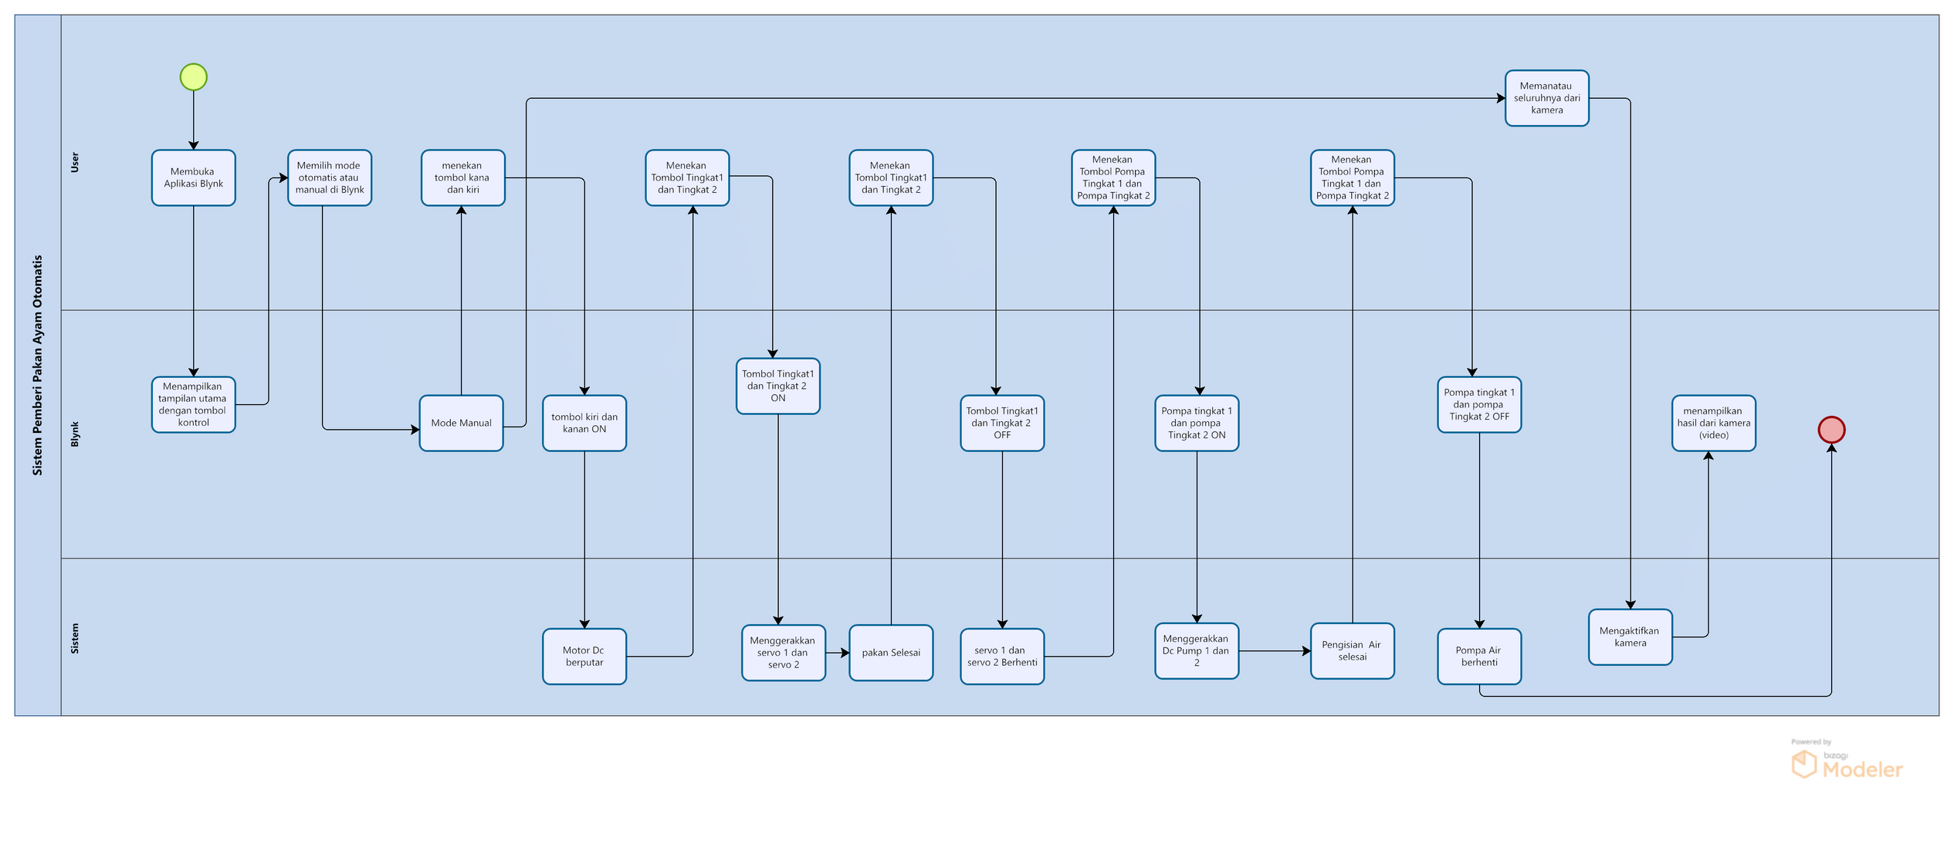
TARGET SYSTEM

Slide 10
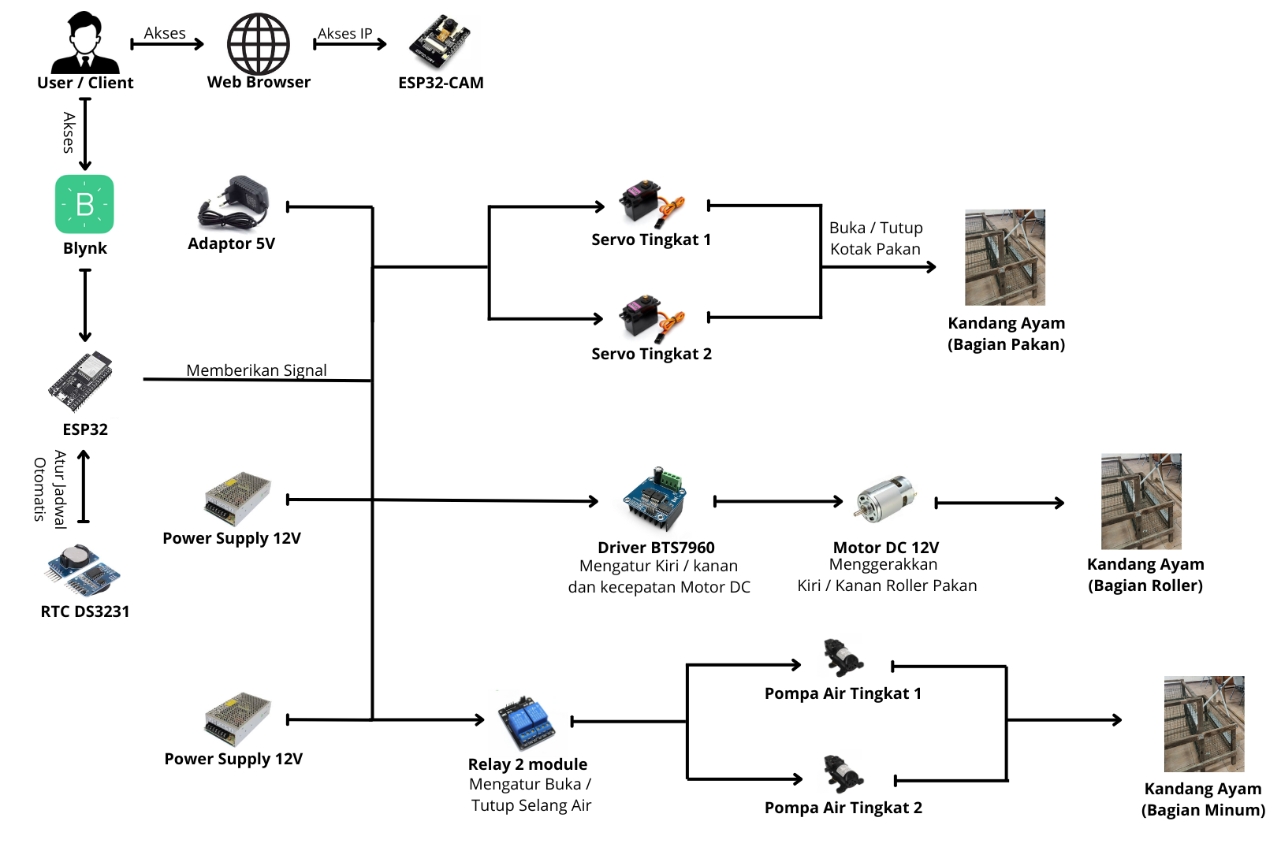
SYSTEM
ARCHITECTURE

Slide 11
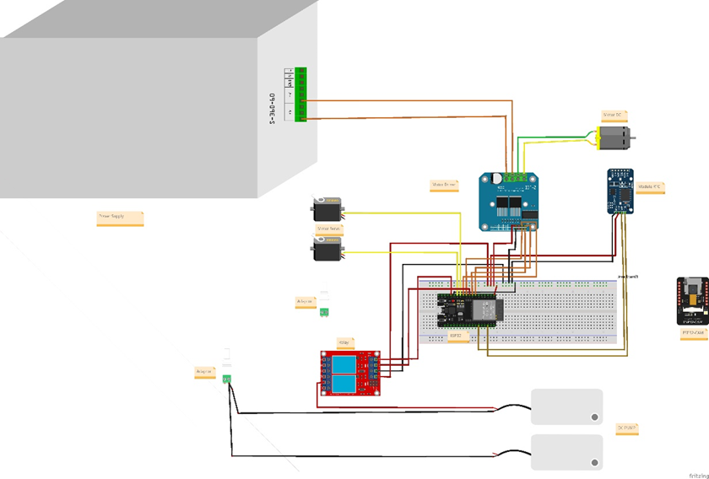
BLOCK SYSTEM

Slide 12
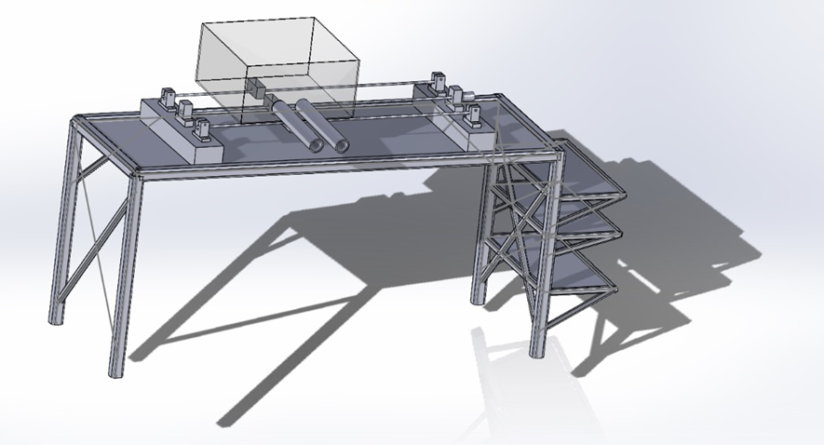
PRODUCT DESIGN

Slide 13
SUMMARY
  The automatic chicken feeding system enhances efficiency and consistency in the feeding and watering process while reducing reliance on manual labor. By utilizing IoT and automation technology, farmers can control and monitor the system in real-time through a mobile application, supporting a more practical and effective farm management. This system is ideal for small to medium-scale farmers aiming to improve their livestock productivity and quality.

Slide 14
DEMO

Slide 15
Q & A

Slide 16
THANK YOU

