Slide 1
Standard algorithm
C1
C4
Datalog program
C2
C5
C3
Output collections
Input collections
Incremental algorithm
C4
C1
Datalog program
C2
C3
C5
Output changes
Input changes

Slide 2
Input changes
DDLog compiler
Rust compiler
DDLog
program
Rust
program
Native executable
Output changes
Differential dataflow
library

Slide 3
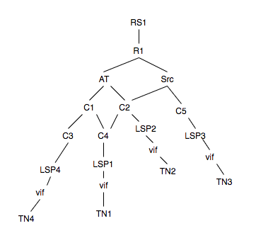
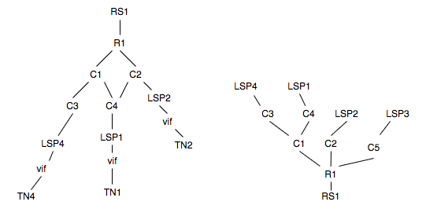
Dependency graph
source graph
falcon graph
Span graph

