Slide 1
CPE 403 Final Project:
BBB/CC1350 Communication
Jeffrey Razon and Argenis Jimenez

Slide 2
Goal
Main Goal
Integrate the temperature sensor by running a “co-processor module” connected between BeagleBone(BBB) and one CC1350 and using a 2nd CC1350 as a transmitter.
Display data from the temperature using the “TI 15.4-Stack Collector app”.
Objectives
Our goals have been achieved by programming C code on the CC1350 and interfacing the CC1350 launchpads to collect and transmit data..
Successful setup of BeagleBone (BBB) and host system such as Linux for application development..

Slide 3
Outcome - Accomplishments
Outcome – result of your project?
We have successfully interfaced our temperature sensor. The outcome of our project demonstrates the result of the transmission of the CC1350 launchpad in charge of sending data towards our receiving CC1350 launchpad. The receiving CC1350 launchpad interacts with the BeagleBone Black(BBB) in order for the (BBB) to upload data to the “TI 15.4-Stack Collector app”.

Slide 4
Components Used in Design
2 x Wireless MCU LaunchPad Development kit (LAUNCHXL-CC1350)
http://www.ti.com/tool/LAUNCHXL-CC1350
BeagleBone Black
https://beagleboard.org/black
Temperature Sensor

Slide 5
Tools used in Design
Uniflash Standalone Flash Tool for TI Microcontrollers (MCU)
http://www.ti.com/tool/UNIFLASH
SimpleLink™ Sub-1 GHz CC13x0 Software Development Kit
http://www.ti.com/tool/simplelink-cc13x0-sdk
TI 15.4-Stack Gateway Linux Software Development Kit
http://www.ti.com/tool/ti-15.4-stack-gateway-linux-sdk
PROCESSOR-SDK-LINUX-AM335X 05_01_00_11
http://software-dl.ti.com/processor-sdk-linux/esd/AM335X/latest/index_FDS.html

Slide 6
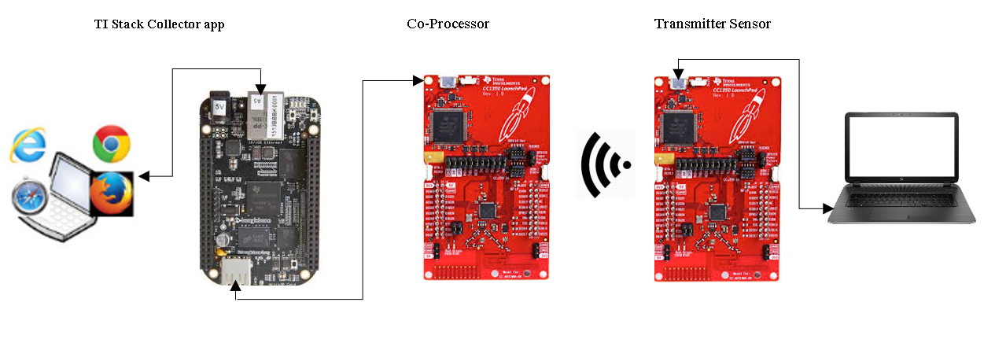
Schematic

Slide 7
Pre-requisites used in Design
Prerequisites
Virtual Machine
Ubuntu
CCS8
Commands to install prerequisites
$$ cd ~/ti/simplelink/ti-15.4stack-x.xx.xx.xx/prebuilt
scp bbb_prebuilt.tar.gz root@<bbb-ip-address>:/home/root/ - copied file to PI
./run_demo.sh

Slide 8
Implementation Details
Flash hex files to CC1350 and flash am335x linux image to the BBB
Untarred the tar folder in the Ubuntu Virtual Machine
Connected the coprocessor CC1350 to the BBB to create the coprocessor collector
Ran the “run_demo.sh” file to obtain url to Stack Collector App
Connected the sensor CC1350 to connect to coprocessor in Stack Collector App network

Slide 9
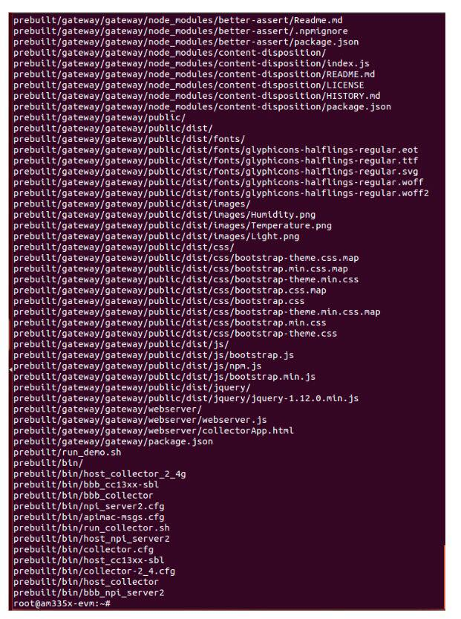
Implementation Details
Untarring the tar folder

Slide 10
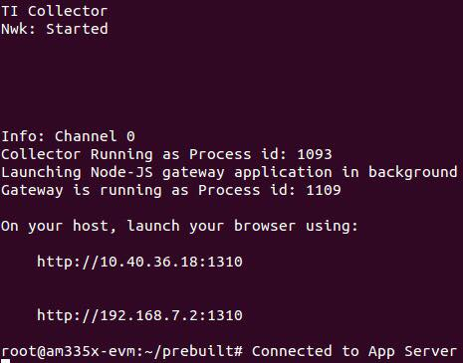
Implementation Details
Connecting to the Stack Collector App

Slide 11
Actual project set-up
Hardware-Setup

Slide 12
Demo
Video link only – https://youtu.be/PKAdnBtK_Zg

Slide 13
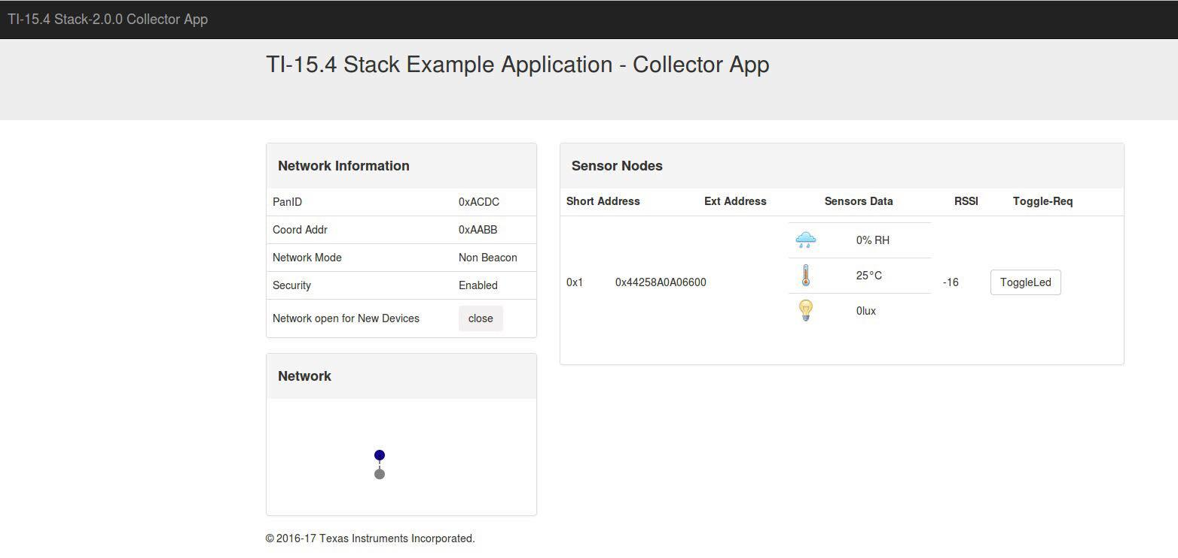
Results and Conclusions
To conclude, the image below shows the result of the transmission of data between the transmitter sensor to the co-processor and TI Stack collector app. Our results show the display of 25 degrees celsius.

Slide 14
References
Official TI Tutorials
Previous assignments (BBB, CC1350)
CCS Resource Explorer
TI Q&A forums
Stack Overflow

