Slide 1
React

Slide 2
What is React
Open source library for building user interface
Not a framework
Focus on UI
Rich ecosystem

Slide 3
Why learn React ?
Created and maintained by Facebook
Huge community
The most in demand skillset

Slide 4
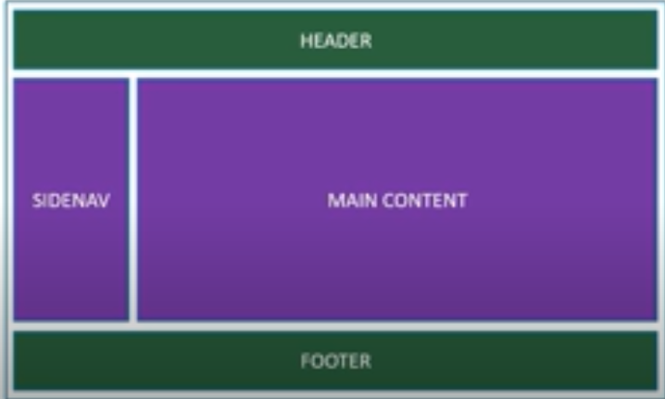
Component Based Architecture

Slide 5
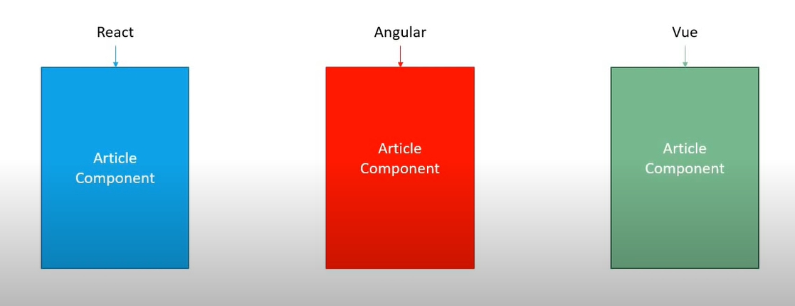
Reusable code

Slide 6
React is Declarative
Tell React what you want and React will build the actual UI
Another is Imparative
i.e: u goes to an artist and have to tell him everything
React will handle efficiently updating and rendering of the components
DOM updates are handles gracefully in React

Slide 7
More on React
Seamlessly integrates react into of your applications
Portions of your page or a complete page or even an entire application itself.
React native for mobile applications

Slide 8
These types of framework has these things in common:
Component
Routing
State management

Slide 9
Content:
Hello World
Folder structure
Component (Functional and Class)
JSX
Hooks
Props
State
Lifecycle

