Slide 1
Web Hosting and bonus concepts

Slide 2
Web Hosting and Bonus concepts
Categories:
Hosting and Cloud Concepts
Devops
Q/A

Slide 3


Hosting and deployments
As a developer we need to showcase our projects so we need to host our projects so popular hosting platforms for free are:

Slide 4
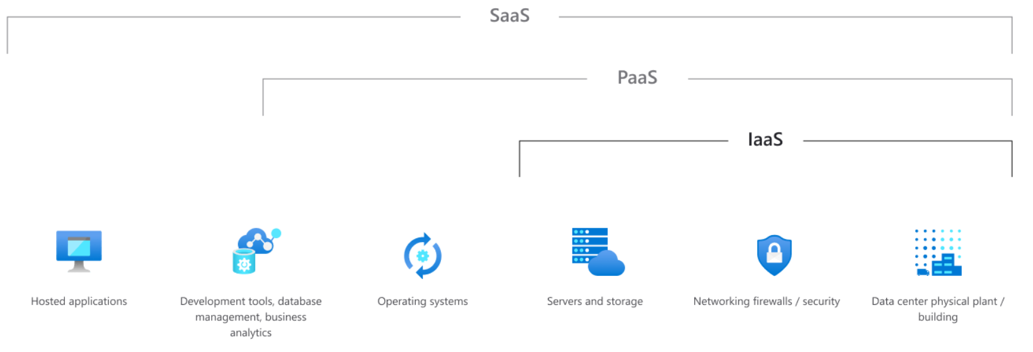
Cloud concepts
Iass (Infrastructure as a service)
Pass (Platform as a Service)
Saas(Software as a Service)

Slide 5
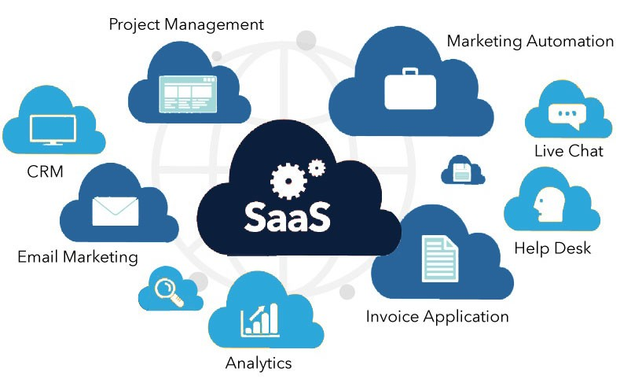
SAAS – Software as a Service
Depends on 3rd Party

Slide 6
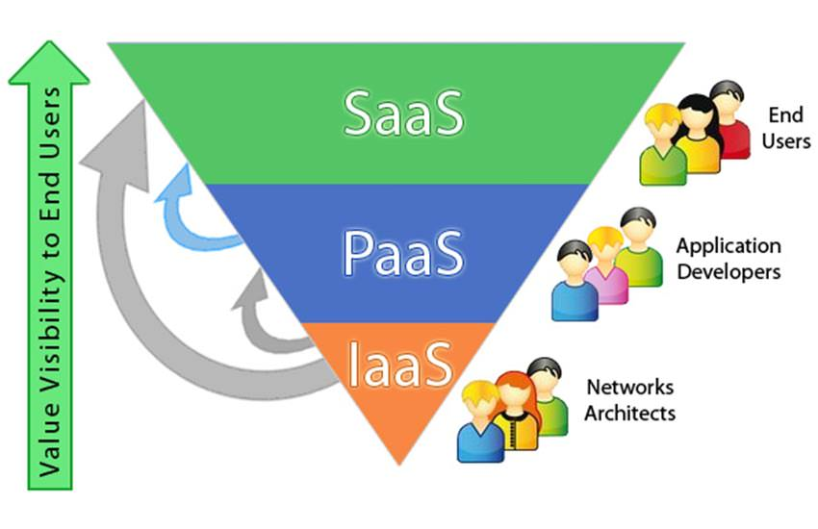
PAAS – Platform as a Service
I can code But I Need a platform to host

Slide 7
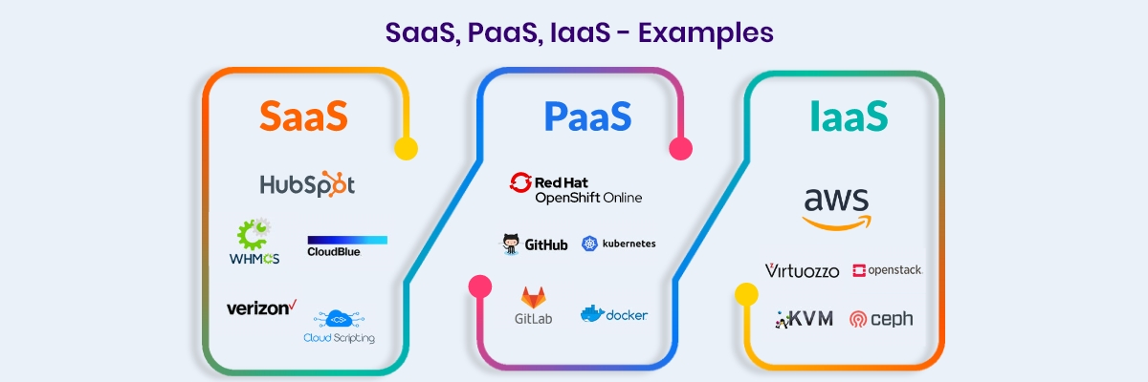
IAAS – Infrastructure as a Service
Cloud will provide infrastructure we will be doing everything by our own

Slide 8
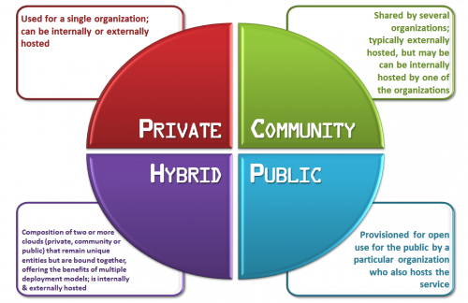
Types of cloud

Slide 9
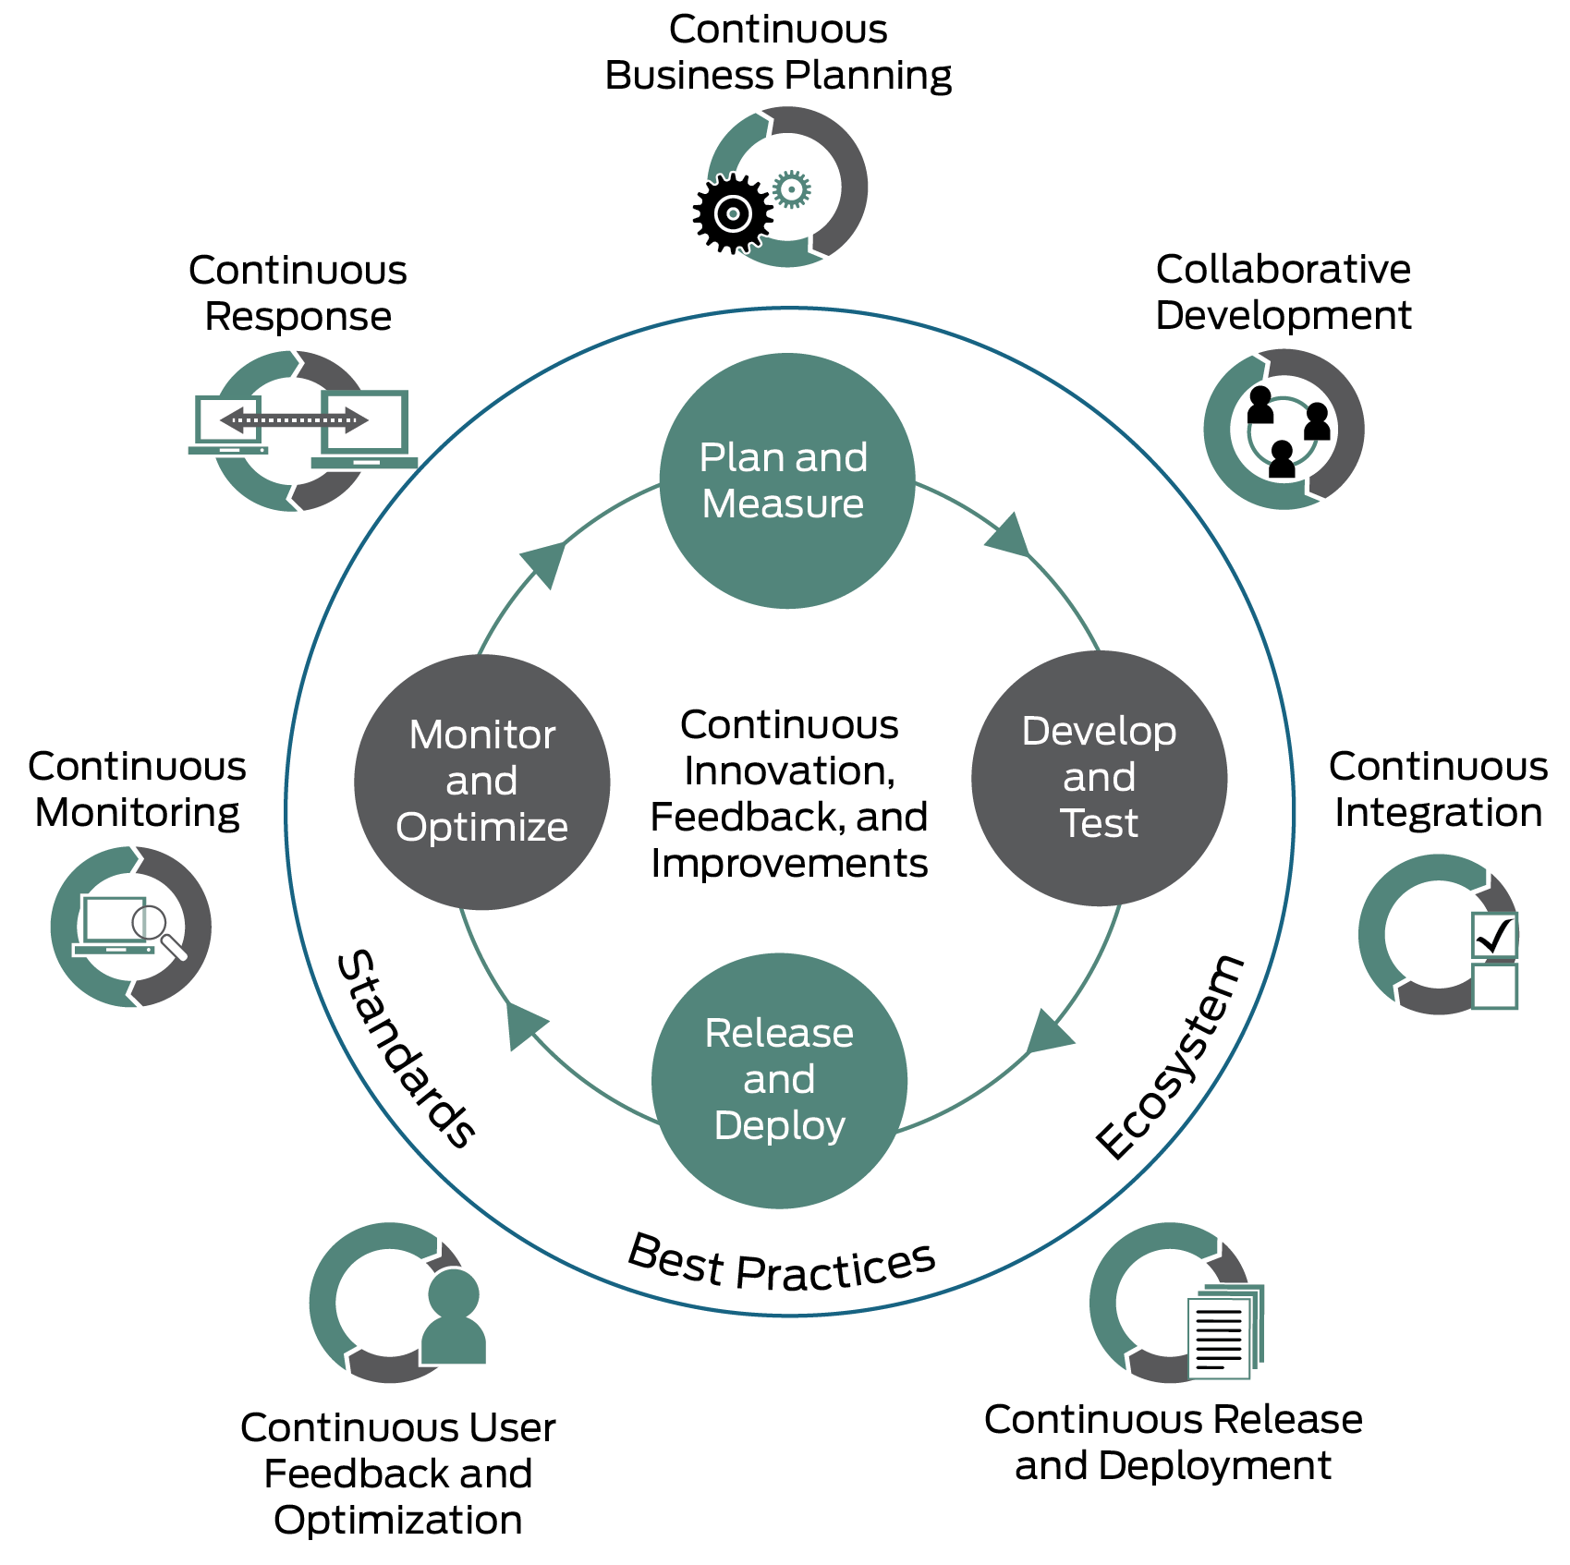
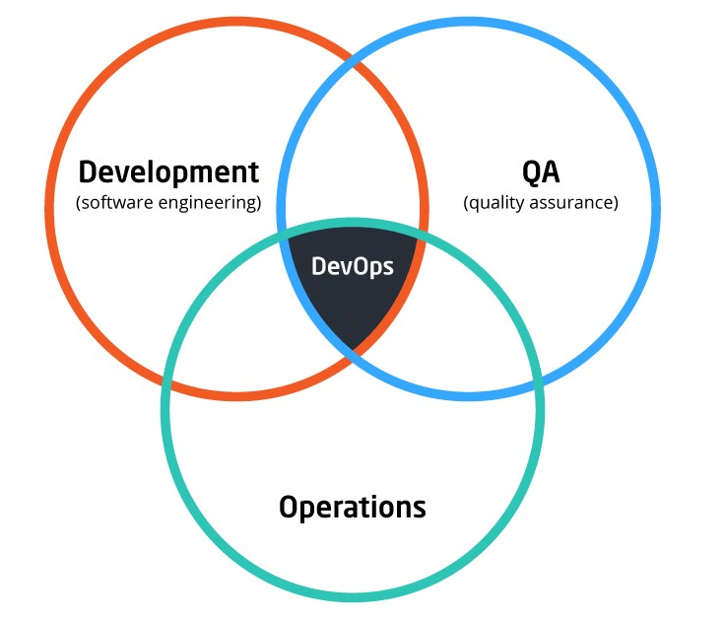
Devops

