Slide 1
Angular

Slide 2
Angular
A framework for building client application in HTML CSS JS/TS
Gives our application a clean structure
Includes a lot of re-usable code
Makes our application more testable

Slide 3
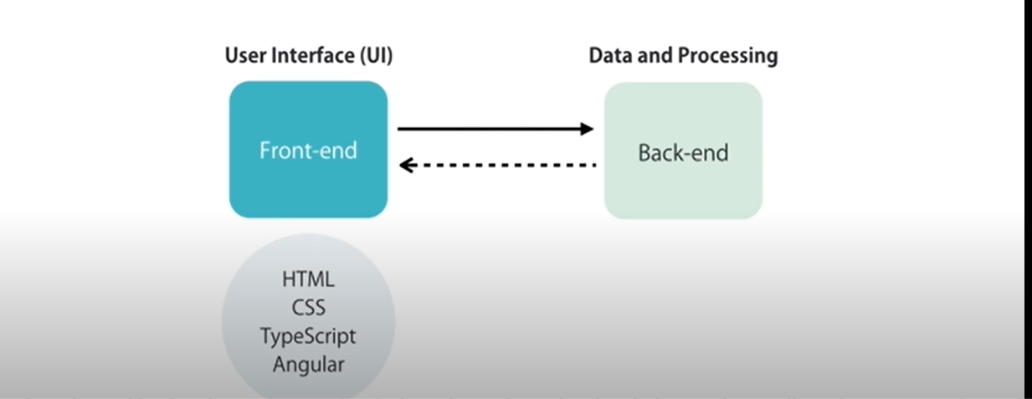
Architecture of Angular

