Slide 1

Electric-Vehicle Analysis In INDIA
Code Basics Resume Challenge #12

Slide 2
AGENDA
01
Project Overview
A brief intro about the project
02
Objective
Understanding the project objective
03
Dashboard
Visualization the data to get Insights
04
Findings
In depth discussion of findings

Slide 3
01
Project Overview
AtliQ Motors is an automotive giant from the USA specializing in electric vehicles (EV). As a part of their expansion plans, they wanted to launch their bestselling models in India. They wanted to do a detailed market study of existing EV/Hybrid market in India before proceeding further.
The project aims to cover the below mentioned points :
Positive & Negative Penetration Rate Analysis
Quarterly Sales Analysis
Compounded Annual Growth Rate (CAGR) Analysis
Revenue Growth Rate Analysis
Peak Season Of Sales Analysis

Slide 4
02
Objective
Identify and analyse the states with positive & negative penetration rate in EV sales from 2022 to 2024.
Analyse the quarterly trends based on sales volume for the makers) from 2022 to 2024?
Identify the compounded annual growth rate (CAGR) for the makers from 2022 to 2024.
Identify the states with highest compounded annual growth rate (CAGR) from 2022 to 2024.
Identify the peak and low season months for EV sales based on the data from 2022 to 2024,
Estimate the revenue growth rate of EVs in India for 2022 vs 2024 and 2023 vs 2024.

Slide 5
03
Dashboard

Slide 6
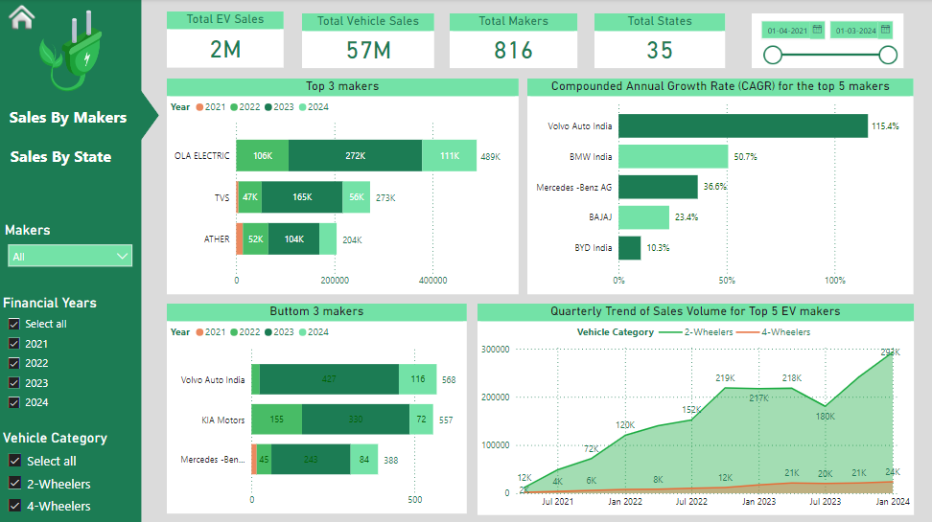

Slide 7
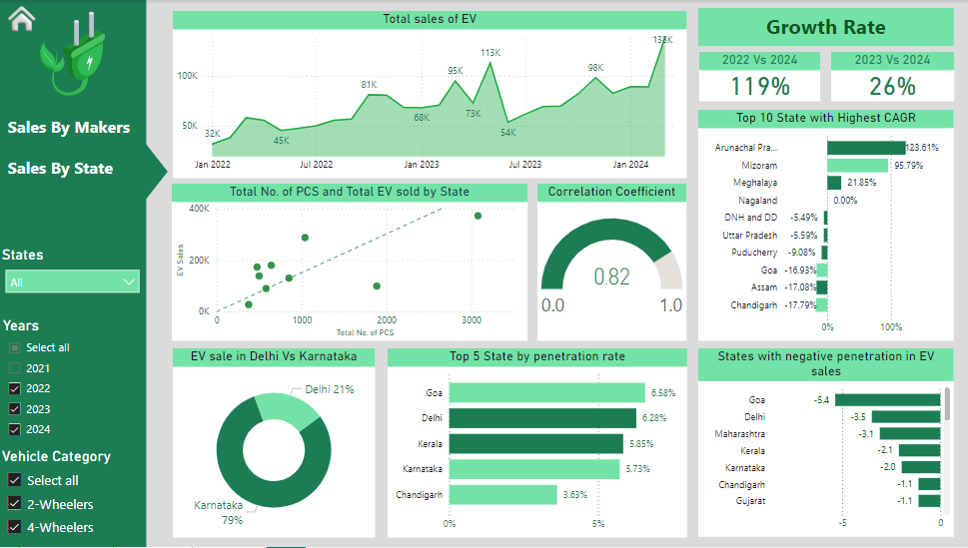

Slide 8
04
Findings

Slide 9
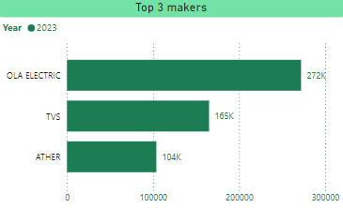
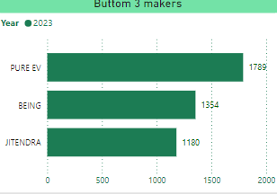
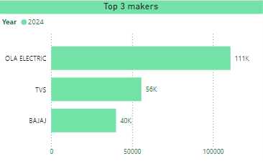
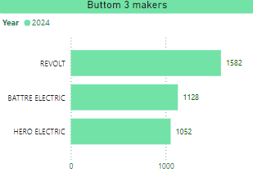
Preliminary Research Questions
1. List the top 3 and bottom 3 makers for the fiscal years 2023 and 2024 in terms of the number of 2-wheelers sold.

Slide 10
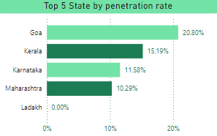
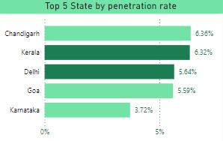
2. Identify the top 5 states with the highest penetration rate in 2-wheeler and 4-wheeler EV sales in FY 2024.
For 2 Wheeler
For 4 Wheeler

Slide 11
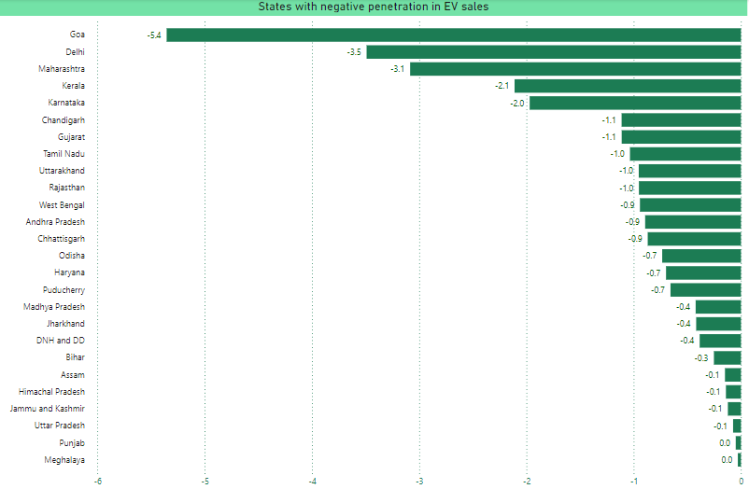
3. List the states with negative penetration (decline) in EV sales from 2022 to 2024?

Slide 12
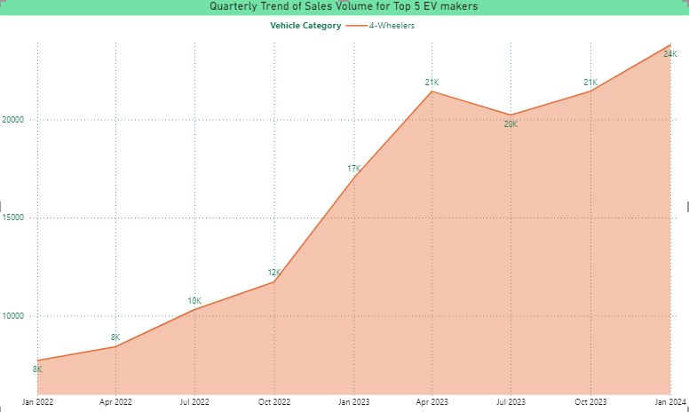
4. What are the quarterly trends based on sales volume for the top 5 EV makers (4-wheelers) from 2022 to 2024?

Slide 13
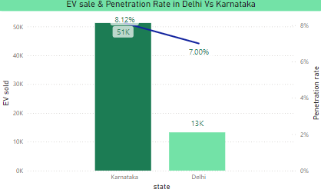
5. How do the EV sales and penetration rates in Delhi compare to Karnataka for 2024?

Slide 14
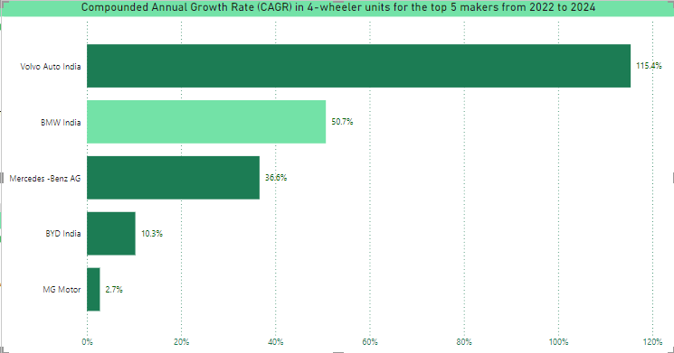
6. List down the compounded annual growth rate (CAGR) in 4-wheeler units for the top 5 makers from 2022 to 2024.

Slide 15
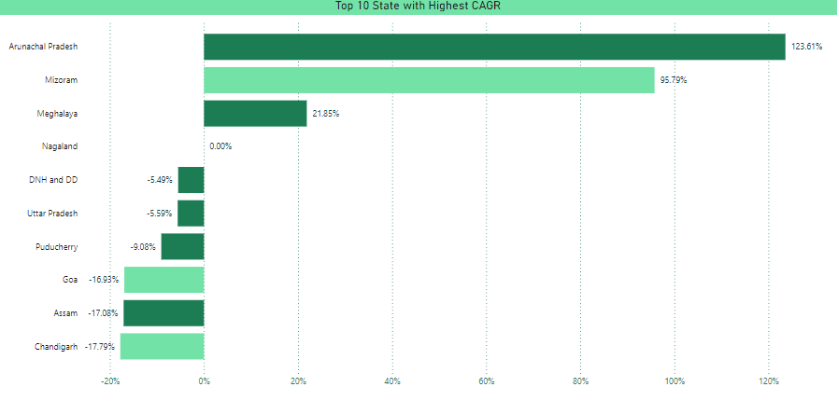
7. List down the top 10 states that had the highest compounded annual growth rate (CAGR) from 2022 to 2024 in total vehicles sold.

Slide 16
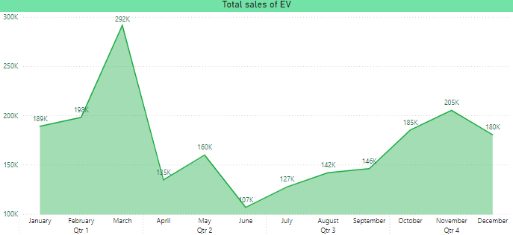
8. What are the peak and low season months for EV sales based on the data from 2022 to 2024?

Slide 17
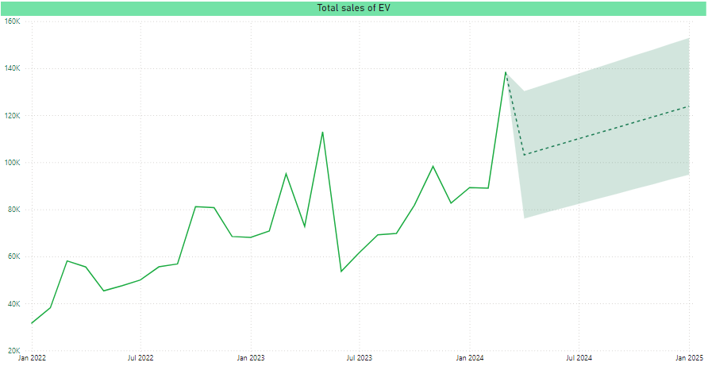
9. What is the projected number of EV sales (including 2-wheelers and 4- wheelers) for the top 10 states by penetration rate in 2030, based on the compounded annual growth rate (CAGR) from previous years?

Slide 18
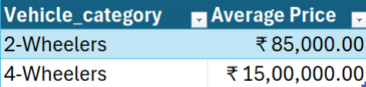

10. Estimate the revenue growth rate of 4-wheeler and 2-wheelers EVs in India for 2022 vs 2024 and 2023 vs 2024, assuming an average unit price. H

Slide 19
Secondary Research Questions
1. What are the primary reasons for customers choosing 4-wheeler EVs in 2023 and 2024 ?
Cost Savings :
Although EVs may have a higher upfront cost compared to traditional gasoline-powered vehicles, they can save owners money in the long run due to lower operating costs, such as lower fuel and maintenance costs.
Environmental friendly :
EVs produce zero emissions, which helps reduce air pollution and greenhouse gas emissions. This makes EVs an attractive option for those who are environmentally conscious and want to reduce their carbon footprint.
Government incentives :
The Indian government offers several incentives for EV purchases through its Faster Adoption and Manufacturing of Hybrid & Electric vehicles (FAME) scheme. These incentives can make EVs more affordable and accessible to a wider audience.
Improved driving experience :
Many EV owners find that driving an EV provides a smooth, quiet, and enjoyable driving experience. In addition, EVs offer instant torque, which makes for a quick and responsive driving experience.

Slide 20
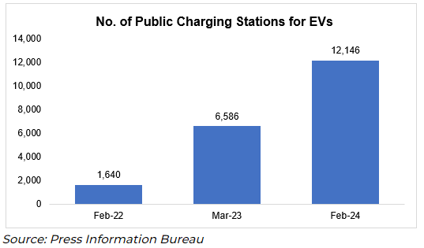
Convenient charging :
With the growth of EV charging infrastructure in India, it is becoming increasingly convenient for EV owners to recharge their vehicles. Fast charging and wireless charging technologies are also making it easier for EV owners to charge their vehicles quickly and conveniently.
In addition to the reasons mentioned above, here are a few more factors that make EVs a compelling choice in India
Reduced Dependence on Imported Oil
Reduced Air Pollution
Reduced Noise Pollution
Innovations in Battery Technology
Overall, the future of EVs in India looks bright, with the government's commitment to promoting the use of EVs, increasing consumer awareness and acceptance, and advancements in technology all set to drive growth in the EV market in India in 2023-2024 and beyond.

Slide 21
2. How do government incentives and subsidies impact the adoption rates of 2-wheelers and 4-wheelers?
Government incentives and subsidies for electric vehicles (EVs) in India have helped to make EVs more affordable and attractive to buyers, which has contributed to increased adoption rates
FAME II program :
Government has approved Phase-II of FAME Scheme with an outlay of Rs. 10,000 Crore for a period of 3 years commencing from 1st April 2019
Charging infrastructure :
The government is also developing essential EV charging infrastructure to encourage the adoption of e-mobility.
State incentives:
Some states offer significant subsidies for EVs, including:
Gujarat: Offers a maximum subsidy of ₹20,000 for electric two-wheelers, and no registration charges
Maharashtra: Offers a maximum subsidy of ₹25,000 for electric two-wheelers, and no registration charges or road taxes
Meghalaya: Offers a subsidy of ₹10,000 per kWh of battery capacity for electric two-wheelers, capped at ₹20,000, and a 100 percent road tax exemption

Slide 22
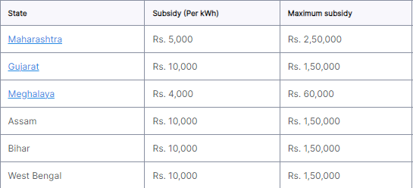
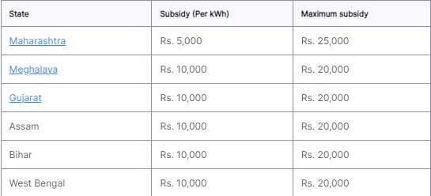
2.1 Which states in India provided most subsidies?
State-wise electric car subsidies
State-wise electric scooter & bike subsidies

Slide 23
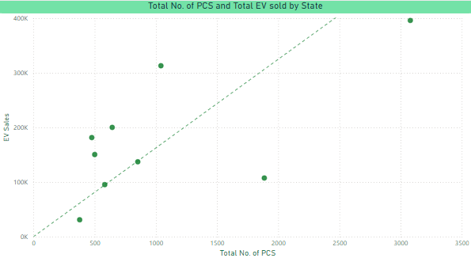
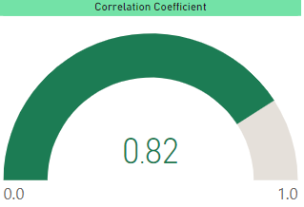
3. How does the availability of charging stations infrastructure correlate with the EV sales and penetration rates in the top 5 states?

Slide 24

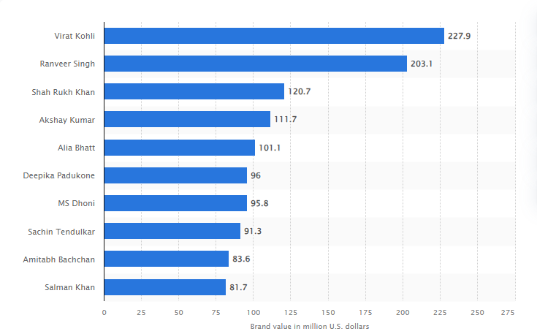
4. Who should be the brand ambassador if AtliQ Motors launches their EV/Hybrid vehicles in India and why?
Virat Kohli should be the brand ambassador of AtliQ Motors in India because of his brand value in India as well as he has been vocal about environmental issues and sustainable livings. As one of the most popular and influential sports personalities in India, Virat Kohli has over 250 million followers on Instagram also he appeals to the younger generation.
Leading Celebrities in India by their brand value (in millions U.S. Dollars)

Slide 25
5. Which state of India is ideal to start the manufacturing unit? (Based on subsidies provided, ease of doing business, stability in governance etc.)
Tamil Nadu:
Tamil Nadu emerges as the ideal state due to its extensive subsidies, tax exemptions, and additional benefits specific to EV manufacturing. This state offers a comprehensive package of incentives including a 15% capital subsidy on eligible investments over 10 years, a special 20% capital subsidy for EV battery manufacturing, 100% electricity duty exemption, 15% land subsidy, and 100% stamp duty exemption. It also provides an employment incentive and a 6% interest subvention for EV components and charging manufacturing.

Slide 26
6. Your top 3 recommendations for AtliQ Motor
Leverage Government Incentives and Policies :
Utilize Subsidies and Tax Benefits: Maximize Indian government subsidies and tax incentives under the FAME scheme to lower consumer costs and enhance AtliQ's market competitiveness.
Highlight these benefits in marketing campaigns: Align with National Policies: Ensure AtliQ’s vehicles comply with India's EV policies on emissions and fuel efficiency to position the brand as compliant and forward-thinking.
2. Focus on Affordability and Localized Features :
Offer Competitive Pricing: Introduce budget-friendly models alongside premium offerings to attract a broader customer base in India's price-sensitive market.
Local Customization: Tailor vehicle features for Indian conditions, such as robust suspension, efficient air conditioning, and advanced infotainment systems.
3. Expand Charging Infrastructure and After-Sales Service :
Partnerships for Charging Stations: Collaborate with local entities to expand charging infrastructure, reducing range anxiety and enhancing EV practicality.
Strengthen After-Sales Service Network : Build a strong after-sales service network with trained technicians and service centers across key regions to improve customer satisfaction and loyalty.

Slide 27
Thank You

